Slide 1
More Divide and Conquer: Closest Pair of Points
CS 3100: DSA 2
Mark Floryan

Slide 2
Closest Pair of Points
Readings: CLRS 33.4

Slide 3
Closest Pair of Points in 2D Space
1
2
Given:
A list of points in 2D space
5
4
Return:
6
Distance of the pair of points that are closest together (and the points themselves too)
7
3
8

Slide 4


Closest Pair of Points: Naïve
Given:
A list of points in 2D space
1
2
Return:
Distance of the pair of points that are closest together (and the points themselves too)
5
4
6
Naive Algorithm:
Test every pair of points, return the closest.
$$O(n^{2})$$
7
3
We can do better!
8
$$Θ(n\log{n)}$$

Slide 5
Closest Pair of Points: D&C
Divide:
1
2
At median x coordinate
5
Conquer:
4
6
???
7
Combine:
3
???
8

Slide 6


Closest Pair of Points: D&C
Divide:
At median x coordinate
1
$$δ_{L}$$
2
$$δ_{R}$$
Conquer:
5
4
Recursively find closest pair of points on left half and right half via two recursive calls
6
7
Combine:
Return
3
8
LeftPoints
RightPoints

Slide 7

Closest Pair of Points: D&C
Divide:
At median x coordinate
1
$$δ_{L}$$
2
$$δ_{R}$$
Conquer:
5
4
Recursively find closest pair of points on left half and right half via two recursive calls
6
7
Combine:
Return $min⁡(δ_{L}, δ_{R})$
3
8
LeftPoints
RightPoints
What is the issue with this combine step?

Slide 8


Closest Pair of Points: D&C
Divide:
At median x coordinate
1
$$δ_{L}$$
2
$$δ_{R}$$
Conquer:
5
4
Recursively find closest pair of points on left half and right half via two recursive calls
6
7
$$δ_{G}$$
Combine:
Return $min⁡(δ_{L}, δ_{R},δ_{G})$
3
8
LeftPoints
RightPoints
Better, but how do we find the shortest pair across the gap?

Slide 9

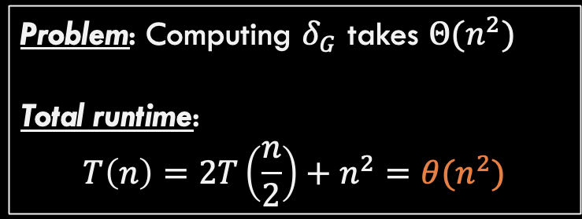
Closest Pair of Points: D&C
Combine:
Compute $δ_{G}$ efficiently Return $min⁡(δ_{L}, δ_{R},δ_{G})$
2
1
5
Possible Solution: Compute all pairs that cross the gap.
4
6
Problem: Computing $δ_{G}$ takes $Θ(n^{2})$
Total runtime:
$$T\left(n\right)=2T\left(\frac{n}{2}\right)+n^{2}=θ(n^{2})$$
7
$$δ_{G}$$
3
8
LeftPoints
RightPoints
Same runtime as naïve solution. Not good enough!

Slide 10


Closest Pair of Points: D&C
Combine:
Compute $δ_{G}$ efficiently Return $min⁡(δ_{L}, δ_{R},δ_{G})$
2
1
5
4
Observation: Let $δ=\min\left(δ_{L},{ δ}_{R}\right)$ If $δ_{G}$ is best, points MUST be within $δ$ of dividing line
6
7
3
$$2δ$$
8
LeftPoints
RightPoints

Slide 11
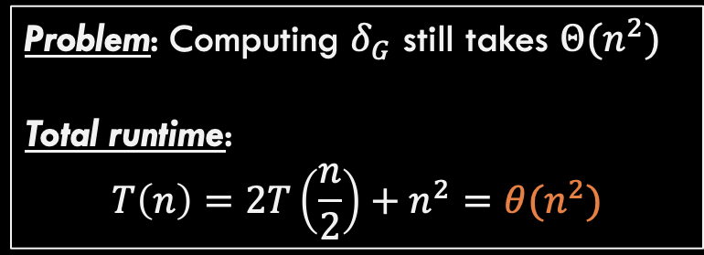
Closest Pair of Points: D&C
Combine:
Compute $δ_{G}$ efficiently Return $min⁡(δ_{L}, δ_{R},δ_{G})$
2
1
5
Possible Solution: Compute all points across gap that are within this strip!
4
6
Problem: Computing $δ_{G}$ still takes $Θ(n^{2})$
Total runtime:
$$T\left(n\right)=2T\left(\frac{n}{2}\right)+n^{2}=θ(n^{2})$$
7
3
$$2δ$$
8
LeftPoints
RightPoints
All the points might be inside this strip (tall vertical lines of points)

Slide 12




Closest Pair of Points: D&C
Combine:
Compute $δ_{G}$ efficiently Return $min⁡(δ_{L}, δ_{R},δ_{G})$
Observation 2: Sort the points in the strip by increasing y-coordinate
When analyzing point 3
If it is the one of the closes points that span the gap then its partner MUST be within the next 7 points in the sorted list. Why?
$$δ$$
$$δ$$
6
5
7
1
$$δ$$
$$2δ$$
4
3
8
2
LeftPoints
RightPoints

Slide 13
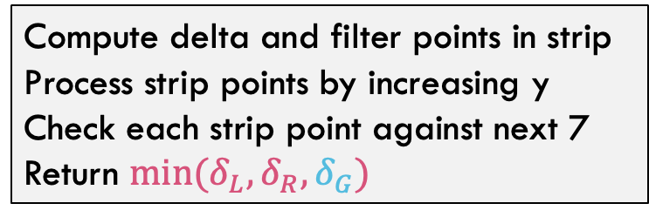

Closest Pair of Points: D&C
Divide:
At median x coordinate
1
$$δ_{L}$$
2
Conquer:
$$δ_{R}$$
Recursively find closest pair of points on left half and right half via two recursive calls
5
4
6
Combine:
7
$$δ_{G}$$
Compute delta and filter points in strip Process strip points by increasing y Check each strip point against next 7 Return $min⁡(δ_{L}, δ_{R},δ_{G})$
3
8
LeftPoints
RightPoints
Combine step is now linear time!!

Slide 14





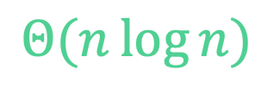

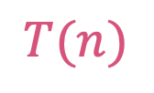


Closest Pair of Points: Divide and Conquer
What is the running time?
$$Θ(n\log{n})$$
$$Θ\left(n\log{n}\right)$$
Initialization: Sort points by $x$-coordinate
Divide: Partition points into two lists of points based on $x$-coordinate (split at the median $x$)
Conquer: Recursively compute the closest pair of points in each list
Combine:
Process runway points by $y$-coordinate and Compare each point in runway to 7 points above it and save the closest pair
Output closest pair among left, right, and runway points
$$Θ\left(1\right)$$
$$2T(n/2)$$
$$T(n)$$
$$T(n)=2T(n/2)+Θ(n)$$
$$Θ\left(n\right)$$
Case 2 of Master’s Theorem
$$T\left(n\right)=Θ\left(n\log{n}\right)$$
$$Θ\left(1\right)$$

Slide 15
Summary for Closest Pair of Points
Comparing all pairs is a brute-force fail
Except for small inputs
Divide and conquer a big improvement
Needed to find an efficient way for part of the combine step
Geometry came through for us here!
Only needed to look at constant number of points for each point in the strip
Implementation subtleties
Don’t want to sort the strip by y-coordinate in each recursive call
In initialization, create an “index” that lets you process all points in order by y-coordinate
(There are other ways to address this.)

