Slide 1
Recurrence Relations
CS 3100: Data Structures and Algorithms II
Mark Floryan

Slide 2
Recurrence Relations

Slide 3
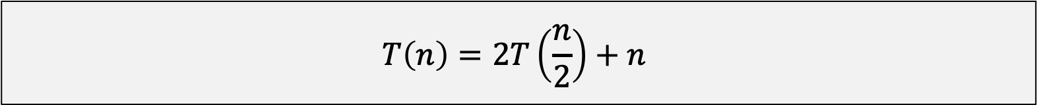

Recurrence Relations
This is an example of a recurrence relation:
$$T\left(n\right)=2T\left(\frac{n}{2}\right)+n$$
In general, how do we solve these formulas?
Especially when our algorithm has one with a non-traditional form: e.g., $T\left(n\right)=3T\left(\frac{3n}{4}\right)+\log_{5}{(n^{2})}$

Slide 4
Methods for Solving Recurrence Relations
Several methods for solving these:
Directly Solve: Roll the recurrence out and solve for a closed-form
Substitution Method: Guess the runtime and check the solution (by induction)
Recurrence Trees: Draw it out and count it manually!
Master Theorem: A proven theorem that provides a solution automatically!

Slide 5
Directly Solving (or Iteration Method)

Slide 6
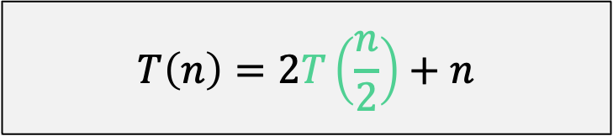
Directly Solve (unrolling the recurrence)
For Mergesort:
$$T\left(n\right)=2T\left(\frac{n}{2}\right)+n$$

Slide 7
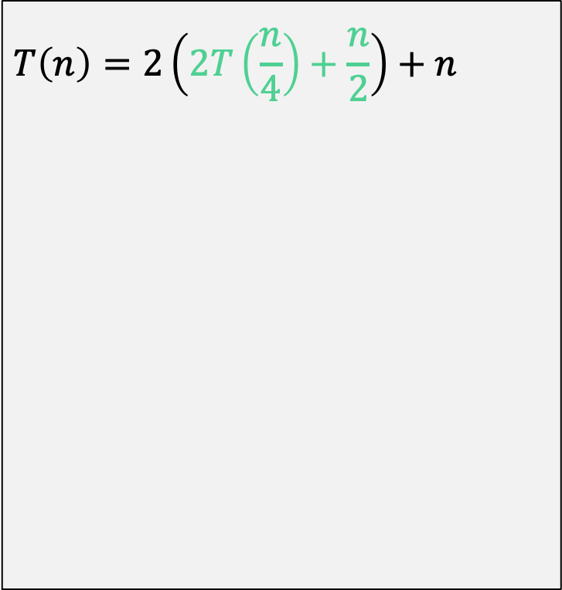
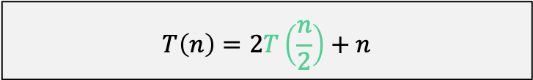
Directly Solve (unrolling the recurrence)
$$T\left(n\right)=2T\left(\frac{n}{2}\right)+n$$
$$T\left(n\right)=2\left(2T\left(\frac{n}{4}\right)+\frac{n}{2}\right)+n$$

Slide 8
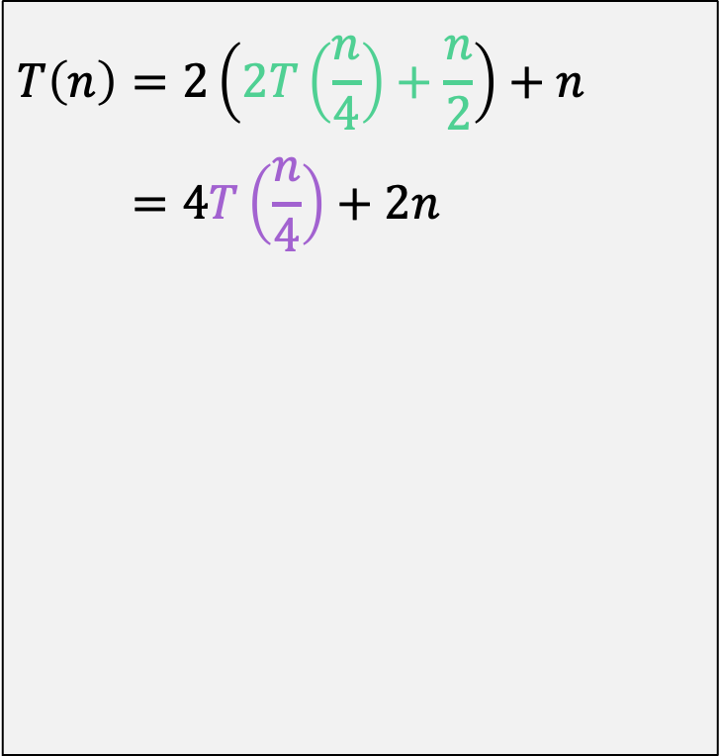
Directly Solve (unrolling the recurrence)
$$T\left(n\right)=2T\left(\frac{n}{2}\right)+n$$
$$T\left(n\right)=2\left(2T\left(\frac{n}{4}\right)+\frac{n}{2}\right)+n \\ =4T\left(\frac{n}{4}\right)+2n$$

Slide 9
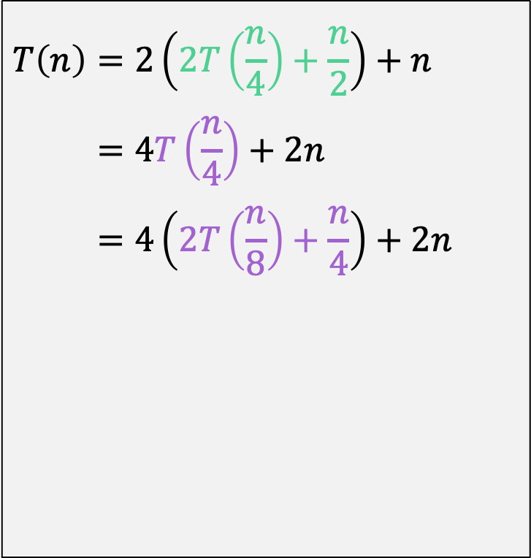
Directly Solve (unrolling the recurrence)
$$T\left(n\right)=2T\left(\frac{n}{2}\right)+n$$
$$T\left(n\right)=2\left(2T\left(\frac{n}{4}\right)+\frac{n}{2}\right)+n \\ =4T\left(\frac{n}{4}\right)+2n \\ =4\left(2T\left(\frac{n}{8}\right)+\frac{n}{4}\right)+2n$$

Slide 10
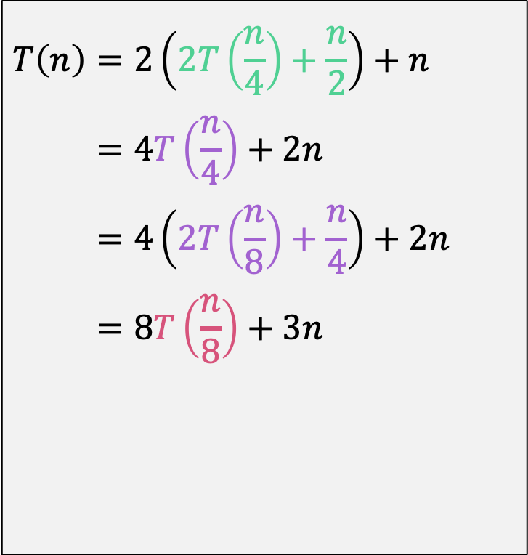
Directly Solve (unrolling the recurrence)
$$T\left(n\right)=2T\left(\frac{n}{2}\right)+n$$
$$T\left(n\right)=2\left(2T\left(\frac{n}{4}\right)+\frac{n}{2}\right)+n \\ =4T\left(\frac{n}{4}\right)+2n \\ =4\left(2T\left(\frac{n}{8}\right)+\frac{n}{4}\right)+2n \\ =8T\left(\frac{n}{8}\right)+3n$$

Slide 11
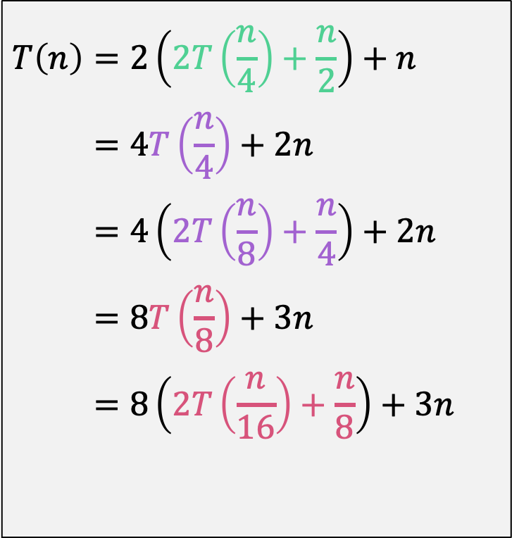
Directly Solve (unrolling the recurrence)
$$T\left(n\right)=2T\left(\frac{n}{2}\right)+n$$
$$T\left(n\right)=2\left(2T\left(\frac{n}{4}\right)+\frac{n}{2}\right)+n \\ =4T\left(\frac{n}{4}\right)+2n \\ =4\left(2T\left(\frac{n}{8}\right)+\frac{n}{4}\right)+2n \\ =8T\left(\frac{n}{8}\right)+3n \\ =8\left(2T\left(\frac{n}{16}\right)+\frac{n}{8}\right)+3n$$

Slide 12
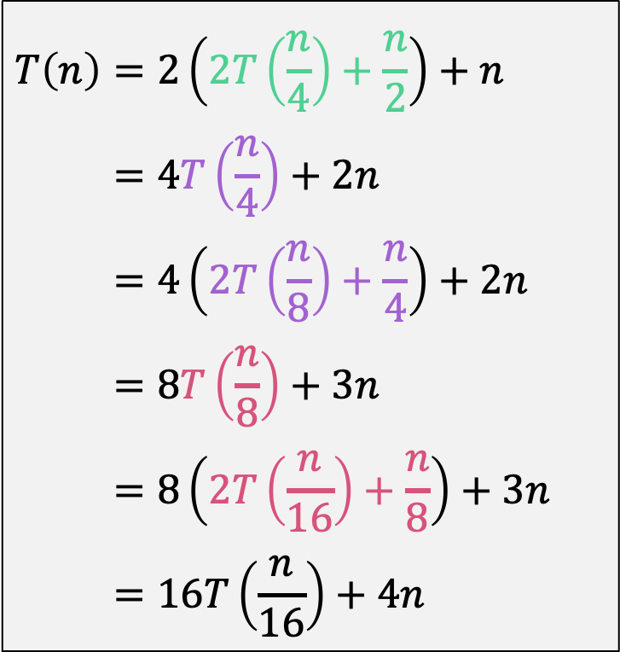
Directly Solve (unrolling the recurrence)
$$T\left(n\right)=2T\left(\frac{n}{2}\right)+n$$
$$T\left(n\right)=2\left(2T\left(\frac{n}{4}\right)+\frac{n}{2}\right)+n \\ =4T\left(\frac{n}{4}\right)+2n \\ =4\left(2T\left(\frac{n}{8}\right)+\frac{n}{4}\right)+2n \\ =8T\left(\frac{n}{8}\right)+3n \\ =8\left(2T\left(\frac{n}{16}\right)+\frac{n}{8}\right)+3n \\ =16T\left(\frac{n}{16}\right)+4n$$
What is the general pattern here? How does this formula change as you continue to unroll?

Slide 13
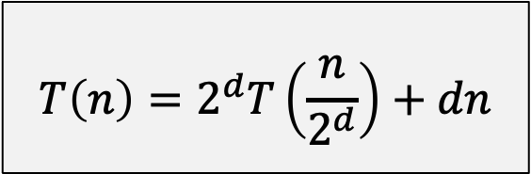
Directly Solve (unrolling the recurrence)
$$T\left(n\right)=2T\left(\frac{n}{2}\right)+n$$
$$T\left(n\right)=2\left(2T\left(\frac{n}{4}\right)+\frac{n}{2}\right)+n \\ =4T\left(\frac{n}{4}\right)+2n \\ =4\left(2T\left(\frac{n}{8}\right)+\frac{n}{4}\right)+2n \\ =8T\left(\frac{n}{8}\right)+3n \\ =8\left(2T\left(\frac{n}{16}\right)+\frac{n}{8}\right)+3n \\ =16T\left(\frac{n}{16}\right)+4n$$
What is the general pattern here? How does this formula change as you continue to unroll?
$$T\left(n\right)=2^{d}T\left(\frac{n}{2^{d}}\right)+dn$$

Slide 14
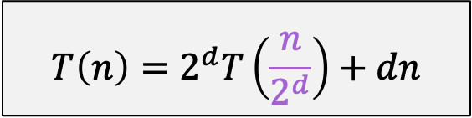
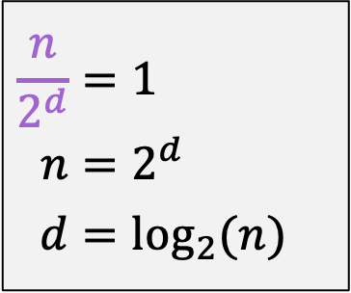
Directly Solve (unrolling the recurrence)
$$T\left(n\right)=2^{d}T\left(\frac{n}{2^{d}}\right)+dn$$
$$\frac{n}{2^{d}}=1 \\ n=2^{d} \\ d=\log_{2}{(n)}$$
Next Step: When does this parameter hit 1? This is when the T() term finally goes away
Assume n is power of 2. Remember that T(1)=1.

Slide 15
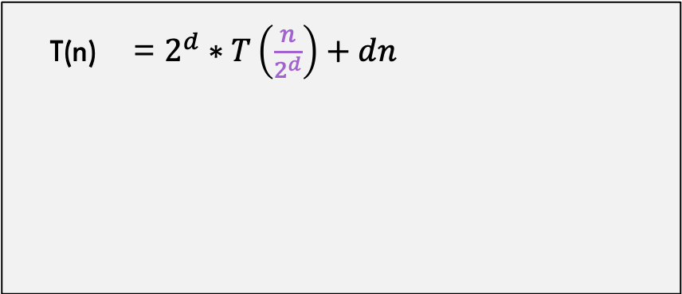
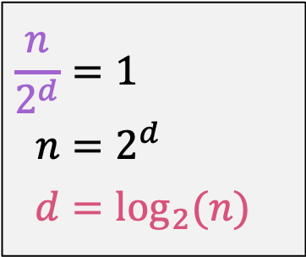
Directly Solve (unrolling the recurrence)
$$\frac{n}{2^{d}}=1 \\ n=2^{d} \\ d=\log_{2}{(n)}$$
T(n) = $2^{d}∗T\left(\frac{n}{2^{d}}\right)+dn$
…from previous slide

Slide 16
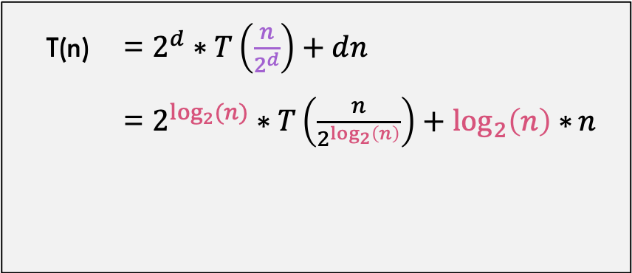
Directly Solve (unrolling the recurrence)
$$\frac{n}{2^{d}}=1 \\ n=2^{d} \\ d=\log_{2}{(n)}$$
T(n) = $2^{d}∗T\left(\frac{n}{2^{d}}\right)+dn$
= $2^{\log_{2}{(n)}}∗T\left(\frac{n}{2^{\log_{2}\left(n\right)}}\right)+\log_{2}\left(n\right)∗n$
…from previous slide

Slide 17
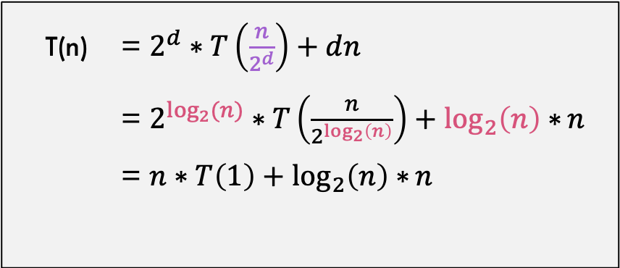
Directly Solve (unrolling the recurrence)
$$\frac{n}{2^{d}}=1 \\ n=2^{d} \\ d=\log_{2}{(n)}$$
T(n) = $2^{d}∗T\left(\frac{n}{2^{d}}\right)+dn$
= $2^{\log_{2}{(n)}}∗T\left(\frac{n}{2^{\log_{2}\left(n\right)}}\right)+\log_{2}\left(n\right)∗n$
= $n∗T\left(1\right)+\log_{2}\left(n\right)∗n$
…from previous slide

Slide 18
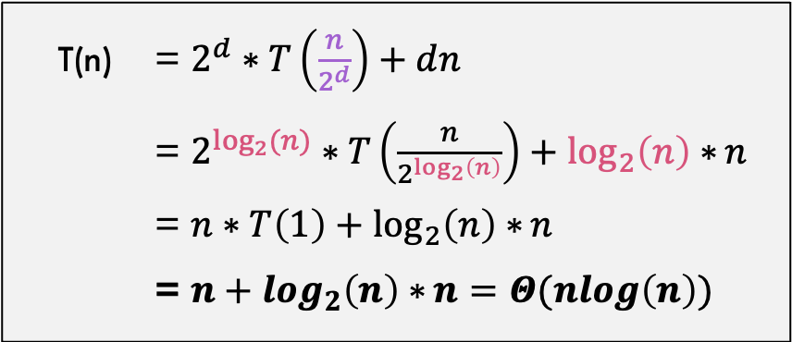

Directly Solve (unrolling the recurrence)
$$\frac{n}{2^{d}}=1 \\ n=2^{d} \\ d=\log_{2}{(n)}$$
T(n) = $2^{d}∗T\left(\frac{n}{2^{d}}\right)+dn$
= $2^{\log_{2}{(n)}}∗T\left(\frac{n}{2^{\log_{2}\left(n\right)}}\right)+\log_{2}\left(n\right)∗n$
= $n∗T\left(1\right)+\log_{2}\left(n\right)∗n$
= $n+\log_{2}\left(n\right)∗n=Θ(nlog\left(n\right))$
…from previous slide
We are done! Solution is $Θ(nlog\left(n\right))$

Slide 19
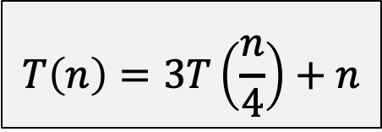
Another Example!!
Consider:
$$T\left(n\right)=3T\left(\frac{n}{4}\right)+n$$

Slide 20
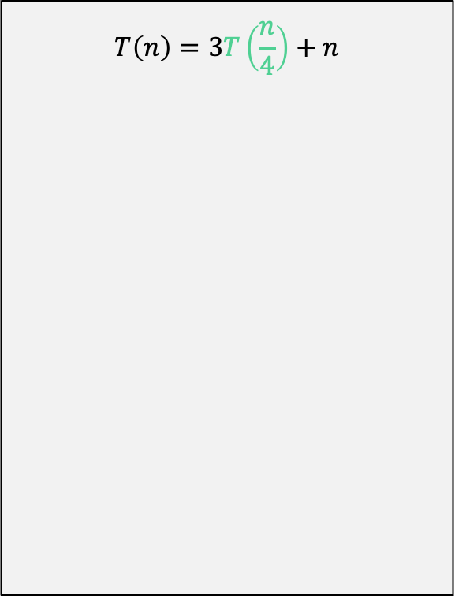
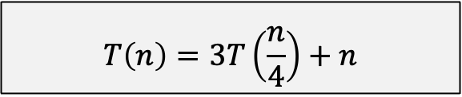
Unroll the recurrence
$$T\left(n\right)=3T\left(\frac{n}{4}\right)+n$$
$$T\left(n\right)=3T\left(\frac{n}{4}\right)+n$$

Slide 21
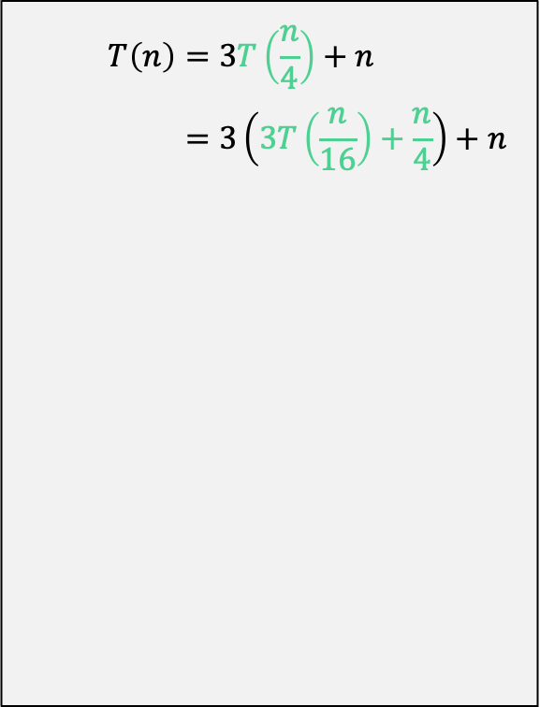
Unroll the recurrence
$$T\left(n\right)=3T\left(\frac{n}{4}\right)+n$$
$$T\left(n\right)=3T\left(\frac{n}{4}\right)+n \\ =3\left(3T\left(\frac{n}{16}\right)+\frac{n}{4}\right)+n$$

Slide 22
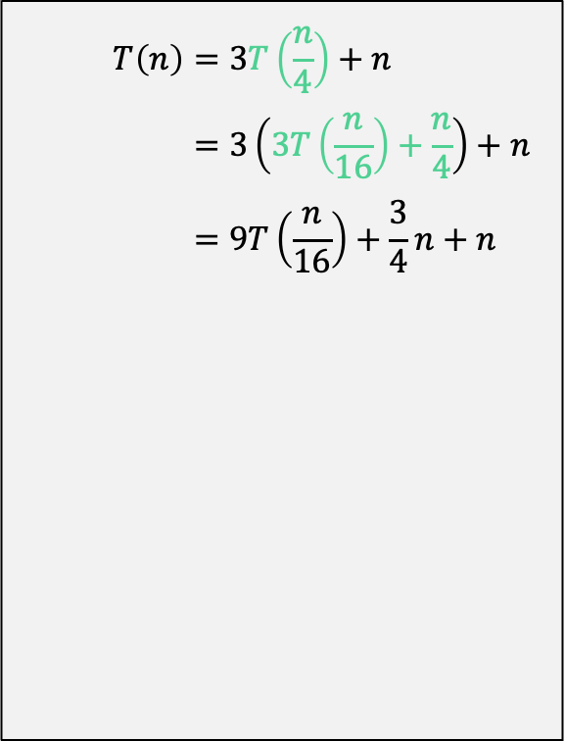
Unroll the recurrence
$$T\left(n\right)=3T\left(\frac{n}{4}\right)+n$$
$$T\left(n\right)=3T\left(\frac{n}{4}\right)+n \\ =3\left(3T\left(\frac{n}{16}\right)+\frac{n}{4}\right)+n \\ =9T\left(\frac{n}{16}\right)+\frac{3}{4}n+n$$

Slide 23
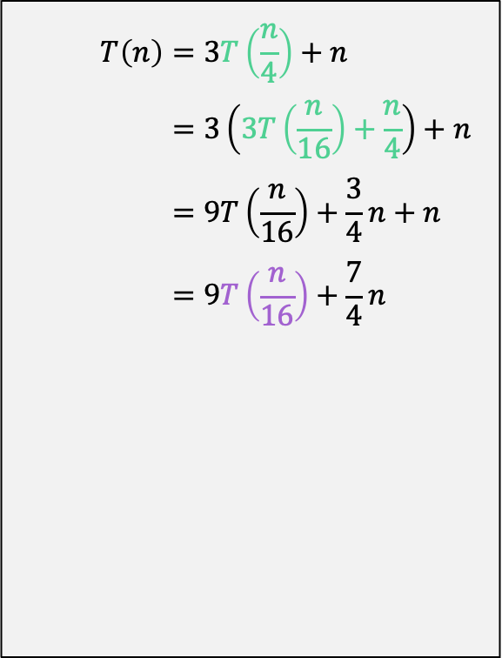
Unroll the recurrence
$$T\left(n\right)=3T\left(\frac{n}{4}\right)+n$$
$$T\left(n\right)=3T\left(\frac{n}{4}\right)+n \\ =3\left(3T\left(\frac{n}{16}\right)+\frac{n}{4}\right)+n \\ =9T\left(\frac{n}{16}\right)+\frac{3}{4}n+n \\ =9T\left(\frac{n}{16}\right)+\frac{7}{4}n$$

Slide 24
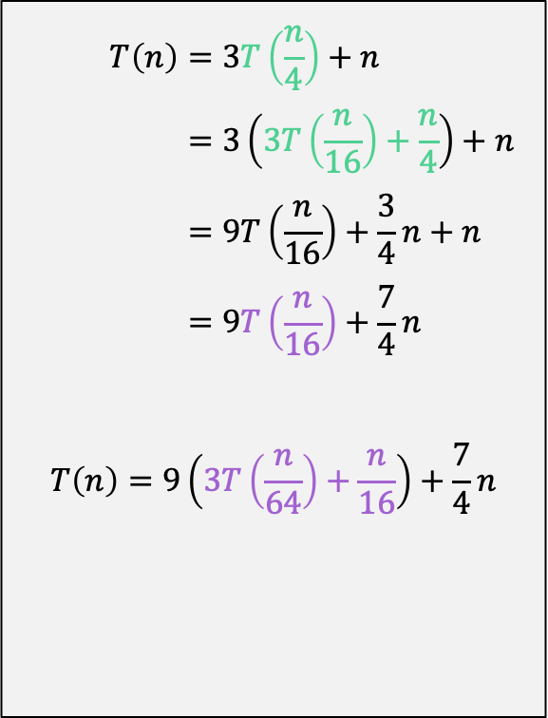
Unroll the recurrence
$$T\left(n\right)=3T\left(\frac{n}{4}\right)+n$$
$$T\left(n\right)=3T\left(\frac{n}{4}\right)+n \\ =3\left(3T\left(\frac{n}{16}\right)+\frac{n}{4}\right)+n \\ =9T\left(\frac{n}{16}\right)+\frac{3}{4}n+n \\ =9T\left(\frac{n}{16}\right)+\frac{7}{4}n$$
$$T\left(n\right)=9\left(3T\left(\frac{n}{64}\right)+\frac{n}{16}\right)+\frac{7}{4}n$$

Slide 25
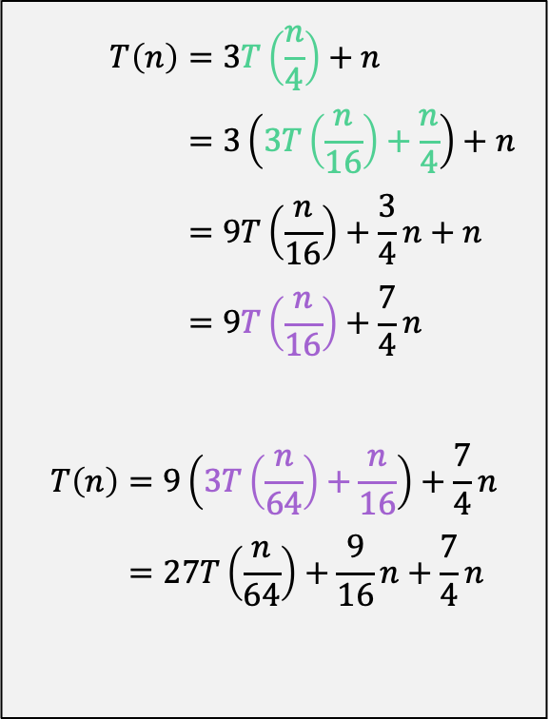
Unroll the recurrence
$$T\left(n\right)=3T\left(\frac{n}{4}\right)+n$$
$$T\left(n\right)=3T\left(\frac{n}{4}\right)+n \\ =3\left(3T\left(\frac{n}{16}\right)+\frac{n}{4}\right)+n \\ =9T\left(\frac{n}{16}\right)+\frac{3}{4}n+n \\ =9T\left(\frac{n}{16}\right)+\frac{7}{4}n$$
$$T\left(n\right)=9\left(3T\left(\frac{n}{64}\right)+\frac{n}{16}\right)+\frac{7}{4}n \\ =27T\left(\frac{n}{64}\right)+\frac{9}{16}n+\frac{7}{4}n$$

Slide 26
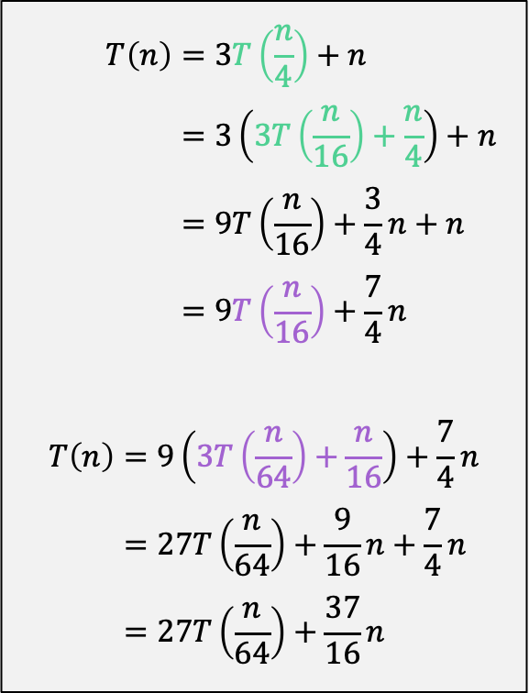
Unroll the recurrence
$$T\left(n\right)=3T\left(\frac{n}{4}\right)+n$$
$$T\left(n\right)=3T\left(\frac{n}{4}\right)+n \\ =3\left(3T\left(\frac{n}{16}\right)+\frac{n}{4}\right)+n \\ =9T\left(\frac{n}{16}\right)+\frac{3}{4}n+n \\ =9T\left(\frac{n}{16}\right)+\frac{7}{4}n$$
$$T\left(n\right)=9\left(3T\left(\frac{n}{64}\right)+\frac{n}{16}\right)+\frac{7}{4}n \\ =27T\left(\frac{n}{64}\right)+\frac{9}{16}n+\frac{7}{4}n \\ =27T\left(\frac{n}{64}\right)+\frac{37}{16}n$$

Slide 27
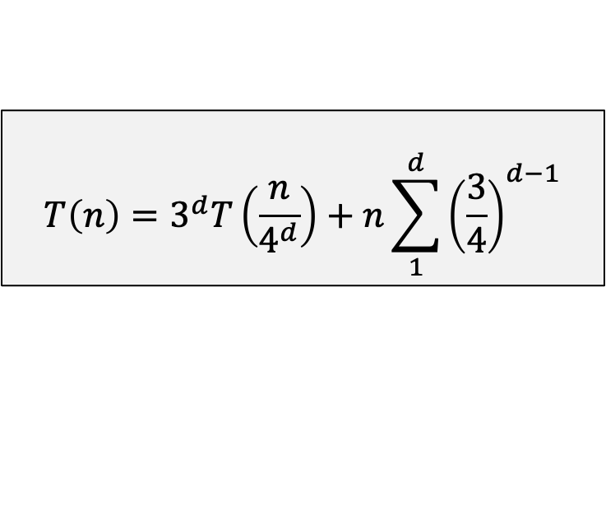
Unroll the recurrence
$$T\left(n\right)=3T\left(\frac{n}{4}\right)+n$$
$$T\left(n\right)=3T\left(\frac{n}{4}\right)+n \\ =3\left(3T\left(\frac{n}{16}\right)+\frac{n}{4}\right)+n \\ =9T\left(\frac{n}{16}\right)+\frac{3}{4}n+n \\ =9T\left(\frac{n}{16}\right)+\frac{7}{4}n$$
$$T\left(n\right)=9\left(3T\left(\frac{n}{64}\right)+\frac{n}{16}\right)+\frac{7}{4}n \\ =27T\left(\frac{n}{64}\right)+\frac{9}{16}n+\frac{7}{4}n \\ =27T\left(\frac{n}{64}\right)+\frac{37}{16}n$$
General pattern is:
$$T\left(n\right)=3^{d}T\left(\frac{n}{4^{d}}\right)+n\sum_{1}^{d}{{\left(\frac{3}{4}\right)}^{d−1}}$$

Slide 28
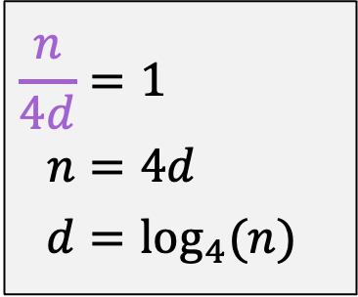
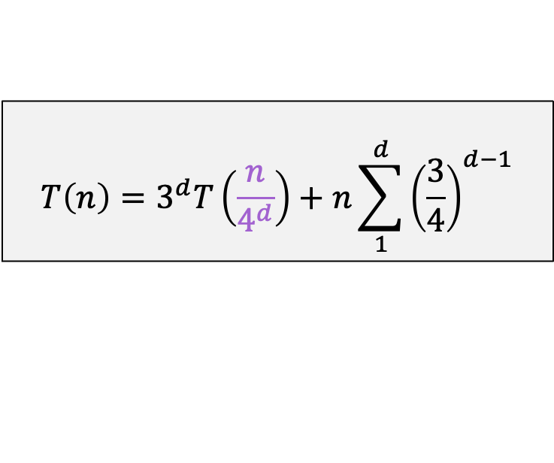
Directly Solve (unrolling the recurrence)
$$T\left(n\right)=3^{d}T\left(\frac{n}{4^{d}}\right)+n\sum_{1}^{d}{{\left(\frac{3}{4}\right)}^{d−1}}$$
$$\frac{n}{4d}=1 \\ n=4d \\ d=\log_{4}{(n)}$$
Next Step: When does this parameter hit 1? This is when the T() term finally goes away

Slide 29
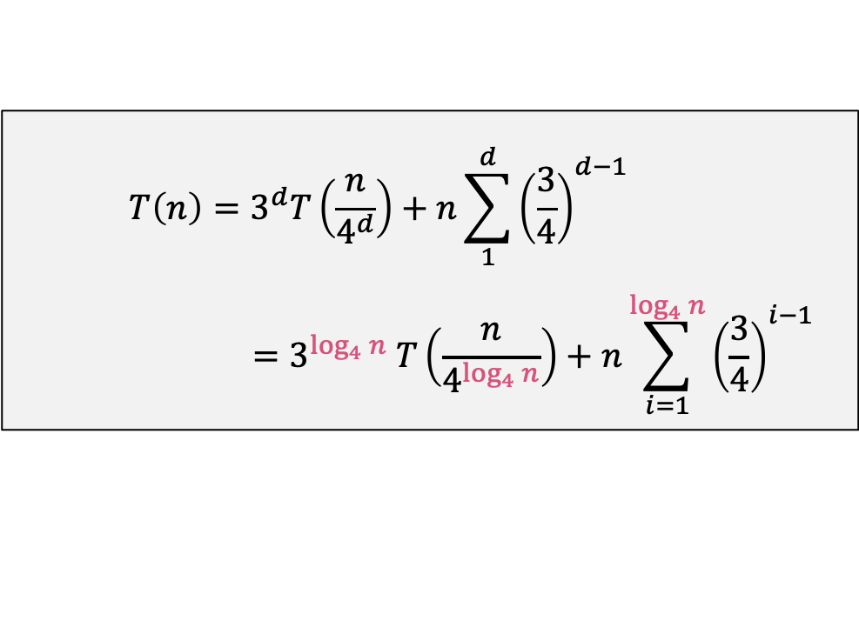
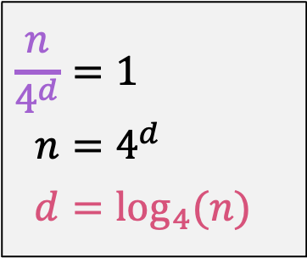
Directly Solve (unrolling the recurrence)
$$\frac{n}{4^{d}}=1 \\ n=4^{d} \\ d=\log_{4}{(n)}$$
$$T\left(n\right)=3^{d}T\left(\frac{n}{4^{d}}\right)+n\sum_{1}^{d}{{\left(\frac{3}{4}\right)}^{d−1}} \\ =3^{\log_{4}{n}} T\left(\frac{n}{4^{\log_{4}{n}}}\right)+n\sum_{i=1}^{\log_{4}{n}}{{\left(\frac{3}{4}\right)}^{i−1}}$$
…from previous slide

Slide 30
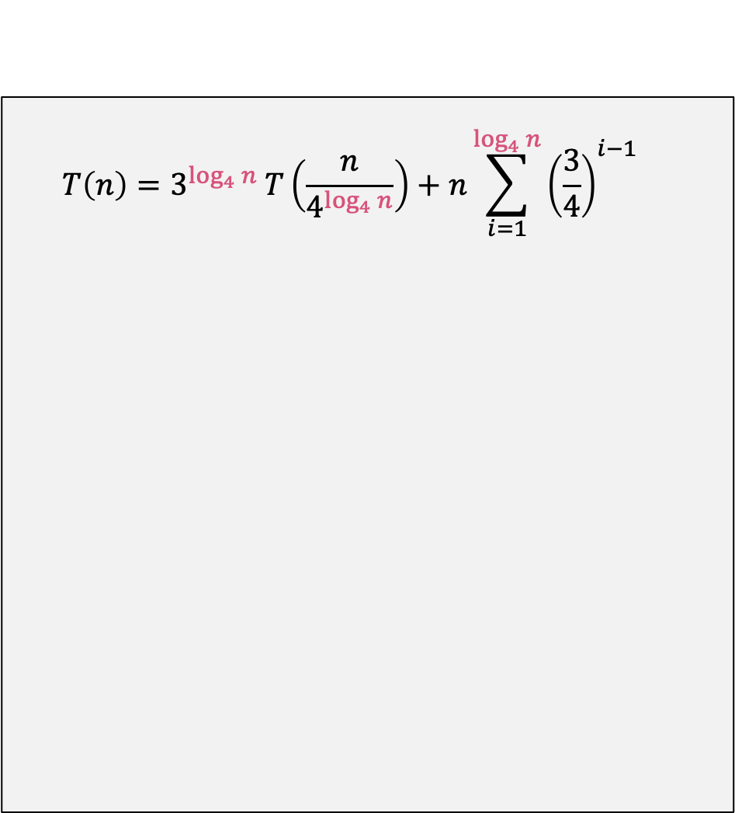
Directly Solve (unrolling the recurrence)
$$T\left(n\right)=3^{\log_{4}{n}} T\left(\frac{n}{4^{\log_{4}{n}}}\right)+n\sum_{i=1}^{\log_{4}{n}}{{\left(\frac{3}{4}\right)}^{i−1}}$$

Slide 31

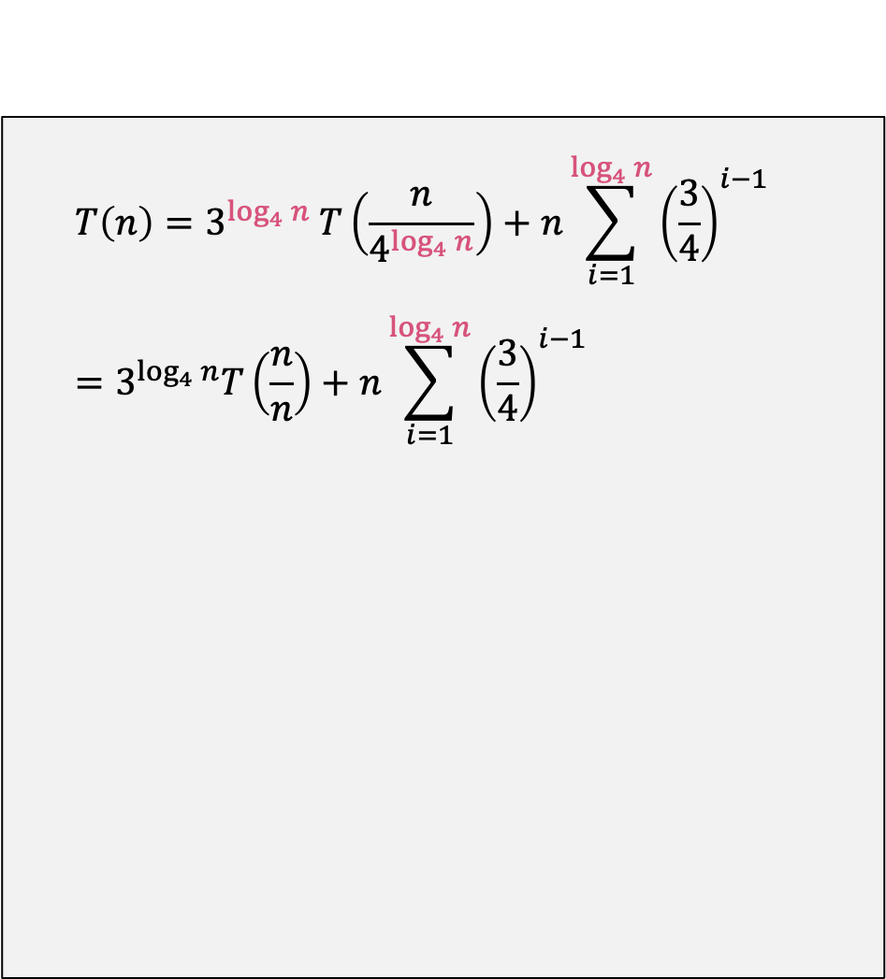
Directly Solve (unrolling the recurrence)
$$T\left(n\right)=3^{\log_{4}{n}} T\left(\frac{n}{4^{\log_{4}{n}}}\right)+n\sum_{i=1}^{\log_{4}{n}}{{\left(\frac{3}{4}\right)}^{i−1}} \\ =3^{\log_{4}{n}}T\left(\frac{n}{n}\right)+n\sum_{i=1}^{\log_{4}{n}}{{\left(\frac{3}{4}\right)}^{i−1}}$$
By simplification of $4^{\log_{4}{n}}=n$

Slide 32

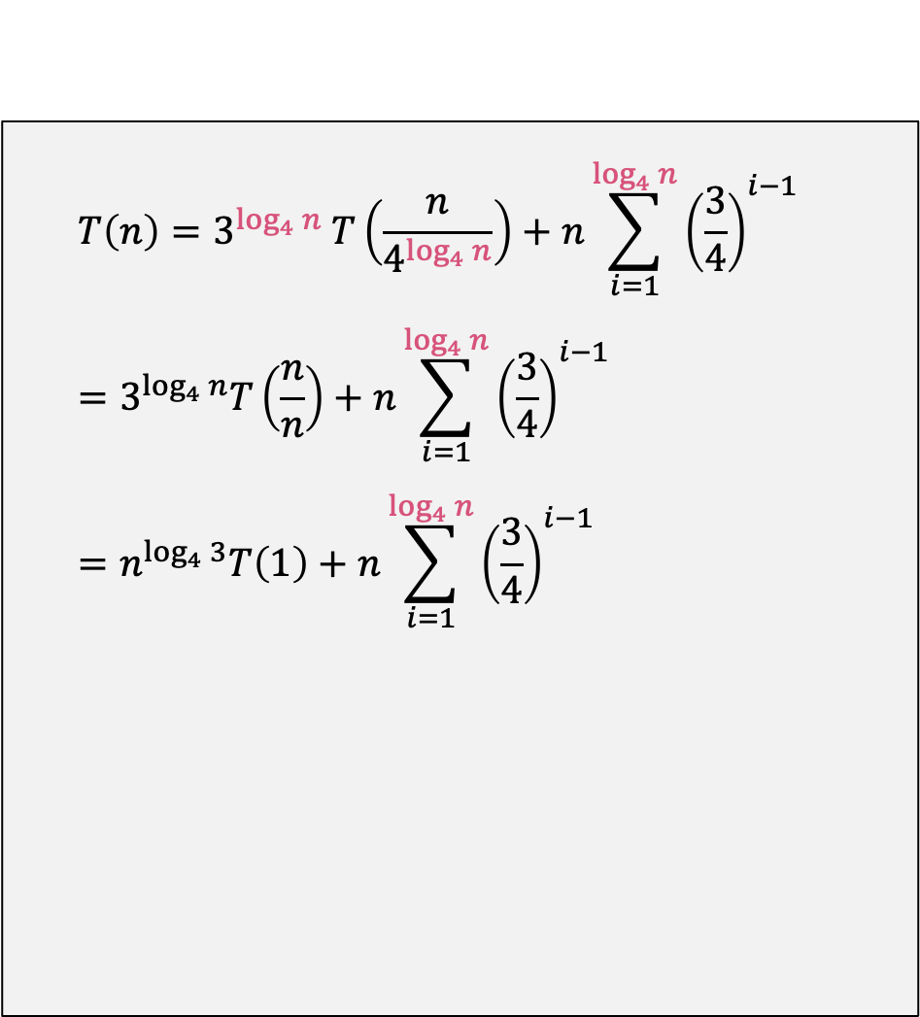
Directly Solve (unrolling the recurrence)
$$T\left(n\right)=3^{\log_{4}{n}} T\left(\frac{n}{4^{\log_{4}{n}}}\right)+n\sum_{i=1}^{\log_{4}{n}}{{\left(\frac{3}{4}\right)}^{i−1}} \\ =3^{\log_{4}{n}}T\left(\frac{n}{n}\right)+n\sum_{i=1}^{\log_{4}{n}}{{\left(\frac{3}{4}\right)}^{i−1}} \\ =n^{\log_{4}{3}}T\left(1\right)+n\sum_{i=1}^{\log_{4}{n}}{{\left(\frac{3}{4}\right)}^{i−1}}$$
By simplification of $4^{\log_{4}{n}}=n$
By log rule $a^{\log_{b}{c}}=c^{\log_{b}{a}}$

Slide 33

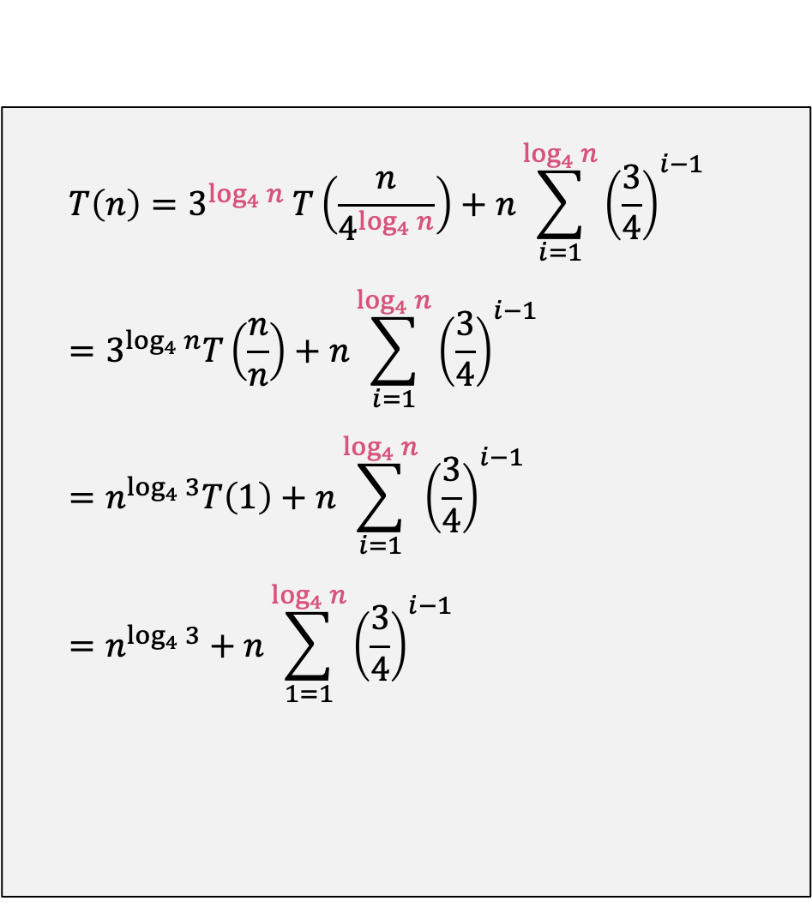
Directly Solve (unrolling the recurrence)
$$T\left(n\right)=3^{\log_{4}{n}} T\left(\frac{n}{4^{\log_{4}{n}}}\right)+n\sum_{i=1}^{\log_{4}{n}}{{\left(\frac{3}{4}\right)}^{i−1}} \\ =3^{\log_{4}{n}}T\left(\frac{n}{n}\right)+n\sum_{i=1}^{\log_{4}{n}}{{\left(\frac{3}{4}\right)}^{i−1}} \\ =n^{\log_{4}{3}}T\left(1\right)+n\sum_{i=1}^{\log_{4}{n}}{{\left(\frac{3}{4}\right)}^{i−1}} \\ =n^{\log_{4}{3}}+n\sum_{1=1}^{\log_{4}{n}}{{\left(\frac{3}{4}\right)}^{i−1}}$$
By simplification of $4^{\log_{4}{n}}=n$
By log rule $a^{\log_{b}{c}}=c^{\log_{b}{a}}$
Because $T\left(1\right)=1$

Slide 34
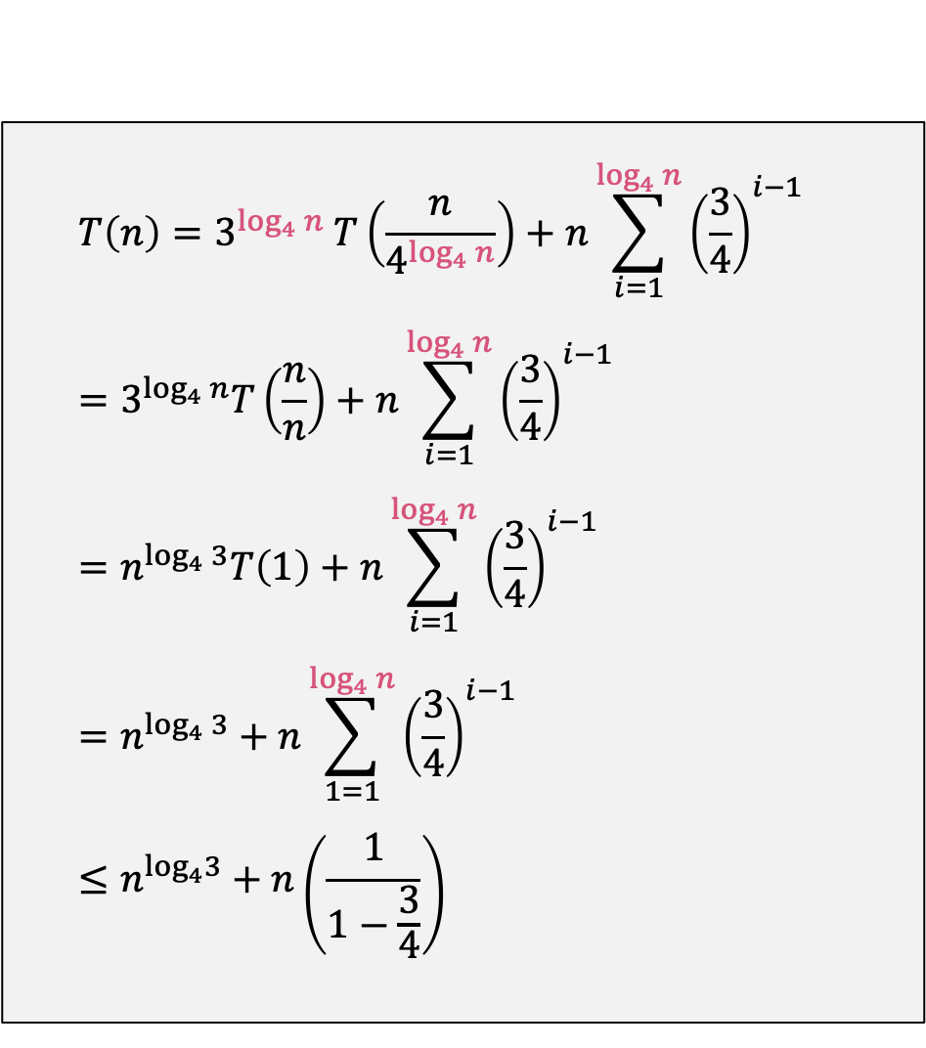

Directly Solve (unrolling the recurrence)
$$T\left(n\right)=3^{\log_{4}{n}} T\left(\frac{n}{4^{\log_{4}{n}}}\right)+n\sum_{i=1}^{\log_{4}{n}}{{\left(\frac{3}{4}\right)}^{i−1}} \\ =3^{\log_{4}{n}}T\left(\frac{n}{n}\right)+n\sum_{i=1}^{\log_{4}{n}}{{\left(\frac{3}{4}\right)}^{i−1}} \\ =n^{\log_{4}{3}}T\left(1\right)+n\sum_{i=1}^{\log_{4}{n}}{{\left(\frac{3}{4}\right)}^{i−1}} \\ =n^{\log_{4}{3}}+n\sum_{1=1}^{\log_{4}{n}}{{\left(\frac{3}{4}\right)}^{i−1}} \\ ≤n^{\log_{4}3}+n\left(\frac{1}{1−\frac{3}{4}}\right)$$
By simplification of $4^{\log_{4}{n}}=n$
By log rule $a^{\log_{b}{c}}=c^{\log_{b}{a}}$
Because $T\left(1\right)=1$
Geometric series: $\sum_{1}^{∞}{{\left(\frac{a}{b}\right)}^{n}}=\frac{1}{1−\frac{a}{b}}$

Slide 35
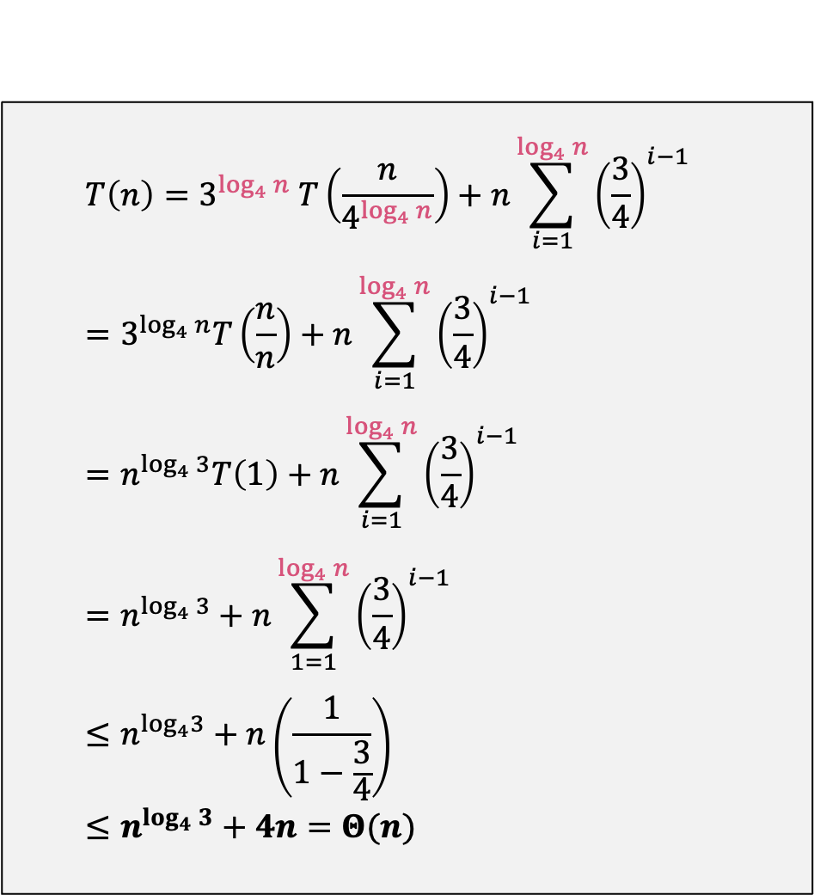
Directly Solve (unrolling the recurrence)
$$T\left(n\right)=3^{\log_{4}{n}} T\left(\frac{n}{4^{\log_{4}{n}}}\right)+n\sum_{i=1}^{\log_{4}{n}}{{\left(\frac{3}{4}\right)}^{i−1}} \\ =3^{\log_{4}{n}}T\left(\frac{n}{n}\right)+n\sum_{i=1}^{\log_{4}{n}}{{\left(\frac{3}{4}\right)}^{i−1}} \\ =n^{\log_{4}{3}}T\left(1\right)+n\sum_{i=1}^{\log_{4}{n}}{{\left(\frac{3}{4}\right)}^{i−1}} \\ =n^{\log_{4}{3}}+n\sum_{1=1}^{\log_{4}{n}}{{\left(\frac{3}{4}\right)}^{i−1}} \\ ≤n^{\log_{4}3}+n\left(\frac{1}{1−\frac{3}{4}}\right) \\ ≤n^{\log_{4}{3}}+4n=Θ(n)$$
By simplification of $4^{\log_{4}{n}}=n$
By log rule $a^{\log_{b}{c}}=c^{\log_{b}{a}}$
Because $T\left(1\right)=1$
Geometric series: $\sum_{1}^{∞}{{\left(\frac{a}{b}\right)}^{n}}=\frac{1}{1−\frac{a}{b}}$

Slide 36
Substitution Method

Slide 37
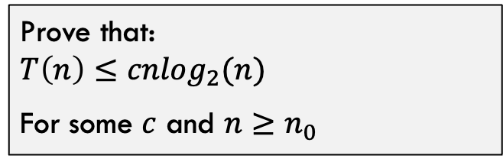
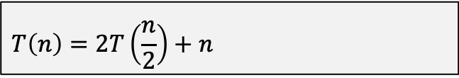
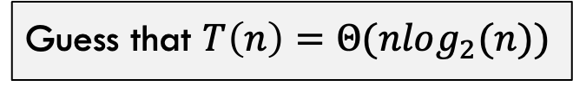
Iteration or Substitution Method
Strategy:
Example:
Look at recurrence carefully
$$T\left(n\right)=2T\left(\frac{n}{2}\right)+n$$
Guess the solution
Guess that $T\left(n\right)=Θ(nlog_{2}(n))$
Check solution w/ induction
Prove that: $$T\left(n\right)≤cnlog_{2}(n)$$
For some $c$ and $n≥n_{0}$

Slide 38
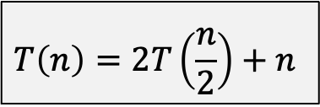
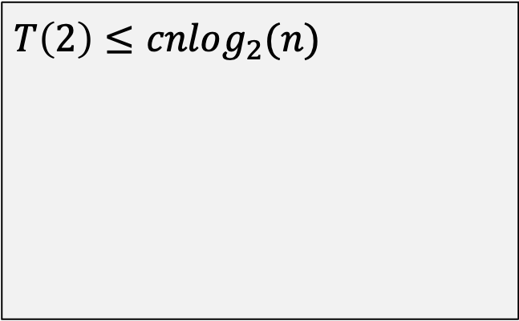
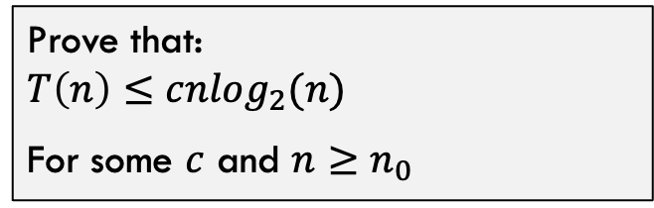
Iteration or Substitution Method
$$T\left(n\right)=2T\left(\frac{n}{2}\right)+n$$
Prove that: $$T\left(n\right)≤cnlog_{2}(n)$$
For some $c$ and $n≥n_{0}$
Base Case (n=2):
$$T\left(2\right)≤cnlog_{2}(n)$$

Slide 39
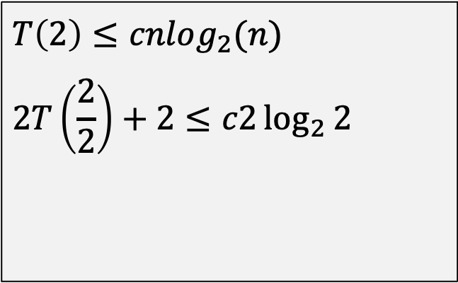
Iteration or Substitution Method
$$T\left(n\right)=2T\left(\frac{n}{2}\right)+n$$
Prove that: $$T\left(n\right)≤cnlog_{2}(n)$$
For some $c$ and $n≥n_{0}$
Base Case (n=2):
$$T\left(2\right)≤cnlog_{2}(n) \\ 2T\left(\frac{2}{2}\right)+2≤c2\log_{2}{2}$$

Slide 40
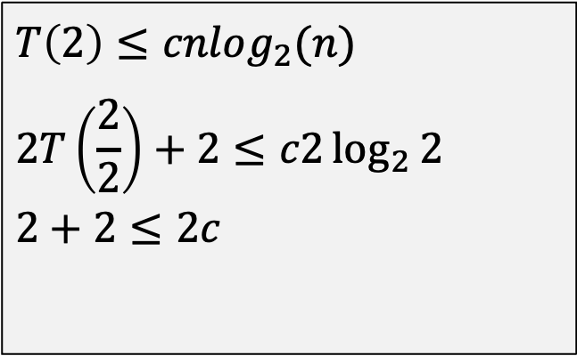
Iteration or Substitution Method
$$T\left(n\right)=2T\left(\frac{n}{2}\right)+n$$
Prove that: $$T\left(n\right)≤cnlog_{2}(n)$$
For some $c$ and $n≥n_{0}$
Base Case (n=2):
$$T\left(2\right)≤cnlog_{2}(n) \\ 2T\left(\frac{2}{2}\right)+2≤c2\log_{2}{2} \\ 2+2≤2c$$

Slide 41
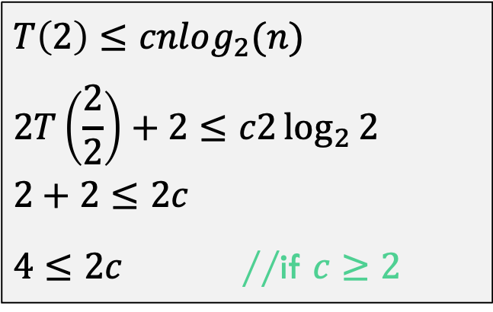
Iteration or Substitution Method
$$T\left(n\right)=2T\left(\frac{n}{2}\right)+n$$
Prove that: $$T\left(n\right)≤cnlog_{2}(n)$$
For some $c$ and $n≥n_{0}$
Base Case (n=2):
$$T\left(2\right)≤cnlog_{2}(n) \\ 2T\left(\frac{2}{2}\right)+2≤c2\log_{2}{2} \\ 2+2≤2c$$ $4≤2c$ //if $c≥2$

Slide 42
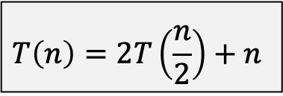
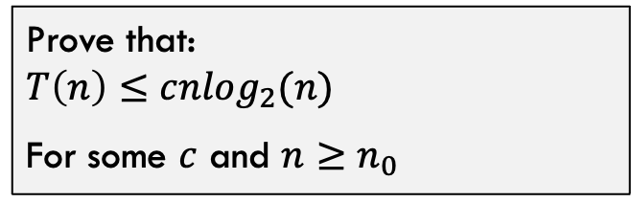
Iteration or Substitution Method
$$T\left(n\right)=2T\left(\frac{n}{2}\right)+n$$
Prove that: $$T\left(n\right)≤cnlog_{2}(n)$$
For some $c$ and $n≥n_{0}$
Inductive Hypothesis:
Assume for all $i<k$ that $T\left(i\right)≤c⋅i⋅\log_{2}{(i)}$

Slide 43

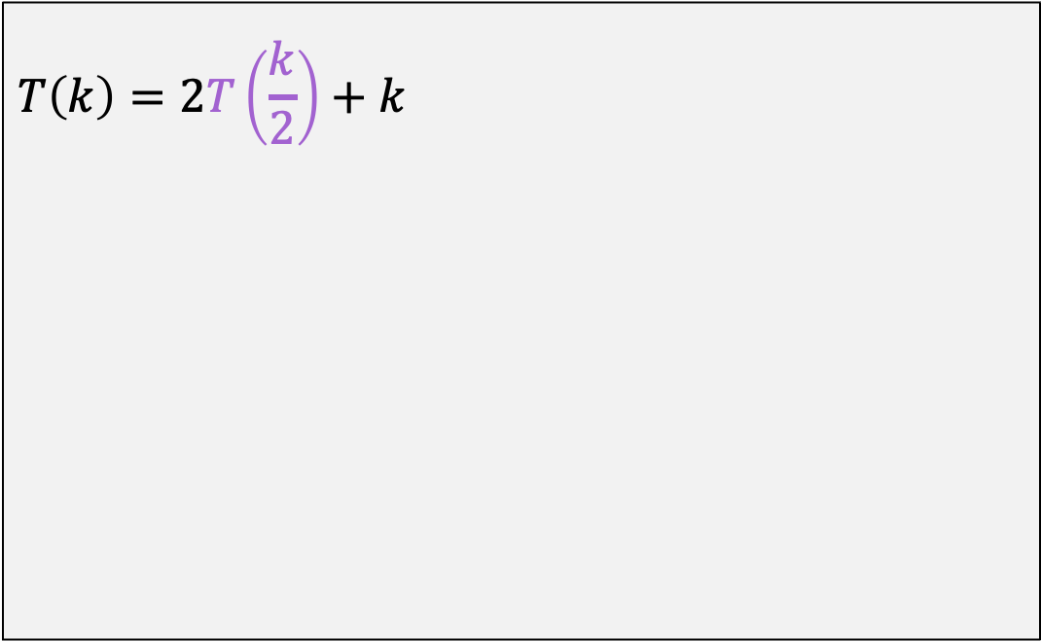
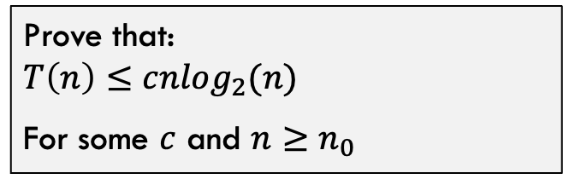
Iteration or Substitution Method
$$T\left(n\right)=2T\left(\frac{n}{2}\right)+n$$
Prove that: $$T\left(n\right)≤cnlog_{2}(n)$$
For some $c$ and $n≥n_{0}$
Inductive Step:
$$T\left(k\right)=2T\left(\frac{k}{2}\right)+k$$

Slide 44

Iteration or Substitution Method
$$T\left(n\right)=2T\left(\frac{n}{2}\right)+n$$
Prove that: $$T\left(n\right)≤cnlog_{2}(n)$$
For some $c$ and $n≥n_{0}$
Inductive Step:
$$T\left(k\right)=2T\left(\frac{k}{2}\right)+k \\ ≤2\left(c\frac{k}{2}log_{2}\left(\frac{k}{2}\right)\right)+k$$

Slide 45

Iteration or Substitution Method
$$T\left(n\right)=2T\left(\frac{n}{2}\right)+n$$
Prove that: $$T\left(n\right)≤cnlog_{2}(n)$$
For some $c$ and $n≥n_{0}$
Inductive Step:
$$T\left(k\right)=2T\left(\frac{k}{2}\right)+k \\ ≤2\left(c\frac{k}{2}log_{2}\left(\frac{k}{2}\right)\right)+k \\ ≤2c\frac{k}{2}\left(\log_{2}\left(k\right)−\log_{2}\left(2\right)\right)+k$$

Slide 46

Iteration or Substitution Method
$$T\left(n\right)=2T\left(\frac{n}{2}\right)+n$$
Prove that: $$T\left(n\right)≤cnlog_{2}(n)$$
For some $c$ and $n≥n_{0}$
Inductive Step:
$$T\left(k\right)=2T\left(\frac{k}{2}\right)+k \\ ≤2\left(c\frac{k}{2}log_{2}\left(\frac{k}{2}\right)\right)+k \\ ≤2c\frac{k}{2}\left(\log_{2}\left(k\right)−\log_{2}\left(2\right)\right)+k \\ ≤ck\left(log_{2}\left(k\right)−1\right)+k$$

Slide 47

Iteration or Substitution Method
$$T\left(n\right)=2T\left(\frac{n}{2}\right)+n$$
Prove that: $$T\left(n\right)≤cnlog_{2}(n)$$
For some $c$ and $n≥n_{0}$
Inductive Step:
$$T\left(k\right)=2T\left(\frac{k}{2}\right)+k \\ ≤2\left(c\frac{k}{2}log_{2}\left(\frac{k}{2}\right)\right)+k \\ ≤2c\frac{k}{2}\left(\log_{2}\left(k\right)−\log_{2}\left(2\right)\right)+k \\ ≤ck\left(log_{2}\left(k\right)−1\right)+k \\ ≤cklog_{2}\left(k\right)−ck+k≤cklog_{2}k$$

Slide 48



Substitution Method: Subtleties
Consider
Inductive Step:
$$T\left(n\right)=2T\left(\frac{n}{2}\right)+1$$
$$T\left(k\right)=2T\left(\frac{k}{2}\right)+1 \\ ≤2\left(c\frac{k}{2}\right)+1 \\ ≤ck+1$$
Prove That:
$$T\left(n\right)≤cn$$
For some $c$ and $n≥n_{0}$
This is NOT correct. Need to prove exact form of inductive hypothesis! How do we fix this?

Slide 49



Substitution Method: Subtleties
Consider
Inductive Step:
$$T\left(n\right)=2T\left(\frac{n}{2}\right)+1$$
$$T\left(k\right)=2T\left(\frac{k}{2}\right)+1 \\ ≤2\left(c\frac{k}{2}−d\right)+1 \\ ≤ck−2d+1≤ck−d$$
Prove That:
$$T\left(n\right)≤cn−d$$
For some $c$ and $n≥n_{0}$
With this constant decrease, we can now prove the exact form of the inductive hypothesis!
We were only “over” by 1, so weaken the claim to be some constant less than $c∗n$

Slide 50


Substitution Method: Another Pitfall
Consider
Prove That:
$$T\left(n\right)=2T\left(\frac{n}{2}\right)+n$$
$$T\left(n\right)≤cn$$
For some $c$ and $n≥n_{0}$
Note that this guess is INCORRECT! We want to see what happens when the proof fails!

Slide 51

Substitution Method: Another Pitfall
Consider
Inductive Step:
$$T\left(n\right)=2T\left(\frac{n}{2}\right)+n$$
$$T\left(k\right)=2T\left(\frac{k}{2}\right)+k \\ ≤2\left(c\frac{k}{2}\right)+k \\ ≤ck+k$$
Prove That:
$$T\left(n\right)≤cn$$
For some $c$ and $n≥n_{0}$
Did not prove the exact form, so proof failed. Why does the trick of removing a constant to weaken the claim not work this time?

Slide 52
Recursion Tree Method

Slide 53























Recursion Tree Method
Consider the classic recurrence: $T\left(n\right)=2T\left(\frac{n}{2}\right)+n$
$$T(n)$$
$$n$$
Count up the recursive work. Parameter value is in green box, amount of work done is in blue box
$$T(\frac{n}{2})$$
$$\frac{n}{2}$$
$$T(\frac{n}{2})$$
$$\frac{n}{2}$$
$$T(\frac{n}{4})$$
$$\frac{n}{4}$$
$$T(\frac{n}{4})$$
$$\frac{n}{4}$$
$$T(\frac{n}{4})$$
$$\frac{n}{4}$$
$$T(\frac{n}{4})$$
$$\frac{n}{4}$$
……………
……………
$$T(1)$$
$$1$$
$$T(1)$$
$$1$$
$$T(1)$$
$$1$$
……………
$$T(1)$$
$$1$$

Slide 54


























Recursion Tree Method
Count up the recursive work. Parameter value is in green box, amount of work done is in blue box
$$T(n)$$
$$n$$
$$n$$
$$T(\frac{n}{2})$$
$$\frac{n}{2}$$
$$T(\frac{n}{2})$$
$$\frac{n}{2}$$
$$\frac{n}{2}+\frac{n}{2}=n$$
$$T(\frac{n}{4})$$
$$\frac{n}{4}$$
$$T(\frac{n}{4})$$
$$\frac{n}{4}$$
$$T(\frac{n}{4})$$
$$\frac{n}{4}$$
$$T(\frac{n}{4})$$
$$\frac{n}{4}$$
$$4\frac{n}{4}=n$$
……………
……………
$$T(1)$$
$$1$$
$$T(1)$$
$$1$$
$$T(1)$$
$$1$$
……………
$$T(1)$$
$$1$$
$$n(1)=n$$

Slide 55




























Recursion Tree Method
Count up the recursive work. Parameter value is in green box, amount of work done is in blue box
$$T(n)$$
$$n$$
$$n$$
How many layers:
$$\log_{2}{n}$$
$$T(\frac{n}{2})$$
$$\frac{n}{2}$$
$$T(\frac{n}{2})$$
$$\frac{n}{2}$$
$$\frac{n}{2}+\frac{n}{2}=n$$
Total Cost:
$n$ work per layer
$\log_{2}{n}$ layers
$$Θ(nlogn)$$
$$T(\frac{n}{4})$$
$$\frac{n}{4}$$
$$T(\frac{n}{4})$$
$$\frac{n}{4}$$
$$T(\frac{n}{4})$$
$$\frac{n}{4}$$
$$T(\frac{n}{4})$$
$$\frac{n}{4}$$
$$4\frac{n}{4}=n$$
……………
……………
$$T(1)$$
$$1$$
$$T(1)$$
$$1$$
$$T(1)$$
$$1$$
……………
$$T(1)$$
$$1$$
$$n(1)=n$$

Slide 56
The Master Theorem

Slide 57
The Master Theorem
Given: a divide and conquer algorithm
Then, the Master Theorem gives us a cookbook for the algorithm’s running time
Some textbooks have a simpler version they call the “Main Recurrence Theorem”

Slide 58


The Master Theorem (from Cormen)
The Master Theorem:
Consider $T\left(n\right)=a T\left(\frac{n}{b}\right)+f(n)$ Let $k=\frac{\lg{a}}{\lg{b}}=\log_{b}{a}$
Case 1:
If $f\left(n\right)∈O(n^{k−ε})$ for some positive $ε$, then $T\left(n\right)∈Θ(n^{k})$
Case 2:
If $f\left(n\right)∈Θ(n^{k})$ then $T\left(n\right)∈Θ\left(f\left(n\right)\log{n}\right)=Θ(n^{k}\log{n})$
Case 3:
If $f\left(n\right)∈Ω(n^{k+ε})$ for some positive $ε$ and $a f\left(\frac{n}{b}\right)≤c f(n)$ for some $c<1$ and sufficiently large n, then $T\left(n\right)∈Θ(f(n))$

Slide 59



The Master Theorem (from Cormen)
The Master Theorem:
Consider $T\left(n\right)=a T\left(\frac{n}{b}\right)+f(n)$ Let $k=\frac{\lg{a}}{\lg{b}}=\log_{b}{a}$
$f(n)$ represents how much work is done by the top level of recursion
k is the depth of the recursion. $n^{k}$ is the amount of work done at the very bottom of the recursion tree.

Slide 60





















The Master Theorem (from Cormen)
The Master Theorem:
Consider $T\left(n\right)=a T\left(\frac{n}{b}\right)+f(n)$ Let $k=\frac{\lg{a}}{\lg{b}}=\log_{b}{a}$
$$T(n)$$
$$f(n)$$
$f(n)$ might dominate the runtime
$$T(\frac{n}{2})$$
$$\frac{n}{2}$$
$$T(\frac{n}{2})$$
$$\frac{n}{2}$$
$$T(\frac{n}{4})$$
$$\frac{n}{4}$$
$$T(\frac{n}{4})$$
$$\frac{n}{4}$$
$$T(\frac{n}{4})$$
$$\frac{n}{4}$$
$$T(\frac{n}{4})$$
$$\frac{n}{4}$$
……………
……………
$n^{k}$ is the total number of times code hits these bottom nodes. This might also dominate runtime
$$T(1)$$
$$1$$
$$T(1)$$
$$1$$
$$T(1)$$
$$1$$
……………
$$T(1)$$
$$1$$

Slide 61












The Master Theorem (from Cormen)
The Master Theorem:
Consider $T\left(n\right)=a T\left(\frac{n}{b}\right)+f(n)$ Let $k=\frac{\lg{a}}{\lg{b}}=\log_{b}{a}$
Case 1:
If $f\left(n\right)∈O(n^{k−ε})$ for some positive $ε$, then $T\left(n\right)∈Θ(n^{k})$
$$T(n)$$
$$f(n)$$
$n^{k}$ is strictly worse, so it IS the runtime! The base cases dominate the runtime!
……………
……………
$$T(1)$$
$$1$$
$$T(1)$$
$$1$$
$$T(1)$$
$$1$$
……………
$$T(1)$$
$$1$$

Slide 62



The Master Theorem (from Cormen)
The Master Theorem:
Consider $T\left(n\right)=a T\left(\frac{n}{b}\right)+f(n)$ Let $k=\frac{\lg{a}}{\lg{b}}=\log_{b}{a}$
Case 2:
If $f\left(n\right)∈Θ(n^{k})$ then $T\left(n\right)∈Θ\left(f\left(n\right)\log{n}\right)=Θ(n^{k}\log{n})$
$$T(n)$$
$$f(n)$$
$n^{k}$ and $f(n)$ have same runtime! You do $n^{k}$ work at each layer for $\log{n}$ layers!
……………
……………
$$T(1)$$
$$1$$
$$T(1)$$
$$1$$
$$T(1)$$
$$1$$
……………
$$T(1)$$
$$1$$

Slide 63











The Master Theorem (from Cormen)
The Master Theorem:
Consider $T\left(n\right)=a T\left(\frac{n}{b}\right)+f(n)$ Let $k=\frac{\lg{a}}{\lg{b}}=\log_{b}{a}$
Case 3:
If $f\left(n\right)∈Ω(n^{k+ε})$ for some positive $ε$ and $a f\left(\frac{n}{b}\right)≤c f(n)$ for some $c<1$ and sufficiently large n, then $T\left(n\right)∈Θ(f(n))$
$$T(n)$$
$$f(n)$$
$f(n)$ dominates the runtime so it is the total runtime. But what about that weird condition!!
……………
……………
$$T(1)$$
$$1$$
$$T(1)$$
$$1$$
$$T(1)$$
$$1$$
……………
$$T(1)$$
$$1$$

Slide 64











The Master Theorem (from Cormen)
The Master Theorem:
Consider $T\left(n\right)=a T\left(\frac{n}{b}\right)+f(n)$ Let $k=\frac{\lg{a}}{\lg{b}}=\log_{b}{a}$
Case 3:
If $f\left(n\right)∈Ω(n^{k+ε})$ for some positive $ε$ and $a f\left(\frac{n}{b}\right)≤c f(n)$ for some $c<1$ and sufficiently large n, then $T\left(n\right)∈Θ(f(n))$
$$T(n)$$
$$f(n)$$
$f(n)$ work at one layer of recursion
$$T\left(\frac{n}{b}\right)$$
$$f\left(\frac{n}{b}\right)$$
$$T\left(\frac{n}{b}\right)$$
$$f\left(\frac{n}{b}\right)$$
$$T\left(\frac{n}{b}\right)$$
$$f\left(\frac{n}{b}\right)$$
$af\left(\frac{n}{b}\right)$ work at the next layer of recursion
Top layer only dominates if $af\left(\frac{n}{b}\right)≤c f(n)$

Slide 65
The Master Theorem (from Cormen)
The Master Theorem:
Consider $T\left(n\right)=a T\left(\frac{n}{b}\right)+f(n)$ Let $k=\frac{\lg{a}}{\lg{b}}=\log_{b}{a}$
Case 1:
If $f\left(n\right)∈O(n^{k−ε})$ for some positive $ε$, then $T\left(n\right)∈Θ(n^{k})$
Case 2:
If $f\left(n\right)∈Θ(n^{k})$ then $T\left(n\right)∈Θ\left(f\left(n\right)\log{n}\right)=Θ(n^{k}\log{n})$
Case 3:
If $f\left(n\right)∈Ω(n^{k+ε})$ for some positive $ε$ and $a f\left(\frac{n}{b}\right)≤c f(n)$ for some $c<1$ and sufficiently large n, then $T\left(n\right)∈Θ(f(n))$

Slide 66




Using the Master Theorem
$$T\left(n\right)=9T\left(\frac{n}{3}\right)+n$$
$$k=\log_{3}{9}=2 \\ n^{k}=n^{2}$$
$$f\left(n\right)=n$$
Compare $n$ and $n^{2}$
$$n∈O\left(n^{2−0.0001}=n^{1.9999}\right)$$ Case 1: $T\left(n\right)∈Θ(n^{2})$

Slide 67






Problems to Try
The Master Theorem:
Consider $T\left(n\right)=a T\left(\frac{n}{b}\right)+f(n)$ Let $k=\frac{\lg{a}}{\lg{b}}=\log_{b}{a}$
Case 1:
If $f\left(n\right)∈O(n^{k−ε})$ for some positive $ε$, then $T\left(n\right)∈Θ(n^{k})$
Case 2:
If $f\left(n\right)∈Θ(n^{k})$ then $T\left(n\right)∈Θ\left(f\left(n\right)\log{n}\right)=Θ(n^{k}\log{n})$
Case 3:
If $f\left(n\right)∈Ω(n^{k+ε})$ for some positive $ε$ and $a f\left(\frac{n}{b}\right)≤c f(n)$ for some $c<1$ and sufficiently large n, then $T\left(n\right)∈Θ(f(n))$
$$T\left(n\right)=T\left(\frac{n}{2}\right)+\sqrt{n}$$
$$T\left(n\right)=2 T\left(\frac{n}{2}\right)+n$$
$$T\left(n\right)=T\left(\frac{n}{2}\right)+n$$
$$T\left(n\right)=4 T\left(\frac{n}{2}\right)+n\log{n}$$

Slide 68








Solutions
$$T\left(n\right)=T\left(\frac{n}{2}\right)+\sqrt{n}$$
$$T\left(n\right)=2 T\left(\frac{n}{2}\right)+n$$
Case 3: $n^{0,5}$
Case 2: $n\log{n}$
$$T\left(n\right)=T\left(\frac{n}{2}\right)+n$$
$$T\left(n\right)=4 T\left(\frac{n}{2}\right)+n\log{n}$$
Case 3: $n$
Case 1: $n^{2}$

Slide 69
More Master Theorem Examples

Slide 70

Problems to Try
Let’s try these?
$T\left(n\right)=7T\left(\frac{n}{3}\right)+n^{2}$
$T\left(n\right)=3T\left(\frac{n}{3}\right)+\frac{n}{2}$
$T\left(n\right)=4T\left(\frac{n}{2}\right)+\frac{n}{\log{n}}$
$T\left(n\right)=3T\left(\frac{n}{3}\right)+\frac{n}{\log{n}}$

Slide 71

Problems to Try
Let’s try these?
$T\left(n\right)=7T\left(\frac{n}{3}\right)+n^{2}=Θ(n^{2})$ Case 3
$T\left(n\right)=3T\left(\frac{n}{3}\right)+\frac{n}{2}=Θ(nlogn)$ Case 2
$T\left(n\right)=4T\left(\frac{n}{2}\right)+\frac{n}{\log{n}}=Θ(n^{2})$ Case 1
$T\left(n\right)=3T\left(\frac{n}{3}\right)+\frac{n}{\log{n}}= ???$ Cannot apply theorem

