Slide 1
Karatsuba Multiplication
Data Structures and Algorithms 2 Mark Floryan

Slide 2
Multiplication

Slide 3
Multiplication
Goal: Efficiently multiply two n-digit numbers
4102
N-digit numbers. Here n=4
x
1819
How do we measure input size?
number of digits
What do we “count” for run time?
number of elementary operations
(single-digit multiplications)

Slide 4
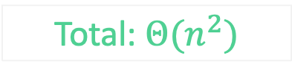
Multiplication
Textbook Algorithm: The way you learned in school!
4102
Total: $Θ(n^{2})$
x
1819
Can we do better?
36918
n multiplications
41020
n multiplications
n levels
3281600
n multiplications
+
4102000
n multiplications
7461538

Slide 5
Divide and Conquer Approach
Goal: Break into smaller subproblems
4102
A
B
x
1819
x
C
D
A = 41 B=02
C = 18 D = 19

Slide 6



Divide and Conquer Approach
Goal: Break into smaller subproblems
A
B
=
$${10}^{\frac{n}{2}}$$
A
+
B
x
C
D
=
$${10}^{\frac{n}{2}}$$
C
+
D
Use foil method to multiply
$${(10}^{\frac{n}{2}}A+B) × ({10}^{\frac{n}{2}}C+D)$$

Slide 7











Divide and Conquer Approach
Goal: Break into smaller subproblems
A
B
=
$${10}^{\frac{n}{2}}$$
A
+
B
x
C
D
=
$${10}^{\frac{n}{2}}$$
C
+
D
=
$${10}^{n}($$
A
$$×$$
C
$$)+$$
$${10}^{\frac{n}{2}}($$
A
$$×$$
D
$$+$$
B
$$×$$
C
$$)+$$
$$($$
B
$$×$$
D
$$)$$

Slide 8
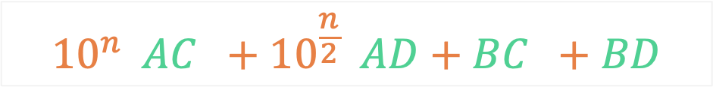

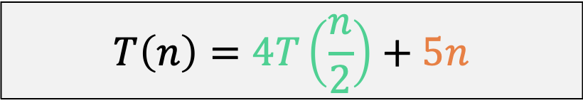
Divide and Conquer Approach
Goal: Is this approach any better!?
$${10}^{n}\left(AC\right)+{10}^{\frac{n}{2}}\left(AD+BC\right)+BD$$
Recurrence Relation Is:
$$T\left(n\right)=4T\left(\frac{n}{2}\right)+5n$$
Master theorem gets us:
$k=\log_{2}\left(4\right)=2$ $n^{2}$
$f\left(n\right)=5n$ $n$
Case 1: $Θ(n^{2})$ //not better!

Slide 9









Divide and Conquer Approach
A
B
=
$${10}^{\frac{n}{2}}$$
A
+
B
x
C
D
=
$${10}^{\frac{n}{2}}$$
C
+
D
=
$${10}^{n}($$
A
$$×$$
C
$$)+$$
How can we make this faster?
Idea: If we can remove at least one recursive multiplication, Master Theorem will give a lower runtime!!
$${10}^{\frac{n}{2}}($$
A
$$×$$
D
$$+$$
B
$$×$$
C
$$)+$$
$$($$
B
$$×$$
D
$$)$$

Slide 10

Divide and Conquer Approach
Goal: Remove recursive calls!
A
B
x
C
D
$${10}^{n}\left(AC\right)+{10}^{\frac{n}{2}}\left(AD+BC\right)+BD$$
These recursive calls cannot be avoided
Can we simplify this from two to one recursive call?

Slide 11
Divide and Conquer Approach
Goal: Remove recursive calls!
A
B
x
Already doing this calls, so don’t have to recompute them!
C
D
$${10}^{n}\left(AC\right)+{10}^{\frac{n}{2}}\left(AD+BC\right)+BD$$
$$\left(A+B\right)×\left(C+D\right)=AC+AD+BC+BD$$
This is what we are looking for, so let’s simplify the expression and solve for AD+BC

Slide 12
Divide and Conquer Approach
Goal: Remove recursive calls!
A
B
x
C
D
$${10}^{n}\left(AC\right)+{10}^{\frac{n}{2}}\left(AD+BC\right)+BD$$
$$\left(A+B\right)×\left(C+D\right)=AC+AD+BC+BD$$
$$AD+BC=\left(A+B\right) × \left(C+D\right)− AC−BD$$
Right side has three multiplications, but two of them we are having to do anyway! So only one extra call

Slide 13
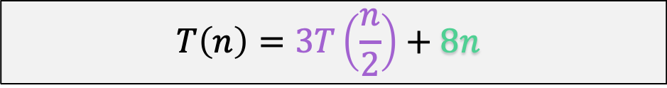

Divide and Conquer Approach
A
B
Final equation:
$${10}^{n}\left(AC\right)+{10}^{\frac{n}{2}}\left(\left(A+B\right) × \left(C+D\right)− AC−BD\right)+BD$$
x
C
D
Recurrence becomes:
$$T\left(n\right)=3T\left(\frac{n}{2}\right)+8n$$
Master theorem gets us:
$k=\log_{2}\left(3\right)=1.585$ $n^{1.585}$
$f\left(n\right)=5n$ $n$
Case 1: $Θ(n^{1.585})$ //Better!!

Slide 14
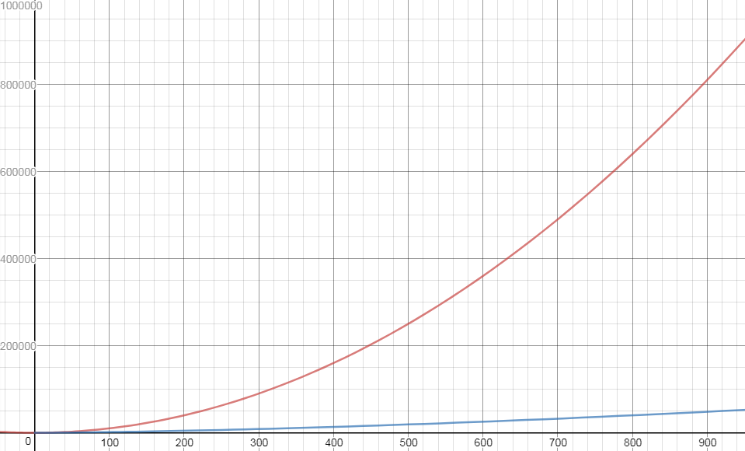



Slide 15
What did we learn?
Karatsuba Multiplication: Cleverly eliminates a recursive call to speed up multiplication algorithm.
Using Recurrences: By looking at your current recurrence and master theorem, you can plan out a strategy for how to lower the runtime.
In this case, find a recursive call to eliminate!

