Slide 1
More Dynamic Programming
Seam Carving
Data Structures and Algorithms 2
Mark Floryan

Slide 2
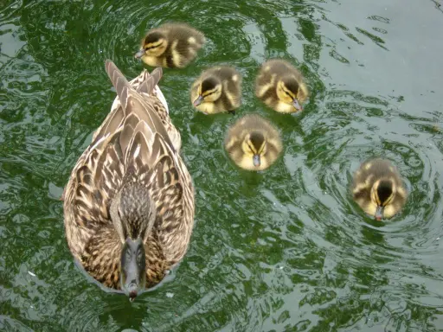
Seam Carving
Seam Carving is a method for image resizing that does not scale or crop the image

Slide 3
Cropping
Cropping simply removes a block of pixels

Slide 4
Scaling
Scaling removes stripes of pixels

Slide 5
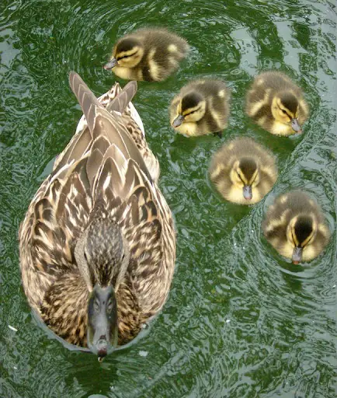

Seam Carving
There are more pleasing ways to scale images!
Seam Carving removes least energy seams of pixels

Slide 6
Comparison
Cropping
Scaling
Carving

Slide 7

Energy of a seam
For each pixel in the image, we will calculate the energy of the pixel. The energy of a seam is simply the sum of the energies of the pixels in the seam.
$$e\left(p\right)=energy of pixel p$$

Slide 8

Energy of a seam
For each pixel in the image, we will calculate the energy of the pixel. The energy of a seam is simply the sum of the energies of the pixels in the seam.
$$e\left(p\right)=energy of pixel p$$
Restriction: seam pixels go up or diagonally up, not to the side
Base on nearby pixels. Change in pixel color from pixel to pixel

