Slide 1
Flow Networks and Max Flow
Data Structures and Algorithms 2
Mark Floryan

Slide 2
Flow Networks

Slide 3
Flow networks
A flow network is a specialized directed graph with a single source and single sink (terminus). Each edge has a capacity of flow that can be carried on that edge.
u
Sink (terminus) node consumes flow
4/20
2/10
s
2/30
t
Source node produces flow
3/10
5/20
Each edge has a capacity (second number) and current flow (first number)
v
What is the maximum flow you can send from s to t?

Slide 4
Applications
Transportation networks
  How many people can be routed?
Computer networks
Electrical distribution
Water distribution
Note that all these applications have multiple sources and multiple sinks!
  Whereas the flow networks we study do not, yet

Slide 5
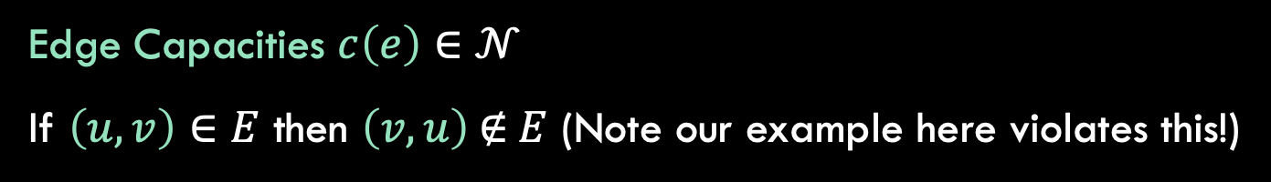


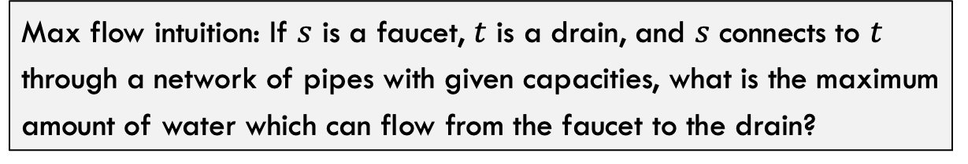



ANother Example of flow Network
Graph $G=(V,E)$
3
2
Sink node $t∈V$
Source node $s∈V$
3
$$s$$
3
2
$$t$$
2
1
3
2
3
Edge Capacities $c\left(e\right)∈𝒩$
If $\left(u,v\right)∈E$ then $\left(v,u\right) \text{∉} E$ (Note our example here violates this!)
Max flow intuition: If $s$ is a faucet, $t$ is a drain, and $s$ connects to $t$ through a network of pipes with given capacities, what is the maximum amount of water which can flow from the faucet to the drain?

Slide 6




Flow Network: Removing Antiparallel Edges
Easy adjustment to remove antiparallel edges and have equivalent flow graph: add intermediate node
3
2
3
2
3
3
$$s$$
$$s$$
2
3
2
$$t$$
3
$$t$$
2
1
3
2
1
3
2
2
2
3
3

Slide 7

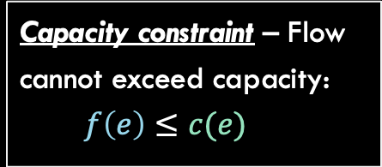
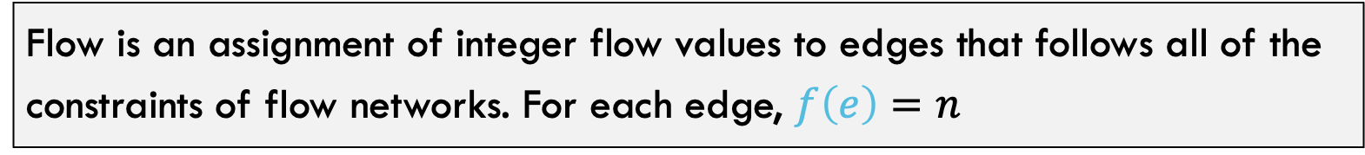


Flow
Flow is an assignment of integer flow values to edges that follows all of the constraints of flow networks. For each edge, $f\left(e\right)=n$
Capacity constraint – Flow cannot exceed capacity:
  $$f\left(e\right)≤c(e)$$
Flow constraint
$∀v∈V−\{s,t\}$, $inflow\left(v\right)=outflow\left(v\right)$
$$inflow\left(v\right)=\sum_{x∈V}{f(x,v)}$$
  $$outflow\left(v\right)=\sum_{x∈V}{f(v,x)}$$
2/2
1/3
2/3
$$s$$
1/3
1/1
2/2
$$t$$
2/3
1/2
1/2
2/3
Flow/Capacity
Total flow of $G$ is net flow out of s: $|f|=outflow\left(s\right)−inflow(s)$

Slide 8


Can Greedy Algorithm Find Max Flow
Possible Greedy Choice: Saturate Highest Capacity Path First
20
10
$$s$$
30
$$t$$
10
20

Slide 9
Can Greedy Algorithm Find Max Flow
Possible Greedy Choice: Saturate Highest Capacity Path First
20
10
$$s$$
30
$$t$$
10
20

Slide 10

Can Greedy Algorithm Find Max Flow
Possible Greedy Choice: Saturate Highest Capacity Path First
20/20
0/10
$$s$$
20/30
$$t$$
0/10
20/20
Greedy gets a solution of $\left|f\right|=20$

Slide 11






Can Greedy Algorithm Find Max Flow
Possible Greedy Choice: Saturate Highest Capacity Path First
20/20
0/10
20/20
10/10
$$s$$
20/30
$$t$$
$$s$$
10/30
$$t$$
0/10
20/20
10/10
20/20
Greedy gets a solution of $\left|f\right|=20$
But $\left|f\right|=30$ is better

Slide 12
Solving Flow Networks
Ford-Fulkerson

Slide 13
Ford-Fulkerson: Algorithm overview
Overall Idea:
Do until not possible anymore:
Find a path through the graph we can push flow through
This path might need to “undo” past choices
Push as much flow through that path as possible
Repeat
Concerns:
How to represent the graph?
How to find safe paths to push flow through?
How to undo past choices that were suboptimal?

Slide 14
Algorithm notation
f(u,v): the flow on the edge from u to v
f(v,u): the backflow on the edge from v to u
c(u,v): the capacity on the edge from u to v
c_{f}(u,v): the residual capacity on the edge from u to v
G_{f} is the graph where the edges weights are the residual capacities
  THIS is usually the graph we actually use when running the algorithm we are about to see.

Slide 15



Residual Graph
We are going to represent the flow network (graph) using a “residual graph”. This graph is an adjacency matrix storing the residual capacities at each edge.
Original Graph
Residual Graph
2/2
s
a
b
c
d
t
1/3
a
c
s
2/3
$$\left(\begin{matrix}− & 2 & 0 & − & − & − \\ − & − & − & 0 & − & − \\ − & 2 & − & − & 1 & − \\ − & − & 0 & − & − & 1 \\ − & − & − & 1 & − & 1 \\ − & − & − & − & − & −\end{matrix}\right)$$
$$s$$
a
1/3
1/1
2/2
$$t$$
b
2/3
c
1/2
d
b
d
2/3
t
Flow/Capacity
Residual Capacity is room left until full: $c_{f}\left(u,v\right)=c\left(u,v\right)−f(u,v)$

Slide 16
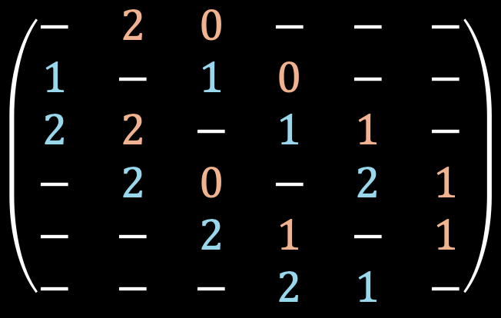
Backflow
The weights highlighted in blue in the residual graph are called backflow edges. These represent flow that can be “removed” on an edge
Original Graph
Residual Graph
2/2
s
a
b
c
d
t
1/3
a
c
s
2/3
$$\left(\begin{matrix}− & 2 & 0 & − & − & − \\ 1 & − & 1 & 0 & − & − \\ 2 & 2 & − & 1 & 1 & − \\ − & 2 & 0 & − & 2 & 1 \\ − & − & 2 & 1 & − & 1 \\ − & − & − & 2 & 1 & −\end{matrix}\right)$$
$$s$$
a
1/3
1/1
2/2
$$t$$
b
2/3
c
1/2
d
b
d
2/3
t
Flow/Capacity
Backflow edges are treated the same, they represent flow that can be pushed through that edge!

Slide 17



Backflow Example
Original Graph
Residual Graph
s
a
b
c
d
t
a
c
s
$$\left(\begin{matrix}− & − & − & − & − & − \\ − & − & − & − & − & − \\ − & − & − & − & − & − \\ − & − & − & − & 0 & − \\ − & − & − & 3 & − & − \\ − & − & − & − & − & −\end{matrix}\right)$$
$$s$$
a
$$t$$
b
0/3
c
b
d
d
t
Flow/Capacity
When no flow is being pushed on this edge the residual capacity is 3 because we can push up to 3 more units on this edge. The backflow capacity is 0 because we can’t undo any of the flow.

Slide 18

Backflow Example
Original Graph
Residual Graph
s
a
b
c
d
t
a
c
s
$$\left(\begin{matrix}− & − & − & − & − & − \\ − & − & − & − & − & − \\ − & − & − & − & − & − \\ − & − & − & − & 3 & − \\ − & − & − & 0 & − & − \\ − & − & − & − & − & −\end{matrix}\right)$$
$$s$$
a
$$t$$
b
3/3
c
b
d
d
t
Flow/Capacity
Let’s say we end up pushing 3 units of flow on this edge. Now the residual capacity is 0 (no more room) but the backflow capacity is 3 (can undo up to 3 units)

Slide 19

Backflow Example
Original Graph
Residual Graph
s
a
b
c
d
t
a
c
s
$$\left(\begin{matrix}− & − & − & − & − & − \\ − & − & − & − & − & − \\ − & − & − & − & − & − \\ − & − & − & − & 1 & − \\ − & − & − & 2 & − & − \\ − & − & − & − & − & −\end{matrix}\right)$$
$$s$$
a
$$t$$
b
1/3
c
b
d
d
t
Flow/Capacity
Now let’s say we “push” 2 units of flow down the backflow edge. This effectively removes two units of flow from the main edge. Our residual capacity becomes 2, our backflow capacity becomes 1

Slide 20
Backflow Example
Original Graph
Residual Graph
s
a
b
c
d
t
a
c
s
$$\left(\begin{matrix}− & − & − & − & − & − \\ − & − & − & − & − & − \\ − & − & − & − & − & − \\ − & − & − & − & 3 & − \\ − & − & − & 0 & − & − \\ − & − & − & − & − & −\end{matrix}\right)$$
$$s$$
a
$$t$$
b
3/3
c
b
d
d
t
Flow/Capacity
An edge and its back edge residual capacities will always add up to the capacity of the edge in the graph!
The algorithm will treat forward and back edges the same. No idea to distinguish between them! Neat!
Removing capacity from an edge or back edge always adds that capacity to the opposite paired edge

Slide 21
Ford-Fulkerson Algorithm
Augmenting Path: A path through the graph from source node to sink node such that each edge along the path has a positive, non-zero residual capacity
Note that augmenting paths might include backflow edges, meaning flow is being removed from some edge!
Algorithm idea: Keep finding augmenting paths until we can’t push anymore flow through the network.

Slide 22
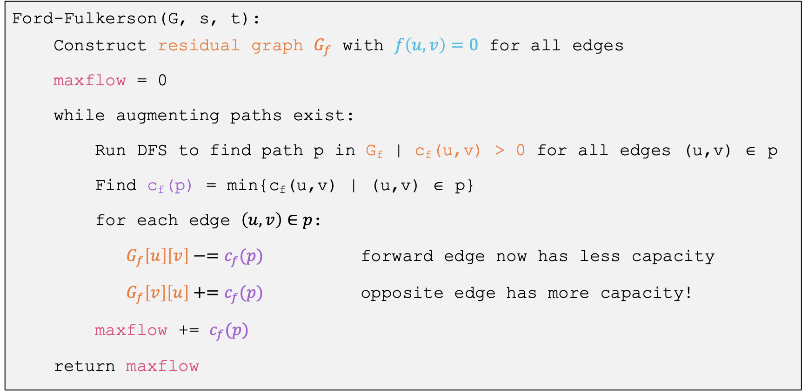
Ford-Fulkerson Algorithm:
Ford-Fulkerson(G, s, t):
Construct residual graph $G_{f}$ with $f\left(u,v\right)=0$ for all edges
maxflow = 0
while augmenting paths exist:
Run DFS to find path p in G_{f} | c_{f}(u,v) > 0 for all edges (u,v) ∈ p
Find c_{f}(p) = min{c_{f}(u,v) | (u,v) ∈ p}
for each edge $\left(u,v\right)∈p$:
$G_{f}\left[u\right]\left[v\right]−=c_{f}(p)$ forward edge now has less capacity
$G_{f}\left[v\right]\left[u\right]+=c_{f}(p)$ opposite edge has more capacity!
maxflow += $c_{f}(p)$
return maxflow

Slide 23

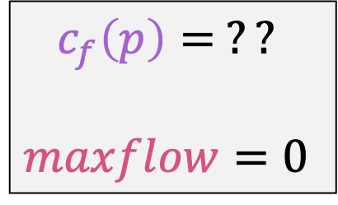
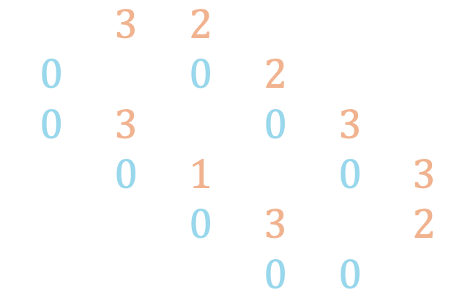

Ford-Fulkerson Example
Original Graph
Residual Graph
0/2
s
a
b
c
d
t
0/3
a
c
s
0/3
$$\left(\begin{matrix}− & 3 & 2 & − & − & − \\ 0 & − & 0 & 2 & − & − \\ 0 & 3 & − & 0 & 3 & − \\ − & 0 & 1 & − & 0 & 3 \\ − & − & 0 & 3 & − & 2 \\ − & − & − & 0 & 0 & −\end{matrix}\right)$$
$$s$$
a
0/3
0/1
0/2
$$t$$
b
0/3
c
0/2
d
b
d
0/3
t
Flow/Capacity
$$c_{f}\left(p\right)= ??$$
$$maxflow=0$$

Slide 24
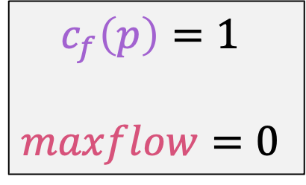
Ford-Fulkerson Example
Original Graph
Residual Graph
0/2
s
a
b
c
d
t
0/3
a
c
s
0/3
$$\left(\begin{matrix}− & 3 & 2 & − & − & − \\ 0 & − & 0 & 2 & − & − \\ 0 & 3 & − & 0 & 3 & − \\ − & 0 & 1 & − & 0 & 3 \\ − & − & 0 & 3 & − & 2 \\ − & − & − & 0 & 0 & −\end{matrix}\right)$$
$$s$$
a
0/3
0/1
0/2
$$t$$
b
0/3
c
0/2
d
b
d
0/3
t
Flow/Capacity
$$c_{f}\left(p\right)=1$$
$$maxflow=0$$

Slide 25
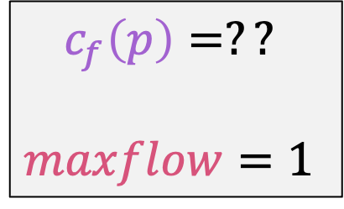
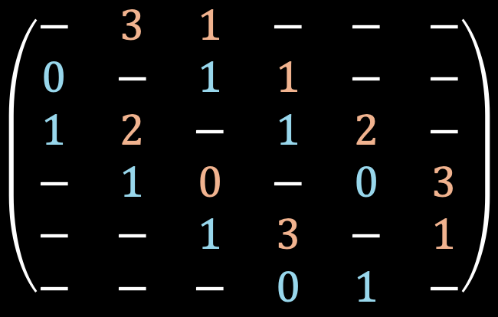
Ford-Fulkerson Example
Original Graph
Residual Graph
1/2
s
a
b
c
d
t
0/3
a
c
s
0/3
$$\left(\begin{matrix}− & 3 & 1 & − & − & − \\ 0 & − & 1 & 1 & − & − \\ 1 & 2 & − & 1 & 2 & − \\ − & 1 & 0 & − & 0 & 3 \\ − & − & 1 & 3 & − & 1 \\ − & − & − & 0 & 1 & −\end{matrix}\right)$$
$$s$$
a
1/3
1/1
1/2
$$t$$
b
0/3
c
1/2
d
b
d
1/3
t
Flow/Capacity
$$c_{f}\left(p\right)=??$$
$$maxflow=1$$

Slide 26
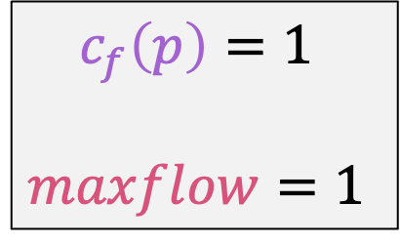
Ford-Fulkerson Example
Original Graph
Residual Graph
1/2
s
a
b
c
d
t
0/3
a
c
s
0/3
$$\left(\begin{matrix}− & 3 & 1 & − & − & − \\ 0 & − & 1 & 1 & − & − \\ 1 & 2 & − & 1 & 2 & − \\ − & 1 & 0 & − & 0 & 3 \\ − & − & 1 & 3 & − & 1 \\ − & − & − & 0 & 1 & −\end{matrix}\right)$$
$$s$$
a
1/3
1/1
1/2
$$t$$
b
0/3
c
1/2
d
b
d
1/3
t
Flow/Capacity
$$c_{f}\left(p\right)=1$$
$$maxflow=1$$

Slide 27
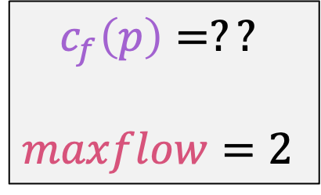
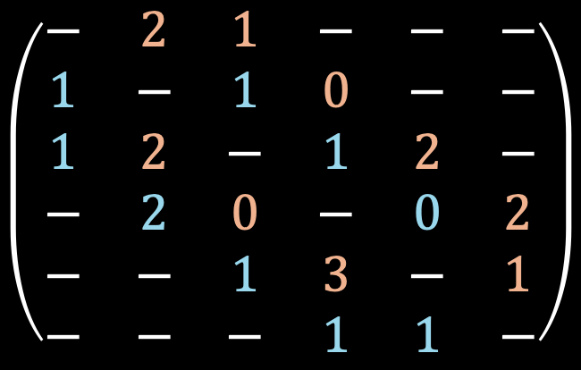
Ford-Fulkerson Example
Original Graph
Residual Graph
2/2
s
a
b
c
d
t
1/3
a
c
s
1/3
$$\left(\begin{matrix}− & 2 & 1 & − & − & − \\ 1 & − & 1 & 0 & − & − \\ 1 & 2 & − & 1 & 2 & − \\ − & 2 & 0 & − & 0 & 2 \\ − & − & 1 & 3 & − & 1 \\ − & − & − & 1 & 1 & −\end{matrix}\right)$$
$$s$$
a
1/3
1/1
1/2
$$t$$
b
0/3
c
1/2
d
b
d
1/3
t
Flow/Capacity
$$c_{f}\left(p\right)=??$$
$$maxflow=2$$

Slide 28
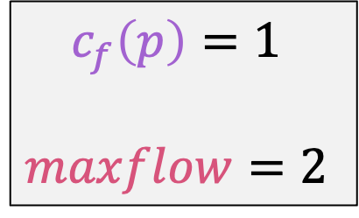
Ford-Fulkerson Example
Original Graph
Residual Graph
2/2
s
a
b
c
d
t
1/3
a
c
s
1/3
$$\left(\begin{matrix}− & 2 & 1 & − & − & − \\ 1 & − & 1 & 0 & − & − \\ 1 & 2 & − & 1 & 2 & − \\ − & 2 & 0 & − & 0 & 2 \\ − & − & 1 & 3 & − & 1 \\ − & − & − & 1 & 1 & −\end{matrix}\right)$$
$$s$$
a
1/3
1/1
1/2
$$t$$
b
0/3
c
1/2
d
b
d
1/3
t
Flow/Capacity
$$c_{f}\left(p\right)=1$$
$$maxflow=2$$

Slide 29

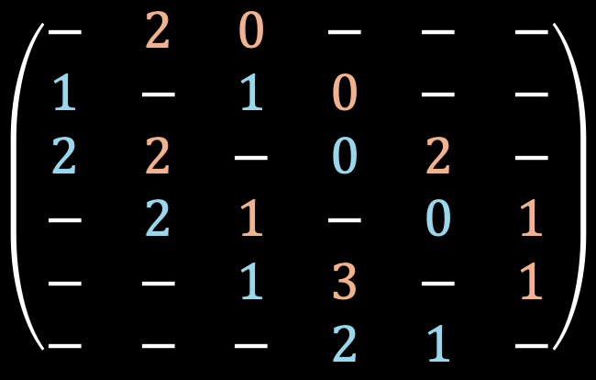
Ford-Fulkerson Example
Original Graph
Residual Graph
2/2
s
a
b
c
d
t
1/3
a
c
s
2/3
$$\left(\begin{matrix}− & 2 & 0 & − & − & − \\ 1 & − & 1 & 0 & − & − \\ 2 & 2 & − & 0 & 2 & − \\ − & 2 & 1 & − & 0 & 1 \\ − & − & 1 & 3 & − & 1 \\ − & − & − & 2 & 1 & −\end{matrix}\right)$$
$$s$$
a
1/3
0/1
2/2
$$t$$
b
0/3
c
1/2
d
b
d
1/3
t
Flow/Capacity
$$c_{f}\left(p\right)=?$$
$$maxflow=3$$

Slide 30

Ford-Fulkerson Example
Original Graph
Residual Graph
2/2
s
a
b
c
d
t
1/3
a
c
s
2/3
$$\left(\begin{matrix}− & 2 & 0 & − & − & − \\ 1 & − & 1 & 0 & − & − \\ 2 & 2 & − & 0 & 2 & − \\ − & 2 & 1 & − & 0 & 1 \\ − & − & 1 & 3 & − & 1 \\ − & − & − & 2 & 1 & −\end{matrix}\right)$$
$$s$$
a
1/3
0/1
2/2
$$t$$
b
0/3
c
1/2
d
b
d
1/3
t
Flow/Capacity
$$c_{f}\left(p\right)=1$$
$$maxflow=3$$

Slide 31

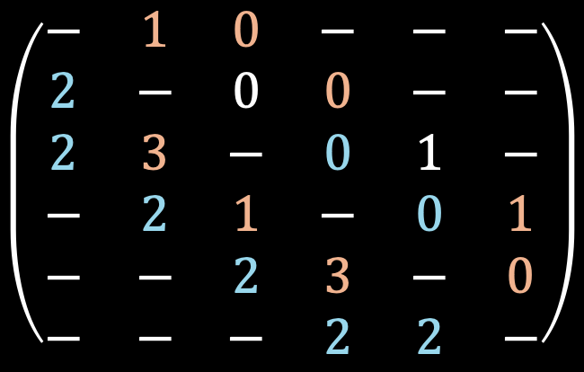
Ford-Fulkerson Example
Original Graph
Residual Graph
2/2
s
a
b
c
d
t
2/3
a
c
s
2/3
$$\left(\begin{matrix}− & 1 & 0 & − & − & − \\ 2 & − & 0 & 0 & − & − \\ 2 & 3 & − & 0 & 1 & − \\ − & 2 & 1 & − & 0 & 1 \\ − & − & 2 & 3 & − & 0 \\ − & − & − & 2 & 2 & −\end{matrix}\right)$$
$$s$$
a
0/3
0/1
2/2
$$t$$
b
0/3
c
2/2
d
b
d
2/3
t
Flow/Capacity
$$c_{f}\left(p\right)=1$$
$$maxflow=4$$

Slide 32
Ford-Fulkerson Example
Original Graph
Residual Graph
2/2
s
a
b
c
d
t
2/3
a
c
s
2/3
$$\left(\begin{matrix}− & 1 & 0 & − & − & − \\ 2 & − & 0 & 0 & − & − \\ 2 & 3 & − & 0 & 1 & − \\ − & 2 & 1 & − & 0 & 1 \\ − & − & 2 & 3 & − & 0 \\ − & − & − & 2 & 2 & −\end{matrix}\right)$$
$$s$$
a
0/3
0/1
2/2
$$t$$
b
0/3
c
2/2
d
b
d
2/3
t
Flow/Capacity
No more residual paths, so max flow is 4!!
$$c_{f}\left(p\right)=1$$
$$maxflow=4$$

Slide 33

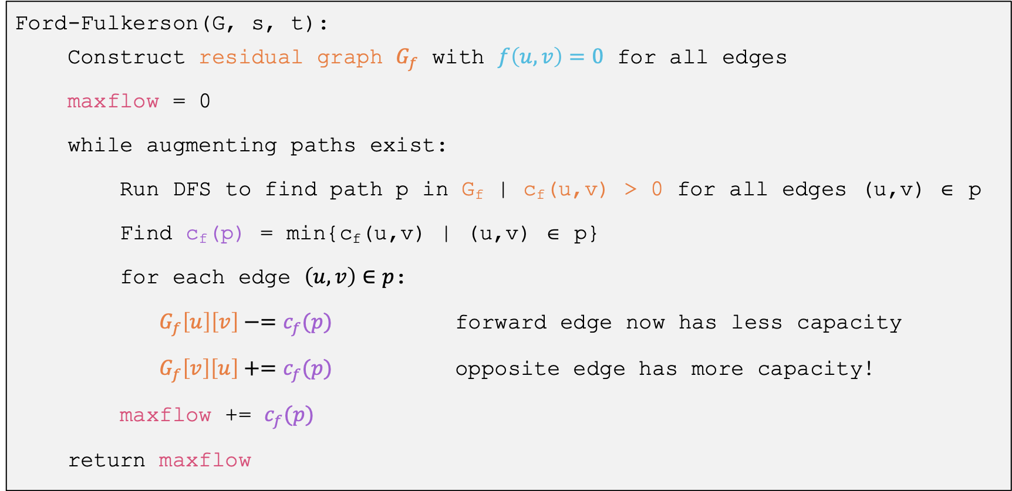
Runtime
Ford-Fulkerson(G, s, t):
Construct residual graph $G_{f}$ with $f\left(u,v\right)=0$ for all edges
maxflow = 0
while augmenting paths exist:
Run DFS to find path p in G_{f} | c_{f}(u,v) > 0 for all edges (u,v) ∈ p
Find c_{f}(p) = min{c_{f}(u,v) | (u,v) ∈ p}
for each edge $\left(u,v\right)∈p$:
$G_{f}\left[u\right]\left[v\right]−=c_{f}(p)$ forward edge now has less capacity
$G_{f}\left[v\right]\left[u\right]+=c_{f}(p)$ opposite edge has more capacity!
maxflow += $c_{f}(p)$
return maxflow
DFS is $Θ(V+E)$, worst case is we update flow by only 1 each time.
Total: $Θ\left(\left|f\right|\left(V+E\right)\right)=Θ(E⋅\left|f\right|)$

Slide 34

What type of search?
“While there is an augmenting path $p$ in $G_{f}$”
  Using a depth-first search is the Ford-Fulkerson algorithm
    Each augmenting path can be found in O(E) time
    And there can be |𝑓| paths
    So the running time is O(𝐸⋅|𝑓|)
    Will not terminate with irrational edge values
  Using a breadth-first search is the Edmonds-Karp algorithm
    Runs in O(V ⋅ E²)
      Total number of augmentations is O(V⋅E)
      And finding each augmentation takes O(E)
    Guaranteed termination with irrational edge values
    Run-time is independent of the maximum flow of the graph

Slide 35
Min-Cuts and Proving Correctness of Ford-Fulkerson

Slide 36
Showing Correctness of Ford-Fulkerson
To prove Ford-Fulkerson correct
  We’ll use the idea of a cut in a network flow graph
  We’ll prove properties related to cuts and flows

Slide 37



Cuts in Network Flow Graphs
A cut C = (S, T) is an assignment of the vertices of a flow-network each to one of two groups S and T.
$$S∪T=V$$
$$s∈S, t∈T$$
2/2
1/3
a
c
1/3
$$s$$
1/3
1/1
2/2
$$t$$
0/3
2/2
b
d
2/3
$$S∩T=∅$$

Slide 38
Properties of a cut
The capacity of a cut Cap(C) where C = (S, T) is the maximum amount of flow that COULD cross the cut.
The net flow of a cut NF(C) C = (S, T) is the net amount of flow that is crossing the cut.
Capacity of C is:
2+3+2 = 7
2/2
---
a
c
---
$$s$$
---
1/1
---
$$t$$
0/3
Net flow is:
2+2-1=4
2/2
b
d
---

Slide 39
We’ll Show These 3 Things
Weak duality property
Flow-value lemma
Max-flow Min-Cut theorem
…and how we can then argue Ford-Fulkerson is correct

Slide 40
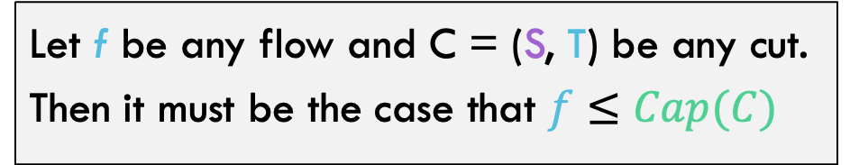
First definition: Weak Duality
Let f be any flow and C = (S, T) be any cut. Then it must be the case that $f≤Cap(C)$
2/2
1/3
a
Intuitively, flow needs to get across the cut at some point, so the capacity of the cut must be high enough to accommodate this!
c
1/3
$$s$$
1/3
1/1
2/2
$$t$$
0/3
2/2
b
d
2/3

Slide 41
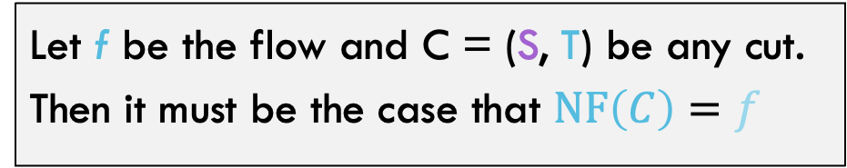
definition: Flow-Value Lemma
Let f be the flow and C = (S, T) be any cut. Then it must be the case that $NF\left(C\right)=f$
The net flow across a cut is always exactly the flow of the network

Slide 42

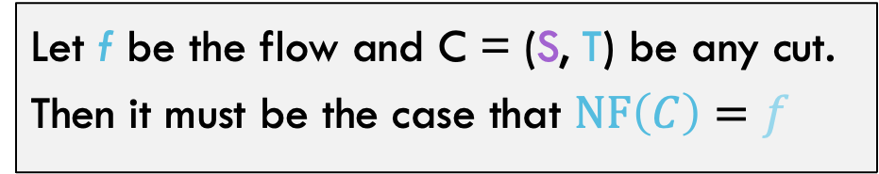

Proof: Flow-value lemma
Let f be the flow and C = (S, T) be any cut. Then it must be the case that $NF\left(C\right)=f$
The net flow across a cut is always exactly the flow of the network
Proof by induction on the size of T
Base Case: $T=\{t\}$
Trivially true, the net-flow of this cut is the flow of the network by definition
$$t$$

Slide 43
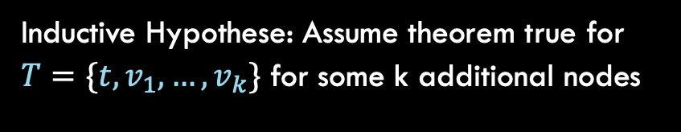

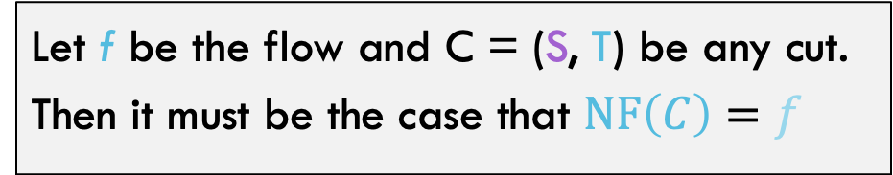



Proof: Flow-value lemma
Let f be the flow and C = (S, T) be any cut. Then it must be the case that $NF\left(C\right)=f$
Inductive Hypothese: Assume theorem true for $T=\{t, v_{1},…,v_{k}\}$ for some k additional nodes
$$t$$
$$v_{1}$$
$$v_{2}$$
$$v_{k}$$

Slide 44
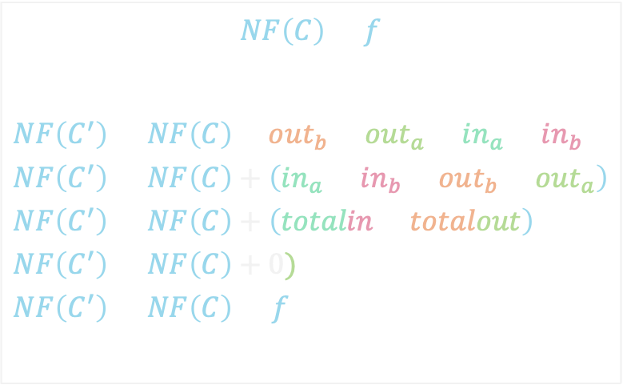





Proof: Flow-value lemma
Let f be the flow and C = (S, T) be any cut. Then it must be the case that $NF\left(C\right)=f$
Inductive Step: Move one more node across the cut. How does flow across cut change?
$$NF\left(C\right)=f$$
$$NF\left(C^{′}\right)=NF\left(C\right)−out_{b}−out_{a}+in_{a}+in_{b} \\ NF\left(C^{′}\right)=NF\left(C\right)+\left(in_{a}+in_{b}−out_{b}−out_{a}\right) \\ NF\left(C^{′}\right)=NF\left(C\right)+\left(totalin−totalout\right) \\ NF\left(C^{′}\right)=NF\left(C\right)+0) \\ NF\left(C^{′}\right)=NF\left(C\right)=f$$
$${out}_{b}$$
$$in_{a}$$
$$v_{k+1}$$
$$in_{b}$$
$${out}_{a}$$

Slide 45
Max-flow Min-cut Theorem
The Max-flow Min-cut theorem: the maximum value of an s-t flow is equal to the minimum capacity of an s-t cut

Slide 46
Max-flow Min-cut Theorem
The Max-flow Min-cut theorem: the maximum value of an s-t flow is equal to the minimum capacity of an s-t cut
0/2
0/3
a
c
0/3
$$s$$
0/3
0/1
0/2
$$t$$
0/3
0/2
b
d
0/3

Slide 47
Let’s draw some cuts and figure out which is the minimum capacity
0/2
0/3
a
c
0/3
$$s$$
0/3
0/1
0/2
$$t$$
0/3
0/2
b
d
0/3

Slide 48
Ford-Fulkerson Proof
We’ll show the following three statements are equivalent, and together this shows Ford-Fulkerson is correct.
A) There is no augmenting path in $G_{f}$ with respect to $f$
B) There exists a cut in $G$ whose capacity equals $f$
C) The flow $f$ is a maximum flow in $G$
We will do the following three mini-proofs:
  A → B
  B → C
  C → A
Why do these three statement imply that ford-fulkerson works correctly and always finds the maximum flow?

Slide 49
A → B: if no augmenting path, cut with capacity f
A) There is no augmenting path in $G_{f}$ with respect to $f$
B) There exists a cut in $G$ whose capacity equals $f$

Slide 50
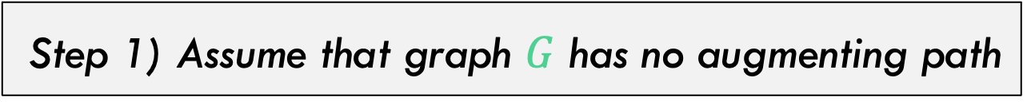
A → B: if no augmenting path, cut with capacity f
Step 1) Assume that graph $G$ has no augmenting path
Proof is general, but here is one example. Graph has no augmenting paths
3/4
2/3
a
c
3/3
$$s$$
1/3
0/1
3/3
$$t$$
0/3
2/2
b
d
2/2
Flow/Capacity

Slide 51

A → B: if no augmenting path, cut with capacity f
Step 2) Find nodes N in $G_{f}$ reachable via DFS, let the cut $C=(N,V−N)$
Purple nodes are reachable. Note one backflow edge is used here
3/4
2/3
a
c
3/3
$$s$$
1/3
0/1
3/3
$$t$$
0/3
2/2
b
d
2/2
Flow/Capacity

Slide 52
A → B: if no augmenting path, cut with capacity f
Step 2) Find nodes N in $G_{f}$ reachable via DFS, let the cut $C=(N,V−N)$
Step 3) Cut C is guaranteed to be at capacity. $cap\left(C\right)=f$
a
c
3/3
$$s$$
$$t$$
b
d
2/2
Flow/Capacity

Slide 53
B → C: IF cut with capacity f, Then Max Flow
B) There exists a cut in $G$ whose capacity equals $f$
C) The flow $f$ is a maximum flow in $G$

Slide 54
B → C: IF cut with capacity f, Then Max Flow
Step 1) Assume that graph $G_{f}$ has a cut C with $cap\left(C\right)=f$
a
c
3/3
$$s$$
$$t$$
b
d
2/2
Flow/Capacity

Slide 55

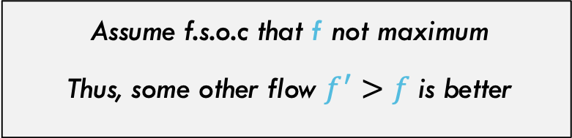
B → C: IF cut with capacity f, Then Max Flow
In this example, we somehow push more than 5 flow through this graph.
Assume f.s.o.c that f not maximum
Thus, some other flow $f^{′}>f$ is better
a
c
3/3
$$s$$
$$t$$
b
d
2/2
Flow/Capacity

Slide 56
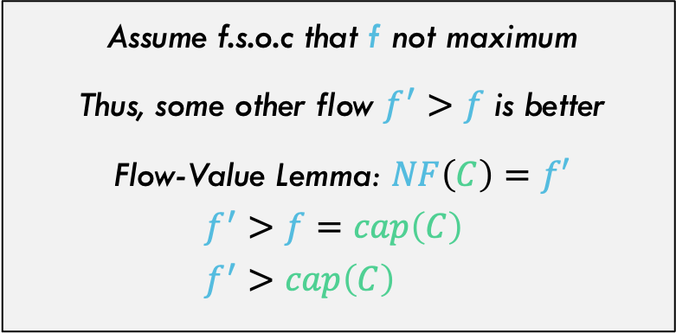
B → C: IF cut with capacity f, Then Max Flow
Thus, you are somehow pushing more flow across this cut than is possible (over capacity)
Assume f.s.o.c that f not maximum
Thus, some other flow $f^{′}>f$ is better
Flow-Value Lemma: $NF\left(C\right)=f′$
$$f^{′}>f=cap\left(C\right) \\ f^{′}>cap\left(C\right)$$
a
c
6/3
$$s$$
$$t$$
b
d
3/2
Flow/Capacity

Slide 57
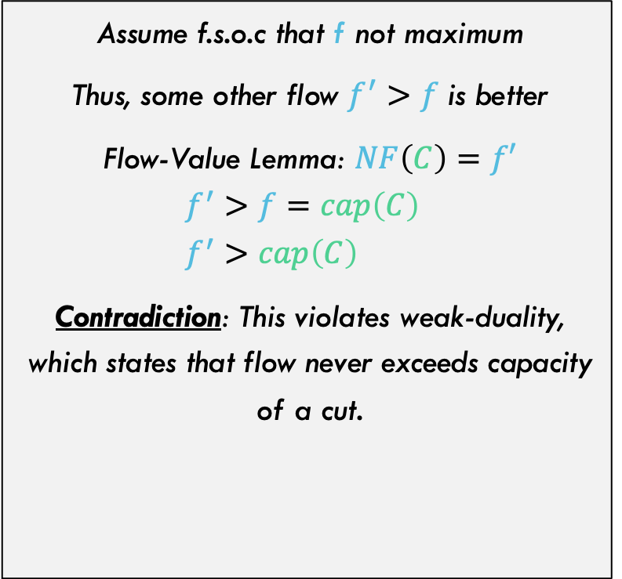
B → C: IF cut with capacity f, Then Max Flow
Assume f.s.o.c that f not maximum
Thus, some other flow $f^{′}>f$ is better
Flow-Value Lemma: $NF\left(C\right)=f′$
$$f^{′}>f=cap\left(C\right) \\ f^{′}>cap\left(C\right)$$
Contradiction: This violates weak-duality, which states that flow never exceeds capacity of a cut.
a
c
3/3
$$s$$
$$t$$
b
d
2/2
Flow/Capacity

Slide 58
C → A: If F is The Max Flow, then No Augmenting Path
A) There is no augmenting path in $G_{f}$ with respect to $f$
C) The flow $f$ is a maximum flow in $G$

Slide 59
C → A: If F is The Max Flow, then No Augmenting Path
Step 1) Assume that $f$ is the maximum flow
This graph is at maximum flow
3/4
2/3
a
c
3/3
$$s$$
1/3
0/1
3/3
$$t$$
0/3
2/2
b
d
2/2
Flow/Capacity

Slide 60
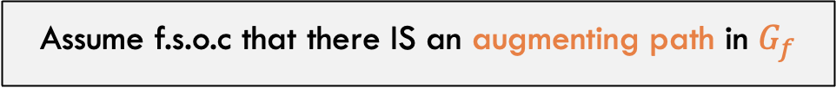
C → A: If F is The Max Flow, then No Augmenting Path
There isn’t, but let’s assume there is…
Assume f.s.o.c that there IS an augmenting path in $G_{f}$
3/4
2/3
a
c
3/3
$$s$$
1/3
0/1
3/3
$$t$$
0/3
2/2
b
d
2/2

Slide 61
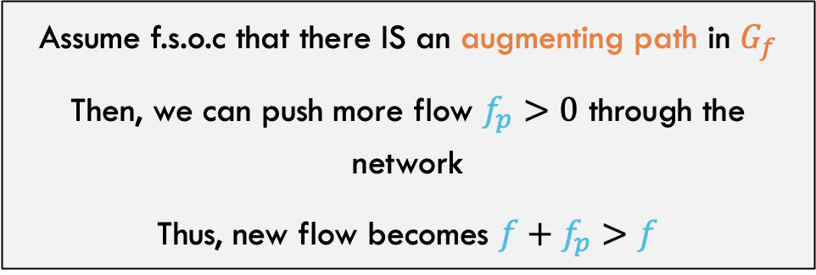

C → A: If F is The Max Flow, then No Augmenting Path
There isn’t, but let’s assume there is…
Assume f.s.o.c that there IS an augmenting path in $G_{f}$
Then, we can push more flow $f_{p}>0$ through the network
Thus, new flow becomes $f+f_{p}>f$
3/4
2/3
a
c
3/3
$$s$$
1/3
0/1
3/3
$$t$$
0/3
2/2
b
d
2/2
$${+f}_{p}$$

Slide 62
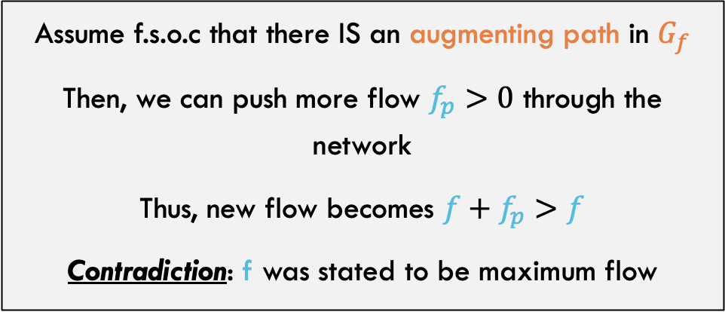
C → A: If F is The Max Flow, then No Augmenting Path
There isn’t, but let’s assume there is…
Assume f.s.o.c that there IS an augmenting path in $G_{f}$
Then, we can push more flow $f_{p}>0$ through the network
Thus, new flow becomes $f+f_{p}>f$
Contradiction: f was stated to be maximum flow
3/4
2/3
a
c
3/3
$$s$$
1/3
0/1
3/3
$$t$$
0/3
2/2
b
d
2/2
$${+f}_{p}$$

Slide 63
Ford-Fulkerson Proof
Thus, it is proven!
A) There is no augmenting path in $G_{f}$ with respect to $f$
B) There exists a cut in $G$ whose capacity equals $f$
C) The flow $f$ is a maximum flow in $G$

Slide 64

Other Max-flow algorithms
Ford-Fulkerson
  $Θ(E\left|f\right|)$
Edmonds-Karp
  $Θ(E^{2}V)$
Push-Relabel (Tarjan)
  $Θ(EV^{2})$
Faster Push-Relabel (also Tarjan)
  $Θ(V^{3})$

