Slide 1
Greedy Algorithms Dividing Resources
Data Structures and Algorithms 2 Mark Floryan

Slide 2
Dividing Resources

Slide 3
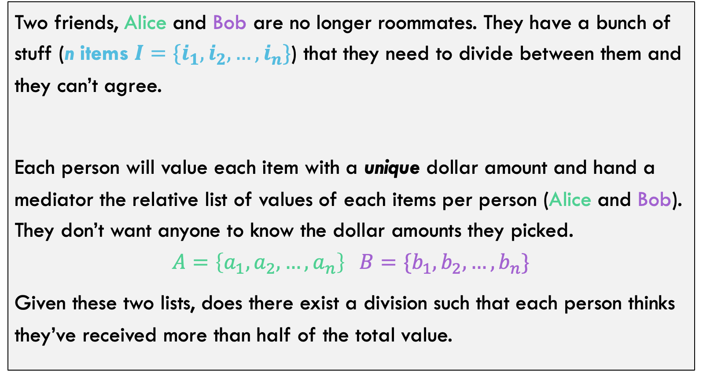
Can you solve it??
Two friends, Alice and Bob are no longer roommates. They have a bunch of stuff (n items $I=\{i_{1},i_{2},…,i_{n}\}$) that they need to divide between them and they can’t agree.
Each person will value each item with a unique dollar amount and hand a mediator the relative list of values of each items per person (Alice and Bob). They don’t want anyone to know the dollar amounts they picked.
$$A=\left\{a_{1},a_{2},…,a_{n}\right\} B=\{b_{1},b_{2},…,b_{n}\}$$
Given these two lists, does there exist a division such that each person thinks they’ve received more than half of the total value.

Slide 4
















Thinking Through Some Examples
Example: The left has no solution, the right does. Why?
Example 1:
Example 2:
$$i_{1}$$
$$i_{2}$$
$$i_{3}$$
$$i_{4}$$
$$i_{1}$$
$$i_{2}$$
$$i_{3}$$
$$i_{4}$$
Alice’s Order =
Alice’s Order =
$$i_{1}$$
$$i_{2}$$
$$i_{3}$$
$$i_{4}$$
$$i_{4}$$
$$i_{3}$$
$$i_{2}$$
$$i_{1}$$
Bob’s Order =
Bob’s Order =

Slide 5
Optimal Substructure?
Does this problem have optimal substructure?
What do you think?

Slide 6







Optimal Substructure?
Does this problem have optimal substructure?
It is REALLY hard to tell here:
Suppose some feasible solution exists
Then is this feasible for one less item?
$$i_{1}$$
$$i_{2}$$
$$i_{3}$$
$$i_{4}$$
$$i_{2}$$
$$i_{3}$$
$$i_{4}$$
Alice’s Order =
Alice’s Order =
Alice does not get these

Slide 7
Let’s think about properties of the problem!
Can you come up with some properties of the problem that might be useful? Here are some probing questions:
Are there any items in Alice’s list, that Alice NEEDs to have?
If Alice gets that item? Are there others that Alice needs to have?
If Alice has a choice between items, which one is the best choice?
Given a possible split, how difficult would it be to verify that the solution works for both parties?

Slide 8


Let’s think about properties of the problem!
Important Properties for Alice (and likewise for Bob):
1. Alice MUST get her top item
Valuation could be $\{1000,1,2,3,4,5\}$
2. Alice must get item 2 OR 3 (but doesn’t need both)
Consider valuation $\{A,B,C,D\}$
A + B > C + D
A + C > B + D
3. In general, for every item Alice does NOT receive, she needs to receive one item higher than that one in her list
…see next slide for example.

Slide 9
























Let’s think about properties of the problem!
3. In general, for every item Alice does NOT receive, she needs to receive one item higher than that one in her list
…see next slide for example.
This works! It is more than half the value for Alice
$$i_{1}$$
$$i_{2}$$
$$i_{3}$$
$$i_{4}$$
$$i_{5}$$
$$i_{6}$$
$$i_{7}$$
$$i_{8}$$
$$i_{10}$$
$$i_{11}$$
$$i_{12}$$
$$i_{13}$$
Alice’s Order =
XX
Bob is NOT guaranteed to have over half his value
$$i_{13}$$
$$i_{2}$$
$$i_{3}$$
$$i_{4}$$
$$i_{5}$$
$$i_{6}$$
$$i_{7}$$
$$i_{8}$$
$$i_{10}$$
$$i_{11}$$
$$i_{12}$$
$$i_{1}$$
Bob’s Order =

Slide 10
Let’s think about properties of the problem!
Verifying a solution: Code below will verify if a list will work for one party
Input: List that Alice received (or Bob)
Verify(List A):
Count = 0
For each item i in A: If Alice received i: count++
else count--
if count == -1 return fail
return pass

Slide 11

Can you solve it??
Can we implement this in $Θ(n log n)$?
Psuedo-code:
FairSplit(AlicePriority, BobPriority):
Maintain a list L of items Alice needs one of
Put AlicePriority[0] on L
Loop n/2 times:
Grab one item from L and give to AliceList
Place up to 2 next items in AlicePriority on L
//Alice’s list definitely works for Alice BobList = BobPriority - AliceList
Call Verify(BobsList) to see if split works for Bob
Which item should we choose from L?

Slide 12
Can you solve it??
Better Pseudo-code (nlogn time):
Priority is items position in Bob’s list. So, always choose an item that works for Alice but is the BEST possible choice for Bob
FairSplit(A, B)
Alist = [], Blist = []
PQ q = {}; i=2;
q.push(A[0], B.indexOf(A[0])
For 1 to n/2:
item = q.pop() Alist.append(item); q.push(A[i]); i++; q.push(A[i]); i++;
Blist = Items – Alist;
Verify(Blist)

