Slide 1
Greedy Algorithms Dividing Resources
CS 3100 – DSA2
Mark Floryan

Slide 2
Dividing Resources

Slide 3
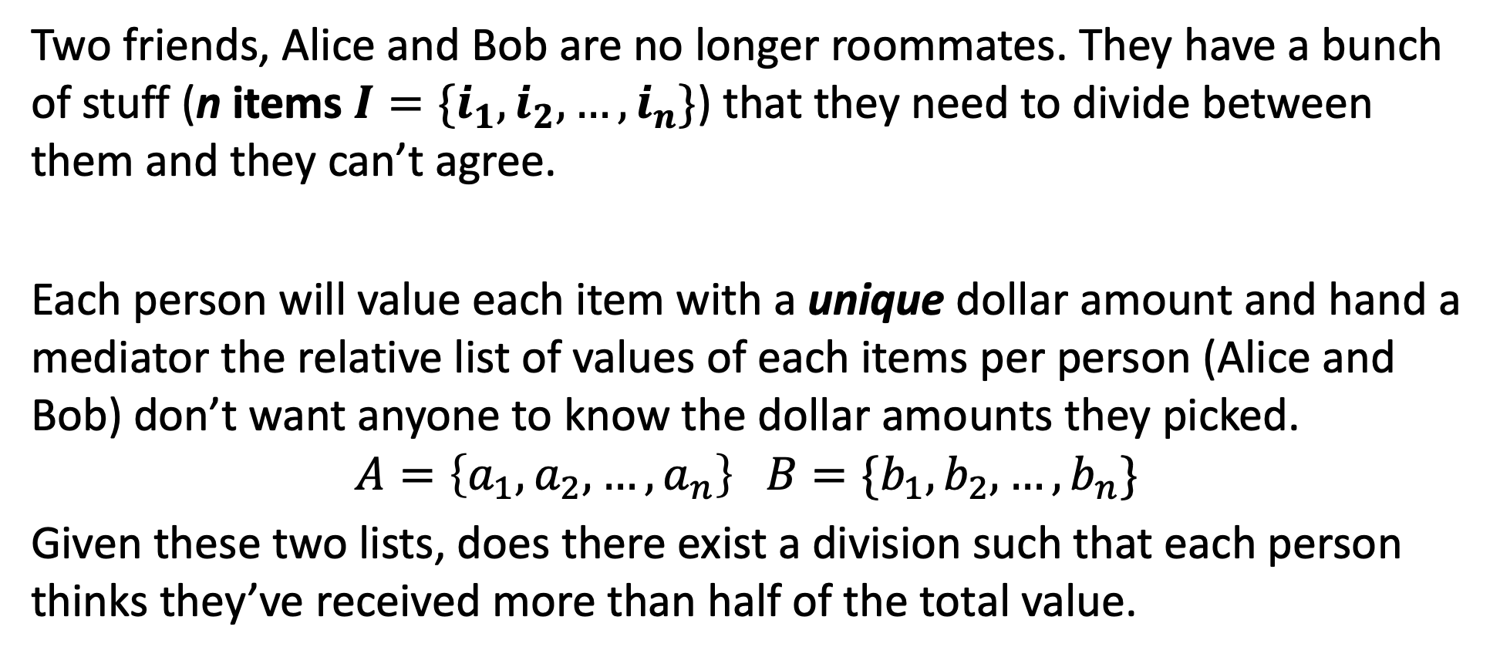
Can you solve it??
Two friends, Alice and Bob are no longer roommates. They have a bunch of stuff (n items $I=\{i_{1},i_{2},…,i_{n}\}$) that they need to divide between them and they can’t agree.
Each person will value each item with a unique dollar amount and hand a mediator the relative list of values of each items per person (Alice and Bob) don’t want anyone to know the dollar amounts they picked.
$$A=\left\{a_{1},a_{2},…,a_{n}\right\} B=\{b_{1},b_{2},…,b_{n}\}$$
Given these two lists, does there exist a division such that each person thinks they’ve received more than half of the total value.

Slide 4
Optimal Substructure…
Example: The left has no solution, the right does. Why?
I1
I2
I3
I4
I1
I2
I3
I4
Alice’s Order =
Alice’s Order =
I1
I2
I3
I4
I4
I3
I2
I1
Bob’s Order =
Bob’s Order =

Slide 5
Optimal Substructure?
Does this problem have optimal substructure?
What do you think?

Slide 6
Optimal Substructure?
Does this problem have optimal substructure?
It is REALLY hard to tell here:
Optimal Solution
Optimal Solution?
I1
I2
I3
I4
I2
I3
I4
Alice’s Order =
Alice’s Order =
Alice does not get these

Slide 7
Let’s think about properties of the problem!
Can you come up with some properties of the problem that might be useful? Here are some probing questions:
Are there any items in Alice’s list, that Alice NEEDs to have?
If Alice gets that item? Are there others that Alice needs to have?
If Alice has a choice between items, which one is the best choice?
Given a possible split, how difficult would it be to verify that the solution works for both parties?

Slide 8
Let’s think about properties of the problem!
Important Properties for Alice (and likewise for Bob):
Alice needs to have her top item (for sure!)
If Alice ranked four items in order A,B,C,D
A + B > C + D
A + C > B + D
In general, for every x items you get in your order in a row, you can skip up x items before needing to get one!!

Slide 9
Let’s think about properties of the problem!
Verifying a solution:
Input: List that Alice received (or Bob)
Verify(List A): //Assume A is a list of True/False, did Alice get item i?
Count = 0
For each item i in A:
If Alice received i:
count++
else
count--;
if count == -1 then return fail
return pass

Slide 10
Can you solve it??
Psuedo-code:
Make a list L of items Alice needs one of
Put a1 on L //a1 is Alice’s first priority item
Loop n/2 times:
Grab one item from L and give to Alice (which one is best choice)?
Place up to 2 next items in Alice list on L
//Alice’s list definitely works for Alice
Call Verify(Bob’s List) to see if this split also works for Bob

Slide 11
Can you solve it??
Psuedo-code:
CAN WE IMPLEMENT THIS IN O(nlogn)??
Make a list L of items Alice needs one of
Put a1 on L //a1 is Alice’s first priority item
Loop n/2 times:
Grab one item from L and give to Alice (which one is best choice)?
Place up to 2 next items in Alice list on L
//Alice’s list definitely works for Alice
Call Verify(Bob’s List) to see if this split also works for Bob

Slide 12
Can you solve it??
Better Pseudo-code (nlogn time):
Alist = [], Blist = []
PQ q = {}; i=2;
q.push(a1) //priority is position in Bob’s List. //a1 is Alice’s highest priority item
For 1 to n/2:
item = q.pop(); Alist.append(item);
q.push(ai); i++;
q.push(ai); i++;
Blist = Items – Alist;
Verify(Blist)

