Slide 1
CS4710: Artificial Intelligence Intro to Machine Learning
Intelligent beings (e.g., humans) are excellent at learning. How can we try to program systems to learn interesting new things?

Slide 2
Decision Tree Induction

Slide 3

Decision Trees
A Decision Tree is a tree that when followed, provides a prediction of interest for a given data point
Think of this as a flow chart
Each node is a feature and based on the value of that feature, we recurse on the appropriate branch of the tree
Leaf nodes are classifications of the data point

Slide 4
Example Decision Tree
Chest pain began
> 48 hours ago
No
Yes
Prior history of angina or heart attack?
Heart Attack Possible
Yes
No
Longest pain episode > 1 hour
Heart Attack Unlikely
No
Yes
Heart Attack Unlikely
Pain worse than prior angina?
No
Yes
Heart Attack Unlikely
Heart Attack Possible

Slide 5
Decision Tree Induction
More common approach to learning
Idea! Use the training set to build a decision tree
Requirements:
Want the tree to be as small as possible

Slide 6
Similar Example
Student | A last year? | Male? | Works Hard? | Drinks? | A this year?
Richard | Yes | Yes | No | Yes | Yes
Allen | Yes | Yes | Yes | No | Yes
Alison | No | No | Yes | No | Yes
Jeff | No | Yes | No | Yes | No
Gail | Yes | No | Yes | Yes | Yes
Simon | No | Yes | Yes | Yes | No

Slide 7
Algorithm
SelectFeature(Examples){
Pick Feature that best splits Examples into different result categories
For each Value of Feature
Find Subset S of Examples such that Feature == Value
If all examples in S are in same result category
Mark relevant node in the tree with that category
Else
Call SelectFeature(S)
}

Slide 8
Algorithm: Example
Student | A last year? | Male? | Works Hard? | Drinks? | A this year?
Richard | Yes | Yes | No | Yes | Yes
Allen | Yes | Yes | Yes | No | Yes
Alison | No | No | Yes | No | Yes
Jeff | No | Yes | No | Yes | No
Gail | Yes | No | Yes | Yes | Yes
Simon | No | Yes | Yes | Yes | No
SelectFeature(Examples){
Pick Feature that best splits Examples into different result categories
For each Value of Feature
Find Subset S of Examples such that Feature == Value
If all examples in S are in same result category
Mark relevant node in the tree with that category
Else
Call SelectFeature(S)
}

Slide 9
Algorithm: Example
Student | A last year? | Male? | Works Hard? | Drinks? | A this year?
Richard | Yes | Yes | No | Yes | Yes
Allen | Yes | Yes | Yes | No | Yes
Alison | No | No | Yes | No | Yes
Jeff | No | Yes | No | Yes | No
Gail | Yes | No | Yes | Yes | Yes
Simon | No | Yes | Yes | Yes | No
SelectFeature(Examples){
Pick Feature that best splits Examples into different result categories
For each Value of Feature
Find Subset S of Examples such that Feature == Value
If all examples in S are in same result category
Mark relevant node in the tree with that category
Else
Call SelectFeature(S)
}

Slide 10
Algorithm: Example
Student | A last year? | Male? | Works Hard? | Drinks? | A this year?
Richard | Yes | Yes | No | Yes | Yes
Allen | Yes | Yes | Yes | No | Yes
Alison | No | No | Yes | No | Yes
Jeff | No | Yes | No | Yes | No
Gail | Yes | No | Yes | Yes | Yes
Simon | No | Yes | Yes | Yes | No
{1,2,3,4,5,6}
A last year?
Yes
No
{1,2,5}
{3,4,6}
SelectFeature(Examples){
Pick Feature that best splits Examples into different result categories
For each Value of Feature
Find Subset S of Examples such that Feature == Value
If all examples in S are in same result category
Mark relevant node in the tree with that category
Else
Call SelectFeature(S)
}

Slide 11
Algorithm: Example
Student | A last year? | Male? | Works Hard? | Drinks? | A this year?
Richard | Yes | Yes | No | Yes | Yes
Allen | Yes | Yes | Yes | No | Yes
Alison | No | No | Yes | No | Yes
Jeff | No | Yes | No | Yes | No
Gail | Yes | No | Yes | Yes | Yes
Simon | No | Yes | Yes | Yes | No
{1,2,3,4,5,6}
A last year?
Yes
No
{1,2,5}
{3,4,6}
SelectFeature(Examples){
Pick Feature that best splits Examples into different result categories
For each Value of Feature
Find Subset S of Examples such that Feature == Value
If all examples in S are in same result category
Mark relevant node in the tree with that category
Else
Call SelectFeature(S)
}

Slide 12
Algorithm: Example
Student | A last year? | Male? | Works Hard? | Drinks? | A this year?
Richard | Yes | Yes | No | Yes | Yes
Allen | Yes | Yes | Yes | No | Yes
Alison | No | No | Yes | No | Yes
Jeff | No | Yes | No | Yes | No
Gail | Yes | No | Yes | Yes | Yes
Simon | No | Yes | Yes | Yes | No
{1,2,3,4,5,6}
A last year?
Yes
No
{1,2,5}
YES
{3,4,6}
SelectFeature(Examples){
Pick Feature that best splits Examples into different result categories
For each Value of Feature
Find Subset S of Examples such that Feature == Value
If all examples in S are in same result category
Mark relevant node in the tree with that category
Else
Call SelectFeature(S)
}

Slide 13
Algorithm: Example
Student | A last year? | Male? | Works Hard? | Drinks? | A this year?
Richard | Yes | Yes | No | Yes | Yes
Allen | Yes | Yes | Yes | No | Yes
Alison | No | No | Yes | No | Yes
Jeff | No | Yes | No | Yes | No
Gail | Yes | No | Yes | Yes | Yes
Simon | No | Yes | Yes | Yes | No
{1,2,3,4,5,6}
A last year?
Yes
No
{1,2,5}
YES
{3,4,6}
SelectFeature(Examples){
Pick Feature that best splits Examples into different result categories
For each Value of Feature
Find Subset S of Examples such that Feature == Value
If all examples in S are in same result category
Mark relevant node in the tree with that category
Else
Call SelectFeature(S)
}

Slide 14
Algorithm: Example
Student | A last year? | Male? | Works Hard? | Drinks? | A this year?
Richard | Yes | Yes | No | Yes | Yes
Allen | Yes | Yes | Yes | No | Yes
Alison | No | No | Yes | No | Yes
Jeff | No | Yes | No | Yes | No
Gail | Yes | No | Yes | Yes | Yes
Simon | No | Yes | Yes | Yes | No
{1,2,3,4,5,6}
A last year?
Yes
No
{1,2,5}
YES
{3,4,6}
SelectFeature(Examples){
Pick Feature that best splits Examples into different result categories
For each Value of Feature
Find Subset S of Examples such that Feature == Value
If all examples in S are in same result category
Mark relevant node in the tree with that category
Else
Call SelectFeature(S)
}

Slide 15
Algorithm: Example
Student | A last year? | Male? | Works Hard? | Drinks? | A this year?
Richard | Yes | Yes | No | Yes | Yes
Allen | Yes | Yes | Yes | No | Yes
Alison | No | No | Yes | No | Yes
Jeff | No | Yes | No | Yes | No
Gail | Yes | No | Yes | Yes | Yes
Simon | No | Yes | Yes | Yes | No
{1,2,3,4,5,6}
A last year?
Yes
No
{1,2,5}
YES
{3,4,6}
Drinks?
SelectFeature(Examples){
Pick Feature that best splits Examples into different result categories
For each Value of Feature
Find Subset S of Examples such that Feature == Value
If all examples in S are in same result category
Mark relevant node in the tree with that category
Else
Call SelectFeature(S)
}

Slide 16
Algorithm: Example
Student | A last year? | Male? | Works Hard? | Drinks? | A this year?
Richard | Yes | Yes | No | Yes | Yes
Allen | Yes | Yes | Yes | No | Yes
Alison | No | No | Yes | No | Yes
Jeff | No | Yes | No | Yes | No
Gail | Yes | No | Yes | Yes | Yes
Simon | No | Yes | Yes | Yes | No
{1,2,3,4,5,6}
A last year?
Yes
No
{1,2,5}
YES
{3,4,6}
Drinks?
SelectFeature(Examples){
Pick Feature that best splits Examples into different result categories
For each Value of Feature
Find Subset S of Examples such that Feature == Value
If all examples in S are in same result category
Mark relevant node in the tree with that category
Else
Call SelectFeature(S)
}
Yes
No
{4,6}
{3}

Slide 17
Algorithm: Example
Student | A last year? | Male? | Works Hard? | Drinks? | A this year?
Richard | Yes | Yes | No | Yes | Yes
Allen | Yes | Yes | Yes | No | Yes
Alison | No | No | Yes | No | Yes
Jeff | No | Yes | No | Yes | No
Gail | Yes | No | Yes | Yes | Yes
Simon | No | Yes | Yes | Yes | No
{1,2,3,4,5,6}
A last year?
Yes
No
{1,2,5}
YES
{3,4,6}
Drinks?
SelectFeature(Examples){
Pick Feature that best splits Examples into different result categories
For each Value of Feature
Find Subset S of Examples such that Feature == Value
If all examples in S are in same result category
Mark relevant node in the tree with that category
Else
Call SelectFeature(S)
}
Yes
No
{4,6}
{3}

Slide 18
Algorithm: Example
Student | A last year? | Male? | Works Hard? | Drinks? | A this year?
Richard | Yes | Yes | No | Yes | Yes
Allen | Yes | Yes | Yes | No | Yes
Alison | No | No | Yes | No | Yes
Jeff | No | Yes | No | Yes | No
Gail | Yes | No | Yes | Yes | Yes
Simon | No | Yes | Yes | Yes | No
{1,2,3,4,5,6}
A last year?
Yes
No
{1,2,5}
YES
{3,4,6}
Drinks?
SelectFeature(Examples){
Pick Feature that best splits Examples into different result categories
For each Value of Feature
Find Subset S of Examples such that Feature == Value
If all examples in S are in same result category
Mark relevant node in the tree with that category
Else
Call SelectFeature(S)
}
Yes
No
{4,6}
NO
{3}

Slide 19
Algorithm: Example
Student | A last year? | Male? | Works Hard? | Drinks? | A this year?
Richard | Yes | Yes | No | Yes | Yes
Allen | Yes | Yes | Yes | No | Yes
Alison | No | No | Yes | No | Yes
Jeff | No | Yes | No | Yes | No
Gail | Yes | No | Yes | Yes | Yes
Simon | No | Yes | Yes | Yes | No
{1,2,3,4,5,6}
A last year?
Yes
No
{1,2,5}
YES
{3,4,6}
Drinks?
SelectFeature(Examples){
Pick Feature that best splits Examples into different result categories
For each Value of Feature
Find Subset S of Examples such that Feature == Value
If all examples in S are in same result category
Mark relevant node in the tree with that category
Else
Call SelectFeature(S)
}
Yes
No
{4,6}
NO
{3}

Slide 20
Algorithm: Example
Student | A last year? | Male? | Works Hard? | Drinks? | A this year?
Richard | Yes | Yes | No | Yes | Yes
Allen | Yes | Yes | Yes | No | Yes
Alison | No | No | Yes | No | Yes
Jeff | No | Yes | No | Yes | No
Gail | Yes | No | Yes | Yes | Yes
Simon | No | Yes | Yes | Yes | No
{1,2,3,4,5,6}
A last year?
Yes
No
{1,2,5}
YES
{3,4,6}
Drinks?
SelectFeature(Examples){
Pick Feature that best splits Examples into different result categories
For each Value of Feature
Find Subset S of Examples such that Feature == Value
If all examples in S are in same result category
Mark relevant node in the tree with that category
Else
Call SelectFeature(S)
}
Yes
No
{4,6}
NO
{3}
YES

Slide 21
Algorithm: Example
Student | A last year? | Male? | Works Hard? | Drinks? | A this year?
Richard | Yes | Yes | No | Yes | Yes
Allen | Yes | Yes | Yes | No | Yes
Alison | No | No | Yes | No | Yes
Jeff | No | Yes | No | Yes | No
Gail | Yes | No | Yes | Yes | Yes
Simon | No | Yes | Yes | Yes | No
{1,2,3,4,5,6}
A last year?
Yes
No
{1,2,5}
YES
{3,4,6}
Drinks?
SelectFeature(Examples){
Pick Feature that best splits Examples into different result categories
For each Value of Feature
Find Subset S of Examples such that Feature == Value
If all examples in S are in same result category
Mark relevant node in the tree with that category
Else
Call SelectFeature(S)
}
Yes
No
{4,6}
NO
{3}
YES

Slide 22
Decision Tree Induction
The ID3 Algorithm

Slide 23
ID3 Algorithm
SelectFeature(Examples){
Pick Feature that best splits Examples into different result categories (HOW?)
For each Value of Feature
Find Subset S of Examples such that Feature == Value
If all examples in S are in same result category
Mark relevant node in the tree with that category
Else
Call SelectFeature(S)
}

Slide 24
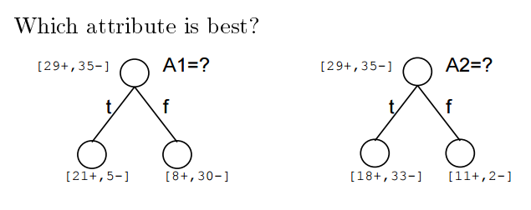
ID3 Algorithm: Which Attribute Best?
A1 and A2 are the features
29+, 35- means 29 positive training examples and 35 negative training examples
T and F (on edges) are the values of the features (so Boolean features in this image)
…so which feature split is better?

Slide 25
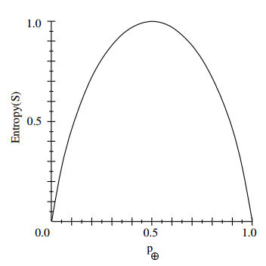
ID3 Algorithm: Entropy
Suppose:
S is sample of training examples
P₊ is proportion of positive examples in S
P₋ is proportion of negative examples in S
Entropy measure the impurity of S:
Entropy(S) = -P₊*log₂(P₊) – P₋*log₂(P₋)

Slide 26
Entropy: Information Theory
Entropy(S) is the expected number of bits needed to encode class (+ or -) of randomly drawn member of S (under optimal, shortest-length code)
Think Huffman Codes here
Optimal length code assigns –log₂(p) bits to message having probability of p
So, over all possibilities we take a weighted average:
Entropy(S) = -P₊*log₂(P₊) – P₋*log₂(P₋)

Slide 27
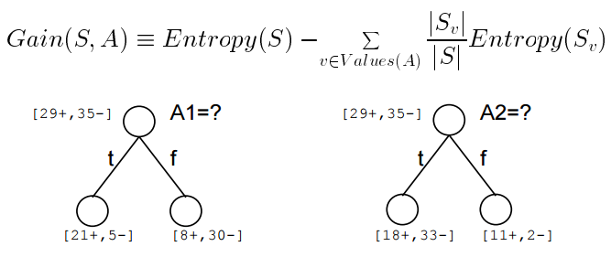
Information Gain
Information Gain is the amount the entropy has dropped given that you split on a specific feature at this step of the algorithm.
Gain(S,A) = expected reduction in entropy due to sorting on A

Slide 28
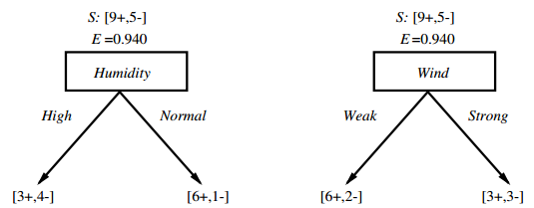
Which Attribute Better?
Try it on your own!

Slide 29
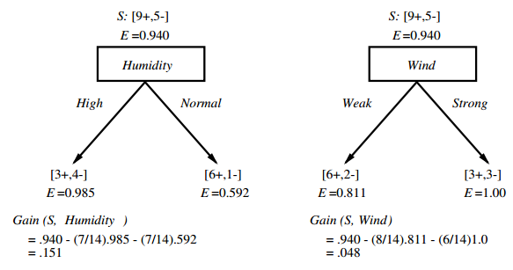
Which Attribute Better?

Slide 30
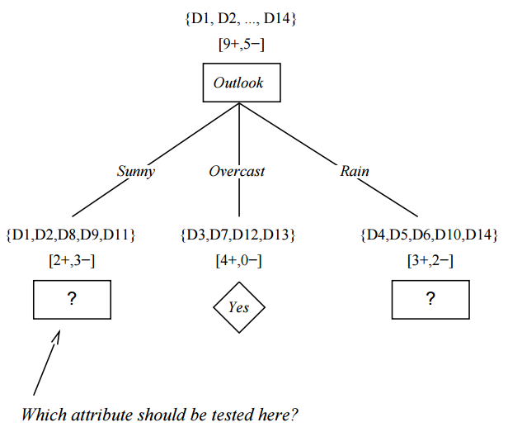
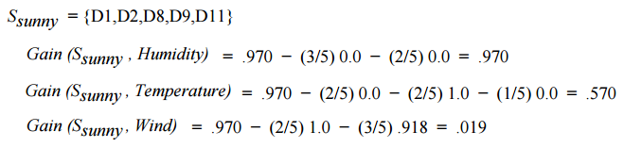

Slide 31
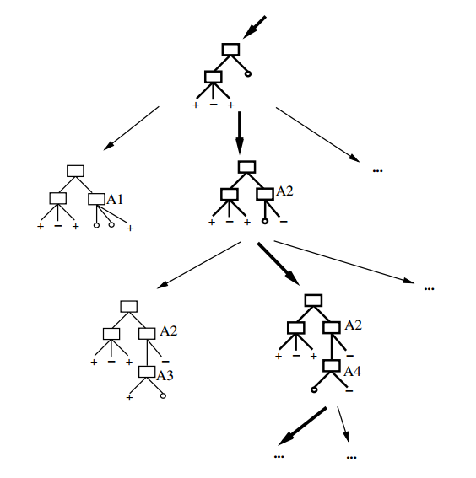
Thinking of ID3 as Space-Search
Hypothesis space is complete
- The best decision tree MUST be in there
ID3 outputs a specific decision tree though
Is it the best one?
No back-tracking
Local-minima (so probably not optimal)
Search choices are stochastic, so pretty robust to noisy data

Slide 32
ID3 is Biased!
Preference for shorter trees with high information gains near the root. ID3 is a greedy algorithm.
Bias is a preference, not a restriction (i.e., defines the choice we make when searching, but whole tree is available)
Occam’s Razor: Prefer the shortest hypothesis

Slide 33
ID3: Why Preference for Shorter Hypothesis?
Pros:
Fewer short hypotheses
Shorter = more general
Longer hypothesis might be coincidence
Cons:
There are many ways to define short hypotheses
e.g., all trees with a prime number of nodes that use attributes beginning with letter Z

Slide 34
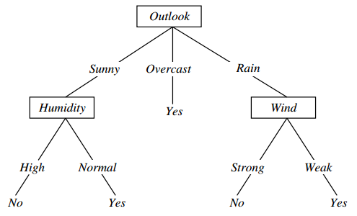
ID3: Overfitting
Overfitting is a problem in many AI algorithms in which learned rules infer noisy variations in data as real underlying differences.
Consider adding this example to earlier tree:
[Sunny, Hot,
Normal Humidity,
Strong Wind,
Play Tennis = NO ]
What is the effect on this tree →

Slide 35
Defining Overfitting
Consider a hypothesis h over both training data and actual distribution:
Error over training data: TrainError(h) Error over entire distribution D: DError(h)
Hypothesis h overfits the training data if there is another hypothesis h’ such that:
TrainError(h) < TrainError(h’)
AND
DError(h) > DError(h’)
Why does this make sense?

Slide 36
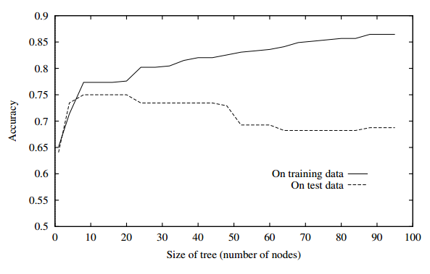
Defining Overfitting

Slide 37
Avoiding Overfitting
Stop growing when data split not statistically significant.
E.g., 101 positive examples and 1 negative at a node. No need to split here.
Grow full tree, then post-prune
Additionally:
Split data into a training set and a validation (or test) set.
Build tree (train) on training set only. Validate on validation set only.
Greedily remove rules in tree until you improve accuracy on validation set.

Slide 38
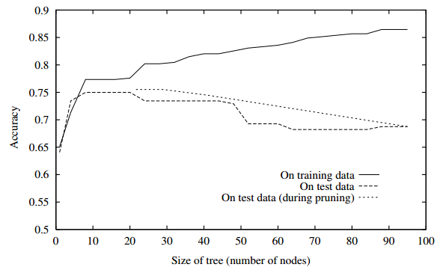
Post-Pruning to fight Overfitting

