Slide 1
CS3100: DSA2 Mark Floryan Machine Learning: Intro
Intelligent beings (e.g., humans) are excellent at learning. How can we try to program systems to learn interesting new things?

Slide 2
Introduction

Slide 3

Learning
What are some different ways in which human beings learn?
Some Ideas:
Rote Learning
Learning by example / recognizing patterns
Learning by observing similarities
Learning by practice

Slide 4
Rote Learning
Memorizing what is learned
Difficult to transfer knowledge to different domains or different problems
Easy (ish) to recall the information
Hard to apply the information
Computers are GREAT at this
String knowledge = “America declared independence in 1776”
The computer is learning!!!!
…but it can’t DO anything with that knowledge

Slide 5
Learning by Doing
Learn to do something by practicing and retrying until you get better
Painting, math, sports, etc.
How can computers do this?
This is called Reinforcement Learning and is a well-studied area

Slide 6
Learning by Doing
Reinforcement Learning Models usually contain (at a minimum):
A concept of reward
A set of actions an agent can take
A set of ways to observe the environment
Can be modeled with Markov Decision Processes and many other techniques

Slide 7

Reinforcement Learning: Example
Suppose we want an agent that plays Mario
A concept of reward
Going to the right = reward (maximize this)
A set of actions an agent can take
Buttons on the controller (jump, etc.)
A set of ways to observe the environment
Depends. What are the options here?

Slide 8
Learning by Example
If I show you a bunch of examples of a new species of animal, you’ll know how to recognize that animal
I didn’t explicitly teach you anything, so how did you do it?
This is called Supervised Learning because a supervisor (teacher, etc.) is telling you the answer to many examples
Then, hopefully you can perform the task independently afterward

Slide 9
Learning by Example
This is called Supervised Learning because a supervisor (teacher, etc.) is telling you the answer to many examples
For supervised learning, we will need:
Many examples with the correct answer!
A set of characteristics to look for in each example
E.g., looking at cardinals, we notice the male cardinals are red and the females are green’ish
We call these features

Slide 10
Learning by Observing Similarities
What if we are looking at pictures of animals, but aren’t given the ground truth of what animal is in which picture?
We can still group similar photos together
E.g., these are all birds, these are all green, etc.
This is called clustering, and is a form of unsupervised learning.

Slide 11
Supervised Learning

Slide 12
Supervised Learning
Sometimes also called classification if you are placing examples into discrete classes
We are given a bunch of data points, each one with the ground truth classification that we care about
Goal: Build a model that allows us to accurately predict new data points not in the original set

Slide 13
Example: Predicting Grades
Student | A last year? | Male? | Works Hard? | Drinks? | A this year?
Richard | Yes | Yes | No | Yes | No
Allen | Yes | Yes | Yes | No | Yes
Alison | No | No | Yes | No | No
Jeff | No | Yes | No | Yes | No
Gail | Yes | No | Yes | Yes | Yes
Simon | No | Yes | Yes | Yes | No

Slide 14
Supervised Learning
The data we are given (previous slide as example) is called a training set
After training your model, you can run it on new data called the test set to judge the accuracy of your model
…we’ll see more of this later in a moment

Slide 15
Example: Predicting Grades
Some possible learned rules?
You will get an A this year if:
A Last Year && Work Hard
(Male && Don’t Drink) || (Female && Drink)
Will these hold up if given a new test set? Probably not…
Student | A last year? | Male? | Works Hard? | Drinks? | A this year?
Richard | Yes | Yes | No | Yes | No
Allen | Yes | Yes | Yes | No | Yes
Alison | No | No | Yes | No | No
Jeff | No | Yes | No | Yes | No
Gail | Yes | No | Yes | Yes | Yes
Simon | No | Yes | Yes | Yes | No

Slide 16
Supervised Learning: Regression

Slide 17
Intro to Regression
Regression is a statistical method for learning and predicting outcome (latent) variables
Works by minimizing a cost function over all data points
Can be extended in several important ways
Is a very good, general, supervised learning technique

Slide 18
Example: Predicting NBA Stats
Suppose we know the number of points several NBA players scored in college and currently score in the NBA.
We want to predict how many points current college players will score in the NBA
* Yes, this model is too simplistic so far
Name | Pts College | Pts in NBA
Joe Harris | 12.6 | 2.5
Sean Singletary | 16.9 | 2.4
Kevin Durant | 25.8 | 25.4
Tony Bennett | 19.4 | 3.5
Chris Paul | 15.0 | 18.9
Anthony Davis | 14.2 | 24.7

Slide 19
Regression Process
Training Examples
Regression Algorithm
Features:
Avg. Points in College
Prediction:
Avg. Points in NBA
H(x)
H(x) is called the hypothesis function
This inputs a data point and outputs a prediction output
Regression algorithm finds the best hypothesis function

Slide 20

Hypothesis Function for Linear Regression
$$Hθ\left(x\right)= θ0+ θ1∗x$$
X is the input feature (average points in college)
Soon, we will extend this to include multiple features
$θ0$ and $θ1$ are real-valued weights
Our regression algorithm will calculate the best theta values that predict our training set

Slide 21

Hypothesis Function
$$Hθ\left(x\right)= θ0+ θ1∗x$$
This is clearly a linear formula, but it doesn’t have to be
We can fit a quadratic by replacing x with x² or even something else
Everything else we see today will be the same regardless, but as programmer, you must settle on a hypothesis function
How to pick a hypothesis? Look at a plot of your data and see what shape it has

Slide 22

Hypothesis Function
$$Hθ\left(x\right)= θ0+ θ1∗x$$
Let’s stick with a linear cost function for now (just for simplicity)
We need to learn what the best values the two theta values are, so we need to define some objective function that measures how “good” our hypothesis is
What makes a hypothesis good? If it does a good job of predicting all of the test data we were given!

Slide 23

Cost Function
$$J\left(θ\right)= \frac{1}{2m} ∗\sum_{i=1}^{m}{\left(Hθ\left(xi\right) −y^{i}\right)2}$$
The cost function measures how well the hypothesis matches the training examples
The i superscript denotes the ith training example (NOT raising anything to the ith power)
The inside of the summation is the difference between the hypothesis prediction and the actual value. This difference is squared (both to give more weight to good guesses, and to get rid of negative values
m is the number of training examples I was given

Slide 24

Gradient Descent Learning Algorithm
$$J\left(θ\right)= \frac{1}{2m} ∗\sum_{i=1}^{m}{\left(Hθ\left(xi\right) −y^{i}\right)2}$$
Goal: Find theta values that minimize $J\left(θ\right)$
Outline:
Start with some arbitrary values of $θ$₀ and $θ$₁
Adjust theta values to reduce J($θ$)
Repeat until no more adjustments can be made (or adjustments are doing VERY little)

Slide 25
Gradient Descent Learning Algorithm
Problem: How do I know how to adjust each theta value so my overall cost function goes down?
Remember, I want to adjust ALL of the theta values at once.
So…it’s not really an option to try different values and see what happens. If we have more features (which we will in a moment), then this will be way too slow.
Solution: let’s differentiate the cost function!

Slide 26

Gradient Descent Learning Algorithm
Repeat:
$θj= θj− α ∗\frac{∂}{∂θj}J(θ)$
$α$ is called the learning rate, this is a value that you choose (higher means you’ll change theta values faster.
$θj$ is the jth theta value from our hypothesis function (remember there were two). When we have more features, we will have more theta values to update.
Partial derivative tells us which direction to change theta to lower the cost function

Slide 27

Gradient Descent Learning Algorithm
Let’s differentiate J:
$$\frac{∂}{∂θj}J\left(θ\right)= ??$$
← On Board

Slide 28

Gradient Descent Learning Algorithm
Let’s differentiate J:
$$\frac{∂}{∂θ0}J\left(θ\right)=\frac{1}{m} \sum_{i=1}^{m}{(hθ\left(xi\right)−y^{i})}$$
$$\frac{∂}{∂θ1}J\left(θ\right)=\frac{1}{m} \sum_{i=1}^{m}{\left(hθ\left(xi\right)−y^{i}\right)∗x^{i}}$$

Slide 29
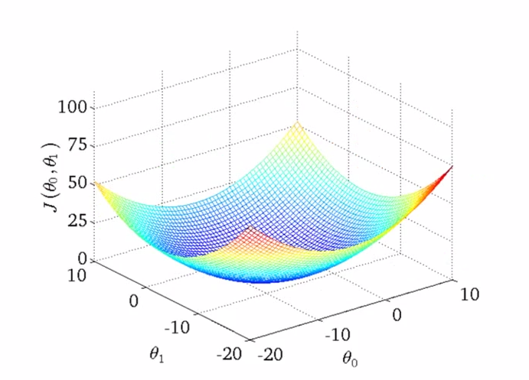
Gradient Descent: Local Minima?

Slide 30
Regression Process
Training Examples
Regression Algorithm
Features:
Avg. Points in College
Prediction:
Avg. Points in NBA
H(x)
H(x) is called the hypothesis function
This inputs a data point and outputs a prediction output
Regression algorithm finds the best hypothesis function

Slide 31
Supervised Learning: Regression
Multiple variables, polynomial regression, feature scaling, and other slight adjustments to linear regression

Slide 32
Example: Predicting NBA Stats
Name | Pts College | Steals/Game | FG% | 3pt% | Pts in NBA
Joe Harris | 12.6 | 0.9 | .445 | .407 | 2.5
Sean Singletary | 16.9 | 1.6 | .406 | .362 | 2.4
Kevin Durant | 25.8 | 1.9 | .473 | .404 | 25.4
Tony Bennett | 19.4 | 1.4 | .528 | .497 | 3.5
Chris Paul | 15.0 | 2.5 | .472 | .470 | 18.9
Anthony Davis | 14.2 | 1.4 | .623 | .150 | 24.7
Our previous data set wasn’t quite as reasonable. Don’t we want more data?
Sure! So what if we had several features for each player, could we more accurately predict NBA performance? Probably!

Slide 33

Hypothesis Function: Multiple Features
$$Hθ\left(x\right)= θ0+ θ1∗x1+ …+ θn ∗x_{n}$$
X is now a vector of features of size (m x n)
$θ$ is a vector of weights of size m+1
Like before, we can use polynomial terms if we’d like.

Slide 34

Hypothesis Function: Polynomial Terms
$$Hθ\left(x\right)= θ0+ θ1∗x1+ …+ θn ∗x_{n}$$
What is an easy way to deal with a feature that should be fit to a polynomial? Two options:
1. You can add $θi∗x_{i}2+θi^{′}{∗x}_{i}$ to the cost function
2. You can scale every instance of that feature by that polynomial and then use these new values as a new feature

Slide 35

Cost Function
$$J\left(θ\right)= \frac{1}{2m} ∗\sum_{i=1}^{m}{\left(Hθ\left(xi\right) −y^{i}\right)2}$$
Doesn’t change!
This is great!
So, gradient descent still works as before.

Slide 36

Gradient Descent Learning Algorithm
Let’s differentiate J:
$$\frac{∂}{∂θ0}J\left(θ\right)=\frac{1}{m} \sum_{i=1}^{m}{(hθ\left(xi\right)−y^{i})}$$
$$\frac{∂}{∂θj}J\left(θ\right)=\frac{1}{m} \sum_{i=1}^{m}{\left(hθ\left(xi\right)−y^{i}\right)∗xji}$$

Slide 37
Logistic Regression

Slide 38
Linear Regression vs. Logistic Regression
Typically used when the ground truth contains continuous values
Used for classification problems where the ground truth takes the form of discrete values
Very widely used in practice
Examples:
Email spam/not spam
Tumor malignant or benign
Etc…

Slide 39

Logistic Regression
Training set x contains n features
As before, these features can be anything but should be numeric
Output variable is one of two classifications
$y ε \{0, 1\}$
0 is one class (e.g., email not spam)
1 is other class (e.g., email is spam)
We will extend this to more than two classifications soon…

Slide 40
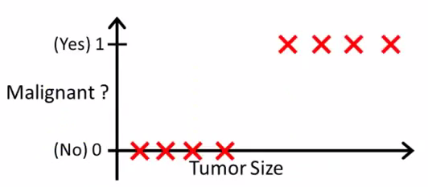

Logistic Regression: Example
Training set x contains n features
As before, these features can be anything but should be numeric
Output variable is one of two classifications
$y ε \{0, 1\}$
0 is one class (e.g., tumor NOT malignant)
1 is other class (e.g., tumor is malignant)
We will extend this to more than two classifications soon…

Slide 41
Logistic Regression: Example
As before, we want to fit a curve to this data
However, a linear fit doesn’t make any sense, so what curve can we fit here?
What might happen if we do fit a line to this data? What if there are some outliers?

Slide 42
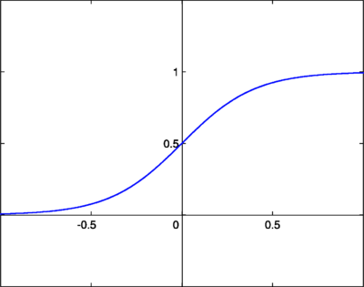

The Sigmoid Function!
$Y= \frac{1}{1+e−x}$
So, logistic regression is basically linear regression but we are fitting to a sigmoid instead!

Slide 43

Interpreting the Sigmoid Function!
$$Y= \frac{1}{1+e−x}$$
Assume I’ve fit this curve to my data and I’m given a new instance z
Plugging the features of z into my sigmoid will give me the probability that z should be classified as a 1
I can use that information however I wish

Slide 44

Logistic Regression: Hypothesis Function
Linear regression was:
$$Hθ\left(x\right)= θ0+ θ1∗x1+ …+ θm ∗x_{m}$$
Which can be written as: $θTx$
Now we will use:
$$Hθ\left(x\right)=g\left(θTx\right)$$
Where:
$$g\left(z\right)= \frac{1}{1+e−z}$$

Slide 45

Logistic Regression: Hypothesis Function
Now we will use:
$$Hθ\left(x\right)=g\left(θTx\right)$$
Where:
$$g\left(z\right)= \frac{1}{1+e−z}$$
What should I do if I plug a new example into my hypothesis and get 0.6?

Slide 46

Logistic Regression: Decision Boundary
Basic Idea: Figure out where cutoff should be between predicting a classification of 0 versus a classification of 1
Very Basic Version:
If $hθ\left(x\right)≥0.5$:
Output 1
Else If $hθ\left(x\right)<0.5$:
Output 0

Slide 47
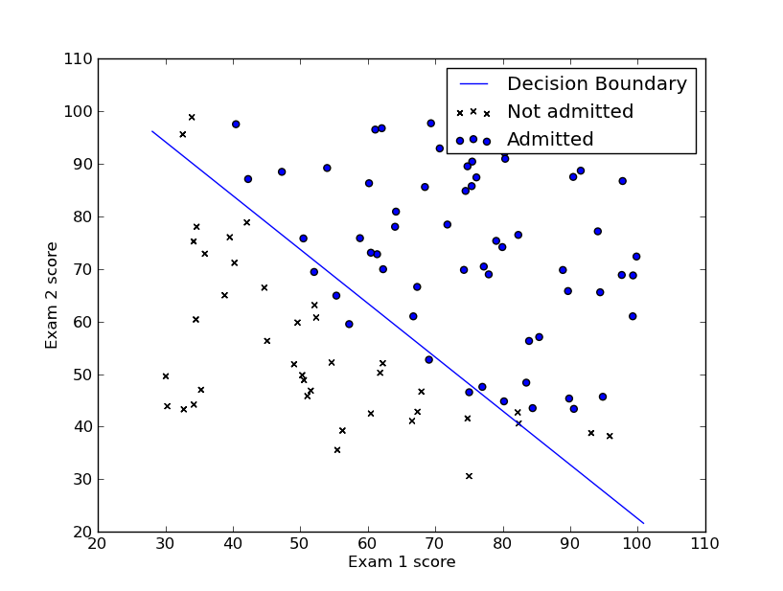
Logistic Regression: Decision Boundary
Because we are passing a linear function into our sigmoid, our decision boundary looks like this
Assumes two features were used
So an input that falls directly on this line will result in exactly 0.5 being output from the sigmoid!
Intuitive, the line separates the two classifications

Slide 48
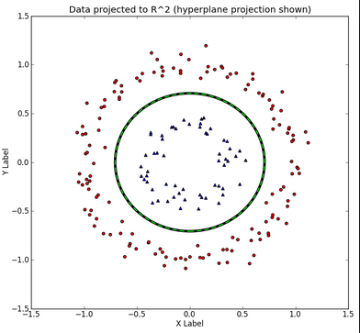
Logistic Regression: Decision Boundary
But what if our data points look like this!?
No line does a good job of splitting these classifications!
Need a new function to use as input to our sigmoid!!

Slide 49

Logistic Regression: Decision Boundary
Instead use:
$$hθ\left(x\right)=g(θ0+θ1x1+θ2x2+θ3x12+θ4x22)$$
Remember that g() is still the sigmoid function

Slide 50

Logistic Regression: Decision Boundary
Instead use:
$$hθ\left(x\right)=g(θ0+θ1x1+θ2x2+θ3x12+θ4x22)$$
Suppose we learn the following theta vals:
$$−1+x12+x22$$
So $θ=[−1, 0, 0, 1, 1]$
This is the formula for a circle! Yay!

Slide 51
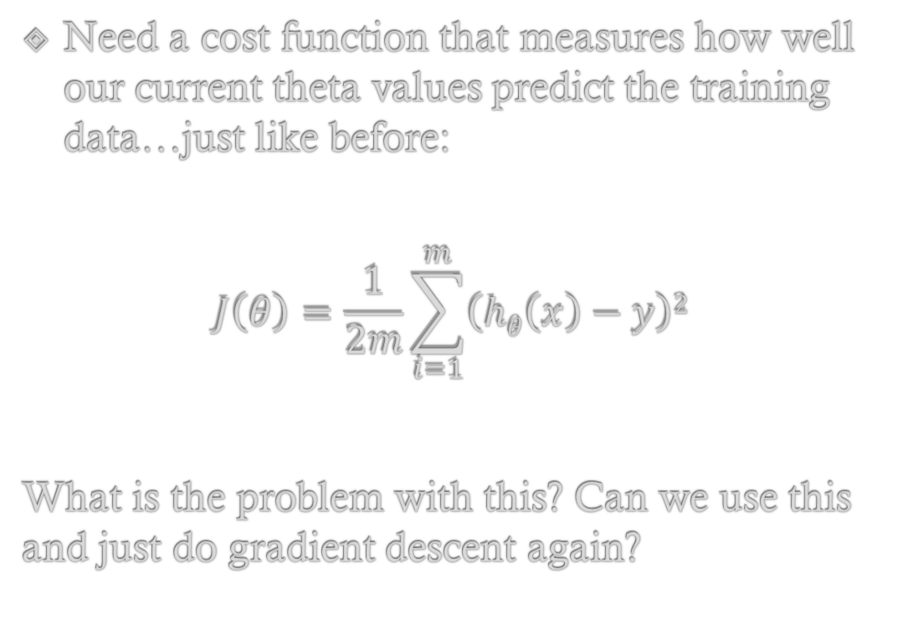
Logistic Regression: Cost Function
Need a cost function that measures how well our current theta values predict the training data…just like before:
$$J\left(θ\right)=\frac{1}{2m}\sum_{i=1}^{m}{\left(hθ\left(x\right)−y\right)2}$$
What is the problem with this? Can we use this and just do gradient descent again?

Slide 52

Logistic Regression: Cost Function
$$J\left(θ\right)=\frac{1}{2m}\sum_{i=1}^{m}{\left(hθ\left(x\right)−y\right)2}$$
What is the problem with this? Can we use this and just do gradient descent again?
Because h(x) is a sigmoid, this cost function is not convex, so we aren’t guaranteed to find global minimum

Slide 53
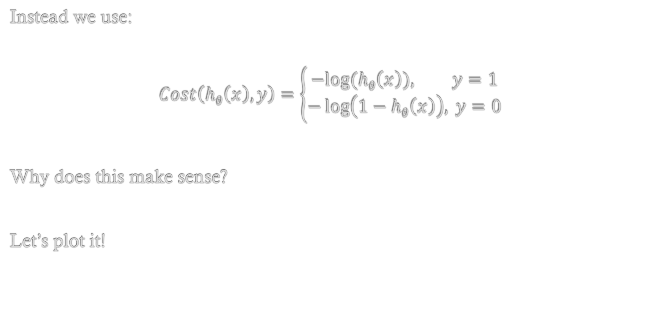
Logistic Regression: Better Cost Function
Instead we use:
$$Cost\left(hθ\left(x\right), y\right)=\left\{\begin{aligned}−&log⁡(hθ\left(x\right)), y=1 \\ −\log\left(1−hθ\left(x\right)\right), y=0\end{aligned}\right.$$
Why does this make sense?
Let’s plot it!

Slide 54

Logistic Regression: Better Cost Function
We can write this function:
$$Cost\left(hθ\left(x\right), y\right)=\left\{\begin{aligned}−&log⁡(hθ\left(x\right)), y=1 \\ −\log\left(1−hθ\left(x\right)\right), y=0\end{aligned}\right.$$
Like this instead:
$$Cost\left(hθ\left(x\right), y\right)=−y∗\log\left(hθ\left(x\right)\right)−\left(1−y\right)∗log⁡(1−hθ\left(x\right))$$
These are equivalent. The y or (1-y) part will cancel out one of the two terms but keep the other.

Slide 55
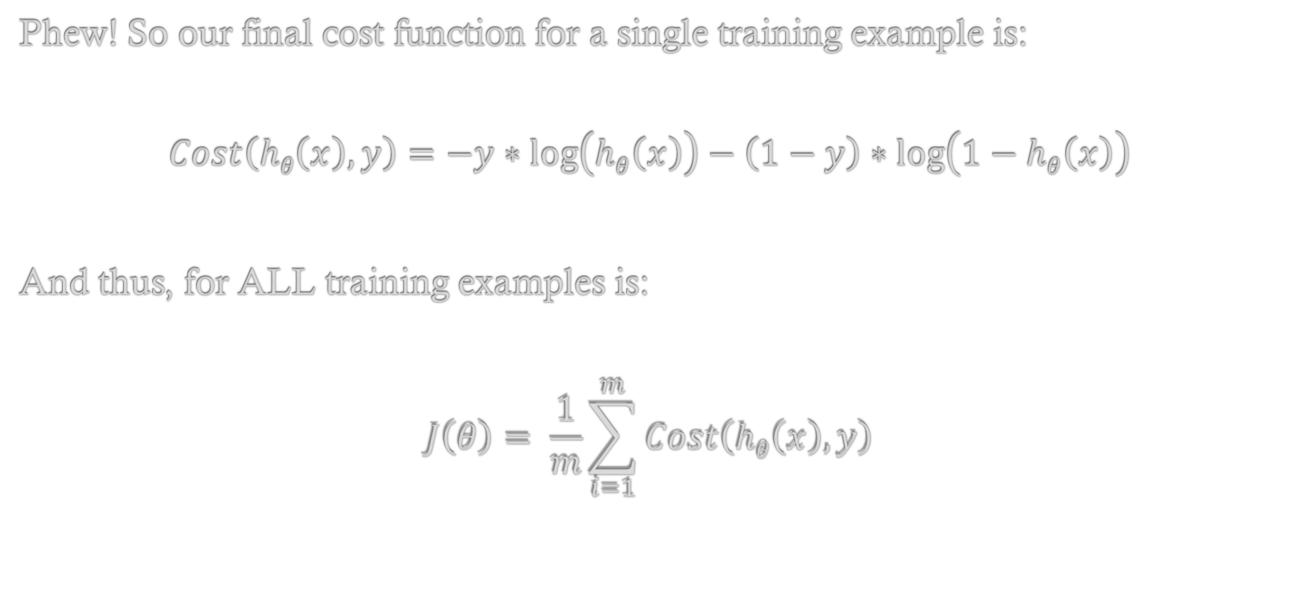
Logistic Regression: Better Cost Function
Phew! So our final cost function for a single training example is:
$$Cost\left(hθ\left(x\right), y\right)=−y∗\log\left(hθ\left(x\right)\right)−\left(1−y\right)∗\log\left(1−hθ\left(x\right)\right)$$
And thus, for ALL training examples is:
$$J\left(θ\right)= \frac{1}{m}\sum_{i=1}^{m}{Cost\left(hθ\left(x\right), y\right)}$$

Slide 56

Logistic Regression: Gradient Descent
So let’s find the values of $θ$ that minimizes this cost function:
$$J\left(θ\right)= \frac{1}{m}\sum_{i=1}^{m}{Cost\left(hθ\left(x\right), y\right)}$$
Reminder:
Loop:
$θj= θj − α\frac{∂}{∂θj}J(θ)$
//So just need to differentiate J and we are done!

Slide 57

Logistic Regression: Gradient Descent
Loop: $θj= θj − α\frac{∂}{∂θj}J(θ)$
Where:
$$\frac{∂}{∂θj}J\left(θ\right)= \frac{1}{m}\sum_{i=1}^{m}{\left(hθ\left(x\right)−y\right)∗x_{j} }$$

Slide 58
Logistic Regression
Multi-class classification

Slide 59
Multi-Class Classification!
Problem: Doing classification but there is more than one class!
Before we had 0 and 1
But we could have 0-5 or anything else!
How can we adapt logistic regression to handle this?

Slide 60
Many vs. One Algorithm!
One way to deal with this is called the many versus one algorithm
Suppose we have 5 classifications (1-5)
Idea:
Treat 1 as a 1 and 2-5 as 0
Run LR as we did before
Then, Treat 2 as 1 and 1,3,4,5 as 0
Run another LR

Slide 61
Many vs. One Algorithm!
One way to deal with this is called the many versus one algorithm
Suppose we have 5 classifications (1-5)
Idea:
Treat 1 as a 1 and 2-5 as 0
Run LR as we did before
Then, Treat 2 as 1 and 1,3,4,5 as 0
Run another LR

Slide 62
Many vs. One Algorithm!
So, we end up with (in this case) five unique logistic regressions!
1 vs 2-5 //Will return the percent chance an example is a 1 or something else
2 vs 1,3-5 //Will return the percent chance an example is a 2 or something else
3 vs 1,2,4,5 //…3 or something else
4 vs 1-3,5 //…4 or something else
5 vs 1-4 //…5 or something else

Slide 63
Many vs. One Algorithm!
So, we end up with (in this case) five unique logistic regressions!
1 vs 2-5 //Will return the percent chance an example is a 1 or something else
2 vs 1,3-5 //Will return the percent chance an example is a 2 or something else
3 vs 1,2,4,5 //…3 or something else
4 vs 1-3,5 //…4 or something else
5 vs 1-4 //…5 or something else
So, if we send an example through each regression it might return something like:
1: 0.2 2: 0.4 3: 0.81 4: 0.46 5: 0.33

Slide 64
Many vs. One Algorithm!
So, if we send an example through each regression it might return something like:
1: 0.2 2: 0.4 3: 0.81 4: 0.46 5: 0.33
In this case we would return that this example is a 3 because that is the highest percentage we calculated
Usually, we return the percentage as well (as a degree of confidence measure)

Slide 65
Summary

Slide 66
Conclusions!
Supervised Learning: Given training examples, learn to recognize patterns and identify new unseen instances of the same kind
Regression:
Really strong, general technique for learning. Good for almost any data set with continuous output variable. Can use Normal Equation or Gradient Descent. Can be adapted to fit polynomials, normalized for simplification, etc. very easily
Not as sophisticated as some approaches we’ll see later (Neural Networks etc.)
Logistic Regression:
Great for classification tasks (output variable is discreet). Naturally probabilistic. Same cost function (in form) as linear regression. Can handle multiple classes quite easily

