Slide 1
More Divide and Conquer: Closest Pair of Points
CS 3100: DSA 2
Mark Floryan and Aaron Bloomfield

Slide 2
Closest Pair of Points
Readings: CLRS 33.4

Slide 3
Closest Pair of Points in 2D Space
1
2
Given:
A list of points in 2D space
5
4
Return:
6
Distance of the pair of points that are closest together (and the points themselves too)
7
3
8

Slide 4


Closest Pair of Points: Naïve
Given:
A list of points in 2D space
1
2
Return:
Distance of the pair of points that are closest together (and the points themselves too)
5
4
6
Naive Algorithm:
Test every pair of points, return the closest.
$$O(n^{2})$$
7
3
We can do better!
8
$$Θ(n\log{n)}$$

Slide 5
Closest Pair of Points: D&C
Divide:
1
2
At median x coordinate
5
Conquer:
4
6
???
7
Combine:
3
???
8

Slide 6


Closest Pair of Points: D&C
Divide:
At median x coordinate
1
$$δ_{L}$$
2
$$δ_{R}$$
Conquer:
5
4
Recursively find closest pair of points on left half and right half via two recursive calls
6
7
Combine:
Return
3
8
LeftPoints
RightPoints

Slide 7

Closest Pair of Points: D&C
Divide:
At median x coordinate
1
$$δ_{L}$$
2
$$δ_{R}$$
Conquer:
5
4
Recursively find closest pair of points on left half and right half via two recursive calls
6
7
Combine:
Return $min⁡(δ_{L}, δ_{R})$
3
8
LeftPoints
RightPoints
What is the issue with this combine step?

Slide 8


Closest Pair of Points: D&C
Divide:
At median x coordinate
1
$$δ_{L}$$
2
$$δ_{R}$$
Conquer:
5
4
Recursively find closest pair of points on left half and right half via two recursive calls
6
7
$$δ_{G}$$
Combine:
Return $min⁡(δ_{L}, δ_{R},δ_{G})$
3
8
LeftPoints
RightPoints
Better, but how do we find the shortest pair across the gap?

Slide 9

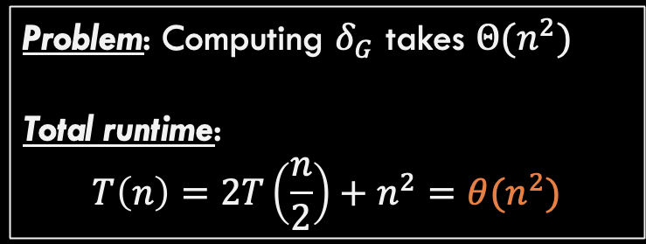
Closest Pair of Points: D&C
Combine:
Compute $δ_{G}$ efficiently Return $min⁡(δ_{L}, δ_{R},δ_{G})$
2
1
5
Possible Solution: Compute all pairs that cross the gap.
4
6
Problem: Computing $δ_{G}$ takes $Θ(n^{2})$
Total runtime:
$$T\left(n\right)=2T\left(\frac{n}{2}\right)+n^{2}=θ(n^{2})$$
7
$$δ_{G}$$
3
8
LeftPoints
RightPoints
Same runtime as naïve solution. Not good enough!

Slide 10


Closest Pair of Points: D&C
Combine:
Compute $δ_{G}$ efficiently Return $min⁡(δ_{L}, δ_{R},δ_{G})$
2
1
5
4
Observation: Let $δ=\min\left(δ_{L},{ δ}_{R}\right)$ If $δ_{G}$ is best, points MUST be within $δ$ of dividing line
6
7
3
$$2δ$$
8
LeftPoints
RightPoints

Slide 11
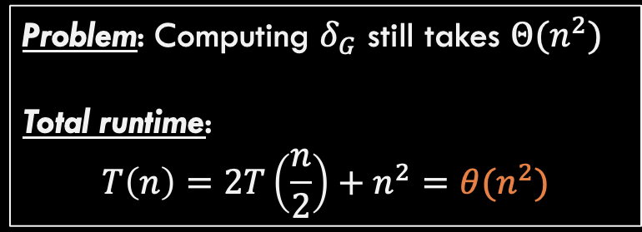
Closest Pair of Points: D&C
Combine:
Compute $δ_{G}$ efficiently Return $min⁡(δ_{L}, δ_{R},δ_{G})$
2
1
4
5
Possible Solution: Compute all points across gap that are within this strip!
6
Problem: Computing $δ_{G}$ still takes $Θ(n^{2})$
Total runtime:
$$T\left(n\right)=2T\left(\frac{n}{2}\right)+n^{2}=θ(n^{2})$$
7
3
$$2δ$$
8
LeftPoints
RightPoints
All the points might be inside this strip (tall vertical lines of points)

Slide 12




Closest Pair of Points: D&C
$$2δ$$
Combine:
Compute $δ_{G}$ efficiently Return $min⁡(δ_{L}, δ_{R},δ_{G})$
$$\frac{δ}{2} x\frac{δ}{2}$$
Observation 2: Maintain strip points sorted by increasing y-coordinate
Divide the runway into squares of size $\frac{δ}{2}$
How many points can be in a single square? Just one!
2
$$\frac{δ}{\sqrt{2}}$$
1
LeftPoints
RightPoints

Slide 13

Closest Pair of Points: D&C
$$2δ$$
Combine:
Compute $δ_{G}$ efficiently Return $min⁡(δ_{L}, δ_{R},δ_{G})$
$$\frac{δ}{2} x\frac{δ}{2}$$
Observation 2: Maintain strip points sorted by increasing y-coordinate
Divide the runway into squares of size $\frac{δ}{2}$
How many points can be in a single square? Just one!
2
$$\frac{δ}{\sqrt{2}}$$
1
Cannot sort here, that would be $Θ\left(n log n\right)$. More on that later.
LeftPoints
RightPoints

Slide 14

Closest Pair of Points: D&C
$$2δ$$
Combine:
Compute $δ_{G}$ efficiently Return $min⁡(δ_{L}, δ_{R},δ_{G})$
$$\frac{δ}{2} x\frac{δ}{2}$$
Observation 2: Maintain strip points sorted by increasing y-coordinate
When analyzing point x, how many other boxes can it possibly be within $δ$ of?
x
LeftPoints
RightPoints
Remember, we sorted by y-value, so point x is on the bottom line of this diagram. Only care about points with same or higher y-value!

Slide 15

Closest Pair of Points: D&C
$$2δ$$
Combine:
Compute $δ_{G}$ efficiently Return $min⁡(δ_{L}, δ_{R},δ_{G})$
$$\frac{δ}{2} x\frac{δ}{2}$$
Observation 2: Maintain strip points sorted by increasing y-coordinate
When analyzing point x, how many other boxes can it possibly be within $δ$ of?
LeftPoints
x
RightPoints
Remember, we sorted by y-value, so point x is on the bottom line of this diagram. Only care about points with same or higher y-value!

Slide 16

Closest Pair of Points: D&C
$$2δ$$
Combine:
Compute $δ_{G}$ efficiently Return $min⁡(δ_{L}, δ_{R},δ_{G})$
$$\frac{δ}{2} x\frac{δ}{2}$$
Observation 2: Maintain strip points sorted by increasing y-coordinate
When analyzing point x, how many other boxes can it possibly be within $δ$ of?
x
x
LeftPoints
RightPoints
Remember, we sorted by y-value, so point x is on the bottom line of this diagram. Only care about points with same or higher y-value!

Slide 17

Closest Pair of Points: D&C
$$2δ$$
Combine:
Compute $δ_{G}$ efficiently Return $min⁡(δ_{L}, δ_{R},δ_{G})$
$$\frac{δ}{2} x\frac{δ}{2}$$
Observation 2: Maintain strip points sorted by increasing y-coordinate
When analyzing point x, how many other boxes can it possibly be within $δ$ of?
x
x
x
Remember, we sorted by y-value, so point x is on the bottom line of this diagram. Only care about points with same or higher y-value!
LeftPoints
RightPoints

Slide 18

Closest Pair of Points: D&C
$$2δ$$
Combine:
Compute $δ_{G}$ efficiently Return $min⁡(δ_{L}, δ_{R},δ_{G})$
$$\frac{δ}{2} x\frac{δ}{2}$$
Observation 2: Maintain strip points sorted by increasing y-coordinate
When analyzing point x, how many other boxes can it possibly be within $δ$ of?
Only 8 boxes are reachable, but point x is in one of them, so only 7 others need to be checked!
5
6
7
8
1
2
3
4
x
x
x
LeftPoints
RightPoints

Slide 19
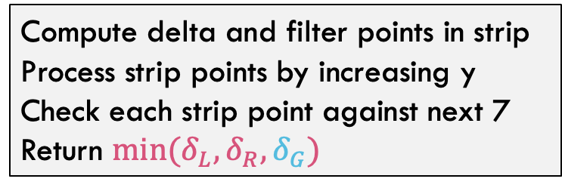

Closest Pair of Points: D&C
Divide:
At median x coordinate
1
$$δ_{L}$$
2
Conquer:
$$δ_{R}$$
Recursively find closest pair of points on left half and right half via two recursive calls
5
4
6
Combine:
7
$$δ_{G}$$
Compute delta and filter points in strip Process strip points by increasing y Check each strip point against next 7 Return $min⁡(δ_{L}, δ_{R},δ_{G})$
3
8
LeftPoints
RightPoints
Combine step is now linear time!!

Slide 20
Closest Pair of Points: D&C
Initialization: sort points by x-coordinate
Divide: Partition into two sides by median x-coordinate
Conquer: recursively compute the closest pair in each side
Combine:
Construct the list of points in the runway
Sort the runway points by y-coordinate
Compare each point in the runway to the 7 above it and save the closest pair
Output closest pair among left, right, and runway points
Initialization: sort points by x-coordinate
Divide: Partition into two sides by median x-coordinate
Conquer: recursively compute the closest pair in each side and each list sorted by y-coordinate
Combine:
Merge sorted list of points by y-coordinate
Construct the list of points in the runway
Compare each point in the runway to the 7 above it and save the closest pair
Output closest pair among left, right, and runway points and y-sorted list

Slide 21






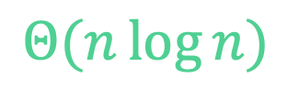

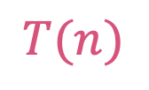


Closest Pair of Points: Divide and Conquer
What is the running time?
$$Θ(n\log{n})$$
$$Θ\left(n\log{n}\right)$$
Initialization: Sort points by $x$-coordinate
Divide: Partition points into two lists of points based on $x$-coordinate (split at the median $x$)
Conquer: Recursively compute the closest pair of points in each list
Combine:
Process runway points by $y$-coordinate and Compare each point in runway to 7 points above it and save the closest pair
Merge sorted-y lists together to return
Output closest pair among left, right, and runway points
$$Θ\left(1\right)$$
$$2T(n/2)$$
$$T(n)$$
$$T(n)=2T(n/2)+Θ(n)$$
$$Θ\left(n\right)$$
Case 2 of Master’s Theorem
$$T\left(n\right)=Θ\left(n\log{n}\right)$$
$$Θ\left(n\right)$$
$$Θ\left(1\right)$$

Slide 22
Summary for Closest Pair of Points
Comparing all pairs is a brute-force fail
Except for small inputs
Divide and conquer a big improvement
Needed to find an efficient way for part of the combine step
Geometry came through for us here!
Only needed to look at constant number of points for each point in the strip
Implementation subtleties
Don’t want to sort the strip by y-coordinate in each recursive call
In initialization, create an “index” that lets you process all points in order by y-coordinate
(There are other ways to address this.)

