Slide 1
A brief Introduction to NP-Completeness
Data Structures and Algorithms 2
Mark Floryan and Aaron Bloomfield

Slide 2
Roadmap: Goals for this deck
Reductions help us establish one problem is at least as hard as another. Can we find the “hardest problems”
What do these hard problems look like and how do we know that they are the “hardest” in some set of problems.
Along the way: A brief introduction to NP-Complete problems.

Slide 3
Reduction Reminders

Slide 4
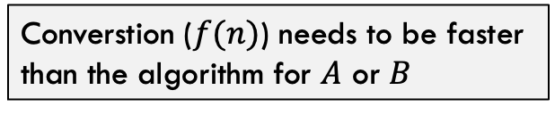

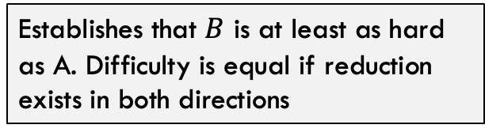

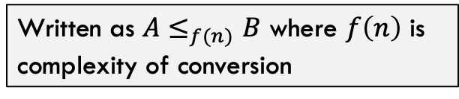


Reminder: Reductions
$$Θ(1)$$
Reduction Facts:
Do nothing to convert
Written as $A≤_{f(n)}B$ where $f\left(n\right)$ is complexity of conversion
Maximum Independent Set
Minimum Vertex Cover
Converstion ($f(n)$) needs to be faster than the algorithm for $A$ or $B$
Establishes that $B$ is at least as hard as A. Difficulty is equal if reduction exists in both directions
$$Θ\left(??\right)$$
Run MIS algorithm
Run MVC algorithm
$$Θ\left(??\right)$$
Take complement of nodes in solution
Matches that can be made
f = ??
flow values on edges
Can be used to establish which problems are the harder than huge numbers of other problems?
$$Θ(1)$$

Slide 5
Reminder: Reductions
$$Θ(1)$$
Reduction Facts:
Do nothing to convert
Written as $A≤_{f(n)}B$ where $f\left(n\right)$ is complexity of conversion
Maximum Independent Set
Minimum Vertex Cover
Converstion ($f(n)$) needs to be faster than the algorithm for $A$ or $B$
Establishes that $B$ is at least as hard as A. Difficulty is equal if reduction exists in both directions
$$Θ\left(??\right)$$
Run MIS algorithm
Run MVC algorithm
$$Θ\left(??\right)$$
Take complement of nodes in solution
Matches that can be made
f = ??
flow values on edges
Can be used to establish which problems are the harder than huge numbers of other problems?
$$Θ(1)$$
So…can we find the hardest problems that computers need to solve?

Slide 6
Complexity Classes

Slide 7
Finding the Hardest Problems
Goal: We want to identify what some of the hardest problems for computers to solve. We can do this by relating the difficulty of problems through reduction!
Complexity Class: A set (group) of problems that all have the same (or similar) difficulty to solve (given some definition of “same”).

Slide 8

The class P
Important: P is a set of problems (not solutions, not algorithms)
Example problems in this set include:
Sorting a list of numbers
Inserting into a binary tree
Computing the average of a list of numbers
Printing “hello world”
Find() in a hash table
…and many more
P
The class P is the set of all problems that can be solved by a computer in time $O(n^{c})$ such that $c∈𝒩$

Slide 9
The class P
Essentially: P is a set of problems we can solve quickly
P

Slide 10
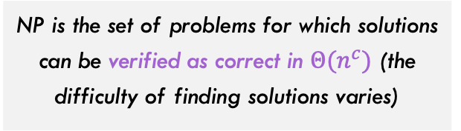

$$NP$$
NP
Hard Problems
NP:
NP is the set of problems for which solutions can be verified as correct in $Θ(n^{c})$ (the difficulty of finding solutions varies)
P
You will see the formal definition and talk about this complexity class in more detail in DMT2!
Easy Problems
For now, just trust us that $P⊆NP$

Slide 11
NP: Quick Verification
What does it mean to “verify quickly”? Consider the following problem?
isComposite(int x): Return true if and only if x is composite (not prime)
isComposite(282475249) = ?

Slide 12
NP: Quick Verification
isComposite(int x): Return true if and only if x is composite (not prime)
isComposite(282475249) = ?
Solve:
Figure out if 282475249 is composite with no additional info. Pretty hard to do (there are algorithms for this FYI)!
Verify:
Given evidence that 282475249 is composite, verify if evidence is accurate.
Evidence: 7
To verify, simply check:
282475249 / 7 = 40353607 (VERIFIED!)

Slide 13

NP: Quick Verification
isComposite(int x): Return true if and only if x is composite (not prime)
isComposite(282475249) = ?
Verify:
Given evidence that 282475249 is composite, verify if evidence is accurate.
Evidence: 7
To verify, simply check:
282475249 / 7 = 40353607 (VERIFIED!)
Since verifying solutions is polynomial time (in this case, $Θ(1)$), this problem is in the set NP

Slide 14
Back to our Diagram
What is the problem that sits at the very top here? For our purposes, this is the “hardest” problem (hardest in these groups we are choosing to study)
NP
Hard Problems
P
Almost every algorithm we have studied has a polynomial time algorithm and is in P
Easy Problems

Slide 15
NP-Hard
NP
Hard Problems
Suppose we have find the hardest problem in NP
P
NP-Hard problems are defined to be all problems that are this hard OR harder.
Easy Problems

Slide 16
NP-Hard
NP-Hard
Goes up to indefinite difficulty.
NP
Hard Problems
Note that NP-Hard and NP intersect here. Problems in this intersection are the hardest problems in NP
P
Easy Problems

Slide 17
NP-Complete
NP-Hard
This section (purple) is the set of NP-Complete problems. The hardest problems in NP
NP
Hard Problems
Definition: A problem is NP-Complete if and only if the problem:
Is in NP
Is NP-Hard
P
Easy Problems

Slide 18

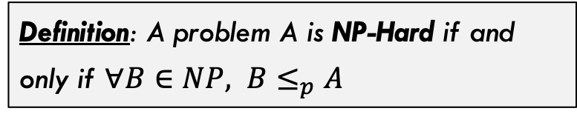
NP-Hard
NP-Hard
A different definition of NP-Hard
Definition: A problem A is NP-Hard if and only if $∀B∈NP, B≤_{p}A$
NP
Hard Problems
$B≤_{p}A$ means that problem A is harder than problem B, shown through a reduction, which we will see in a moment.
P
Easy Problems

Slide 19
NP-Hard
Remember that goal is to find a really hard problem in this NP-Complete region. But what is that problem?
NP
Hard Problems
P
Easy Problems

Slide 20
Satisfiability

Slide 21


Satisfiability (SAT)
Satisfiability (SAT) Problem: Given a boolean formula, is it possible to assign the variables true false values such that the entire expression evaluates to “true”
Example 1:
$$x_{1}∧\left(x_{2}∨¬x_{3}\right)∧\left(¬x_{1}∨x_{3}\right)∧(x_{2}∨¬x_{3})$$
True: Set all variables to True
Example 2:
$$x_{1}∧\left(x_{2}∨¬x_{3}\right)∧\left(¬x_{1}∨x_{3}\right)∧({¬x}_{2}∨¬x_{3})$$
False: All assignment Fail

Slide 22
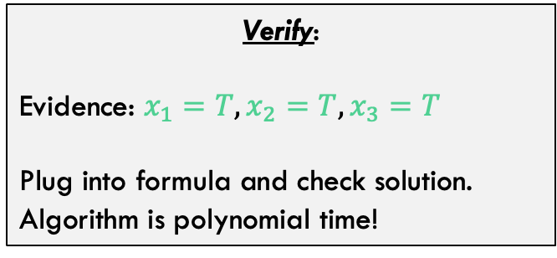
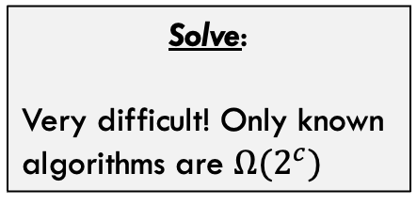
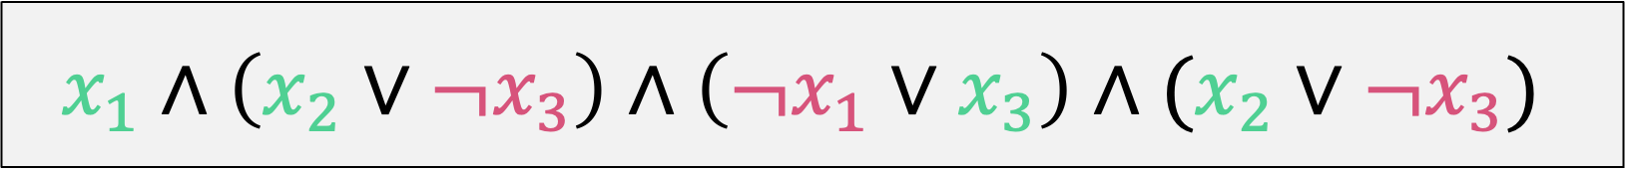
Satisfiability (SAT)
$$x_{1}∧\left(x_{2}∨¬x_{3}\right)∧\left(¬x_{1}∨x_{3}\right)∧(x_{2}∨¬x_{3})$$
…but imagine this formula could be VERY long!
Solve:
Very difficult! Only known algorithms are $Ω(2^{c})$
Verify:
Evidence: $x_{1}=T, x_{2}=T, x_{3}=T$
Plug into formula and check solution. Algorithm is polynomial time!

Slide 23

NP-Hard
Claim: SAT is NP-Complete
SAT
NP
Hard Problems
…but how do we prove it? Need to show that every other problem down here somewhere
Problem A
P
Can be reduced to SAT:
$$A≤SAT$$
Easy Problems

Slide 24
NP-Hard
Claim: SAT is NP-Complete
SAT
NP
Hard Problems
Problem A
What do we know about any generic problem A: It has a computer program that solves it!
P
Easy Problems

Slide 25
Computer Programs!

Slide 26
Quick Roadmap
All computer programs can be represented with computational models
A computational model is a simple reduced version of the program but fully describes how to solve the problem.
There is a reduction between a computational model’s description (“code”) and an equivalent SAT expression!
Disclaimer!
Everything in this section is going to be a bit vague. It is A LOT of material and we don’t have time to go over it thoroughly. This will give you a rough idea of how these things work and you will see it in much more detail in DMT2!

Slide 27
Simple Program Example
Consider the following problem:
Given a string input: Is this string a valid UVa Computing ID?
Format:
Starts with two or three letters (L)
Optional digit (D)
1-3 more letters IF there was a digit
Valid Formats:
LL, LLL, LLDL, LLDLL, LLLDLL, LLDLLL, LLLDLLL

Slide 28
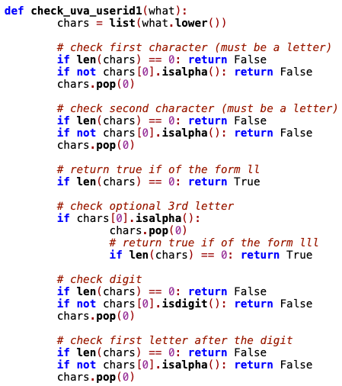
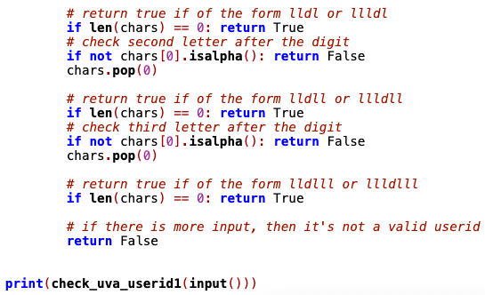
Python Code
Main Point: This code works! It uses a bunch of if-statements and is a working computer program for this problem. Great!

Slide 29
A different Way of “Coding” This…
1
A-Z
2
A-Z
3
A-Z
4
3
4
Start
1-9
1-9
8
7
A-Z
6
A-Z
5
8
A-Z
5
6
Procedure:
Try it out:
mrf8t
as8f
afde9d
Start at the start state
For each symbol of the computing id:
Go to the next state as per transition labels
If finished and state your end in is accepting (double circles):
Return True (Valid ID)
Else:
Return False (Not Valid ID)

Slide 30
All DFA can be reduced to SAT
1
A-Z
2
A-Z
3
A-Z
4
3
4
Start
1-9
1-9
8
7
A-Z
6
A-Z
5
8
A-Z
5
6
Example Input: mrf8t

Slide 31
All DFA can be reduced to SAT
1
A-Z
2
A-Z
3
A-Z
4
3
4
Start
1-9
1-9
8
7
A-Z
6
A-Z
5
8
A-Z
5
6
Example Input: mrf8t

Slide 32
All DFA can be reduced to SAT
1
m
2
A-Z
3
A-Z
4
3
4
Start
1-9
1-9
8
7
A-Z
6
A-Z
5
8
A-Z
5
6
Example Input: mrf8t

Slide 33
All DFA can be reduced to SAT
1
m
2
r
3
A-Z
4
3
4
Start
1-9
1-9
8
7
A-Z
6
A-Z
5
8
A-Z
5
6
Example Input: mrf8t

Slide 34
All DFA can be reduced to SAT
1
m
2
r
3
f
4
3
4
Start
1-9
1-9
8
7
A-Z
6
A-Z
5
8
A-Z
5
6
Example Input: mrf8t

Slide 35
All DFA can be reduced to SAT
1
m
2
r
3
f
4
3
4
Start
8
8
7
A-Z
6
A-Z
5
8
A-Z
5
6
Example Input: mrf8t

Slide 36
All DFA can be reduced to SAT
1
m
2
r
3
f
4
3
4
Start
8
8
7
6
t
5
8
5
6
ACCEPT!!
Example Input: mrf8t

Slide 37
A different Way of “Coding” This…
1
A-Z
2
A-Z
3
A-Z
4
3
4
Start
1-9
1-9
8
7
A-Z
6
A-Z
5
8
A-Z
5
6
Definition:
By the way, this is called a Deterministic Finite Automata. You’ll learn more about these in DMT2! A lot (but not all) programs can be expressed as a DFA.

Slide 38
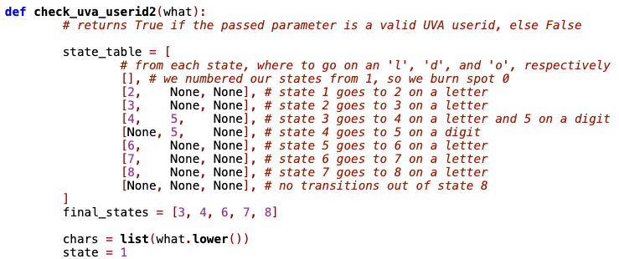
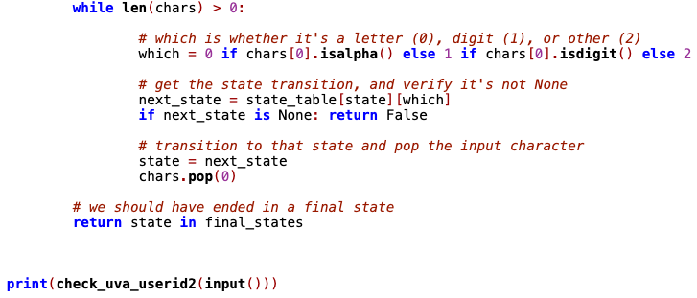
Python Code
Main Point: Coding up these machines is easy, very general, and works for a wide array of problems!!

Slide 39
Aside: More Machine Types
1
2
3
4
3
Deterministic Finite Automata. Machine that processes input with no memory (except the current state)
8
7
6
5
8
5
6
1
2
3
4
3
Non-deterministic Finite Automata. DFA that can be in multiple states at once (more in a moment)
8
7
6
5
8
5
6

Slide 40
Aside: More Machine Types
1
2
3
4
3
Pushdown Automata. An NFA with a stack
8
7
6
5
8
5
6
stack
1
2
3
4
3
Turing Machine. An NFA with a tape (array)
8
7
6
5
8
5
6
You’ll see these in a lot more detail in DMT2. They exist, but we are going to stick with the first two for now (to keep things simple)…
^
Tape

Slide 41
Uva ID Detection with NFA
Start
1
A-Z
Try it out:
mrf8t
as8f
afde9d
2
8
A-Z
8
A-Z
A-Z
A-Z
3
Remember:
String is a valid Uva user id if there is at least one path from start to finish on that string.
7
A-Z
A-Z
0-9
A-Z
A-Z
4
6
5
0-9
A-Z

Slide 42
Reduction of DFA to Satisfiability

Slide 43

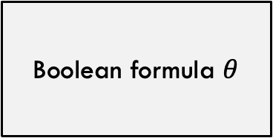
Reduction Idea
Convert DFA into equivalent Boolean formula
Is mrf a valid uva computing id?
Boolean formula $θ$
Reduction Idea:
Gives us TWO different ways to “run” this program. We can run the DFA directly OR we can convert into a formula and solve the Boolean formula instead.
Run the DFA machine
Is $θ$ satisfiable?
If true, accept mrf
If false, reject mrf
Accept or Reject
mrf
True (satisfiable)
or
False (not satisfiable)

Slide 44
Convert this DFA into a formula
1
A-Z
2
A-Z
3
A-Z
4
3
4
Start
1-9
1-9
Input: mrf
6
5
A-Z
Notice we are simplifying the DFA here to make the reduction simpler…now only one letter allowed after the number.

Slide 45
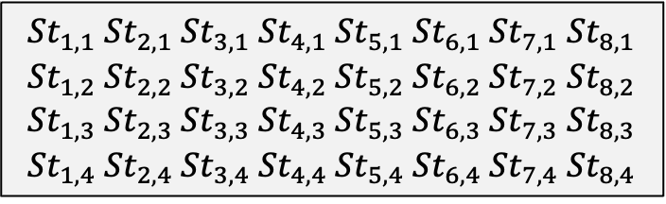
Important Variables!
1
A-Z
2
A-Z
3
A-Z
4
3
4
Start
1-9
1-9
Input: mrf
6
A-Z
5
Represents whether machine in state i at step j
$${St}_{1,1} {St}_{2,1} {St}_{3,1} {St}_{4,1} {St}_{5,1} {St}_{6,1} {St}_{7,1} {St}_{8,1} \\ {St}_{1,2} {St}_{2,2} {St}_{3,2} {St}_{4,2} {St}_{5,2} {St}_{6,2} {St}_{7,2} {St}_{8,2} \\ {St}_{1,3} {St}_{2,3} {St}_{3,3} {St}_{4,3} {St}_{5,3} {St}_{6,3} {St}_{7,3} {St}_{8,3} \\ {St}_{1,4} {St}_{2,4} {St}_{3,4} {St}_{4,4} {St}_{5,4} {St}_{6,4} {St}_{7,4} {St}_{8,4}$$
Notice that each row represents one STEP, so one variable in each row can be true, the others in that row must be false.

Slide 46
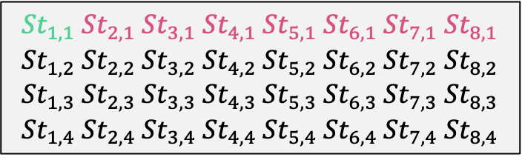
Important Variables!
1
A-Z
2
A-Z
3
A-Z
4
3
4
Start
1-9
Input: mrf
1-9
6
A-Z
5
6
Represents whether machine in state i at step j
$${St}_{1,1} {St}_{2,1} {St}_{3,1} {St}_{4,1} {St}_{5,1} {St}_{6,1} {St}_{7,1} {St}_{8,1} \\ {St}_{1,2} {St}_{2,2} {St}_{3,2} {St}_{4,2} {St}_{5,2} {St}_{6,2} {St}_{7,2} {St}_{8,2} \\ {St}_{1,3} {St}_{2,3} {St}_{3,3} {St}_{4,3} {St}_{5,3} {St}_{6,3} {St}_{7,3} {St}_{8,3} \\ {St}_{1,4} {St}_{2,4} {St}_{3,4} {St}_{4,4} {St}_{5,4} {St}_{6,4} {St}_{7,4} {St}_{8,4}$$

Slide 47
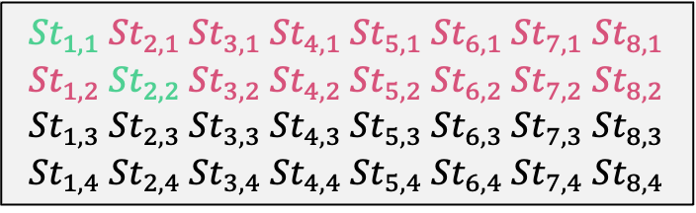
Important Variables!
1
m
2
A-Z
3
A-Z
4
3
4
Start
1-9
Input: mrf
1-9
6
A-Z
5
6
Represents whether machine in state i at step j
$${St}_{1,1} {St}_{2,1} {St}_{3,1} {St}_{4,1} {St}_{5,1} {St}_{6,1} {St}_{7,1} {St}_{8,1} \\ {St}_{1,2} {St}_{2,2} {St}_{3,2} {St}_{4,2} {St}_{5,2} {St}_{6,2} {St}_{7,2} {St}_{8,2} \\ {St}_{1,3} {St}_{2,3} {St}_{3,3} {St}_{4,3} {St}_{5,3} {St}_{6,3} {St}_{7,3} {St}_{8,3} \\ {St}_{1,4} {St}_{2,4} {St}_{3,4} {St}_{4,4} {St}_{5,4} {St}_{6,4} {St}_{7,4} {St}_{8,4}$$

Slide 48
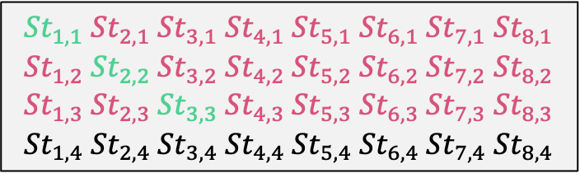
Important Variables!
1
m
2
r
3
A-Z
4
3
4
Start
1-9
Input: mrf
1-9
6
A-Z
5
6
Represents whether machine in state i at step j
$${St}_{1,1} {St}_{2,1} {St}_{3,1} {St}_{4,1} {St}_{5,1} {St}_{6,1} {St}_{7,1} {St}_{8,1} \\ {St}_{1,2} {St}_{2,2} {St}_{3,2} {St}_{4,2} {St}_{5,2} {St}_{6,2} {St}_{7,2} {St}_{8,2} \\ {St}_{1,3} {St}_{2,3} {St}_{3,3} {St}_{4,3} {St}_{5,3} {St}_{6,3} {St}_{7,3} {St}_{8,3} \\ {St}_{1,4} {St}_{2,4} {St}_{3,4} {St}_{4,4} {St}_{5,4} {St}_{6,4} {St}_{7,4} {St}_{8,4}$$

Slide 49
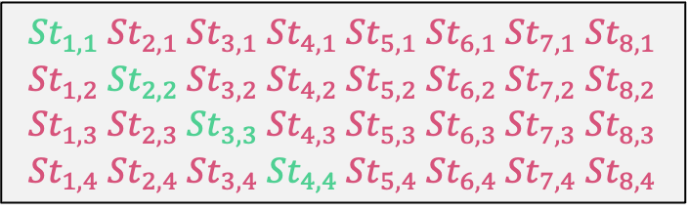
Important Variables!
1
m
2
r
3
f
4
3
4
Start
1-9
Input: mrf
1-9
6
A-Z
5
6
Represents whether machine in state i at step j
$${St}_{1,1} {St}_{2,1} {St}_{3,1} {St}_{4,1} {St}_{5,1} {St}_{6,1} {St}_{7,1} {St}_{8,1} \\ {St}_{1,2} {St}_{2,2} {St}_{3,2} {St}_{4,2} {St}_{5,2} {St}_{6,2} {St}_{7,2} {St}_{8,2} \\ {St}_{1,3} {St}_{2,3} {St}_{3,3} {St}_{4,3} {St}_{5,3} {St}_{6,3} {St}_{7,3} {St}_{8,3} \\ {St}_{1,4} {St}_{2,4} {St}_{3,4} {St}_{4,4} {St}_{5,4} {St}_{6,4} {St}_{7,4} {St}_{8,4}$$
This is how we eventually want these set when we “run” this machine.

Slide 50
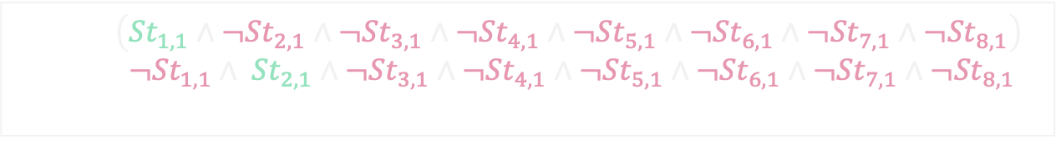
Important Variables!
1
m
2
r
3
f
4
3
4
Start
1-9
Input: mrf
1-9
6
A-Z
5
6
Useful shorthand:
$$S_{1,1}=\left({St}_{1,1}∧¬{St}_{2,1}∧{¬St}_{3,1}∧{¬St}_{4,1}∧{¬St}_{5,1}∧{¬St}_{6,1}∧{¬St}_{7,1}∧{¬St}_{8,1}\right) \\ S_{2,1}=({¬St}_{1,1}∧ {St}_{2,1}∧{¬St}_{3,1}∧{¬St}_{4,1}∧{¬St}_{5,1}∧{¬St}_{6,1}∧{¬St}_{7,1}∧{¬St}_{8,1})$$
…
From now on, these SS variables tell us which state we are in at some step AND has terms for not being in all other states at the same time.

Slide 51
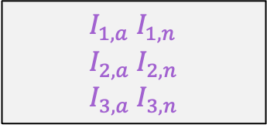
Important Variables!
1
A-Z
2
A-Z
3
A-Z
4
3
4
Start
1-9
Input: mrf
1-9
6
A-Z
5
6
Variables representing the input being a letter (a) or number (n)
So, for our input (mrf) we want:
$$I_{1,a} I_{1,n} \\ I_{2,a} I_{2,n} \\ I_{3,a} I_{3,n}$$
$$\left(I_{1,a}∧¬I_{1,n}\right)∧\left(I_{2,a}∧¬I_{2,n}\right)∧(I_{3,a}∧{¬I}_{3,n})$$

Slide 52
The conversion
1
A-Z
2
A-Z
3
A-Z
4
3
4
Start
1-9
Input: mrf
1-9
6
A-Z
5
6
Ok, we are finally ready to do the conversion of this DFA into a Boolean formula!

Slide 53
The conversion
1
A-Z
2
A-Z
3
A-Z
4
3
4
Start
1-9
Input: mrf
1-9
6
A-Z
5
6
$$θ=S_{1,1}$$
Must start in state 1 on first step

Slide 54
The conversion
1
A-Z
2
A-Z
3
A-Z
4
3
4
Start
1-9
Input: mrf
1-9
6
A-Z
5
6
$$θ=S_{1,1}∧\left(I_{1,a}∧¬I_{1,n}\right)∧\left(I_{2,a}∧¬I_{2,n}\right)∧(I_{3,a}∧{¬I}_{3,n})∧ …$$
input string (“mrf”) has all three characters being letters (a) and NOT numbers (n)

Slide 55
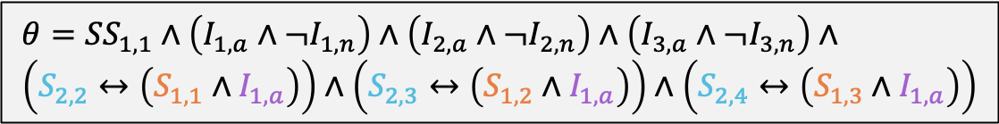
The conversion
1
A-Z
2
A-Z
3
A-Z
4
3
4
Start
1-9
Input: mrf
1-9
6
A-Z
5
6
$$θ={SS}_{1,1}∧\left(I_{1,a}∧¬I_{1,n}\right)∧\left(I_{2,a}∧¬I_{2,n}\right)∧\left(I_{3,a}∧{¬I}_{3,n}\right)∧ \\ \left(S_{2,2}↔\left(S_{1,1}∧I_{1,a}\right)\right)∧\left(S_{2,3}↔\left(S_{1,2}∧I_{1,a}\right)\right)∧\left(S_{2,4}↔\left(S_{1,3}∧I_{1,a}\right)\right)$$
Since input has exactly three characters, there are three different times we can go from state 1 to state 2.

Slide 56
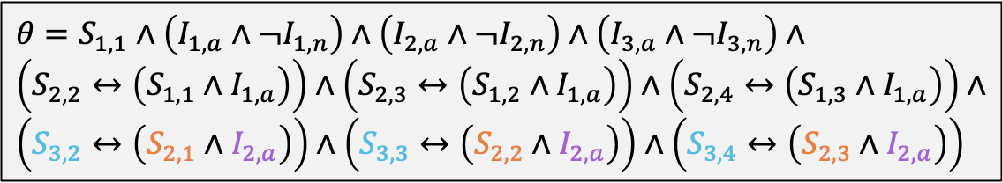
The conversion
1
A-Z
2
A-Z
3
A-Z
4
3
4
Start
1-9
Input: mrf
1-9
6
A-Z
5
6
$$θ=S_{1,1}∧\left(I_{1,a}∧¬I_{1,n}\right)∧\left(I_{2,a}∧¬I_{2,n}\right)∧\left(I_{3,a}∧{¬I}_{3,n}\right)∧ \\ \left(S_{2,2}↔\left(S_{1,1}∧I_{1,a}\right)\right)∧\left(S_{2,3}↔\left(S_{1,2}∧I_{1,a}\right)\right)∧\left(S_{2,4}↔\left(S_{1,3}∧I_{1,a}\right)\right)∧ \\ \left(S_{3,2}↔\left(S_{2,1}∧I_{2,a}\right)\right)∧\left(S_{3,3}↔\left(S_{2,2}∧I_{2,a}\right)\right)∧\left(S_{3,4}↔\left(S_{2,3}∧I_{2,a}\right)\right)$$
Similar, but for the next transition!

Slide 57
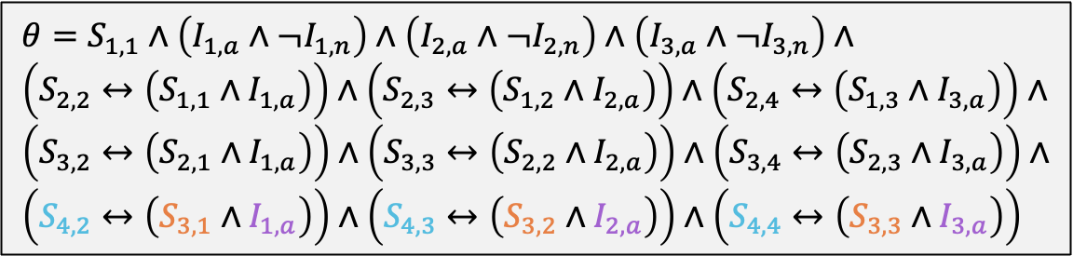
The conversion
1
A-Z
2
A-Z
3
A-Z
4
3
4
Start
1-9
Input: mrf
1-9
6
A-Z
5
6
$$θ=S_{1,1}∧\left(I_{1,a}∧¬I_{1,n}\right)∧\left(I_{2,a}∧¬I_{2,n}\right)∧\left(I_{3,a}∧{¬I}_{3,n}\right)∧ \\ \left(S_{2,2}↔\left(S_{1,1}∧I_{1,a}\right)\right)∧\left(S_{2,3}↔\left(S_{1,2}∧I_{2,a}\right)\right)∧\left(S_{2,4}↔\left(S_{1,3}∧I_{3,a}\right)\right)∧ \\ \left(S_{3,2}↔\left(S_{2,1}∧I_{1,a}\right)\right)∧\left(S_{3,3}↔\left(S_{2,2}∧I_{2,a}\right)\right)∧\left(S_{3,4}↔\left(S_{2,3}∧I_{3,a}\right)\right)∧ \\ \left(S_{4,2}↔\left(S_{3,1}∧I_{1,a}\right)\right)∧\left(S_{4,3}↔\left(S_{3,2}∧I_{2,a}\right)\right)∧\left(S_{4,4}↔\left(S_{3,3}∧I_{3,a}\right)\right)$$

Slide 58
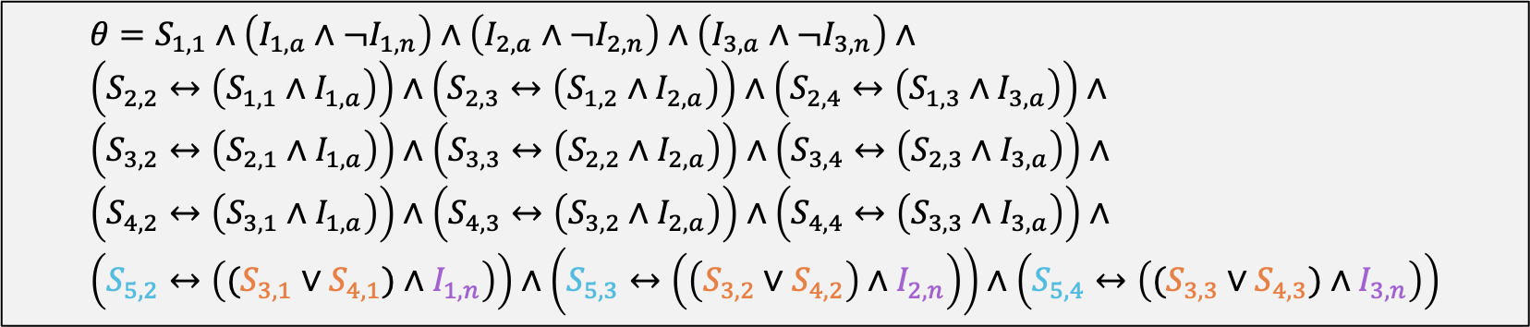
The conversion
1
A-Z
2
A-Z
3
A-Z
4
3
4
Start
1-9
Input: mrf
1-9
6
A-Z
5
6
$$θ=S_{1,1}∧\left(I_{1,a}∧¬I_{1,n}\right)∧\left(I_{2,a}∧¬I_{2,n}\right)∧\left(I_{3,a}∧{¬I}_{3,n}\right)∧ \\ \left(S_{2,2}↔\left(S_{1,1}∧I_{1,a}\right)\right)∧\left(S_{2,3}↔\left(S_{1,2}∧I_{2,a}\right)\right)∧\left(S_{2,4}↔\left(S_{1,3}∧I_{3,a}\right)\right)∧ \\ \left(S_{3,2}↔\left(S_{2,1}∧I_{1,a}\right)\right)∧\left(S_{3,3}↔\left(S_{2,2}∧I_{2,a}\right)\right)∧\left(S_{3,4}↔\left(S_{2,3}∧I_{3,a}\right)\right)∧ \\ \left(S_{4,2}↔\left(S_{3,1}∧I_{1,a}\right)\right)∧\left(S_{4,3}↔\left(S_{3,2}∧I_{2,a}\right)\right)∧\left(S_{4,4}↔\left(S_{3,3}∧I_{3,a}\right)\right)∧ \\ \left(S_{5,2}↔\left((S_{3,1}∨S_{4,1})∧I_{1,n}\right)\right)∧\left(S_{5,3}↔\left(\left(S_{3,2}∨S_{4,2}\right)∧I_{2,n}\right)\right)∧\left(S_{5,4}↔\left((S_{3,3}∨S_{4,3})∧I_{3,n}\right)\right)$$

Slide 59
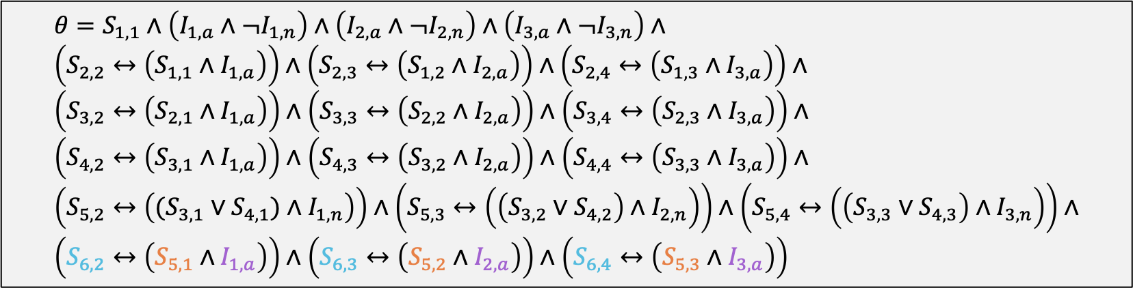
The conversion
1
A-Z
2
A-Z
3
A-Z
4
3
4
Start
1-9
Input: mrf
1-9
6
A-Z
5
6
$$θ=S_{1,1}∧\left(I_{1,a}∧¬I_{1,n}\right)∧\left(I_{2,a}∧¬I_{2,n}\right)∧\left(I_{3,a}∧{¬I}_{3,n}\right)∧ \\ \left(S_{2,2}↔\left(S_{1,1}∧I_{1,a}\right)\right)∧\left(S_{2,3}↔\left(S_{1,2}∧I_{2,a}\right)\right)∧\left(S_{2,4}↔\left(S_{1,3}∧I_{3,a}\right)\right)∧ \\ \left(S_{3,2}↔\left(S_{2,1}∧I_{1,a}\right)\right)∧\left(S_{3,3}↔\left(S_{2,2}∧I_{2,a}\right)\right)∧\left(S_{3,4}↔\left(S_{2,3}∧I_{3,a}\right)\right)∧ \\ \left(S_{4,2}↔\left(S_{3,1}∧I_{1,a}\right)\right)∧\left(S_{4,3}↔\left(S_{3,2}∧I_{2,a}\right)\right)∧\left(S_{4,4}↔\left(S_{3,3}∧I_{3,a}\right)\right)∧ \\ \left(S_{5,2}↔\left((S_{3,1}∨S_{4,1})∧I_{1,n}\right)\right)∧\left(S_{5,3}↔\left(\left(S_{3,2}∨S_{4,2}\right)∧I_{2,n}\right)\right)∧\left(S_{5,4}↔\left(\left(S_{3,3}∨S_{4,3}\right)∧I_{3,n}\right)\right)∧ \\ \left(S_{6,2}↔\left(S_{5,1}∧I_{1,a}\right)\right)∧\left(S_{6,3}↔\left(S_{5,2}∧I_{2,a}\right)\right)∧\left(S_{6,4}↔\left(S_{5,3}∧I_{3,a}\right)\right)$$

Slide 60
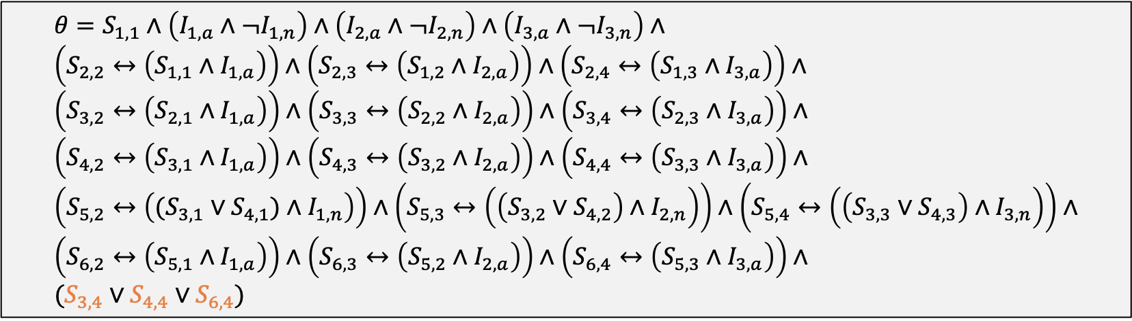
The conversion
1
A-Z
2
A-Z
3
A-Z
4
3
4
Start
1-9
Input: mrf
1-9
6
A-Z
5
6
Need to be in a final state at the last step (in this case, step 4!
$$θ=S_{1,1}∧\left(I_{1,a}∧¬I_{1,n}\right)∧\left(I_{2,a}∧¬I_{2,n}\right)∧\left(I_{3,a}∧{¬I}_{3,n}\right)∧ \\ \left(S_{2,2}↔\left(S_{1,1}∧I_{1,a}\right)\right)∧\left(S_{2,3}↔\left(S_{1,2}∧I_{2,a}\right)\right)∧\left(S_{2,4}↔\left(S_{1,3}∧I_{3,a}\right)\right)∧ \\ \left(S_{3,2}↔\left(S_{2,1}∧I_{1,a}\right)\right)∧\left(S_{3,3}↔\left(S_{2,2}∧I_{2,a}\right)\right)∧\left(S_{3,4}↔\left(S_{2,3}∧I_{3,a}\right)\right)∧ \\ \left(S_{4,2}↔\left(S_{3,1}∧I_{1,a}\right)\right)∧\left(S_{4,3}↔\left(S_{3,2}∧I_{2,a}\right)\right)∧\left(S_{4,4}↔\left(S_{3,3}∧I_{3,a}\right)\right)∧ \\ \left(S_{5,2}↔\left((S_{3,1}∨S_{4,1})∧I_{1,n}\right)\right)∧\left(S_{5,3}↔\left(\left(S_{3,2}∨S_{4,2}\right)∧I_{2,n}\right)\right)∧\left(S_{5,4}↔\left(\left(S_{3,3}∨S_{4,3}\right)∧I_{3,n}\right)\right)∧ \\ \left(S_{6,2}↔\left(S_{5,1}∧I_{1,a}\right)\right)∧\left(S_{6,3}↔\left(S_{5,2}∧I_{2,a}\right)\right)∧\left(S_{6,4}↔\left(S_{5,3}∧I_{3,a}\right)\right)∧ \\ (S_{3,4}∨S_{4,4}∨S_{6,4})$$

Slide 61
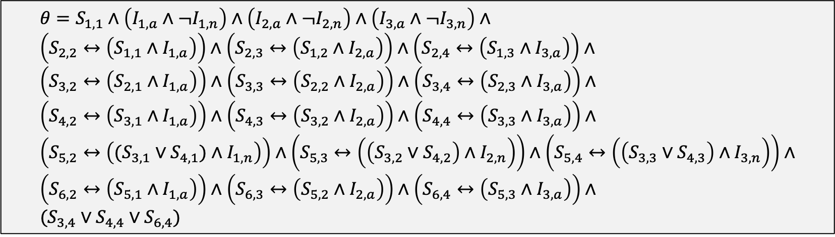
The conversion
1
A-Z
2
A-Z
3
A-Z
4
3
4
Start
Input: mrf
1-9
1-9
We are done!
Claim: We have two different ways to test if mrf is valid computing id. We can run DFA or we can try to satisfy the equation below!
6
A-Z
5
6
$$θ=S_{1,1}∧\left(I_{1,a}∧¬I_{1,n}\right)∧\left(I_{2,a}∧¬I_{2,n}\right)∧\left(I_{3,a}∧{¬I}_{3,n}\right)∧ \\ \left(S_{2,2}↔\left(S_{1,1}∧I_{1,a}\right)\right)∧\left(S_{2,3}↔\left(S_{1,2}∧I_{2,a}\right)\right)∧\left(S_{2,4}↔\left(S_{1,3}∧I_{3,a}\right)\right)∧ \\ \left(S_{3,2}↔\left(S_{2,1}∧I_{1,a}\right)\right)∧\left(S_{3,3}↔\left(S_{2,2}∧I_{2,a}\right)\right)∧\left(S_{3,4}↔\left(S_{2,3}∧I_{3,a}\right)\right)∧ \\ \left(S_{4,2}↔\left(S_{3,1}∧I_{1,a}\right)\right)∧\left(S_{4,3}↔\left(S_{3,2}∧I_{2,a}\right)\right)∧\left(S_{4,4}↔\left(S_{3,3}∧I_{3,a}\right)\right)∧ \\ \left(S_{5,2}↔\left((S_{3,1}∨S_{4,1})∧I_{1,n}\right)\right)∧\left(S_{5,3}↔\left(\left(S_{3,2}∨S_{4,2}\right)∧I_{2,n}\right)\right)∧\left(S_{5,4}↔\left(\left(S_{3,3}∨S_{4,3}\right)∧I_{3,n}\right)\right)∧ \\ \left(S_{6,2}↔\left(S_{5,1}∧I_{1,a}\right)\right)∧\left(S_{6,3}↔\left(S_{5,2}∧I_{2,a}\right)\right)∧\left(S_{6,4}↔\left(S_{5,3}∧I_{3,a}\right)\right)∧ \\ (S_{3,4}∨S_{4,4}∨S_{6,4})$$

Slide 62
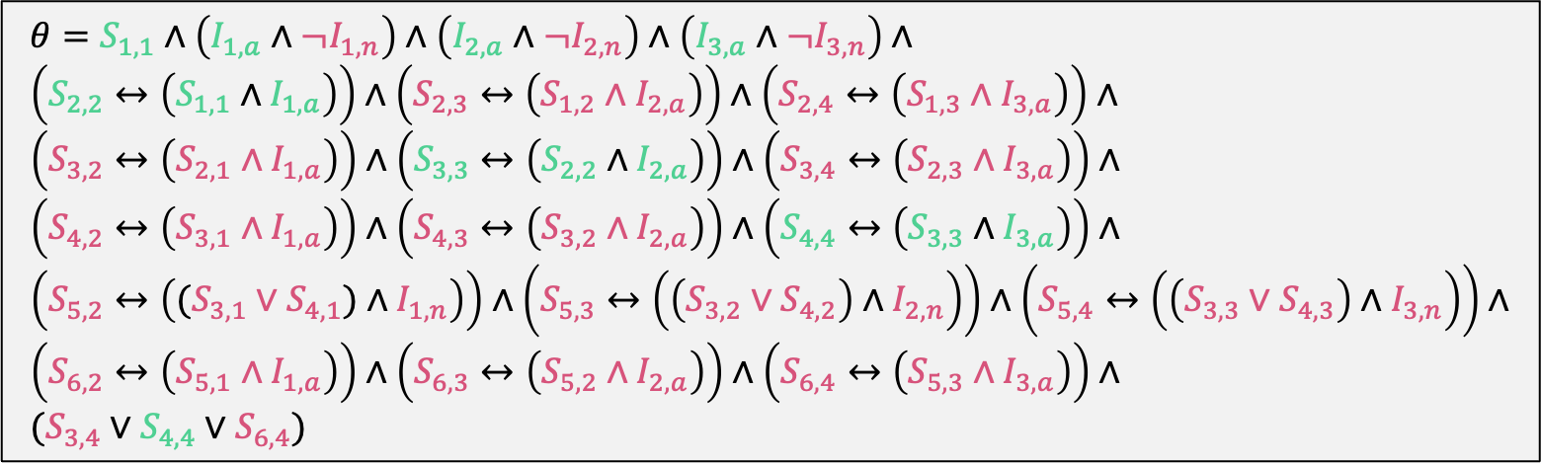
The conversion
1
m
2
r
3
f
4
3
4
Start
Input: mrf
1-9
1-9
The assignment below works, thus mrf is a valid UVa computing id!! Notice that the variables set to TRUE tell us exactly how we went from state to state in the DFA
6
A-Z
5
6
$$θ=S_{1,1}∧\left(I_{1,a}∧¬I_{1,n}\right)∧\left(I_{2,a}∧¬I_{2,n}\right)∧\left(I_{3,a}∧{¬I}_{3,n}\right)∧ \\ \left(S_{2,2}↔\left(S_{1,1}∧I_{1,a}\right)\right)∧\left(S_{2,3}↔\left(S_{1,2}∧I_{2,a}\right)\right)∧\left(S_{2,4}↔\left(S_{1,3}∧I_{3,a}\right)\right)∧ \\ \left(S_{3,2}↔\left(S_{2,1}∧I_{1,a}\right)\right)∧\left(S_{3,3}↔\left(S_{2,2}∧I_{2,a}\right)\right)∧\left(S_{3,4}↔\left(S_{2,3}∧I_{3,a}\right)\right)∧ \\ \left(S_{4,2}↔\left(S_{3,1}∧I_{1,a}\right)\right)∧\left(S_{4,3}↔\left(S_{3,2}∧I_{2,a}\right)\right)∧\left(S_{4,4}↔\left(S_{3,3}∧I_{3,a}\right)\right)∧ \\ \left(S_{5,2}↔\left((S_{3,1}∨S_{4,1})∧I_{1,n}\right)\right)∧\left(S_{5,3}↔\left(\left(S_{3,2}∨S_{4,2}\right)∧I_{2,n}\right)\right)∧\left(S_{5,4}↔\left(\left(S_{3,3}∨S_{4,3}\right)∧I_{3,n}\right)\right)∧ \\ \left(S_{6,2}↔\left(S_{5,1}∧I_{1,a}\right)\right)∧\left(S_{6,3}↔\left(S_{5,2}∧I_{2,a}\right)\right)∧\left(S_{6,4}↔\left(S_{5,3}∧I_{3,a}\right)\right)∧ \\ (S_{3,4}∨S_{4,4}∨S_{6,4})$$

Slide 63
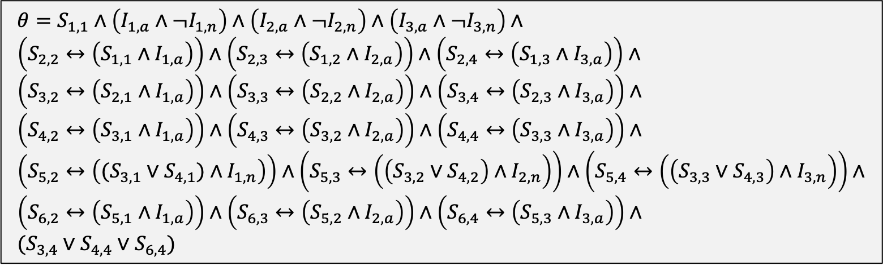
The conversion
1
A-Z
2
A-Z
3
A-Z
4
3
4
Start
Input: mr8
1-9
1-9
How about an input (also with three characters) that is NOT a valid computing id. What happens when we try to satisfy the equation below?
6
5
6
A-Z
$$θ=S_{1,1}∧\left(I_{1,a}∧¬I_{1,n}\right)∧\left(I_{2,a}∧¬I_{2,n}\right)∧\left(I_{3,a}∧{¬I}_{3,n}\right)∧ \\ \left(S_{2,2}↔\left(S_{1,1}∧I_{1,a}\right)\right)∧\left(S_{2,3}↔\left(S_{1,2}∧I_{2,a}\right)\right)∧\left(S_{2,4}↔\left(S_{1,3}∧I_{3,a}\right)\right)∧ \\ \left(S_{3,2}↔\left(S_{2,1}∧I_{1,a}\right)\right)∧\left(S_{3,3}↔\left(S_{2,2}∧I_{2,a}\right)\right)∧\left(S_{3,4}↔\left(S_{2,3}∧I_{3,a}\right)\right)∧ \\ \left(S_{4,2}↔\left(S_{3,1}∧I_{1,a}\right)\right)∧\left(S_{4,3}↔\left(S_{3,2}∧I_{2,a}\right)\right)∧\left(S_{4,4}↔\left(S_{3,3}∧I_{3,a}\right)\right)∧ \\ \left(S_{5,2}↔\left((S_{3,1}∨S_{4,1})∧I_{1,n}\right)\right)∧\left(S_{5,3}↔\left(\left(S_{3,2}∨S_{4,2}\right)∧I_{2,n}\right)\right)∧\left(S_{5,4}↔\left(\left(S_{3,3}∨S_{4,3}\right)∧I_{3,n}\right)\right)∧ \\ \left(S_{6,2}↔\left(S_{5,1}∧I_{1,a}\right)\right)∧\left(S_{6,3}↔\left(S_{5,2}∧I_{2,a}\right)\right)∧\left(S_{6,4}↔\left(S_{5,3}∧I_{3,a}\right)\right)∧ \\ (S_{3,4}∨S_{4,4}∨S_{6,4})$$

Slide 64
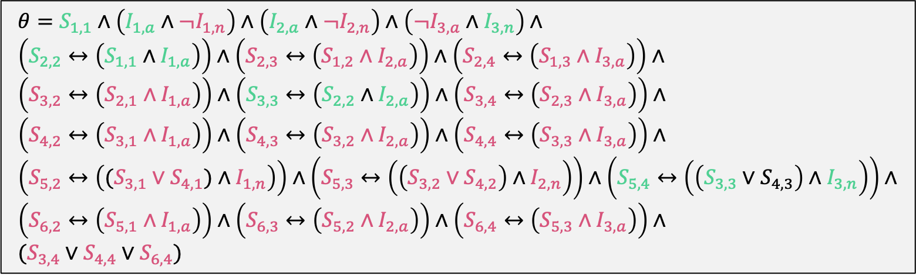
The conversion
1
A-Z
2
A-Z
3
A-Z
4
3
4
Start
Input: mr8
1-9
1-9
We can satisfy most of the clauses but we can’t get any of the final state clauses (last line) to be true!
6
A-Z
5
6
$$θ=S_{1,1}∧\left(I_{1,a}∧¬I_{1,n}\right)∧\left(I_{2,a}∧¬I_{2,n}\right)∧\left(¬I_{3,a}∧I_{3,n}\right)∧ \\ \left(S_{2,2}↔\left(S_{1,1}∧I_{1,a}\right)\right)∧\left(S_{2,3}↔\left(S_{1,2}∧I_{2,a}\right)\right)∧\left(S_{2,4}↔\left(S_{1,3}∧I_{3,a}\right)\right)∧ \\ \left(S_{3,2}↔\left(S_{2,1}∧I_{1,a}\right)\right)∧\left(S_{3,3}↔\left(S_{2,2}∧I_{2,a}\right)\right)∧\left(S_{3,4}↔\left(S_{2,3}∧I_{3,a}\right)\right)∧ \\ \left(S_{4,2}↔\left(S_{3,1}∧I_{1,a}\right)\right)∧\left(S_{4,3}↔\left(S_{3,2}∧I_{2,a}\right)\right)∧\left(S_{4,4}↔\left(S_{3,3}∧I_{3,a}\right)\right)∧ \\ \left(S_{5,2}↔\left((S_{3,1}∨S_{4,1})∧I_{1,n}\right)\right)∧\left(S_{5,3}↔\left(\left(S_{3,2}∨S_{4,2}\right)∧I_{2,n}\right)\right)∧\left(S_{5,4}↔\left(\left(S_{3,3}∨S_{4,3}\right)∧I_{3,n}\right)\right)∧ \\ \left(S_{6,2}↔\left(S_{5,1}∧I_{1,a}\right)\right)∧\left(S_{6,3}↔\left(S_{5,2}∧I_{2,a}\right)\right)∧\left(S_{6,4}↔\left(S_{5,3}∧I_{3,a}\right)\right)∧ \\ (S_{3,4}∨S_{4,4}∨S_{6,4})$$

Slide 65
Reduction Idea
Convert DFA into equivalent Boolean formula
Is mrf a valid uva computing id?
Boolean formula $θ$
Reduction Idea:
Gives us TWO different ways to “run” this program. We can run the DFA directly OR we can convert into a formula and solve the Boolean formula instead.
Run the DFA machine
Is $θ$ satisfiable?
If true, accept mrf
If false, reject mrf
Accept or Reject
mrf
True (satisfiable)
or
False (not satisfiable)

Slide 66
Other Complexity Classes

Slide 67
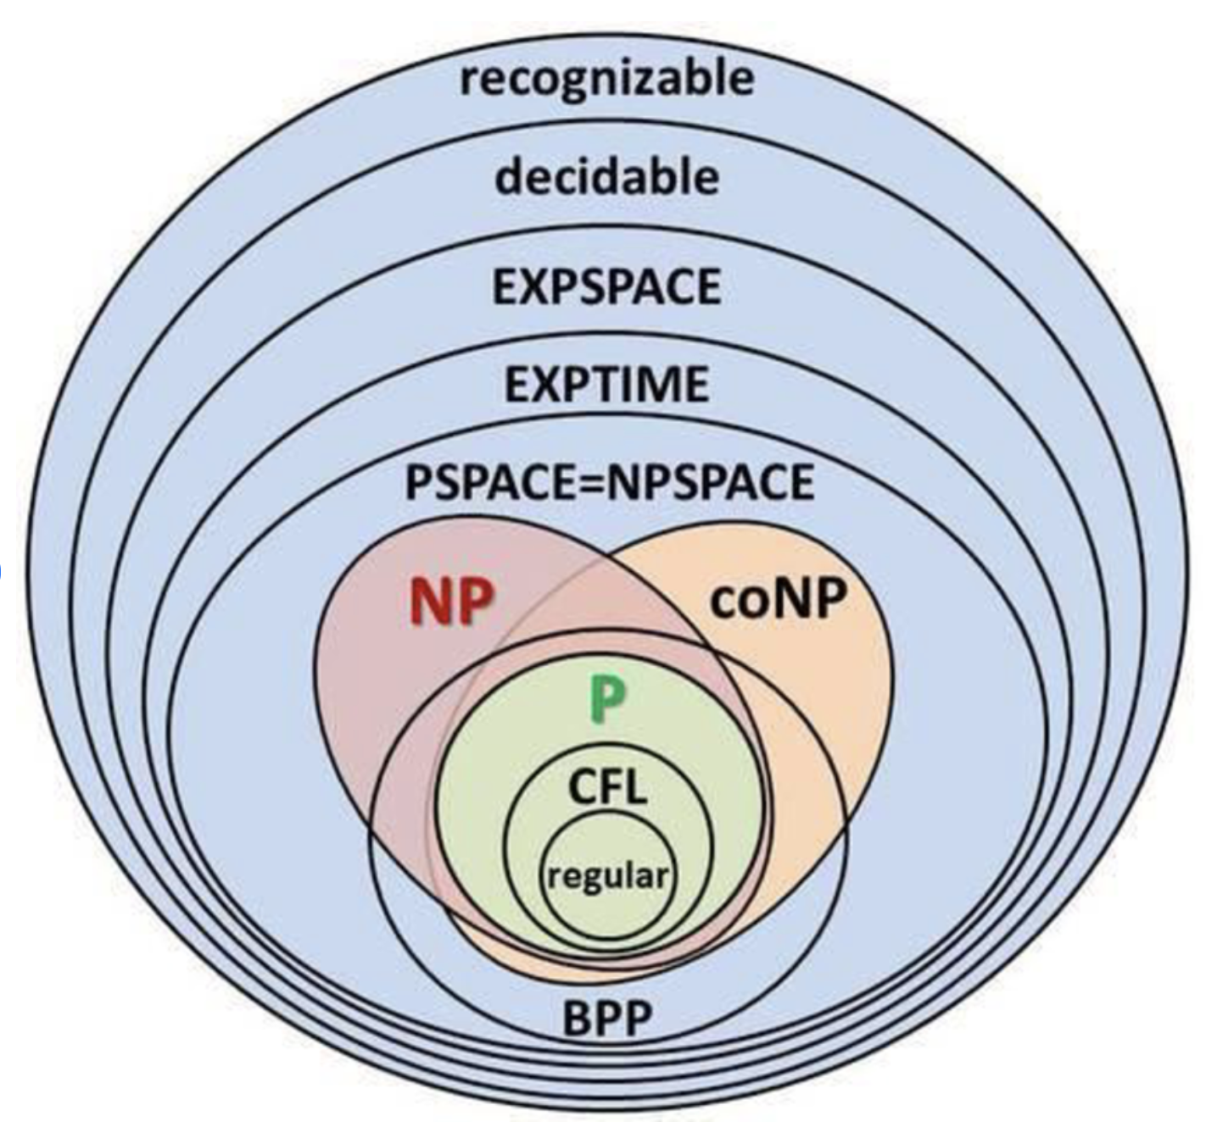
Complexity Classes

