Slide 1
Using DFS for Topological Sorting and Strongly Connected Components
CS 3100: DSA2
Mark Floryan

Slide 2
Module 1: Graphs (cont’d)

Slide 3
Topics in This Deck
Depth First Search: Another way to traverse graphs
Topological Sort: An algorithm for naturally sorting items in a graph
Strongly Connected Components: Finding patterns in a graph’s structure

Slide 4
Depth First Search (DFS)
CLRS Section 22.3 on DFS

Slide 5
DFS: Overall Strategy
Overall Idea: Search as deep as possible down one path until a dead end is reached. Back up and continue after that.
1
2
3
4
5
For example, DFS might search nodes 1,2,4,6 first. Once we hit a dead end, we will back up and search other avenues (e.g., node 5)
7
6

Slide 6
Depth-First Search: Node Colors
1
Same node colors as before; white, gray, and black:
2
3
White: This node has not been seen yet
4
5
Gray: This node has been seen but NOT processed
7
6
Black: This node has been processed (we are done with it)

Slide 7
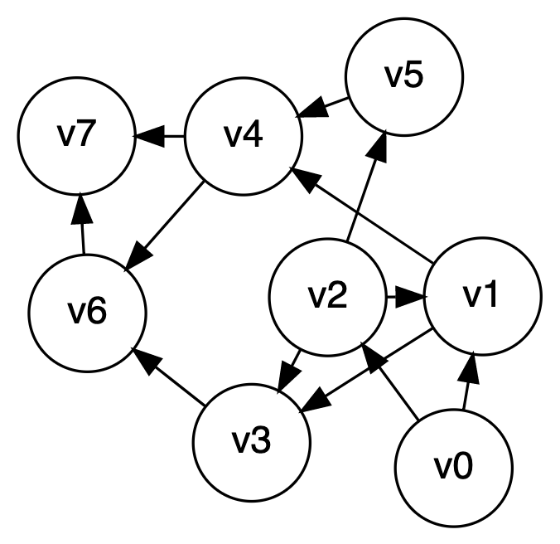
depth-first search, example

Slide 8
DFS Algorithm 1 (Recursion)
Note this “time” variable. I will explain verbally
DFS-VISIT(G, u):
time = time + 1
u.d = time
u.color = GRAY
for each v in G.Adj[u]
if v.color == WHITE
v.π = u
DFS-VISIT(G, v)
u.color = BLACK
time = time + 1
u.f = time
DFS(G):
for each vertex u in G.V
u.color = WHITE
u.π = NIL
time = 0
for each vertex u in G.V
if u.color == WHITE
DFS-VISIT(G, u)

Slide 9
DFS Algorithm 1 (Recursion)
Initialize each node to white with a “parent” of Null
DFS(G):
for each vertex u in G.V
u.color = WHITE
u.π = NIL
time = 0
for each vertex u in G.V
if u.color == WHITE
DFS-VISIT(G, u)
For each vertex, if it is still white then search it and everything it is connected to. How many times will this loop run?

Slide 10
DFS Algorithm 1 (Recursion)
Increment time by 1 and mark this node as being discovered at this time. Make the node gray also!
DFS-VISIT(G, u):
time = time + 1
u.d = time
u.color = GRAY
for each v in G.Adj[u]
if v.color == WHITE
v.π = u
DFS-VISIT(G, v)
u.color = BLACK
time = time + 1
u.f = time
Search each neighbor of u. If you find a white neighbor then recursively explore it!
We are now done with node u, so set it to black and increment the time and set the finish time

Slide 11
DFS Algorithm 1 (Recursion)
DFS-VISIT(G, u):
time = time + 1
u.d = time
u.color = GRAY
for each v in G.Adj[u]
if v.color == WHITE
v.π = u
DFS-VISIT(G, v)
u.color = BLACK
time = time + 1
u.f = time
DFS(G):
for each vertex u in G.V
u.color = WHITE
u.π = NIL
time = 0
for each vertex u in G.V
if u.color == WHITE
DFS-VISIT(G, u)
What is the runtime? Just like BFS, we get $Θ(V+E)$ time. Why?

Slide 12
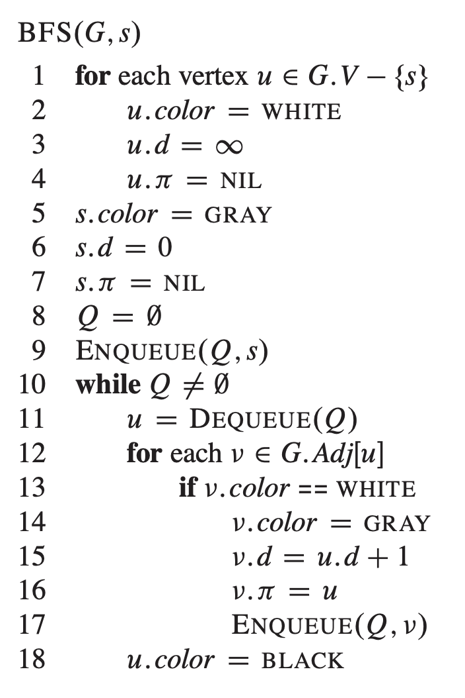
DFS Strategy 2: Use a stack
This is BFS from last time. However, if we change the queue to a stack then we get DFS!
Q=new Stack()
Push(Q,s)
Pop(Q)
Note that ‘d’ represents the start (discovery) time. Recording the finish time using the strategy is non-trivial. If we need the finish time then this is a bad algorithm to use!
Push(Q,v)

Slide 13
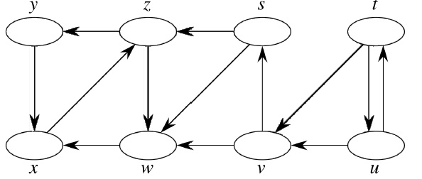
DFS Example
Source vertex: s

Slide 14
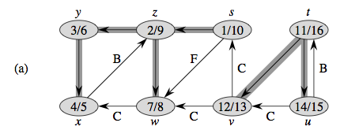
Properties of DFS Search, DFS Trees

Slide 15
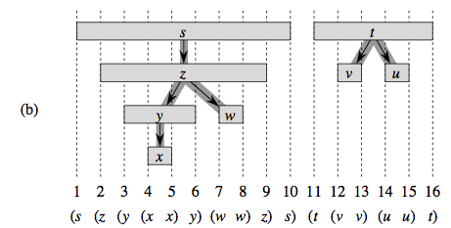
Properties of DFS Search, DFS Trees

Slide 16
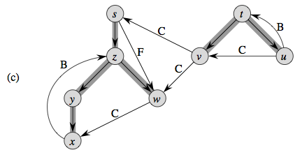
Properties of DFS Search, DFS Trees

Slide 17
Using DFS to Find Patterns In Graphs

Slide 18
Using DFS To Find A Cycle
Problem Statement: Given a graph, determine if it has a cycle or not
Any ideas on how to accomplish this? Think about the node colors that we are keeping track of!

Slide 19
Depth-first search tree
Normal DFS Edge:
X
Back Edge:
Z
Y
Descendent Edge:
Cross Edge:
W
Which edges indicate a cycle? How do we tell if we have seen this kind of edge?

Slide 20
Depth-first search tree
Finding Cycles becomes easy. Back edges always point to gray nodes and back edges are always cycles (in a direct graph)
X
DFS-VISIT(G, u):
time = time + 1
u.d = time
u.color = GRAY
for each v in G.Adj[u]
if v.color == GRAY
//FOUND A CYCLE!
if v.color == WHITE
v.π = u
DFS-VISIT(G, v)
u.color = BLACK
time = time + 1
u.f = time
Z
Y
W
There is one exception for undirected graphs…do you see it? How to deal with this?

Slide 21
Depth-first search tree
X
X
Z
Y
Z
Y
W
W
Both Decendent Edges and Cross Edges lead to black nodes and are NOT cycles. So no need to bother with them if we are looking for cycles. If we DID need to distinguish between them, how would we do it?

Slide 22
Topological Sorting
Readings: CLRS 22.4

Slide 23
Topological Sort
Given a directed acyclic graph, construct a linear ordering of the vertices such that if there is an edge from u to v, then u appears before v in the ordering.
One valid topological sort is:
V1 V6 V8 V3 V2 V7 V4 V5

Slide 24
Topological Sort
What are allowable orderings I can take all these CS classes?
Note there are many possible orderings
Unlike sorting a list

Slide 25
Getting Dressed
Underwear
Socks
Watch
Pants
Shoes
Shirt
Belt
Tie
Jacket

Slide 26
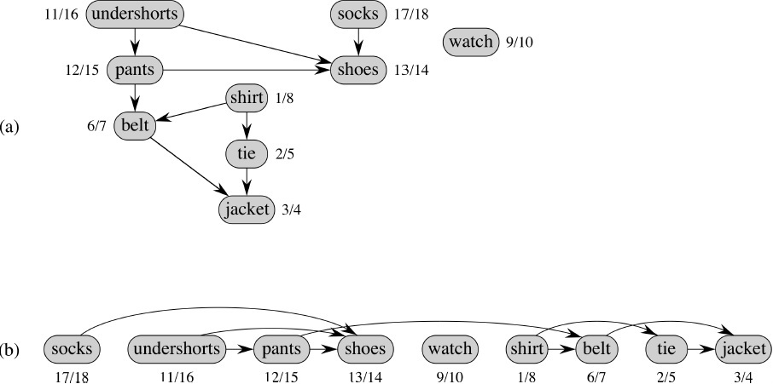
We Can Use DFS and Finish Times
Topologically sorted vertices appear in reverse order of their finish times!

Slide 27
Topological Sort Algorithm
Strategy: modify the two DFS functions so that they order nodes by finish-time in reverse order. This slide: DFS “Sweep”.
DFS(G)
0 toposort-list = [ ] // empty list
1 for each vertex u in G.V
2 u.color = WHITE
3 u.π = NIL
4 time = 0
5 for each vertex u in G.V
6 if u.color == WHITE // if unseen
DFS-VISIT(G, u) // explore paths out of u
8 // toposort-list contains the result

Slide 28
Topological Sort Algorithm
DFS-VISIT(G, u)
1 time = time + 1
2 u.d = time
3 u.color = GRAY
for each v in G.Adj[u]
if v.color == Gray
//Cycle, no valid sort!
5 if v.color == WHITE
6 v.π = u
7 DFS-VISIT(G, v)
8 u.color = BLACK
9 time = time + 1
10 u.f = time
11 toposort-list.prepend(u)
DFS(G)
0 toposort-list = [ ]
1 for each vertex u in G.V
2 u.color = WHITE
3 u.π = NIL
4 time = 0
5 for each vertex u in G.V
6 if u.color == WHITE
DFS-VISIT(G, u)
8 // toposort-list contains result
Why do we need this bit?

Slide 29
Topological Sort Algorithm
DFS-VISIT(G, u)
1 time = time + 1
2 u.d = time
3 u.color = GRAY
for each v in G.Adj[u]
if v.color == Gray
//Cycle, no valid sort!
5 if v.color == WHITE
6 v.π = u
7 DFS-VISIT(G, v)
8 u.color = BLACK
9 time = time + 1
10 u.f = time
11 toposort-list.prepend(u)
What is the topological sort of this graph?
Why do we need this bit?

Slide 30
Strongly Connected Components in a Digraph
Readings: CLRS 22.5, but you can ignore the proof-y parts

Slide 31
Strongly Connected Components (SCC)
In a directed graph, Strongly Connected Components (SCCs) are subgraphs where all vertices in each SCC are reachable from one another
A
B
C
D
E
F
G
How many SCCs does this graph have? Can you find them?

Slide 32
Strongly Connected Components (SCC)
This graph has 3 SCCs. Notice that there is a CYCLE in each component
A
B
C
D
E
F
G
Applications:
Traffic optimization
Social network analysis
Data compression
2-Satisfiability problem

Slide 33
Component Graph
A
B
C
D
c1
c2
E
F
G
c3
Component Graph: Shows each SCC as a single node. Edges represent existence of paths that cross from one SCC to another
Original Graph w/ SCCs shown

Slide 34
SCC Algorithm (Kosaraju and Sharir)
c1
c2
Key Idea: Consider a DFS on the component graph. No matter where you start the DFS you will always end up in node 3 before hitting a dead end. DFS on original graph will also end up somewhere in component 3 before hitting the dead end. After back up, the node with the highest finish time MUST be in c1.
c3

Slide 35
SCC Algorithm (Kosaraju and Sharir)
11/12
9/14
1/8
6/7
A
B
C
D
Key Idea: Consider a DFS on the component graph. No matter where you start the DFS you will always end up in node 3 before hitting a dead end. DFS on original graph will also end up somewhere in component 3 before hitting the dead end. After back up, the node with the highest finish time MUST be in c1.
10/13
3/4
2/5
E
F
G
Times shown as:
Start / Finish
Notice that all of the highest finish times are in component 1 (blue)

Slide 36
SCC Algorithm (Kosaraju and Sharir)
Highest finish time is node B (finish time of 14). This node is guaranteed to be in the topologically first SCC.
We now want to explore the blue SCC (by running a DFS on B). However, we will exit the SCC when we follow one of the black edges. How do we avoid this!?
11/12
9/14
1/8
6/7
A
B
C
D
10/13
3/4
2/5
E
F
G
Times shown as:
Start / Finish

Slide 37
SCC Algorithm (Kosaraju and Sharir)
Transpose Graph: Flip all of the edges of the graph to point in the other direction!
Notice we can still reach every node in an SCC from every other node in same SCC
11/12
9/14
1/8
6/7
A
B
C
D
But…we can no longer LEAVE the top level SCC (blue one)
10/13
3/4
2/5
E
F
G
Times shown as:
Start / Finish

Slide 38
SCC Algorithm (Kosaraju and Sharir)
Overall Algorithm:
Run DFS on Graph G
Compute Transpose graph G’
Call DFS again on G’
Within DFS, nodes explored by each sub-call to DFS-Visit represents one SCC

Slide 39
What Did we learn in this deck?
Depth First Search: Another way to traverse graphs
Topological Sort: An algorithm for naturally sorting items in a graph
Strongly Connected Components: Finding patterns in a graph’s structure

