Slide 1
Kruskal’s MST and Find-Union Data Structure
CS 3100
Mark Floryan
CLRS 21.1-21.4, 23.2

Slide 2
Topics

Slide 3
Topics in this slide-deck:
Minimum Spanning Trees: This is a graph problem, and you’ve seen it already
Another Solution: Kruskal’s Algorithm (Uses a find-union structure)
Find-Union Data Structure: Define and design the find-union to support Kruskal’s Algorithm…will require some clever implementation details

Slide 4
Minimum Spanning Trees

Slide 5
REMINDER: Minimum Spanning Tree
A minimum spanning tree of a weighted graph G is the spanning tree that has the lowest overall cost (sum of the cost of the edges in the spanning tree)
Original Graph:
3
8
MST:
3
4
6
4
6
5
5

Slide 6
Kruskal’s Algorithm

Slide 7
Kruskal’s MST Algorithm
Idea: Grow a forest out of edges that do not create a cycle. Pick an edge with the smallest weight.
Edges that exist across trees are candidate edges. We will add the cheapest one to our solution
Algorithm maintains a forest (made up of individual trees)
An edge that is within a single tree creates a cycle and is NOT a candidate edge

Slide 8







Example Execution
$$v_{0}$$
2
$$v_{1}$$
4
1
3
10
2
7
$$v_{4}$$
$$v_{2}$$
$$v_{3}$$
8
4
5
6
$$v_{5}$$
1
$$v_{6}$$

Slide 9
Kruskal code
void Graph::kruskal():
int edgesAccepted = 0
DisjSet s(NUM_VERTICES)
PriorityQueue Q()
Add all edges of graph by cost to Q
while (edgesAccepted < NUM_VERTICES – 1):
e = Q.dequeue()
// edge e = (u, v)
uset = s.find(u)
vset = s.find(v)
if (uset != vset):
edgesAccepted++
s.unionSets(uset, vset)
|E| heap ops
2|E| finds
|V| unions

Slide 10

Kruskal code
void Graph::kruskal():
int edgesAccepted = 0
DisjSet s(NUM_VERTICES)
PriorityQueue Q()
Add all edges of graph by cost to Q
while (edgesAccepted < NUM_VERTICES – 1):
e = Q.dequeue()
// edge e = (u, v)
uset = s.find(u)
vset = s.find(v)
if (uset != vset):
edgesAccepted++
s.unionSets(uset, vset)
Run time:
Let f(V) be time of find, and u(V) be time of union.
$$Θ\left(E∗2f\left(v\right)+V∗u(v)\right)$$

Slide 11
Find-Union Data Structure

Slide 12
Union/Find and Disjoint Sets
Needs to support the following operations:
void makeSet(int n) //construct n independent sets
int findSet(int i) //given i, which set does i belong to
void union(int i, int j) //merge sets containing i and j

Slide 13
Union/Find and Disjoint Sets
Needs to support the following operations:
void makeSet(int n) //construct n independent sets
Solution:
Store as array of size n. Each location stores label for that set.
0 1 2 3 4 5 6 7
0 1 2 3 4 5 6 7

Slide 14
Union/Find and Disjoint Sets
Needs to support the following operations:
void union(int i, int j) //merge sets containing i and j
Solution: find label for each set (call find() method), then set one label to point to other
Label1 = find(i) Label2 = find(j)
a[Label1] = Label2 //OR a[Label2] = Label1
0 1 2 3 5 5 6 7
0 1 2 3 4 5 6 7

Slide 15
Union/Find and Disjoint Sets
Needs to support the following operations:
int findSet(int i) //given i, which set does i belong to
Solution: Trace around array until we find place where index and contents match
Start at index i and repeat:
If a[i] == i then return i
Else set i = a[i]
0 2 4 3 5 5 6 7
0 1 2 3 4 5 6 7

Slide 16
Union/Find and Disjoint Sets
Example:
merge(4,5)
merge(6,7)
merge(1,2)
merge(5,6)
find(1); find(4); find(6)
0 1 1 3 4 4 4 6
0 1 2 3 4 5 6 7

Slide 17
Union/Find and Disjoint Sets
Time-complexity if where n is size of array?
makeSet()
Linear: just create array and fill it with values
One time only, so not a big problem
find()
Linear if have to trace a long way to get to label
Constant if lucky and label given as input
union()
Constant to change the label BUT…
Could be linear to find the two labels first.

Slide 18
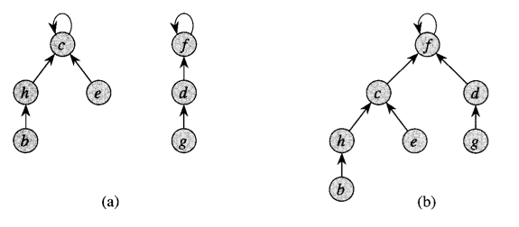
Optimization 1: Union by rank

Slide 19
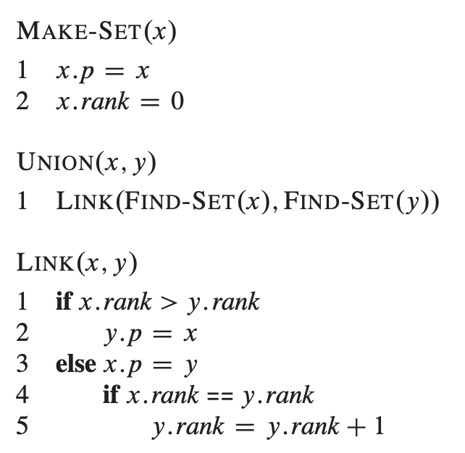
Optimization 1: Union by rank
Easy to implement!!

Slide 20
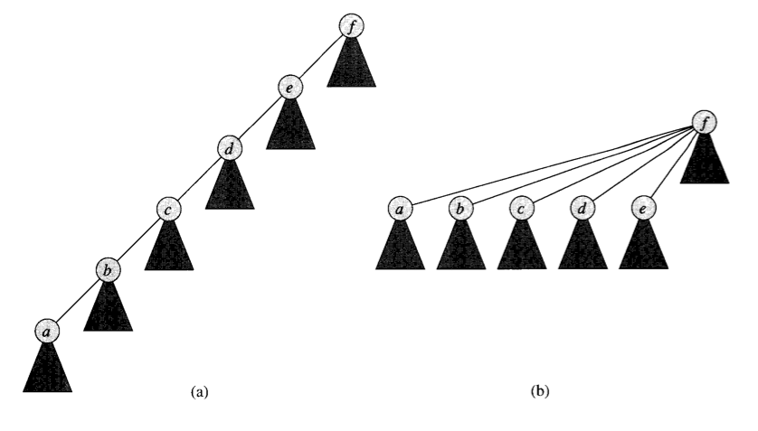
Optimization 2: Path Compression

Slide 21
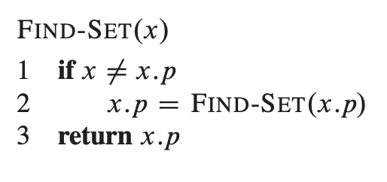
Optimization 2: Path Compression
Also easy to implement

Slide 22

Complexity for Kruskal’s
Union-by-rank and path compression yields m operations in $Θ\left(m∗α\left(n\right)\right)$
where $α\left(n\right)$ a VERY slowly growing function. (See textbook for details)
m is the number of times you run the operation. So constant time, for each operation
So Kruskal’s overall:
$Θ\left(E∗\log\left(V\right)+E∗1\right)=Θ(E∗\log\left(V\right))$ //now the heap is slowest part

Slide 23
Summary

Slide 24
What did we learn?
Minimum Spanning Trees
Review!
Kruskal’s Algorithm
Different Algorithm for MST!
Find-union
How to implement
How to optimize
How it affects runtime of Kruskal’s algorithm.

