Slide 1
Divide and Conquer Algorithms
CS3100

Slide 2
Module 3: Divide and Conquer

Slide 3
Topics
Algorithm Design Strategy: Divide and Conquer
Simple Examples:
Mergesort and MaxSum
Solving Recurrence Relations
Four different Strategies
Advanced Div. and Con. Examples:
Closest Pair of Points
QuickSelect
Strassen’s Algorithm

Slide 4
Divide & Conquer

Slide 5
Divide and Conquer: A Strategy
Our first design strategy: Divide and Conquer
Often recursive, at least in definition
Strategy:
Break a problem into 1 or more smaller subproblems that are identical in nature to the original problem
Solve these subproblems (recursively)
Combine the results for the subproblems (somehow) to produce a solution to original problem
Note the assumption:
We can solve original problem given subproblems’ solutions

Slide 6
Design Strategy: Divide and Conquer
It is often easier to solve several small instances of a problem than one large one.
divide the problem into smaller instances of the same problem
solve (conquer) the smaller instances recursively
combine the solutions to obtain the solution for original input
Must be able to solve one or more small inputs directly
Solve(I)
n = size(I)
if (n <= smallsize)
solution = directlySolve(I);
else
divide I into I₁, …, I_{k}.
for each i in {1, …, k}
S_{i} = solve(I_{i});
solution = combine(S₁, …, S_{k});
return solution;

Slide 7
Why Divide and Conquer?
Sometimes it’s the simplest approach
Divide and Conquer is often more efficient than “obvious” approaches
E.g. Mergesort, Quicksort
But, not necessarily efficient
Might be the same or worse than another approach
Must analyze cost
Note: divide and conquer may or may not be implemented recursively

Slide 8
Cost for a Divide & Conquer Algorithm
Perhaps there is…
A cost for dividing into sub problems
A cost for solving each of several subproblems
A cost to combine results
So (for n > smallSize)
T(n) = D(n) + ΣT(size(Ii)) + C(n)
often rewritten as: T(n) = a T(n/b) + f(n)
These formulas are recurrence relations

Slide 9
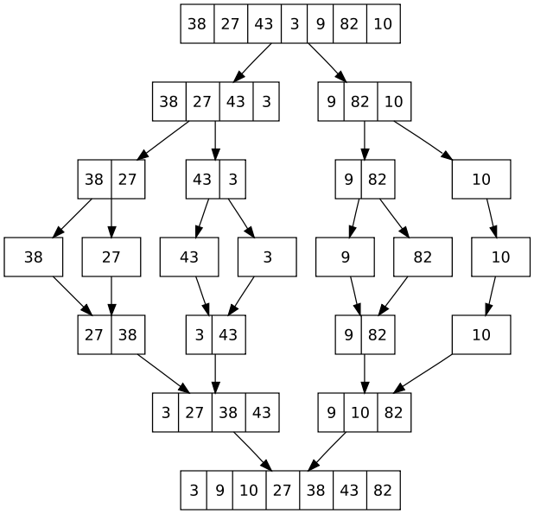
Mergesort is Classic Divide & Conquer
Mergesort Strategy:

Slide 10
Algorithm: Mergesort
Specification:
Input: Array E and indexes first and last, such that the elements E[i] are defined for first <= i <= last.
Output: E[first], …, E[last] is sorted rearrangement of the same elements
Algorithm:
def mergesort(list, first, last):
if first < last:
mid = (first+last)/2
mergesort(list, first, mid)
mergesort(list, mid+1, last)
merge(list, first, mid, last) # merge 2 halves
return

Slide 11
Simple Exam: Find Max

Slide 12
Exercise: Find Max AND Second Max
Given a list of elements, find both the maximum element and second maximum element (assume integers)
Obvious solution:
Consider first two elements to be first and second max
Loop through indices 3 through end of array and update max and second max if necessary.
Another way:
Write a recursive function that solves this using divide and conquer.
Prototype: (int, int) FindMax (list, first, last);
Base case(s)? Subproblems? How to combine results?

Slide 13
Exercise: Find Max AND Second Max
Div. and Con. Solution:
Base Case?
N=1? N=2? N=3?
Divide:
Split list in half
Combine:
Take 4 numbers (left max / max2 and right max / max2). How to combine?

Slide 14
Recursive calls are OF THE SAME FORM
FindMax(list, 0, n)
[x₀, x₁, x₂, …, x_{n}]
FindMax(list, 0, n/2)
[x₁, …, x_{n/2}]
FindMax(list, n/2+1, n)
[x_{n/2+1}, …, x_{n}]
A LOT MORE RECURSION HAPPENS HERE
max1, max2
combine()
return real max1, max2
max1, max2

Slide 15
Solution
Base Case?
When n is small (say, n<=3), just manually check and return two largest values
What would happen if we let n=1 during recursion? Can we solve that issue?
Divide:
Split list in half and make two recursive calls
Combine:
Manually find two largest values of the four returned. Largest of the four is largest overall, second largest overall is second largest overall.

Slide 16
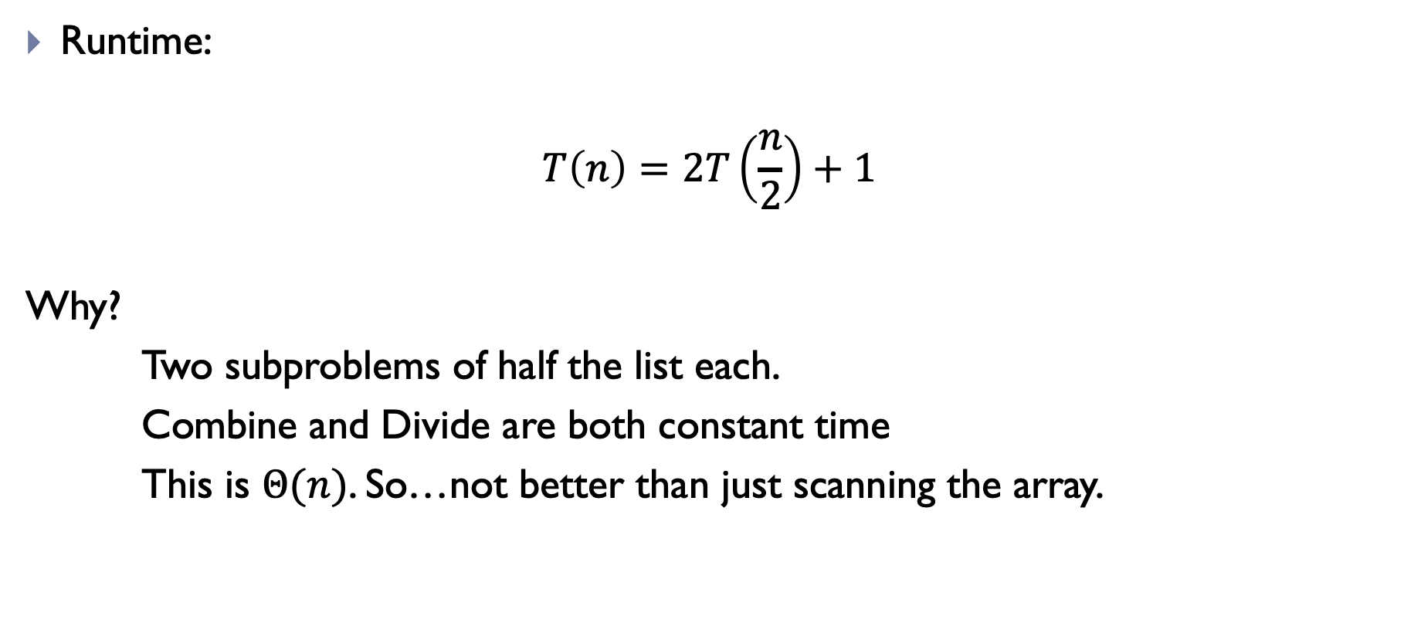
Exercise: Find Max AND Second Max
Runtime:
$$T\left(n\right)=2T\left(\frac{n}{2}\right)+1$$
Why?
Two subproblems of half the list each.
Combine and Divide are both constant time
This is $Θ(n)$. So…not better than just scanning the array.

Slide 17
Another Example: Maximum Subarray

Slide 18
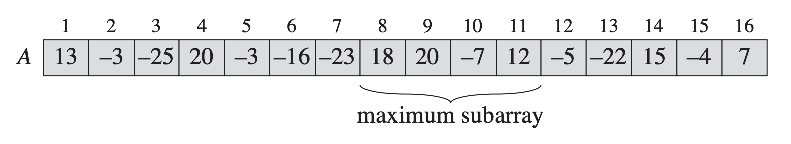
Maximum Subarray Problem
Given a list A of positive and negative integers
Return the indices i and j such that:
i <= j
0 <= i, j <= A.length
A[i…j] maximizes sum of elements in range i, j
Example:

Slide 19
Brute-Force
Given every i, j combination with i <= j
Iterate from A[i] to A[j] to compute sum
Keep track of best sum seen so far
Return best sum we see
Runtime: n^3

Slide 20
Better Brute-Force
Slightly better:
Store sums from A[0] to A[i] in separate array at position i
For every i and j
Sum A[i…j] = Sums[j] – Sums[i-1]
Runtime: n^2

Slide 21
Can we do better?
Let’s use divide-and-conquer to get an nlogn runtime
Recurrence we want:
T(n) = 2T(n/2) + n //just like mergesort

Slide 22
Can we do better?
IDEA:
MaxSum(A):
Divide list in half
Recursively find MaxSum(A_left) and MaxSum(A_right)
Return best of these two solutions
Problem! Solution could be across the dividing line!

Slide 23
Can we do better?
Ok, so find best solution that crosses the dividing line
How? Let’s call it MaxSum_Divide
Once we do that, solution will be
Max(MaxSum(A_left), MaxSum(A_right), MaxSum_Divide)

Slide 24
How to find MaxSum_Divide
Needs to be in linear time:

Slide 25
How to find MaxSum_Divide
Needs to be in linear time:
Accumulate sum from array as we move left from dividing line
…
-21
-5
18

Slide 26
How to find MaxSum_Divide
Needs to be in linear time:
Accumulate sum from array as we move left from dividing line
Best is 18. this takes linear time!
-19
-32
-29
-4
-24
-21
-5
18

Slide 27
How to find MaxSum_Divide
Needs to be in linear time:
Accumulate sum from array as we move left from dividing line
Best is 18. this takes linear time!
Do same on this side…best is 25
-19
-32
-29
-4
-24
-21
-5
18
20
13
25
20
-2
13
9
16

Slide 28
How to find MaxSum_Divide
Needs to be in linear time:
Best overall that divides the line is best two concatenated
18
20
13
25
REMEMBER! Best solution is not necessarily one that crosses the line! Might be solution on left, solution on right, OR solution that crosses divide line. Return the highest of all three!

Slide 29
How to find MaxSum_Divide
Intuition:
Best solution that crosses divide MUST be made up of array on left side that bumps up against divide and array on right side that bumps into divide.
So:
Start at A[mid-1] and sum all the way down to A[0], keeping track of the best sum
Start at A[mid] and work up to A[A.length-1] and keep track of best sum along the way
Simply concatenate these two arrays to one another for MaxSum_Divide

Slide 30
Divide and Conquer: Bottom-line
Powerful technique for a wide array of problems
Don’t let a lot of “extra” work fool you:
Sometimes recursive pays off
But you need to know when
Algorithm analysis!

