Slide 1
Strassen’s Algorithm and Trominos
CS 3100 – DSA2
Mark Floryan

Slide 2
Matrix Multiplication

Slide 3

Matrix Multiplication
$$n$$
$$\left[\begin{matrix}1 & 2 & 3 \\ 4 & 5 & 6 \\ 7 & 8 & 9\end{matrix}\right]×\left[\begin{matrix}2 & 4 & 6 \\ 8 & 10 & 12 \\ 14 & 16 & 18\end{matrix}\right]$$
$$n$$
$$=\left[\begin{matrix}2+16+42 & 4+20+48 & 6+24+54 \\ ⋅ & ⋅ & ⋅ \\ ⋅ & ⋅ & ⋅\end{matrix}\right]$$
$$=\left[\begin{matrix}60 & 72 & 84 \\ 132 & 162 & 192 \\ 204 & 252 & 300\end{matrix}\right]$$
Run time?
$$O(n^{3})$$
Lower Bound?
$$Ω\left(n^{2}\right)$$

Slide 4
Matrix Multiplication D&C
Multiply $n×n$ matrices ($A$ and $B$)
Divide:
$$A=\left[\begin{matrix}a_{1} & a_{2} & a_{3} & a_{4} \\ a_{5} & a_{6} & a_{7} & a_{8} \\ a_{9} & a_{10} & a_{11} & a_{12} \\ a_{13} & a_{14} & a_{15} & a_{16}\end{matrix}\right]$$
$$B=\left[\begin{matrix}b_{1} & b_{2} & b_{3} & b_{4} \\ b_{5} & b_{6} & b_{7} & b_{8} \\ b_{9} & b_{10} & b_{11} & b_{12} \\ b_{13} & b_{14} & b_{15} & b_{16}\end{matrix}\right]$$

Slide 5
Matrix Multiplication D&C
Multiply $n×n$ matrices ($A$ and $B$)
$$A=\left[\begin{matrix}a_{1} & a_{2} & a_{3} & a_{4} \\ a_{5} & a_{6} & a_{7} & a_{8} \\ a_{9} & a_{10} & a_{11} & a_{12} \\ a_{13} & a_{14} & a_{15} & a_{16}\end{matrix}\right]$$
$$A_{1,1}$$
$$A_{1,2}$$
$$B=\left[\begin{matrix}b_{1} & b_{2} & b_{3} & b_{4} \\ b_{5} & b_{6} & b_{7} & b_{8} \\ b_{9} & b_{10} & b_{11} & b_{12} \\ b_{13} & b_{14} & b_{15} & b_{16}\end{matrix}\right]$$
$$B_{1,1}$$
$$B_{1,2}$$
$$A_{2,1}$$
$$A_{2,2}$$
$$B_{2,1}$$
$$B_{2,2}$$
Combine:
$$AB=\left[\begin{matrix}A_{1,1}B_{1,1}+A_{1,2}B_{2,1} & A_{1,1}B_{1,2}+A_{1,2}B_{2,2} \\ A_{2,1}B_{1,1}+A_{2,2}B_{2,1} & A_{2,1}B_{1,2}+A_{2,2}B_{2,2}\end{matrix}\right]$$
$$T\left(n\right)=8T\left(\frac{n}{2}\right)+4{\left(\frac{n}{2}\right)}^{2}$$
Case 1!
Run time?
$$T\left(n\right)=Θ(n^{3})$$

Slide 6
Find an Algorithm with Better Recurrence?
$$T\left(n\right)=8T\left(\frac{n}{2}\right)+4{\left(\frac{n}{2}\right)}^{2}$$
We’ve got a recurrence and want to improve things. You know how the Master Theorem works. What can we change to make it better?
Reduce the number of subproblems.
Reduce the order class of the non-recursive work. (OK to do more non-recursive work if new f(n) is same $Θ$)

Slide 7
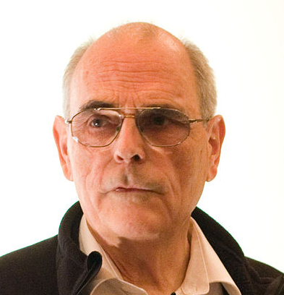
Strassen’s Algorithm
Multiply $n×n$ matrices ($A$ and $B$)
$$A=\left[\begin{matrix}a_{1} & a_{2} & a_{3} & a_{4} \\ a_{5} & a_{6} & a_{7} & a_{8} \\ a_{9} & a_{10} & a_{11} & a_{12} \\ a_{13} & a_{14} & a_{15} & a_{16}\end{matrix}\right]$$
$$A_{1,1}$$
$$A_{1,2}$$
$$B=\left[\begin{matrix}b_{1} & b_{2} & b_{3} & b_{4} \\ b_{5} & b_{6} & b_{7} & b_{8} \\ b_{9} & b_{10} & b_{11} & b_{12} \\ b_{13} & b_{14} & b_{15} & b_{16}\end{matrix}\right]$$
$$B_{1,1}$$
$$B_{1,2}$$
$$A_{2,1}$$
$$A_{2,2}$$
$$B_{2,1}$$
$$B_{2,2}$$
Calculate:
Find $AB$:
$$Q_{1}=\left(A_{1,1}+A_{2,2}\right)(B_{1,1}+B_{2,2})$$
$$\left[\begin{matrix}A_{1,1}B_{1,1}+A_{1,2}B_{2,1} & A_{1,1}B_{1,2}+A_{1,2}B_{2,2} \\ A_{2,1}B_{1,1}+A_{2,2}B_{2,1} & A_{2,1}B_{1,2}+A_{2,2}B_{2,2}\end{matrix}\right]$$
$$Q_{2}=\left(A_{2,1}+A_{2,2}\right)B_{1,1}$$
$$Q_{3}=A_{1,1}(B_{1,2} −B_{2,2})$$
$$=$$
$$Q_{4}=A_{2,2}(B_{2,1}−B_{1,1})$$
$$\left[\begin{matrix}Q_{1}+Q_{4}−Q_{5}+Q_{7} & Q_{3}+Q_{5} \\ Q_{2}+Q_{4} & Q_{1}−Q_{2}+Q_{3}+Q_{6}\end{matrix}\right]$$
$$Q_{5}=\left(A_{1,1}+A_{1,2}\right)B_{2,2}$$
$$Q_{6}=\left(A_{2,1}−A_{1,1}\right)(B_{1,1}+B_{1,2})$$
Number Mults.: 7
Number Adds: 18
$$Q_{7}=\left(A_{1,2}−A_{2,2}\right)(B_{2,1}+B_{2,2})$$
$$T\left(n\right)=7T\left(\frac{n}{2}\right)+18{\left(\frac{n}{2}\right)}^{2}$$

Slide 8
Strassen’s Algorithm
$$T\left(n\right)=7T\left(\frac{n}{2}\right)+\frac{9}{2}n^{2}$$
$$a=7, b=2, f\left(n\right)={\frac{9}{2}n}^{2}$$
$$n^{\log_{b}{a}}=n^{\log_{2}{7}}≈n^{2.807}$$
Case 1!
$$T\left(n\right)=Θ\left(n^{\log_{2}{7}}\right)≈Θ(n^{2.807})$$

Slide 9
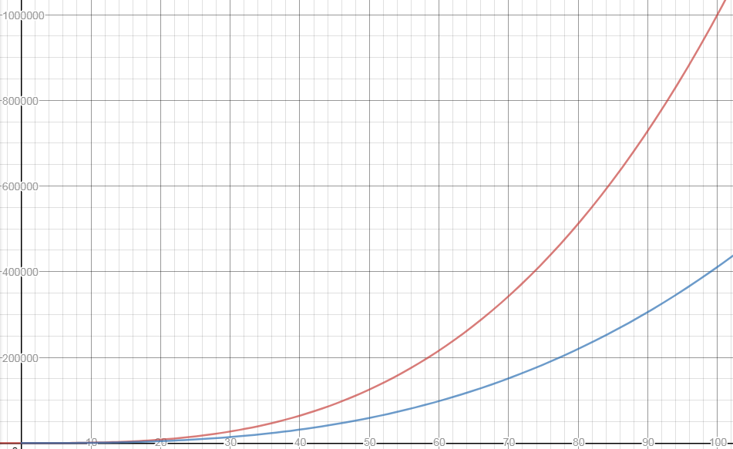
$$n^{3}$$
$$n^{\log_{2}{7}}$$

Slide 10
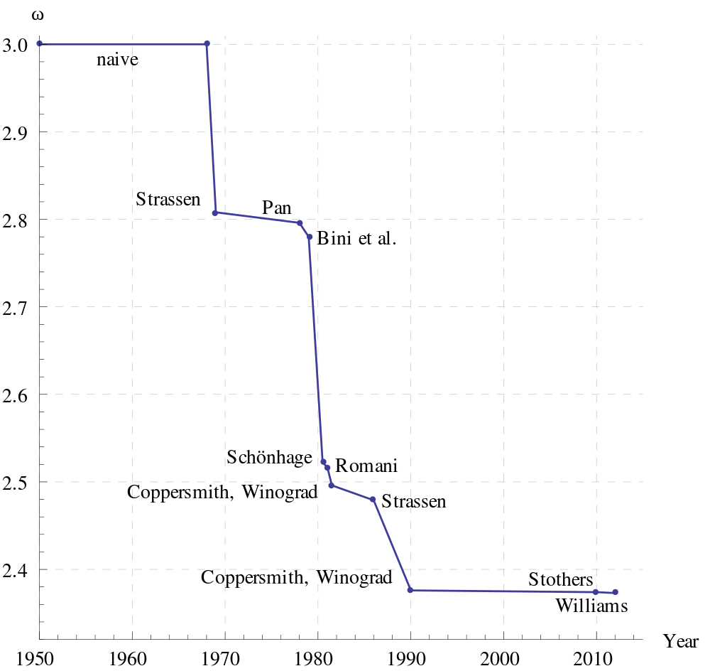
Is this the fastest?
Best possible is unknown
May not even exist!

Slide 11
Trominoes

Slide 12
Next Example: Trominos
Tiling problems
For us, a game: Trominos
In “real” life: serious tiling problems regarding component layout on VLSI chips
Definitions
Tromino
A deficient board
n x n where n = 2^{k}
exactly one square missing
Problem statement:
Given a deficient board, tile it with trominos
Exact covering, no overlap

Slide 13
Trominos: Playing the Game, Strategy
Java app for Trominos: http://www3.amherst.edu/~nstarr/puzzle.html
How can we approach this problem using Divide and Conquer?
Small solutions: Can we solve them directly?
Yes: 2 x 2 board
Next larger problem: 4 x 4 board
Hmm, need to divide it
Four 2 x 2 boards
Only one of these four has the missing square
Solve it directly!
What about the other three?

Slide 14
Trominos: Key to the Solution
Place one tromino where three 2 x 2 boards connect
You now have three 2 x 2 deficient boards
Solve directly!
General solution for deficient board of size n
Divide into four boards
Identify the smaller board that has the removed tile
Place one tromino that covers the corner of the other three
Now recursively process all four deficient boards
Don’t forget! First, check for n==2

Slide 15
Input Parameters: n, a power of 2 (the board size);
the location L of the missing square
Output Parameters: None
tile(n,L) {
if (n == 2) {
// the board is a right tromino T
tile with T
return
}
divide the board into four n/2 × n/2 subboards
place one tromino as in Figure 5.1.4(b)
// each of the 1 × 1 squares in this tromino
// is considered as missing
let m₁,m₂,m₃,m₄ be the locations of the missing squares
tile(n/2,m₁)
tile(n/2,m₂)
tile(n/2,m₃)
tile(n/2,m₄)
}

Slide 16
Trominos: Analysis
What do we count? What’s the basic operation?
Note we place a tromino and it stays put
No loops or conditionals other than placing a tile
Assume placing or drawing a tromino is constant
Assume that finding which subproblem has the missing tile is constant
Conclusion: we can just count how many trominos are placed
How many fit on a n x n board?
(n² – 1) / 3
Do you think this optimal?

Slide 17
Trominos: Analysis
Runtime?
If ‘n’ is the size of one board dimension (nxn board)
4 subproblems of size n/2 x n/2
O(1) to place one tromino “across the cuts” and “combine”
T(n) = 4T(n/2) + 1 = ??
Also, think intuitively. There are n^2 board spaces and each “round” you are placing one tromino (3 spaces)
So at least n^2 / 3 JUST to place the Trominos

