Slide 1
Greedy Algorithms Introduction / Making Change
CS 3100 – DSA2
Mark Floryan

Slide 2
CLRS Readings
Chapter 16, Greedy Algorithms

Slide 3
Topics
Greedy Algorithms: Our next algorithmic technique
How to analyze problems with greedy solutions:
Optimal substructure property
Greedy choice property
Proving correctness of greedy algorithms
First example problem:
Coin Change

Slide 4
Optimization Problems
Greedy algorithms can (sometimes) solve optimization problems:
Find the best solution among all feasible solutions
An example you know: Find the shortest path in a weighted graph G from s to v
Form of the solution: a path (and sum of its edge-weights)
Feasible solutions must meet problem constraints
Example: All edges in solution are in graph G and form a simple path from s to v
We can get a score for each feasible solution on some criteria:
We call this the objective function
Example: the sum of the edge weights in path
One (or more) feasible solutions that scores highest (by the objective function) is the optimal solution(s)

Slide 5
Coin Change, Optimal Substructure, and the Greedy Choice Property

Slide 6
Goals!
First problem with a greedy algorithm solution (Coin Change!)
What is optimal substructure? Why is it useful?
Making a greedy choice to solve the problem
What is the greedy choice property?

Slide 7
Everyone Already Knows Many Algorithms!
Worked retail? You know how to make change!
Example:
My item costs $4.37. I give you a five dollar bill. What do you give me in change?
Answer: two quarters, a dime, three pennies
Why? How do we figure that out?

Slide 8
Making Change
Inputs: the dollar-amount A to return and set of coins
Output: a set of coins
Feasible Solution: Any set of coins that makes exactly A cents
Optimal Solution: The feasible solution with fewest coins!
Brute Force Algorithm: Loop through all feasible solutions. How many are there?
What is the algorithm we use here?

Slide 9
Optimal Substructure
This problem has optimal substructure
Optimal Substructure: If given an optimal solution to the larger problem, it can be seen to be made up of optimal solutions to smaller versions of the same problem.
e.g., Optimal solution for giving 15 cents of change contains within it the optimal set of coins to make 5 cents of change (because a dime is part of the solution for 15 cents)
Another way of stating it: If A is an optimal solution to a problem, then the components of A are optimal solutions to subproblems

Slide 10
Optimal Substructure
This problem has optimal substructure
Lemma 1: If a problem has optimal substructure, then a greedy algorithm MIGHT solve it (but not necessarily).
Lemma 2: If a greedy algorithm solves the problem, then it has optimal substructure.
Lesson: Check for optimal substructure to see if a greedy algorithm MIGHT be applicable. Also gives hints as to what the algorithm might be!!

Slide 11
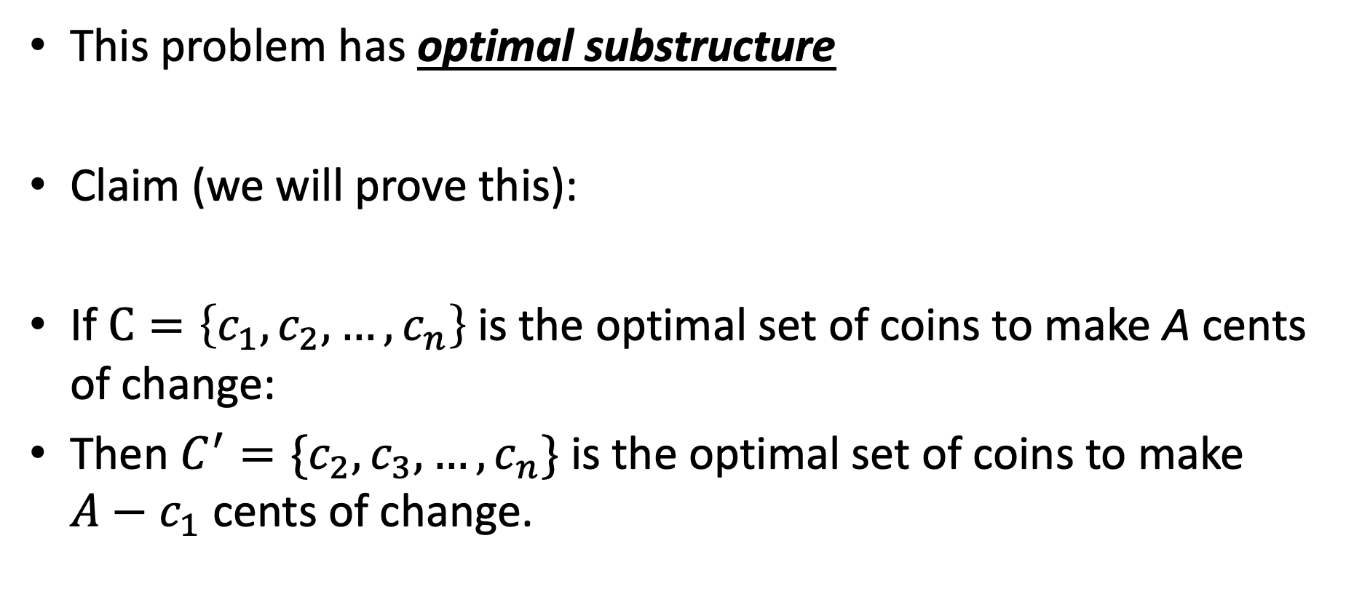
Optimal Substructure
This problem has optimal substructure
Claim (we will prove this):
If $C=\left\{c_{1},c_{2},…,c_{n}\right\}$is the optimal set of coins to make A cents of change:
Then $C^{′}=\{c_{2},c_{3},…,c_{n}\}$ is the optimal set of coins to make $A−c_{1}$ cents of change.

Slide 12
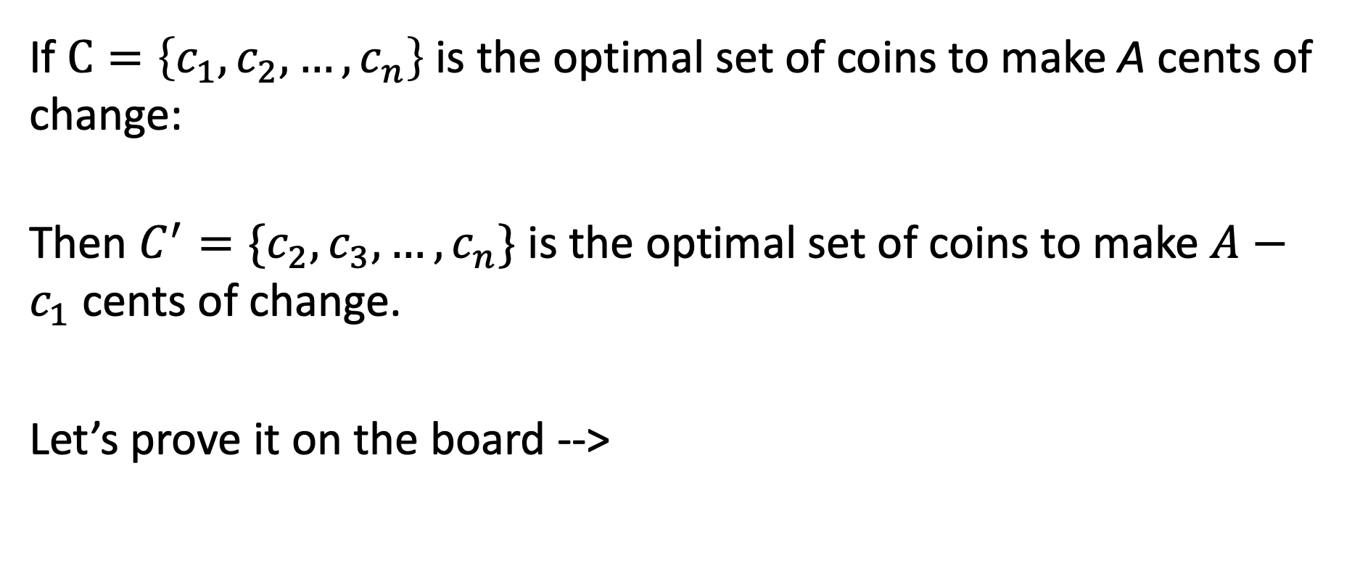
Proof
If $C=\left\{c_{1},c_{2},…,c_{n}\right\}$is the optimal set of coins to make A cents of change:
Then $C^{′}=\{c_{2},c_{3},…,c_{n}\}$ is the optimal set of coins to make $A−c_{1}$ cents of change.
Let’s prove it on the board -->

Slide 13
Need more on Optimal Substructure Property?
Detailed discussion on p. 379 of CLRS (chapter on Dynamic Programming)
If A is an optimal solution to a problem, then the components of A are optimal solutions to subproblems
Another example: Shortest Path in graph problem
Say P is min-length path from CHO to LA and includes DAL
Let P₁ be component of P from CHO to DAL, and P₂ be component of P from DAL to LA
P₁ must be shortest path from CHO to DAL, and P₂ must be shortest path from DAL to LA
Why is this true? Can you prove it? Yes, by contradiction. (Try this at home!)

Slide 14
A Change Algorithm
Consider the largest coin
How many go into the amount left?
Add that many of that coin to the output
Subtract the amount for those coins from the amount left to return
If the amount left is zero, done!
If not, consider next largest coin, and go back to Step 2
Notes:
Will this always finish? Yes, because we have pennies!

Slide 15
Evaluating Our Greedy Algorithm
How much work does it do?
Say C is the amount of change, and N is the number of coins in our coin-set
Loop at most N times, and inside the loop we do:
A division
Add something to the output list
A subtraction, and a test
We say this is O(N), or linear in terms of the size of the coin-set
Could we do better?
Is this an optimal algorithm?
We need to do a proof somehow to show this

Slide 16
Algorithm for making change
This algorithm makes change for an amount A using coins of denominations
denom[1] > denom[2] > ··· > denom[n] = 1.
Input Parameters: denom, A
Output Parameters: None
greedy_coin_change(denom, A) {
i = 1
while (A > 0) {
c = A / denom[i]
println(“use ” + c + “ coins of denomination ” + denom[i])
A = A - c * denom[i]
i = i + 1
}
}

Slide 17
Summary So Far
Done
We’ve shown the Coin Change Problem has Optimal Substructure
We’ve presented a Greedy Algorithm that MIGHT solve it
Up Next:
Prove that the greedy algorithm is correct.

Slide 18
Making change proof
One methodology for proving correctness of greedy algorithms:
A greedy algorithm is correct if the following hold:
The problem has optimal substructure
The algorithm has the greedy choice property (see next slide)

Slide 19
Making change proof
What is the greedy choice property?
Your algorithm makes some greedy choice and then continues
e.g., choose largest coin, then continue
Prove that the one thing the greedy algorithm selects MUST be in some optimal solution to the problem.

Slide 20
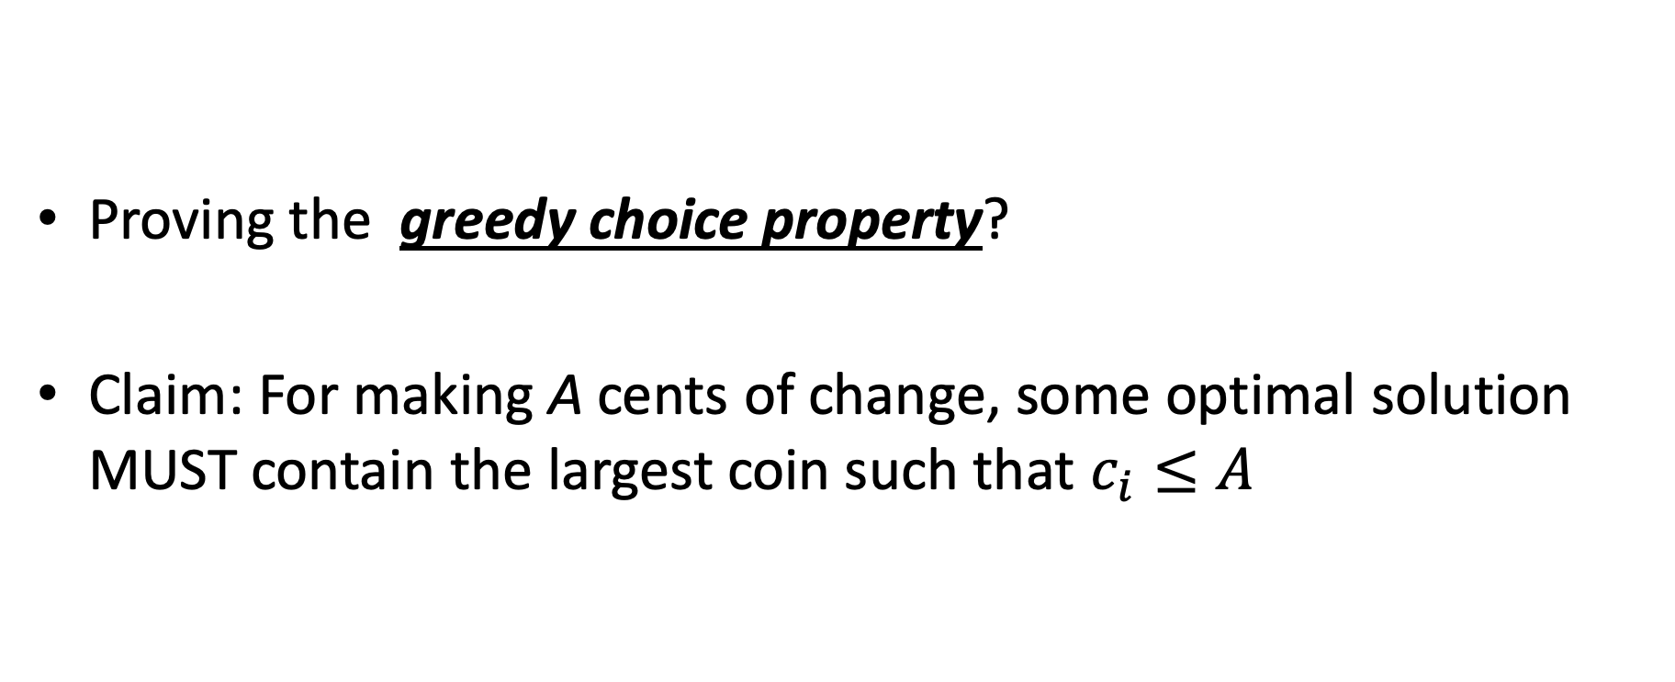
Making change proof
Proving the greedy choice property?
Claim: For making A cents of change, some optimal solution MUST contain the largest coin such that $c_{i}≤A$

Slide 21
Proof
Overview of proof:
Assume largest coin NOT in some optimal solution
Ok, some other coins must be in there instead.
4 Cases:
Largest coin that fits is penny (1 cent) //this one is trivial though!
Largest coin that fits is nickel (5 cent)
Largest coin that fits is dime (10 cent)
Largest coin that fits is quarter (25 cent)
… and so on if more coins are available

Slide 22
Proof
Largest coin that fits is penny (1 cent) //this one is trivial though!
means A < 5
Only penny fits, so penny must be in some optimal solution!
Largest coin that fits is nickel (5 cent)
Assume nickel not in optimal solution. Note A >= 5
Pennies are only other option, so 5 or more pennies in optimal solution
But I can swap out 5 of those pennies with a nickel
Solution decreases by 4 coins!! Contradiction!!

Slide 23
Proof
Largest coin that fits is Dime (10 cent)
Assume dime not in optimal solution. Note A >= 10 and A < 25
So the optimal solution contains one of the following:
>= 2 nickels, some number of pennies (might be 0)
1 nickel, some pennies (at least 5)
all pennies (more than 10)
In each case above, I can swap a dime in for some combination of nickels or pennies
Solution decreases by 1, 5, or 9 coins respectively. Contradiction!
Largest coin that fits is quarter (25 cent)
Assume quarter not in optimal solution. Note A >= 25
So the optimal solution contains:

Slide 24
Proof
Largest coin that fits is quarter (25 cent)
Assume quarter not in optimal solution. Note A >= 25
So the optimal solution contains:
2 dimes, 1 nickel, some pennies maybe
2 dimes, 0 nickels, 5 or more pennies
1 dime, 3 nickels, 0 or more pennies
1 dime, 2 nickels, 5 or more pennies
1 dime, 1 nickel, 10 or more pennies
1 dime, 0 nickel, 15 or more pennies
0 dime, 5 nickels, 0 or more pennies
…
For each case above, a quarter can be swapped back in for more than 1 coin to make the solution better!! Contradiction!

Slide 25
How would a failed proof work?
Prove greedy choice property for denominations 1, 6, and 10
This is going to fail because the algorithm doesn’t work. Let’s see it!
For A = 12, greedy outputs 10,1,1
Best answer is 6,6

Slide 26
How would a failed proof work?
Largest coin that fits is Dime (10 cent)
Assume dime not in optimal solution. Note A >= 10
So the optimal solution contains:
2 or more six-cent coins, pennies maybe (could be 0)
1 six-cent coin, at least 4 pennies
0 six-cent coins, at least 10 pennies
For the second two, we can do the exchange, but NOT for the first one. The proof doesn’t work!!

