Slide 1
Dynamic Programming Activity Selection
CS 3100 – DSA2
Mark Floryan

Slide 2
Dynamic Programming and Greedy Approach
TOPICS:
Weighted Activity Selection

Slide 3
Weighted Activity Selection

Slide 4
Weighted Interval Scheduling
Recall Interval Scheduling:
Given a list of intervals pick a schedule of non-overlapping intervals that maximizes the number chosen
i.e. each one has the same value
Weighted interval scheduling is similar, but…
Each interval has a different value

Slide 5
Greedy solution to interval scheduling
The algorithm:
Sort the activities by finish time
Schedule the first activity
Then schedule the next activity in sorted list which starts after previous activity finishes
Repeat until no more activities
Intuition is even more simple:
Always pick next activity that finishes earliest

Slide 6
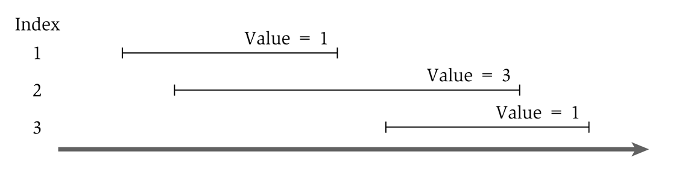
Greedy solution to the weighted version
What would the greedy algorithm pick for this example?
And is that answer optimal?
We can see that the greedy algorithm does not work for the weighted version

Slide 7
Step 1
Define the sub-problem
This problem has optimal substructure, so let’s only consider intervals up to a certain point.
Let Opt(j) be the solution to this problem when only considering intervals 1 through j
How should we order the intervals? Does it matter? We will see soon that it does.
Note that Opt(0) = 0

Slide 8
Step 2
Define solution to problem in terms of sub-problems
Base Case:
Opt(0) = 0
Opt(j) = ?

Slide 9
Step 2
Opt(j) = ?
Two cases:
Interval j is not in the optimal solution
Opt(j) = Opt(j-1) //same solution, because j interval doesn’t matter
Interval j is in the optimal solution
Opt(j) = Vj + Opt(intervals compatible with j)
Intervals compatible with j? Yikes? How do we calculate that?

Slide 10
Calculating Opt(j)
Sort all intervals by their finish time
And number them sequentially
We define interval i is less than interval j if i finishes before j (i.e. is before it in the sort)
Define p(j) to be the highest numbered interval i<j such that i and j are disjoint
Define OPT(j) to be the value of an optimal solution for intervals 1 through j only

Slide 11
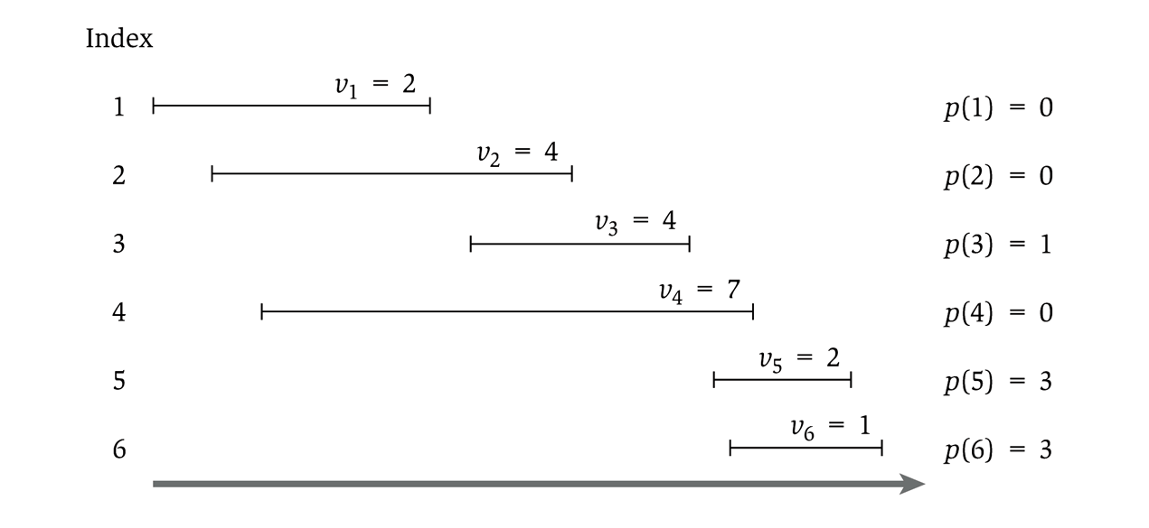
Showing p(j)

Slide 12
Step 2
Opt(j) = ?
Two cases:
Interval j is not in the optimal solution
Opt(j) = Opt(j-1) //same solution, because j interval doesn’t matter
Interval j is in the optimal solution
Opt(j) = Vj + Opt(p(j))
So…we have
Opt(j) = Max( Opt(j-1), Vj + Opt(p(j)) )

Slide 13
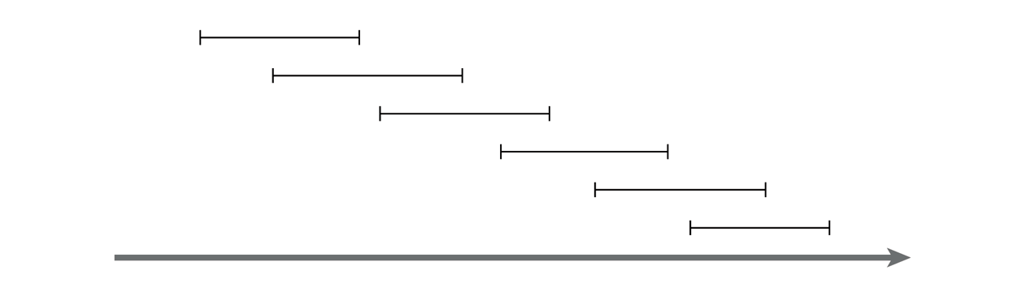
Recursive solution
OPT(j) = max(v_{j} + OPT(p(j)), OPT(j-1))
And OPT(0) = 0
This is similar in running time to the Fibonacci sequence
And similarly exponential
Consider a simple example:
Notes:
For any j, will generate recursive calls on inputs of size j-1 and j-2.
Just like Fibonacci!

Slide 14
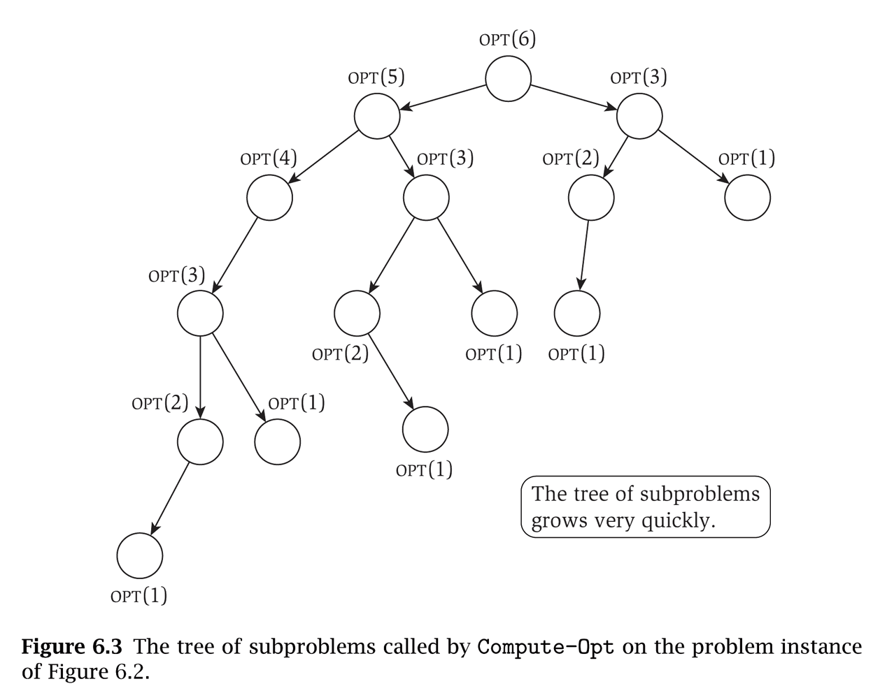
That example will take exponential time
Notice that the sub-problems are being re-computed each time

Slide 15
Step 3!
Formulate the data structure to look up subproblems.
Pretty simple, define M[n]
M[j] stores the solution to Opt(j)

Slide 16
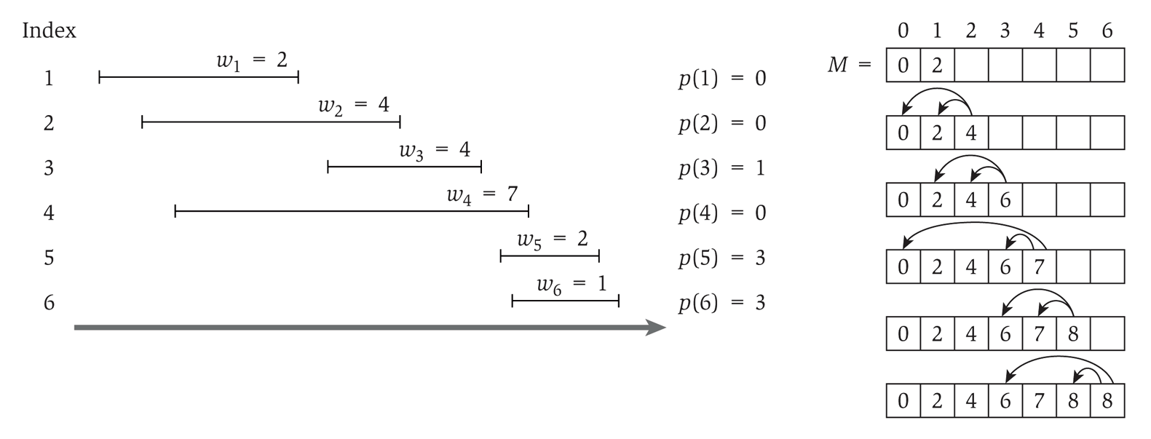
So we add memoization…
This runs in linear time

Slide 17
Computing the intervals
The solution only gives us the final value
Computing a sub-array each step would make it quadratic running time
To determine the intervals:
If v_{j} + M[p(j)] ≥ M[j-1]
Then j is part of the solution, and consider p(j)
Else
Then j is NOT part of the solution, and consider j-1

