Slide 1
Dynamic Programming Knapsack Problem
CS 3100 – DSA2
Mark Floryan

Slide 2
Dynamic Programming and Greedy Approach
TOPICS:
0/1 Knapsack

Slide 3
0/1 Knapsack Problem

Slide 4


Reminder: Knapsack Problems
Pages 425-427 in textbook
Description: Thief robbing a store finds n items, each with a profit amount p_{i} and a weight w_{i}
Wants to steal as valuable a load as possible
But can only carry total weight C in their knapsack
Which items should they take to maximize profit?
Form of the solution: an x_{i} value for each item, showing if (or how much) of that item is taken
Inputs are: C, n, the p_{i} and w_{i} values
4

Slide 5
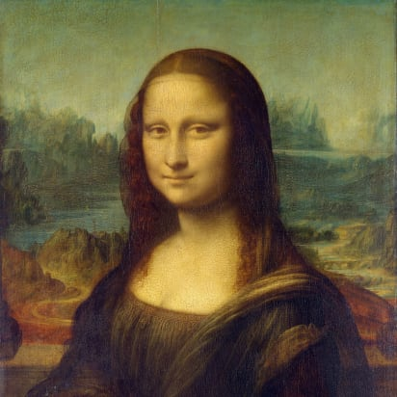

Two Types of Knapsack Problem
0/1 knapsack problem
Each item is discrete: must choose all of it or none of it. So each x_{i} is 0 or 1
Greedy approach does not produce optimal solutions
But dynamic programming does
Fractional knapsack problem (AKA continuous knapsack)
Can pick up fractions of each item. So each x_{i} is a value between 0 or 1
A greedy algorithm finds the optimal solution
5

Slide 6
A Bit More Terminology
Problems solvable by both Dynamic Programming and the Greedy approach have the optimal substructure property:
An optimal solution to a problem contains within it optimal solutions to subproblems
This allows us to build a solution one step at a time, because we can solve increasingly smaller problems with confidence
Dynamic Programming not a good solution for problems that have the greedy-choice property:
We can assemble a globally-optimal solution for the current by making a locally-optimal choice, without considering results from subproblems

Slide 7
0/1 knapsack
n = 3, C = 4
Let’s try this same greedy solution with the 0/1 version
New example inputs →
Item 1 first. So x₁ is 1. Capacity used is 1 of 4. Profit so far is 3.
Item 2 next. There’s room for it! So x₂ is 1. Capacity used is 3 of 4. Profit so far is 3 + 5 = 8.
Item 3 would be next, but its weight is 3 and knapsack only has 1 unit left! So x₃ is 0. Total profit is 8. x_{i} = (1, 1, 0)
But picking items 1 and 3 will fit in knapsack, with total value of 9
Thus, the greedy solution does not produce an optimal solution to the 0/1 knapsack algorithm
Greedy choice left unused room, but we can’t take a fraction of an item
The 0/1 knapsack problem doesn’t have the greedy choice property
Item | Value | Weight | Ratio
1 | 3 | 1 | 3
2 | 5 | 2 | 2.5
3 | 6 | 3 | 2

Slide 8
Reminders about Dynamic Programming
Requires Optimal Substructure
Solution to larger problem contains the solutions to smaller ones
Strategy:
Identify the recursive structure of the problem
What is the “last thing” done?
Formulate a data structure (array, table) that can look-up solution to any sub-problem in constant time
Select a good order for solving subproblems
“Bottom Up”: Iteratively solve smallest to largest
“Top Down”: Solve each recursively. (We won’t do this for 0/1 knapsack.)

Slide 9
Dynamic programming solution to 0/1
We need to:
Identify a recursive definition of how a larger solution is built from optimal results for smaller sub-problems.
For 0/1 knapsack, what a sub-problem solution look like? What can be “smaller”?
Smaller capacity for the knapsack
Fewer items

Slide 10
Some assumptions and observations
Given a set S of the objects and a capacity C
We assume the optimal solution is O, a subset of S
For example, the items in O could be the bolded ones: S = { s₁, s₂, s₃, …, s_{k-1}, s_{k}, …, s_{n} }
Note that the last item s_{n} may or may not be in the solution O
Let’s use subscripts on O_{k} and S_{k} when we’re talking about the first k items
BTW, we’ll assume C and all w_{i} are integer values
And, most books etc. use “W” for what we’re calling C

Slide 11
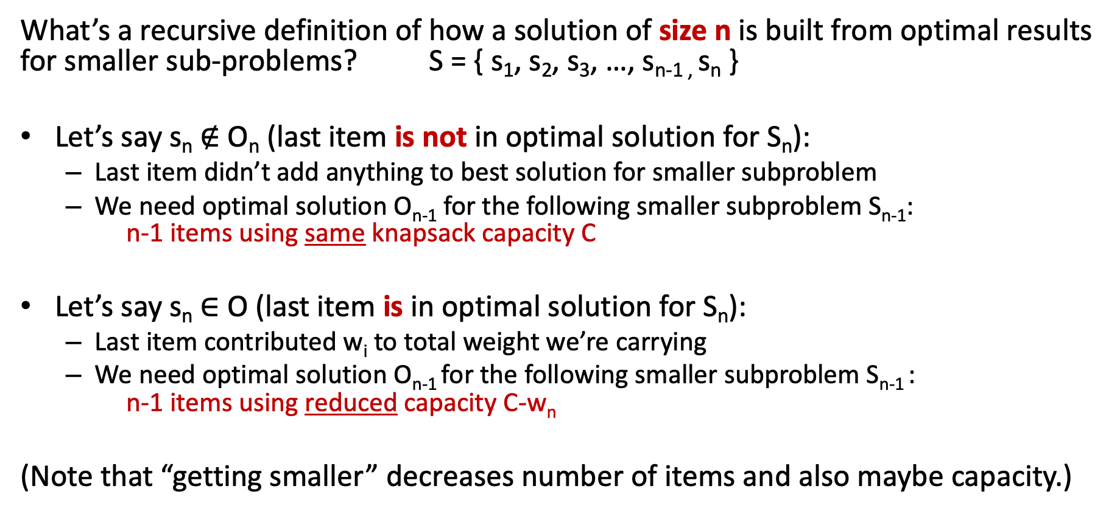
Recursive Structure
What’s a recursive definition of how a solution of size n is built from optimal results for smaller sub-problems? S = { s₁, s₂, s₃, …, s_{n-1 ,} s_{n} }
Let’s say s_{n} $∉$ O_{n} (last item is not in optimal solution for S_{n}):
Last item didn’t add anything to best solution for smaller subproblem
We need optimal solution O_{n-1} for the following smaller subproblem S_{n-1}: n-1 items using same knapsack capacity C
Let’s say s_{n} $∈$ O (last item is in optimal solution for S_{n}):
Last item contributed w_{i} to total weight we’re carrying
We need optimal solution O_{n-1} for the following smaller subproblem S_{n-1} : n-1 items using reduced capacity C-w_{n}
(Note that “getting smaller” decreases number of items and also maybe capacity.)

Slide 12
First Step: Getting Things Started
For sub-problems, what variables change in size?
Maybe C (the capacity) and definitely k (number of items to steal)
Define what we’re calculating: call it Knap(k, w)
Note: we’ll use “w” for the changing capacity value in Knap(), but keep “C” as the overall total capacity for the entire problem. (Sorry if confusing!)
Whether we do recursion of work bottom-up, we need to know the smallest cases
Some small or boundary cases:
No knapsack capacity (w=0), can’t add an item, so Knap(k, 0) = 0
Nothing to steal (k=0), so Knap(0, w) = 0

Slide 13
Three cases to calculate Knap(k, w)
Three cases for calculating Knap(k, w):
There is sufficient capacity to add item s_{k} to the knapsack, and that creates an optimal solution for k items
There is sufficient capacity to add item s_{k} to the knapsack, and that does NOT create an optimal solution for k items
There is insufficient capacity to add item s_{k} to the knapsack
Case 3 is easy to determine; we’ll have to compute whether 1 or 2 is optimal
How do we know which is optimal? Compute both, pick larger value!

Slide 14
Case 1: Sufficient capacity and Optimal
There is sufficient capacity to add item s_{k} to the knapsack, and that creates an optimal solution for k items
Thus, our solution for the first k items is when we add item s_{k} to the optimal solution for the first k-1 items
But by adding item s_{k} to the knapsack, we have reduced capacity
In particular, we only have w-w_{k} for to steal the first k-1 items
So the value for Knap(k, w) = v_{k} + Knap(k-1, w-w_{k})

Slide 15
Case 2: Sufficient Capacity but Non-optimal
There is sufficient capacity to add item s_{k} to the knapsack, and that does NOT create an optimal solution for k items
Thus, our solution for the first k items is when we do NOT add item s_{k} to the solution for the first k-1 items
Since we are not adding item s_{k} to the knapsack, the solution is the optimal solution to steal the first k-1 items with the same capacity
So Knap(k, w) = Knap(k-1, w)

Slide 16
Case 3: Insufficient Capacity
There is insufficient capacity to add item s_{k} to the knapsack
This is because w-w_{k} < 0 (i.e. w < w_{k})
Then Knap(k, w) = Knap(k-1, w)
Since we can’t add item s_{k} to the knapsack, the solution is the same as the first k-1 items with the same capacity
Note that this formula is the same as case 2

Slide 17
Putting It All Together
Recursively define solutions to sub-problems
Base Case
Knap(k,0) = 0
Knap(0,w) = 0
Recursive Case
Knap(k, w) = max( Knap(k-1, w), Knap(k-1, w-w_{k}) + v_{k} )
Subproblems are smaller!
No room for s_{k} or not part optimal solution
s_{k} is part of optimal solution

Slide 18
Reminders about Dynamic Programming
Requires Optimal Substructure
Solution to larger problem contains the solutions to smaller ones
Strategy:
Identify the recursive structure of the problem
What is the “last thing” done?
Formulate a data structure (array, table) that can look-up solution to any sub-problem in constant time
Select a good order for solving subproblems
“Bottom Up”: Iteratively solve smallest to largest
“Top Down”: Solve each recursively. (We won’t do this for 0/1 knapsack.)

Slide 19
Lookup Table
We want a data-structure that allows us to lookup a sub-problem value in O(1) time
Knap(k, w) has two parameters, so two-dimensional array works great.
Make an array called V[k, w]
Store solution to Knap(k, w) at position V[k, w]

Slide 20
Determining the cases
To determine between cases 1 and 2
Simply compute both values, and take the higher
if (w-w_{k}< 0) // not room for item k
V[k, w] = V[k-1, w] // best result for k-1 items
else {
val_with_kth = v_{k} + V[k-1, w-w_{k}] // Case 1 above
val_for_k-1 = V[k-1, w] // Case 2 above
V[k, w] = max( val_with_kth, val_for_k-1 )
}

Slide 21
Put Values in Table
Write a loop that fills in the table one cell at a time
The table fills in one row at a time, moving rightwards and downwards
V[k,w] | w = 0 | w = 1 | w = 2 | … | w = C
k = 0 | 0 | 0 | 0 | 0 | 0
k = 1 | 0
k = 2 | 0
… | 0
k = n | 0

Slide 22
Pseudo-code
Knapsack(v, w, C) {
for (w = 0 to C) V[0, w] = 0
for (k = 0 to n) V[k, 0] = 0
for (k = 1 to n) { // loop over all rows
for (w = 1 to C) { // loop over all columns
if (w-w_{k} < 0) // not room for item k
V[k, w] = V[k-1, w] // best result for k-1 items
else {
val_with_kth = v_{k} + V[k-1, w-w_{k}] // Case 1 above
val_for_k-1 = V[k-1, w] // Case 2 above
V[k, w] = max( val_with_kth, val_for_k-1 )
}
}
}
return V[n,C]
}

Slide 23
But our solution is only the value!
Value V[n, C] is the optimal value
To find which items were chosen, we can trace backward through the table starting at V[n, C]
If V[k, w] = V[k-1, w], then s_{k} is not an item in the knapsack (this was from cases 2 and 3). Look at V[k-1, w] next.
Otherwise, s_{k} is an item in the knapsack, and we look at V[k-1, w-w_{k}] next (this was from case 1)

