Slide 1
NP-Completeness: Reduction Examples
CS 3100: DSA2
Mark Floryan

Slide 2
Topics

Slide 3
NP-Completeness

Slide 4
Reminder: Complexity Classes!
P: Set of problems solved in polynomial time (e.g., sorting a list)
NP: Set of problems that can be:
1) Solved in non-deterministic polynomial time
2) Verified in polynomial time
NP-Hard: Set of problems that are as hard as (or harder) than the hardest problems in NP
NP-Complete: Set of problems that are both NP and NP-Hard (i.e., the equally hardest problems in NP)

Slide 5
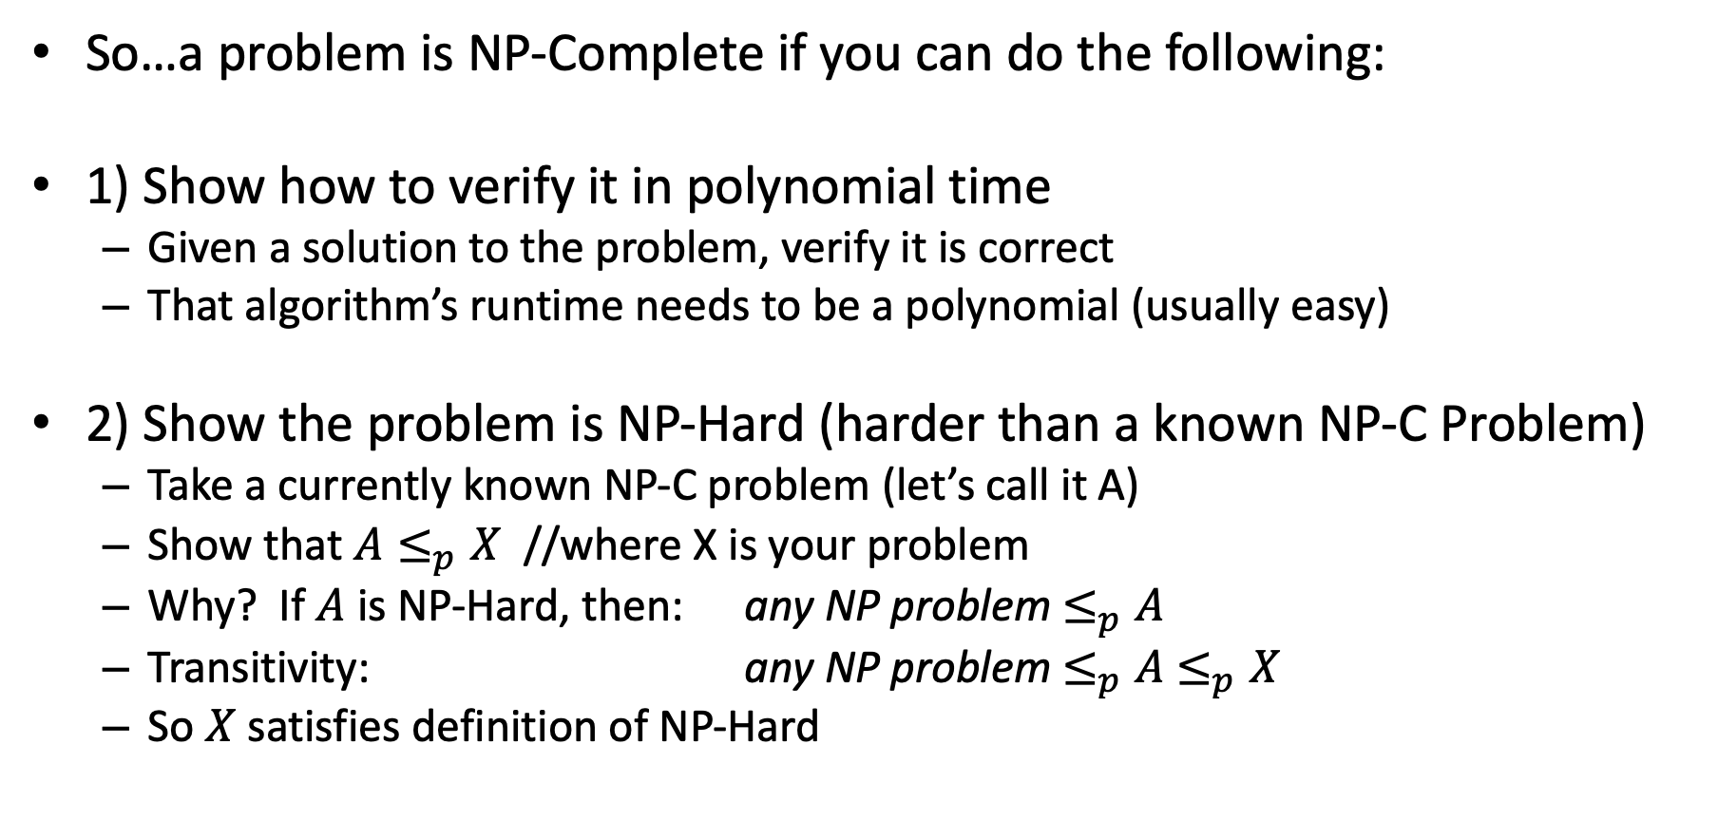
NP-Completeness
So…a problem is NP-Complete if you can do the following:
1) Show how to verify it in polynomial time
Given a solution to the problem, verify it is correct
That algorithm’s runtime needs to be a polynomial (usually easy)
2) Show the problem is NP-Hard (harder than a known NP-C Problem)
Take a currently known NP-C problem (let’s call it A)
Show that $A≤_{p}X$ //where X is your problem
Why? If $A$ is NP-Hard, then: any NP problem $≤_{p}A$
Transitivity: any NP problem $≤_{p}A$ $≤_{p}X$
So $X$ satisfies definition of NP-Hard

Slide 6
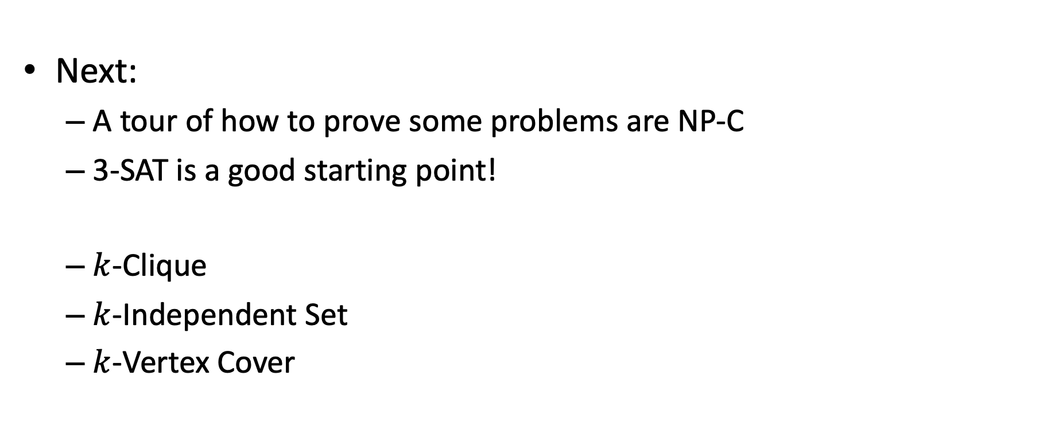
Reductions to Prove NP-C
Next:
A tour of how to prove some problems are NP-C
3-SAT is a good starting point!
$k$-Clique
$k$-Independent Set
$k$-Vertex Cover

Slide 7
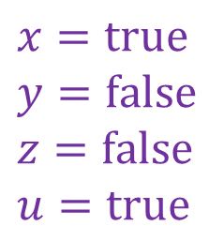
Reminder about 3-SAT
Shown to be NP-hard by Cook
Given a 3-CNF formula (logical AND of clauses, each an OR of 3 variables), is there an assignment of true/false to each variable to make the formula true (i.e., satisfy the formula)?
$$\left(x∨y∨z\right)∧\left(x∨\overline{y}∨y\right)∧\left(u∨y∨\overline{z}\right)∧\left(z∨\overline{x}∨u\right)∧(\overline{x}∨\overline{y}∨\overline{z})$$
Clause
$$x=true$$
$$y=false$$
$$z=false$$
$$u=true$$
Variables

Slide 8
Next example: k-Clique
Let’s show that k-Clique is NP-Complete!

Slide 9
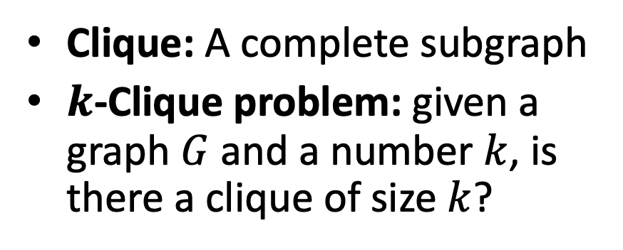

$k$-Clique Problem
Clique: A complete subgraph
$k$-Clique problem: given a graph $G$ and a number $k$, is there a clique of size $k$?
4-Clique
3-Clique

Slide 10
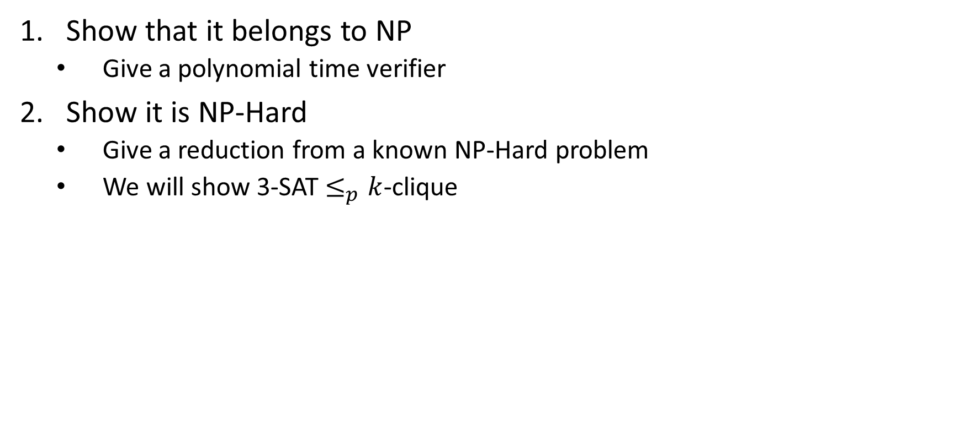

$k$-Clique is NP-Complete
Show that it belongs to NP
Give a polynomial time verifier
Show it is NP-Hard
Give a reduction from a known NP-Hard problem
We will show 3-SAT $≤_{p}k$-clique

Slide 11
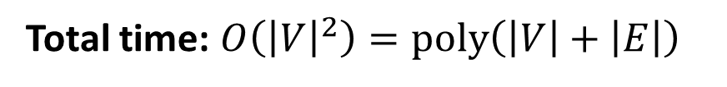
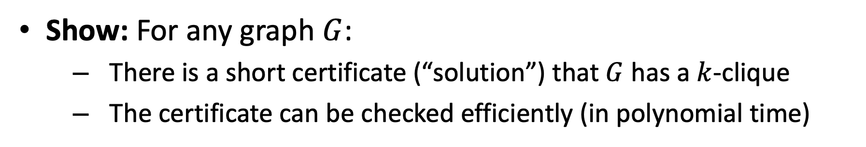



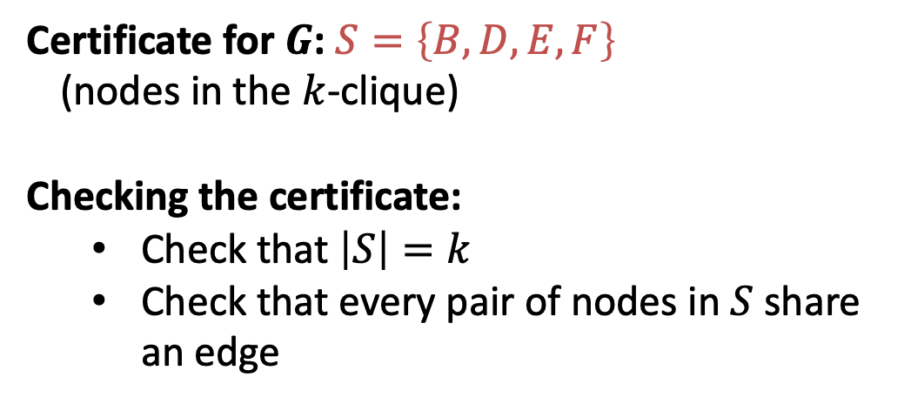
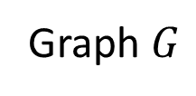
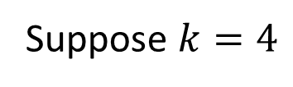
$k$-Clique is in NP
Show: For any graph $G$:
There is a short certificate (“solution”) that $G$ has a $k$-clique
The certificate can be checked efficiently (in polynomial time)
Suppose $k=4$
C
Certificate for $G$: $S=\left\{B,D,E,F\right\}$
(nodes in the $k$-clique)
Checking the certificate:
Check that $\left|S\right|=k$
Check that every pair of nodes in $S$ share an edge
B
4-Clique
A
E
D
F
$$O\left(k\right)=O\left(\left|V\right|\right)$$
G
I
3-Clique
$$O\left(k^{2}\right)=O({\left|V\right|}^{2})$$
H
Graph $G$
Total time: $O\left({\left|V\right|}^{2}\right)=poly\left(\left|V\right|+\left|E\right|\right)$

Slide 12

$k$-Clique is NP-Complete
Show that it belongs to NP
Give a polynomial time verifier
Show it is NP-Hard
Give a reduction from a known NP-Hard problem
We will show 3-SAT $≤_{p}k$-clique

Slide 13
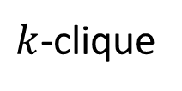

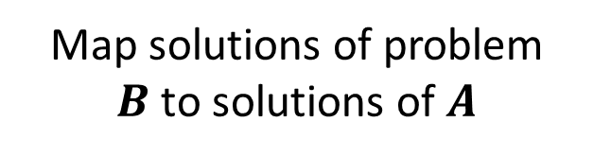
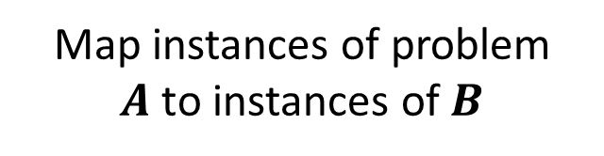
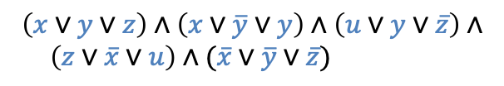

3-SAT $≤_{p}$ $k$-Clique
3-SAT
$k$-clique
Map instances of problem $A$to instances of $B$
$$\left(x∨y∨z\right)∧\left(x∨\overline{y}∨y\right)∧\left(u∨y∨\overline{z}\right)∧$$ $\left(z∨\overline{x}∨u\right)∧(\overline{x}∨\overline{y}∨\overline{z})$
polynomial time
Map solutions of problem $B$to solutions of $A$
$$x=true$$
$$y=false$$
$$z=false$$
$$u=true$$
polynomial time
polynomial-time reduction

Slide 14
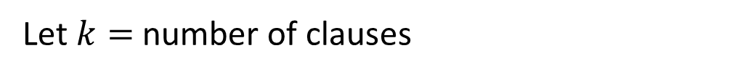



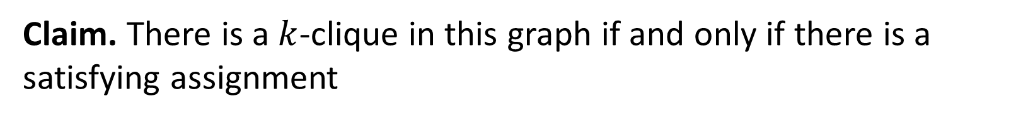












3-SAT $≤_{p}$ $k$-Clique
$$\left(x∨y∨z\right)∧\left(x∨\overline{y}∨y\right)∧\left(u∨y∨\overline{z}\right)∧\left(z∨\overline{x}∨u\right)∧(\overline{x}∨\overline{y}∨\overline{z})$$
$$x$$
$$\overline{y}$$
$$y$$
$$z$$
$$\overline{x}$$
$$u$$
$$x$$
(also do this for the other clauses, omitted due to clutter)
$$y$$
$$z$$
$$u$$
$$y$$
$$\overline{z}$$
$$\overline{x}$$
$$\overline{y}$$
$$\overline{z}$$
For each clause, introduce a node for each of its three variables
Add an edge from each node to all non-contradictory nodes in the other clauses (i.e., to all nodes that is not the negation of its own variable)
Let $k=$ number of clauses
Claim. There is a $k$-clique in this graph if and only if there is a satisfying assignment

Slide 15


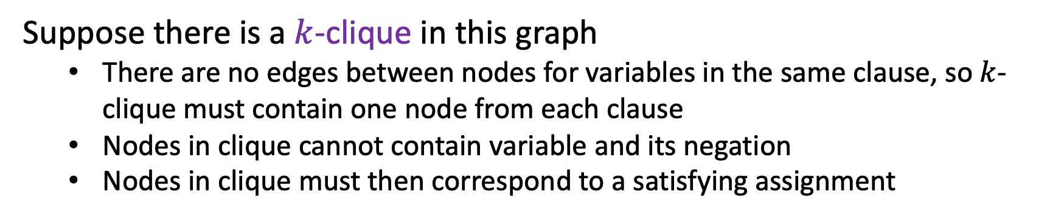
3-SAT $≤_{p}$ $k$-Clique
$$\left(x∨y∨z\right)∧\left(x∨\overline{y}∨y\right)∧\left(u∨y∨\overline{z}\right)∧\left(z∨\overline{x}∨u\right)∧(\overline{x}∨\overline{y}∨\overline{z})$$
$$x$$
$$y$$
$$\overline{y}$$
$$z$$
$$\overline{x}$$
$$u$$
$$x$$
$$y$$
$$z$$
$$u$$
$$y$$
$$\overline{z}$$
$$\overline{x}$$
$$\overline{y}$$
$$\overline{z}$$
Suppose there is a $k$-clique in this graph
There are no edges between nodes for variables in the same clause, so $k$-clique must contain one node from each clause
Nodes in clique cannot contain variable and its negation
Nodes in clique must then correspond to a satisfying assignment

Slide 16


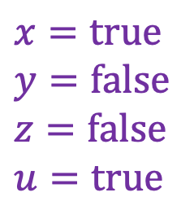



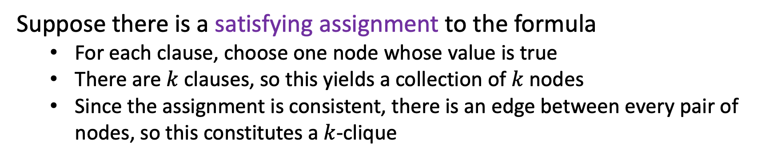
3-SAT $≤_{p}$ $k$-Clique
$$\left(x∨y∨z\right)∧\left(x∨\overline{y}∨y\right)∧\left(u∨y∨\overline{z}\right)∧\left(z∨\overline{x}∨u\right)∧(\overline{x}∨\overline{y}∨\overline{z})$$
$$x$$
$$y$$
$$\overline{y}$$
$$z$$
$$\overline{x}$$
$$u$$
$$x$$
$$y$$
$$x=true$$
$$y=false$$
$$z=false$$
$$u=true$$
$$z$$
$$u$$
$$y$$
$$\overline{z}$$
$$\overline{x}$$
$$\overline{y}$$
$$\overline{z}$$
Suppose there is a satisfying assignment to the formula
For each clause, choose one node whose value is true
There are $k$ clauses, so this yields a collection of $k$ nodes
Since the assignment is consistent, there is an edge between every pair of nodes, so this constitutes a $k$-clique

Slide 17
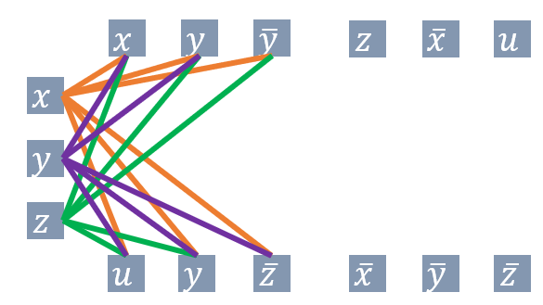
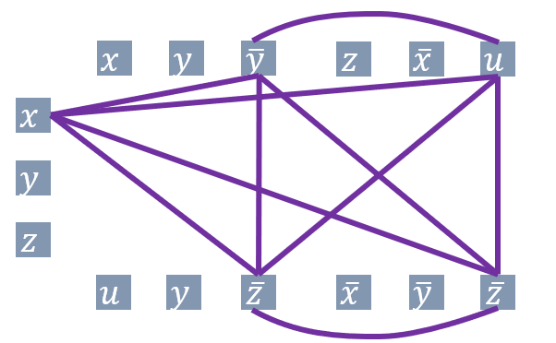
3-SAT $≤_{p}$ $k$-Clique
3-SAT
$k$-clique
Map instances of problem $A$to instances of $B$
$$\left(x∨y∨z\right)∧\left(x∨\overline{y}∨y\right)∧\left(u∨y∨\overline{z}\right)∧$$ $\left(z∨\overline{x}∨u\right)∧(\overline{x}∨\overline{y}∨\overline{z})$
polynomial time
Map solutions of problem $B$to solutions of $A$
$$x=true$$
$$y=false$$
$$z=false$$
$$u=true$$
polynomial time
polynomial-time reduction

Slide 18
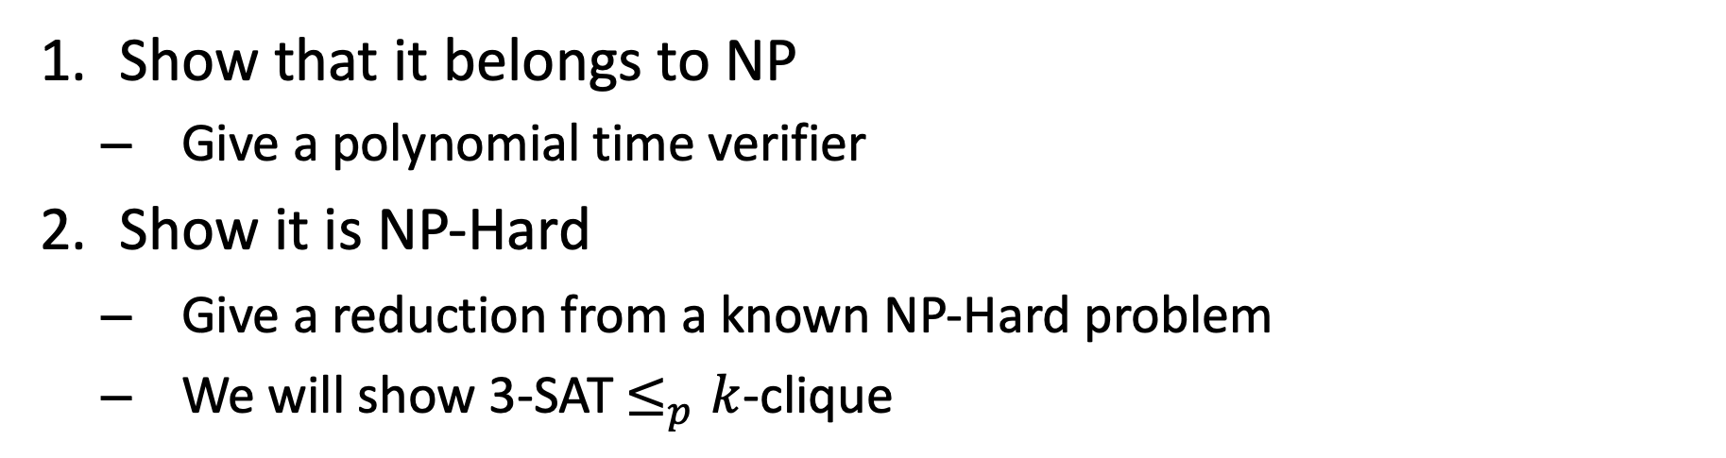
$k$-Clique is NP-Complete
Show that it belongs to NP
Give a polynomial time verifier
Show it is NP-Hard
Give a reduction from a known NP-Hard problem
We will show 3-SAT $≤_{p}k$-clique

Slide 19
K-Independent Set

Slide 20
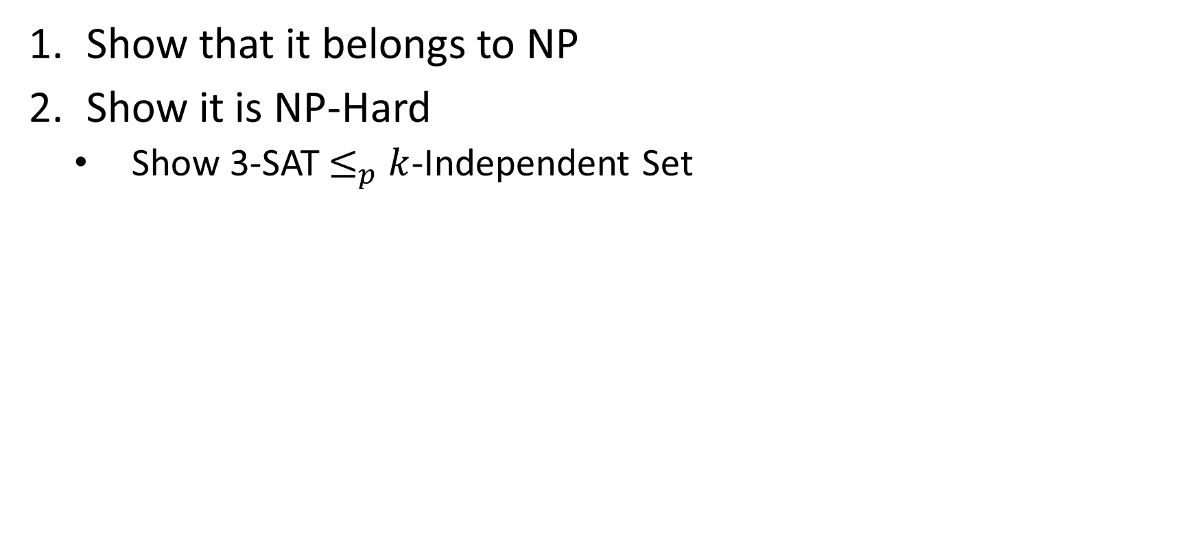
$k$-Independent Set is NP-Complete
Show that it belongs to NP
Show it is NP-Hard
Show 3-SAT$≤_{p}$ $k$-Independent Set

Slide 21
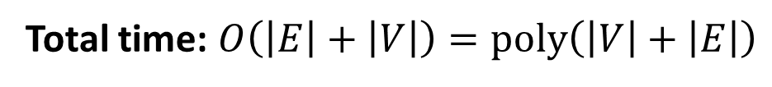
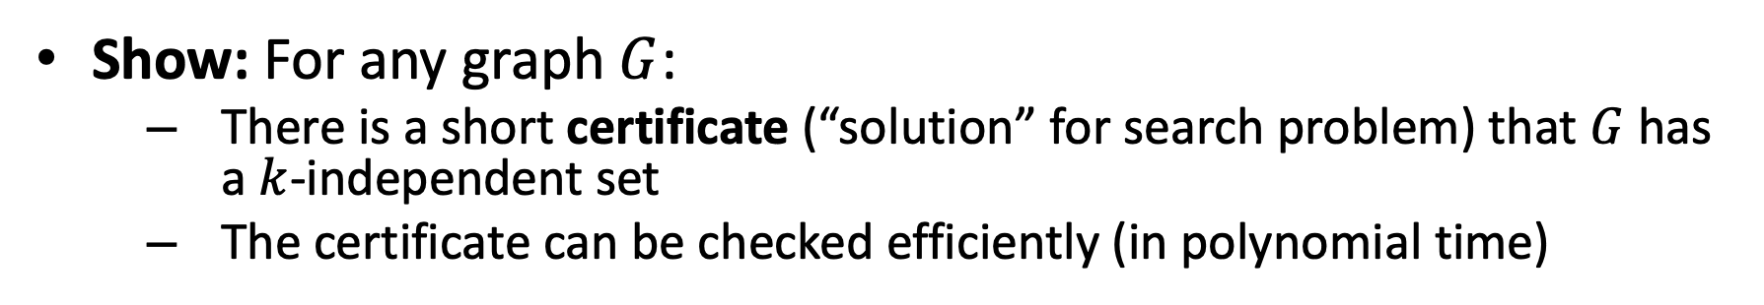



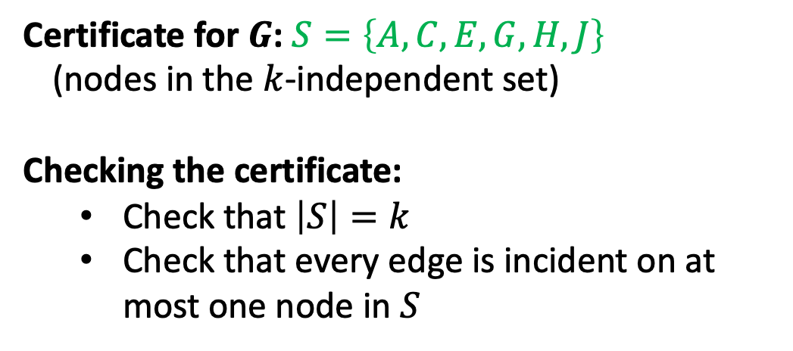
$k$-Independent Set is in NP
Show: For any graph $G$:
There is a short certificate (“solution” for search problem) that $G$ has a $k$-independent set
The certificate can be checked efficiently (in polynomial time)
A
B
Certificate for $G$: $S=\left\{A,C,E,G,H,J\right\}$
(nodes in the $k$-independent set)
Checking the certificate:
Check that $\left|S\right|=k$
Check that every edge is incident on at most one node in $S$
C
D
E
F
G
$$O\left(k\right)=O\left(\left|V\right|\right)$$
J
H
I
$$O\left(\left|V\right|+\left|E\right|\right)$$
K
L
Total time: $O\left(\left|E\right|+\left|V\right|\right)=poly\left(\left|V\right|+\left|E\right|\right)$
Graph $G$

Slide 22
$k$-Independent Set is NP-Complete
Show that it belongs to NP
Show it is NP-Hard
Show 3-SAT$≤_{p}$ $k$-Independent Set

Slide 23
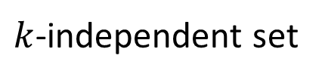

3-SAT $≤_{p}$ $k$-Independent Set
3-SAT
$k$-independent set
Map instances of problem $A$to instances of $B$
polynomial time
Map solutions of problem $B$to solutions of $A$
$$x=true$$
$$y=false$$
$$z=false$$
$$u=true$$
polynomial time
polynomial-time reduction

Slide 24


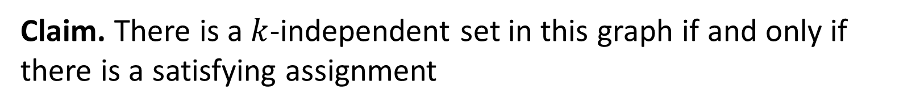












3-SAT $≤_{p}$ $k$-Independent Set
$$\left(x∨y∨z\right)∧\left(x∨\overline{y}∨y\right)∧\left(u∨y∨\overline{z}\right)∧\left(z∨\overline{x}∨u\right)∧(\overline{x}∨\overline{y}∨\overline{z})$$
$$x$$
$$x$$
$$u$$
$$z$$
$$\overline{u}$$
$$z$$
$$y$$
$$y$$
$$\overline{y}$$
$$\overline{z}$$
$$y$$
$$u$$
$$\overline{x}$$
$$\overline{z}$$
$$\overline{y}$$
For each clause, construct a triangle graph with its three variables as nodes
Add an edge between each node and its negation
Let $k=$ number of clauses
Claim. There is a $k$-independent set in this graph if and only if there is a satisfying assignment

Slide 25



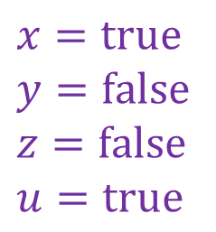

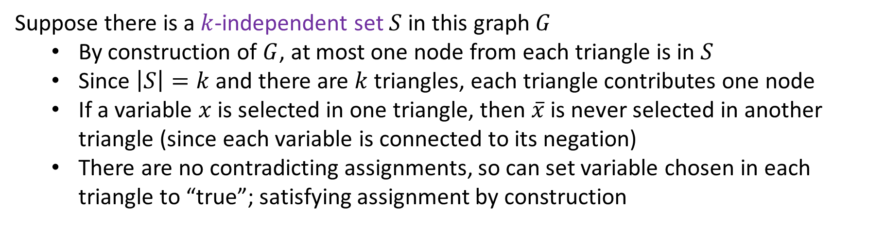

3-SAT $≤_{p}$ $k$-Independent Set
$$\left(x∨y∨z\right)∧\left(x∨\overline{y}∨y\right)∧\left(u∨y∨\overline{z}\right)∧\left(z∨\overline{x}∨u\right)∧(\overline{x}∨\overline{y}∨\overline{z})$$
$$x=true$$
$$y=false$$
$$z=false$$
$$u=true$$
$$x$$
$$x$$
$$u$$
$$z$$
$$\overline{u}$$
$$z$$
$$y$$
$$y$$
$$\overline{y}$$
$$\overline{z}$$
$$y$$
$$u$$
$$\overline{x}$$
$$\overline{z}$$
$$\overline{y}$$
Suppose there is a $k$-independent set $S$ in this graph $G$
By construction of $G$, at most one node from each triangle is in $S$
Since $\left|S\right|=k$ and there are $k$ triangles, each triangle contributes one node
If a variable $x$ is selected in one triangle, then $\overline{x}$ is never selected in another triangle (since each variable is connected to its negation)
There are no contradicting assignments, so can set variable chosen in each triangle to “true”; satisfying assignment by construction

Slide 26
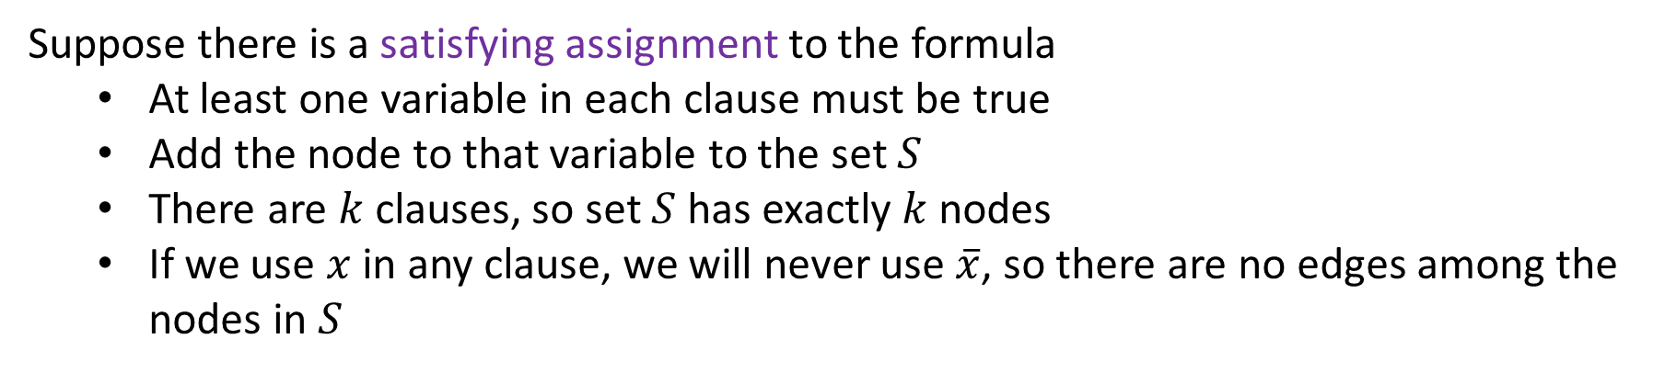
3-SAT $≤_{p}$ $k$-Independent Set
$$\left(x∨y∨z\right)∧\left(x∨\overline{y}∨y\right)∧\left(u∨y∨\overline{z}\right)∧\left(z∨\overline{x}∨u\right)∧(\overline{x}∨\overline{y}∨\overline{z})$$
$$x=true$$
$$y=false$$
$$z=false$$
$$u=true$$
$$x$$
$$x$$
$$u$$
$$z$$
$$\overline{u}$$
$$z$$
$$y$$
$$y$$
$$\overline{y}$$
$$\overline{z}$$
$$y$$
$$u$$
$$\overline{x}$$
$$\overline{z}$$
$$\overline{y}$$
Suppose there is a satisfying assignment to the formula
At least one variable in each clause must be true
Add the node to that variable to the set $S$
There are $k$ clauses, so set $S$ has exactly $k$ nodes
If we use $x$ in any clause, we will never use $\overline{x}$, so there are no edges among the nodes in $S$

Slide 27
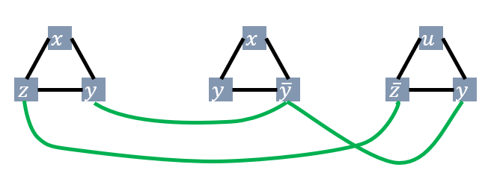
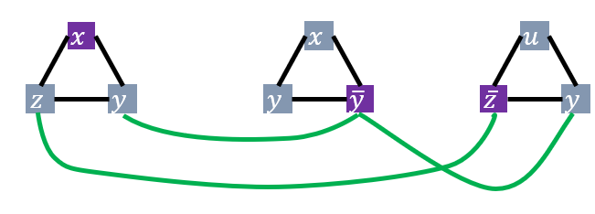
3-SAT $≤_{p}$ $k$-Independent Set
3-SAT
$k$-independent set
Map instances of problem $A$to instances of $B$
polynomial time
Map solutions of problem $B$to solutions of $A$
$$x=true$$
$$y=false$$
$$z=false$$
$$u=true$$
polynomial time
polynomial-time reduction

Slide 28
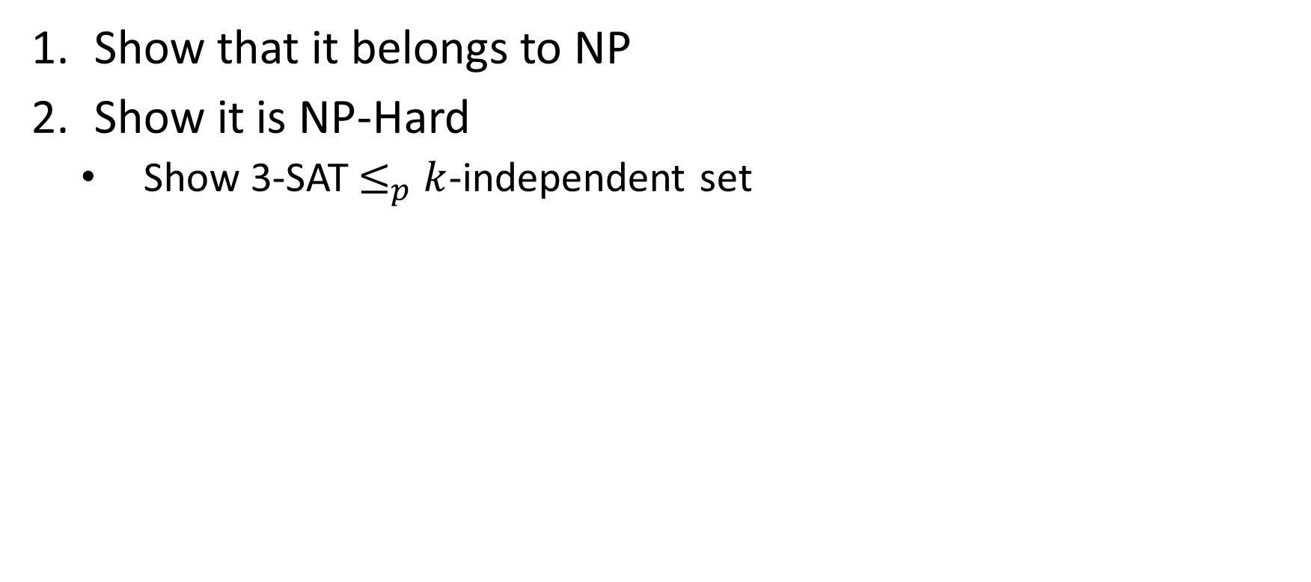
$k$-Independent Set is NP-Complete
Show that it belongs to NP
Show it is NP-Hard
Show 3-SAT$≤_{p}$ $k$-independent set

Slide 29
K-Vertex Cover

Slide 30
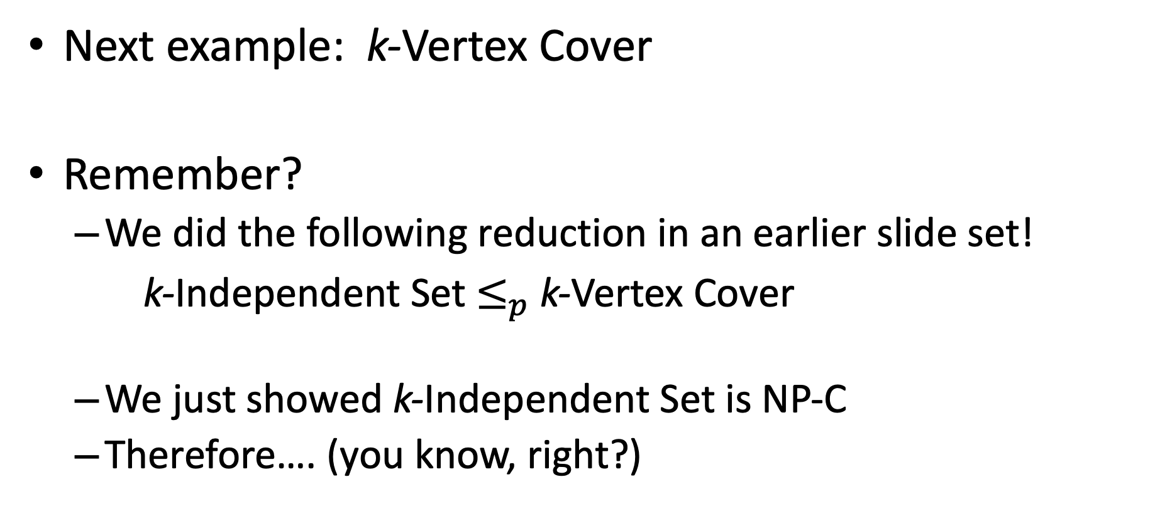
Next example: k-Vertex Cover
Remember?
We did the following reduction in an earlier slide set!
k-Independent Set $≤_{p}$ k-Vertex Cover
We just showed k-Independent Set is NP-C
Therefore…. (you know, right?)

Slide 31
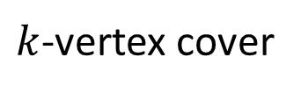

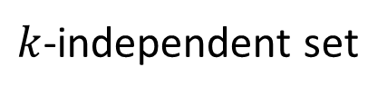


Max Independent Set $≤_{p}$ k-Vertex Cover
$k$-independent set
$k$-vertex cover
Map instances of problem $A$to instances of $B$
$O(1)$ time
Map solutions of problem $B$to solutions of $A$
$O\left(\left|V\right|\right)$ time
Reduction

Slide 32


$k$-Vertex Cover is NP-Complete
Show that it belongs to NP
Given a candidate cover, check that every edge is covered
Show it is NP-Hard
Show $k$-independent set$≤_{p}$ $k$-vertex cover

Slide 33
Reductions: 3-Coloring

Slide 34
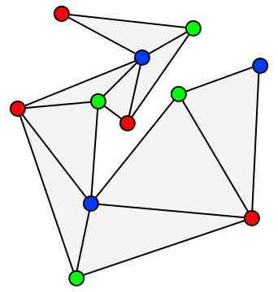
3-Coloring
Given graph G, and three colors c1,c2,c3 (not really given as input)
Can we color the graph with these colors such that no adjacent nodes have the same color.
Turns out that 3-Coloring is NP-Complete

Slide 35
3-Coloring
First show:
3-Coloring ∈ NP
How?
Given a coloring of the graph, is it valid?
Must do this in polynomial time!

Slide 36
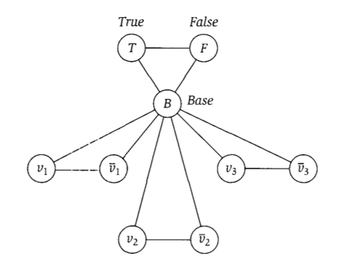
Reducing 3-SAT to 3-coloring

Slide 37
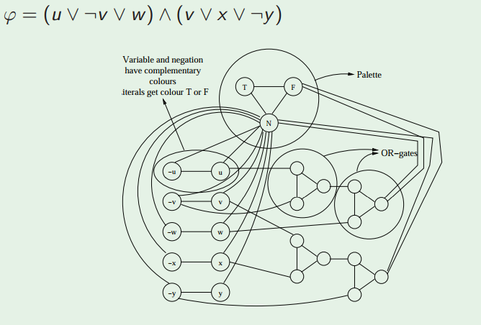
Reducing 3-SAT to 3-coloring

Slide 38
(VERY informal) proof of reduction
Sat(Φ) → G is 3-Colorable
Assume Φ is satisfiable
3 colors (true, false, base)
Color B,T,F with these colors
Color variable nodes with T and F depending on their satisfying values for Φ
Or gates always colorable so that they represent correct OR (output is true iff one or more inputs true)
Thus G is 3-Colorable
G is 3-Colorable → Sat(Φ)
Assume G is 3-Colorable
Color the graph
Let the colors of the B,T,F nodes represent base, true, and false respectively.
Re-arrange OR gate colors slightly if necessary so output is always T or F
Let variable assignments be the color they were given
These assignments satisfy Φ

Slide 39
Wrap-Up

Slide 40
Why Prove NP-Completeness?
Though nobody has proven that P ≠ NP, if you prove a problem NP-Complete, most people accept that it is probably exponential
Therefore it can be important for you to prove that a problem is NP-Complete
Don't need to try to come up perfect non-exponential algorithm
Can instead work on approximation algorithms

Slide 41
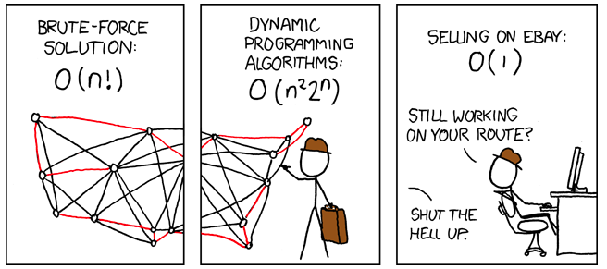
What’s a poor salesperson to do?
http://xkcd.com/399/

Slide 42
Approximation Algorithms
Look at first 3 pages of Ch. 35 of CLRS textbook
Can we find an algorithm for problem A ∈ NP-C that:
Runs in polynomial time
Gets “near optimal” results
Prove some bound on the algorithm’s correctness in terms of the true optimal result
No worse that (some factor) of optimal
“It’s not always right (best), but it’s guaranteed to be this close.”

Slide 43
General Comments
At least 3000 problems have been shown to be NP-Complete
That number is from a non-recent report, so we might say that counts is a weak lower-bound on the true number found
https://en.wikipedia.org/wiki/List_of_NP-complete_problems including some popular games
Some reductions are profound, some are comparatively easy, many are easy once the key insight is given

Slide 44
Other NP-Complete Problems
Hamilton Path/Cycle, Traveling Salesperson
Subset-sum: Given a set of integers, does there exist a subset that adds up to some target T ?
0-1 knapsack: when weights not just integers
Graph coloring: can a given graph be colored with k colors such that no adjacent vertices are the same color?
Etc…

Slide 45
Review (Again)
A problem B is NP-complete
if it is in NP and it is NP-hard.
A problem B is NP-hard
if every problem in NP is reducible to B.
A problem A is reducible to a problem B if
there exists a polynomial reduction function T such that
For every string x,
if x is a yes input for A, then T(x) is a yes input for B
if x is a no input for A, then T(x) is a no input for B.
T can be computed in polynomially bounded time.

Slide 46
“Consequences” of NP-Completeness
NP-Complete the set of the“hardest” problems in NP, with these important properties:
If any one NP-Complete problem can be solved in polynomial time…
…then every NP-Complete problem can be solved in polynomial time…
…and in fact every problem in NP can be solved in polynomial time (which would show P = NP)
Or, prove an exponential lower-bound for any single NP-C problem, then every NP-C problem is exponential
Therefore: solve (say) traveling salesperson problem in O(n¹⁰⁰) time, you've proved that P = NP. Retire rich & famous!

Slide 47
What We Don’t Know: Open Questions
Is it impossible to solve an NP-c problem in polynomial time?
No one has proved an exponential lower bound for any problem in NP.
But, most computer scientists believe such a lower bound exists for NP-c problems.
Are all problems in NP tractable or intractable? I.e., does P=NP or not?
If someone found a polynomial solution to any NP-c problem, we’d know P = NP.
But, most computer scientists believe P≠ NP.

