Slide 1
CS3100: DSA2 ML - Clustering
Let’s look at a couple more machine learning algorithms!

Slide 2
Unsupervised Learning: Clustering

Slide 3
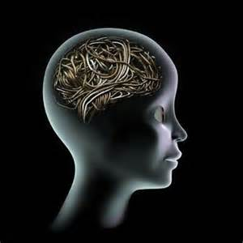
Unsupervised Learning
Supervised Learning:
Given a list of labeled training examples, fit a hypothesis function to those examples as best as you can.
Unsupervised Learning:
Given a list of unlabeled training examples, figure out which are likely to have the same output variable (if they were labeled)
IDEA!
Compute the “clusters” in the data (the data with similar features)

Slide 4
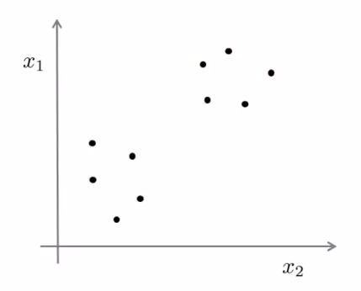
Unsupervised Learning
Unsupervised Learning:
Given a list of unlabeled training examples, figure out which are likely to have the same output variable (if they were labeled)
IDEA!
Compute the “clusters” in the data (the data with similar features)
In the image here, it looks like there are two different clusters.

Slide 5
What is clustering good for?
Market Segmentation
Figure out different types of customers your company has.
Organize Data Centers based on characteristics of the network traffic you are getting.
Social Network Analysis
Automatically compute different types of users in a social network

Slide 6
K-Means Algorithm
VERY popular clustering algorithm.
Really simple (which is awesome!)
Inputs:
The (unlabeled) training examples
The number of clusters (k) to compute
Outputs:
k subsets of the data that are similar to each other (i.e., the clusters).

Slide 7
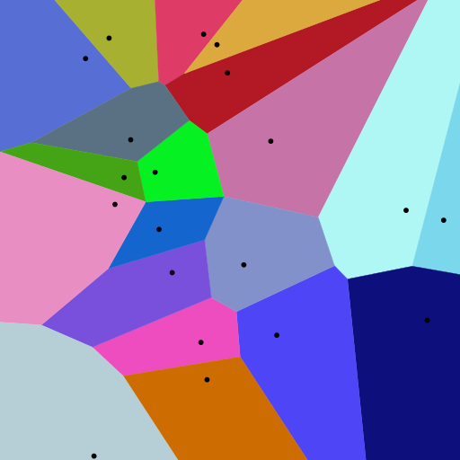
Aside: Voronoi Cells
A partitioning of planes into regions
Each black dot is called a centroid
Every color represents which centroid is closest to that particular point in the diagram
K-Means is similar:
Initialize exactly K centroids
Training examples belong to closest centroid
Update centroid locations, etc.

Slide 8
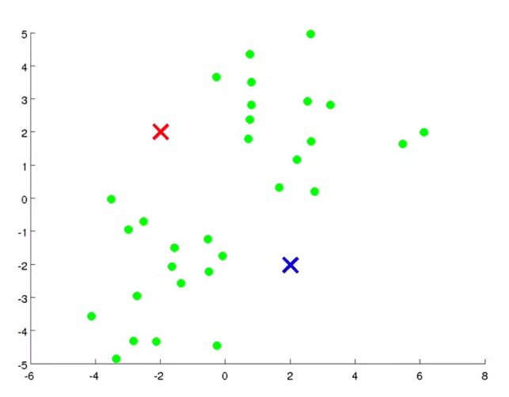
K-Means Algorithm
Initialize K (here, 2) cluster centroids
Repeat:
Assign each training example to a group
Via closest centroid
Update centroid locations

Slide 9
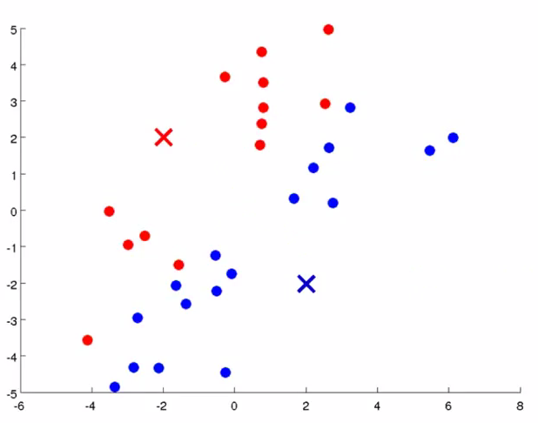
K-Means Algorithm
Assign each training example to a group
Via closest centroid
As seen here
How is this actually done?

Slide 10
K-Means Algorithm
More detail on this formula:
S is each set (so the clusters) and there are k total
xp is training examples belonging to that cluster
mi is the mean location of the centroid
n-dimensional where n is # of features
The subtraction here is Euclidean distance

Slide 11
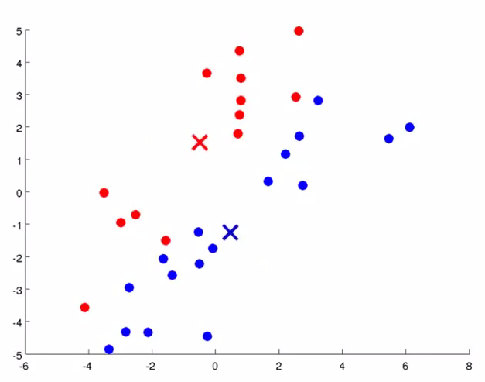

K-Means Algorithm
Move Cluster Centroids
By moving them to the mean position of everything in that cluster
As seen here
How is this actually done?

Slide 12
K-Means Algorithm
More detail on this formula:
mi is the next mean (centroid location)
t+1 is “at the next time step of the algorithm”
The summation is simply the average of all the features of each assigned point.
Notice that these means are n-dimensional vectors (the mean value of each of the n features)

Slide 13
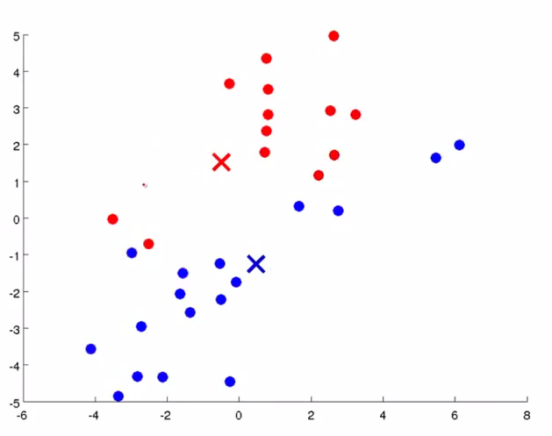
K-Means Algorithm

Slide 14
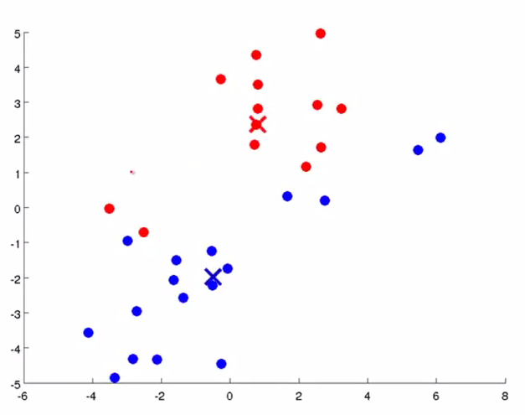
K-Means Algorithm

Slide 15
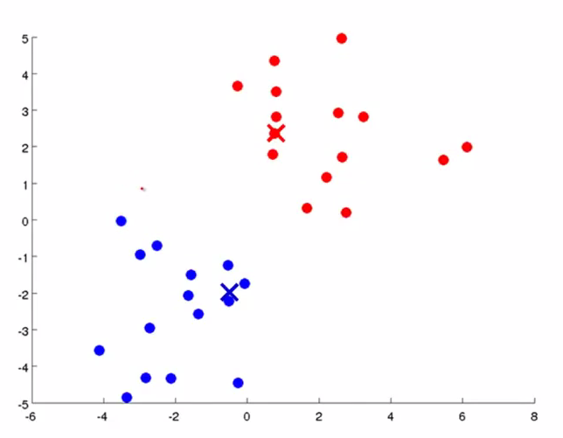
K-Means Algorithm

Slide 16
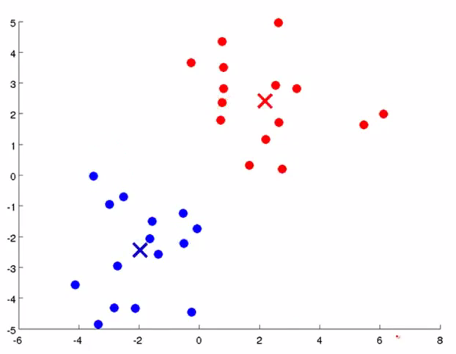
K-Means Algorithm
We’ve converged!!!!!!

Slide 17
K-Means: Summary
Good For:
Easy to implement
Guaranteed to converge
Finds good solutions quickly
Bad For:
Not optimal
This problem is NP-Hard
Need to figure out what ‘k’ should be
Tends to find equal sized clusters, which can be bad. Can you give an example?
Expectation-Maximization can be used instead

