Slide 1
CS3100: DSA2 Neural Networks
Let’s look at a couple more machine learning algorithms!

Slide 2
Artificial Neural Networks

Slide 3

Intro to Neural Networks
Used for many pattern recognition tasks
Biologically inspired
Must first understand the very basics of how neurons work

Slide 4
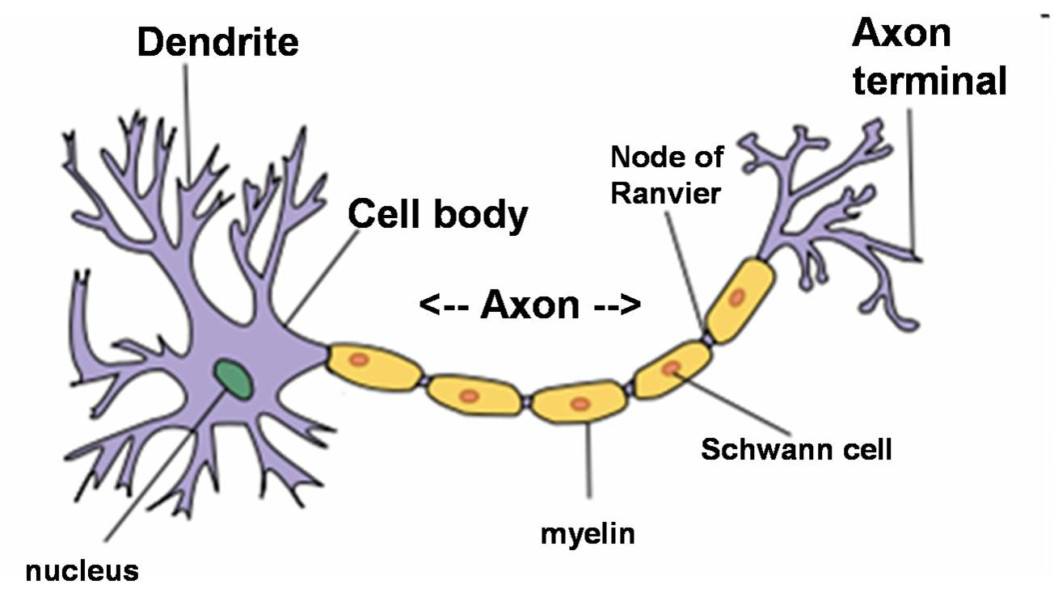
Neurons
Dendrite:
Extend from the cell body
Receive messages from other neurons
Axon:
Where signal is outputted from the neuron
Electrical signal moves across axon
Synapse (Axon terminal in image here):
Connects this neuron to Dendrite of another
Allows only a certain amount of the “signal” through (via chemical processes)

Slide 5
Neurons
Basic functionality of neuron:
Electrical signal arrives at Dendrites (from other neurons)
Axon transmits the signal along to the synapses
At the synapse, a molecule called a neurotransmitter is released, this chemical stimulates the next neuron, creating an electrical signal at the next Dendrite
So the amount of neurotransmitters that are released controls the amount of signal that “gets through”

Slide 6
Neurons
Basic Idea (as a CS person):
A neuron receives a bunch of electrical signals from other neurons.
There is some function that determines how much of that signal gets through to the connecting neurons

Slide 7
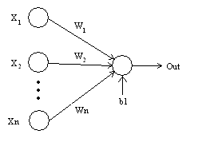
Perceptron
A computational model that simulates a neuron
Captures the basic ideas of a neuron and its behavior
We will start by looking at networks with only one perceptron or only one layer of “neurons”

Slide 8
Perceptron
X1…Xn : 0 or 1, represents inputs to neuron
W1…Wn : 0-1, represents weight for that input
B1 : Threshold
Out : 0 if neuron not firing, otherwise 1

Slide 9
Perceptron: Basic Functionality
If X1*W1 + X2*W2 … > b1 (Threshold){
Output = 1
}
Else{
Output = 0
}
*This is called a threshold activation function. We will see different versions of this later

Slide 10
A Last Year? 1
Male? 1
Works Hard? 0
Drinks a lot? 1
0.2
0.2
0.5
A This Year?
0.2
0.2

Slide 11
A Last Year? 1
Male? 1
Works Hard? 0
Drinks a lot? 1
0.2
0.2
0.5
A This Year?
0.2
0.2
Ok! But how is this learning?
Well, we want to 1) test the network on every example we have available to us and 2) adjust the weights on the edges until the network correctly classifies every single example.

Slide 12
A Last Year? 1
Male? 1
Works Hard? 0
Drinks a lot? 1
0.2
0.2
0.5
A This Year?
0.2
0.2
Let d = learning rate (float)
Until every example produces the correct output
For each example in training set:
If output is 0 but should be 1: Raise weights on active connections by d
If output is 1 but should be 0: Lower weights on active connections by d

Slide 13
A Last Year? 1
Male? 1
Works Hard? 0
Drinks a lot? 1
0.2
0.2
0.5
A This Year?
0.2
0.2
Student | A last year? | Male? | Works Hard? | Drinks? | A this year?
Richard | Yes | Yes | No | Yes | No
Allen | Yes | Yes | Yes | No | Yes
Alison | No | No | Yes | No | No
Jeff | No | Yes | No | Yes | No
Gail | Yes | No | Yes | Yes | Yes
Simon | No | Yes | Yes | Yes | No
Let d = learning rate (float)
Until every example produces the correct output
For each example in training set:
If output is 0 but should be 1: Raise weights on active connections by d
If output is 1 but should be 0: Lower weights on active connections by d

Slide 14
A Last Year? 1
Male? 1
Works Hard? 0
Drinks a lot? 1
0.15
0.15
0.5
A This Year?
0.2
0.15
Student | A last year? | Male? | Works Hard? | Drinks? | A this year?
Richard | Yes | Yes | No | Yes | No
Allen | Yes | Yes | Yes | No | Yes
Alison | No | No | Yes | No | No
Jeff | No | Yes | No | Yes | No
Gail | Yes | No | Yes | Yes | Yes
Simon | No | Yes | Yes | Yes | No
Let d = learning rate (float)
Until every example produces the correct output
For each example in training set:
If output is 0 but should be 1: Raise weights on active connections by d
If output is 1 but should be 0: Lower weights on active connections by d

Slide 15
A Last Year? 1
Male? 1
Works Hard? 1
Drinks a lot? 0
0.15
0.15
0.5
A This Year?
0.2
0.15
Student | A last year? | Male? | Works Hard? | Drinks? | A this year?
Richard | Yes | Yes | No | Yes | No
Allen | Yes | Yes | Yes | No | Yes
Alison | No | No | Yes | No | No
Jeff | No | Yes | No | Yes | No
Gail | Yes | No | Yes | Yes | Yes
Simon | No | Yes | Yes | Yes | No
Let d = learning rate (float)
Until every example produces the correct output
For each example in training set:
If output is 0 but should be 1: Raise weights on active connections by d
If output is 1 but should be 0: Lower weights on active connections by d

Slide 16
A Last Year? 1
Male? 1
Works Hard? 1
Drinks a lot? 0
0.2
0.2
0.5
A This Year?
0.25
0.15
Student | A last year? | Male? | Works Hard? | Drinks? | A this year?
Richard | Yes | Yes | No | Yes | No
Allen | Yes | Yes | Yes | No | Yes
Alison | No | No | Yes | No | No
Jeff | No | Yes | No | Yes | No
Gail | Yes | No | Yes | Yes | Yes
Simon | No | Yes | Yes | Yes | No
Let d = learning rate (float)
Until every example produces the correct output
For each example in training set:
If output is 0 but should be 1: Raise weights on active connections by d
If output is 1 but should be 0: Lower weights on active connections by d

Slide 17
A Last Year? 0
Male? 0
Works Hard? 1
Drinks a lot? 0
0.2
0.2
0.5
A This Year?
0.25
0.15
Student | A last year? | Male? | Works Hard? | Drinks? | A this year?
Richard | Yes | Yes | No | Yes | No
Allen | Yes | Yes | Yes | No | Yes
Alison | No | No | Yes | No | No
Jeff | No | Yes | No | Yes | No
Gail | Yes | No | Yes | Yes | Yes
Simon | No | Yes | Yes | Yes | No
Let d = learning rate (float)
Until every example produces the correct output
For each example in training set:
If output is 0 but should be 1: Raise weights on active connections by d
If output is 1 but should be 0: Lower weights on active connections by d

Slide 18
A Last Year? 0
Male? 1
Works Hard? 1
Drinks a lot? 1
0.2
0.2
0.5
A This Year?
0.25
0.15
Student | A last year? | Male? | Works Hard? | Drinks? | A this year?
Richard | Yes | Yes | No | Yes | No
Allen | Yes | Yes | Yes | No | Yes
Alison | No | No | Yes | No | No
Jeff | No | Yes | No | Yes | No
Gail | Yes | No | Yes | Yes | Yes
Simon | No | Yes | Yes | Yes | No
Let d = learning rate (float)
Until every example produces the correct output
For each example in training set:
If output is 0 but should be 1: Raise weights on active connections by d
If output is 1 but should be 0: Lower weights on active connections by d

Slide 19
A Last Year? 0
Male? 1
Works Hard? 1
Drinks a lot? 1
0.2
0.15
0.5
A This Year?
0.2
0.1
Student | A last year? | Male? | Works Hard? | Drinks? | A this year?
Richard | Yes | Yes | No | Yes | No
Allen | Yes | Yes | Yes | No | Yes
Alison | No | No | Yes | No | No
Jeff | No | Yes | No | Yes | No
Gail | Yes | No | Yes | Yes | Yes
Simon | No | Yes | Yes | Yes | No
Let d = learning rate (float)
Until every example produces the correct output
For each example in training set:
If output is 0 but should be 1: Raise weights on active connections by d
If output is 1 but should be 0: Lower weights on active connections by d

Slide 20
A Last Year? 0
Male? 1
Works Hard? 1
Drinks a lot? 1
0.2
0.15
0.5
A This Year?
0.2
0.1
Student | A last year? | Male? | Works Hard? | Drinks? | A this year?
Richard | Yes | Yes | No | Yes | No
Allen | Yes | Yes | Yes | No | Yes
Alison | No | No | Yes | No | No
Jeff | No | Yes | No | Yes | No
Gail | Yes | No | Yes | Yes | Yes
Simon | No | Yes | Yes | Yes | No
Not done yet
Need to go through training examples again until the network converges and produces good output for all examples
What if this is not possible?

Slide 21
A Last Year? 0
Male? 1
Works Hard? 1
Drinks a lot? 1
0.25
0.1
0.5
A This Year?
0.2
0.1
Student | A last year? | Male? | Works Hard? | Drinks? | A this year?
Richard | Yes | Yes | No | Yes | No
Allen | Yes | Yes | Yes | No | Yes
Alison | No | No | Yes | No | No
Jeff | No | Yes | No | Yes | No
Gail | Yes | No | Yes | Yes | Yes
Simon | No | Yes | Yes | Yes | No
After another pass, the weights are as above
These work for all training examples!

Slide 22
A Last Year? 0
Male? 1
Works Hard? 1
Drinks a lot? 1
0.25
0.1
0.5
A This Year?
0.2
0.1
This single-layer network works for this example…however simple networks like this cannot solve any problem.
Famously: It is not possible to use one neuron to recognize the XOR function
Go on…try to
Shown by Minsky and Papert in 1969 (Book is called Perceptrons)

Slide 23
Artificial Neural Networks
More Advanced Networks

Slide 24
XOR Network: Does This Work?
Input 1
Input 2
1.0
1.0
1.5
-2.0
0.5
Output
1.0
1.0

Slide 25
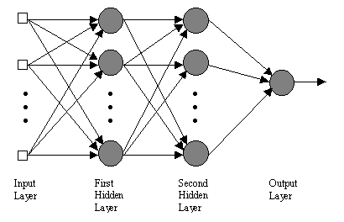
Multi-Layer Networks
Input Layer:
Left-most layer that accepts inputs directly
Hidden Layer(s):
Layers that receive input from and output to other neurons
Output Layer:
Layer of neurons whose output is the output of the system

Slide 26
Perceptron: Basic Functionality
We have seen a basic perceptron like this:
If X1*W1 + X2*W2 … > b1 (Threshold){
Output = 1
}
Else{
Output = 0
}

Slide 27
Multi-Layer Networks
Works the same way…however:
How do we update the weights when training the network? It’s not clear how this should work.
Solution: Backpropagation!
We’ll get there in a sec. First, some more basic stuff.

Slide 28
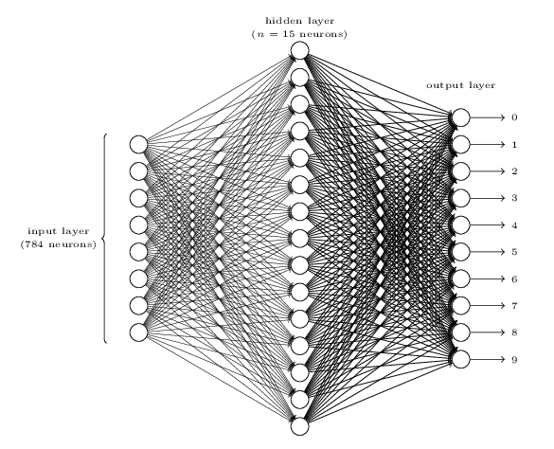
Multi-Layer Networks
This network will recognize the single hand-written digits 0-9
Some of the network is not drawn for simplicity
You would have to train the network on many examples of hand-written images of these ten digits
Notice that there are multiple outputs. How would we interpret these?

Slide 29
Artificial Neural Networks Activation Functions

Slide 30
A Last Year? 1
Male? 1
Works Hard? 0
Drinks a lot? 1
0.2
0.2
0.5
A This Year?
0.2
0.2
The activation function of a neuron is the function it uses to determine whether to fire or not
These perceptrons we have seen so far have a simple activation function:
Threshold Activation Function: Fire a 1 on output if total input (plus some bias) exceeds zero
…but we can certainly use others!

Slide 31
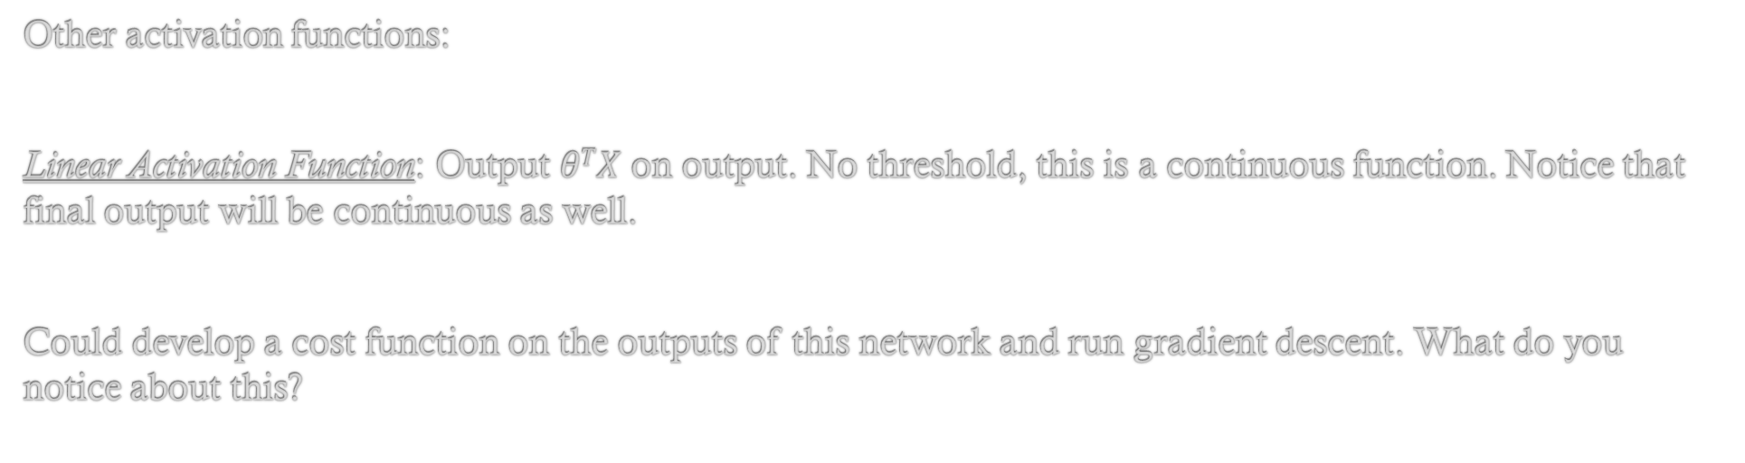

A Last Year? 1
Male? 1
Works Hard? 0
Drinks a lot? 1
0.2
0.2
$$θTX$$
A This Year?
0.2
0.2
Other activation functions:
Linear Activation Function: Output $θTX$ on output. No threshold, this is a continuous function. Notice that final output will be continuous as well.
Could develop a cost function on the outputs of this network and run gradient descent. What do you notice about this?

Slide 32
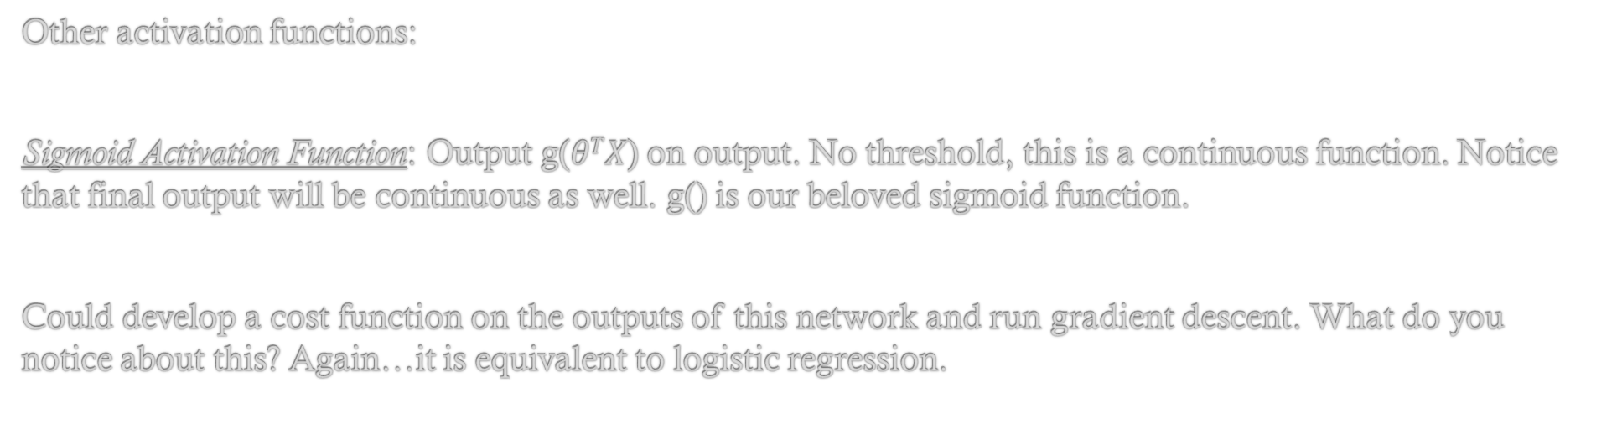
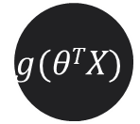
A Last Year? 1
Male? 1
Works Hard? 0
Drinks a lot? 1
0.2
0.2
$$g(θTX)$$
A This Year?
0.2
0.2
Other activation functions:
Sigmoid Activation Function: Output g($θTX$) on output. No threshold, this is a continuous function. Notice that final output will be continuous as well. g() is our beloved sigmoid function.
Could develop a cost function on the outputs of this network and run gradient descent. What do you notice about this? Again…it is equivalent to logistic regression.

Slide 33
Artificial Neural Networks Backpropagation

Slide 34
Cost Function
For the purposes of simplifying our discussion of this algorithm, we are going to assume:
- That our network has hidden layers
- That activation function is a sigmoid
- The cost function is same as logistic reg.
Problem:
We know how to update weights on a single perceptron network (same as logistic regression)
Need a way to update weights on edges in middle of the network.

Slide 35
Backpropagation: Overview
An algorithm that updates all theta weights in network (to descend on optimal values)
At right most level, works much like gradient descent (use error between predicted output and correct output)
At inner layers, we need a way to propagate the error back into earlier levels of the network.
I will present an overview of this algorithm.

Slide 36
Backpropagation Algorithm: Overview
Given the Training Set
Repeat until Theta values on each edge converge:
For each example in Training Set:
Perform Forward-Propagation to determine output of network on this example
Compute the error of the output (network output minus expected output)
Compute the error terms for every other node in network (backwards through network)
*Notice that first layer has no error term because it represents input (never changes)
Compute Delta values for each edge (essentially a cumulative error term at each edge)
#END FOR LOOP
Compute Gradient values as a function of Delta values for each edge
This Gradient value tells you how much to change each edge weight (theta)
#END MAIN LOOP

Slide 37
Backpropagation Algorithm: Intuition / Notation
Show image on board

Slide 38

Backpropagation Algorithm: Notation
Neural Networks have a lot of notation, let’s review!!
$θ\left(4\right)23$ //The weight on edge headed out of layer 4 from node 3 (in layer 4) to node 2 (in layer 5)
//Superscript is the layer, subscripts are node indices within a layer (top to bottom)
a⁽⁴⁾₃ //The output of third neuron on layer 4 of the network (heading into layer 5)
//This value is same edges coming out of this node, so second subscript not necessary
z⁽⁵⁾₂₃ //Input to the 2nd node on layer 5 from the 3rd node on layer 4
//Equal to the $θ\left(4\right)23∗a\left(4\right)23$ *Plus any other inputs from graph
$δ\left(2\right)3$ //The error associated with the 3rd node on layer 2 of the network

Slide 39
Given the Training Set
Repeat until Theta values on each edge converge:
For each example in Training Set:
Perform Forward-Propagation to determine output of network on this example
Compute the error of the output (network output minus expected output)
Compute the error terms for every other node in network (backwards through network)
*Notice that first layer has no error term because it represents input (never changes)
Computer Delta values for each edge (essentially a cumulative error term at each edge)
#END FOR LOOP
Compute Gradient values as a function of Delta values for each edge
This Gradient value tells you how much to change each edge weight (theta)
#END MAIN LOOP

Slide 40

Given the Training Set
Repeat until Theta values on each edge converge:
For each example in Training Set:
Perform Forward-Propagation to determine output of network on this example
Compute the error of the output (network output minus expected output)
Compute the error terms for every other node in network (backwards through network)
*Notice that first layer has no error term because it represents input (never changes)
Computer Delta values for each edge (essentially a cumulative error term at each edge)
#END FOR LOOP
Compute Gradient values as a function of Delta values for each edge
This Gradient value tells you how much to change each edge weight (theta)
#END MAIN LOOP
$$δ\left(l\right)j=a\left(l\right)j −yj$$
Talking about last layer’s output only.
The error is simply the difference between actual and expected output
‘l’ here represents the last layer of the network only

Slide 41

Given the Training Set
Repeat until Theta values on each edge converge:
For each example in Training Set:
Perform Forward-Propagation to determine output of network on this example
Compute the error of the output (network output minus expected output)
Compute the error terms for every other node in network (backwards through network)
*Notice that first layer has no error term because it represents input (never changes)
Computer Delta values for each edge (essentially a cumulative error term at each edge)
#END FOR LOOP
Compute Gradient values as a function of Delta values for each edge
This Gradient value tells you how much to change each edge weight (theta)
#END MAIN LOOP
$$δ\left(3\right)j=Sum(\left(θ\left(3\right)ij\right)∗δ\left(4\right)i) ∗(g^{′}\left(z\left(3\right)j\right))$$
Compute this for every layer down to 2 (1 is the input layer so no error associated there)
*3 is just an example here, really the layer should be generalized
g’(z⁽³⁾_{j}) = a⁽³⁾_{j} * (1-a⁽³⁾_{j}) //trust me, this is the derivative of g

Slide 42

Given the Training Set
Repeat until Theta values on each edge converge:
For each example in Training Set:
Perform Forward-Propagation to determine output of network on this example
Compute the error of the output (network output minus expected output)
Compute the error terms for every other node in network (backwards through network)
*Notice that first layer has no error term because it represents input (never changes)
Compute Delta values for each edge (essentially a cumulative error term at each edge)
#END FOR LOOP
Compute Gradient values as a function of Delta values for each edge
This Gradient value tells you how much to change each edge weight (theta)
#END MAIN LOOP
$$∆\left(l\right)ij+=a\left(l\right)j∗δ\left(l+1\right)i$$
These values start at 0 and are accumulated over all training examples. So don’t reset them after each training example
Note there is one of these for each edge in the network

Slide 43

Given the Training Set
Repeat until Theta values on each edge converge:
For each example in Training Set:
Perform Forward-Propagation to determine output of network on this example
Compute the error of the output (network output minus expected output)
Compute the error terms for every other node in network (backwards through network)
*Notice that first layer has no error term because it represents input (never changes)
Compute Delta values for each edge (essentially a cumulative error term at each edge)
#END FOR LOOP
Compute Gradient values as a function of Delta values for each edge
This Gradient value tells you how much to change each edge weight (theta)
#END MAIN LOOP
$$D\left(l\right)ij=\left(\frac{1}{m}\right)∗∆\left(l\right)ij$$
This is (again, trust me) the value of the partial derivative with respect to theta on each edge. So…just update theta by this value.
Most of the time we include a regularization term, I’m leaving this out for now, but don’t be scared if you see that in a reading

Slide 44
Interesting Video
Neural Network to play Super Mario World:
http://digg.com/video/computer-program-learns-how-to-play-mario

