Slide 1
CS 3100 Data Structures and Algorithms 2 Lecture 23: Reductions
Co-instructors: Robbie Hott and Ray Pettit
Spring 2024
Readings from CLRS 4th Ed: Network flow etc. in Chapter 24 (Reductions covered in CLRS but in a context we’re not studying in CS3100)

Slide 2






Two Ways to use Reductions
Suppose we have a “fast” reduction from A to B
A “fast” algorithm for B gives a fast algorithm for A
If we have a worst-case lower bound for A, we also have one for B
$$A$$
$$B$$
fast
$$A$$
$$B$$
Then A is fast
fast
If B is fast
$$A$$
$$B$$
If A is slow
fast
Then B is slow

Slide 3
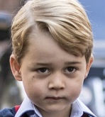
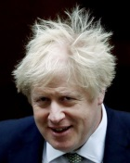


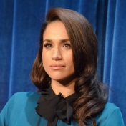
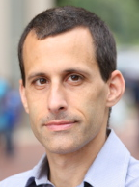




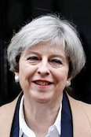
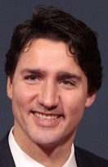
Party Problem
Draw Edges between people who don’t get along
Find the maximum number of people who get along

Slide 4
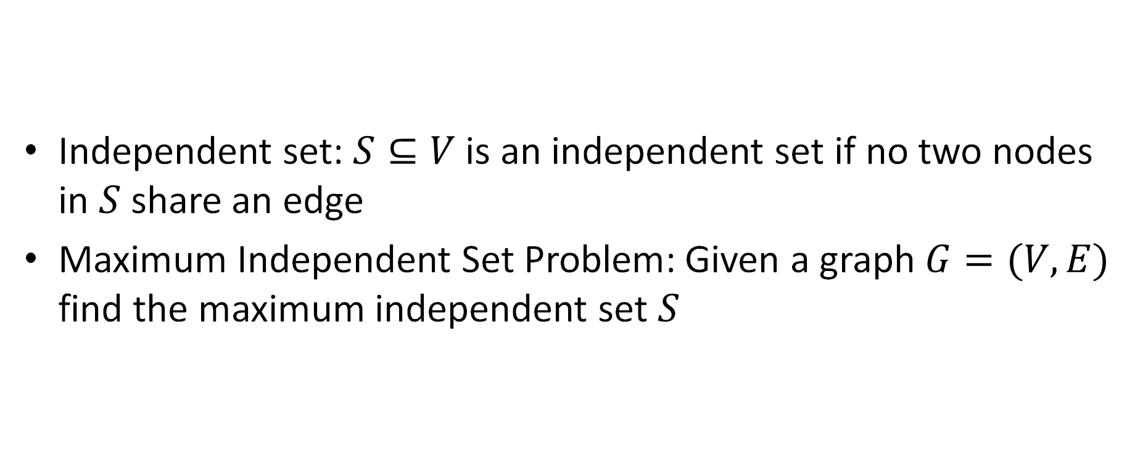
Maximum Independent Set
Independent set: $S⊆V$ is an independent set if no two nodes in $S$ share an edge
Maximum Independent Set Problem: Given a graph $G=(V,E)$ find the maximum independent set $S$

Slide 5
Example
Independent set of size 6

Slide 6
Generalized Baseball

Slide 7
Generalized Baseball
Need to place defenders on bases such that every edge is defended
What’s the fewest number of defenders needed?

Slide 8
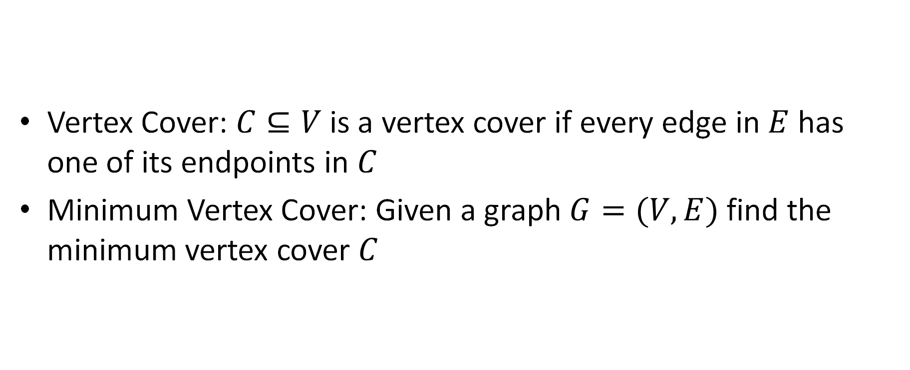
Minimum Vertex Cover
Vertex Cover: $C⊆V$ is a vertex cover if every edge in $E$ has one of its endpoints in $C$
Minimum Vertex Cover: Given a graph $G=(V,E)$ find the minimum vertex cover $C$

Slide 9
Example
Vertex cover of size 5

Slide 10



















MaxIndSet$≤_{V}$MinVertCov
$$A$$
$$B$$
$O(V)$-reduces to
Problem B
Problem A
$$Y$$
$$X$$
can be used to make
With $O(V)$ overhead
Algorithm for B
Algorithm for A
If $A$ requires time $Ω(f\left(n\right))$ time then $B$ also requires $Ω(f\left(n\right))$ time
$A≤_{V}B$

Slide 11




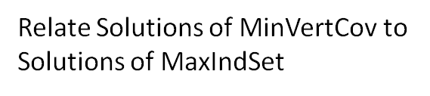
We need to build this Reduction
MaxIndSet
O(V) Time
MinVertCov
$$A$$
Relate Instances of MaxIndSet
to Instances of MinVertCov
$$B$$
Using any Algorithm for MinVertCov
Relate Solutions of MinVertCov to Solutions of MaxIndSet
Solution for MaxIndSet
Solution for MinVertCov
$$X$$
$$Y$$
Reduction

Slide 12










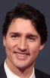
Reduction Idea
$S$ is an independent set of $G$ iff $V−S$ is a vertex cover of $G$
Independent Set
Vertex Cover

Slide 13
Reduction Idea
$S$ is an independent set of $G$ iff $V−S$ is a vertex cover of $G$
Vertex Cover
Independent Set

Slide 14

MaxVertCov $V$-Time Reducible to MinIndSet
MaxIndSet
O(V) Time
MinVertCov
$$A$$
$$B$$
Do nothing
Using any Algorithm for MinVertCov
Solution for MaxIndSet
Take complement of solution
Solution for MinVertCov
$$X$$
$$Y$$
Must show (prove): 1) how to make construction
2) Why it works
Reduction

Slide 15



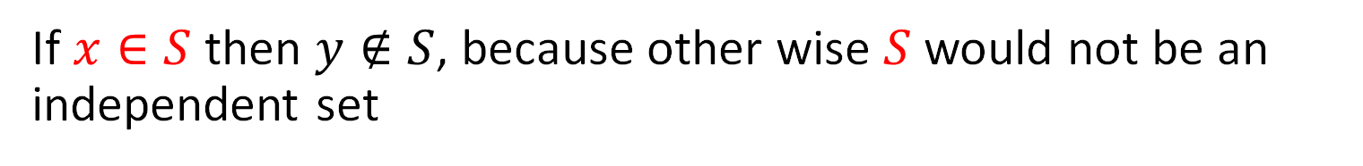
Proof: $⇒$
$S$ is an independent set of $G$ iff $V−S$ is a vertex cover of $G$
Let $S$ be an independent set
Consider any edge $\left(x,y\right)∈E$
If $x∈S$ then $y∉S$, because other wise $S$ would not be an independent set
Therefore $y∈V−S$, so edge $(x,y)$ is covered by $V−S$

Slide 16
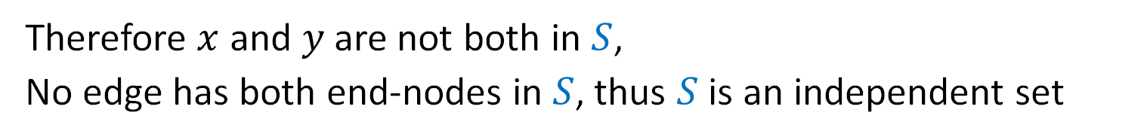

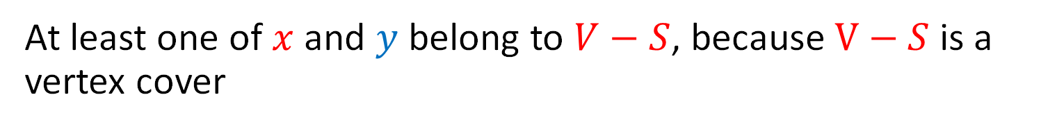
Proof: $⇐$
$S$ is an independent set of $G$ iff $V−S$ is a vertex cover of $G$
Let $V−S$ be a vertex cover
Consider any edge $\left(x,y\right)∈E$
At least one of $x$ and $y$ belong to $V−S$, because $V−S$ is a vertex cover
Therefore $x$ and $y$ are not both in $S$,
No edge has both end-nodes in $S$, thus $S$ is an independent set

Slide 17

MaxIndSet $V$-Time Reducible to MinVertCov
MaxIndSet
O(V) Time
MinVertCov
$$A$$
$$B$$
Do nothing
Using any Algorithm for MinVertCov
Solution for MaxIndSet
Take complement of solution
Solution for MinVertCov
$$X$$
$$Y$$
Reduction

Slide 18

MinVertCov $V$-Time Reducible to MaxIndSet
MaxIndSet
MinVertCov
O(V) Time
$$A$$
$$B$$
Do nothing
Using any Algorithm for MaxIndSet
Solution for MinVertCov
Take complement of solution
Solution for MaxIndSet
$$X$$
$$Y$$
Reduction

Slide 19


Corollary
MaxIndSet
O(V) Time
MinVertCov
$$A$$
$$B$$
Do nothing
Using any Algorithm for MinIndSet
If Solving $A$ was always slow
Then this shows solving $B$ is also slow
Solution for MaxIndSet
Take complement of solution
Solution for MinVertCov
$$X$$
$$Y$$
Reduction

Slide 20

Corollary
MaxIndSet
MinVertCov
O(V) Time
$$A$$
$$B$$
Do nothing
Using any Algorithm for MaxVertCov
If Solving $A$ was always slow
Then this shows solving $B$ is also slow
Solution for MinVertCov
Take complement of solution
Solution for MaxIndSet
$$X$$
$$Y$$
Reduction

Slide 21
Conclusion
MaxIndSet and MinVertCov are either both fast, or both slow
Spoiler alert: We don’t know which!
(But we think they’re both slow)
Both problems are NP-Complete

Slide 22
NP Complete Problems: A Short Overview

Slide 23
Problems and Exponential Solutions
We’ve not been able to find polynomial-time algorithms for some problems
Example graph problems
Travelling Salesperson Problem. (Similar problem: does a graph have a Hamilton Cycle?)
Can a graph be colored with k colors (for k>2)?
Max Independent Set and Min Vertex Cover
Other examples
Satisfiability: Given a Boolean logic expression like: (x₁ ∨ ¬x₂) ∧ (¬x₁ ∨ x₃ ∨ x₄) ∧ (¬x₅) can we assign True or False to the Boolean variables so this is true?
https://en.wikipedia.org/wiki/List_of_NP-complete_problems

Slide 24

Exponential? It’s an Open Question
Perhaps we just haven’t found a polynomial algorithm yet
Option 1: Keep trying!
Option 2: Prove an exponential lower bound for a problem, thus showing it’s impossible for the problem to have a polynomial solution
For the problems just listed, no one’s made such a lower bound proof either
Bottom-line: We don’t know if these problems are exponential or not!

Slide 25
Before we go further on this topic….
This is a complex (and interesting!) topic in CS theory
In these slides, we will approach things from a simpler viewpoint than you’d get in a CS theory course (like CS 3120)
For example, the math and theory related to this starts with decision problems
But we’re not going to say much about that, and instead we’ll be less formal than perhaps we should be

Slide 26
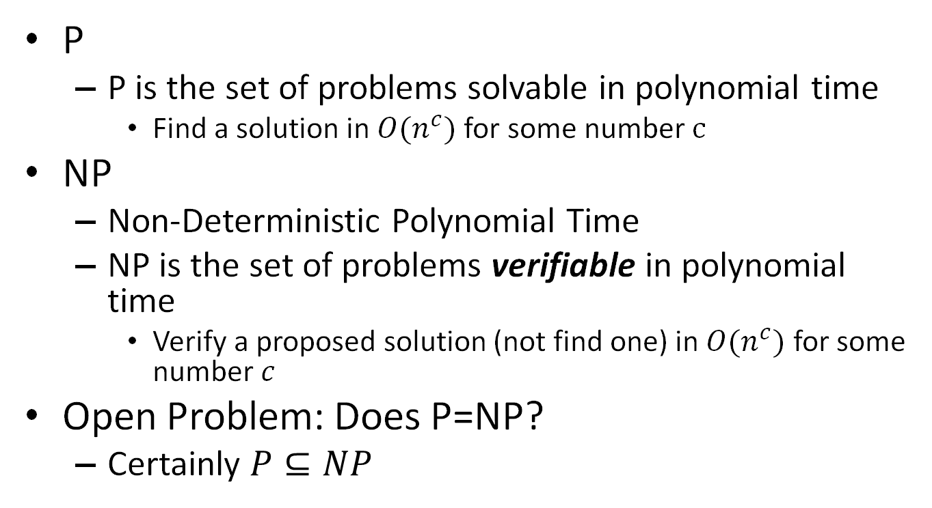
Classes of Problems: P vs NP
P
P is the set of problems solvable in polynomial time
Find a solution in $O(n^{c})$ for some number $c$
NP
Non-Deterministic Polynomial Time
NP is the set of problems verifiable in polynomial time
Verify a proposed solution (not find one) in $O(n^{c})$ for some number $c$
Open Problem: Does P=NP?
Certainly $P⊆NP$
NP
P
-or-
P = NP

Slide 27
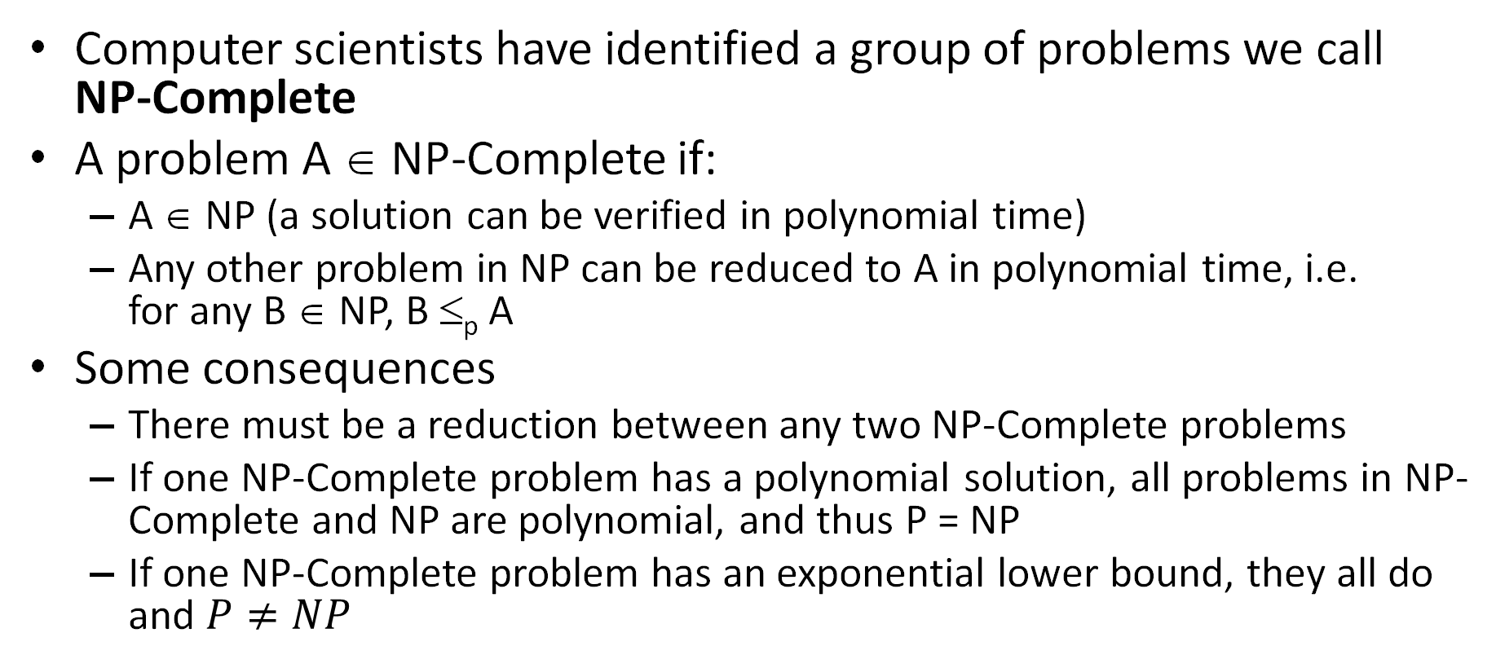
NP-Complete Problems
Computer scientists have identified a group of problems we call NP-Complete
A problem A ∈ NP-Complete if:
A ∈ NP (a solution can be verified in polynomial time)
Any other problem in NP can be reduced to A in polynomial time, i.e. for any B ∈ NP, B ≤_{p} A
Some consequences
There must be a reduction between any two NP-Complete problems
If one NP-Complete problem has a polynomial solution, all problems in NP-Complete and NP are polynomial, and thus P = NP
If one NP-Complete problem has an exponential lower bound, they all do and $P≠NP$

Slide 28
Take-Aways for CS 3100
What an NP-Complete Problem is
Informally: a group of problems that are “equivalent” in that they’re either all polynomial or all exponential, and we don’t know which
The big open question in CS: Does P=NP?
Given a problem, if we can verify a solution is polynomial time, does this mean we can always solve it directly in polynomial time?
Some problems we’ve studied are NP-Complete problems
Max Independent Set, Min Vertex Cover, dynamic programming problems that are pseudo-polynomial
More about this topic in CS3120! https://en.wikipedia.org/wiki/NP-completeness

