Slide 1
Dynamic Programming Intro and Log / Rod Cutting
CS 3100 – DSA2
Mark Floryan

Slide 2
Dynamic Programming and Greedy Approach
TOPICS:
Intro to Dynamic Programming
Memoization
Example DP Problem:
Log Cutting

Slide 3

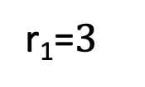


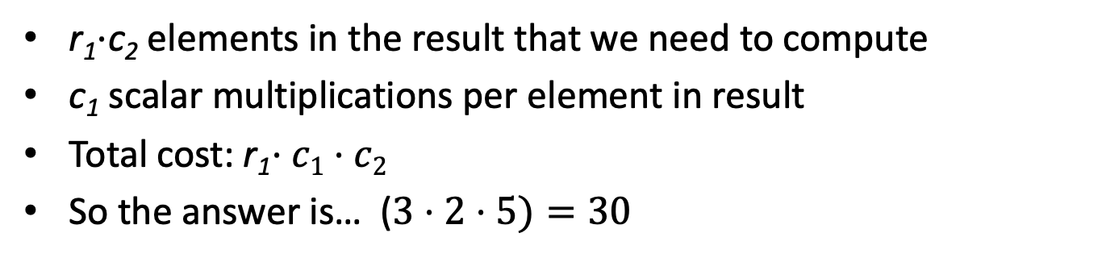
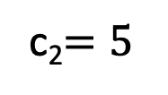



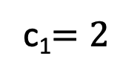

Motivating Example
How many scalar multiplications are required to multiply matrices A and B in this example?
c₁$=2$
c₂$=5$
$$5$$
r₁=$3$
$$×$$
$$2$$
$$=$$
$$3$$
$$A$$
$$B$$
r₁$⋅$c₂ elements in the result that we need to compute
c₁ scalar multiplications per element in result
Total cost: r₁$⋅c1⋅c2$
So the answer is… ($3⋅2⋅5)=30$

Slide 4

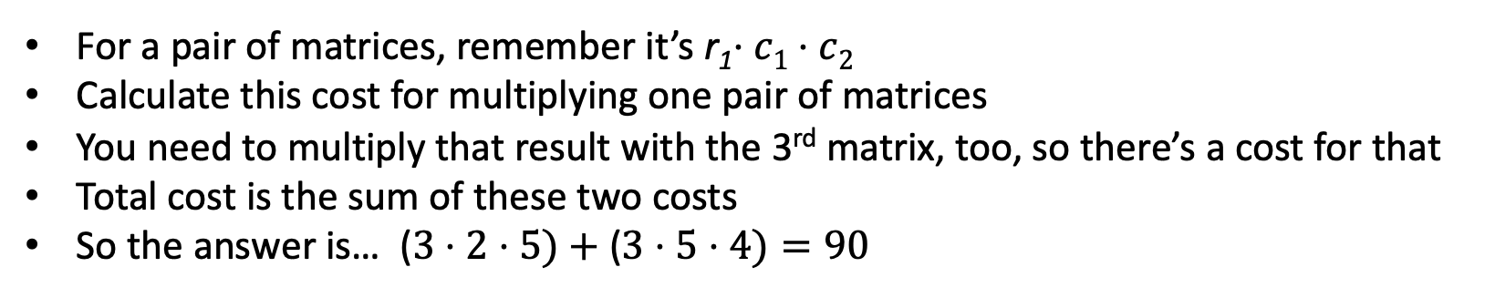












Trickier Question
What’s the smallest number of scalar multiplications required to calculate the matrix product ABC in this example?
$$4$$
$$2$$
$$5$$
$$4$$
$$3$$
$$×$$
$$2$$
$$×$$
$$5$$
$$=$$
$$3$$
$$A$$
$$B$$
$$C$$
For a pair of matrices, remember it’s r₁$⋅c1⋅c2$
Calculate this cost for multiplying one pair of matrices
You need to multiply that result with the 3rd matrix, too, so there’s a cost for that
Total cost is the sum of these two costs
So the answer is… ($3⋅2⋅5)+$($3⋅5⋅4)=90$
Nope! The answer is 64. Think about how this might be!
Notes:
A(BC) vs. (AB)C

Slide 5
CLRS Readings
Chapter 15, Dynamic Programming
Section 15.1, Log/Rod cutting, optimal substructure property
Note: r_{i} in book is called Cut() or C[] in our slides. We do use their example.
Section 15.3, More on elements of DP, including optimal substructure property

Slide 6
Dynamic Programming and Greedy Approach
Module 5 is on Dynamic Programming
Similar to Greedy Algorithms
Solves problems that have optimal substructure, but do NOT have a known greedy choice for optimal solutions
Instead, try every option for the first “greedy” choice and see which one leads to optimal solution.
Will need some optimizations to make this efficient.

Slide 7
Optimization Problems
Both DP and Greedy solve optimization problems:
Find the best solution among all feasible solutions
An example you know: Find the shortest path in a weighted graph G from s to v
Form of the solution: a path (and sum of its edge-weights)
Feasible solutions must meet problem constraints
Example: All edges in solution are in graph G and form a simple path from s to v
We can get a score for each feasible solution on some criteria:
We call this the objective function
Example: the sum of the edge weights in path
One (or more) feasible solutions that scores highest (by the objective function) is the optimal solution(s)

Slide 8
Memoization

Slide 9
Remember Fibonacci numbers?
Formula: F(n) = F(n-1) + F(n-2)
Recursive code: long fib(int n) { assert(n >= 0); if ( n == 0 ) return 0; if ( n == 1 ) return 1; return fib(n-1) + fib(n-2); }
What's the problem?
Repeatedly solves the same subproblems
“Obscenely” exponential

Slide 10
Top-down using Memoization
Before talking about bottom-up dynamic programming using tables, top-down approach uses general technique of Memoization
AKA using a memory function
Simple idea:
Calculate and store solutions to subproblems
Before solving it (again), look to see if you've remembered it

Slide 11
Memoization
Use a Table abstract data type
Lookup key: whatever identifies a subproblem
Value stored: the solution
Could be an array/vector or 2D table(s)
E.g. for Fibonacci, store fib(n) using index n
Need to initialize the array
Could use a map / hash-table

Slide 12
Memoization and Fibonacci
Before recursive code below called, must initialize results[] so all values are -1 long fib_mem(int n, long results[]) { if ( results[n] != -1 ) return results[n]; // return stored value long val; if ( n == 0 || n ==1 ) val = n; // odd but right else val = fib_mem(n-1, results) + fib_mem(n-2, results); results[n] = val; // store calculated value return val; }

Slide 13
Observations on fib_mem()
Same elegant top-down, recursive approach based on definition
Without repeated subproblems
Memory function: a function that remembers
Save time by using extra space
Can show this runs in Θ(n)

Slide 14
Bottom-Up Dynamic Programming
Bottom-Up Dynamic Programming is similar
Solve the base cases first!
Fill in the next biggest sub-problems next
Repeat.
Draw a picture to visualize →

Slide 15
Bottom-Up Fibonacci
Not recursive. Just fills in answers
fib(int n):
long result[n+1]; //index n stores nth fib number
result[0] = 0; result[1] = 1; //fill in base cases
for i = 2 to n:
result[i] = result[i-1] + result[i-2];
return result[n];

Slide 16
Dynamic Programming and Log Cutting

Slide 17
Dynamic programming
Old “bad” name (see Wikipedia or textbook)
Useful when the solution can be recursively described in terms of solutions to sub-problems (optimal substructure)
But greedy choice property doesn’t hold for the problem
Algorithm finds solutions to sub-problems and stores them in memory for later use
More efficient than brute-force methods or recursive approaches that solve the same sub-problems over and over again

Slide 18
Optimal Substructure Property
Definition
If S is an optimal solution to a problem, then the components of S are optimal solutions to sub-problems
Examples:
True for coin-changing
True for single-source shortest path
Not true for longest-simple-path
True for knapsack

Slide 19
Dynamic Programming
Can work “bottom-up” or “top-down” (as seen with fib)
Both techniques store answers to subproblems in memory and look them up when necessary.
Comparison to greedy approach
Also requires optimal substructure
But greedy makes choice first, then solves
Greedy looks only at the current situation, not at a past ‘history’
DP is good when sub-problems overlap, when they’re not independent
No need to repeat the calculation to solve them
Dynamic programming has stored them, so doesn’t repeat the calculation

Slide 20
Process for Dynamic Programming
Recognize what the sub-problems are
Identify the recursive structure of the problem in terms of its sub-problems
At the top level, what is the “last thing” done?
This helps you see a recursive solution for any generic sub-problem in terms of smaller sub-problems
Formulate a data structure (array, table) that can look-up solution to any sub-problem in constant time
Develop an algorithm that loops through data structure solving each sub-problem one at a time
Bottom-up: from smallest sub-problems, to next largest, …, to complete problem
Or top-down: implement recursively and store solutions as you go.

Slide 21
Problems Solved with Dyn. Prog.
Log cutting (first example, uses list data structure)
0/1 knapsack problem
Coin changing with “non-standard” coin selection
Longest common subsequence
Multiplying a sequence of matrices
Can do in various orders: (AB)C vs. A(BC)
Pick order that does fewest number of scalar multiplications
And ones we might not get to:
All-pairs shortest paths (Floyd’s algorithm)
Constructing optimal binary search trees

Slide 22
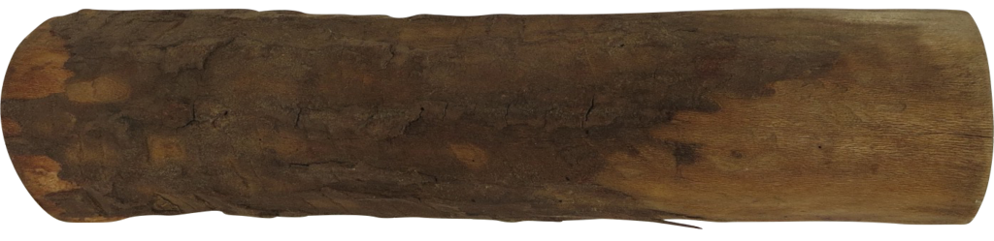
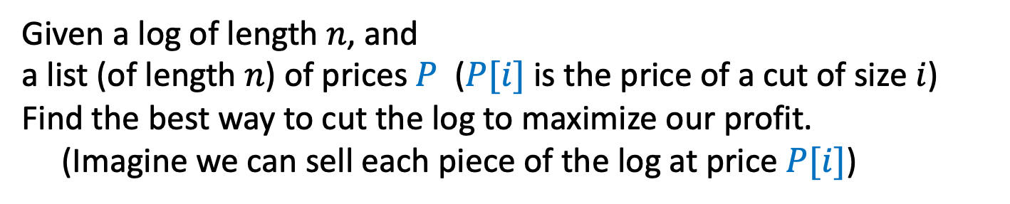
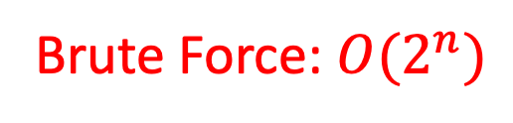
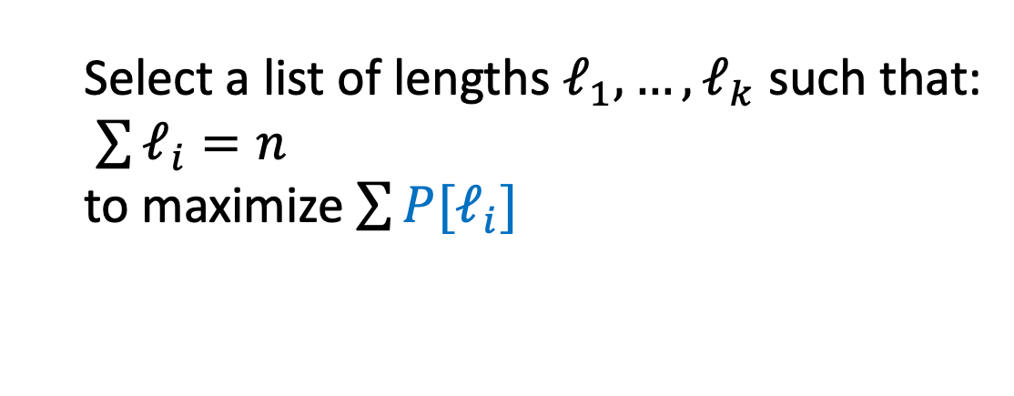
Log Cutting
Given a log of length $n$, and
a list (of length $n$) of prices $P$ ($P[i]$ is the price of a cut of size $i$)
Find the best way to cut the log to maximize our profit.
(Imagine we can sell each piece of the log at price $P[i]$)
Price:
1
5
8
9
10
17
17
20
24
30
Length:
1
2
3
4
5
6
7
8
9
10
Select a list of lengths $ℓ_{1}, …, ℓ_{k}$ such that:
$\sum{ℓ_{i}=n}$
to maximize $\sum{{P[ℓ}_{i}]}$
Brute Force: $O(2^{n})$

Slide 23
Dynamic Programming
Requires Optimal Substructure
Solution to larger problem contains the solutions to smaller ones
Idea:
Identify the recursive structure of the problem
What is the “last thing” done?
Formulate a data structure (array, table) that can look-up solution to any sub-problem in constant time
Select a good order for solving subproblems
“Top Down”: Solve each recursively. (Using memorization – we’ll do later!)
“Bottom Up”: Iteratively solve smallest to largest

Slide 24
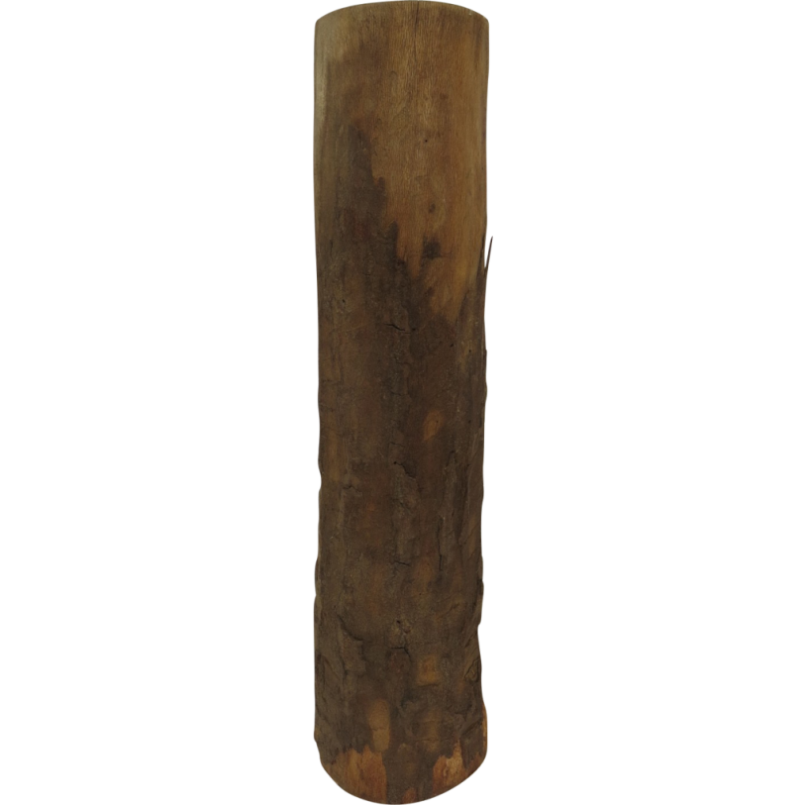

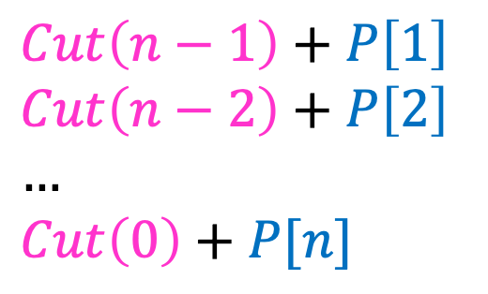



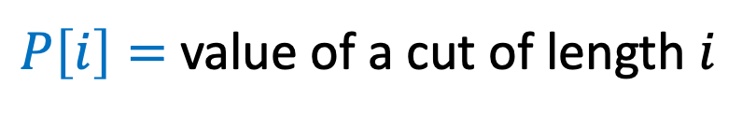
1. Identify Recursive Structure
$P\left[i\right]=$ value of a cut of length $i$
$Cut(n)=$ value of best way to cut a log of length $n$
$Cut\left(n−1\right)+P\left[1\right]$
$Cut\left(n−2\right)+P\left[2\right]$
$…$
$Cut\left(0\right)+P[n]$
So for a given value of n, to find Cut(n), we need sub-problem solutions for Cut(n-1) down to Cut(0).
$Cut\left(n\right)=max⁡$
$$Cut(n−ℓ_{k})$$
What’s the problem with a top-down recursive approach?
$$ℓ_{k}$$
best way to cut a log of length $n−ℓ_{k}$
Last Cut

Slide 25
Dynamic Programming
Requires Optimal Substructure
Solution to larger problem contains the solutions to smaller ones
Idea:
Identify the recursive structure of the problem
What is the “last thing” done?
Save the solution to each subproblem in memory
Select a good order for solving subproblems
“Top Down”: Solve each recursively
“Bottom Up”: Iteratively solve smallest to largest

Slide 26

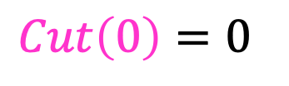
3. Select a Good Order for Solving Subproblems
Solve smallest sub-problem first
$Cut\left(0\right)=0⁡$
$Cut(i)$:
0
Length:
0
1
2
3
4
5
6
7
8
9
10
0

Slide 27
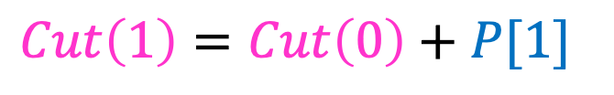
3. Select a Good Order for Solving Subproblems
Solve smallest sub-problem first
$Cut\left(1\right)=Cut\left(0\right)+P[1]⁡$
$Cut(i)$:
0
Length:
0
1
2
3
4
5
6
7
8
9
10
1
Price:
1
5
8
9
10
17
17
20
24
30
Length:
1
2
3
4
5
6
7
8
9
10

Slide 28
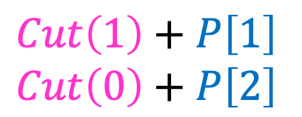

3. Select a Good Order for Solving Subproblems
Solve smallest sub-problem first
$Cut\left(1\right)+P\left[1\right]$
$Cut\left(0\right)+P\left[2\right]$
$Cut\left(2\right)=max⁡$
$Cut(i)$:
0
Length:
0
1
2
3
4
5
6
7
8
9
10
2
Price:
1
5
8
9
10
17
17
20
24
30
Length:
1
2
3
4
5
6
7
8
9
10

Slide 29
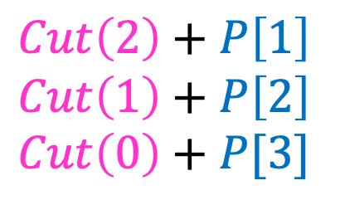

3. Select a Good Order for Solving Subproblems
Solve smallest sub-problem first
$Cut\left(2\right)+P\left[1\right]$
$Cut\left(1\right)+P\left[2\right]$
$Cut\left(0\right)+P[3]$
$Cut\left(3\right)=max⁡$
$Cut(i)$:
0
Length:
0
1
2
3
4
5
6
7
8
9
10
3
Price:
1
5
8
9
10
17
17
20
24
30
Length:
1
2
3
4
5
6
7
8
9
10

Slide 30
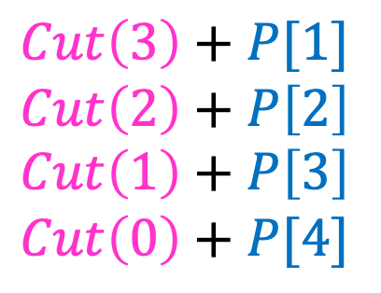

3. Select a Good Order for Solving Subproblems
Solve smallest sub-problem first
$Cut\left(3\right)+P[1]$
$Cut\left(2\right)+P\left[2\right]$
$Cut\left(1\right)+P\left[3\right]$
$Cut\left(0\right)+P[4]$
$Cut\left(4\right)=max⁡$
$Cut(i)$:
0
Length:
0
1
2
3
4
5
6
7
8
9
10
4
Price:
1
5
8
9
10
17
17
20
24
30
Length:
1
2
3
4
5
6
7
8
9
10

Slide 31
Price:
1
5
8
9
10
17
17
20
24
30
Length:
1
2
3
4
5
6
7
8
9
10

Slide 32
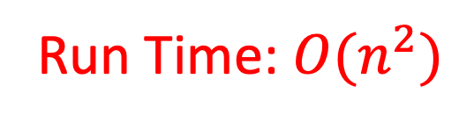
Log Cutting Pseudocode
Initialize Memory C
Cut(n):
C[0] = 0
for i=1 to n: // log size
best = 0
for j = 1 to i: // last cut
best = max(best, C[i-j] + P[j])
C[i] = best
return C[n]
Run Time: $O(n^{2})$

Slide 33
How to find the cuts?
This procedure told us the profit, but not the cuts themselves
Idea: remember the choice that you made, then backtrack

Slide 34
Remember the choice made
Initialize Memory C, Choices
Cut(n):
C[0] = 0
for i=1 to n:
best = 0
for j = 1 to i:
if best < C[i-j] + P[j]:
best = C[i-j] + P[j]
Choices[i]=j
C[i] = best
return C[n]
Gives the size of the last cut

Slide 35
Reconstruct the Cuts
Backtrack through the choices
Choices:
0
1
1
2
4
3
4
1
2
4
3
Length:
0
1
2
3
4
5
6
7
8
9
10
1
2
6
7
Example to demo Choices[] only. Profit of 20 is not optimal!

Slide 36
Backtracking Pseudocode
i = n
while i > 0:
print Choices[i]
i = i – Choices[i]

Slide 37
Our Example: Getting Optimal Solution
i | 0 | 1 | 2 | 3 | 4 | 5 | 6 | 7 | 8 | 9 | 10
C[i] | 0 | 1 | 5 | 8 | 10 | 13 | 17 | 18 | 22 | 25 | 30
Choices[i] | 0 | 1 | 2 | 3 | 2 | 2 | 6 | 1 | 2 | 3 | 10
If n were 5
Best score is 13
Cut at Choices[n]=2, then cut at Choices[n-Choices[n]]= Choices[5-2]= Choices[3]=3
If n were 7
Best score is 18
Cut at 1, then cut at 6

