Slide 1
CS 3100 DSA2 Mark Floryan
Topics: NP, NP-Hard, NP Complete
Readings: CLRS Chapter 34 (be selective)

Slide 2
Some Preliminaries
Before we go further on this topic….
This is a complex (and interesting!) topic in CS theory
In our few lectures, we may approach things from a simpler viewpoint than you’d get in a CS theory course
The math and theory related to NP-complete problems starts with decision problems
What’s that? Let’s use vertex cover as an example
What’s described next applies to any optimization problems we’ve seen

Slide 3
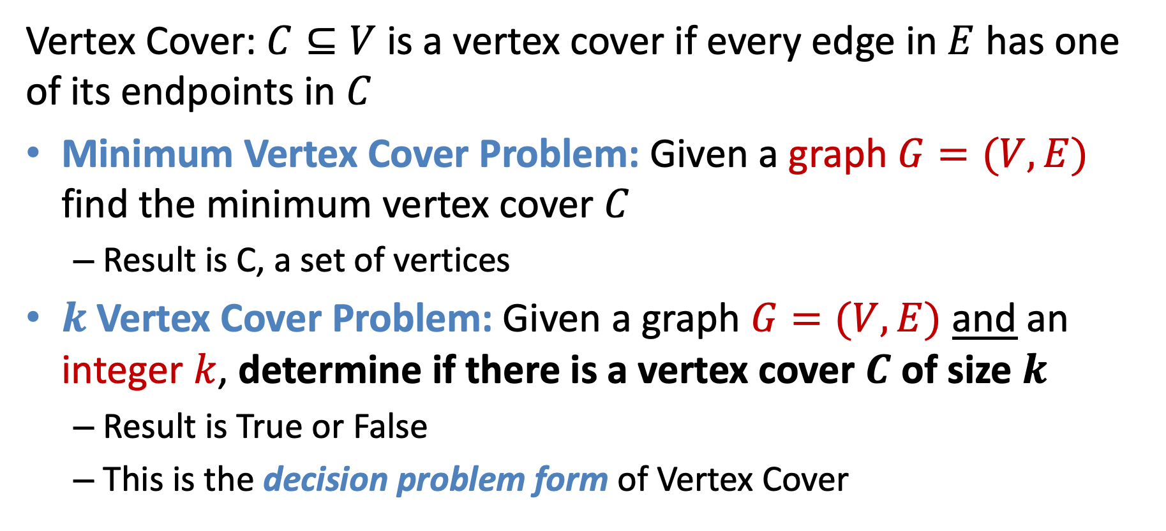
Forms of the Vertex Cover Problem
Vertex Cover: $C⊆V$ is a vertex cover if every edge in $E$ has one of its endpoints in $C$
Minimum Vertex Cover Problem: Given a graph $G=(V,E)$ find the minimum vertex cover $C$
Result is C, a set of vertices
$k$Vertex Cover Problem: Given a graph $G=(V,E)$ and an integer $k$, determine if there is a vertex cover $C$ of size $k$
Result is True or False
This is the decision problem form of Vertex Cover

Slide 4

k Vertex Cover
$k$Vertex Cover Problem: Given a graph $G=(V,E)$ and an integer $k$, determine if there is a vertex cover $C$ of size $k$
True for k=6
True for k=5
Is 5 the smallest? True for k=4?

Slide 5
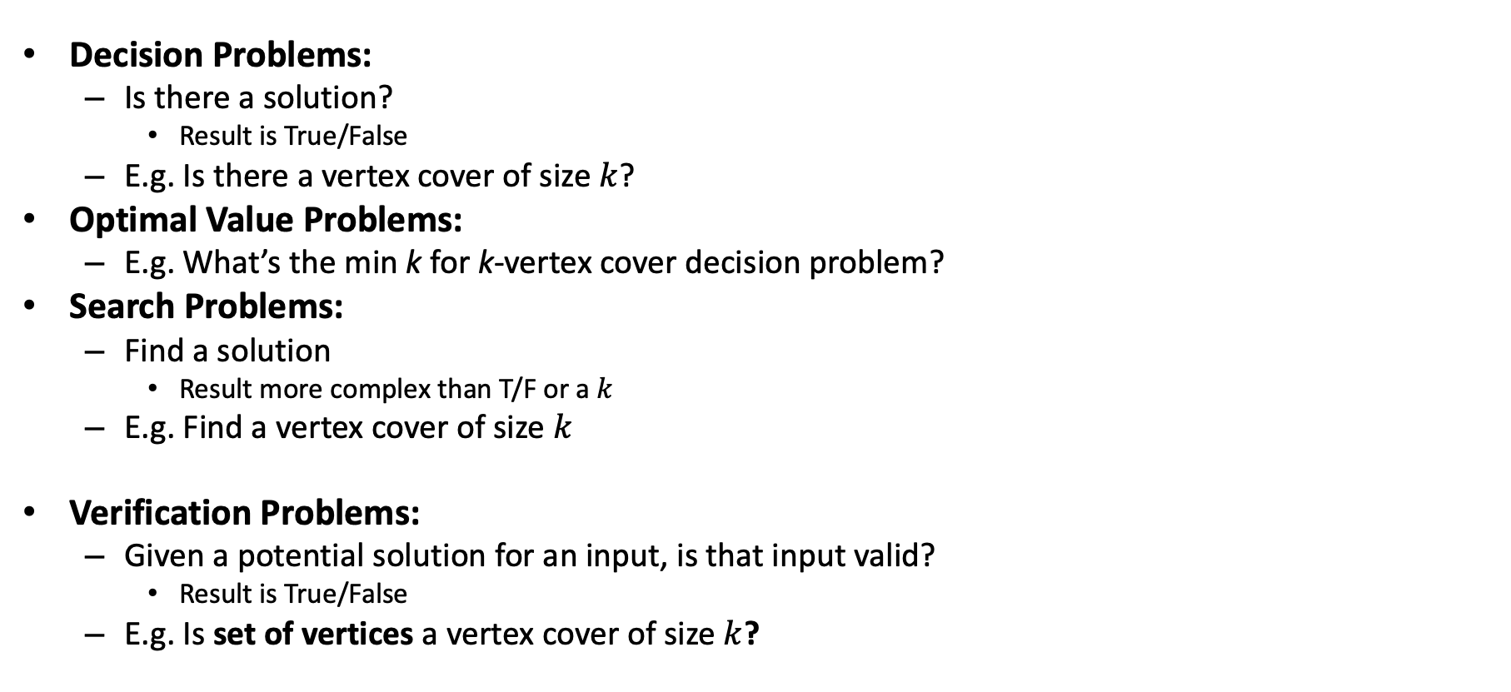
Problem Types
Decision Problems:
Is there a solution?
Result is True/False
E.g. Is there a vertex cover of size $k$?
Optimal Value Problems:
E.g. What’s the min k for k-vertex cover decision problem?
Search Problems:
Find a solution
Result more complex than T/F or a $k$
E.g. Find a vertex cover of size $k$
Verification Problems:
Given a potential solution for an input, is that input valid?
Result is True/False
E.g. Is set of vertices a vertex cover of size $k$?
If we can solve this…
Looking ahead: We’ll use this to define a problem classes P and NP
…Then we can solve this,… …and also this
Looking ahead: We’ll use this to define a problem class called NP

Slide 6
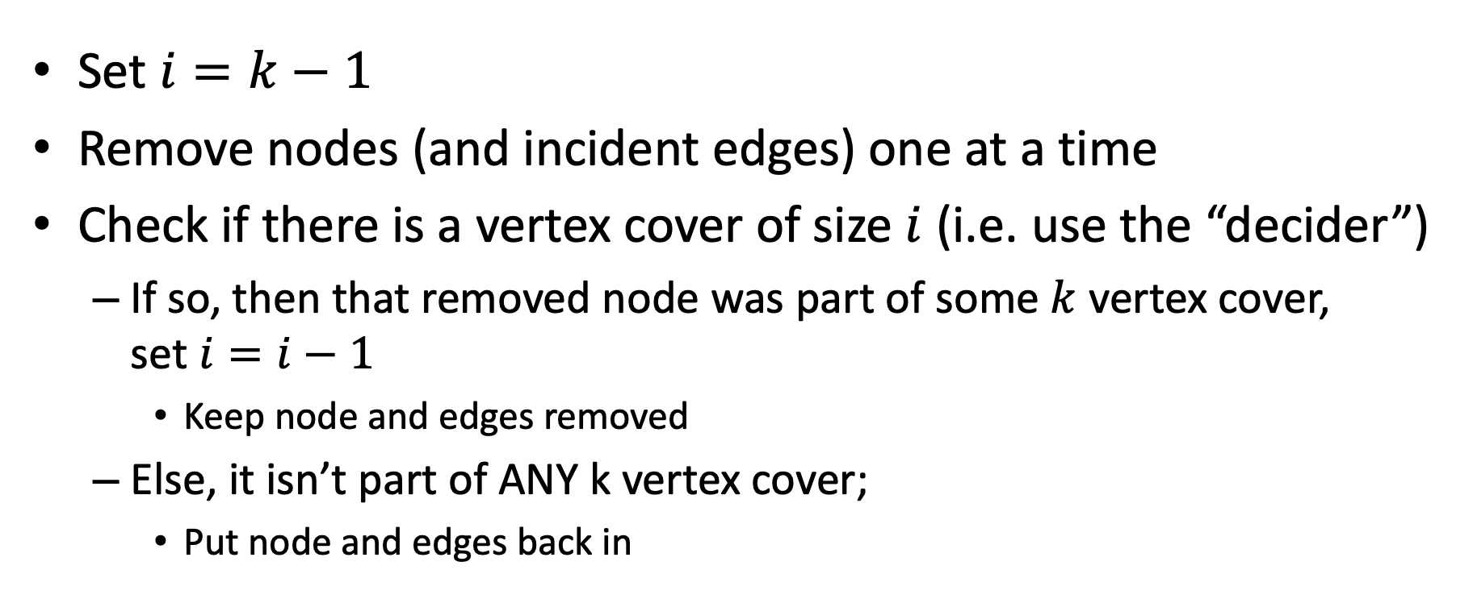
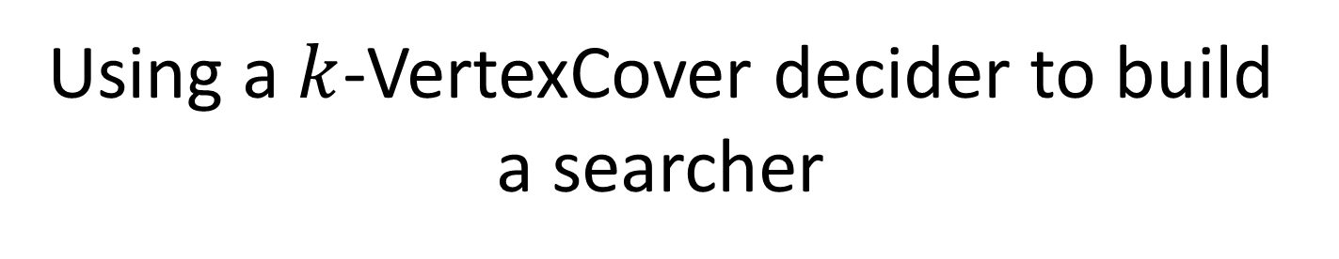
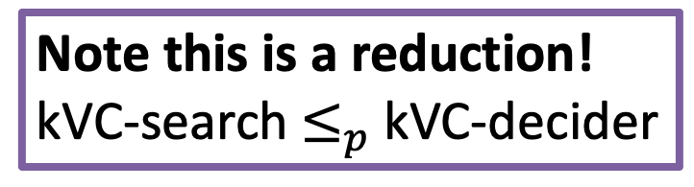
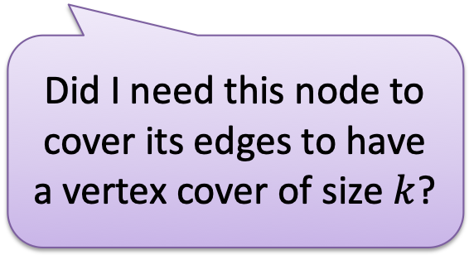
Using a $k$-VertexCover decider to build a searcher
Note this is a reduction! kVC-search$≤_{p}$kVC-decider
Set $i=k−1$
Remove nodes (and incident edges) one at a time
Check if there is a vertex cover of size $i$ (i.e. use the “decider”)
If so, then that removed node was part of some $k$ vertex cover, set $i=i−1$
Keep node and edges removed
Else, it isn’t part of ANY k vertex cover;
Put node and edges back in
Did I need this node to cover its edges to have a vertex cover of size $k$?

Slide 7
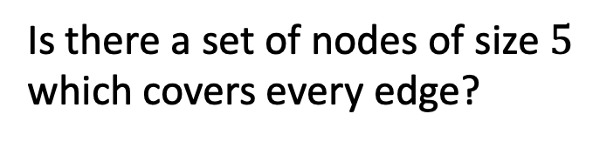

$5$ Vertex Cover (Decision)
Is there a set of nodes of size $5$ which covers every edge?
Yes!

Slide 8
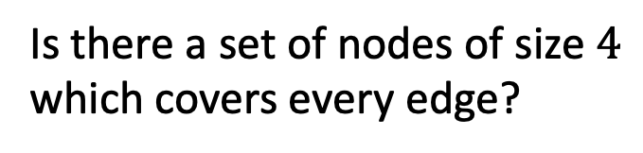

$4$ Vertex Cover (Decision)
Is there a set of nodes of size $4$ which covers every edge?
No! This node is NOT in the vertex cover

Slide 9
$4$ Vertex Cover (Decision)
Is there a set of nodes of size $4$ which covers every edge?
Yes! This node IS in the vertex cover

Slide 10
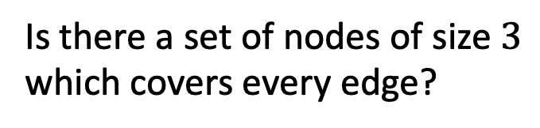

$3$ Vertex Cover (Decision)
Is there a set of nodes of size $3$ which covers every edge?
Yes!
This node IS in the vertex cover!
Wait, what!? Actually, this blue node is in SOME vertex cover of size 4 so algorithm still works.

Slide 11
Why does this work?
If node ‘v’ IS in any VC: Then ‘v’ covers its incident edges and k-1 nodes can be used to cover the rest (use decider to find out). Node can safely be removed because it has already been “counted”
If node ‘v’ NOT in any VC: Then another node needs to cover it’s edges, but it won’t be usable with k = i-1 (not enough nodes)

Slide 12
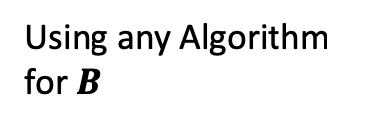






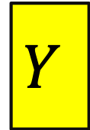

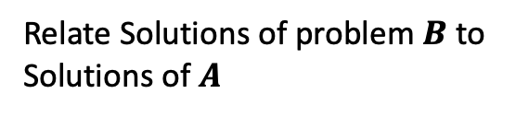
Reduction
$k$-VertexCover Solver
$k$-VertexCover Decider
$$A$$
Remove a node, etc…
$$B$$
Using any Algorithm for $B$
Relate Solutions of problem $B$to Solutions of $A$
Solution for $A$
Solution for $B$
$$X$$
$$Y$$
Reduction

Slide 13
Classes of Problems (P, NP, NP-Hard)

Slide 14
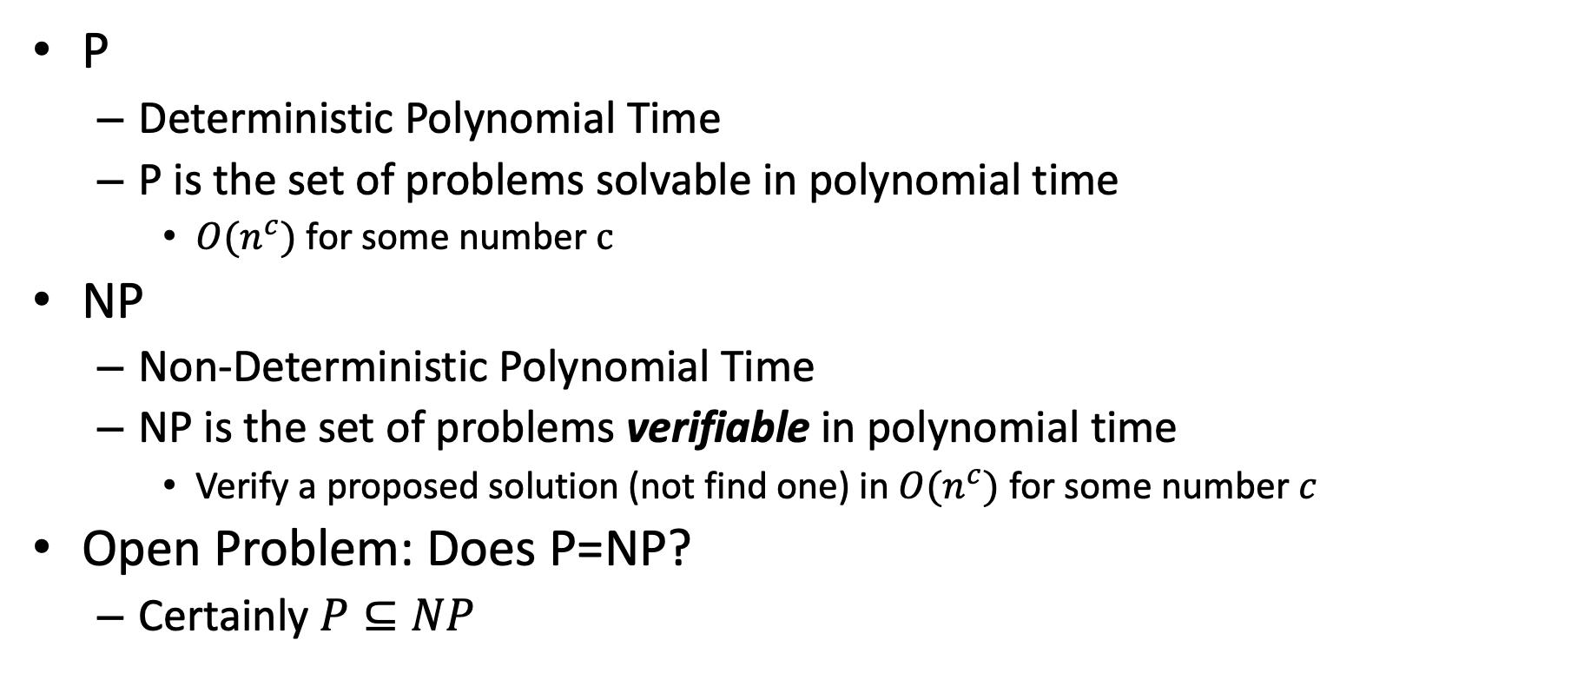
Classes of Problems: P vs NP
P
Deterministic Polynomial Time
P is the set of problems solvable in polynomial time
$O(n^{c})$ for some number $c$
NP
Non-Deterministic Polynomial Time
NP is the set of problems verifiable in polynomial time
Verify a proposed solution (not find one) in $O(n^{c})$ for some number $c$
Open Problem: Does P=NP?
Certainly $P⊆NP$
NP
P

Slide 15
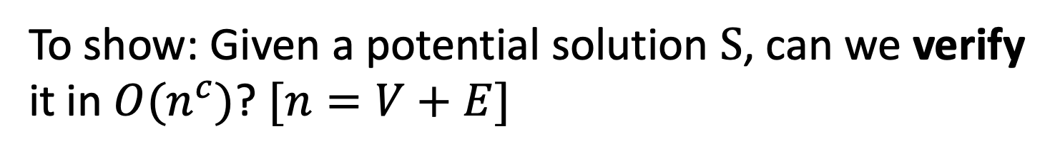


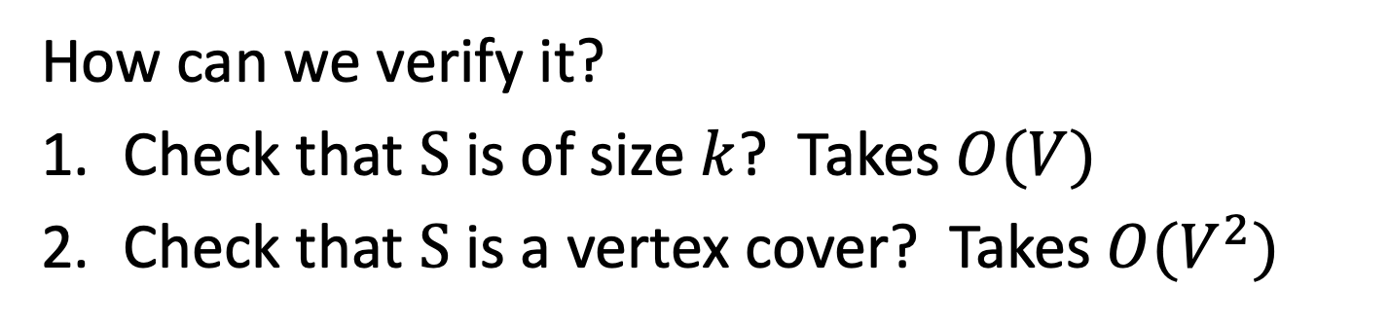
$k$-Vertex Cover is NP
To show: Given a potential solution $S$, can we verify it in $O(n^{c})$? $[n=V+E]$
How can we verify it?
Check that $S$ is of size $k$? Takes $O(V)$
Check that $S$ is a vertex cover? Takes $O(V^{2})$
Therefore, k-VertCover $⊆NP$

Slide 16
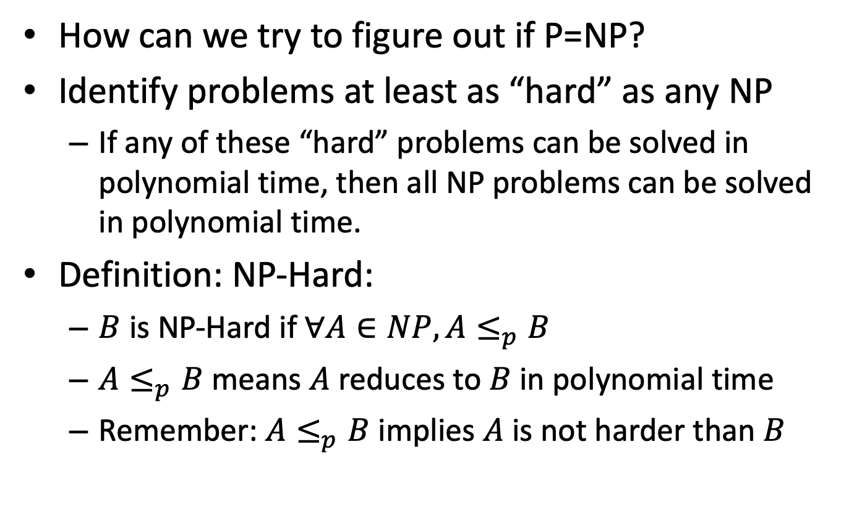
NP-Hard
How can we try to figure out if P=NP?
Identify problems at least as “hard” as any NP
If any of these “hard” problems can be solved in polynomial time, then all NP problems can be solved in polynomial time.
Definition: NP-Hard:
$B$ is NP-Hard if $∀A∈NP, A≤_{p}B$
$A≤_{p}B$ means $A$ reduces to $B$ in polynomial time
Remember: $A≤_{p}B$implies $A$ is not harder than $B$
NP-Hard
At least as “hard” as NP
NP
P

Slide 17


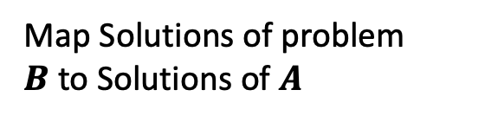
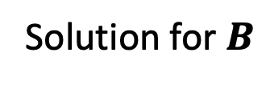
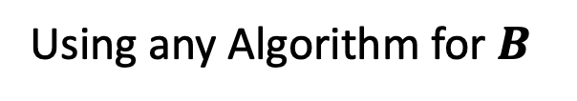





Polynomial Reduction & Relative Hardness
$$A≤_{p}B$$
Polynomial Reduction
A problem we do know how to solve
A problem we don’t know how to solve
$$A$$
$$B$$
Map Instances of problem $A$to Instances of $B$
Using any Algorithm for $B$
Then A could be solved in polynomial time
Map Solutions of problem $B$to Solutions of $A$
If B could be solved in polynomial time
Solution for $A$
Solution for $B$
$$RA$$
$$RB$$

Slide 18
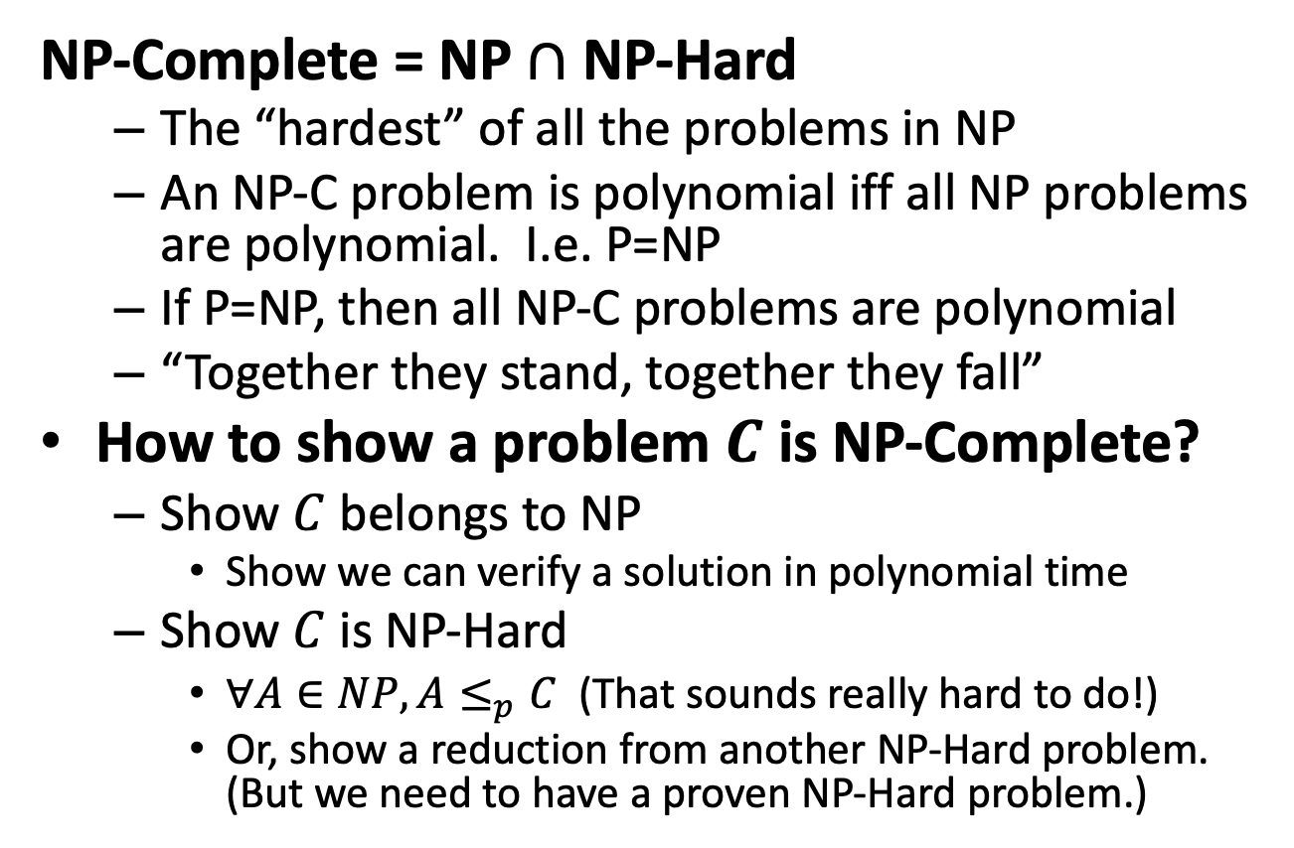
NP-Complete
NP-Complete = NP $∩$ NP-Hard
The “hardest” of all the problems in NP
An NP-C problem is polynomial iff all NP problems are polynomial. I.e. P=NP
If P=NP, then all NP-C problems are polynomial
“Together they stand, together they fall”
How to show a problem $C$ is NP-Complete?
Show $C$ belongs to NP
Show we can verify a solution in polynomial time
Show $C$ is NP-Hard
$∀A∈NP, A≤_{p}C$ (That sounds really hard to do!)
Or, show a reduction from another NP-Hard problem. (But we need to have a proven NP-Hard problem.)
NP-C
NP-Hard
At least as “hard” as NP
NP
P
We now just need a FIRST NP-Hard problem

Slide 19
“Stand and Fall Together”
$$A≤_{p}B$$
Polynomial Reduction
Any other NP-C problem
Any NP-C problem
$$A$$
$$B$$
Map Instances of problem $A$to Instances of $B$
Using any Algorithm for $B$
Then A could be solved in polynomial time
Map Solutions of problem $B$to Solutions of $A$
If B could be solved in polynomial time
Solution for $A$
Solution for $B$
$$RA$$
$$RB$$

Slide 20
“Stand and Fall Together”
$$A≤_{p}B$$
Polynomial Reduction
Any other NP-C problem
Any NP-C problem
$$A$$
$$B$$
Map Instances of problem $A$to Instances of $B$
Using any Algorithm for $B$
If A cannot be solved in polynomial time
Map Solutions of problem $B$to Solutions of $A$
Then B cannot be solved in polynomial time
Solution for $A$
Solution for $B$
$$RA$$
$$RB$$

Slide 21
Summary of Where We Are
Focusing on “hard” problems, those that seem to be exponential
Reductions used to show “hardness” relationships between problems
Starting to define “classes” of problems based on complexity issues
P are problems that can be solved in polynomial time
NP are problems where a solution can be verified in polynomial time
NP-hard are problems that are at least as hard as anything in NP
NP-complete are NP-hard problems that “stand or fall together”

Slide 22
Proving NP-Completeness
What steps do we have to take to prove a problem B is NP-Complete?
Pick a known NP-Hard (or NP-Complete) problem A
Assuming there is one! (More later.)
1. Reduce A to B
Describe a transformation that maps instances of A to instances of B, such that “yes” for instance of B = “yes” for instance of A
Prove the transformation works
Prove it runs in polynomial time
2. Prove B ∈ NP
(This one is usually easy)

Slide 23
Order of the Reduction When Proving NP-Completeness
To prove B is NP-C, show A ≤_{p} B where A ∈ NP-Hard
Why have the known NP-Hard problem “on the left”? Shouldn’t it be the other way around? (No!)
If A ∈ NP-Hard, then: all NP problems ≤_{p} A
If you show A ≤_{p} B, then: any-NP-problem ≤_{p} A ≤_{p} B
Thus any problem in NP can be reduced to B if the two transformations are applied in sequence
And both are polynomial
NP-C are “complete” because: if A ∈ NP-C and A ≤_{p} B, then B ∈ NP-c
As long as both ∈ NP

Slide 24
What’s Next?
Where we want to go next:
Are there any NP-Hard problems? Are there any NP-C problems?
Reminder: why do we care?
We know P ⊆ NP
But are they equal or is it a proper subset?
In other words, is there a problem in NP that cannot be directly solved in polynomial time? Do some problems in NP have an exponential lower bound?
Is P = NP? Or not? (The big question!)

Slide 25
What was the first NP-Complete Problem?

Slide 26
But You Need One NP-Hard First…
If you have one NP-Hard problem, you can use the technique just described to prove other problems are NP-Hard and NP-c
We need an NP-Hard problem to start this off
The definition of NP-Hard was created to prove a point
There might be problems that are at least as hard as “anything” (i.e. all NP problems)
Are there really NP-complete problems?
Cook-Levin Theorem: The satisfiability problem (SAT) is NP-Complete.
Stephen Cook proved this “directly”, from first principles, in 1971
Proven independently by Leonid Levin (USSR)
Showed that any problem that meets the definition of NP can be transformed in polynomial time to a CNF formula.
Proof outside the scope of this course (lucky you)

Slide 27
More About The SAT Problem
The first problem to be proved NP-Complete was satisfiability (SAT):
Given a Boolean expression on n variables, can we assign values such that the expression is TRUE?
Ex: ((x₁ →x₂) ∨ ¬((¬x₁ ↔ x₃) ∨ x₄)) ∧¬x₂
You might imagine that lots of decision problems could be expressed as a complex logical expression
And Cook and Levin proved you were right!
Proved the general result that any NP problem can be expressed this way

Slide 28
3-SAT

Slide 29
Conjunctive Normal Form (CNF)
Even if the form of the Boolean expression is simplified, the problem may be NP-Complete
Literal: an occurrence of a Boolean or its negation
A Boolean formula is in conjunctive normal form, or CNF, if it is an AND of clauses, each of which is an OR of literals
Ex: (x₁ ∨ ¬x₂) ∧ (¬x₁ ∨ x₃ ∨ x₄) ∧ (¬x₅)
3-CNF: each clause has exactly 3 distinct literals
Ex: (x₁ ∨ ¬x₂ ∨ ¬x₃) ∧ (¬x₁ ∨ x₃ ∨ x₄) ∧ (¬x₅ ∨ x₃ ∨ x₄)
Notice: true if at least one literal in each clause is true
Note: Arbitrary SAT expressions can be translated into CNF forms by introducing intermediate variables etc.

Slide 30
The 3-CNF Problem
Satisfiability of Boolean formulas in 3-CNF form (the 3-CNF Problem) is NP-Complete
Proof: Also done by Cook (“part 2” of Cook’s theorem)
But it’s not that hard to show SAT ≤_{p} 3-CNF
The reason we care about the 3-CNF problem is that it is relatively easy to reduce to others
Thus by proving 3-CNF is NP-Complete we can prove many seemingly unrelated problems are NP-Complete

Slide 31
Showing 3-SAT is NP-complete
First, we must show it’s in NP
A NTM can decide it in polynomial time
Rephrased: it can be verified by a DTM in polynomial time
The equivalence of those two statements is on slide 30
This second one is easy to show
A formal proof would require showing how, which I’ll do verbally
Next we must show that 3-SAT is NP-hard: that we can reduce an NP-complete problem to 3-SAT
Not surprisingly, we choose SAT
We’ll consider the following formula:
φ = ((x₁ → x₂) ∨ ¬((¬x₁ ↔ x₃) ∨ x₄)) ∧ ¬x₂

Slide 32
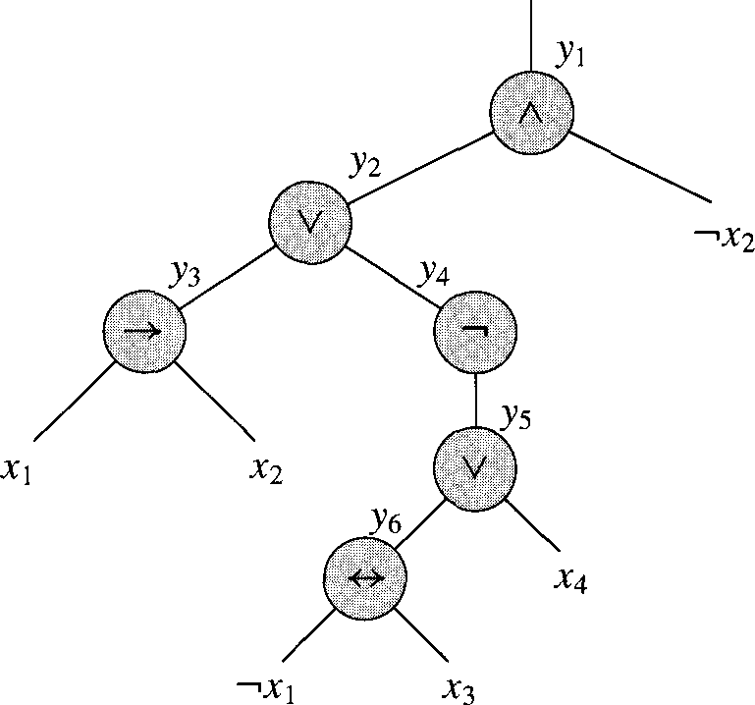
Converting SAT to 3-SAT, step 1
φ = ((x₁ → x₂) ∨ ¬((¬x₁ ↔ x₃) ∨ x₄)) ∧ ¬x₂
We parse the expression into an expression tree
Standard Algorithm Applies
Since each operator (other than ¬) is binary, it will be a binary tree

Slide 33
Converting SAT to 3-SAT, step 2
We introduce a variable y_{i} for each internal node
We can then re-write our expression:
φ’ = y₁ ∧ (y₁ ↔ (y₂ ∧ ¬x₂)
∧ (y₂ ↔ (y₃ ∨ y₄))
∧ (y₃ ↔ (x₁ → x₂))
∧ (y₄ ↔ ¬y₅)
∧ (y₅ ↔ (y₆ ∨ x₄))
∧ (y₆ ↔ (¬x₁ ↔ x₃))

Slide 34
Converting SAT to 3-SAT, step 3
φ’ = y₁ ∧ (y₁ ↔ (y₂ ∧ ¬x₂)
∧ (y₂ ↔ (y₃ ∨ y₄))
∧ (y₃ ↔ (x₁ → x₂))
∧ (y₄ ↔ ¬y₅)
∧ (y₅ ↔ (y₆ ∨ x₄))
∧ (y₆ ↔ (¬x₁ ↔ x₃))
We have an equation with at most 3 literals each
But it’s not in CNF!
So we build a truth table for each clause φ’_{i}:
y₁ | y₂ | _{X2} | (y₁ ↔ (y₂ ∧ ¬x₂))
1 | 1 | 1 | 0
1 | 1 | 0 | 1
1 | 0 | 1 | 0
1 | 0 | 0 | 0
0 | 1 | 1 | 1
0 | 1 | 0 | 0
0 | 0 | 1 | 1
0 | 0 | 0 | 1

Slide 35
Converting SAT to 3-SAT, step 4
For each clause φ’_{i}, we create new DNF (disjunctive normal form) clauses for when it’s false:
¬φ’_{i} = (y₁∧y₂∧x₂) ∨ (y₁∧¬y₂∧x₂) ∨ (y₁∧¬y₂∧¬x₂) ∨ (¬y₁∧y₂∧¬x₂)
We then negate that to get when it’s true
So we build a truth table for each clause φ’_{i}:
y₁ | y₂ | x₂ | (y₁ ↔ (y₂ ∧ ¬x₂))
1 | 1 | 1 | 0
1 | 1 | 0 | 1
1 | 0 | 1 | 0
1 | 0 | 0 | 0
0 | 1 | 1 | 1
0 | 1 | 0 | 0
0 | 0 | 1 | 1
0 | 0 | 0 | 1

Slide 36
Converting SAT to 3-SAT, step 5
¬φ’_{i} = (y₁∧y₂∧x₂) ∨ (y₁∧¬y₂∧x₂) ∨ (y₁∧¬y₂∧¬x₂) ∨ (¬y₁∧y₂∧¬x₂)
Then the negation (DeMorgan’s law!) is:
φ’_{i} = (¬y₁∨¬y₂∨¬x₂) ∧ (¬y₁∨y₂∨¬x₂) ∧ (¬y₁∨y₂∨x₂) ∧ (y₁∨¬y₂∨x₂)
So we build a truth table for each clause φ’_{i}:
y₁ | y₂ | x₂ | (y₁ ↔ (y₂ ∧ ¬x₂))
1 | 1 | 1 | 0
1 | 1 | 0 | 1
1 | 0 | 1 | 0
1 | 0 | 0 | 0
0 | 1 | 1 | 1
0 | 1 | 0 | 0
0 | 0 | 1 | 1
0 | 0 | 0 | 1

Slide 37
Converting SAT to 3-SAT, step 6
Three cases can occur for all the CNF clauses C_{i}:
C_{i} has 3 literals: then we include it in the final formula
C_{i} has 2 literals (l₁ and l₂): we include (l₁ ∨ l₂ ∨ p) ∧ (l₁ ∨ l₂ ∨ ¬p)
It doesn’t matter whether p is true or false; one clause will evaluate to true, the other to l₁ ∨ l₂
C_{i} has just one literal (l): we include the following:
(l ∨ p ∨ q) ∧ (l ∨ ¬p ∨ q) ∧ (l ∨ p ∨ ¬q) ∧ (l ∨ ¬p ∨ ¬q)
Regardless of what p and q are, 3 clauses will evaluate to true, and the other one to l

Slide 38
We’re done!
Whew!
Note that each step of converting SAT to 3-SAT was in polynomial time
And thus the entire thing in polynomial time

Slide 39
Joining the Club
Given one NP-c problem, others can join the club
Prove that SAT reduces to another problem, and so on…
Membership in NP-c grows…
Classic textbook: Garey, M. and D. Johnson, Computers and Intractability: A Guide to the Theory of NP-Completeness, 1979.
SAT
3-CNF-SAT
SUBSET-SUM
CLIQUE
VERTEX- COVER
HAM- CYCLE
TSP

Slide 41
“Consequences” of NP-Completeness
NP-Complete is the set of “hardest” problems in NP, with these important properties:
If any one NP-Complete problem can be solved in polynomial time…
…then every NP-Complete problem can be solved in polynomial time…
…and in fact every problem in NP can be solved in polynomial time (which would show P = NP)
Or, prove an exponential lower-bound for any single NP-hard problem, then every NP-hard problem (including NP-C) is exponential
Therefore: solve (say) traveling salesperson problem in O(n¹⁰⁰) time, you've proved that P = NP. Retire rich & famous!

Slide 42
Can a Problem be NP-Hard but not NP-C?
So, find a reduction and then try to prove B ∈ NP
What if you can’t?
Are there any problems B that are NP-hard but not NP-complete? This means:
All problems in NP reduce to B . (A known NP-Hard problem can be reduced to B.)
But, B cannot be proved to be in NP
Yes! Of course!
Any problem that has an exponential size output would apply!

