Slide 1
Quickselect and Median of Medians: Improving Quicksort
CS 3100: DSA2
Mark Floryan

Slide 2
Readings
CLRS:
Chapter 9
Wikipedia articles on Quickselect and Median of Medians

Slide 3
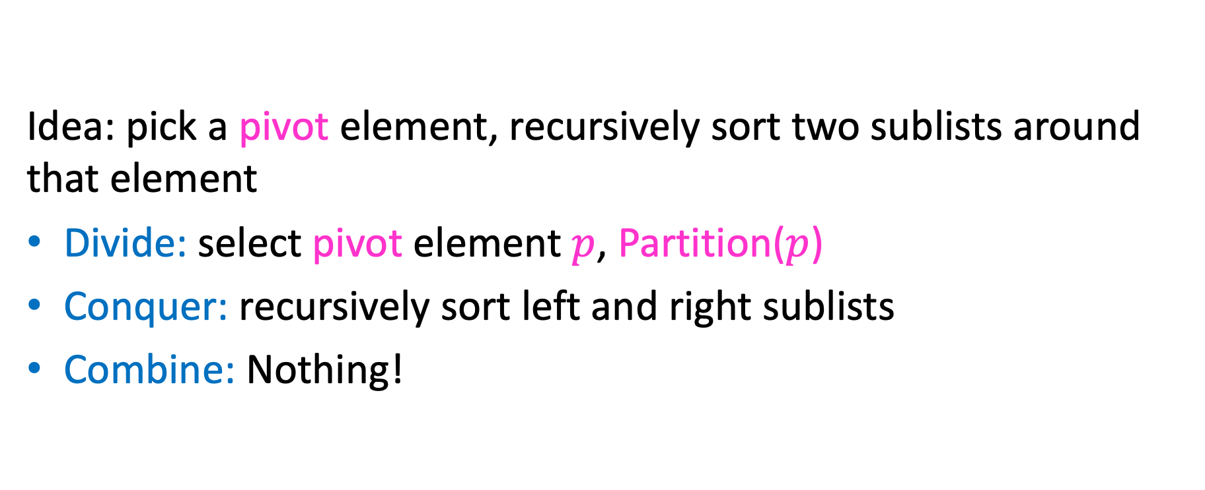
Review: Quicksort
Idea: pick a pivot element, recursively sort two sublists around that element
Divide: select pivot element $p$, Partition($p$)
Conquer: recursively sort left and right sublists
Combine: Nothing!

Slide 4


Reviewing Quicksort
Divide Step: Select a pivot and move elements around that pivot
Given: an unordered list, pick a pivot $p$
8
5
7
3
12
10
1
2
4
9
6
11
Goal: All elements $<p$ on left, all $>p$ on right, pivot in correct position
5
7
3
1
2
4
6
8
12
10
9
11

Slide 5
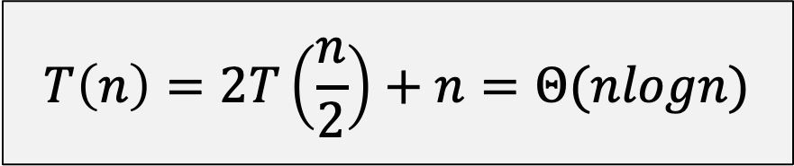
Quicksort Run Time (Best)
If the pivot is always the median:
2
5
1
3
6
4
7
8
10
9
11
12
2
1
3
5
6
4
7
8
9
10
11
12
Then we divide in half each time and get:
$$T\left(n\right)=2T\left(\frac{n}{2}\right)+n=Θ(nlogn)$$

Slide 6
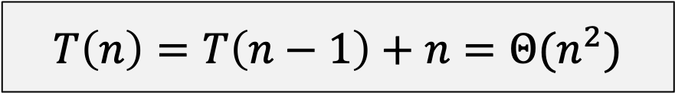
Quicksort Run Time (Worst)
If the pivot is always at the extreme:
1
5
2
3
6
4
7
8
10
9
11
12
1
2
3
5
6
4
7
8
10
9
11
12
Then we shorten by one each time and get:
$$T\left(n\right)=T\left(n−1\right)+n=Θ(n^{2})$$

Slide 7
Can we Guarantee a Good Pivot for Quicksort?
What makes a good Pivot for Quicksort?
Roughly even split between left and right
Ideally: the median
Can we find a list’s median in linear time?
Quickselect (https://en.wikipedia.org/wiki/Quickselect)
Finds the median
Works a lot like Quicksort: needs to do a Partition
We need a good pivot for Quickselect for it to have good time-complexity
Median of Medians (https://en.wikipedia.org/wiki/Median_of_medians)
Can be used to find “pretty good” pivot for QS, or with Quickselect

Slide 8
Quickselect

Slide 9

Quickselect
Problem: Given a list A and an integer I, calculate the i-th order statistic (the i-th smallest element in the list)
For example:
$i$^{th} smallest element in the list
0th order statistic: minimum
$n−1$^{th} order statistic: maximum
$\frac{n}{2}$^{th} order statistic: median
So, if we can solve this problem efficiently, we can call that method to get the median pivot and speed up quicksort!

Slide 10


QuickSelect: Basic Idea
Note: now using “x” to refer to pivot value. We called it “p” in previous slides.
Given: a list, pick a pivot value $x$
11
5
7
3
12
10
1
2
4
9
6
8
Goal: All elements $<p$ on left, all $>p$ on right, pivot in correct position
5
7
3
1
2
4
6
8
12
10
9
11
Hmmm…seems familiar. Are we going to have the same problem as before? Let’s keep going for now…

Slide 11


Conquer
Position
in list
0
1
2
3
4
5
6
7
8
9
10
11
2
5
7
3
6
4
1
8
10
9
11
12
All elements $<x$
All elements $>x$
$x=8 put e$xactly where it belongs at position 8 (the split-point)
Example 1: Looking for 4th order statistic
Example 2: Looking for 7th order statistic
Example 2: Looking for 10th order statistic
Because 4 < 7 Solution is solve(left,i)
Because 7 == 7 Solution is return pivot
Because 10 > 7 Solution is solve(right,i-pivot-1)

Slide 12
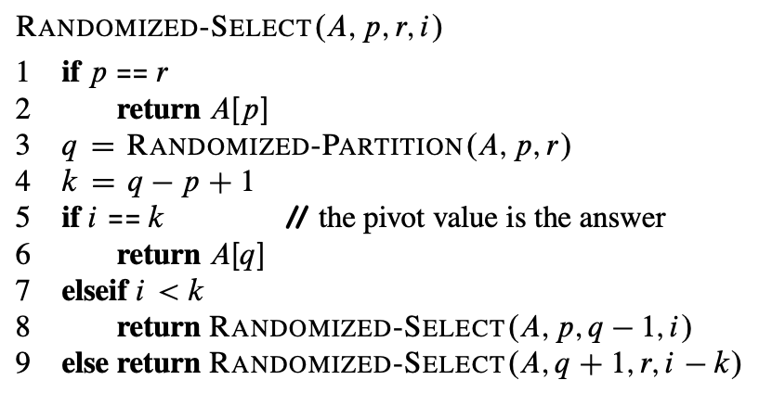
CLRS Pseudocode for Quickselect
A – the list
p – index of first item r – index of last item
i – find ith smallest item
q – pivot location
k – number on left + 1
Note: In CLRS, they’re using a partition that randomly chooses the pivot element.
That’s why you see “Randomized” in the names here. Ignore that for the moment.

Slide 13
Work These Examples!
For each of the following calls, show
The value of q after each partition,
Which recursive calls made
Select( [3, 2, 9, 0, 7, 5, 6, 1], p=0, r=7, i=2)
Select( [3, 2, 9, 0, 7, 5, 6, 1], p=0, r=7, i=5)
Select( [3, 2, 9, 0, 7, 5, 6, 1], p=0, r=7, i=7)

Slide 14
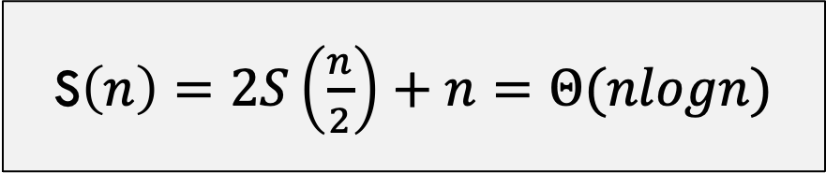
QuickSelect Run Time (Best)
If the pivot is always the median:
2
5
1
3
6
4
7
8
10
9
11
12
2
1
3
5
6
4
7
8
9
10
11
12
Then we divide in half each time and get:
S$\left(n\right)=2S\left(\frac{n}{2}\right)+n=Θ(nlogn)$

Slide 15
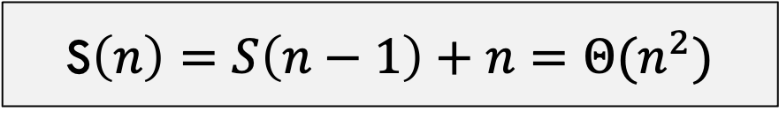
QuickSelect Run Time (Worst)
If the pivot is always at the extreme:
1
5
2
3
6
4
7
8
10
9
11
12
1
2
3
5
6
4
7
8
10
9
11
12
Ugh! We have the same problem as last time!
Then we shorten by one each time and get:
S$\left(n\right)=S\left(n−1\right)+n=Θ(n^{2})$

Slide 16
Summary So Far!
Quicksort: Sorts a list of numbers. Uses a pivot to split the list. Degrades when a bad pivot is chosen over and over again.
Idea: Design an algorithm that picks the best pivot (median) every time
Quickselect: Can quickly find the median (to choose pivot). But this algorithm itself chooses a pivot. Degrades if bad pivot chosen.
Ok, what do we do now? We need to think of a different pivot choice method. Maybe just find a pivot that is good enough! Still going to use Quickselect so don’t forget about it yet!

Slide 17
Pretty Good Pivot
Goal: Choose a pivot that is somewhere in the middle 40 percent of the list. This is how we define a “pretty good pivot”
>30%
Select Pivot from this range
Or
>30%

Slide 18
Median of Medians
Median of Medians: Algorithm that finds some pivot that is within the middle 40 percent of the sorted list. Basic idea is to break the list into “chunks”, find the median of each chunk, then find the median of those medians.
CLRS, pp. 220-221
https://en.wikipedia.org/wiki/Median_of_medians

Slide 19
Median of Medians
1. Break list into chunks of size 5
List could be long, many more than 5 chunks!
2. Find the median of each chunk (using insertion sort: n=5, 20 comparisons)
3. Return median of medians (using Quickselect, this algorithm, called recursively, on list of medians)
List could be long, many more than 5 medians!

Slide 20



















Why is this good?
Imagine each chunk sorted, chunks ordered by their medians
MedianofMedians is Greater than all of these
$$<$$
$$<$$
$$<$$
$$<$$
$$<$$
$$<$$
$$<$$
$$<$$
$$<$$
$$<$$
$$<$$
$$<$$
$$<$$
$$5$$
$$<$$
$$<$$
$$<$$
$$<$$
$$<$$
$$<$$
$$<$$
$$<$$
$$<$$
$$<$$
List could be long, so not a small number!
$$\left\lceil \frac{n}{5}\right\rceil$$

Slide 21











Why is this good?
MedianofMedians is Greater than all of these
$$<$$
$$<$$
$$<$$
$$<$$
$$<$$
$$<$$
$$<$$
$$<$$
$$<$$
$$<$$
$$<$$
$$<$$
$$<$$
$$5$$
$$<$$
$$<$$
$$<$$
$$<$$
$$<$$
$$<$$
$$<$$
$$<$$
$$<$$
$$<$$
$$\left\lceil \frac{n}{5}\right\rceil$$
Larger than three things in each list to left (except one that median is in
$3\left(\frac{1}{2}⋅\left\lceil \frac{n}{5}\right\rceil −2\right)≈\frac{3n}{10}−6$ elements
$$<$$
Similarly:
$3\left(\frac{1}{2}⋅\left\lceil \frac{n}{5}\right\rceil −2\right)≈\frac{3n}{10}−6$ elements
$$>$$

Slide 22
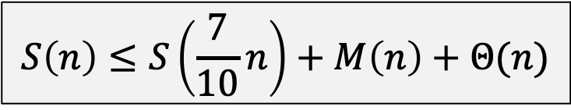

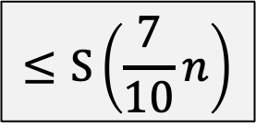

Run-time of Quickselect with Median of Medians
Quickselect w/ Median of Medians:
Find partition element by calling medianOfMedians() Pivot around this selected pivot value Recurse left or right or return depending
$$M\left(n\right)$$
$$Θ\left(n\right)$$
$$≤S\left(\frac{7}{10}n\right)$$
Total Runtime:
$$S\left(n\right)≤S\left(\frac{7}{10}n\right)+M\left(n\right)+Θ(n)$$
Need to figure out runtime of M(n)

Slide 23


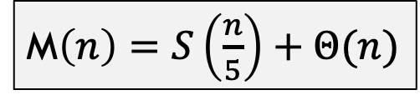
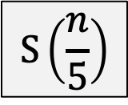
Median of Medians
1. Break list into chunks of size 5
$$Θ\left(n\right)$$
2. Find the median of each chunk (using insertion sort: n=5, 20 comparisons)
$$Θ\left(n\right)$$
3. Return median of medians (using Quickselect, this algorithm, called recursively, on list of medians)
$$S\left(\frac{n}{5}\right)$$
Total Runtime:
M$\left(n\right)=S\left(\frac{n}{5}\right)+Θ(n)$

Slide 24
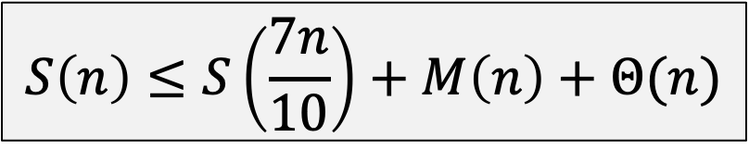
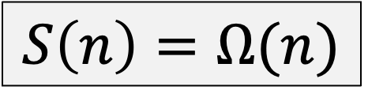
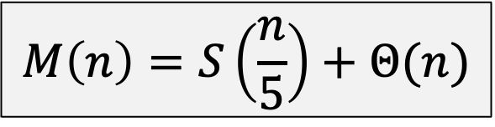
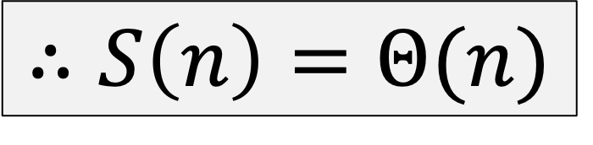
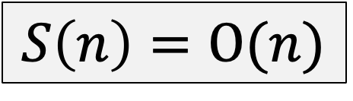
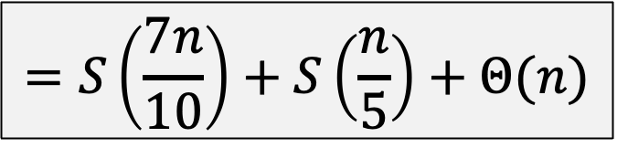
Quickselect
$$S\left(n\right)≤S\left(\frac{7n}{10}\right)+M\left(n\right)+Θ(n)$$
$$M\left(n\right)=S\left(\frac{n}{5}\right)+Θ(n)$$
$$=S\left(\frac{7n}{10}\right)+S\left(\frac{n}{5}\right)+Θ(n)$$
We can show by proof by induction that:
$$S\left(n\right)=O(n)$$
(next two slides)
$$S\left(n\right)=Ω(n)$$
$$∴S\left(n\right)=Θ(n)$$

Slide 25

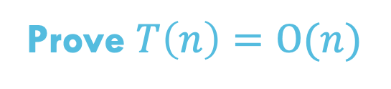
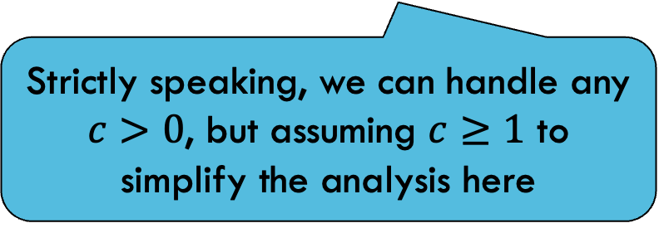


Proof by Induction
$$S\left(n\right)=S\left(n/5\right)+S\left({7n}/{10}\right)+c⋅n$$
Prove $T\left(n\right)=O(n)$
Claim: $T\left(n\right)≤10cn$
Base Case: $T\left(0\right)=0$
$T\left(1\right)=c≤10c$ which is true since $c≥1$
Strictly speaking, we can handle any $c>0$, but assuming $c≥1$ to simplify the analysis here

Slide 26





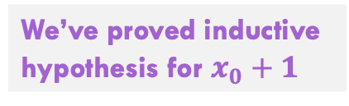


Proof by Induction
$$T\left(n\right)=T\left(n/5\right)+T\left({7n}/{10}\right)+c⋅n$$
Inductive hypothesis: $∀n≤x_{0}$ : $T\left(n\right)≤10cn$
Inductive step:
$$=T\left(\frac{1}{5}\left(x_{0}+1 \right)\right)+T\left(\frac{7}{10}\left(x_{0}+1 \right)\right)+c(x_{0}+1)$$
$$T\left(x_{0}+1\right)$$
$$≤10c\left(\frac{1}{5}\left(x_{0}+1\right)\right)+10c\left(\frac{7}{10}\left(x_{0}+1\right)\right)+c(x_{0}+1)$$
Use inductive hypothesis
$$=10c\left(\frac{1}{5}+\frac{7}{10}\right)\left(x_{0}+1\right)+c(x_{0}+1)$$
Simplify terms w/ algebra
We’ve proved inductive
hypothesis for $x_{0}+1$
$$=9c\left(x_{0}+1\right)+c\left(x_{0}+1\right)=10c(x_{0}+1)$$

Slide 27

Compare to ‘Obvious’ Approach
An “obvious” approach to Selection Problem:
Given list and value i: Sort list, then choose i-th item
We’ve only seen sorting algorithms that are $Ω(n\log{n})$
So this approach is $Θ(n\log{n})$
Therefore Quickselect is asymptotically better than this sorting-based solution for Selection Problem!

Slide 28
Improving Quicksort w/ Quickselect

Slide 29
Quicksort Run Time (Best)
If using quickselect with median of medians the pivot is always the median and we find it in $Θ(n)$ time
2
5
1
3
6
4
7
8
10
9
11
12
2
1
3
5
6
4
7
8
9
10
11
12
Then we divide in half each time and get:
$$T\left(n\right)=2T\left(\frac{n}{2}\right)+n=Θ(nlogn)$$

Slide 30

Is it worth it?
Using Quickselect to pick median guarantees $Θ(n\log{n})$ run time
But, this approach has very large constants
If you really want $Θ(n\log{n})$, better off using MergeSort
Better approach: Choose random pivot for Quicksort
Very small constant (random() is a fast algorithm)
Can prove the expected runtime is $Θ(n\log{n})$
Why? Unbalanced partitions are very unlikely

