Slide 1
Data Structures and Algorithms 2 Introduction and Logistics
Co-instructors: Aaron Bloomfield and Mark Floryan
Spring 2026

Slide 2
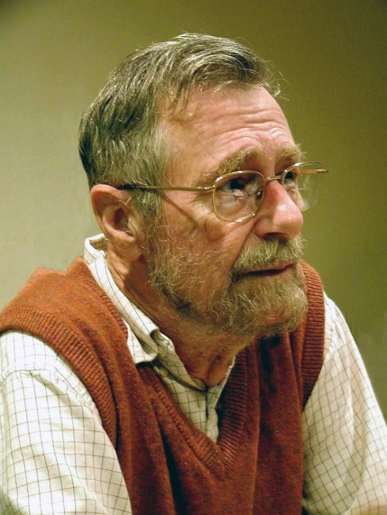
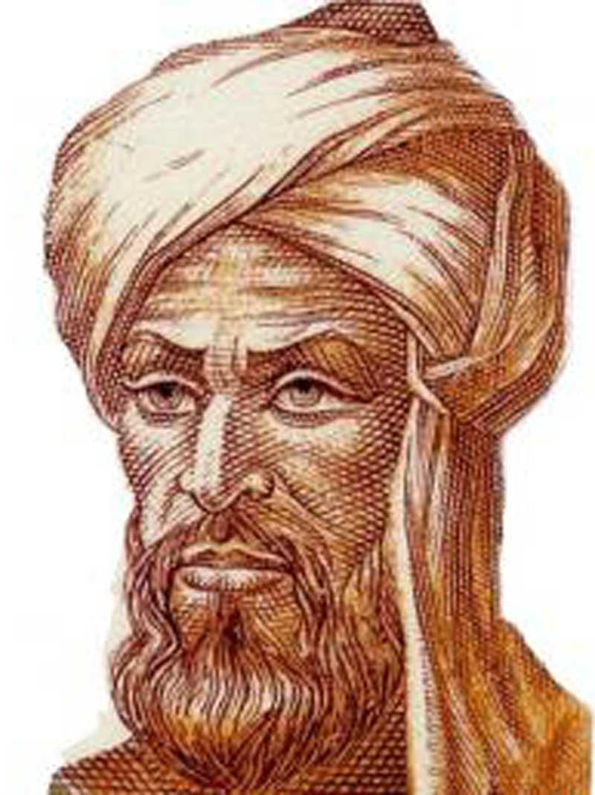
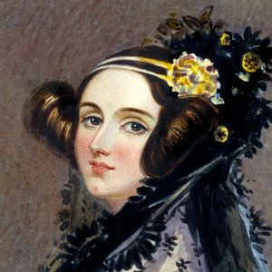
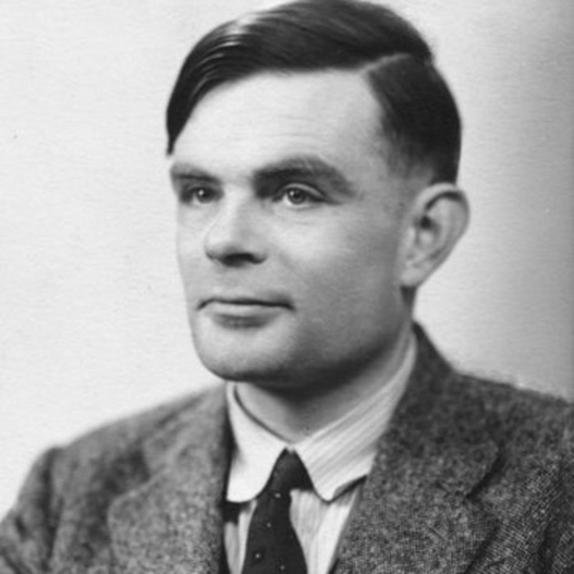
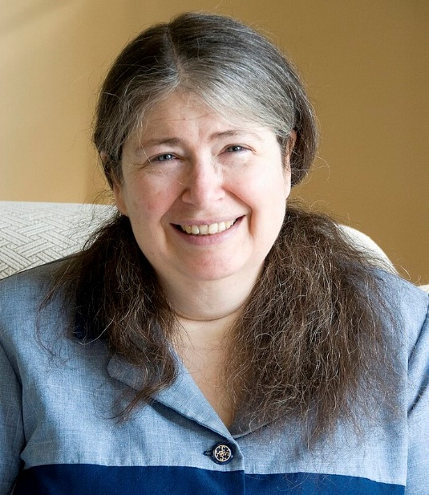
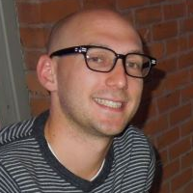
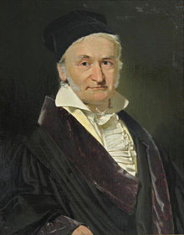
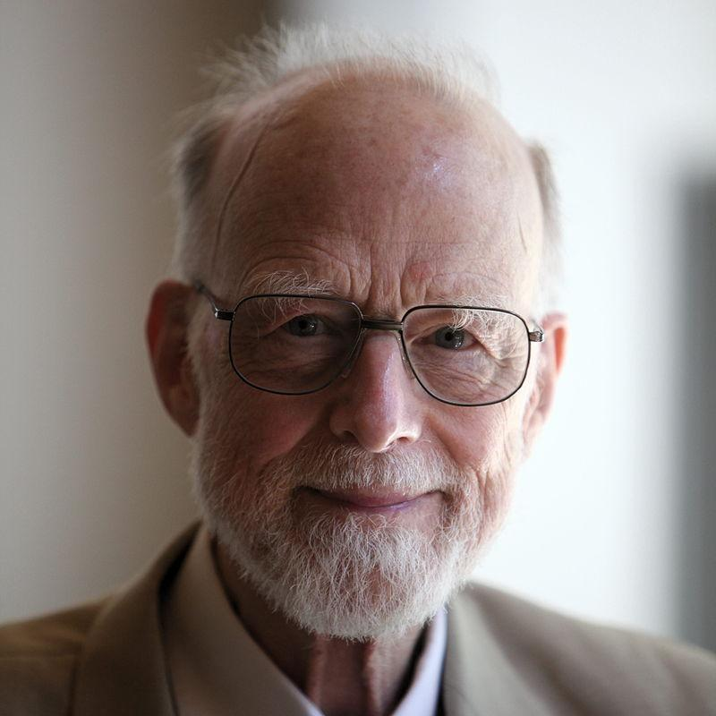
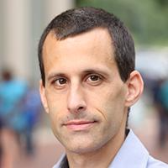
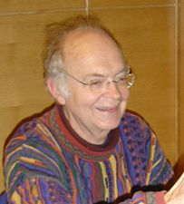
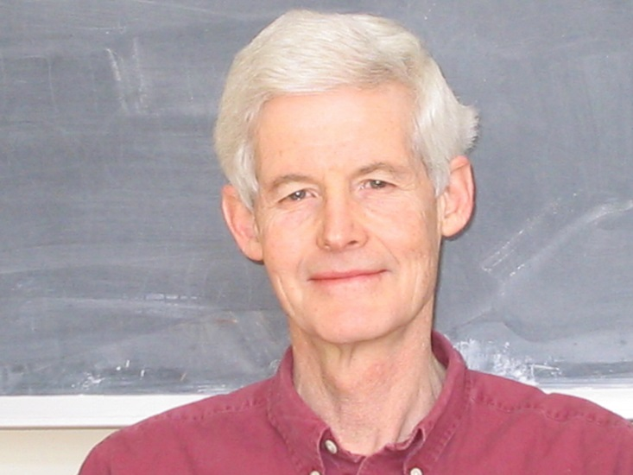
Who’s Who in Algorithms?
Notes:
Euclid – first algorithm (Euclidean algorithm for computing gcds)
Al-Khwarizmi – where the word “algebra” comes from, introduced positional number system (major improvement over systems like Roman numerals)
Gauss – mathematician (numerous contributions: e.g., Gaussian elimination)
Ada Lovelace – wrote the first computer algorithm for calculating Bernoulli numbers (for Babbage’s proposed general computer, the Analytical Engine)
Alan Turing – abstract models for computing
Radia Perlman – algorithm based on SP and MSTs that revolutionized internet network routing
Stephen Cook – theory of NP hardness
Edsger Dijkstra – graph algorithms
Don Knuth – asymptotic notation, Art of Computer Programming

Slide 3
Who’s Who in Algorithms?
Al-
Khwarizmi
Edsger
Dijkstra
Alan Turing
Ada Lovelace
Ray Pettit
Mark Floryan
Radia
Perlman
Gauss
Aaron Bloomfield
Tony Hoare
Donald Knuth
Stephen Cook

Slide 4
Who’s Who in Algorithms?
Euclid – father of geometry, logic, number theory
Al-Khwarizmi – algebra, solution to linear and quadratic equations
Gauss – fundamental theorem of algebra, numeric analysis
Ada Lovelace – first computer program, more than number crunching
Alan Turing – breaking Engima, Turing Machine (abstract model of computation)
Edsger Dijkstra – structured programming languages, graph algorithms
Tony Hoare – Algol, Hoare logic, null reference, quicksort
Stephen Cook – polynomial time reduction, NP-completeness, proof complexity
Donald Knuth – analysis of algorithms, TAOCP, TeX, literate programming
Radia Perlman – spanning tree algorithm and protocol (STP), LOGO-Tortis language

Slide 5
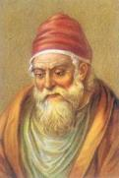
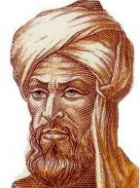






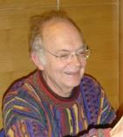
A Historic Perspective
Euclid
Al-Khwarizmi
Gauss
Ada Lovelace
Stephen Cook
Radia Perlman
300 BC
800
1600
1800
1900
Alan Turing
Edsger Dijkstra
Don Knuth
Notes:
Euclid – first algorithm (Euclidean algorithm for computing gcds)
Al-Khwarizmi – where the word “algebra” comes from, introduced positional number system (major improvement over systems like Roman numerals)
Gauss – mathematician (numerous contributions: e.g., Gaussian elimination)
Ada Lovelace – wrote the first computer algorithm for calculating Bernoulli numbers (for Babbage’s proposed general computer, the Analytical Engine)
Alan Turing – abstract models for computing
Radia Perlman – algorithm based on SP and MSTs that revolutionized internet network routing
Stephen Cook – theory of NP hardness
Edsger Dijkstra – graph algorithms
Don Knuth – asymptotic notation, Art of Computer Programming

Slide 6
What Is an Algorithm?
In mathematics and computer science, an algorithm is a finite sequence of well-defined, computer-implementable instructions, typically to solve a class of problems or to perform a computation. Algorithms are unambiguous specifications for performing calculation, data processing, automated reasoning, and other tasks. [Wikipedia Jan 2020]
An algorithm is a step by step procedure to solve logical and mathematical problems. [Simple English Wikipedia Aug 2019]
Being unambiguous is not always easy!
An example

Slide 7
Goals
Create an awesome learning experience
Instill enthusiasm for problem solving
Give broad perspective on computer science
Have fun!

Slide 8
Co-Instructors
Prof. Bloomfield
Rice 402
aaron@virginia.edu Email or Piazza
Prof. Floryan
Rice 203
mrf8t@virginia.edu Email or Piazza
Office Hours TBD, and start next week
See Canvas for office hour times
cs3100@cshelpdesk.atlassian.net

Slide 9
Overview of Platforms
Canvas
Mostly for linking to other things
Course Webpage
https://uva-cs.github.io/dsa2/
Contains syllabus, coursework instructions, lecture slides, lecture recordings
Gradescope (linked through Canvas)
For submitting all assignments, viewing grades, requesting regrades
Piazza (available through Canvas)
For Q&A about content and assignments
Instructors, TAs and other students read and answer, so ask here rather than email instructors

Slide 10
Requirements
Discrete Math and Theory 1 (CS 2120 or CS 2102) with C- or higher
Data Structures and Algorithms 1 (CS 2100) with C- or higher
Logarithms, exponents, summations, derivatives, limits & series (Calc I)
Tenacity
Inquisitiveness
Creativity
I have a “no laptop / phone” policy when in lecture. Please put all technology aware and “be here with me”
Note: CS2100 and CS2120 pre-req taken seriously. Don’t meet it? Need approval or you will be dropped (after add deadline). ☹

Slide 11

Warning
This can be a very challenging class
Hard material that combines problem-solving, logic, math and programming
“Holy grail” of computer science
Useful in practice
Job interviews
Lots of opportunities to succeed!
I Quit!
Hopefully not you…

Slide 12

“Learning Sources”
From what sources will you learn?
What we say in lectures
What you get from the slides
Explanations you read in CLRS
Activities you do in/out of class
Assignments
All of these are important.
Realistically, IMHO it’s impossible to get all the “book knowledge” from lectures and slides!

Slide 13
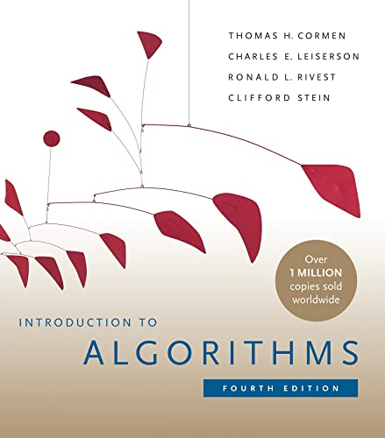
Textbook
You really need to read and study material other than the slides.
There are options, but a textbook is the easiest option.
We’ll post readings from CLRS, urge you to read them. Note: We will also have some resources posted on Collab site.
Freely accessible online via the UVA library Follow this link!
Cormen et al. (CLRS) Introduction to Algorithms 4th Edition. (3rd edition OK, but…)
We may also ask you to read other online materials!

Slide 14

Units and Assignments
Five Units:
Graph Algorithms
Divide and Conquer
Greedy Algorithms
Dynamic Programming
Reductions, including Network Flow & Machine Learning
Course work for each unit will include:
Quiz (in-class, closed book)
1 Programming Assignment (PA)
2 Weekly Problem Sets (PS)
Additional coursework:
“PS0”, a warm-up exercise on using LaTeX typesetting
Surveys, activities along the way

Slide 15
Course Learning Objectives
By the end of this course, students will:
Understand and implement more advanced data structures, including (but not limited to) graphs and sets (e.g., find-union). Be able to analyze the asymptotic complexity of the operations of these structures and use them to solve problems.
Understand a variety of problem solving paradigms such as dynamic programming, divide-and-conquer, and greedy algorithms. Be able to implement a variety of algorithms, including Breadth-First (and Depth-First) Search, Dijkstra’s algorithm, Ford-Fulkerson, and others.
Analyze a new problem and select an appropriate problem-solving technique. Be able to construct an algorithm to solve the problem, prove the correctness of their algorithm, and analyze the asymptotic behavior of the algorithm.
Analyze behavior of algorithms with recursive, and other more advanced properties. Solve recurrence relations for their closed form either manually or via the Master Theorem. Prove both upper and lower bounds on the behavior of such algorithms.
Note: department course specification also includes an introduction to machine learning and topics on ethics and machine learning.

Slide 16
Grading Breakdown
Note: each assignment gets a numeric score, and they’re combined to get an overall course score from 0-100
Exams: 60%
Each unit has one quiz; two quizzes are like a midterm
Programming Assignments (PAs): 20%
Reminder: one per unit
Problem Sets (PSs): 20%
Reminder: two per unit
Your final grade average cannot be more than 10% higher than your quiz average!

Slide 17
Quizzes
In-person, in your assigned section’s classroom
February 24th: Quiz 1 (Graphs), Quiz 2 (Divide and Conquer)
April 9th: Quiz 3 (Greedy), Quiz 4 (Dynamic Programming)
Saturday, May 2nd (7-10 pm): Quiz 5 (Network Flow, Machine Learning), Re-take questions
You must be physically present on that date!
“Re-take” Opportunity for Quizzes 1-4
During final exam period (along with Quiz 5)
Available only if you made a reasonable first attempt on quiz
Answer 2-3 questions on that unit
Grade on those questions will replace up to 10 missing points on score from first attempt of that unit’s quiz
Example: First attempt score is a 75/100. You get 5 of 10 on re-take. Final score: 80/100.

Slide 18
Problem Sets (PSs)
Goal: Think carefully and practice problem solving with techniques discussed during the unit
Grading: We will assign points for each question based on a rubric
What are they like? A set of approximately 2-3 questions
Concept-level questions, details of what we've studied
Design an algorithm for a given problem (pseudocode, words)
Analyze an algorithm (mathematically), provide a proof of correctness
Collaborate? Yes, in groups of up to 5
But everyone must prepare and submit an individual write-up
Submissions must be formatted in LaTeX! (more later)

Slide 19
Programming Assignment (PAs)
Goal: Explore one or more topics from a unit by applying and implementing it
Grading: Primarily based on passing test-cases on Gradescope
Include comments: any sources, collaborators
We may ask you to answer short discussion questions about your solution
Languages accepted: Python (3.10 or newer), Java (21 or newer)
Collaborate? Not in writing or debugging the code, but…
Can discuss the problem and the overall strategy with other students
Must list these people in your submission
Cannot share code, look at each other’s code! (Read syllabus carefully!)

Slide 20
Extension Policy
Anybody can request up to 8 extensions on any homework or programming assignment for any reason
Request an extension via an online extension system, and a 4-day (96 hour) extension is automatically granted
Can be done as early as you would like
Strictly closes 3 days (72 hours) after the (original) due date!
You can "undo" an extension request, but only up to 3 days after the (original) due date
A late penalty kicks in after the deadline (or deadline + extension): -25% per day (or fraction thereof)

Slide 21
Extension Policy
Pros:
Flexibility in deadlines
This covers ALL accommodations: travel, holidays, being busy, family emergencies, SDAC (generally), dog ate your homework, religious observances, interviews, thunderstorms, power outages, temporal dislocation, etc.
Cons:
TA office hours are optimized for the actual due date
TAs will prioritize the current assignment, not the late one
Late submission means very late grading return
You won’t be as prepared for the quizzes
If you use them all early, you will not have any flexibility for the later assignments

Slide 22
PS0 – LaTeX Warmup
PS0 is out, due next week
Learning LaTeX
LaTeX (pronounced “LAH-tech”) is a markup language where you mix text and commands in a .tex file, run process the file to get a publication-quality PDF output file
Created to format mathematical symbols and texts
You can create .tex files and run LaTeX in the cloud using a site called Overleaf at https://overleaf.com
PS0 is due next week (Wednesday at 11:59 pm)

Slide 23
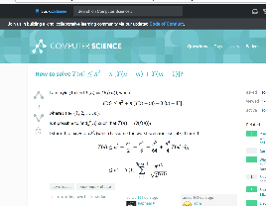
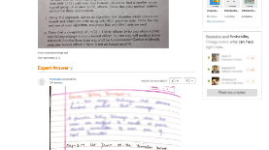
Academic Integrity
Collaboration Encouraged!
For PSs: groups of up to 5 per assignment (you + 4)
List your collaborators (by name and UVA computing ID)
OK to discuss problem, approach to solution, even details about solution, but… collaboration is "whiteboard only"
Write-ups (.tex files) must be created independently
DO NOT share written notes / pictures / code / etc
DO NOT share documents (ex: Overleaf)
Be able to explain any solution you submit!
See syllabus about online code examples

Slide 24
Generative AI Usage
You may use generative AI to check your answers on the problem sets and programming assignments
Note that the grades are 60% quizzes, and the way to learn how to solve the problem is to work through the problem sets
We are going to SPECIFICALLY put problems on the quizzes that test whether you did the assignments yourselves
The TAs can also help you understand how to work through the problems

Slide 25
Generative AI Usage
You may use Generative AI to check your answers on the assignments
Note: it is often wrong for these types of questions!
Warning: if you use Generative AI to do your assignments, you will get a very low quiz grade
The quiz questions are like the homework questions, and the only real way to learn them is to do them
Recall that your final average cannot be more than 10% higher than your quiz grade

Slide 26
Feedback
We professors are not course dictators, more like civil servants.
We’re open to any suggestion to help you learn.
Let us know!
In person
Anonymous feedback
Course staff email: cs3100@cshelpdesk.atlassian.net

Slide 27
Keys to success
Three things will make a huge difference in your performance in this class:
Attending lecture (with no laptop / phone / tech usage)
Working on the problem sets
Putting time into the course
My recommendation is 1 hour per day

Slide 28

Who is your instructor?
Mark Floryan
Education: Ph.D., Computer Science, University of Massachusetts
Main Research Area: AIED, Intelligent Tutoring Systems, Game Design. These days mostly CS Education stuff
Work History:
UVa: I've been here for 12 years
Game Development: 3 years
Hitpoint Studios (Massachusetts)
Grad Student Researcher

Slide 29
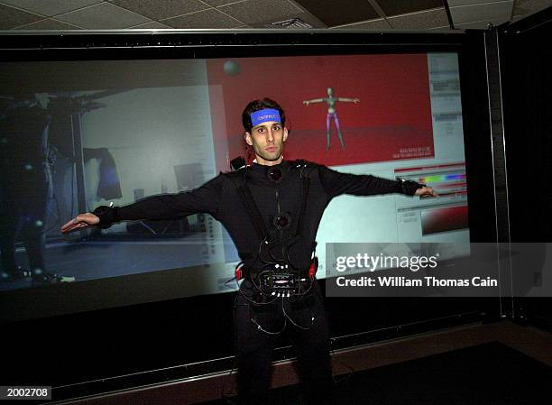
Who is your instructor?
Aaron Bloomfield
Education: Ph.D., Computer Science, University of Pennsylvania
Main Research Area: computer science education. Previously: graphics, haptics, virtual reality
Has been at UVA for 21 years

Slide 30
Motivating problems

Slide 31
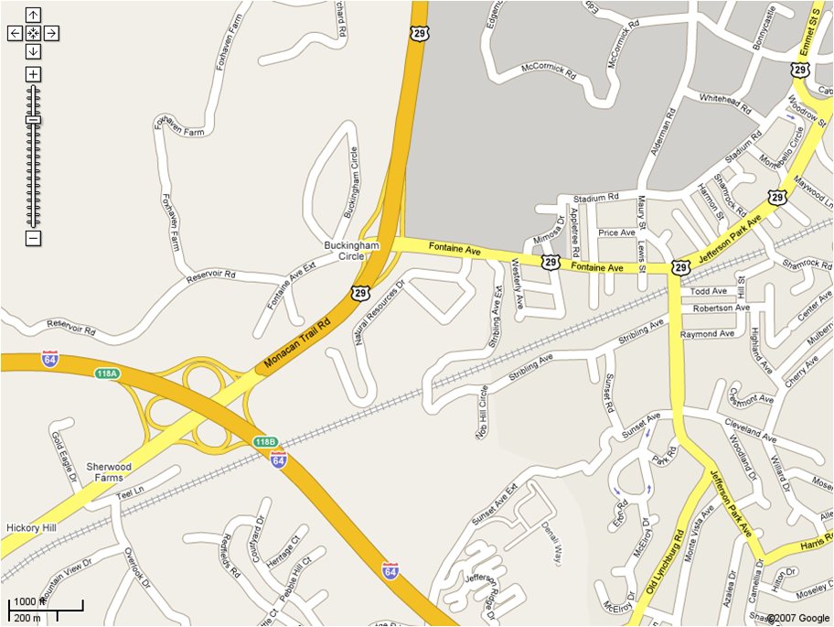
Problem 1: Map routing
How does a GPS program find the shortest path from here to there?
Notice the three road types

Slide 32
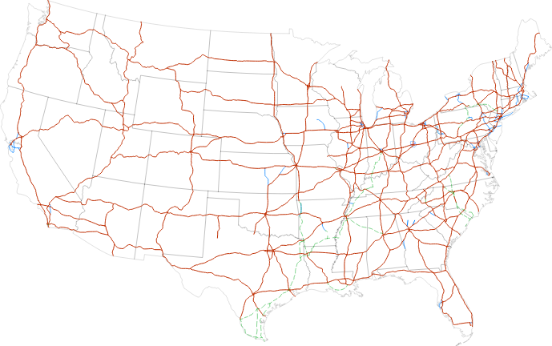
Map routing
One solution:
Get to a highway
Get as close as you can to the destination on highways
Then as close as you can on main roads
Then arrive via side roads
But how to find the shortest path on highways?

Slide 33
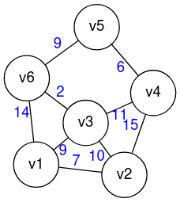
Shortest Path
Formally: given a weighted graph, what is the shortest path from a start vertex to one (or many) end vertices?
The solution to the weighted version is Dijkstra’s Shortest Path algorithm
Similar applications: Internet routing (unweighted version)

Slide 34
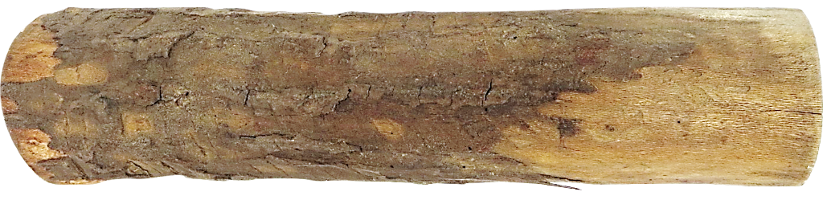
Problem 2: Log Cutting
You own a company that gets some item in bulk, and cuts it to customers’ requests
Cloth, pipes, logs, lumber, etc.
Assume you own a series of lengths, and customer orders arrive for a different (smaller) set of lengths
What is the most profitable way to cut the item?

Slide 35
Log Cutting
A variant of that problem: how to cut the log to maximize profit
Price:
1
5
8
9
10
17
17
20
24
30
Length:
1
2
3
4
5
6
7
8
9
10

Slide 36
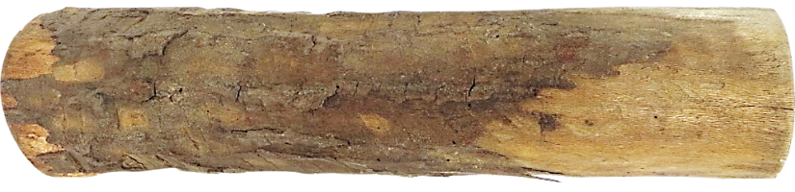
Greedy Algorithm
Greedy algorithms build a solution by picking the best option “right now
Select the most profitable cut first
1
18
26
30
48
50
Greedy: Lengths: 3, 3
Profit: 52
Price:
Length:
1
2
3
4
5
6
Better: Lengths: 2, 2, 2
Profit: 54

Slide 37
Recursive Algorithm
A recursive algorithm will try every single possibility recursively
Running times can be exponential (for some recursive algorithms)
But produces a better solution that greedy, just sloooooooooow
1
18
26
30
48
50
Greedy: Lengths: 3, 3
Profit: 52
Price:
Length:
1
2
3
4
5
6
Better: Lengths: 2, 2, 2
Profit: 54

Slide 38
Dynamic Programming
Dynamic programming (DP) is like recursion, but it saves previously computed answers
DP Fibonacci (1, 1, 2, 3, 5, 8, 13, …) where F(n)=F(n-1)+F(n-2)
Recursive Fibonacci runs in exponential time
Dynamic programming Fibonacci runs linear time
(Formulaic Fibonacci runs in constant time)
1
18
26
30
48
50
Greedy: Lengths: 3, 3
Profit: 52
Price:
Length:
1
2
3
4
5
6
Better: Lengths: 2, 2, 2
Profit: 54

Slide 39
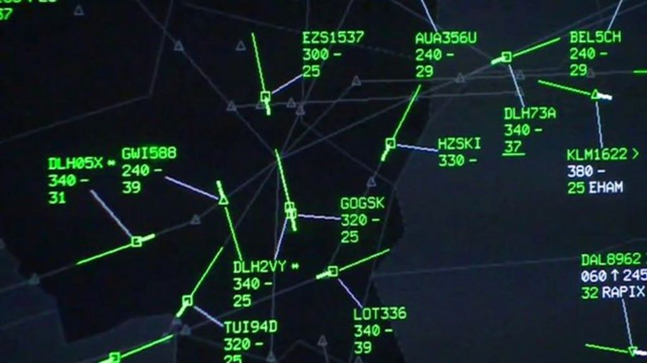
Problem 3: Closest Pair of Points
ATC (Air Traffic Control) wants to monitor planes that are too close
We can do this by finding the two closest planes (points) in the airspace

Slide 40
Closest Pair of Points
2
Given: A list of points
Return: The pair of points with smallest distance apart
Naive algorithm: consider all possible pairs of points: Θ(n²)
That’s slow; can we do better?
1
5
4
6
7
3
8

Slide 41
Closest Pair of Points: Divide and Conquer
Basic idea: split the area into halves, and then repeat (recurse) on the halves
When recombining, only consider the points “close” to the split
Running time: Θ(n log n)
(Similar to mergesort)
2
1
5
4
6
7
?
3
8
LeftPoints
RightPoints

Slide 42
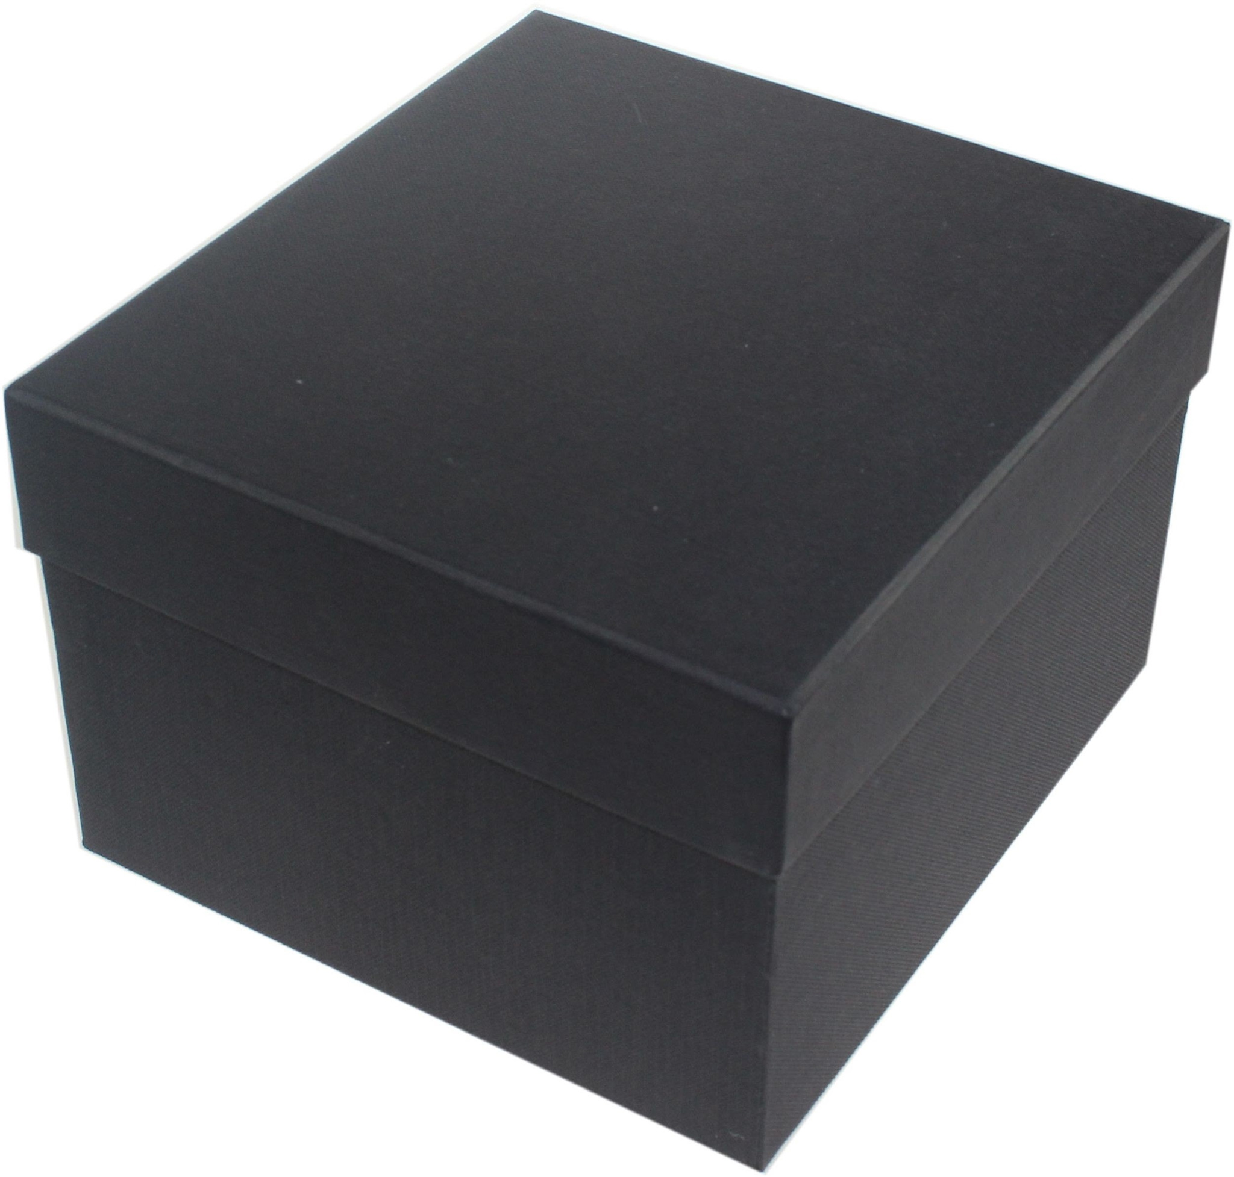
Problem 4: Reductions
Imagine we have a “black box” solution for a problem A
A library routine in a programming language
How can we adapt that to solve a similar problem B?
This is called a reduction
Converting one problem to another one to use an existing solution

Slide 43
Semester topics
We’ve seen examples of the five modules this semester:
Graphs (shortest path, Internet routing)
Divide & conquer (closest pair of points, mergesort)
Greedy (shortest path, first take at log cutting)
Dynamic programming (better log cutting solution, Fibonacci)
Reductions

Slide 44
Next Steps

Slide 45
Review
Next class we will:
Review how we analyze algorithms, including
Asymptotic notation, order classes, worst-case, etc.
Remind you how all this works by applying/reviewing it with sorting and searching you did in previous course
Sequential search, binary search
Sorting: insertion, quicksort, maybe mergesort
Review and/or introduce proofs from CS 2120
Proof by induction
Introduce you to how this can be used for proving algorithm correctness

