Slide 1
Kruskal’s MST and Find-Union Data Structure
CS 3100
Mark Floryan
CLRS 21.1-21.4, 23.2

Slide 2
Topics

Slide 3
Topics in this slide-deck:
Motivating Problem: Minimum Spanning Trees
This is a graph problem, and you’ve seen it
One solution
Kruskal’s Algorithm (Uses a find-union structure)
Define and design the find-union to support Kruskal’s Algorithm
Will require some clever implementation details

Slide 4
Minimum Spanning Trees

Slide 5
REMINDER: Minimum Spanning Tree
Given a connected and undirected graph G=(V, E)
Find a graph G’ = (V, E’) such that:
E’ is a subset of E
|E’| = |V| - 1
G’ is connected (assuming G was connected)
Sum of cost of edges in E’ is minimum
G’ is then the minimum spanning tree

Slide 6
Kruskal’s Algorithm

Slide 7
Kruskal’s MST Algorithm
Prim’s approach:
Build one tree. Make the one tree bigger and as good as it can be.
Kruskal’s approach
Choose the best edge possible: smallest weight
Not one tree – maintain a forest!
Each edge added will connect two trees. Can’t form a cycle in a tree!
After adding n-1 edges, you have one tree, the MST

Slide 8
Kruskal’s MST Algorithm
Idea: Grow a forest out of edges that do not create a cycle. Pick an edge with the smallest weight.
G=(V,E)
v

Slide 9
MST
2
v₂
v₁
4
1
3
10
v₃
2
v₄
7
v₅
5
8
4
6
v₆
1
v₇

Slide 10
MST
2
v₂
v₁
4
1
3
10
v₃
2
v₄
7
v₅
5
8
4
6
v₆
1
v₇
v₁
v₂
v₃
v₄
v₅
v₇
v₆

Slide 11
Kruskal code
void Graph::kruskal(){
int edgesAccepted = 0;
DisjSet s(NUM_VERTICES);
while (edgesAccepted < NUM_VERTICES – 1){
e = smallest weight edge not deleted yet;
// edge e = (u, v)
uset = s.find(u);
vset = s.find(v);
if (uset != vset){
edgesAccepted++;
s.unionSets(uset, vset);
}
}
}
|E| heap ops
2|E| finds
|V| unions

Slide 12
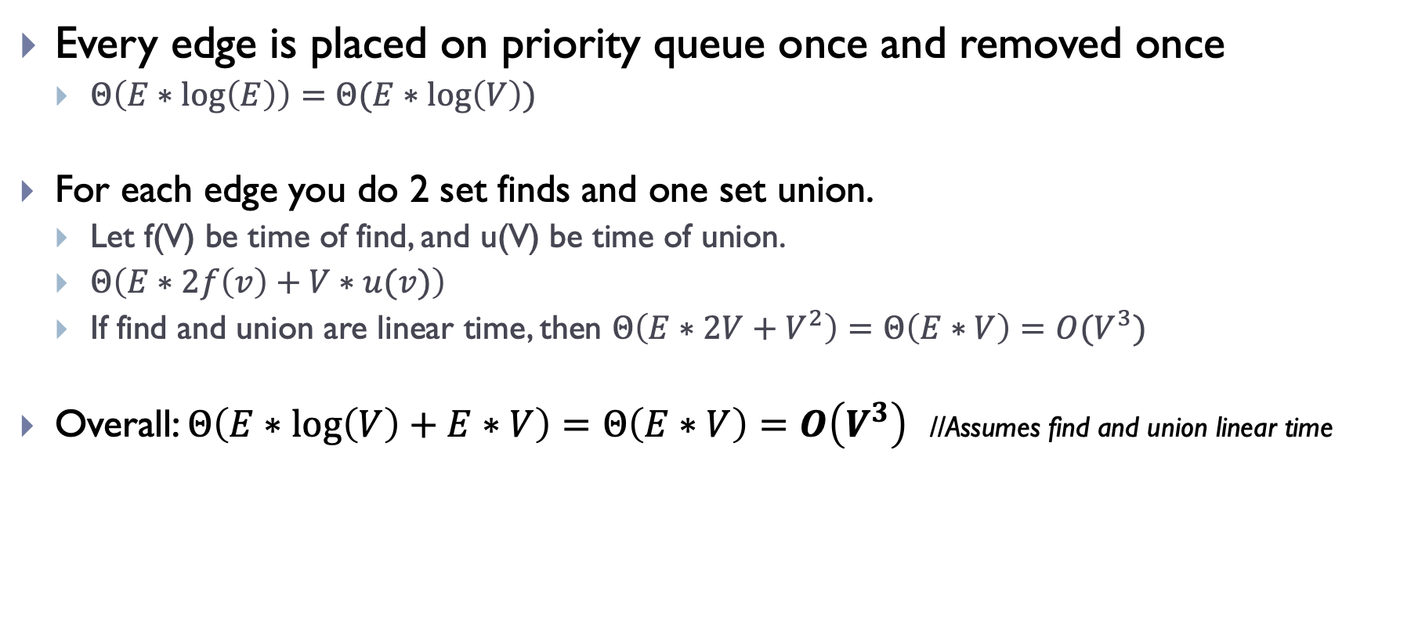
Runtime of Kruskal’s
Every edge is placed on priority queue once and removed once
$Θ\left(E∗\log\left(E\right)\right)=Θ(E∗\log\left(V\right))$
For each edge you do 2 set finds and one set union.
Let f(V) be time of find, and u(V) be time of union.
$Θ\left(E∗2f\left(v\right)+V∗u(v)\right)$
If find and union are linear time, then $Θ\left(E∗2V+V^{2}\right)=Θ\left(E∗V\right)=O(V^{3})$
Overall: $Θ\left(E∗\log\left(V\right)+E∗V\right)=Θ\left(E∗V\right)=O\left(V^{3}\right)$ //Assumes find and union linear time

Slide 13
Strategy for Kruskal’s
EL = sorted set of edges ascending by weight
For each edge e in EL
T1 = tree for head(e)
T2 = tree for tail(e)
If (T1 != T2)
add e to the output (the MST)
Combine trees T1 and T2
Seems simple, no?
But, how do you keep track of what trees a node is in?
Trees are sets. Need to findset(v) and “union” two sets

Slide 14
Find-Union Data Structure

Slide 15
Union/Find and Disjoint Sets
Needs to support the following operations
void makeSet(int n) //construct n independent sets
int findSet(int i) //given i, which set does i belong to?
void union(int i, int j) //merge sets containing i and j

Slide 16
Union/Find and Disjoint Sets
Needs to support the following operations
void makeSet(int n) //construct n independent sets
Solution:
Store as array of size n. Each location stores label for that set.
0 1 2 3 4 5 6 7
0 1 2 3 4 5 6 7

Slide 17
Union/Find and Disjoint Sets
Needs to support the following operations
void union(int i, int j) //merge sets i and j
Solution: find label for each set (call find() method), then set one label to point to other
Label1 = find(i); Label2 = find(j)
a[Label1] = Label2 //OR a[Label2] = Label1
0 1 2 3 5 5 6 7
0 1 2 3 4 5 6 7

Slide 18
Union/Find and Disjoint Sets
Needs to support the following operations
int findSet(int i) //given i, which set does i belong to?
Solution: Trace around array until we find place where index and contents match
Start at index i and repeat:
If a[i] == i then return i
Else set i = a[i]
0 2 4 3 5 5 6 7
0 1 2 3 4 5 6 7

Slide 19
Union/Find and Disjoint Sets
Example:
merge(4,5)
merge(6,7)
merge(1,2)
merge(5,6)
find(1); find(4); find(6)
0 1 1 3 4 4 4 6
0 1 2 3 4 5 6 7

Slide 20
Union/Find and Disjoint Sets
Time-complexity if where n is size of array?
makeSet()
Linear: just create array and fill it with values
One time only, so not a big problem
find()
Linear if have to trace a long way to get to label
Constant if lucky and label given as input
union()
Constant to change the label BUT…
Could be linear to find the two labels first.

Slide 21
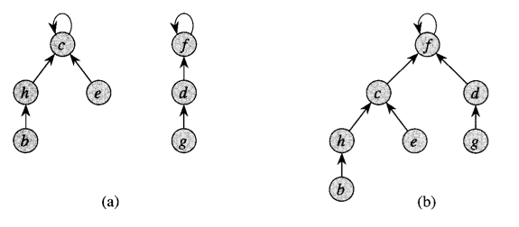
Optimization 1: Union by rank

Slide 22
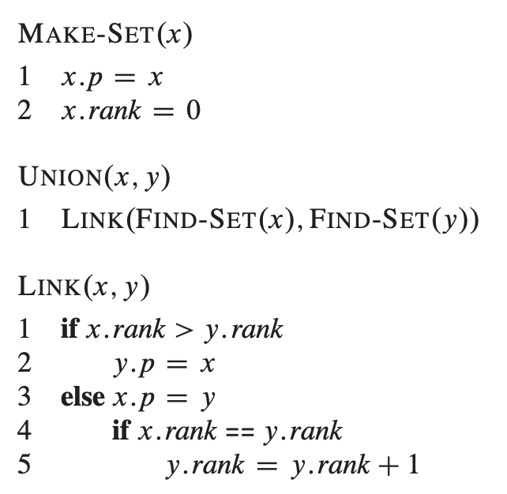
Optimization 1: Union by rank
Easy to implement!!

Slide 23
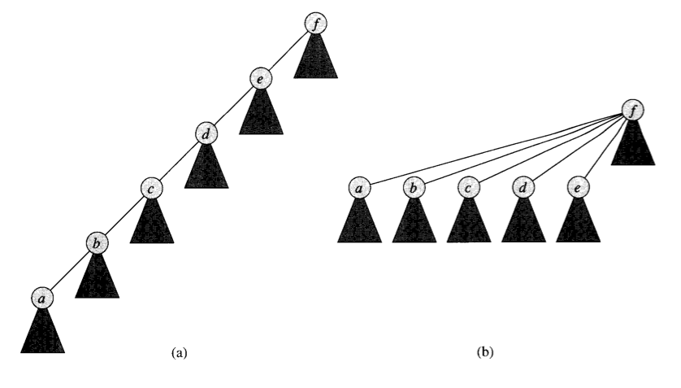
Optimization 2: Path Compression

Slide 24
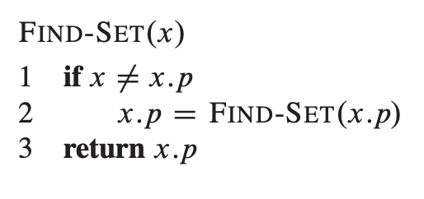
Optimization 2: Path Compression
Also easy to implement

Slide 25
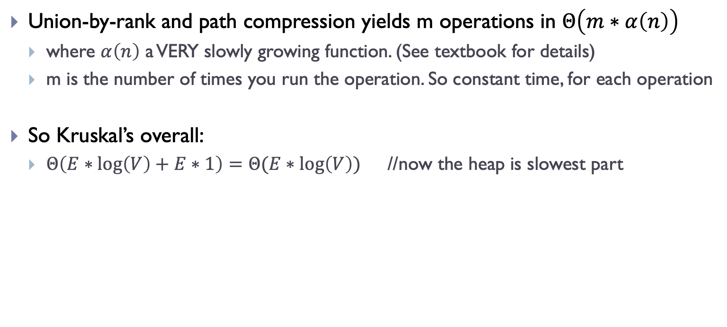
Complexity for Kruskal’s
Union-by-rank and path compression yields m operations in $Θ\left(m∗α\left(n\right)\right)$
where $α\left(n\right)$ a VERY slowly growing function. (See textbook for details)
m is the number of times you run the operation. So constant time, for each operation
So Kruskal’s overall:
$Θ\left(E∗\log\left(V\right)+E∗1\right)=Θ(E∗\log\left(V\right))$ //now the heap is slowest part

Slide 26
Summary

Slide 27
What did we learn?
Minimum Spanning Trees
Review!
Kruskal’s Algorithm
Review again!
Find-union
How to implement
How to optimize
How it affects runtime of Kruskal’s algorithm.

