Slide 1
CS 3100 - DSA2 Mark Floryan
Min-cut Max-flow, proof of Ford-Fulkerson
CLRS 26.1 – 26.2

Slide 2
Module 6!
Flow Networks:
A new type of problem that is broadly applicable to many areas
Solving Flow Networks:
Ford-Fulkerson Algorithm
Related problems and introduction to reductions:
Min-Cut vs. Max-flow
Bi-partite matching
Circulation networks

Slide 3

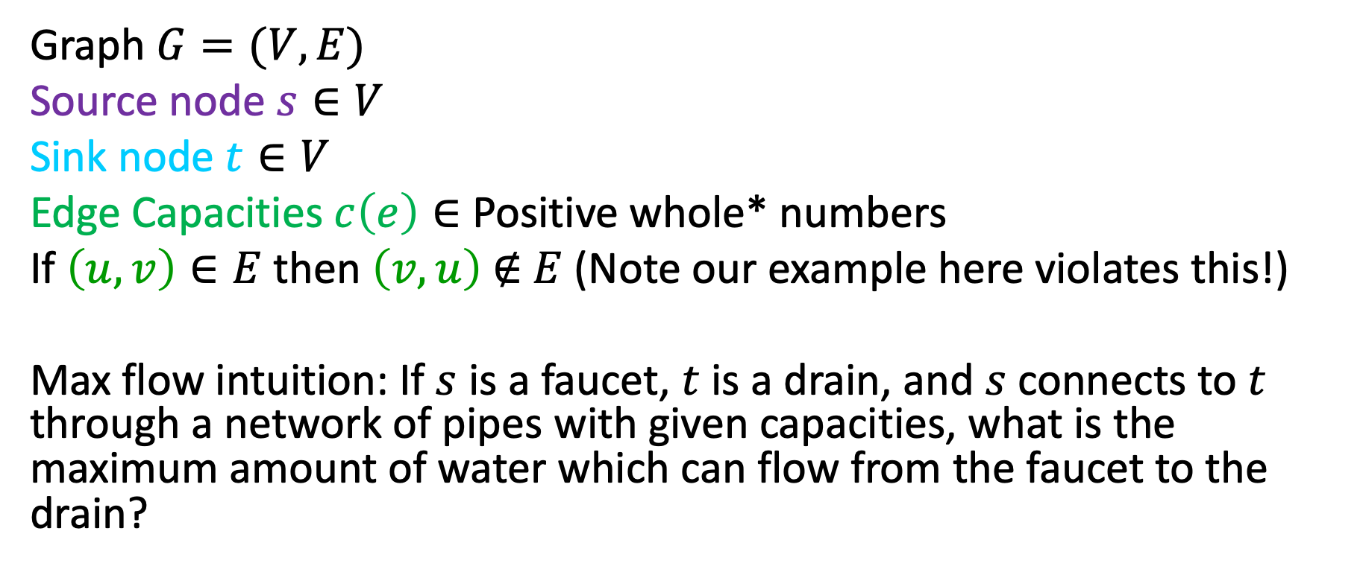

Flow Network
3
2
3
Graph $G=(V,E)$
Source node $s∈V$
Sink node $t∈V$
Edge Capacities $c\left(e\right)∈$ Positive whole* numbers
If $\left(u,v\right)∈E$ then $\left(v,u\right) \text{∉} E$ (Note our example here violates this!)
Max flow intuition: If $s$ is a faucet, $t$ is a drain, and $s$ connects to $t$ through a network of pipes with given capacities, what is the maximum amount of water which can flow from the faucet to the drain?
$$s$$
3
2
$$t$$
2
1
3
2
3

Slide 4
Flow Network: Antiparallel Edges
Easy adjustment to remove antiparallel edges and have equivalent flow graph: add intermediate node
(Note: our later examples use graph on the left without this adjustment.)
2
3
2
3
3
3
$$s$$
$$s$$
2
3
$$t$$
3
$$t$$
2
1
3
2
2
1
3
2
2
2
3
3

Slide 5
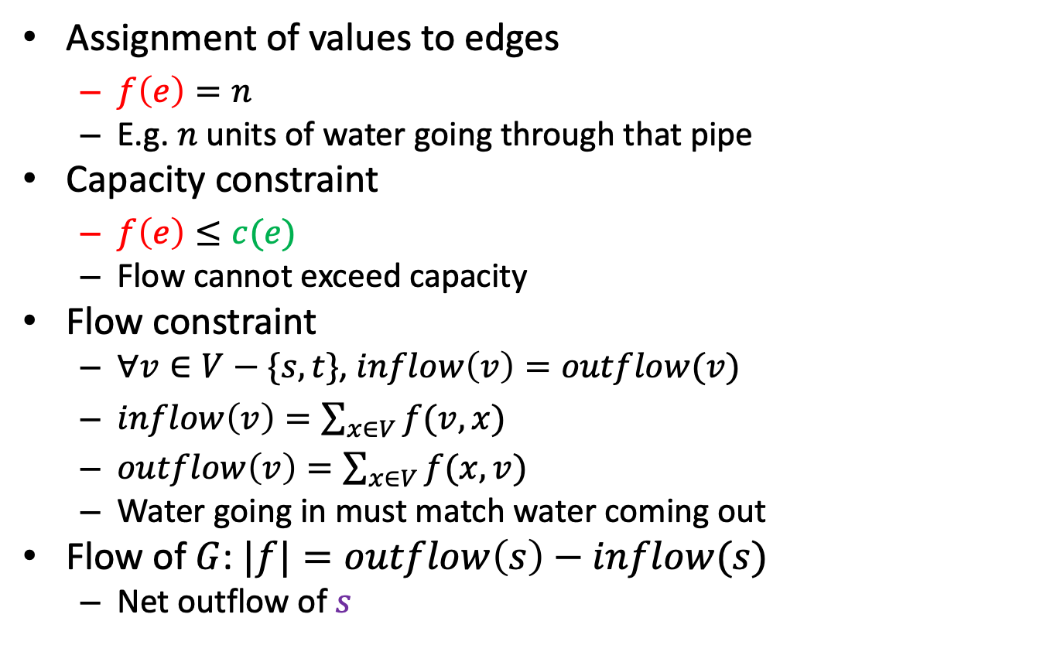


Flow
2/2
1/3
2/3
$$s$$
Assignment of values to edges
$f\left(e\right)=n$
E.g. $n$units of water going through that pipe
Capacity constraint
$f\left(e\right)≤c(e)$
Flow cannot exceed capacity
Flow constraint
$∀v∈V−\{s,t\}$, $inflow\left(v\right)=outflow(v)$
$inflow\left(v\right)=\sum_{x∈V}{f(v,x)}$
$outflow\left(v\right)=\sum_{x∈V}{f(x,v)}$
Water going in must match water coming out
Flow of $G$: $|f|=outflow\left(s\right)−inflow(s)$
Net outflow of $s$
1/1
1/3
$$t$$
2/2
1/2
2/3
1/2
2/3
Flow/Capacity
3 in example above

Slide 6
Ford-Fulkerson: Algorithm overview
Iterative algorithm: push some flow along some path at each step
Model or record the residual capacities
how much capacity is left after taking into account how much flow is going through that edge at this time
Find a path from s to t such that the minimum residual capacity of an edge on that path is greater than zero
Since each value is an integer, it must be 1 or more
Update the residual capacities after taking into account this new flow
Repeat until no more such paths are found

Slide 7
Showing Correctness of Ford-Fulkerson
To prove Ford-Fulkerson correct
We’ll use the idea of a cut in a network flow graph
We’ll prove properties related to cuts and flows

Slide 8



Cuts in Network Flow Graphs
Given a flow network, we want to cut edges…
A cut C = (S, T) where:
S is a set of vertices (S is a subset of V)
T is a set of vertices (T also a subset of V)
S intersect T = null set (no shared vertices)
S union T = V (all vertices in either S or T)
s in S, t in T
What do we care about?
Well, we care about the edges that go across this cut.
Either from node in S to a node in T or vice versa.
$$S$$
3
2
$$T$$
3
$$s$$
3
$$t$$
2
1
3
2
3

Slide 9
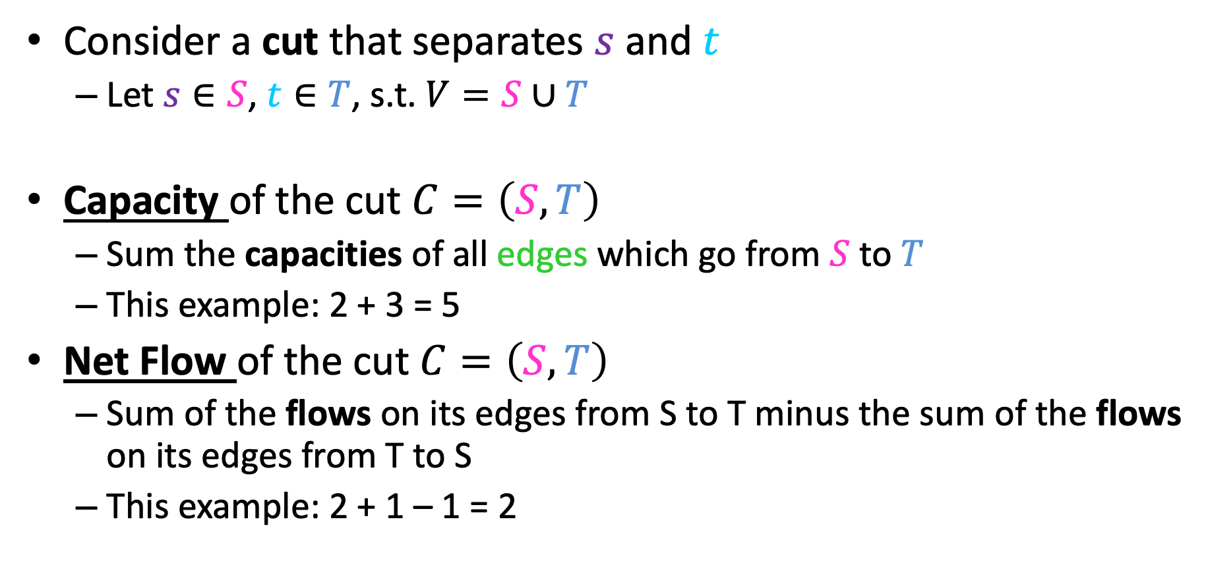


Two Properties of a Cut
$$S$$
2/2
3
$$T$$
Consider a cut that separates $s$ and $t$
Let $s∈S$, $t∈T$, s.t. $V=S∪T$
Capacity of the cut $C=\left(S,T\right)$
Sum the capacities of all edges which go from $S$ to $T$
This example: 2 + 3 = 5
Net Flow of the cut $C=\left(S,T\right)$
Sum of the flows on its edges from S to T minus the sum of the flows on its edges from T to S
This example: 2 + 1 – 1 = 2
3
$$s$$
3
$$t$$
2
1/1
3
2
1/3

Slide 10
We’ll Show These 3 Things
Weak duality property
Flow-value lemma
Max-flow Min-Cut theorem
…and how we can then argue Ford-Fulkerson is correct

Slide 11

First definition: Weak Duality
Let f be any flow and C = (S, T) be any cut
Then the value of f <= capacity of C
We’ll refer to this as the weak duality property
Note: We are talking about the capacity of C, not the value of the flow across C (i.e. not the net flow of C)
$$S$$
3
2
$$T$$
3
$$s$$
3
$$t$$
2
1
3
2
3

Slide 12
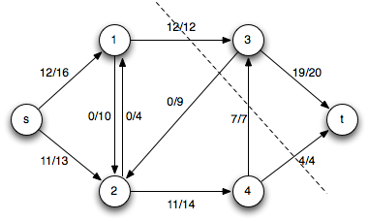


Definition: Flow-value lemma
Let f be any flow and C = (S, T) be any cut in G
The net flow across (S, T) equals the value of the flow f
2/2
2/3
2/3
$$s$$
0/3
0/1
0/2
$$t$$
1/2
0/3
1/2
1/3

Slide 13
Proof: Flow-value lemma
Let f be any flow and C = (S, T) be any cut
The net flow across (S, T) equals the value of the flow f
Proof by induction on the size of T
B.C. T = {t} (T is only the sink)
Clearly this is true as the flow across the cut is everyone sinking into t, which is the definition of the flow f
I.H. Assume true for some cut C = (S, T)
I.S. Move one node from S to T
Choose a node p to move that has at least one edge to a node in T
We know the flow f never changes
How does the value of the new cut C’ = (S’, T’) change?
It doesn’t! Why? See next slide…

Slide 14
Proof: Flow-value lemma cont.
Let f be any flow and C = (S, T) be any cut
The net flow across (S, T) equals the value of the flow f
Why does C’ = (S’, T’) have the same net flow?
Local equilibrium: net flow coming into node p from nodes in S only must equal the flow going out across the cut to nodes in T
After node p is moved:
everything going across the cut now goes to something in T from T, everything going to or from a node in S now goes across the cut.
Thus, by local equilibrium the value of the cut C’ is equivalent to the value of the cut C
Induction done!

Slide 15
Max-flow Min-cut Theorem
Reminder about weak duality:
Let f be any flow and C = (S, T) be any cut
Then the value of f <= capacity of C
The max flow f <= capacity of any cut C
So the best f can be is the capacity of the smallest-capacity cut
Can we guarantee that a flow with that value exists? (Yes, in later slides.)
The Max-flow Min-cut theorem: the maximum value of an s-t flow is equal to the minimum capacity of an s-t cut
In other words, if you look at all the possible cuts in the graph, and find the smallest capacity of those cuts, then that value is the value of the maximum flow for that network.

Slide 16





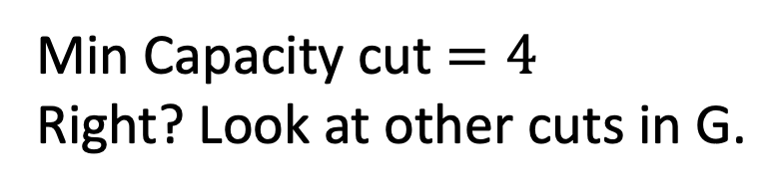

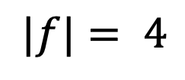
Example: Max-flow/Min-cut
Flow Graph $G$
Residual Graph $G_{f}$
2
2
2/3
2/2
0
2
2/3
1
$$s$$
0/3
1/1
$$s$$
1
1
2/2
1/2
$$t$$
0
2/3
3
0
3
$$t$$
0
2
2
0
2
2/2
0
3/3
3
No Augmenting Paths
$$|f|= 4$$
Min Capacity cut $=4$
Right? Look at other cuts in G.

Slide 17

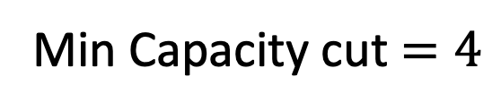
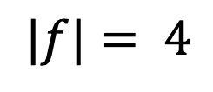
Max-flow Min-cut and Ford-Fulkerson
Flow Graph $G$
Residual Graph $G_{f}$
2
2
2/3
2/2
0
1
2
2/3
$$s$$
0/3
1/1
$$s$$
1
1
$$t$$
0
2/2
1/2
3
0
3
$$t$$
2/3
0
2
2
0
2
2/2
0
3/3
$$|f|= 4$$
3
No Augmenting Paths
Min Capacity cut $=4$
Idea: When there are no more augmenting paths, there exists a cut in the graph with cost matching the flow
(We’re going to use the flow-value lemma here.)

Slide 18
Ford-Fulkerson Proof: Outline
To show Ford-Fulkerson is correct we will prove:
When there are no more augmenting paths in G_{f} there is a cut in G with capacity equal to the flow f found by Ford-Fulkerson
It’s not possible for any other flow to have larger value than this f
This lets us conclude: the maximum flow through a network matches the minimum-capacity cut
Duality
When we’ve maximized max flow, we’ve minimized min cut (and vice-versa), so we can check when we’ve found one by finding the other

Slide 19
Ford-Fulkerson Proof
We’ll show the following three statements are equivalent, and together this shows Ford-Fulkerson is correct.
For some flow f
A) There is no augmenting path in G_{f} with respect to f
B) There exists a cut in G whose capacity equals the value of f
C) The flow f is a maximum flow in G
Let’s prove this equivalence by proving the following three implications:
A → B
B → C
C → A

Slide 20



A → B: if no augmenting path, cut with capacity f
If there is no augmenting path in G_{f} with respect to f , then there exists a cut in G whose capacity equals the value of f
Define $S=$ nodes reachable from source node $s$ by positive-weight edges in the residual graph $T=V−S \text{and} S$ separates $s$ , $t$ (otherwise there’s an augmenting path)
Let C = (S, T) be the cut that separates S and T
Flow Graph $G$
Residual Graph $G_{f}$
2
2
2/3
2/2
0
1
2
2/3
$$s$$
$$s$$
1
1
0/3
1/1
0
2/2
1/2
$$t$$
3
0
3
$$t$$
2/3
0
2
2
0
2
2/2
0
3/3
3

Slide 21

A → B: if no augmenting path, cut with capacity f
Let C = (S, T) be the cut that separates S and T
We’re trying to show capacity of C is f
We can see that Net-Flow(C) = Capacity(C). Why? Because…
Each of the “cut edges” in G have forward-flow in G_{f} of 0 and back-flow in G_{f} equal to edge’s capacity.
This means flow in G for each of these edges is max-capacity
Flow Graph $G$
Residual Graph $G_{f}$
2
2
2/3
2/2
0
1
2
2/3
$$s$$
0/3
1/1
$$s$$
1
1
$$t$$
0
2/2
1/2
3
0
3
$$t$$
2/3
0
2
2
0
2
2/2
0
3/3
3

Slide 22
A → B: if no augmenting path, cut with capacity f
Let C = (S, T) be the cut that separates S and T
We’re trying to show capacity of C is f
We know Net-Flow(C) = Capacity(C). Why? Because…
Each of the “cut edges” in G have forward-flow in G_{f} of 0 and back-flow in G_{f} equal to edge’s capacity.
This means flow in G for each of these edges is max-capacity
Flow-value Lemma: The net flow across C equals the value of the flow f
Therefore: The capacity across C equals the value of the flow f
We’ve thus proven: If there is no augmenting path in G_{f} with respect to f , then there exists a cut in G whose capacity equals the value of f
Tell me: how could we identify this cut C = (S, T)?

Slide 23
B → C: if cut with capacity f, f is max-flow
If there exists a cut in G whose capacity equals the value of f , then the flow f is a maximum flow in G
Proof by contradiction
Let f’ be a flow larger than f (the capacity of the cut C found by Ford-Fulkerson)
Flow-value lemma tells us: f’ = Net-Flow(C)
Given: f = Capacity(C)
If f’ > f , then Net-Flow(C) > Capacity(C)
Contradicts weak-duality property: Value of any flow through C <= Capacity(C)

Slide 24
These Prove Correctness of Ford-Fulkerson
We said: To show Ford-Fulkerson is correct we will prove:
When there are no more augmenting paths in G_{f} there is a cut in G with capacity equal to the flow f found by Ford-Fulkerson
It’s not possible for any other flow to have larger value than this f
A → B: If there is no augmenting path in G_{f} with respect to f , then there exists a cut in G whose capacity equals the value of f
B → C: If there exists a cut in G whose capacity equals the value of f , then the flow f is a maximum flow in G

Slide 25
C → A: if f is max-flow, then no augmenting path
Just to go “full circle”, let’s show this too!
If the flow f is a maximum flow in G, then there is no augmenting path in G_{f} with respect to f
Proof by contradiction
Assume f is max-flow but there exists an augmenting path p in G_{f}
Path p can add positive-value flow f_{p} to the overall flow through G
So overall flow of f + f_{p} is possible in G
Contradiction: we said f is maximum flow that’s possible

Slide 26
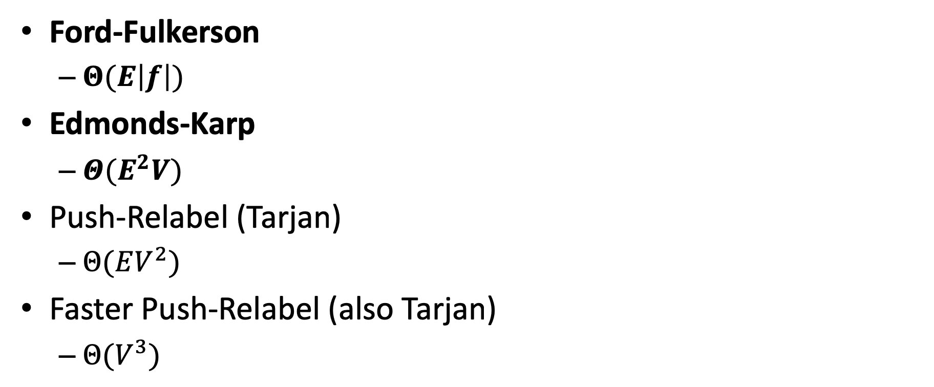
Other Max-flow algorithms
Ford-Fulkerson
$Θ(E\left|f\right|)$
Edmonds-Karp
$Θ(E^{2}V)$
Push-Relabel (Tarjan)
$Θ(EV^{2})$
Faster Push-Relabel (also Tarjan)
$Θ(V^{3})$

