Slide 1
CS 3100 – DSA2 Mark Floryan
Network Flow, Ford-Fulkerson
CLRS 26.1 – 26.2

Slide 2
In your textbook
CLRS 26.1 and 26.2
Includes simple solutions to the following “complications”
What if (u,v) and (v,u) are in the flow graph?
Called “Antiparallel” edges – easy to adjust for this, example later
What if we need >1 source? >1 sink?

Slide 3
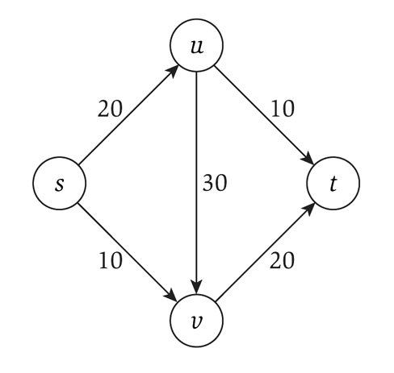
Flow networks
Consider a flow network, which is a specialized directed graph with:
A single source node s
A single terminus node t
Capacities on each edge
That must be integer!
What is the maximum flow you can send from s to t?

Slide 4
Applications
Transportation networks
How many people can be routed?
Computer networks
Electrical distribution
Water distribution
Note that all these applications have multiple sources and multiple sinks!
Whereas the flow networks we study do not, yet

Slide 5

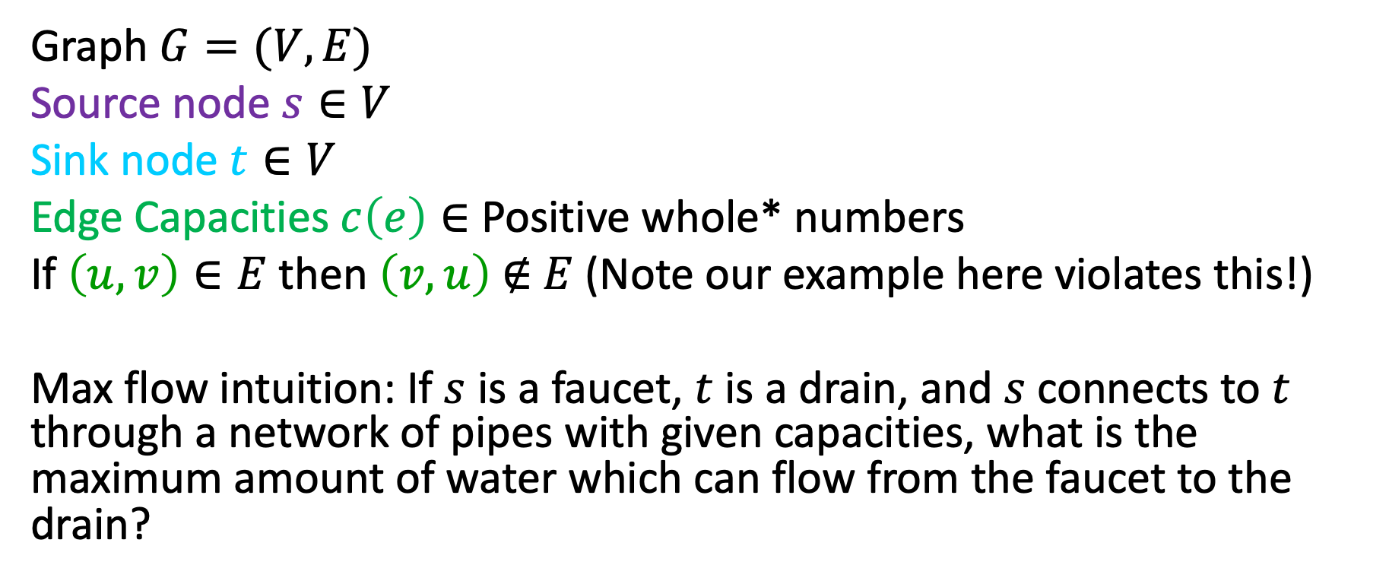

Flow Network
3
2
3
Graph $G=(V,E)$
Source node $s∈V$
Sink node $t∈V$
Edge Capacities $c\left(e\right)∈$ Positive whole* numbers
If $\left(u,v\right)∈E$ then $\left(v,u\right) \text{∉} E$ (Note our example here violates this!)
Max flow intuition: If $s$ is a faucet, $t$ is a drain, and $s$ connects to $t$ through a network of pipes with given capacities, what is the maximum amount of water which can flow from the faucet to the drain?
$$s$$
3
2
$$t$$
2
1
3
2
3

Slide 6
Flow Network: Antiparallel Edges
Easy adjustment to remove antiparallel edges and have equivalent flow graph: add intermediate node
(Note: our later examples use graph on the left without this adjustment.)
2
3
2
3
3
3
$$s$$
$$s$$
2
3
$$t$$
3
$$t$$
2
1
3
2
2
1
3
2
2
2
3
3

Slide 7
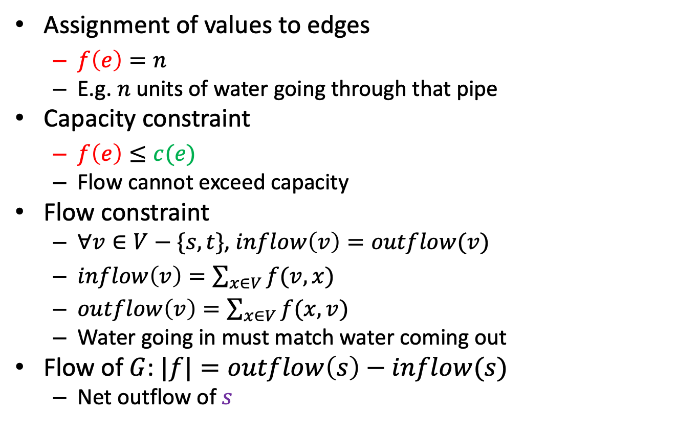


Flow
2/2
1/3
2/3
$$s$$
Assignment of values to edges
$f\left(e\right)=n$
E.g. $n$units of water going through that pipe
Capacity constraint
$f\left(e\right)≤c(e)$
Flow cannot exceed capacity
Flow constraint
$∀v∈V−\{s,t\}$, $inflow\left(v\right)=outflow(v)$
$inflow\left(v\right)=\sum_{x∈V}{f(v,x)}$
$outflow\left(v\right)=\sum_{x∈V}{f(x,v)}$
Water going in must match water coming out
Flow of $G$: $|f|=outflow\left(s\right)−inflow(s)$
Net outflow of $s$
1/1
1/3
$$t$$
2/2
1/2
2/3
1/2
2/3
Flow/Capacity
3 in example above

Slide 8
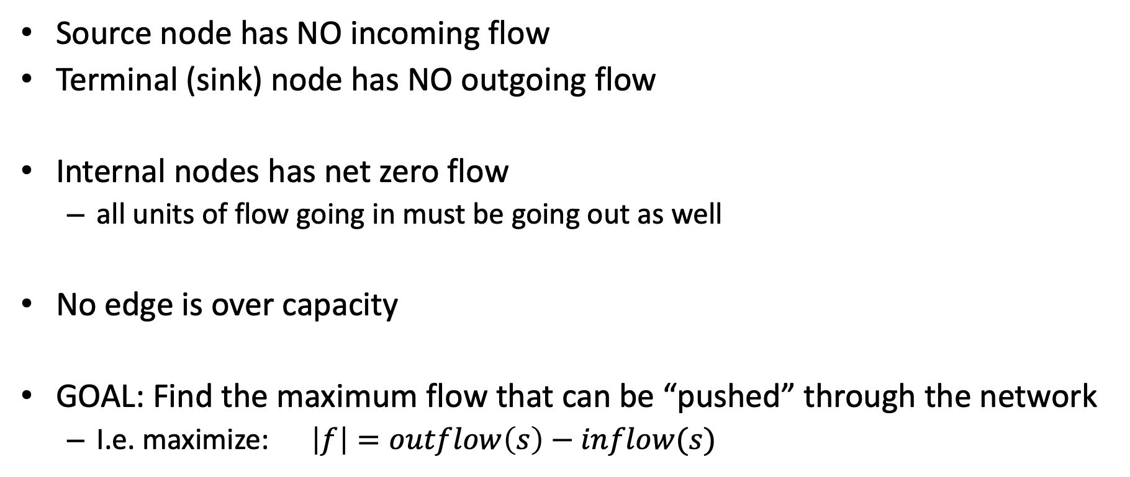
Let’s Make Some Rules
Source node has NO incoming flow
Terminal (sink) node has NO outgoing flow
Internal nodes has net zero flow
all units of flow going in must be going out as well
No edge is over capacity
GOAL: Find the maximum flow that can be “pushed” through the network
I.e. maximize: $\left|f\right|=outflow\left(s\right)−inflow(s)$

Slide 9


How to Solve This? This Greedy doesn’t work
Saturate Highest Capacity Path First
20
10
$$s$$
30
$$t$$
20
10

Slide 10
Greedy doesn’t work
Saturate Highest Capacity Path First
20
10
$$s$$
30
$$t$$
20
10

Slide 11
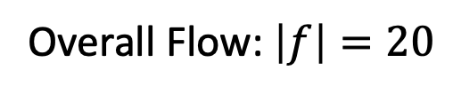
Greedy doesn’t work
Saturate Highest Capacity Path First
20/20
0/10
$$s$$
20/30
$$t$$
0/10
20/20
Overall Flow: $\left|f\right|=20$

Slide 12
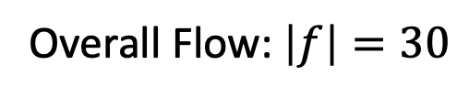
Greedy doesn’t work
Better Solution
20/20
10/10
$$s$$
10/30
$$t$$
10/10
20/20
Overall Flow: $\left|f\right|=30$

Slide 14
Ford-Fulkerson: Algorithm overview
Iterative algorithm: push some flow along some path at each step
Model or record the residual capacities
how much capacity is left after taking into account how much flow is going through that edge at this time
Find a path from s to t such that the minimum residual capacity of an edge on that path is greater than zero
Since each value is an integer, it must be 1 or more
Update the residual capacities after taking into account this new flow
Repeat until no more such paths are found

Slide 15
Algorithm notation
f(u,v): the flow on the edge from u to v
f(v,u): the backflow on the edge from v to u
c(u,v): the capacity on the edge from u to v
c_{f}(u,v): the residual capacity on the edge from u to v
G_{f} is the graph where the edges weights are the residual capacities
THIS is usually the graph we actually use when running the algorithm we are about to see.

Slide 16
Backflow
Each edge has forward flow and backflow
The two must always be “inverses” of each other!
I.e. they sum to the total capacity for that edge
This allows for modeling of flow “returning” along a given edge
One way to think about this:
How much of the forward flow we could “un-do”

Slide 17

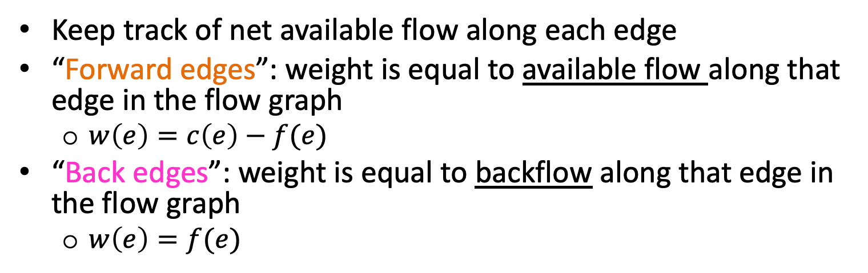






Residual Graph $G_{f}$
Keep track of net available flow along each edge
“Forward edges”: weight is equal to available flow along that edge in the flow graph
$w\left(e\right)=c\left(e\right)−f(e)$
“Back edges”: weight is equal to backflow along that edge in the flow graph
$w\left(e\right)=f(e)$
Flow I could add
Flow I could remove
Residual Graph $G_{f}$
Flow Graph $G$
2
1
1/3
a
2/2
a
0
2
2
2/3
1
1
$$s$$
1/3
1/1
$$s$$
1
1/2
$$t$$
2
0
3
$$t$$
2/2
2/3
0
2
2
1
1
b
1/2
b
1
2/3
2

Slide 18








Residual Graphs Example
Flow Graph
Residual Graph
20
0
10
0
20/20
0/10
$$s$$
20
$$t$$
$$s$$
20/30
$$t$$
10
10
0
20/20
0
20
0/10
20
20/20
10
10/10
0
0
$$s$$
10/30
$$t$$
$$s$$
20
10
$$t$$
0
0
10/10
20/20
10
20

Slide 19
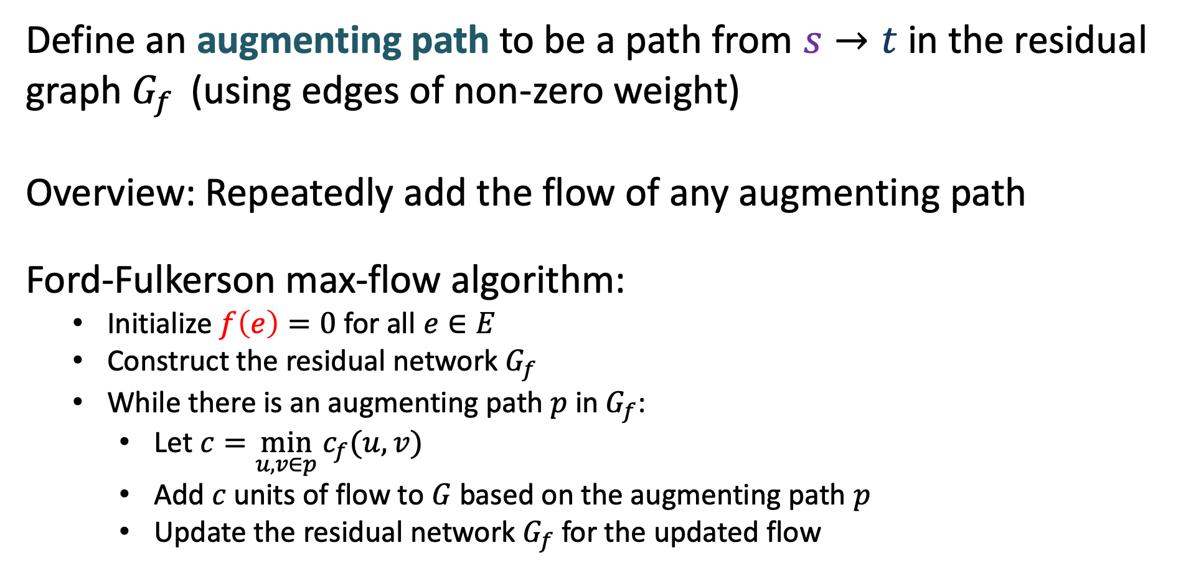
Ford-Fulkerson Algorithm
Define an augmenting path to be a path from $s→t$ in the residual graph $G_{f }$ (using edges of non-zero weight)
Overview: Repeatedly add the flow of any augmenting path
Ford-Fulkerson max-flow algorithm:
Initialize $f\left(e\right)=0$ for all $e∈E$
Construct the residual network $G_{f}$
While there is an augmenting path $p$ in $G_{f}$:
Let $c=\min_{u,v∈p}{c_{f}(u,v)}$
Add $c$ units of flow to $G$ based on the augmenting path $p$
Update the residual network $G_{f}$ for the updated flow

Slide 20
Ford-Fulkerson Algorithm
Define an augmenting path to be a path from $s→t$ in the residual graph $G_{f }$ (using edges of non-zero weight)
Overview: Repeatedly add the flow of any augmenting path
Ford-Fulkerson max-flow algorithm:
Initialize $f\left(e\right)=0$ for all $e∈E$
Construct the residual network $G_{f}$
While there is an augmenting path $p$ in $G_{f}$:
Let $c=\min_{u,v∈p}{c_{f}(u,v)}$
Add $c$ units of flow to $G$ based on the augmenting path $p$
Update the residual network $G_{f}$ for the updated flow
Ford-Fulkerson approach: take any augmenting path
(will revisit this later)

Slide 21
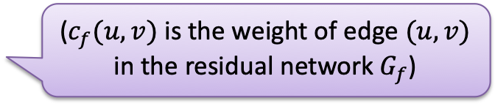
Ford-Fulkerson Algorithm
Define an augmenting path to be a path from $s→t$ in the residual graph $G_{f }$ (using edges of non-zero weight)
Overview: Repeatedly add the flow of any augmenting path
Ford-Fulkerson max-flow algorithm:
Initialize $f\left(e\right)=0$ for all $e∈E$
Construct the residual network $G_{f}$
While there is an augmenting path $p$ in $G_{f}$:
Let $c=\min_{u,v∈p}{c_{f}(u,v)}$
Add $c$ units of flow to $G$ based on the augmenting path $p$
Update the residual network $G_{f}$ for the updated flow
Ford-Fulkerson approach: take any augmenting path
(will revisit this later)
($c_{f}(u,v)$ is the weight of edge $(u,v)$ in the residual network $G_{f}$)

Slide 22
Ford-Fulkerson Algorithm: Updating G_{f}
f(u,v) = 0 for all edges (u,v)
While there is an “augmenting” path p from s to t in G_{f} such that c_{f}(u,v) > 0 for all edges (u,v) ∈ p
Find c_{f}(p) = min{c_{f}(u,v) | (u,v) ∈ p}
For each edge (u,v) ∈ p
f(u,v) = f(u,v) + c_{f}(p) send flow along the path
f(v,u) = f(v,u) - c_{f}(p) send backflow the other way

Slide 23


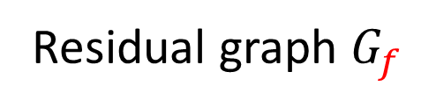
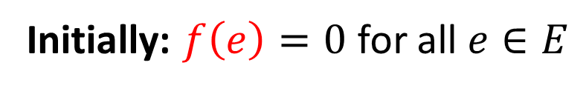
Ford-Fulkerson Example
0/2
2
0/3
3
0/3
$$s$$
0/3
$$s$$
3
3
0/1
1
0/2
$$t$$
2
$$t$$
0/2
3
0/3
2
0/2
2
0/3
3
Initially: $f\left(e\right)=0$ for all $e∈E$
Residual graph $G_{f}$

Slide 24
Ford-Fulkerson Example
Increase flow by 1 unit
0/2
2
0/3
3
0/3
$$s$$
0/3
$$s$$
3
3
0/1
1
0/2
$$t$$
2
$$t$$
0/2
3
0/3
2
0/2
2
0/3
3
Residual graph $G_{f}$

Slide 25
Ford-Fulkerson Example
Increase flow by 1 unit
1/2
2
1/3
3
0/3
$$s$$
0/3
$$s$$
3
3
1/1
1
0/2
$$t$$
2
$$t$$
0/2
3
0/3
2
1/2
2
1/3
3
Residual graph $G_{f}$

Slide 26
Ford-Fulkerson Example
1/2
1
1/3
2
0/3
1
$$s$$
0/3
$$s$$
1
3
3
1/1
1
0/2
$$t$$
2
1
$$t$$
0/2
3
0/3
2
1
1/2
1
1/3
2
Residual graph $G_{f}$

Slide 27
Ford-Fulkerson Example
Increase flow by 1 unit
1/2
1
1/3
2
0/3
1
$$s$$
0/3
$$s$$
1
3
3
1/1
1
0/2
$$t$$
2
1
$$t$$
0/2
3
0/3
2
1
1/2
1
1/3
2
Residual graph $G_{f}$

Slide 28
Ford-Fulkerson Example
Increase flow by 1 unit
2/2
1
2/3
2
1/3
1
$$s$$
0/3
$$s$$
1
3
3
1/1
1
0/2
$$t$$
2
1
$$t$$
0/2
3
0/3
2
1
1/2
1
1/3
2
Residual graph $G_{f}$

Slide 29
Ford-Fulkerson Example
Increase flow by 1 unit
2/2
2/3
1
1/3
2
1
$$s$$
0/3
$$s$$
2
3
2
1/1
1
0/2
$$t$$
2
1
$$t$$
0/2
3
0/3
2
1
1/2
1
1/3
2
Residual graph $G_{f}$

Slide 30


Ford-Fulkerson Example
2/2
2/3
1
1/3
2
1
$$s$$
0/3
$$s$$
2
3
2
1/1
1
0/2
$$t$$
2
1
$$t$$
0/2
3
0/3
2
1
1/2
1
1/3
2
Residual graph $G_{f}$

Slide 31
Ford-Fulkerson Example
Increase flow by 1 unit
2/2
2/3
1
2/3
2
1
$$s$$
0/3
$$s$$
2
3
2
0/1
1
0/2
$$t$$
2
1
$$t$$
1/2
3
0/3
2
1
1/2
1
1/3
2
Residual graph $G_{f}$

Slide 32
Ford-Fulkerson Example
Increase flow by 1 unit
2/2
2/3
1
2/3
2
2
$$s$$
0/3
$$s$$
2
3
1
0/1
1
0/2
$$t$$
2
1
$$t$$
1/2
1
3
0/3
1
1
1/2
1
1/3
2
Residual graph $G_{f}$

Slide 33
Ford-Fulkerson Example
2/2
2/3
1
2/3
2
2
$$s$$
0/3
$$s$$
2
3
1
0/1
1
0/2
$$t$$
2
1
$$t$$
1/2
1
3
0/3
1
1
1/2
1
1/3
2
Residual graph $G_{f}$

Slide 34
Ford-Fulkerson Example
Increase flow by 1 unit
2/2
2/3
1
2/3
2
2
$$s$$
0/3
$$s$$
2
3
1
0/1
1
0/2
$$t$$
2
1
$$t$$
2/2
1
3
0/3
1
1
2/2
1
2/3
2
Residual graph $G_{f}$

Slide 35
Ford-Fulkerson Example
2/2
2/3
1
2/3
2
2
$$s$$
0/3
$$s$$
2
3
1
0/1
1
0/2
$$t$$
2
2
$$t$$
2/2
2
3
0/3
2
2/2
2/3
1
Residual graph $G_{f}$

Slide 36
Ford-Fulkerson Example
No more augmenting paths
2/2
2/3
1
2/3
2
2
$$s$$
0/3
$$s$$
2
3
1
0/1
1
0/2
$$t$$
2
2
$$t$$
2/2
2
3
0/3
2
2/2
2/3
1
Residual graph $G_{f}$
Maximum flow: 4

Slide 37


Our example
20
10
$$s$$
30
$$t$$
10
20

Slide 38
Ford-Fulkerson Algorithm - Runtime
Define an augmenting path to be a path from $s→t$ in the residual graph $G_{f }$ (using edges of non-zero weight)
Overview: Repeatedly add the flow of any augmenting path
Ford-Fulkerson max-flow algorithm:
Initialize $f\left(e\right)=0$ for all $e∈E$
Construct the residual network $G_{f}$
While there is an augmenting path $p$ in $G_{f}$:
Let $c=\min_{u,v∈p}{c_{f}(u,v)}$
Add $c$ units of flow to $G$ based on the augmenting path $p$
Update the residual network $G_{f}$ for the updated flow
Time to find an augmenting path:
Number of iterations of While loop:

Slide 39

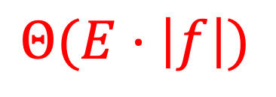

Ford-Fulkerson Algorithm - Runtime
Define an augmenting path to be a path from $s→t$ in the residual graph $G_{f }$ (using edges of non-zero weight)
Overview: Repeatedly add the flow of any augmenting path
Ford-Fulkerson max-flow algorithm:
Initialize $f\left(e\right)=0$ for all $e∈E$
Construct the residual network $G_{f}$
While there is an augmenting path $p$ in $G_{f}$:
Let $c=\min_{u,v∈p}{c_{f}(u,v)}$
Add $c$ units of flow to $G$ based on the augmenting path $p$
Update the residual network $G_{f}$ for the updated flow
Time to find an augmenting path:
$$DFS: Θ(V+E)$$
Number of iterations of While loop:
$$|f|$$
$$Θ(E⋅\left|f\right|)$$

Slide 40
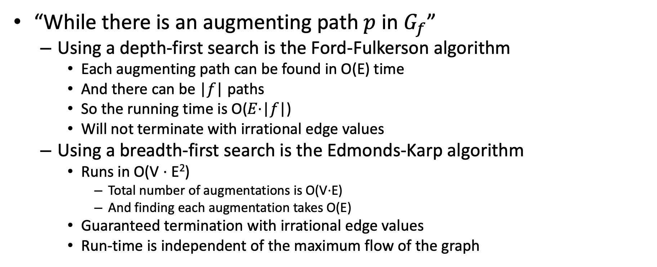
What type of search?
“While there is an augmenting path $p$ in $G_{f}$”
Using a depth-first search is the Ford-Fulkerson algorithm
Each augmenting path can be found in O(E) time
And there can be |𝑓| paths
So the running time is O(𝐸⋅|𝑓|)
Will not terminate with irrational edge values
Using a breadth-first search is the Edmonds-Karp algorithm
Runs in O(V ⋅ E²)
Total number of augmentations is O(V⋅E)
And finding each augmentation takes O(E)
Guaranteed termination with irrational edge values
Run-time is independent of the maximum flow of the graph

