Slide 1
Greedy Algorithms Knapsack Problems
Data Structures And Algorithms 2 Mark Floryan

Slide 2
CLRS Readings
Chapter 16, Greedy Algorithms
Intro, page 414
Section 16.2, Elements of the Greedy Strategy, Knapsack problem

Slide 3
Knapsack Problems

Slide 4



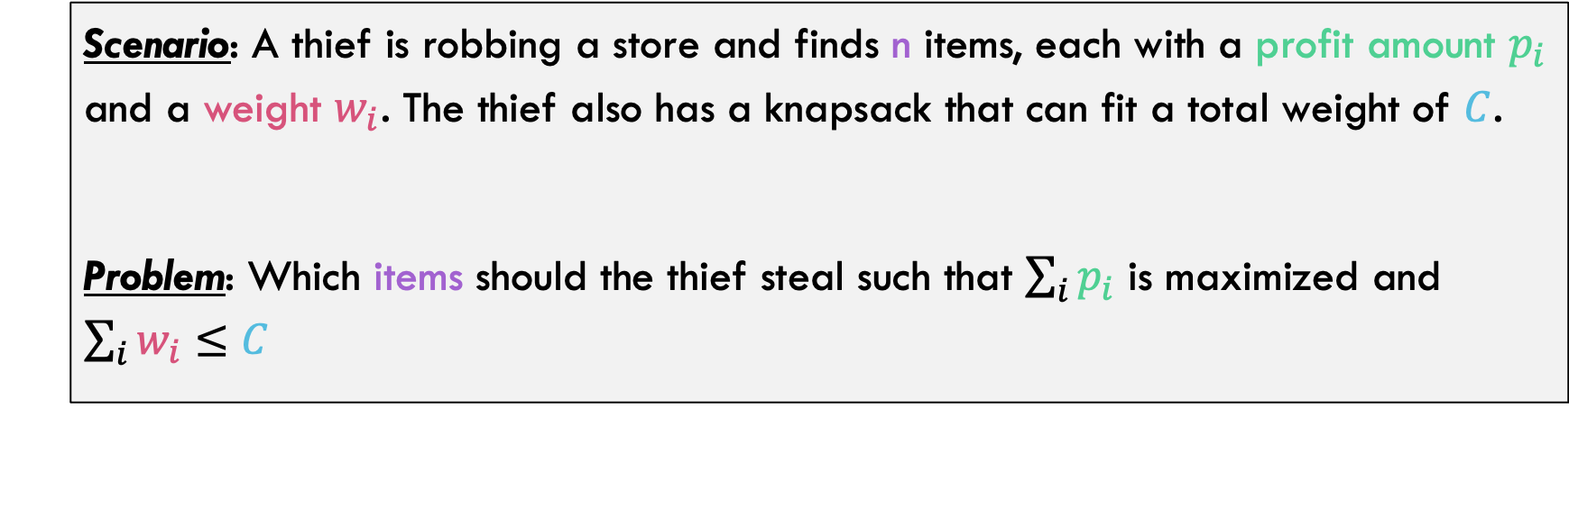
Knapsack Problems
Knapsack Problem:
Scenario: A thief is robbing a store and finds n items, each with a profit amount $p_{i}$ and a weight $w_{i}$. The thief also has a knapsack that can fit a total weight of $C$.
Problem: Which items should the thief steal such that $\sum_{i}{p_{i}}$ is maximized and $\sum_{i}{w_{i}≤C}$
Example:
Weight
$$p_{2}=12$$
$$p_{3}=3$$
Knapsack capacity
$$p_{1}=10$$

Slide 5






Knapsack Problems
Example:
Weight
$$p_{2}=12$$
$$p_{3}=3$$
Knapsack capacity
$$p_{1}=10$$
Sub-Optimal Solution
Optimal Solution
Total profit:
12
$$p_{1}=10$$
Total profit:
10+3=13
$$p_{2}=12$$
$$p_{3}=3$$

Slide 6





Types of Knapsack Problems
Example:
Weight
$$p_{2}=12$$
$$p_{3}=3$$
Knapsack capacity
$$p_{1}=10$$
Optimal Solution
Definition: This is called a 0/1 Knapsack Problem because the algorithm must take the ENTIRE item or not take the item at all. In other words, the item is all or nothing.
$$p_{1}=10$$
Total profit:
10+3=13
$$p_{3}=3$$
0/1 Knapsack is harder, and we will show an algorithm in the next module

Slide 7



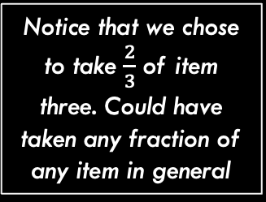
Types of Knapsack Problems
Example:
Weight
$$p_{2}=12$$
$$p_{3}=3$$
Knapsack capacity
$$p_{1}=10$$
Notice that we chose to take $\frac{2}{3}$ of item three. Could have taken any fraction of any item in general
Is this solution optimal?
Definition: With a Fractional Knapsack Problem, the algorithm can take any fractional percentage of each item.
$$p_{2}$$
Total profit:
10+8=18
$$12∗\frac{2}{3}=8$$
$$p_{1}=10$$
Fractional Knapsack is easier, and can be solved with a Greedy Algorithm

Slide 8
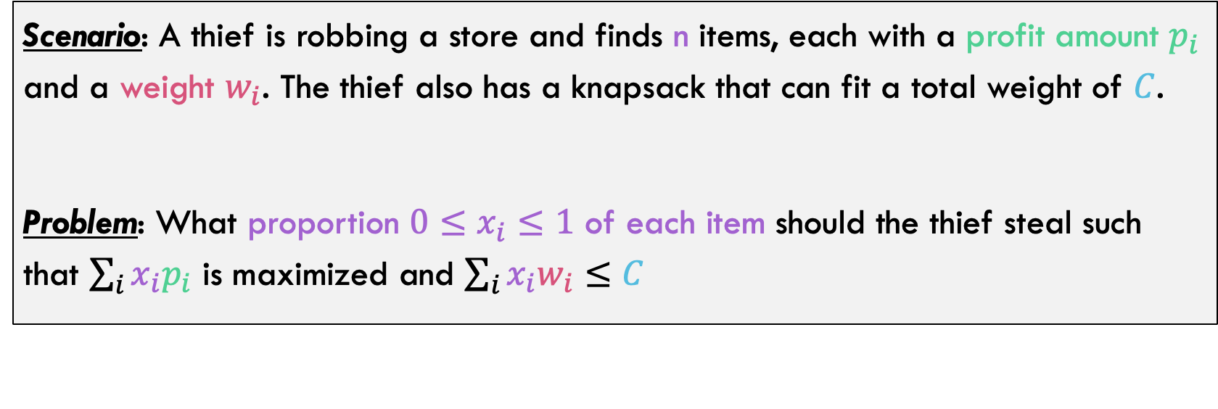
Updating Our Problem Statement
Knapsack Problem:
Scenario: A thief is robbing a store and finds n items, each with a profit amount $p_{i}$ and a weight $w_{i}$. The thief also has a knapsack that can fit a total weight of $C$.
Problem: What proportion ${0≤x}_{i}≤1$ of each item should the thief steal such that $\sum_{i}{x_{i}p_{i}}$ is maximized and $\sum_{i}{{x_{i}w}_{i}≤C}$
Notice that we take some proportion of each item in this version. We use up that proportion of the item’s weight in our knapsack and also get that proportion of the item’s value

Slide 9
Optimal Substructure

Slide 10
Aside: Optimal Substructure
Does the Knapsack Problem have Optimal Substructure?
What do you think?

Slide 11


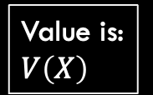




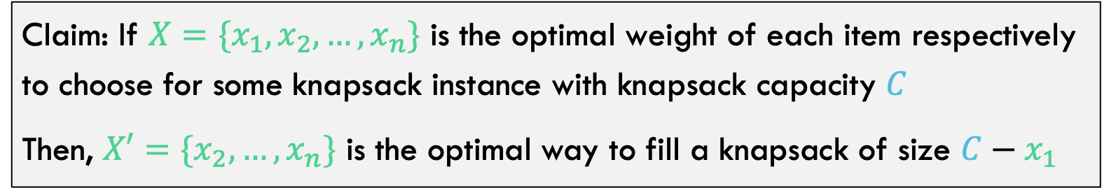



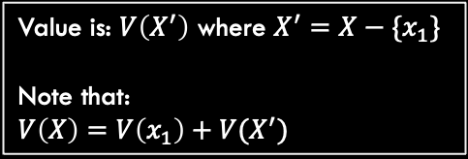


Aside: Optimal Substructure
Claim: If $X=\{x_{1},x_{2},…,x_{n}\}$ is the optimal weight of each item respectively to choose for some knapsack instance with knapsack capacity $C$
Then, $X′=\{x_{2},…,x_{n}\}$ is the optimal way to fill a knapsack of size $C−x_{1}$
Value is: $V\left(X\right)$
Optimal Solution
Optimal Solution?
$$x_{1}$$
$$x_{2}$$
then
$$x_{2}$$
If this is optimal
Is this optimal too?
$$C$$
$$x_{3}$$
$$x_{3}$$
$$x_{4}$$
$$C−x_{1}$$
$$x_{4}$$
…
…
Value is: $V\left(X^{′}\right)$ where $X^{′}=X−\{x_{1}\}$
Note that: $V\left(X\right)=V\left(x_{1}\right)+V(X^{′})$
$$x_{n}$$
$$x_{n}$$

Slide 12







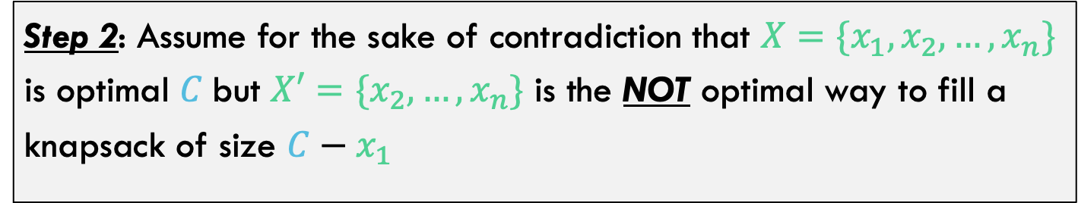






Aside: Optimal Substructure
Step 2: Assume for the sake of contradiction that $X=\{x_{1},x_{2},…,x_{n}\}$ is optimal $C$but $X′=\{x_{2},…,x_{n}\}$ is the NOT optimal way to fill a knapsack of size $C−x_{1}$
$$V\left(X\right)=V\left(X^{′}\right)+{V(x}_{1})$$
Value is: $V(X^{′})$
This IS Optimal
But somehow this is NOT optimal
$$x_{1}$$
$$x_{2}$$
$$x_{2}$$
$$C$$
$$x_{3}$$
$$x_{3}$$
$$C−x_{1}$$
$$x_{4}$$
$$x_{4}$$
…
…
$$x_{n}$$
$$x_{n}$$

Slide 13






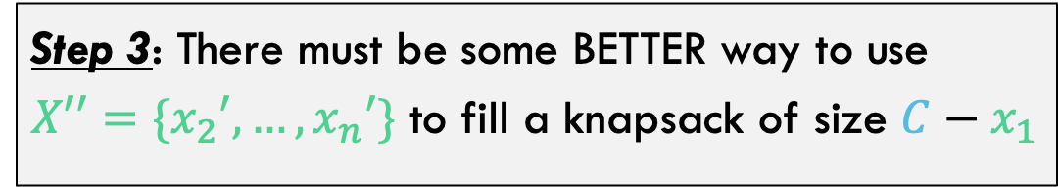





Aside: Optimal Substructure
Step 3: There must be some BETTER way to use $X′′=\{x_{2}′,…,x_{n}′\}$ to fill a knapsack of size $C−x_{1}$
Value is: $V(X^{′})$
Value is: $V\left(X′′\right)>V(X^{′})$
But somehow this is NOT optimal
This IS Optimal
$$x_{2}$$
$$x_{2}′$$
There must be a better way to fill this part of the knapsack
$$x_{3}′$$
$$x_{3}$$
$$C−x_{1}$$
$$C−x_{1}$$
$$x_{4}$$
…
…
$$x_{n}$$
$$x_{n}′$$

Slide 14
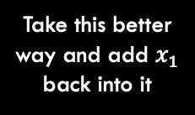









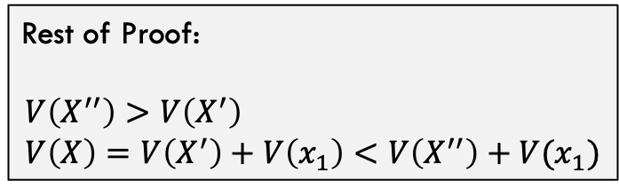


Aside: Optimal Substructure
Step 3: There must be some BETTER way to use $X′′=\{x_{2}′,…,x_{n}′\}$ to fill a knapsack of size $C−x_{1}$
Value is: $V\left(X′′\right)>V(X^{′})$
Value is: $V\left(X′′\right)+V(x_{1})$
This IS Optimal
??????
$$x_{1}$$
Rest of Proof:
$$V\left(X^{′′}\right)>V\left(X^{′}\right) \\ V\left(X\right)=V\left(X^{′}\right)+V\left(x_{1}\right)<V\left(X^{′′}\right)+V(x_{1})$$
$$x_{2}′$$
$$x_{2}′$$
Take this better way and add $x_{1}$ back into it
$$x_{3}′$$
$$x_{3}′$$
$$C−x_{1}$$
$$C−x_{1}$$
…
…
This is optimal solution
$$x_{n}′$$
$$x_{n}′$$
But this is better solution. Contradiction!

Slide 15
Optimal Substructure
The Knapsack Problem has Optimal Substructure?

Slide 16
What is the greedy Choice?

Slide 17
Back To Algorithm!
What is the greedy choice we should make for this one?
Chose item with highest value?
Choose item that maximizes knapsack space left over
Choose item with highest weight – value ratio
Chose item with lowest weight?
Choose item with highest value – weight ratio

Slide 18

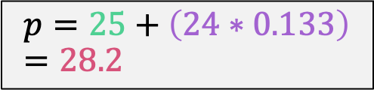
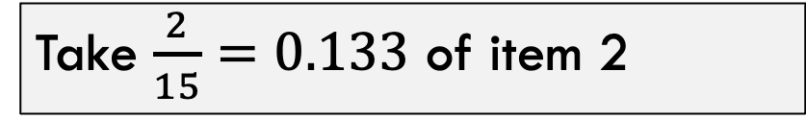
Greedy Choice
Chose item with highest value?
Step 1:
n = 3, C = 20
Take all of item 1 (highest value)
$$p=25, c=2$$
Item | Value | Weight
1 | 25 | 18
2 | 24 | 15
3 | 15 | 10
Step 2:
Take $\frac{2}{15}=0.133$ of item 2
$$p=25+\left(24∗0.133\right)=28.2$$
But this is NOT the optimal solution (see next slide)

Slide 19

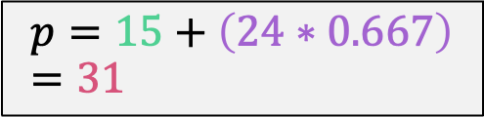
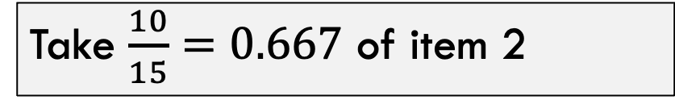
Greedy Choice
Chose item with lowest weight?
Step 1:
n = 3, C = 20
Take all of item 3 (lowest weight)
$$p=15, c=10$$
Item | Value | Weight
1 | 25 | 18
2 | 24 | 15
3 | 15 | 10
Step 2:
Take $\frac{10}{15}=0.667$ of item 2
$$p=15+\left(24∗0.667\right)=31$$
But this is STILL NOT the optimal solution (see next slide)

Slide 20
Back To Algorithm!
What is the greedy choice we should make for this one?
Choose item with highest value – weight ratio

Slide 21

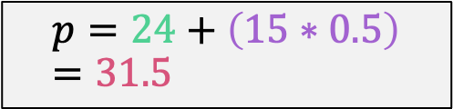
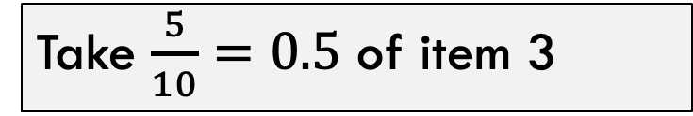
Greedy Choice
Choose item with highest value – weight ratio
Step 1:
n = 3, C = 20
Take all of item 2 (best ratio)
$$p=24, c=10$$
Item | Value | Weight | Ratio
1 | 25 | 18 | 1.4
2 | 24 | 15 | 1.6
3 | 15 | 10 | 1.5
Step 2:
Take $\frac{5}{10}=0.5$ of item 3
$$p=24+\left(15∗0.5\right)=31.5$$
This is the optimal solution!

Slide 22
Fractional Knapsack Algorithm
FRACTIONAL_KNAPSACK(a, C)
1 n = a.last
2 for i = 1 to n
3 ratio[i] = a[i].p / a[i].w
4 sort(a, ratio)
5 weight = 0
6 i = 1
7 while (i ≤ n and weight < C)
8 if (weight + a[i].w ≤ C)
9 println “select all of object “ + a[i].id
10 weight = weight + a[i].w
11 else
12 r = (C – weight) / a[i].w
13 println “select “ + r + “ of object “ + a[i].id
14 weight = C
15 i = i+1
Worst-case runtime: for loop and while loop take θ(n) time,
sorting takes θ(nlgn) time, so algorithm takes θ(nlgn) time

Slide 23
Proving Correctness

Slide 24

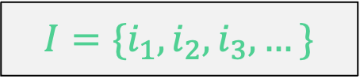

Proving Correctness
Greedy Choice Property: The item with the largest value-to-weight ratio, filled to its max possible amount, must be in some optimal solution.
Some terms before we get started:
$$I=\{i_{1}, i_{2},i_{3},…\}$$
The items. Each has a value (v) and weight (w) field
$$R=\left\{r_{1}, r_{2},r_{3},…\right\}$$
The value-to-weight ratios. Each $r_{j}=\frac{I\left[j\right].v}{I\left[j\right].w}$ and $r_{1}≤r_{2}≤r_{3}…≤r_{n}$
$$C≥0$$
The capacity of the knapsack

Slide 25

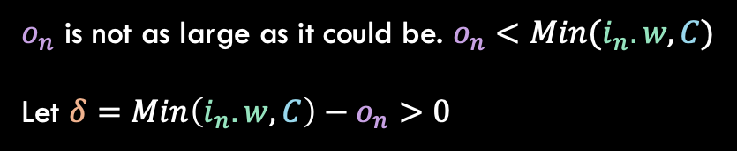
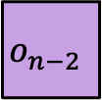

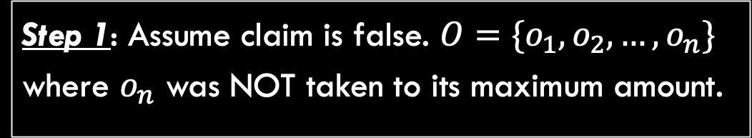
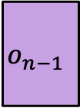




Proving Correctness
Greedy Choice Property: The item with the largest value-to-weight ratio, filled to its max possible amount, must be in some optimal solution.
Step 1: Assume claim is false. $O=\{o_{1},o_{2},…,o_{n}\}$ where $o_{n}$ was NOT taken to its maximum amount.
$o_{n}$ is not as large as it could be. $o_{n}<Min(i_{n}.w,C)$
Let $δ=Min\left(i_{n}.w,C\right)−o_{n}>0$
$$o_{4}$$
$$o_{3}$$
$$o_{n−1}$$
$$δ$$
$$o_{n−2}$$
$$C$$
$$o_{1}$$
$$o_{n}$$
$i_{1}$ $i_{2}$ $i_{3}$ $i_{4}$ … $i_{n−2}$ $i_{n−1}$ $i_{n}$

Slide 26

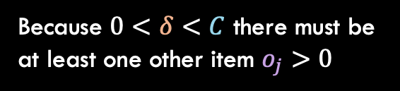
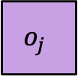

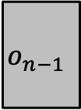


Proving Correctness
Greedy Choice Property: The item with the largest value-to-weight ratio, filled to its max possible amount, must be in some optimal solution.
Step 2: Thus there must be weight in some other item $o_{j}$
Because $0<δ<C$ there must be at least one other item $o_{j}>0$
$$o_{4}$$
Also notice that $r_{j}≤r_{n}$
$$o_{3}$$
$$o_{n−1}$$
$$δ$$
$$o_{j}$$
$$o_{1}$$
$$o_{n}$$
$i_{1}$ $i_{2}$ $i_{3}$ $i_{4}$ … $i_{n−2}$ $i_{n−1}$ $i_{n}$

Slide 27
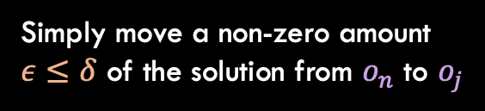



Proving Correctness
Greedy Choice Property: The item with the largest value-to-weight ratio, filled to its max possible amount, must be in some optimal solution.
Step 2: Swap some of $o_{j}$ out and put back into $o_{n}$
Simply move a non-zero amount $ε≤δ$ of the solution from $o_{n}$ to $o_{j}$
$$o_{4}$$
$$o_{3}$$
$$o_{n−1}$$
$$ε≤δ$$
$$o_{j}$$
$$o_{1}$$
$$o_{n}$$
$i_{1}$ $i_{2}$ $i_{3}$ $i_{4}$ … $i_{n−2}$ $i_{n−1}$ $i_{n}$

Slide 28

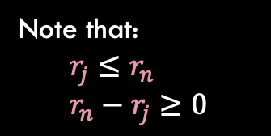




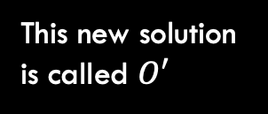

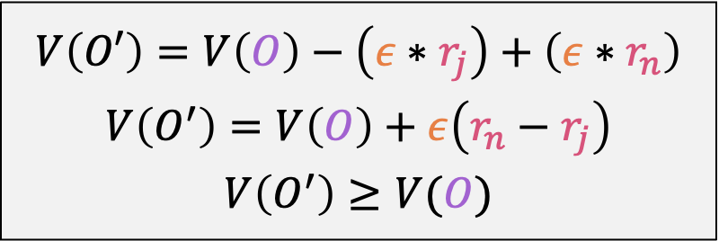
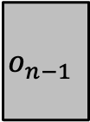

Proving Correctness
Simply move a non-zero amount $ε≤δ$ of the solution from $o_{n}$ to $o_{j}$
$$o_{4}$$
This new solution is called $O′$
$$o_{3}$$
$$o_{n−1}$$
$$ε$$
$$o_{j}$$
$$o_{1}$$
$$o_{n}$$
$i_{1}$ $i_{2}$ $i_{3}$ $i_{4}$ … $i_{n−2}$ $i_{n−1}$ $i_{n}$
Note that:
$$r_{j}≤r_{n} \\ r_{n}−r_{j}≥0$$
$$V\left(O′\right)=V\left(O\right)−\left(ε∗r_{j}\right)+\left(ε∗r_{n}\right)$$
$$V\left(O^{′}\right)=V\left(O\right)+ε\left(r_{n}−r_{j}\right)$$
$$V\left(O^{′}\right)≥V(O)$$
Contradiction!

Slide 29



Greedy Choice
Does this greedy choice work for the 0/1 Knapsack Problem?
n = 3, C = 4
Step 1:
Take all of item 1
$$p=3, c=3$$
Item | Value | Weight | Ratio
1 | 3 | 1 | 3
2 | 5 | 2 | 2.5
3 | 6 | 3 | 2
Step 2:
Take all of item 2
$$p=3 +5=8, c=1$$
Step 3:
Cannot fit item 3
$$p=8$$
But items 1 and 3 give value 6+3=9 which is more optimal!

Slide 30
What did we learn?
Knapsack Problems
Has optimal substructure!
Fractional version solved with greedy algorithm
0/1 version is harder

