Slide 1
Greedy Algorithms Introduction / Making Change
CS 3100 – Data structures and Algorithms II
Mark Floryan

Slide 2
CLRS Readings
Chapter 16, Greedy Algorithms

Slide 3
Topics
Greedy Algorithms: Our next algorithmic technique
How to analyze problems with greedy solutions:
Optimal substructure property
Greedy choice property
Proving correctness of greedy algorithms
First example problem:
Coin Change

Slide 4
Optimization Problems
Infeasible solutions
Optimal Solution(s)
Feasible solutions
Quality of
Feasible solutions
Objective function f(x)
Returns the quality of solution x
Infeasible solutions

Slide 5
Optimization Problems
These do not have proper format. For example, a path but it doesn’t end at the intended destination
There may be multiple optimal solutions of equal value
Infeasible solutions
Optimal Solution(s)
Feasible solutions
Quality of
Feasible solutions
These solutions have proper format, could be the answer, but there are many of them to check!
Objective function f(x)
Returns the quality of solution x
Value of solutions usually spans a very wide range
Infeasible solutions
Objective function takes feasible solution as input and outputs the quality of that solution

Slide 6
Coin Change, Optimal Substructure, and the Greedy Choice Property

Slide 7
Simple Algorithm: Making Change
Make Change
$5.00
??
Cost = $4.37
What is the minimum number of coins to make change for this?

Slide 8
Simple Algorithm: Making Change
.25
.25
Make Change
$5.00
.10
Cost = $4.37
.01
.01
.01
6 coins…is that the best we can do? How did you figure it out? What algorithm did you use?

Slide 9
Making Change visualized
X = 1 quarter
63 coins
…
9 coins
8 coins
7 coins
X = 63 pennies
X = 6 dimes, three pennies
Etc.
number of coins(x)
Want the minimum here!
6 coins
X = 100 pennies

Slide 10
Making Change visualized
X = 1 quarter
63 coins
…
9 coins
8 coins
7 coins
All optimization problems have this algorithm:
X = 63 pennies
X = 6 dimes, three pennies
Etc.
best = infinity //or -infinity
solution = null
For each feasible solution x:
if objective(x) < best: //or >
best = objective(x)
solution = x
return (solution, best)
number of coins(x)
Want the minimum here!
6 coins
X = 100 pennies
Just try every solution one at a time. For making change, how many solutions are there to try?

Slide 11
Simple Algorithm: Making Change
.25
.25
Make Change
$5.00
.10
Cost = $4.37
.01
.01
.01
denom = [25,10,5,1] //coin denominations
sol = []
makeChange(cents):
for each coin in denom:
while coin > cents:
sol.append(coin)
cents -= coin
return sol

Slide 12
Greedy Algorithm
Greedy Algorithm: A greedy algorithm is an algorithm for an optimization problem that makes a greedy choice at each step. The algorithm makes a choice to extend the solution and never backtracks to change its mind. In. some cases these algorithms are optimal.
denom = [25,10,5,1] //coin denominations
sol = []
makeChange(cents):
for each coin in denom:
while coin > cents:
sol.append(coin)
cents -= coin
return sol
Here, we always choose to add the next largest coin denomination and never go back to change our mind. Thus, this is a greedy algorithm. Does it always return the optimal solution?

Slide 13
Optimal Substructure

Slide 14
Optimal Substructure
Optimal Substructure: If given an optimal solution to the larger problem, it can be seen to be made up of optimal solutions to smaller versions of the same problem.
.25
.25
.25
.25
Optimal solution for $.60
.10
.10
.01
.01
.01
.01
.01
.01
Optimal solution for $.03
Optimal solution for $.63

Slide 15
Optimal Substructure
Note: Optimal substructure does NOT work the other way around. If you have two small optimal solutions you cannot always combine them. In other words you can’t split the problem arbitrarily to FIND an optimal solution
Subproblem: Make change for $.07
.05
.01
.01
Optimal solution for $.07
Goal: Make change for $.63
Uses 7 coins instead of 6!!
.25
.25
Subproblem: Make change for $.56
Optimal solution for $.56
.05
.01

Slide 16
Optimal Substructure
Lemma 1: If a problem has optimal substructure, then a greedy algorithm MIGHT solve it (but not necessarily).
Lemma 2: If a greedy algorithm solves the problem, then it has optimal substructure.
Lesson: Check for optimal substructure to see if a greedy algorithm MIGHT be applicable. Also gives hints as to what the algorithm might be!!

Slide 17
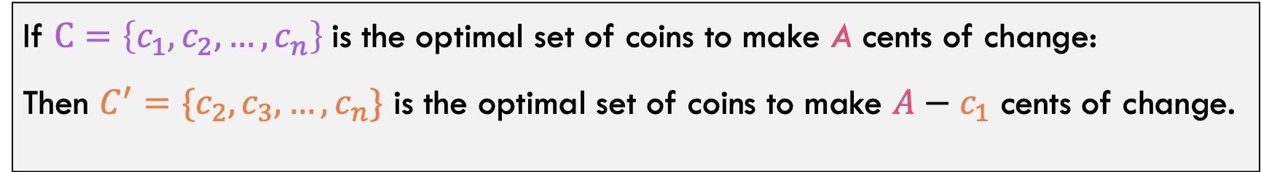
Optimal Substructure
Prove: The coin change problem has optimal substructure
Claim:
If $C=\left\{c_{1},c_{2},…,c_{n}\right\}$is the optimal set of coins to make A cents of change:
Then $C^{′}=\{c_{2},c_{3},…,c_{n}\}$ is the optimal set of coins to make $A−c_{1}$ cents of change.

Slide 18
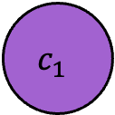
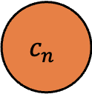
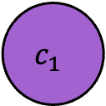


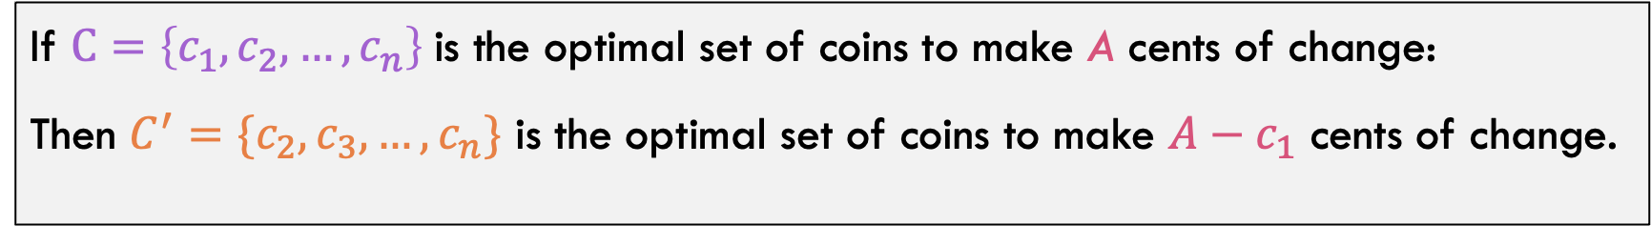
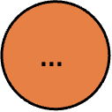
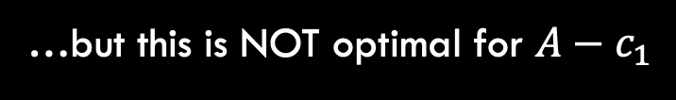
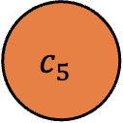
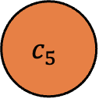
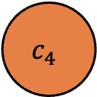
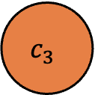
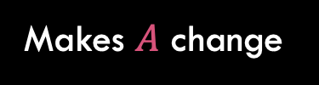
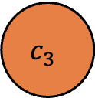

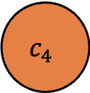
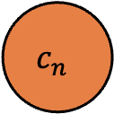
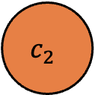

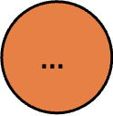
Proof
Claim:
If $C=\left\{c_{1},c_{2},…,c_{n}\right\}$is the optimal set of coins to make A cents of change:
Then $C^{′}=\{c_{2},c_{3},…,c_{n}\}$ is the optimal set of coins to make $A−c_{1}$ cents of change.
Suppose for the sake of contradiction that C is optimal for A. So n coins is best way to make A cents!
…but this is NOT optimal for $A−c_{1}$
$$c_{1}$$
$$c_{2}$$
$$c_{3}$$
$$c_{4}$$
$$c_{1}$$
$$c_{2}$$
$$c_{3}$$
$$c_{4}$$
$$c_{5}$$
$$…$$
$$c_{n}$$
$$c_{5}$$
$$…$$
$$c_{n}$$
$$C \\ \left|C\right|=n$$
$$C′ \\ \left|C′\right|=n−1$$
Makes $A$ change
Makes $A−c_{1}$ change

Slide 19














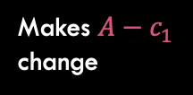
Proof
Claim:
If $C=\left\{c_{1},c_{2},…,c_{n}\right\}$is the optimal set of coins to make A cents of change:
Then $C^{′}=\{c_{2},c_{3},…,c_{n}\}$ is the optimal set of coins to make $A−c_{1}$ cents of change.
If C’ is not optimal, there is some way to make A-c_1 cents with fewer coins!
$$c_{2}$$
$$c_{3}$$
$$c_{4}$$
$$d_{1}$$
$$d_{2}$$
This is the better way to make A-c_1 cents. It uses fewer coins!
$$c_{5}$$
$$…$$
$$c_{6}$$
$$…$$
$$d_{j}$$
$$C′ \\ \left|C\right|=n−1$$
$$C′′ \\ \left|C′′\right|=j<n−1$$
Makes $A−c_{1}$ change
Makes $A−c_{1}$ change

Slide 20




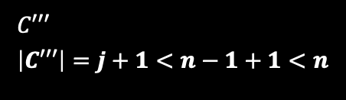

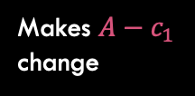


Proof
$$d_{1}$$
$$d_{2}$$
$$c_{1}$$
$$…$$
$$d_{j}$$
Makes $A$ change
$$C′′ \\ \left|C′′\right|=j<n−1$$
Makes $A−c_{1}$ change
$$C′′′ \\ \left|C′′′\right|=j+1<n−1+1<n$$
Adding the original coin back in gets us a solution with less than n coins, which should be impossible!
Q.E.D. The coin change problem has optimal substructure

Slide 21
Summary So Far
Done
We’ve shown the Coin Change Problem has Optimal Substructure
We’ve presented a Greedy Algorithm that MIGHT solve it
Up Next:
Prove that the greedy algorithm is correct.

Slide 22
Proving Correctness of A greedy Algorithm
A greedy algorithm is correct if the following hold:
The problem has optimal substructure
The algorithm has the greedy choice property
Greedy Choice Property: The greedy choice that the algorithm makes must be a member of some optimal solution

Slide 23
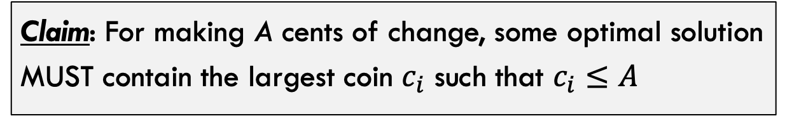
Making change proof
Claim: For making A cents of change, some optimal solution MUST contain the largest coin $c_{i}$ such that $c_{i}≤A$
4 Cases:
Largest coin is a penny Largest coin is a nickel Largest coin is a dime Largest coin is a quarter
Basic Idea: Show that if we don’t use the largest coin, then a “better” solution could have just used the largest coin instead

Slide 24

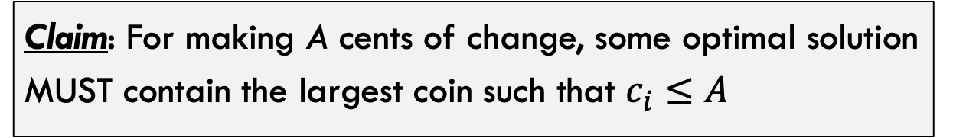
Making change proof
Claim: For making A cents of change, some optimal solution MUST contain the largest coin such that $c_{i}≤A$
Case 1: Largest coin is a penny
Thus, $A≤4$
.01
.01
Theorem is trivially true because penny is the only option
.01
.01

Slide 25
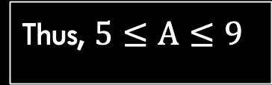

Making change proof
Claim: For making A cents of change, some optimal solution MUST contain the largest coin such that $c_{i}≤A$
Case 2: Largest coin is a nickel
Thus, $5≤A≤9$
If solution does NOT contain a nickel, then it can only contain pennies
.01
.01
.01
Q.E.D. There is a better solution that contains a nickel!
Num pennies is $p≥5$
.05
.01
.01
…
…

Slide 26
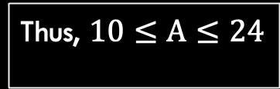
Making change proof
Claim: For making A cents of change, some optimal solution MUST contain the largest coin such that $c_{i}≤A$
Case 3: Largest coin is a dime
Thus, $10≤A≤24$
If solution does NOT contain a dime, then it can only contain nickels and pennies (see next slide).

Slide 27







Making change proof
Thus, $10≤A≤24$
If solution does NOT contain a dime, then it can only contain nickels and pennies.
Solution then must contain:
.01
.01
.01
.05
$$N=1$$
.05
.05
.01
.01
$$N≥2$$
$$N=0$$
OR
.01
.01
$$P≥5$$
OR
.01
.01
$$P≥10$$
$$P≥0$$
.01
.01
.01
.01
.01
.01
All of these can be replaced with a dime instead which lowers the number of coins!

Slide 28















Making change proof
.01
.01
.01
.05
$$N=1$$
.05
.05
.01
.01
$$N≥2$$
$$N=0$$
OR
.01
.01
$$P≥5$$
OR
.01
.01
$$P≥10$$
$$P≥0$$
.01
.01
.01
.01
.01
.01
$$D=1$$
$$D=1$$
$$D=1$$
.10
.10
.10
$$N=0$$
$$N=0$$
$$N=0$$
$$P≥0$$
$$P≥0$$
$$P≥0$$
All of these can be replaced with a dime instead which lowers the number of coins!

Slide 29

Making change proof
Claim: For making A cents of change, some optimal solution MUST contain the largest coin such that $c_{i}≤A$
Case 4: Largest coin is a quarter
Thus, $A≥25$
If solution does NOT contain a quarter, then it can only contain dimes, nickels and pennies (see next slide).

Slide 30
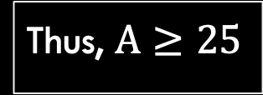
Making change proof
Thus, $A≥25$
If solution does NOT contain a quarter, then it can only contain dimes, nickels and pennies (see next slide).
Options then include:
2 dimes, 1 nickel, 0 or more pennies
2 dimes, 0 nickels, 5 or more pennies
1 dime, 3 nickels, 0 or more pennies
1 dime, 2 nickels, 5 or more pennies
1 dime, 1 nickel, 10 or more pennies
1 dime, 0 nickel, 15 or more pennies
0 dime, 5 nickels, 0 or more pennies
0 dime, 4 nickels, 5 or more pennies
…
We won’t enumerate each of these in class, but for each possible combination, a set of coins equaling exactly 25 cents can be removed and replaced with one quarter

Slide 31
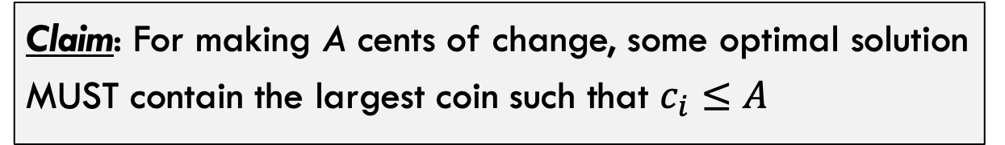
Making change proof
Claim: For making A cents of change, some optimal solution MUST contain the largest coin such that $c_{i}≤A$
Q.E.D.: Coin change problem has greedy choice property!

Slide 32

Proving Correctness of A greedy Algorithm
A greedy algorithm is correct if the following hold:
The problem has optimal substructure
The algorithm has the greedy choice property
Thus, the algorithm is correct / optimal for ALL inputs

Slide 33
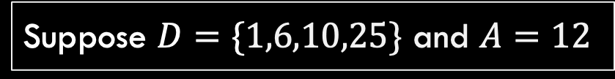
Does this Algorithm ALWAYS Work!?
Consider this slightly altered version of coin change:
Problem: Given any arbitrary coin set D, make change for A cents
Suppose $D=\{1,6,10,25\}$ and $A=12$
.01
.06
.10
.25
Notice that the “nickel” is now worth 6 cents
Goal: Make 12 cents with these coins

Slide 34
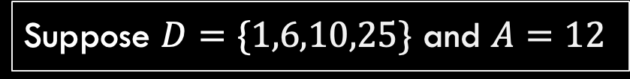
Does this Algorithm ALWAYS Work!?
Suppose $D=\{1,6,10,25\}$ and $A=12$
.01
.06
.10
.25
Greedy Algorithm:
Optimal Solution:
.10
.01
.01
.06
.06
Greedy algorithm chooses dime first, and then is forced to take two pennies afterwards
Best solution is to use 2 “nickels”

Slide 35

Making change proof – Does it fail?
.01
.06
.10
.25
Claim: For making A cents of change, some optimal solution MUST contain the largest coin such that $c_{i}≤A$
If attempting to prove greedy choice property for this coin set, where does the proof fail?

Slide 36
Making change proof
Claim: For making A cents of change, some optimal solution MUST contain the largest coin such that $c_{i}≤A$
Case 3: Largest coin is a dime
This is the case that is going to fail!
Thus, $10≤A≤24$
If solution does NOT contain a dime, then it can only contain nickels and pennies (see next slide).

Slide 37

Making change proof
Thus, $10≤A≤24$
If solution does NOT contain a dime, then it can only contain nickels and pennies.
Solution then must contain:
.01
.01
.01
.06
$$N=1$$
.06
.06
.01
.01
$$N≥2$$
$$N=0$$
OR
.01
.01
$$P≥4$$
OR
.01
.01
$$P≥10$$
$$P≥0$$
.01
.01
.01
.01
.01
Can all of these be replaced with dime instead which maintains or lowers the number of coins!

Slide 38






Making change proof
Solution then must contain:
.01
.01
.01
.06
$$N=1$$
.06
.06
.01
.01
$$N≥2$$
$$N=0$$
OR
.01
.01
$$P≥4$$
OR
.01
.01
$$P≥10$$
$$P≥0$$
.01
.01
.01
.01
.01
Here, we CANNOT replace coins with a dime to lower number of coins! So not necessarily the case that dime is always in optimal solution! Proof has failed
These two CAN be replaced with dime to lower number of coins!

Slide 39
What did we learn in this section
Greedy Algorithms: Our next algorithmic technique
How to analyze problems with greedy solutions:
Optimal substructure property
Greedy choice property
Proving correctness of greedy algorithms
Coin Change:
Greedy algorithm works for some coin sets
…but not for others!

