Slide 1
CS3205 – HCI in Software Development Conceptualizing Interaction
Dr. Mark Floryan
Rice Hall 203
mrf8t@cs.virginia.edu

Slide 2
Goals Today: To Understand…
How to frame your problem space.
How to conceptualize the interaction.
How to define a conceptual model.

Slide 3
What is a Problem Space?
“A Problem Space is the bounds within which an interaction takes place. It includes the relevant parties, objects, tasks, behaviors, etc.”

Slide 4
What Does It Mean To Conceptualize Interaction
“To conceptualize the interaction is to define the interaction within a problem space abstractly without reference to any particular technology or design.”

Slide 5
Imagine
You are designing a system that enables people to share photos, videos, music, documents, etc.
Let’s pretend that no sharing software currently exists.
Do you begin by sketching out possible interfaces?
Or do you start by asking users about their experiences sharing photos, videos, music, documents, etc.??

Slide 6
Understanding The Problem Space
Rarely will anyone design something that is perfectly novel!
Usually need to understand:
The current interaction available with technology.
The interaction(s) available without technology that mimic the same task.

Slide 7
Example: Sharing Media
What kinds of interaction exist for this that involve as little technology as possible?

Slide 8
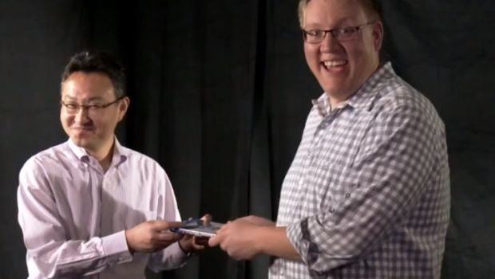
Sharing Media
Hand the media to your friend. The most basic form of sharing.
What are the characteristics of this interaction?

Slide 9
Sharing Media
What are some of the problems and/or issues with this form of sharing?
How can your design ideas overcome these?

Slide 10
Sharing Media
Ways to improve this basic interaction?
Both parties can keep the media after it is “shared”.
No need to necessarily meet in person.
What aspects of interaction to keep?
Concept of everyone having a personal library.
Others?

Slide 11
Problem Space: Perspectives
Caution: different team members will often have different assumptions about the problem space.
You need to define the problem space as a group, decide on a set of mutual terminology, etc.

Slide 12
Why Are Assumptions Dangerous?
They can lead you to ASSUME incorrectly how users feel about a product or design.

Slide 13
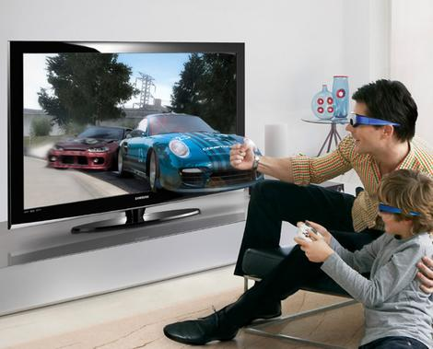
Example: 3D TV
What are some of the assumptions the designers (likely) made?

Slide 14
Example 3D TV
Some assumptions:
People are okay with wearing 3d glasses when watching TV.
People don’t mind paying A LOT of money for the new 3d enabled models.
The successful experience of watching 3d films in a movie theater translates to a home living room.
Others?

Slide 15
Benefits of Understanding Problem Space EARLY
Orientation
Enabling the design team to ask specific kinds of questions about how the conceptual models will be understood by the targeted users.

Slide 16
Benefits of Understanding Problem Space EARLY
Open-mindedness
Preventing the design team from becoming narrowly focused early on.

Slide 17
Benefits of Understanding Problem Space EARLY
Common Ground
Allowing the design team to establish a set of common terms that all can understand and agree upon, reducing the chance of misunderstandings and confusion arising later on.

Slide 18
Conceptual Models!
“A conceptual model is a high-level description of how a system is organized and operates”
* Johnson and Henderson, 2002

Slide 19
Conceptual Models!
The most important thing to design is the user's conceptual model. Everything else should be subordinated to making that model clear, obvious, and substantial. That is almost exactly the opposite of how most software is designed. (Liddle, 1996, p. 17)

Slide 20
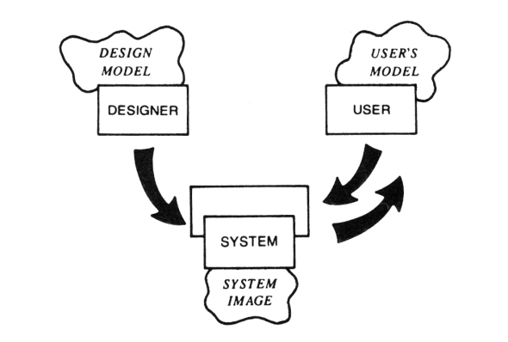
Overview

Slide 21
Video Break!
Let’s watch some movies!
http://www.youtube.com/watch?v=xNqs_S-zEBY
http://www.youtube.com/watch?v=TudFAEUkR9Y

Slide 22
Core Components of A Conceptual Model
Metaphors / Analogies
Concepts (or Objects)
Relationships (between Concepts)
Mappings (or Operations

Slide 23
Metaphors / Analogies
The major metaphors and analogies that are used to convey to the user how to understand what a product is for and how to use it for an activity.
Example (The Internet)
Browsing the web.
The idea of following links to explore what information is available.

Slide 24
Concepts
The concepts that users are exposed to through the product, including the task–domain objects they create and manipulate, their attributes, and the operations that can be performed on them.
Example (The Internet):
URLs
Web Pages
Links

Slide 25
Relationships (Between Concepts)
The relationships between those concepts, e.g. whether one object contains another, the relative importance of actions to others, and whether an object is part of another.
Example (The Internet)
Links connect Web Pages together.
A bookmark saves one web page and allows you to return later
You history shows previously viewed pages
Etc…

Slide 26
Mappings
The mappings between the concepts and the user experience the product is designed to support or invoke.
Slightly different than relationships.
Example (The Internet):
The user invokes a ‘Bookmark’ to pull up a web page.
Others?

Slide 27
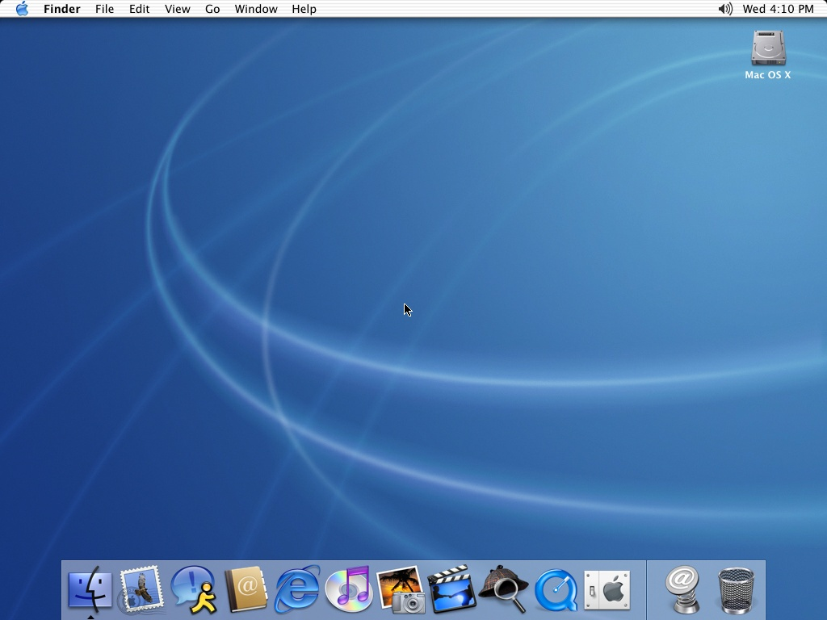
The Desktop

Slide 28
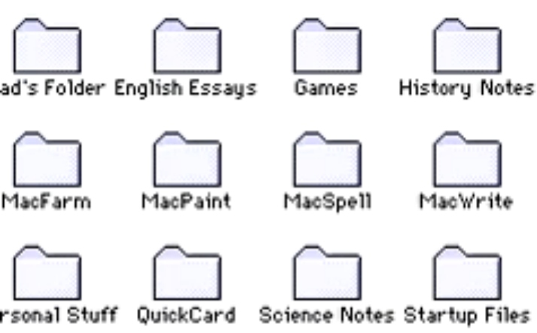
Example of failed conceptual model
*From Norman

Slide 29
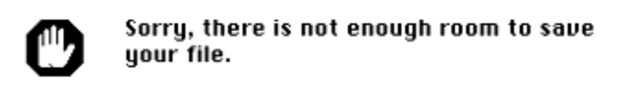
Example of failed conceptual model
*From Norman

Slide 30
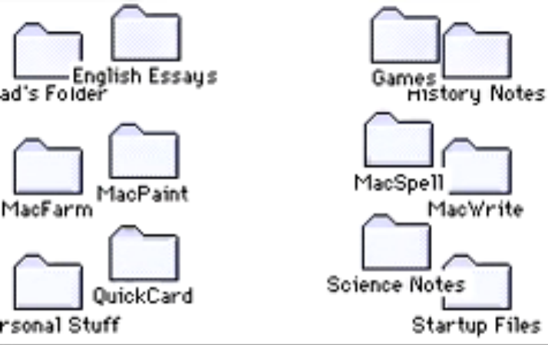
Example of failed conceptual model
*From Norman

Slide 31
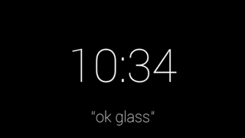
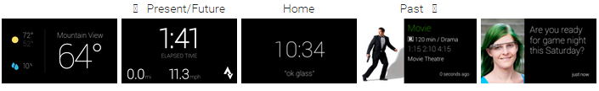
Let’s Talk About Google Glass https://developers.google.com/glass/design/ui
What is the conceptual model here?

Slide 32
Be Careful!
Metaphors are NOT perfect, and indeed have many valid criticisms!
1) Breaks the rules.
E.g., Desktop trash can ON TOP of the desk?
2) Too Constraining
I.e., A computer can do some things faster (and better) than the physical design can.
E.g., Deeply nested folders not feasible in real world, but very useful on the computer’s desktop

Slide 33
Be Careful!
3) Conflicts with design principles.
Trying to force the metaphor too literally can cause bad design choices later.
E.g., Mac trashcan used to mean both “delete this” and “eject this”. Has since been improved.
4) Not being able to understand the system functions beyond the metaphor.
If the metaphor is too literal, users won’t understand the aspects of your system that don’t fit the metaphor.

Slide 34
Be Careful!
5) Overly literal translation of a bad design.
If the physical object being mimicked is poorly designed, than your software probably will be also.
6) Limits the designers creativity in conjuring up new designs.
IMO, the best of the six criticisms.
Solution? Strive for balance!

Slide 35
Video Break: Conceptual Model
https://www.youtube.com/watch?v=pAOyWFOFhsg

Slide 36
Interaction Types
Most conceptual models fit into one of these four interaction types.
Instructing
Conversing
Manipulating
Exploring

Slide 37
Interaction Types: Instructing
Instructing—where users issue instructions to a system. This can be done in a number of ways, including: typing in commands, selecting options from menus in a windows environment or on a touch screen, speaking aloud commands, pressing buttons, or using a combination of function keys.

Slide 38
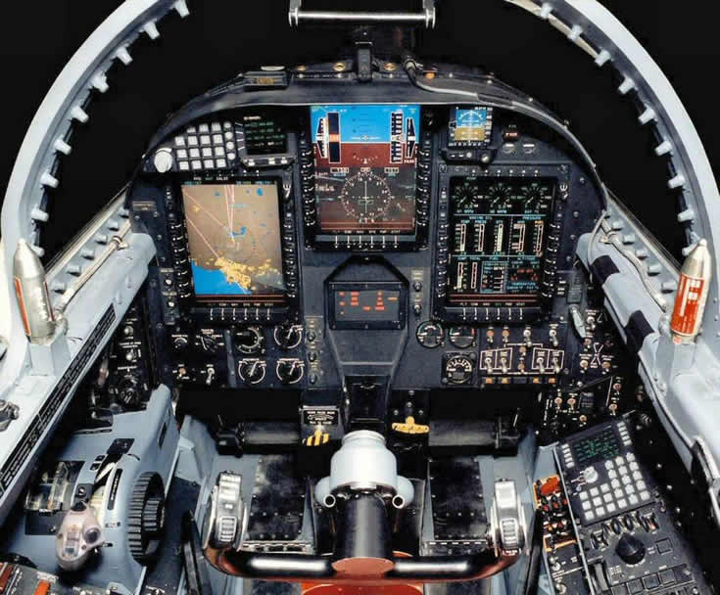
Interaction Types: Instructing

Slide 39
Interaction Types: Conversing
Conversing—where users have a dialog with a system. Users can speak via an interface or type in questions to which the system replies via text or speech output.

Slide 40
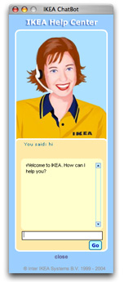
Interaction Types: Conversing

Slide 41
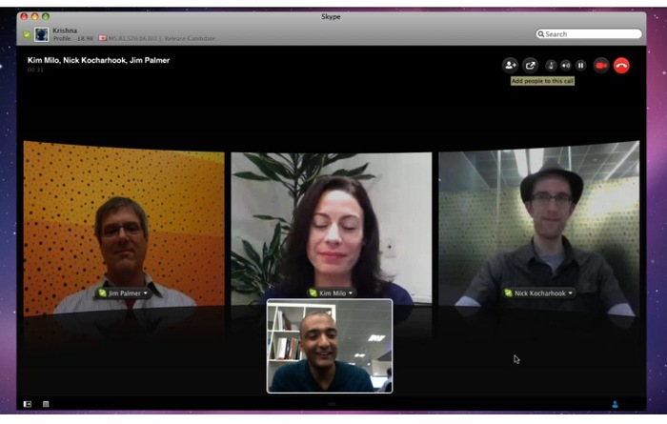
Interaction Types: Conversing

Slide 42
Interaction Types: Manipulating
Manipulating—where users interact with objects in a virtual or physical space by manipulating them, e.g. opening, holding, closing, placing. Users can hone in on their familiar knowledge of how to interact with objects.

Slide 43
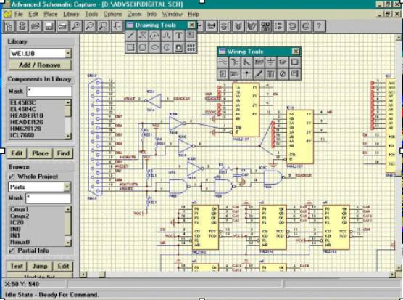
Interaction Types: Manipulating

Slide 44
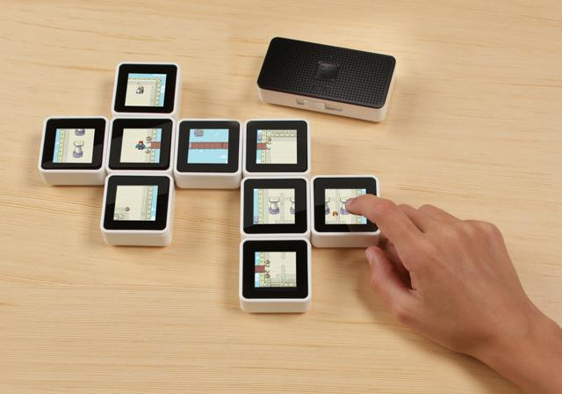
Interaction Types: Manipulating

Slide 45
Interaction Types: Exploring
where users move through a virtual environment or a physical space. Virtual environments include 3D worlds and virtual reality systems. They enable users to hone in on their familiar knowledge of physically moving around. Physical spaces that use sensor-based technologies include smart rooms and ambient environments, also enabling people to capitalize on familiarity.

Slide 46
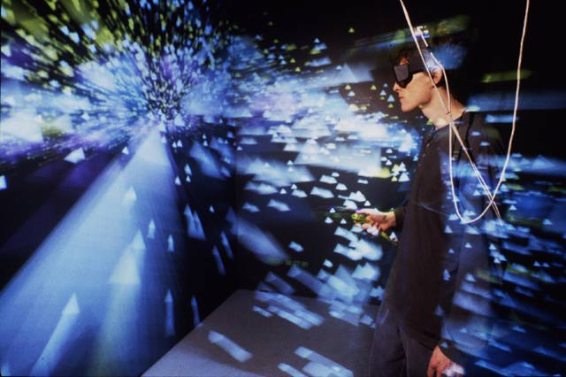
Interaction Types: Exploring

Slide 47
Any Questions Before We Continue?

Slide 48
4 Concepts Related To Conceptual Models…
1) Paradigms
2) Theories
3) Predictive Models
4) Frameworks

Slide 49
Paradigms
A set of practices that a community has agreed upon. Includes:
The questions to be asked and how they should be framed.
The phenomena to be observed.
The way in which findings from studies are to be analyzed and interpreted.

Slide 50
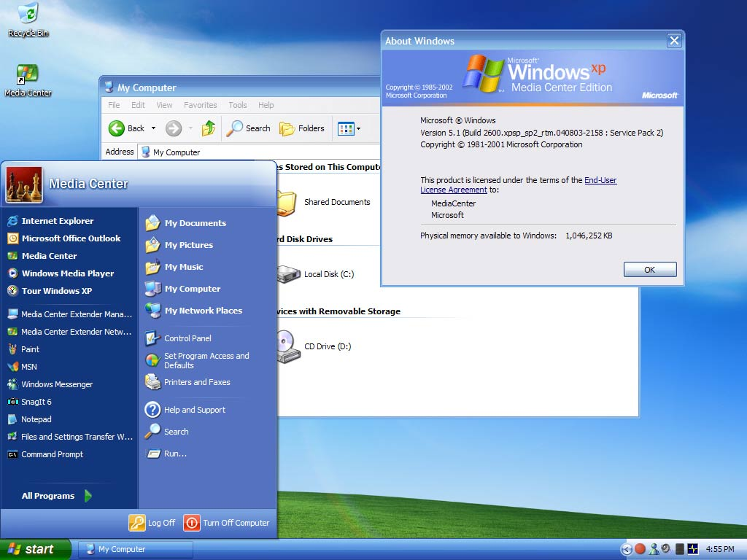
Paradigms: Example
WIMP (Windows, Icons, Menus, and Pointer)

Slide 51
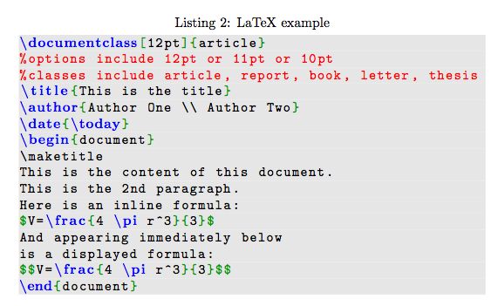
Paradigms: Example
WYSIWYG (What You See Is What You Get)
^^ Latex: Not WYSIWYG!

Slide 52
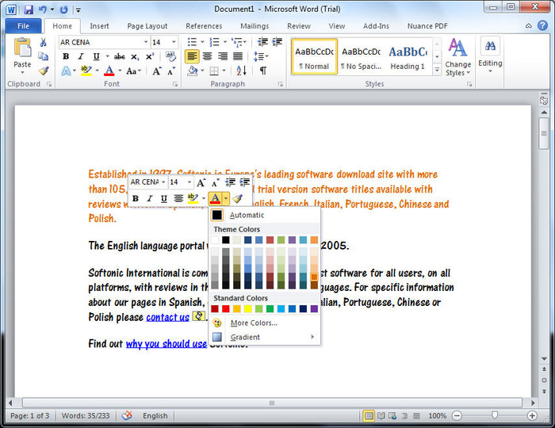
Paradigms: Example
WYSIWYG (What You See Is What You Get)

Slide 53
Theories
Theories of Cognition, Memory, Etc. can often inform and/or inspire a design.
E.g., Limiting the memory requirements of the user is often a good idea.
We will see examples of this soon!

Slide 54
Predictive Models
A method for predicting how usable an interface is as a function of certain design characteristics.
E.g., calculating how long it will take a user to find and click on a button as a function of the button’s size and how far away it is on the screen.
Models are validated by empirical data (i.e., real users using various interfaces).

Slide 55
Frameworks
A set of steps, concepts, questions, etc. for guiding designers.
Later in the course, we will see the DECIDE framework which provides steps for evaluating prototypes.

Slide 56
Summary
Conceptual Models are a strong way to understand the design space without narrowing in on a particular design too quickly.
Must keep in mind the drawbacks.

Slide 57
Summary
Other forms of design inspiration can be useful (in conjunction with conceptual modeling).
Paradigms
Theories
Models
Frameworks
*We will see some of these in more detail in the next few lectures!

Slide 58
What’s Coming Up?
Design Principles!
Usability Laws!
Visual Principles
Etc…

