Slide 1
CS3205 – HCI in Software Development Usability Laws
Dr. Mark Floryan
Rice Hall 203
mrf8t@cs.virginia.edu

Slide 2
Today: Seven Usability Laws
1. Miller’s Law of Short-Term Memory Load
2. Fitts’ Law
3. Keystroke Level Model (KLM)
4. Hick’s Law
5. Power Law of Practice
6. Pareto and Zipf Laws
7. Peak End Rule

Slide 3
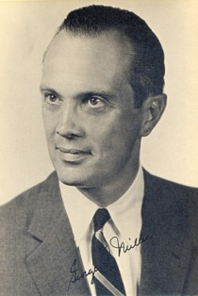
1. Miller’s Law of Short-Term Memory Load
George Miller
Princeton (Never heard of it) Professor
“Magic Number” published in ‘Psychology Review’ in 1956

Slide 4
1. Miller’s Law of Short-Term Memory Load
Chunking:
A psychological phenomenon whereby individuals group responses when performing a memory task.

Slide 5
1. Miller’s Law of Short-Term Memory Load
Measured short-term memory in terms of “Chunks”.
Chunks are a single unit of information.
Part of a phone number
A name
Etc…

Slide 6
1. Miller’s Law of Short-Term Memory Load
Discovered, among other things, that users are generally able to remember 7 plus or minus 2 ‘chunks’ of information.
More efficient “chunking” equals more memory!
Users typically have to practice memorizing.

Slide 7
1. Miller’s Law of Short-Term Memory Load
Likewise, Miller concluded that humans can only categorize stimuli into about 7 categories.
E.g., People can categorize sounds into one of 7 categories of pitch effectively, but get worse at the task very quickly after that.

Slide 8
What Does Miller’s Law Mean For HCI Designers
Miller’s law does NOT mean that you should have 7’ish menu items in a drop down display.
The law is about HOLDING items in a user’s memory.
A good example:
Motions / # of fingers used to perform various actions on an iPad. In general, users will only be able to remember 7 +- 2 of these quickly.
Yes, with more practice they would probably memorize more.

Slide 9
2. Fitts’ Law
In short, states the time it takes to reach a target with a pointing device given it’s distance and size from the current pointer position.
Fitts’ Law is an example of a predictive model because it predicts things without the need for users.

Slide 10

2. Fitts’ Law
T = time to move pointer to target
D = distance between the pointer and target
W = size of target

Slide 11
2. Fitts’ Law
Things done more often should be assigned a larger button. This seems an intuitive principle, but it needs to be used very carefully, since it harms the consistency of the interface.

Slide 12
2. Fitts’ Law
Things done more often should be closer to the average position of the user's cursor. The Distance (D) of a widget allows more control from interface designers compared to the width (W). Again, this needs to be used with caution, since frequency-based widget arrangements may slow down the user from finding things compared to logic-based arrangements.

Slide 13
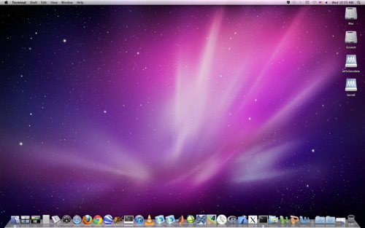
2. Fitts’ Law: Hmmmmmm…

Slide 14
2. Fitts’ Law
The top, bottom, and sides of the screen are infinitely targetable because of the boundary created by the edges of the screen (unless a virtual screen exists). They should be fully utilized.

Slide 15
Fitts’ Law: Predictive Models
Fitts’ Law describes one of many predictive models.
These models attempt to highlight how well a user will use a system without the need to find actual users!

Slide 16
3. Keystroke Level Model (KLM)
A model that provides numerical predictions of user performance.

Slide 17
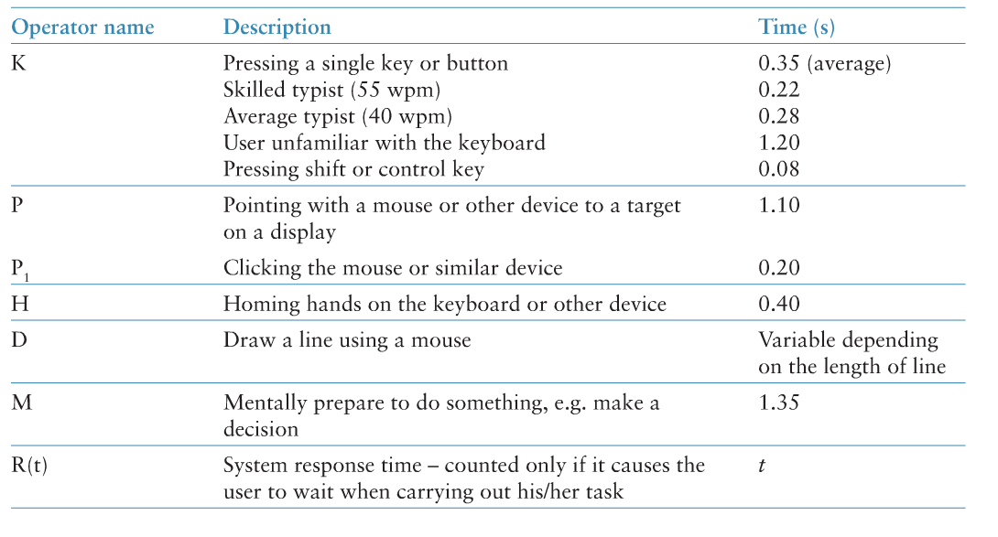
3. Keystroke Level Model (KLM)

Slide 18

3. Keystroke Level Model (KLM)

Slide 19
3. Keystroke Level Model (KLM) Example
How long does it take to take this sentence:
Running through the streets naked is normal.
And change it so that it becomes:
Running through the streets naked is not normal.

Slide 20
3. Keystroke Level Model (KLM) Example
List all of the sub-tasks necessary to perform the action (according to the KLM).
Simply sum up the predicted times to perform each individual sub-task.

Slide 21
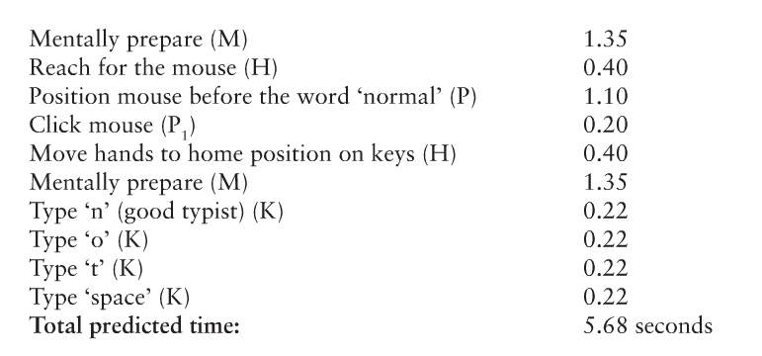
3. Keystroke Level Model (KLM) Example

Slide 22
4. Hick’s Law
Describes the time it takes for a person to make a decision based on the number of choices available.
T: average reaction time to choose among ‘n’ equally probable choices.
b: constant determined empirically by drawing best fit line to measured data.
Log2: For small ‘n’, additional options add a lot of time with eventual diminishing returns.
+1: due to uncertainty when making selections.

Slide 23
4. Hick’s Law
Essentially, users quickly categorize and halve the number of choices iteratively until they select what they want.
This is a bit of a mis-categorization, but an ok way to think about it.
‘b’ is a constant that is empirically derived.

Slide 24

4. Hick’s Law
Law can be generalized to menu items with unequal probability of being selected:

Slide 25
4. Hick-Hyman Law
Be Careful!
This law only applies to groups of items that can be reasonable categorized.
For example, the law would probably not work with a randomized list of unrelated options.
But would work for an alphabetized list of options.

Slide 26
5. Power Law of Practice
The power law of practice states that the logarithm of the reaction time for a particular task decreases linearly with the logarithm of the number of practice trials taken. It is an example of the learning curve effect on performance.

Slide 27
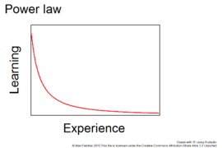
5. Power Law of Practice

Slide 28
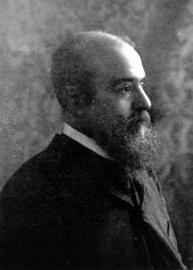
6. Pareto and Zipf Laws
Vilfredo Pareto, Italy
observed that wealth was unequally distributed in Italy. He noted that 80% of the land and wealth was owned by 20% of the people (early 1900’s).
Sound familiar?
Top 20% of earners make 51% of all income in the U.S.

Slide 29
6. Pareto and Zipf Laws
Examples of the Pareto Principle.
Microsoft noted that by fixing the top 20% of the most reported bugs, 80% of the errors and crashes would be eliminated
The top 10% of cell phone users consume 90% of wireless bandwidth.
The top 20% of U.S, taxpayers pay 68% of all taxes

Slide 30
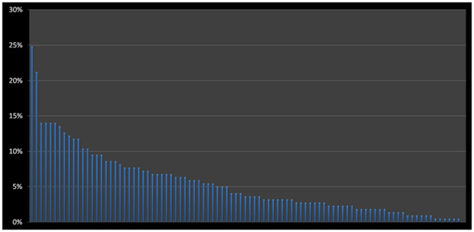
6. Pareto and Zipf Laws
Applications to HCI:
Of 94 tasks (on a large informational website) presented to users, just 15 account for 41% of all votes (users asked which tasks were most important).
*http://www.measuringusability.com/blog/pareto-ux.php

Slide 31
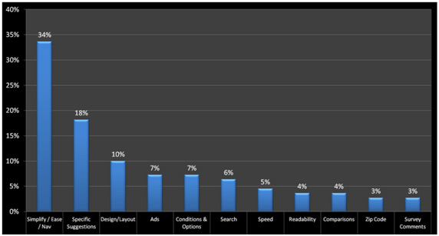
6. Pareto and Zipf Laws
Applications to HCI:
When asked what users would fix on a website, two issues account for 50% of all comments and five account for 75%.

Slide 32
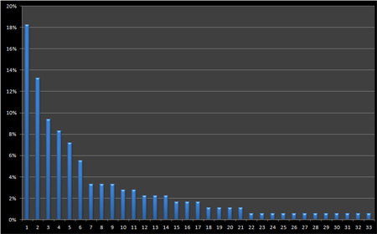
6. Pareto and Zipf Laws
Applications to HCI (Large Informational Website):
Of the 33 usability problems identified across 50 users, fixing nine of them would address 72% of all poor interactions.

Slide 33
6. Pareto and Zipf Laws
The bottom line:
There is almost always a time-budget tradeoff when designing.
Often times, Pareto’s law can help designers focus on fixing the majority of issues with an interface quickly.

Slide 34
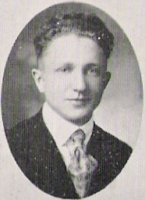
6. Pareto and Zipf Laws
George Kingsley Zipf
American linguist
Noticed that the most frequent word occurs about twice as much as the second most frequent.
In general, nth most frequent word occurs 2x more often than the (n+1)th most frequent.

Slide 35
6. Pareto and Zipf Laws
As it turns out, the most frequently used command used in a piece of software is used about twice as often as the second most frequently used.

Slide 36
6. Pareto and Zipf Laws
Why does it matter?
Means that generally, you can design for the masses.

Slide 37
7. Peak End Rule
The Peak-End Rule states that humans judge their past experiences on the peak of that experience (whether pleasant or unpleasant) and how it ended. The net pleasantness or unpleasantness or the length of experience is disregarded.
*http://www.peakusability.com.au/articles/usability-heuristics-rules-laws-and-things-to-remember

Slide 38
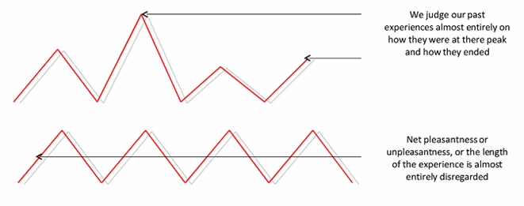
7. Peak End Rule

Slide 39
7. Peak End Rule
The best or worst moment in their interaction, whether that's a moment of delight created by skillful design or the moment of frustration when they have just spent 5 minutes looking for a form and now can't find a phone number to get it mailed to them.
How it ended – was it a success? Did they find what they needed? Complete that form? Watch the video they intended to? Or did it end in miserable failure. What taste does that leave in the user's mouth?
*http://www.peakusability.com.au/articles/usability-heuristics-rules-laws-and-things-to-remember

Slide 40
Krug’s Usability Laws: For Fun!
Krug’s 3 laws of Usability
“Don’t make me think.”
“It doesn’t matter how many times I have to click, as long as each click is a mindless, unambiguous choice.”
“Get rid of half the words on each page, then get rid of half of what is left.”
From: Krug, S. (2006), Don’t Make Me Think: A Common Sense Approach to Web Usability, Berkeley, CA: New Riders

Slide 41
Video!
https://www.youtube.com/watch?feature=player_embedded&v=6lyudeTqggE

