Slide 1
CS3205 – HCI in Software Development Introduction To Prototyping
Dr. Mark Floryan
Rice Hall 203
mrf8t@cs.virginia.edu
* Material from: [Klemmer, Stanford]

Slide 2
What is Prototyping?
Prototyping is:
“The rapid creation of an approximation to a design idea for the purpose of retrieving feedback and knowledge.”

Slide 3
What is Prototyping?
We prototype to:
1. Gain insights into user behavior.
2. Communicate ideas to other teammates and stakeholders.
3. Collect data for arguing the best design choice.

Slide 4
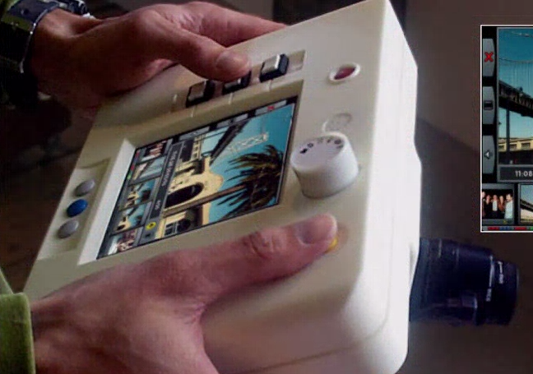
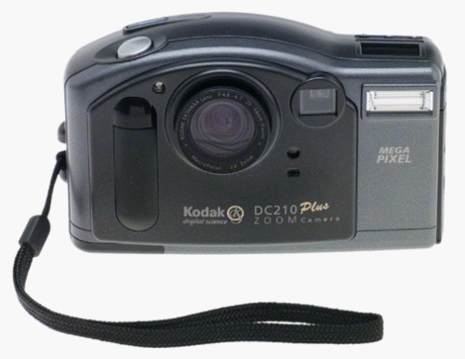
Example: IDEO Digital Camera
No Computation on device!
No Pictures (No lens, etc.)

Slide 5
Lessons from IDEO
Prototypes are nearly ALWAYS incomplete.
Goal is to SIMULATE specific aspects of the design and acquire knowledge regarding these targeted aspects.
IDEO wanted to know more about the digital aspects of the camera.

Slide 6
More About Prototyping
‘Known Unknowns’: Aspects of a design that you know you don’t understand and wish to learn.
i.e., “Which color scheme is most user friendly?”
i.e., “Should this be a mobile or desktop application?”
‘Unknown Unknowns’: Aspects of a design that you don’t know are open issues.
i.e., “Why can’t old people use this tiny screen!?”

Slide 7
Prototyping Process
Prototyping is NOT a process in which you haphazardly create designs that you believe are various levels of “awesome”.
Prototyping is about defining questions regarding your designs, and building something that answers those questions.

Slide 8
Prototyping Process
1. What are your goals for the prototype? What do you wish to learn?
2. How can you measure whether or not that goal has been achieved? How can you measure which of multiple prototypes is superior?
3. What is the MINIMUM amount of work necessary to produce, measure, and learn from your prototype?

Slide 9
1. Prototyping Goals
If you perform your user and task analysis well, then these are represented by your usability goals and requirements.
Thus we can select the usability requirements (probably a subset) that we wish to test with a given prototype.

Slide 10
1. Prototyping Goals
Example:
UR: User must be able to type text messages at a minimum of 50 wpm while making less than 3 errors on average.
What do you wish to learn?
What physical interface is best for supporting users that wish to text and type on their phone?
Prototype choices:
Physical keypad
Touchscreen
Others?

Slide 11
2. Measuring Goals
We talked about the falsifiability of usability requirements.
If requirements are truly falsifiable, then we should be able to design user studies that prove (based on data) that our prototype is sufficient.

Slide 12
2. Measuring Goals
Example:
UR: User must be able to type text messages at a maximum of 50 wpm while making less than 3 errors on average.
How to measure this:
Pretty simple, give users different phone prototypes and see how well they type.
In reality, a bit more complicated than this, but a good start.

Slide 13
3. Minimum Work Necessary
What is the absolute minimal working prototype with which we can perform our user study?
Strip out every feature that is not absolutely necessary.

Slide 14
3. Minimum Work Necessary
Example:
UR: User must be able to type text messages at a maximum of 50 wpm while making less than 3 errors on average.
Minimal:
Physical devices that can be typed on, need to be able to record speed and errors while typing.
Unnecessary features:
Sending texts to other phones
Selecting contacts to send to
Etc.

Slide 15
3. Minimum Work Necessary
Show graph on board (Time Spent vs. Learned)!

Slide 16
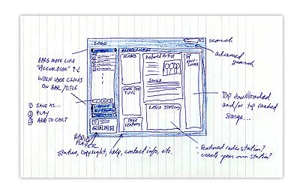
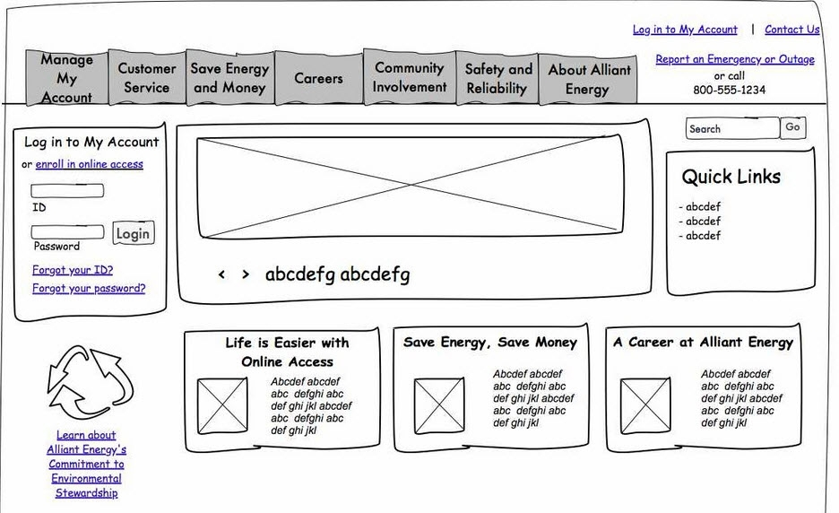
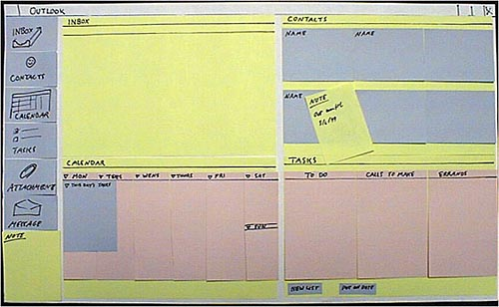
Types of Prototypes
Low-Fidelity:

Slide 17
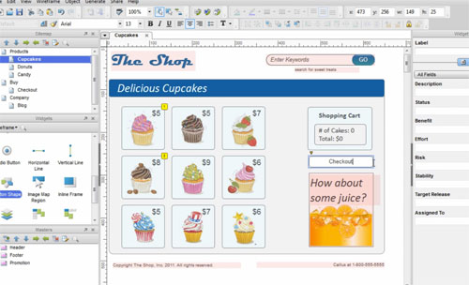
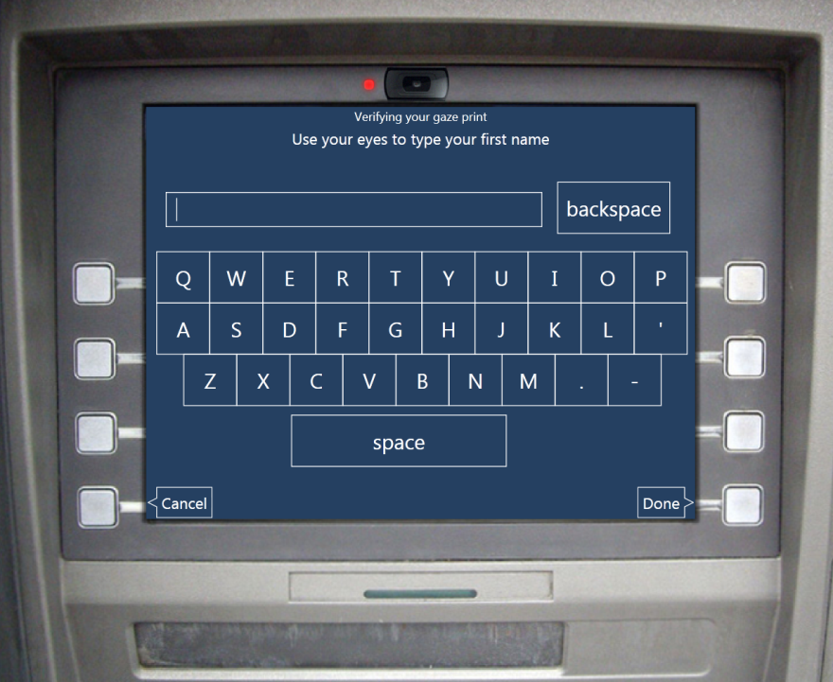
Types of Prototypes
High-Fidelity:

Slide 18
Prototyping Sets Over Time
Graph on board (num prototypes vs time)

Slide 19
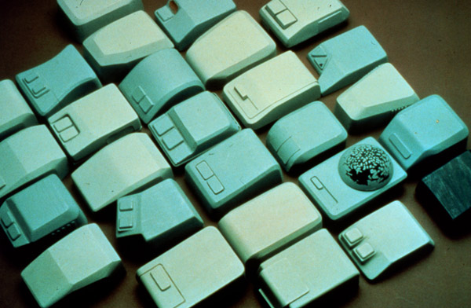
A Lot of Prototypes is GOOD!

Slide 20
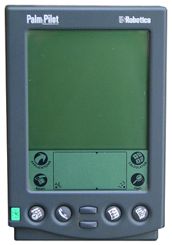
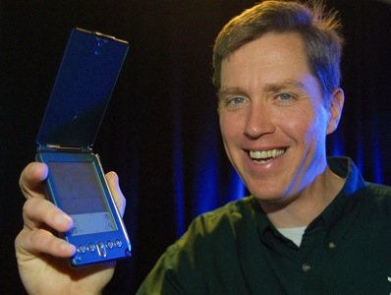
Jeff Hawkins’ Block Of Wood

Slide 21
Jeff Hawkins’ Block Of Wood

Slide 22
Jeff Hawkins’ Block Of Wood
Did NOT learn about:
Battery Life
Interface and other digital interactions
Sound effects, feedback, etc.
DID learn about:
Form Factor
Living with the device 24/7

Slide 23
Types of Prototypes:
Feel
What does it look and feel like?
Implementation
How does it work?
Role
What is the experience like?

Slide 24
Prototyping Rules
Prototypes should NOT be required to be complete.
Prototypes should be easy to change.
Prototypes should be disposable.
Or, at least, you should mentally be prepared to dispose them.

Slide 25
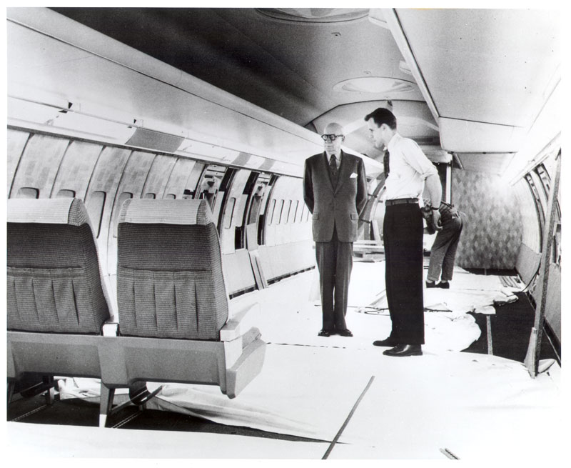
Prototypes Can be BIG!
Walter Teague

Slide 26
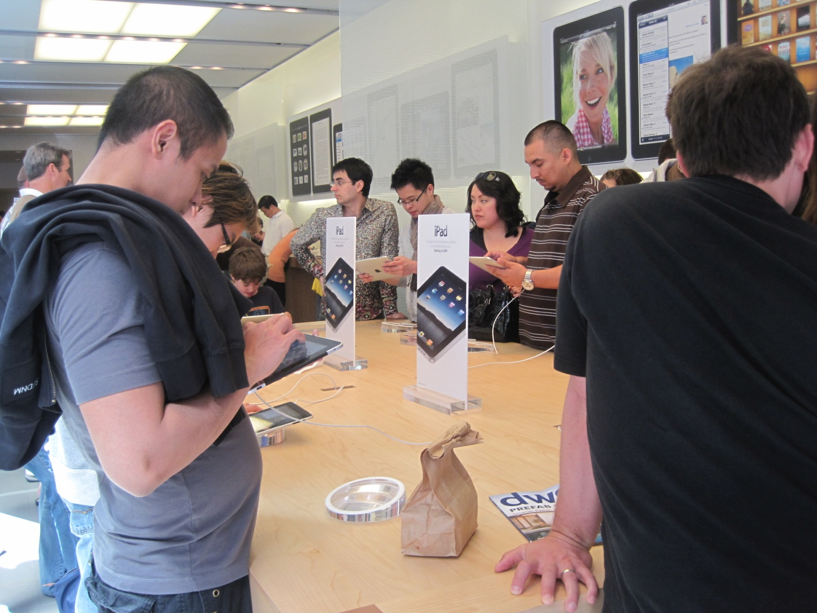
Another BIG Prototype

Slide 27
Cost of Change Over Time
Prototypes are MORE expensive to change the more high-fidelity they become.
SO BE CAREFUL!
The most common estimate is that it's 100 times cheaper to make a change before any code has been written than it is to wait until after the implementation is complete [Jakob Nielsen].
Twenty years of usability engineering experience uniformly indicates that the biggest improvements in user experience come from gathering usability data as early as possible in a design project [Jakob Nielsen].

Slide 28
Prototyping Strategies
A few we will look at:
Paper Prototyping
Digital Mockups
Video Prototypes
Wizard of Oz Prototypes

Slide 29

Assignment 3!
Let’s talk about assignment 3 ☺

Slide 30
Assignment 3 Stuff
Due Date TBD
What will you be doing?
Building at least one prototype per team member.
Short writeup containing a description of the prototypes, your design decisions, images of the prototypes, etc.
At least one of the prototypes should be “outside the box”.

Slide 31
Building Prototypes
Must build at least one prototype per team member.
Must be either a physical or digital prototype that your peers can actually use (again, we’ll see techniques to make this easier).

Slide 32
Building Prototypes
Do I need to code?
Not necessarily...depends on what design questions you are trying to answer.
I strongly suggest that all prototypes be the same ‘type’.
Why? In the next homework you will be evaluating and comparing them to one another.

Slide 33
Write-up
What will I turn in?
You do not need to turn in your prototypes (I will see them later on in the semester).
You will write a short description of your prototypes.
~4-6 pages ‘ish depending on the specifics of your project. Again, page limit is just a guideline.

Slide 34
Write-up
The write-up should contain:
List / description of each prototype
Pictures / screenshots of your prototype (I need to see that you actually built something).
Don’t be lazy! You will need these prototypes in order to do HW 4.
Description of the important differences.
What important design questions are you unsure about, how have you accounted for various possibilities via your different designs?
What is your conceptual model?
What design principles have you applied and why?
What else from lecture informed your prototype designs?

