Slide 1
CS3205 – HCI in Software Development Prototyping Strategies
Dr. Mark Floryan
Rice Hall 203
mrf8t@cs.virginia.edu
* Material from: [Klemmer, Stanford]

Slide 2
What Will We Be Talking About?
Specific Prototyping Strategies!
Low-Fidelity Strategies
Storyboarding
Video Prototypes
Paper Prototyping

Slide 3
Big Picture!
Remember that you should always use stage appropriate tools!
Fidelity vs. Time graph!
The general rule is that you should progress from low to high fidelity slowly as the design process continues.

Slide 4
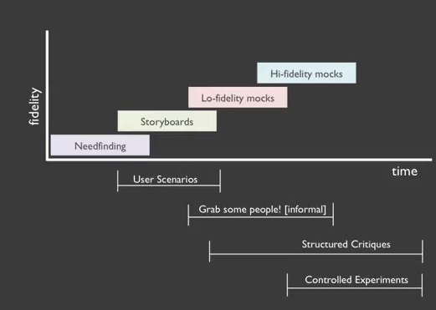
Prototyping Over Time

Slide 5
Storyboarding & Video Prototypes
These next two are typically used VERY early in design process. Probably while still thinking about users and needfinding. We will look at these now, but you will NOT be using these for hw3

Slide 6
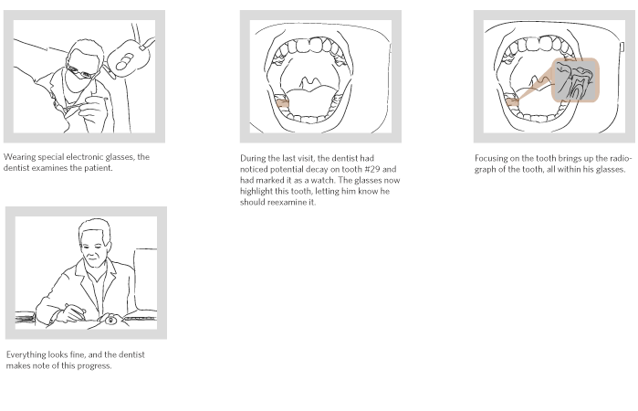
Storyboarding!
Storyboarding is ALL about tasks!
NOT focused on specific interface elements and how they look, etc.
Thus it is incredibly low-fidelity.

Slide 7
Storyboarding
Storyboarding IS about
The tasks users want to complete.
The FLOW of the user’s interaction.
Storyboarding is NOT about
Pretty pictures (in fact bad drawing helps focus on task and not on imagery).
Showing specific interface elements.

Slide 8
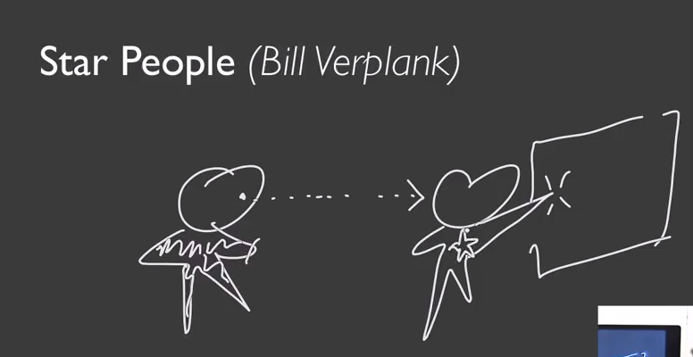

Slide 9
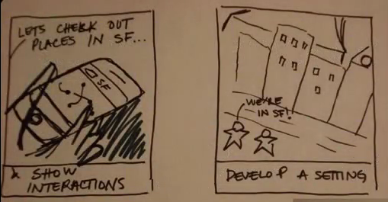
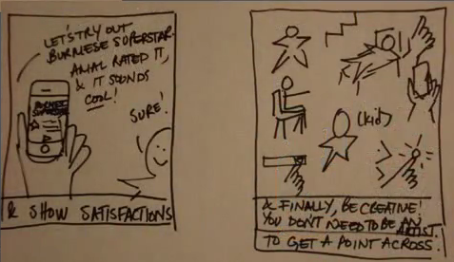
Example Storyboard

Slide 10
Storyboards Should Convey
Setting
People Involved
Environment(s)
Task being accomplished
Sequence
What steps are involved?
What leads someone to use the app or system?
What task is being illustrated?

Slide 11
Storyboards Should Convey
Satisfaction
What motivates people to use the system?
What does it enable people to accomplish?
What need does system fill?

Slide 12
Benefits of Storyboarding
Holistic Focus: helps emphasize how an interface accomplishes a task.
Avoids commitment to a particular user interface (no buttons yet).
Helps get ALL stakeholders on the same page in terms of the goal.

Slide 13
Some Advice Regarding Storyboarding
DO NOT spend too much time on a storyboard.
Set a short time limit to enforce this.
Focus on tasks and scenarios that are the MOST common for your users.

Slide 14
Video Prototyping
What is video prototyping?

Slide 15
Benefits of Video Prototyping
Cheap and fast
Great communication tools
Helps achieve common ground
Ideally, portable and self-explanatory
Can serve as a ‘spec’ for developers
Ties interface designs to tasks
Aligns and orients interface choices
Makes sure you have a complete interface

Slide 16
Video Prototyping
Can be any level of fidelity.
Can make videos with paper prototype examples.
Fancy high fidelity videos are ok too!
Usually, dependent on where you are in the design process.

Slide 17
What do you put in video prototype?
The WHOLE task including motivation and success.
Establishing shots and narrative help.
Draw on tasks you observe.
Illustrate important tasks your system enables.
Not in video, probably not necessary for version one of the system.
Can help scope a minimum viable product.
Changes what design teams argue about (in a good way).

Slide 18
Steps to Video Prototyping
1) Outline / Storyboard the Video
2) Obtain Equipment.
A camera (nothing fancy required). Could be a phone even!
People
Realistic Location
3) Focus on MESSAGE, not on production value.
4) Film it!!

Slide 19
Video Prototyping Examples!
http://www.youtube.com/watch?v=OlQvolZEtcE
http://youtu.be/UAOptso2owU

Slide 20
Considerations
Audio? Not always necessary.
You can verbally describe video in person while showing it to someone.
Interface fidelity? Paper, digital, etc.
Can even be invisible!
Show both success and failure. Several use-cases always a plus.
Don’t spend too much time editing.

Slide 21
Paper Prototyping!

Slide 22
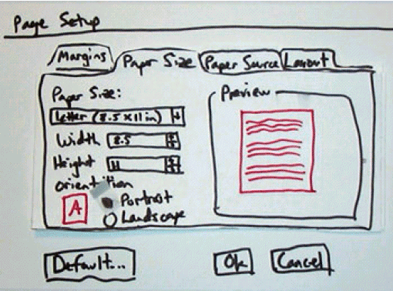
Paper Prototyping!
Quite literally, using paper to produce a potential interface design.

Slide 23
Paper Prototyping
Has several benefits:
Very fast evaluation and testing of an interface!
Very Cheap! Less resource consuming.
Easy to change and adapt
Estimated to be 100 times cheaper if NO code is written.
Can be used to collect important usability information!
User involvement at an early stage
Encourages creativity (not limited by coding skills)
Can be used as subset of system documentation (e.g., hand to engineers and say “build this”)
*Jakob Nielson

Slide 24
Demonstration Video
https://www.youtube.com/watch?v=GrV2SZuRPv0

Slide 25
Paper Prototyping Tips and Tricks
1) Keep materials in one place! Small interface widgets tend to get lost or damaged easily.
2) Work quickly and make reusable components.
3) If something is difficult to simulate (progress indicators, right mouse menus, hyperlinks), have the user ask if it is available and then verbally describe the interaction.

Slide 26
Paper Prototyping Tips and Tricks
4) Backgrounds (Poster Board, etc.) can be useful to contain the prototype and provide context for the user.
5) Don’t be afraid to mix and match hardware and software! Maybe a physical block of wood with paper on it!
6) When appropriate, add context by including familiar operating system elements.

Slide 27
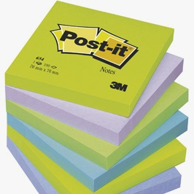
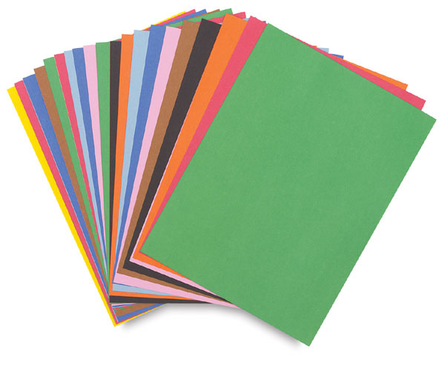

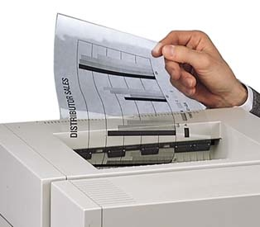
Paper Prototyping Materials
Widgets!

Slide 28
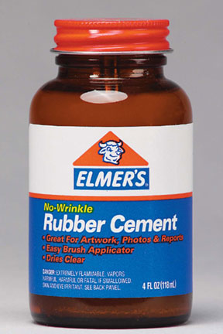
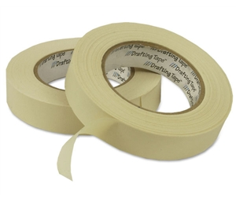
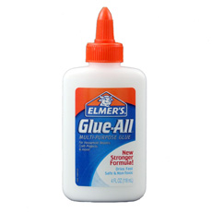
Paper Prototyping Materials
Connectors

Slide 29

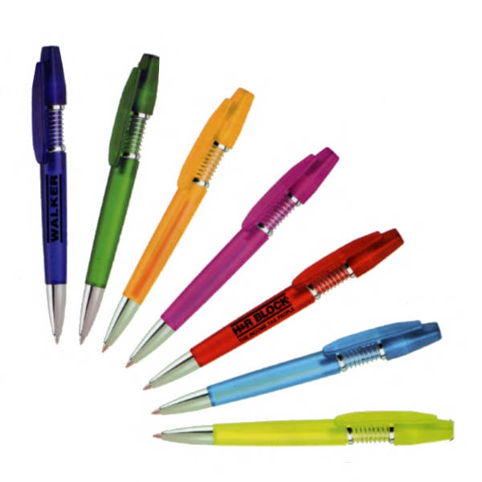
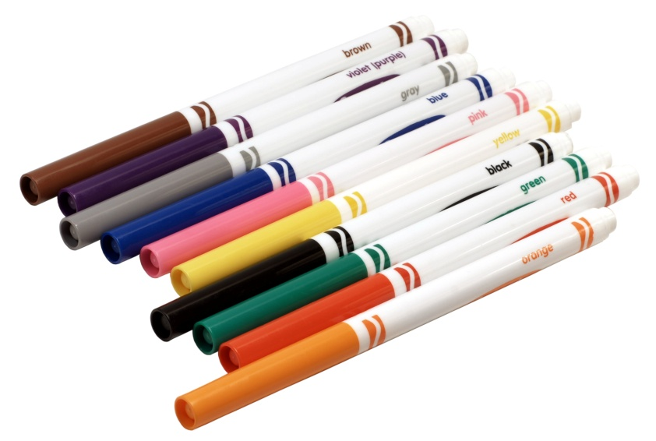
Paper Prototyping Materials
Drawing

Slide 30
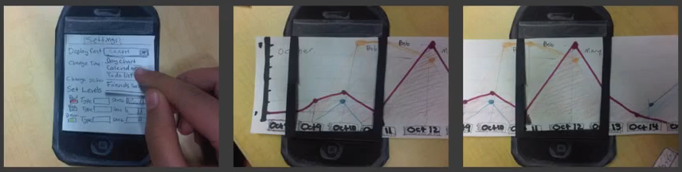
Another Example

