Slide 1
CS3205 – HCI in Software Development More Prototyping Strategies
Dr. Mark Floryan
Rice Hall 203
mrf8t@cs.virginia.edu
* Material from: [Klemmer, Stanford]

Slide 2
What Are We Doing Today?
Digital Mock-Ups
Wizard of Oz Prototyping

Slide 3
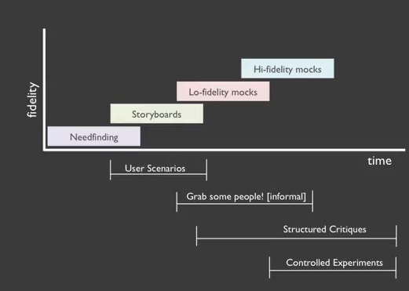
Prototyping Over Time

Slide 4
What is a High-Fidelity Prototype?
“A prototype that mimics the design very closely, but remains functionally incomplete.”
This might be actual code, or actual physical devices that don’t work fully.

Slide 5
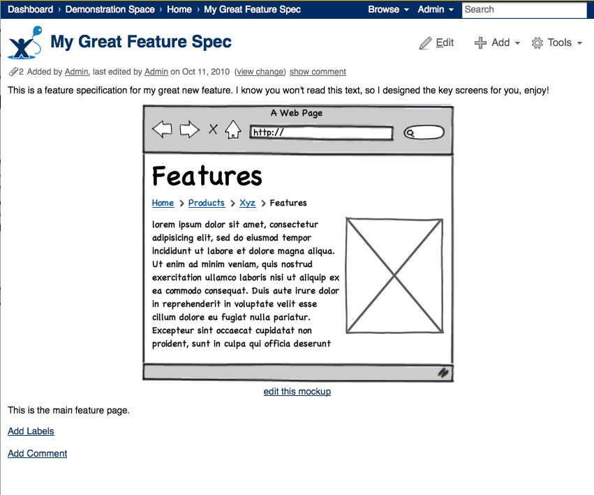
Digital Mockups

Slide 6
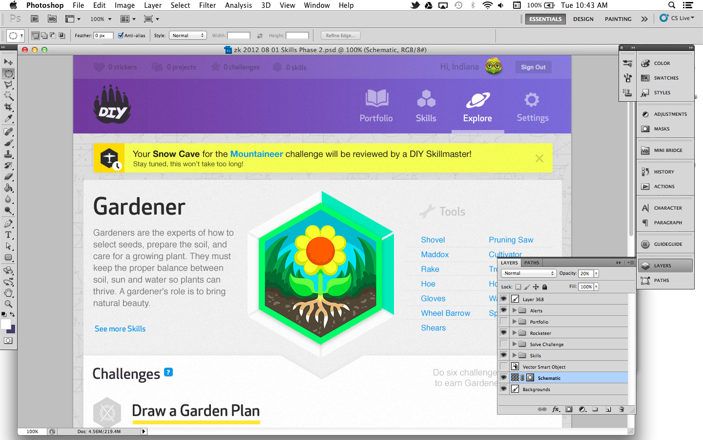
Digital Mockups

Slide 7
Digital Mockups
Free software exists for doing this!
http://mashable.com/2012/06/07/mockup-tools/
Balsamiq Mockups (desktop application)
Mockingbird (online in-browser mockups)
Mockup Builder
POP (Prototyping on paper) app
Can also use tools like powerpoint to simulate a design relatively effectively.

Slide 8
Wizard of Oz Prototypes

Slide 9
Motivation: Prototyping Problem
Need feedback from real people in order to improve your design. However,
Can’t get feedback unless you have something built and working!
What if your system is very complicated?

Slide 10
Motivation: What if we could…
Make an interactive application without (much) code, but still:
Get feedback from real users.

Slide 11
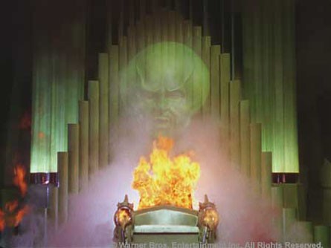
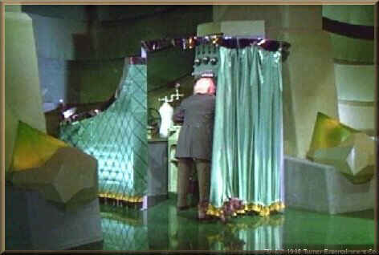
Wizard of Oz Prototyping!

Slide 12
Wizard Of Oz Prototyping
Human operator simulates the functionality of the system behind the scenes.
Don’t need to build the whole system! Just have your “wizard” simulate it for the user.

Slide 13
Wizard Of Oz Technique
Make an interactive application without much code.
Front end interface is coded.
A remote wizard controls the interface’s characteristics based on user input directly.
Makes sense to do this if it’s faster/cheaper/easier than making a real thing.
Get feedback from real users.
Users will think the system is more real if done well!

Slide 14
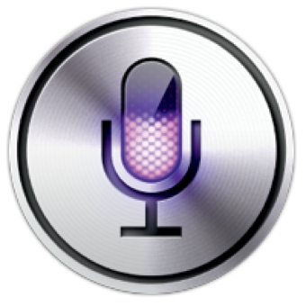
Another Example: Speech Recognition
There was a time when:
Speech recognition software was NOT good at all (still not great).
We knew it would get better.
We wanted to know what user’s interactions with this technology should be like.
How to study this without building a speech recognition system ourselves?

Slide 15
Another Example: Speech Recognition
Wizard of Oz the interaction!
Human listens to the voice commands of the user.
Adjusts the interface accordingly.

Slide 16
Funny Example
https://www.youtube.com/watch?v=AlyvYLLtQOg

Slide 17
Another Example: Intelligent Tutors!

Slide 18
When to use Wizard Of Oz?
Useful when:
There is an advanced technology in your system that you don’t have time to build / incorporate into prototype.
Speech recognition, artificial intelligence, etc.
You haven’t determined how best to implement a feature (e.g., personalized feedback) and want to test it first.

Slide 19
Wizard of Oz Can be Low-Fidelity!
You can have a “Wizard” control the look and feel of a paper prototype while users use it.
However, remember that the more ‘real’ the wizard’s mirage is, the more realistic the user’s reactions will be.

Slide 20
Example!
http://m.youtube.com/watch?v=RPjlJKRa7Uw

Slide 21
Making A WOO Prototype
1. Map out scenarios and application flow.
Enumerate ALL scenarios if possible.
If not, provide guidelines in as specific a format as possible.
2. Put together interface “skeletons”
3. Develop “hooks” for wizard input.
If paper, hooks will be very manual.
If done in software, some code will need to be developed.

Slide 22
Making A WOO Prototype
4. Put it all together.
Where and how will the wizard provide input?
How will the wizard receive input from the user?
* Remember that you’ll need to build actual software for wizard’s role eventually, so it must be possible!
5. Rehearse wizard role with a colleague.
Being the wizard is surprisingly difficult.
Work out easy bugs in interaction before using real users.

Slide 23
Collecting Data for WOO Prototypes
Practice with friends first.
Once comfortable, recruit “users”
Two roles: facilitator and wizard
Facilitator: Provides tasks (paper) and takes notes.
Wizard: Operates the interface.

Slide 24
Collecting Data for WOO Prototypes
User feedback can be:
Think aloud (speak freely as performing tasks)
Retrospective (discuss task afterwards)
Heuristic Evaluation (experts are watching interaction unfold)
Interaction is normally video taped so designers can review later.
Always debrief users, reveal the wizard if necessary / appropriate.

Slide 25
Wizards Throughout Development
Functionality vs. Time graph

Slide 26
Advantages of Wizards
Faster to make / cheaper, thus more iterative prototypes possible.
Creating multiple variations is usually very easy (no code to rewrite).
More “real” than pure paper prototyping or mockups.
Identifies bugs and problems with current design.
Places user at center of development.
Can envision challenging to build application.
Designers learn by playing wizard.

Slide 27
Disadvantages of Wizards
Simulations may represent otherwise imperfect (or impossible) tech.
Wizards require training and can be inconsistent.
Playing the wizard can be exhausting ☹
Some features are difficult (or impossible) to simulate perfectly.
May be inappropriate in some venues.

Slide 28
Questions?

