Slide 1
CS3205 – HCI in Software Development More Prototyping / Intro To Evaluation
Dr. Mark Floryan
Rice Hall 203
mrf8t@cs.virginia.edu
* Material from: [Klemmer, Stanford]

Slide 2
Quantity vs. Quality
Is it better to produce a large quantity of designs, or to focus on creating the best one design?

Slide 3
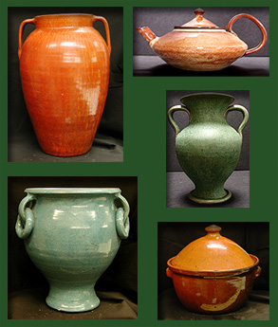

Quantity vs. Quality
Bayles and Orland put this to the test.

Slide 4
Quantity vs. Quality
Well, come grading time and a curious fact emerged: the works of highest quality were all produced by the group being graded for quantity. It seems that while the "quantity" group was busily churning out piles of work - and learning from their mistakes -- the "quality" group had sat theorizing about perfection, and in the end had little more to show for their efforts than grandiose theories and a pile of dead clay. [Bayles, Orland]

Slide 5
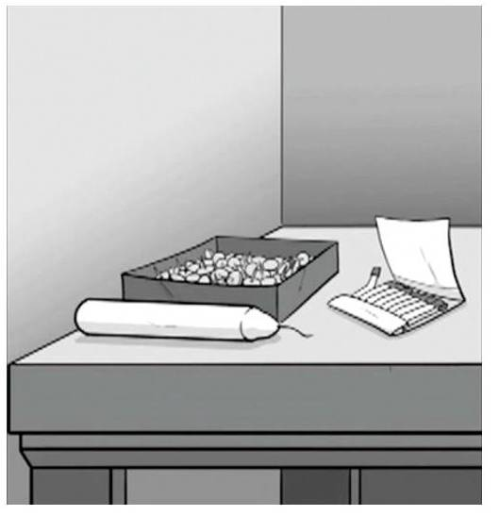
Functional Fixation
[Duncker, 1945]

Slide 6

Functional Fixation
[Duncker, 1945]

Slide 7
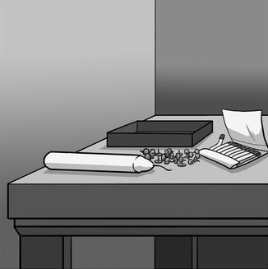
Functional Fixation
[Duncker, 1945]

Slide 8
Better Approach?
Parallel Prototyping:
Making multiple prototypes in parallel
Studies show that this leads to better designs!
i.e., designs led to statistically higher values in quantifiable variables of interest (more on this later).
*Klemmer, Gentner, Loewenstein, Thomson, etc.
Seperates Ego from Artifact
i.e., a criticism of one design is NOT a criticism towards the designer.

Slide 9
Parallel Prototyping
Another advantage:
Supports TRANSFER of positive attributes across designs.
Study:
Three groups (n=84)
1: each member made multiple prototypes and shared them among team.
2: each team member shared only their best prototype.
3: each team (as a group) created a single prototype together (only one design).

Slide 10
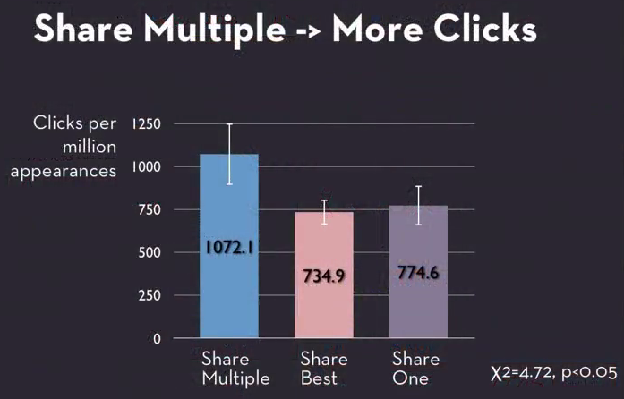
Parallel Prototyping
*Klemmer

Slide 11
Ok fine…so how do we compare prototypes?
We perform an evaluation!
An evaluation is an experiment (or set of experiments) meant to provide answers to at least one design question.

Slide 12
Starting An Evaluation
MUST have a research question!
Typically, these research questions are related to your usability requirements!
‘Which design accomplishes usability requirement X best!”
It is very common to ask things like “Do you like my interface?”
Anything wrong with just asking people this?

Slide 13
Leading Questions
Firstly, ‘Do you like my interface?’ is a leading question!
A Leading Question is a question that suggests the answer the examiner is looking for or contains the information the examiner is looking to have confirmed.
Don’t ask users leading questions!

Slide 14
Please the Experimenter Bias
People want to make you feel good about your work (because it’s assumed that you worked hard).
So users will tend to say ‘Yes’ to this question.
How do we get around this?

Slide 15
Getting Beyond “Do you like my interface?”
Ways to get around please the experimenter bias
1) Double-blind studies
i.e., Both user and facilitator don’t know which experimental group the user is in.
2) Don’t let the user know what you are measuring / what you care about (until study is over).
E.g., Don’t tell the user that the number of mistakes while typing is being measured.
3) Ask questions that cancel each other out
E.g., Ask about how useful the interface was AND how frustrating it is. User can’t tell which you care about.

Slide 16
Getting Beyond “Do you like my interface?”
If possible, evaluation measures (quantifiable variables) should ALWAYS have a baserate.
Baserates: How often does ‘Y’ occur in the current setting (if one exists)?
Very reasonable for some of your projects, if there is a competing product that exists.

Slide 17
Getting Beyond “Do you like my interface?”
Baserates: How often does ‘Y’ occur in the current setting (if one exists)?
Example: “User will make less than 3 mistakes while performing task X”
Where did the 3 come from?
If 3 is the average that users make on some competing system, than that is a good baserate!
If 3 was made up, then it is not. It provides little context.
* Need to define what ‘mistake’ means clearly…but that’s another story.

Slide 18
Getting Beyond “Do you like my interface?”
Correlations: Do X and Y co-vary?
Requires measuring X and Y.
Probably need two prototypes OR two versions of a prototype (each with different X).
Causes: Does X cause Y?
Requires measuring X and Y (establishing correlation).
Requires establishing time precedence.
Requires controlling for all confounding variables.

Slide 19
Examples of Correlation != Causation
http://www.buzzfeed.com/kjh2110/the-10-most-bizarre-correlations

Slide 20
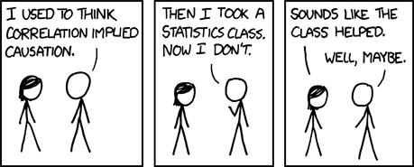
Correlation != Causation
*from http://xkcd.com/552/

Slide 21
A few terms:
Independent Variables
Variable that is being manipulated to study an effect via a change.
Dependent Variables
Variable that is measured for change after IV is altered.
Time to complete a task
Emotion

Slide 22
Internal Validity
Can you reproduce the experiment multiple times yourself!?
Same prototypes
Different users
Same experimental setup, conditions, etc.

Slide 23
External Validity
Does your experiment apply generally to other ‘outside’ settings?
Different users selected from a different “pool”.
Different prototypes with same general independent and dependent variables.
Different designers running the experiments.
Etc…
In short, EV means your results apply generally to experiments with the same abstract characteristics as yours.

Slide 24
Questions?

Slide 25
Daily Movie
http://www.youtube.com/watch?v=kCSzjExvbTQ

Slide 26
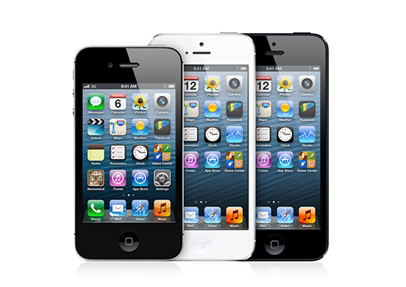
Iphone Study
Study meant to measure the usability of typing on the Iphone.
Bring in two groups:
Numeric Keypad users
QWERTY users
Measure typing speed (wpm) for each group on the new IPhone.

Slide 27
Iphone Study
Manipulation: Input Style
Measure: Words per minute
Internal Validity: Yea…probably!
External Validity: Not so much, why?
Results: Both groups did the same (and did poorly compared to their own phones).
*Pc world, User-Centric

Slide 28
Better Version
Comparison of:
Iphone users (after a month at least)
QWERTY users
Numeric users
This time, measure BOTH speed and error rate while typing!

Slide 29
Results
Iphone and QWERTY users type about the same speed (numeric much slower).
But…Iphone users make MANY more errors!
*Note: Any problems with this study? Think about the users in each group?

Slide 30
Self Selection
“Self selection occurs when the experimental groups are chosen by the participants in some manner.”
Even better study?
Select participants for each phone group at random.
Train them on the phone for a while.
Run the experiment as before.

Slide 31
Strategies For Fair Comparison
Insert new approach into an actual production setting.
Recreate the production approach in your new setting.
Scale things down so you’re looking at a piece of a larger system (most relevant for you!).
When expertise is relevant, train people up BEFORE running your study.

Slide 32
Is Interface X better than interface Y?
What does better mean?
Need explicit measures when possible.
Nearly always, your answer will be that ‘It Depends’.
So, more interestingly, what does it depend on?
Figure that out! And then describe your results!

Slide 33
Controlled Comparison Enables Causal Inference
When possible, control as many external variables as possible.
Users placed in groups randomly.
Users perform experiment in exact same environment.
Users are given the exact same instructions, training time, etc.
Any outside variable that could affect the result of the study should be equivalent for ALL test subjects.
If done well, then the third requirement (confounding factors) for causal inference is satisfied.

Slide 34
Types of Evaluation
Heuristic Evaluation
Experts look at a system and analyze carefully.
Produce a report of usability problems.

Slide 35
Types of Evaluation
Quantitative Analysis
Perform an experiment that involves the collection of quantitative data (numeric data or data that can be translated into numeric data).
Run statistical tests to evaluate differences across prototypes.

Slide 36
Types of Evaluation
Qualitative Analysis
Collect non-numerical data.
Conversation transcripts, general observations, etc.
Analyze for broad consistent patterns.

Slide 37
What’s Coming Up!
Let’s look at each type of evaluation in more detail!
Heuristic Evaluation
Quantitative Evaluation
Qualitative Evaluation

