Slide 1
CS3205 – HCI in Software Development Heuristic Evaluations
Dr. Mark Floryan
Rice Hall 203
mrf8t@cs.virginia.edu
Slide deck by Saul Greenberg. Permission is granted to use this for non-commercial purposes as long as general credit to Saul Greenberg is clearly maintained. Warning: some material in this deck is used from other sources without permission. Credit to the original source is given if it is known.

Slide 2
Overview
Qualitative Evaluation – Collect data from people in some form. Data collected in the form of notes, transcripts, interviews, etc.
A bit subjective
Great for finding broad patterns, trends, etc.
Techniques / considerations for qualitative evaluation
Naturalistic vs. Experimental design
How to conduct the evaluation
How to interpret data

Slide 3
Naturalistic vs. Experimental Studies

Slide 4

Naturalistic approach
Observation occurs in realistic setting
Advantages:
Occurs in a realistic setting, so outside variables mimic real life
Provides useful, realistic data
More likely to generalize (though do not assume it will)
Disadvantages:
hard to arrange and do
time consuming

Slide 5
Experimental approach
Experimenter controls all environmental factors
study relations by manipulating independent variables
observe effect on one or more dependent variables
nothing else changes
There is no difference in user performance (time and error rate) when selecting an item from a pull down or a pull right menu of 4 items
File Edit View Insert
File
New
New
Edit
Open
Open
View
Close
Close
Insert
Save
Save

Slide 6
Validity
External validity
confidence that results applies to real situations
usually good in natural settings
Internal validity
confidence in our explanation of experimental results
usually good in experimental settings
Trade-off: Natural vs Experimental
precision and direct control over experimental design versus
desire for maximum generalizability in real life situations

Slide 7
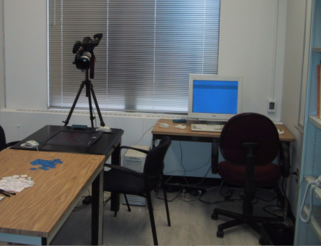
Usability Engineering Approach
A compromise between naturalistic and experimental
Observe people using systems in simulated settings
people brought in to artificial setting that simulates aspects of real world setting
people given specific tasks to do
observations / measures made as people do their tasks
look for problem areas / successes
good for uncovering ‘big effects’

Slide 8
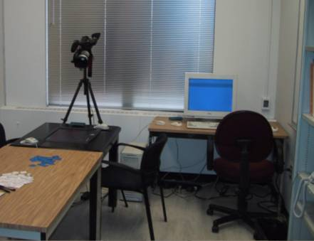
Usability Engineering Approach
Is the test result relevant to the usability of real products in real use outside of lab?
Problems
non-typical users tested
non-typical tasks
different physical environment
different social context
motivation towards experimenter vs motivation towards boss
Partial Solution
use real users
task-centered system design tasks
environment similar to real situation

Slide 9
Usability Engineering Approach
How many users should you observe?
observing many users is expensive
but individual differences matter
best user 10x faster than slowest
best 25% of users ~2x faster than slowest 25%
partial solution
reasonable number of users tested (5-10)
reasonable range of users
big problems usually detected with handful of users
small problems / fine measures need many users

Slide 10
Qualitative Evaluation Methods

Slide 11
Qualitative Evaluation Methods
inspection
extracting the conceptual model
direct observation
think-aloud
constructive interaction
query techniques (interviews and questionnaires)
continuous evaluation (user feedback and field studies)

Slide 12
1. Inspection
Designer tries the system (or prototype)
does the system “feel right”?
benefits
can catch some major problems in early versions
Extremely cheap and fast
problems
not reliable as completely subjective
not valid as introspector is a non-typical user
intuitions and introspection are often wrong

Slide 13
2. Conceptual model extraction
How?
show the user static images of
the prototype or screens during use
ask the user explain
the function of each screen element
how they would perform a particular task and why they think that
What?
Initial conceptual model
how person perceives a screen the very first time it is viewed
Formative conceptual model
How person perceives a screen after its been used for a while
Value?
good for eliciting people’s understanding before & after use
poor for examining system exploration and learning

Slide 14
3. Direct observations
Evaluator observes users interacting with system
in lab:
user asked to complete a set of pre-determined tasks
in field:
user goes through normal duties
Value
excellent at identifying gross design/interface problems
validity depends on how controlled/contrived the situation is

Slide 15

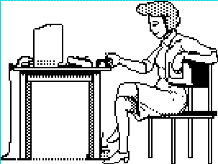
3.1 Simple observation method
User is given the task
Evaluator just watches the user
Problem
does not give insight into the user’s decision process or attitude

Slide 16
3.2 Think aloud method
Users speak their thoughts while doing the task
what they are trying to do
why they took an action
how they interpret what the system did
gives insight into what the user is thinking
most widely used evaluation method in industry
may alter the way users do the task
unnatural (awkward and uncomfortable)
hard to talk if they are concentrating
Hmm, what does this do? I’ll try it… Ooops, now what happened?

Slide 17
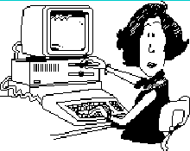
Example Usability Test
Drawing some cats!
https://www.youtube.com/watch?v=9wQkLthhHKA

Slide 18
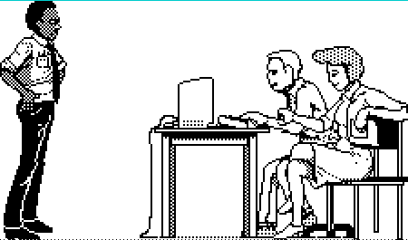
3.3 Constructive interaction method
Two people work together on a task
monitor their normal conversations
removes awkwardness of think-aloud
Co-discovery learning
use semi-knowledgeable “coach” and novice
only novice uses the interface
novice ask questions
coach responds
gives insights into two user groups
Oh, I think you clicked on the wrong icon
Now, why did it do that?

Slide 19
4. Interviews
Good for pursuing specific issues
vary questions to suit the context
probe more deeply on interesting issues as they arise
good for exploratory studies via open-ended questioning
often leads to specific constructive suggestions
Problems:
accounts are subjective
time consuming
evaluator can easily bias the interview
prone to rationalization of events/thoughts by user
user’s reconstruction may be wrong

Slide 20
How to Interview
Plan a set of central questions
a few good questions gets things started
avoid leading questions
focuses the interview
could be based on results of user observations
Let user responses lead follow-up questions
follow interesting leads vs bulldozing through question list

Slide 21
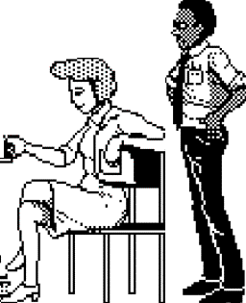

4.1 Retrospective testing interviews
Post-observation interview to
perform an observational test
create a video record of it
have users view the video and comment on what they did
clarify events that occurred during system use
excellent for grounding a post-test interview
avoids erroneous reconstruction
users often offer concrete suggestions
Do you know why you never tried that option?
I didn’t see it. Why don’t you make it look like a button?

Slide 22
4.2 Critical incidence interviews
People talk about incidents that stood out
usually discuss extremely annoying problems with fervor
not representative, but important to them
often raises issues not seen in lab tests
Tell me about the last big problem you had with Word
I can never get my figures in the right place. Its really annoying. I spent hours on it and I had to…

Slide 23

4.3 Questionnaires and Surveys
Questionnaires / Surveys
preparation “expensive,” but administration cheap
can reach a wide subject group (e.g. mail)
does not require presence of evaluator
results can be quantified
But
only as good as the questions asked

Slide 24
4.3 Questionnaires and Surveys
How
establish the purpose of the questionnaire
what information is sought?
how would you analyze the results?
what would you do with your analysis?
do not ask questions whose answers you will not use!
determine the audience you want to reach
determine how would you will deliver / collect the questionnaire
on-line for computer users
web site with forms
surface mail
pre-addressed reply envelope gives far better response

Slide 25

5. Continuous Evaluation
Monitor systems in actual use
usually late stages of development
ie beta releases, delivered system
fix problems in next release
User feedback via gripe lines
users can provide feedback to designers while using the system
help desks
bulletin boards
email
built-in gripe facility
best combined with trouble-shooting facility
users always get a response (solution?) to their gripes

Slide 26
You know now
Why evaluation is crucial
Quickly debug prototypes by observing people use them
Methods reveal what a person is thinking about

Slide 27
Primary Sources
This slide deck is partly based on concepts as taught by:
Nielsen, J. (1993) Usability Engineering, Chapter 6: Usability testing
Gomoll, Kathleen & Nicol, Anne (1990) User Observation: Guidelines for Apple Developers, Apple Inc., January
Dumas, J.S. and Redish, J.C. A Practical Guide to Usability Testing. Revised Edition. (1999)
Gould, J. (1988) How to design usable systems. In Readings in Human Computer Interaction: Towards the Year 2000 (2nd Edition). Baecker, R., Grudin, J., Buxton, W., and Greenberg, S. (1995). Morgan-Kaufmann.

Slide 28



Permissions
You are free:
to Share — to copy, distribute and transmit the work
to Remix — to adapt the work
Under the following conditions:
Attribution — You must attribute the work in the manner specified by the author (but not in any way that suggests that they endorse you or your use of the work) by citing:
“Lecture materials by Saul Greenberg, University of Calgary, AB, Canada. http://saul.cpsc.ucalgary.ca/saul/pmwiki.php/HCIResources/HCILectures”
Noncommercial — You may not use this work for commercial purposes, except to assist one’s own teaching and training within commercial organizations.
Share Alike — If you alter, transform, or build upon this work, you may distribute the resulting work only under the same or similar license to this one.
With the understanding that:
Not all material have transferable rights — materials from other sources which are included here are cited
Waiver — Any of the above conditions can be waived if you get permission from the copyright holder.
Public Domain — Where the work or any of its elements is in the public domain under applicable law, that status is in no way affected by the license.
Other Rights — In no way are any of the following rights affected by the license:
Your fair dealing or fair use rights, or other applicable copyright exceptions and limitations;
The author's moral rights;
Rights other persons may have either in the work itself or in how the work is used, such as publicity or privacy rights.
Notice — For any reuse or distribution, you must make clear to others the license terms of this work. The best way to do this is with a link to this web page.

