Slide 1
Weather Type Classification
Hands-on Data Science
Yucheng Ma
School of Computer Science
12/12/2024
https://github.com/markfromcd/Weather-Type-Classification.git

Slide 2
1. Recap

Slide 3
Intro: A classification Problem
The problem: Given a set of weather-related features such as temperature, humidity, wind speed, precipitation percentage, cloud cover, atmospheric pressure, UV index, season, visibility, and location, the objective is to predict the weather type (e.g., Rainy, Cloudy, Sunny, Snowy).
Why important: Weather predictions impact a wide range of industries and everyday life decisions. Like: Real-world applicability, safety and disaster preparedness, environmental protection. In details: agriculture, transportation, retail, early warnings...
Source: https://www.kaggle.com/datasets/nikhil7280/weather-type-classification/data
Notes:
Agriculture: Farmers rely on accurate weather predictions to plan planting, irrigation, and harvesting schedules. Predicting rainfall or dry weather helps optimize crop growth and minimize risks.
Transportation: Airlines, shipping companies, and logistics firms need to plan routes based on weather conditions to ensure safety and efficiency.
Retail: Businesses can adjust inventory and marketing strategies based on weather forecasts. For example, stores may stock more umbrellas and raincoats if rainy weather is expected.

Slide 4
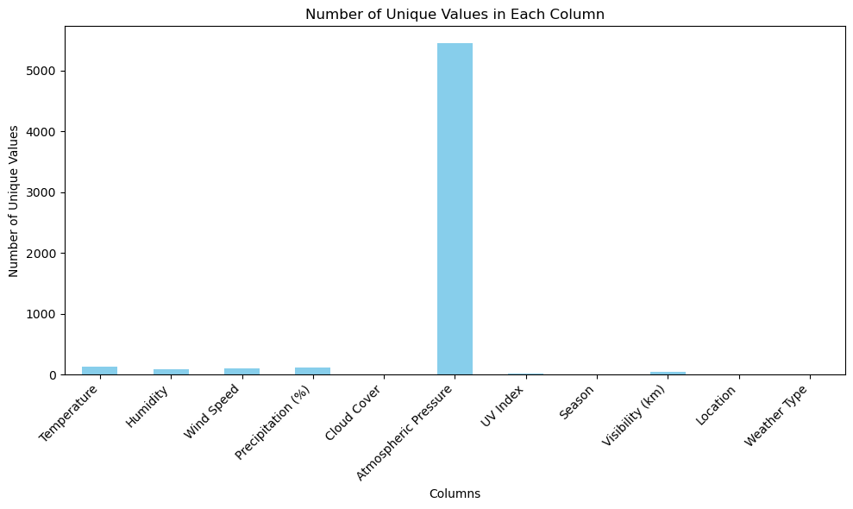
EDA. Check the nunique value of each column
Only atmospheric pressure has a lot values, but it really plays a vital role in weather prediction, so I will not drop it.
Notes:
Do not drop it.

Slide 5
Preprocessing
StandardScaler: to scale each continuous features.
OneHotEncoder: Location, allowing models to interpret categorical features correctly.
OrdinalEncoder: Season and Cloud Cover since they may contain inherent orders.
Since I used XGBoost, I translated target variables using label encoding.
No missing value at all

Slide 6
2. Cross Validation

Slide 7
How I split the data
Dataset → Stratified Split (80% Train( and Valid), 20% Test) → Kfold (4, each fold be valid set once) in Model Training & Evaluation
Stratification enusures Consistent Class Proportions Across Splits
Notes:
Have trained vali set

Slide 8
CV PIPLINE
1. Stratified K-Fold Cross-Validation
2. Preprocessing
3. Random State Variation:
Used to repeat the cross-validation process for multiple random states (e.g., 10 runs).
Reduces bias caused by a single random split.
4. ParamsTuning (GridSearchCV):
Explores combinations of hyperparameters for each model.
Evaluates each combination using stratified K-fold CV on the training set.
Scoring Metric: Accuracy for consistent evaluation across models.
5. Store Scores
Test Scores: Stores test accuracy for each random state.
Best Models: Retains the best model for each random state.
6. Best Model Selection:
Chooses the model and hyperparameters that yield the highest mean test scores and std.
7. Final Model

Slide 9
Algorithms and params
Algorithms | Parameters | Best Combinations
Logistic Regression | C = [0.01, 0.1, 1, 10, 100] penalty = ['l2'] solver = ['lbfgs', 'sag', 'newton-cg'] | C = 0.1 Penalty = l2 Solver = lbfgs
Random Forest | max_depth = [5, 10, None] max_features = ['sqrt', 'log2', None] min_samples_split = [2, 5, 10] | max_depth = None Max_features = sqrt Min_sample_split = 10
SVM | C = [0.01, 0.1, 1, 10] gamma = [0.001, 0.01, 0.1, 1, 10, 100] kernel = ['rbf', 'sigmoid'] | C = 1 gamma = 0.1 Kernel = rbf
XGBoost | learning_rate = [0.01, 0.1, 0.3] reg_lambda = [0e0, 1e-2, 1e-1, 1e0, 1e1, 1e2] max_depth = [3, 6, 9] | learning_rate = 0.3 reg_lambda = 0.01 Max_depth = 9
KNN | n_neighbors = [3, 5, 7, 10] weights = ['uniform', 'distance'] metric = ['euclidean', 'manhattan', 'minkowski'] | n_neighbors = 7 weights = uniform metric = manhattan
Notes:
Each model, the best params

Slide 10
3. Results

Slide 11
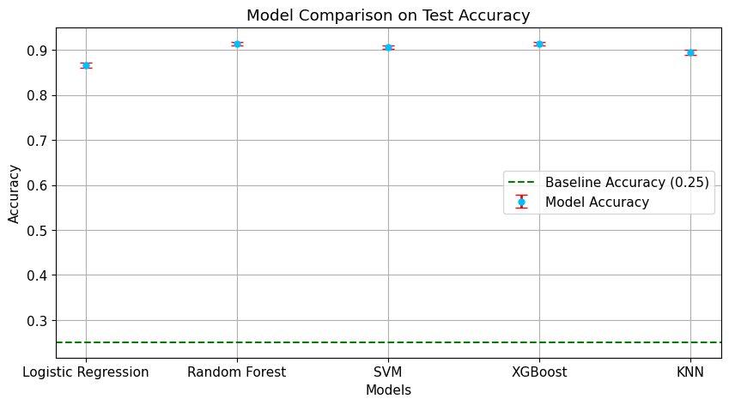
Scores

Slide 12
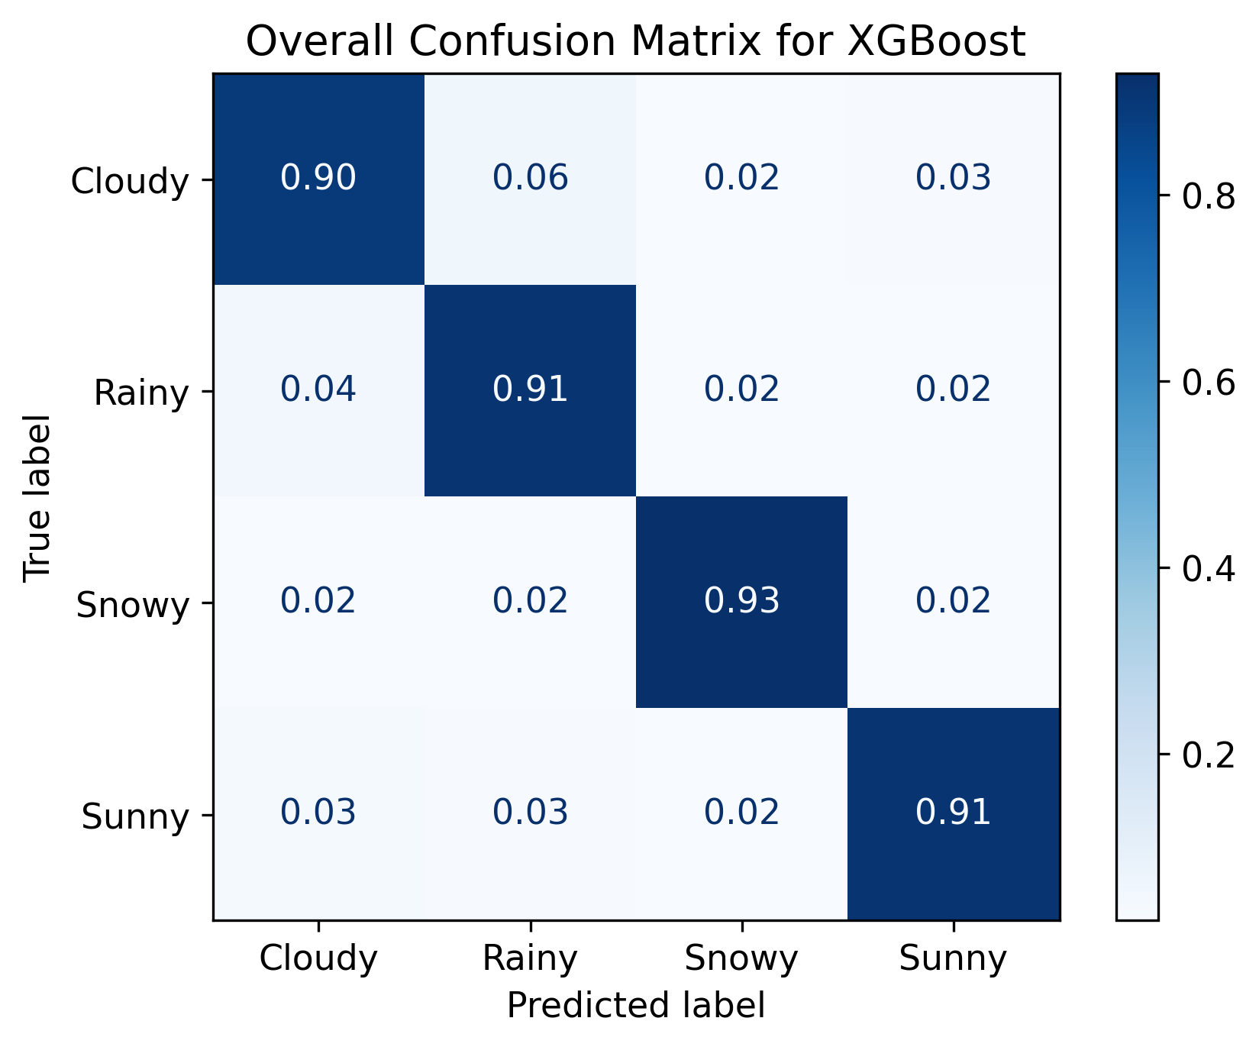
Comfusion Matrix of XGBoost

Slide 13
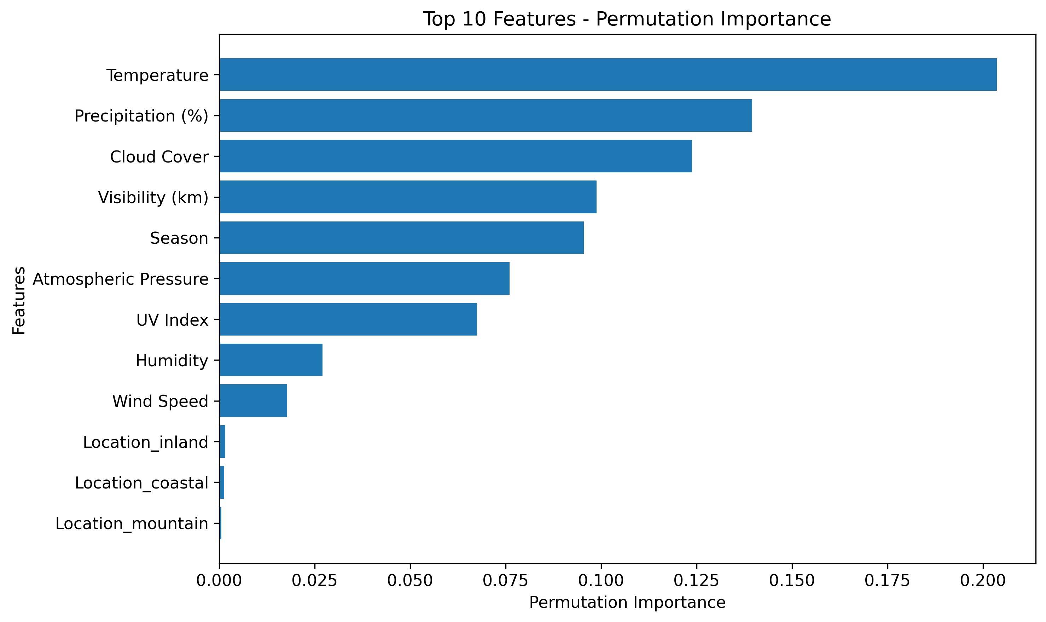
Global Perturbation

Slide 14
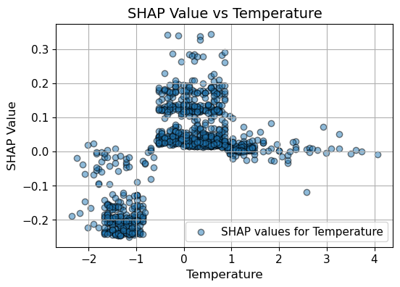
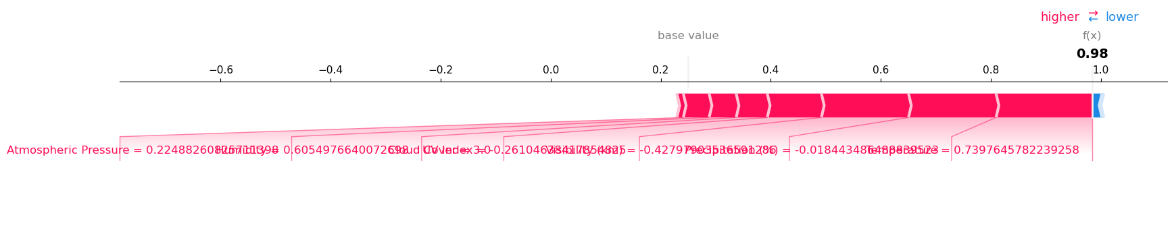
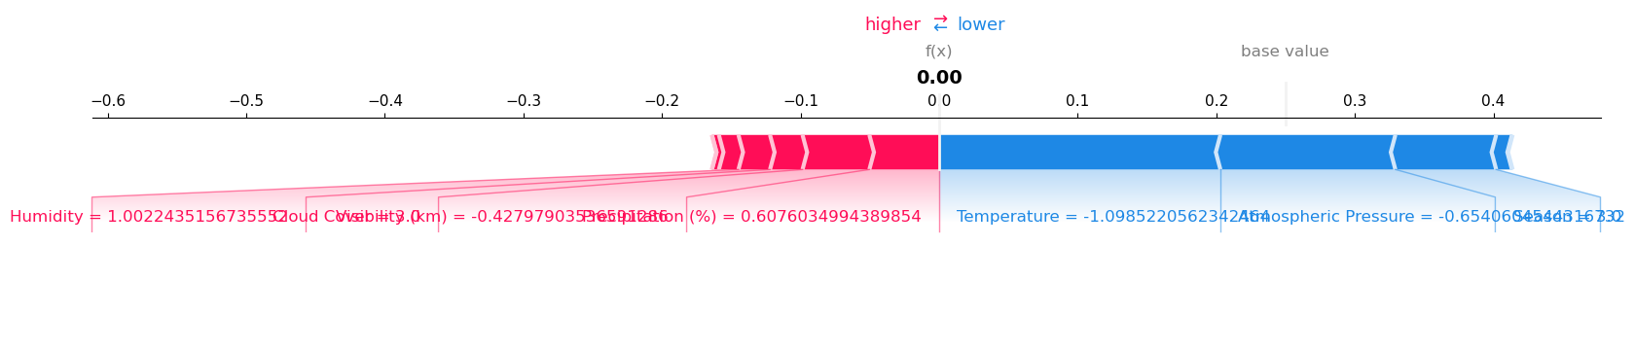
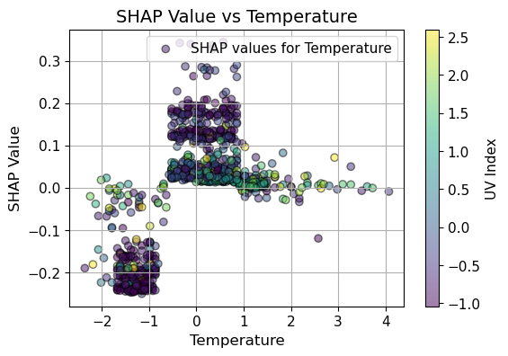
Local

Slide 15
Steps Taken to Make the Model Interpretable
Feature Importance Analysis:
Feature_importances_ :
Extracted feature importances for models like Random Forest and XGBoost using the feature_importances_ attribute.
Visualized global feature importances with horizontal bar plots to identify the most influential features for model predictions.
Permutation Importance:
Applied permutation importance to assess the impact of individual features on model performance.
Shuffled the values of each feature in the test set and observed how it affected the accuracy of the model.
Visualized results with boxplots to show the variability of model performance when features were perturbed.
SHAP (SHapley Additive exPlanations):
Local Interpretability:
Used SHAP to explain individual predictions.
Visualized SHAP force plots for specific test instances to show how each feature contributed to the prediction, relative to the base value.
Highlighted features that increased or decreased the likelihood of a specific class.
Confusion Matrix Analysis:
Generated confusion matrices to inspect how well the model classified instances of each class.
Normalized confusion matrices for better visualization of errors across classes.
Used decoded class labels for better interpretability of the confusion matrix.

Slide 16
I Learned from models
Model Performance:
01
XGBoost and Random Forest achieved the best accuracy and stability. (Both above 91.2%)
Temperature, Precipitation, Cloud Cover were the most impactful features across models.
Interpretability:
02
SHAP values provided insights into global and local feature contributions.
Permutation importance confirmed feature significance, with notable drops in accuracy when key features were shuffled.

Slide 17
I learned from project
After encoding, careful attention to the order of feature name concatenation to prevent feature-value mismatches
.XGBoost Specifics: XGBoost is highly effective in handling missing values and performs exceptionally well in classification tasks. However, it requires target variables to be numeric and cannot directly process string-based target variables.

Slide 18
4. Outlook

Slide 19
Models
Collect more features, expand target values for bigger model
Deep learning
Explore neural networks, particularly for large datasets or when patterns might be nonlinear and complex.

Slide 20
interpretability
Check all the importance in the 5 metrics:
Weight, Gain, Cover, Total_gain, Total_cover.
Partial Dependence Plots (PDP):
Examined the marginal relationship between a feature and the predicted outcome while controlling for other features.
Visualized how specific features (e.g., Temperature) impacted predictions across the feature range.

Slide 21
Thanks for listening

