Slide 1
Weather Type Classification
Hands-on Data Science
Yucheng Ma
School of Computer Science
10/25/2024
https://github.com/markfromcd/Weather-Type-Classification.git

Slide 2
1. INtro

Slide 3
Intro: A classification Problem
The problem: Given a set of weather-related features such as temperature, humidity, wind speed, precipitation percentage, cloud cover, atmospheric pressure, UV index, season, visibility, and location, the objective is to predict the weather type (e.g., Rainy, Cloudy, Sunny, Snowy). This is a multiclass classification problem, where each weather type is a discrete category.
Objective: To build a machine learning model that can accurately predict the weather type based on the given input features. I will use the dataset to train the model, evaluate its performance, and use it to classify unseen data into one of the possible weather types.
Why important: Weather predictions impact a wide range of industries and everyday life decisions. Like: Real-world applicability, safety and disaster preparedness, environmental protection. In details: agriculture, transportation, retail, early warnings...
Source: https://www.kaggle.com/datasets/nikhil7280/weather-type-classification/data with modification
Notes:
Agriculture: Farmers rely on accurate weather predictions to plan planting, irrigation, and harvesting schedules. Predicting rainfall or dry weather helps optimize crop growth and minimize risks.
Transportation: Airlines, shipping companies, and logistics firms need to plan routes based on weather conditions to ensure safety and efficiency.
Retail: Businesses can adjust inventory and marketing strategies based on weather forecasts. For example, stores may stock more umbrellas and raincoats if rainy weather is expected.

Slide 4
Please Note
This dataset is synthetically produced and does not convey real-world weather data. It includes intentional outliers to provide opportunities for practicing outlier detection and handling. The values, ranges, and distributions may not accurately represent real-world conditions, and the data should primarily be used for educational and experimental purposes.
Notes:
Agriculture: Farmers rely on accurate weather predictions to plan planting, irrigation, and harvesting schedules. Predicting rainfall or dry weather helps optimize crop growth and minimize risks.
Transportation: Airlines, shipping companies, and logistics firms need to plan routes based on weather conditions to ensure safety and efficiency.
Retail: Businesses can adjust inventory and marketing strategies based on weather forecasts. For example, stores may stock more umbrellas and raincoats if rainy weather is expected.

Slide 5
2. EDA

Slide 6
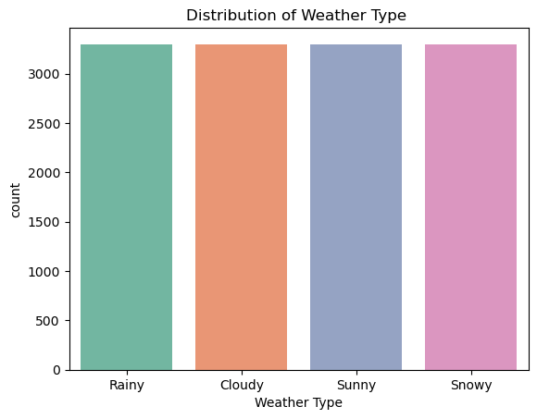
1. DATA
Target data distribution:
Nicely balanced.
13,200 data points in total,
11 columns
11 indexes: temperature, humidity, wind speed, precipitation percentage, cloud cover, atmospheric pressure, UV index, season, visibility, and location
Notes:
Distribution of weather type to be the title

Slide 7
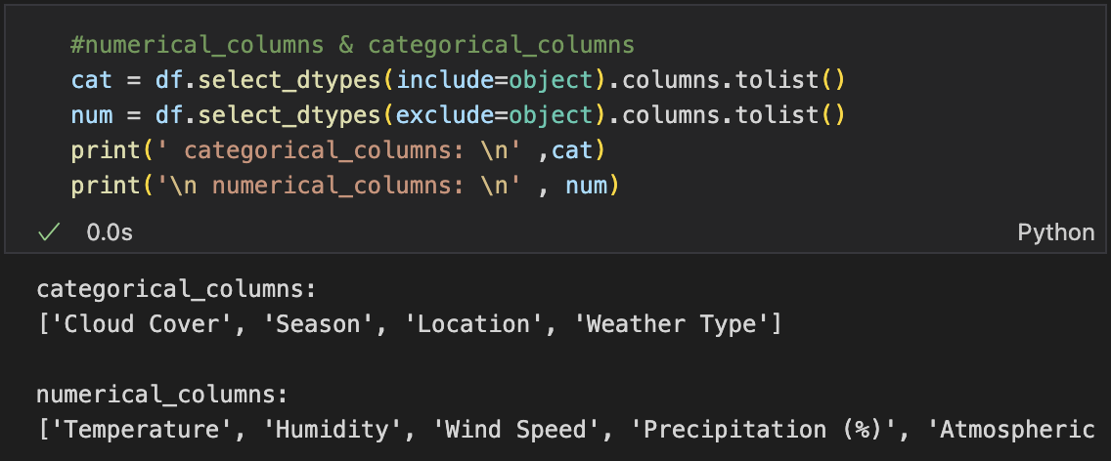
2. Data Type
Contains both continuous and categorical variables

Slide 8
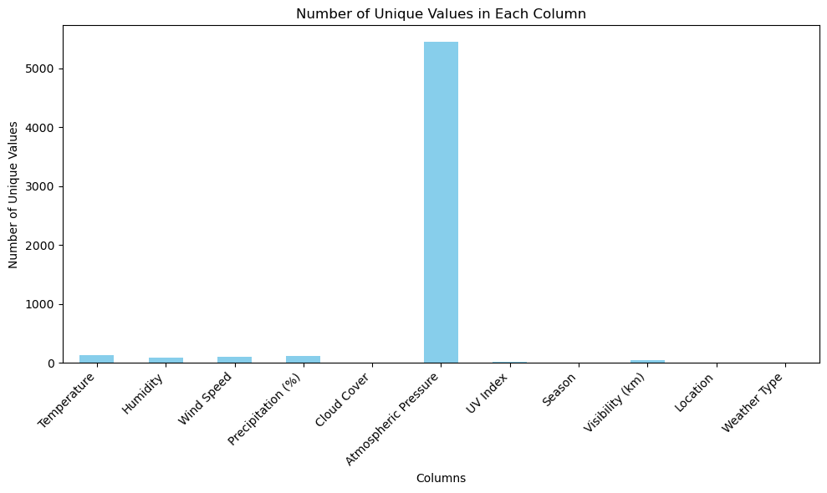
3. Check the nunique value of each column
Only atmospheric pressure has a lot values, but it really plays a vital role in weather prediction, so I will not drop it.
Notes:
Do not drop it.

Slide 9
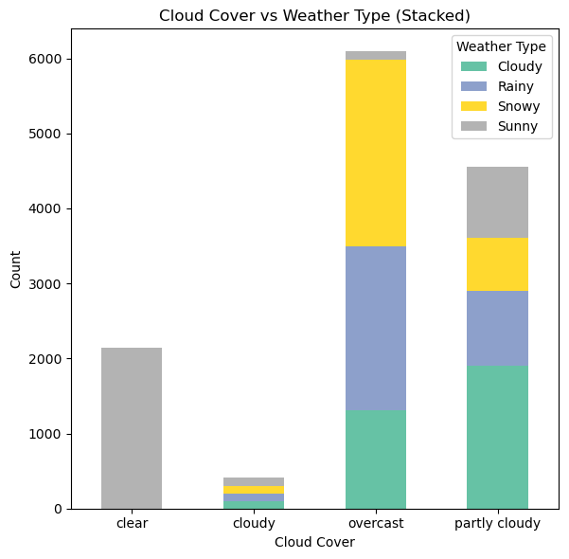
4. Categorical values play roles in model
Different column has different distribution
(A example here)
Notes:
Cloud cover and season should use ordinal encoding, they may have like some related features.

Slide 10
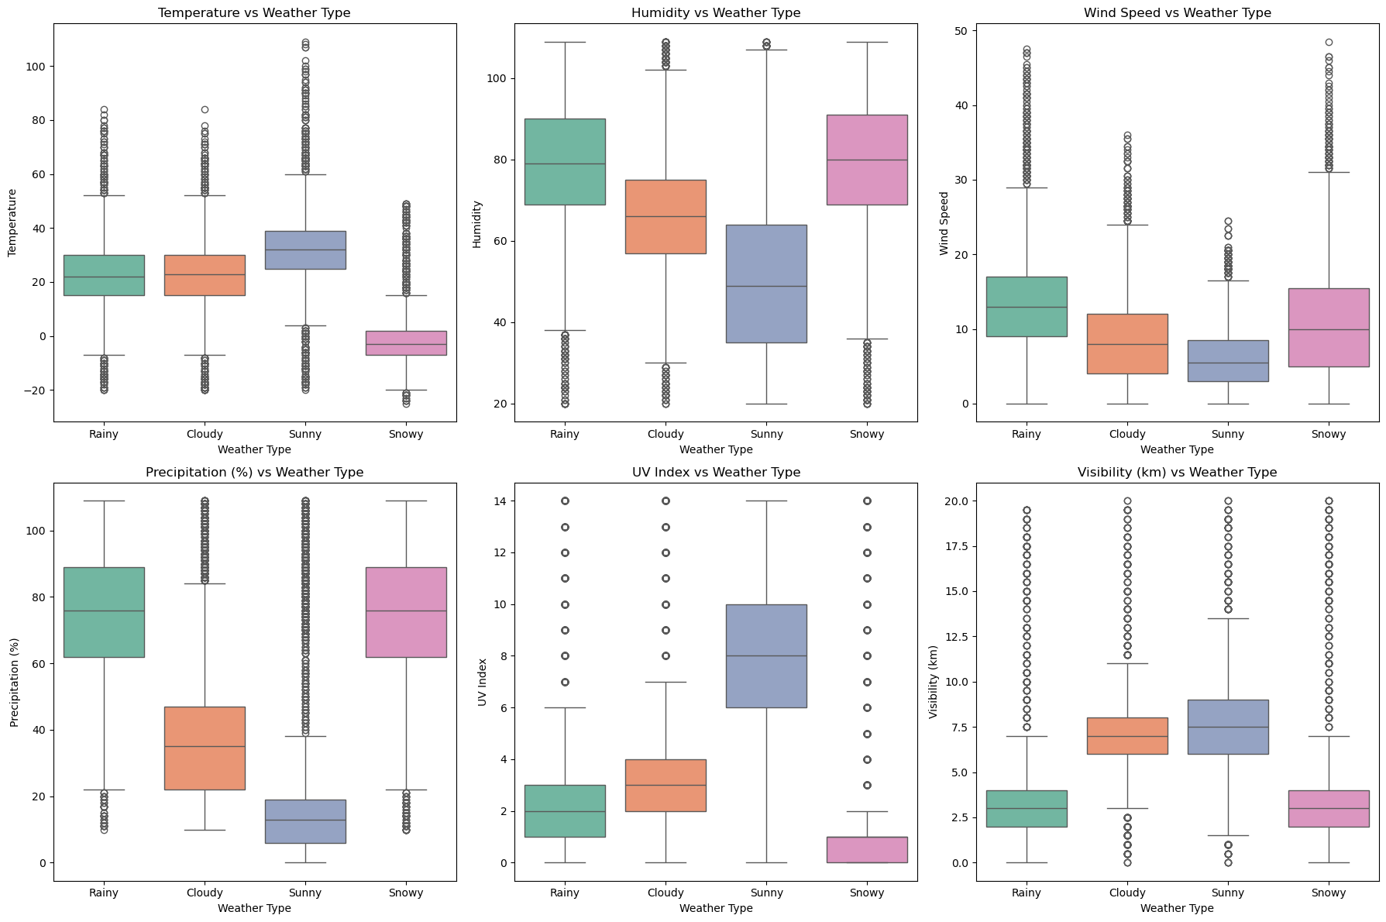
5. 6 Continuous values are useful
The distributions of box plot are different. Only wind speed is slightly unimportant. (A example here)
Notes:
One img is fine.

Slide 11
3. Splitting

Slide 12
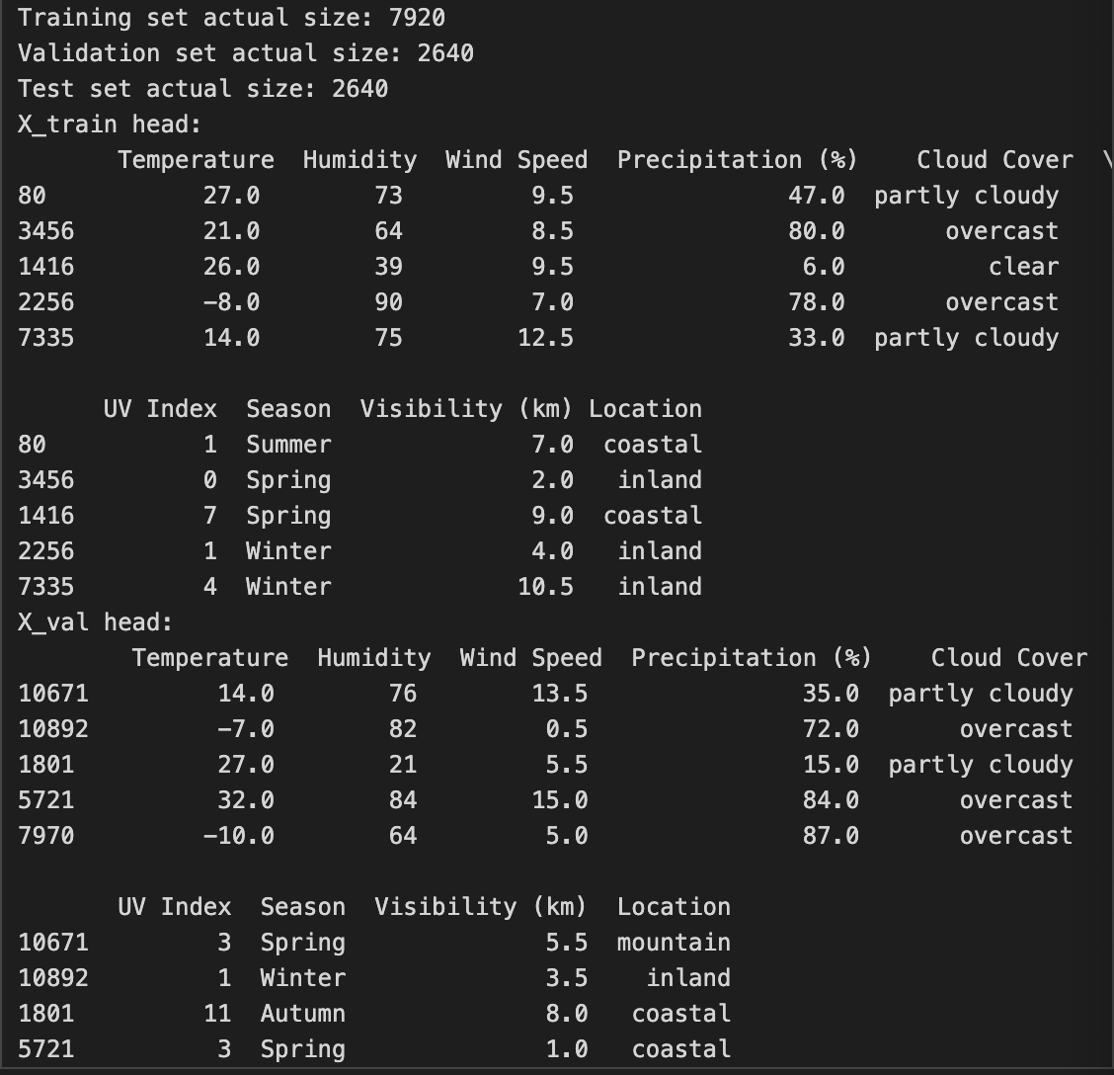
Stratified shuffle split
Since the target data is nicely balanced, using it is to ensure that the class proportions (the balance between categories in the target variable) remain consistent across the training, validation, and test sets.
Training set: 60%, Validation set: 20%, Test set: 20%

Slide 13
4. Preprocessing

Slide 14
Preprocessors that I used
I used StandardScaler to ensures that each continuous feature has a mean of 0 and a standard deviation of 1 so that to make model better perform.
I used OneHotEncoder to transform Location feature, allowing models to interpret categorical features correctly, treating them as distinct entities rather than imposing a numerical relationship. This ensures the model doesn't misinterpret categorical data.
I used OrdinalEncoder to transform Season and Cloud Cover since they may contain inherent orders. OneHotEncoding will make them independent.
So, help have better performance, avoids biases due to feature scaling, interpret categorical data correctly and even help convergence.

Slide 15
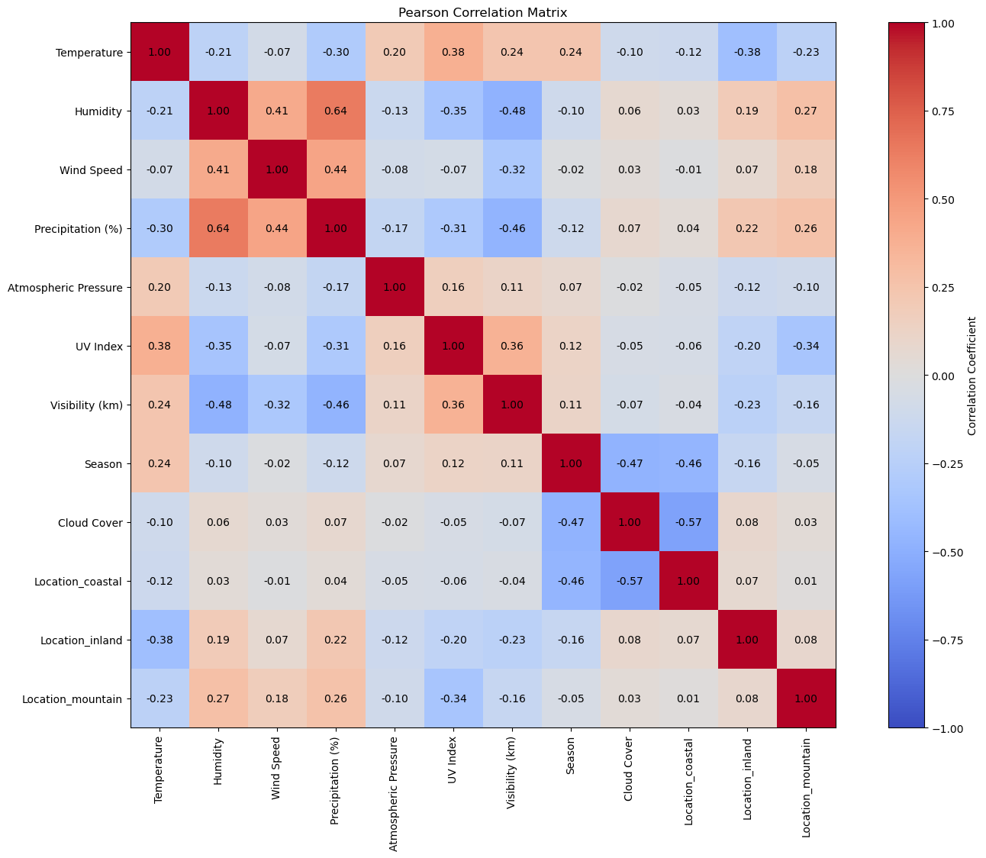
Features’ difference after preprocessing
By checking the correlation matrix, no more feature needed to be removed.
Since no missing value, no rows needed to be replaced or removed.
Since used one-hot encoding for categorical columns, the features from 10 used to 12 used. (temperature, humidity, wind speed, precipitation percentage, cloud cover, UV index, season, visibility plus location’s sub-categories.)
Also, I changed target value from words to ordinal encoding.

Slide 16
Thanks for listening

