Slide 1

Computation of resonant modes in cavities with a Discontinuous Galerkin time domain approach
ACME April 2015
Mark Dawson
Rubén Sevilla
Oubay Hassan
Kenneth Morgan

Slide 2
Outline
Motivation
Governing Equations
Numerical Method
Parallelisation
Speed Improvement
Solution With Dispersive Materials
Resonant Frequencies
Obtaining Mode Shapes
Example: 2D Circular Cavity
Conclusion

Slide 3
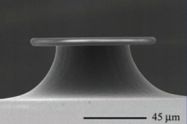

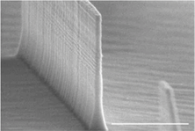
Motivation
RUBEN: The first sentence is not appropriate. You cannot focus on resonators only. This is just one example of a cavity, what you are doing is more general. Find examples of different cavities. Put a sentence on each one of them and why do we want to solve these problems I cannot find anything about how how people solve these problems (reference to FDTD and frequency domain solvers must be made) and say that we do something different
A resonant cavity is a device which has natural frequencies, at which waves oscillate with larger amplitudes.
[1]
ACOUSTICS & VIBRATIONS
Musical instrument
Speaker boxes
Car exhausts
Theatre or recording studios
Buildings and structures
ELECTROMAGNETICS
Band-pass filter
Multiplexing (add-drop) filters
Particle accelerator
Biological/chemical sensors
Laser and Nanolasers
[2]
Uses in:
Nanocavity lasers on optical integrated circuits
Highly selective add-drop wavelength filters
Optical memory
Optoelectronic biological sensing
Interesting due to:
Small scale
High quality factors
Well defined resonant frequencies
Large Free Spectral Range
[3]
QUESTIONS:
What are the resonant frequencies?
How well does it store energy?
How do these resonant waves look?
HOW DO WE ANSWER?
Experimental prototyping
Numerical simulations
Frequency domain
Finite Difference Time Domain
[1] Science 10 August 2007: Vol. 317 no. 5839 pp. 783-787
[2] Nanophotonics, vol. 1, no. 1, pp. 23--29, Jan. 2012
[3] Optics Express, Vol. 17, Issue 13, pp. 11107-11112 (2009)
Notes:
RESONANT FREQUENCIES DETERMINED BY
SHAPE
MATERIAL
RESONANT CAVITIES CAN BE USED TO MANIPULATE WAVES
EG:
CONFINE THEM SPACE
CHANGE THEIR FREQUENCIES
Musical instrument or speaker
Waves interfere - standing wave patterns (when at the right frequency)
Car exhaust design, design of recording studios
buldings -> resonators -> seismic wave
MIGHT NOT BE SO INSTANTLY FAMILIAR WITH EM RES
TELECOMS, OPTICAL CHIPS, LASERS
cavity res -> hollow metal box -> can be used as a band pass filter

Slide 4
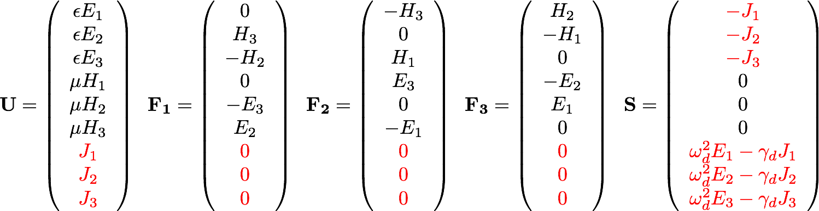
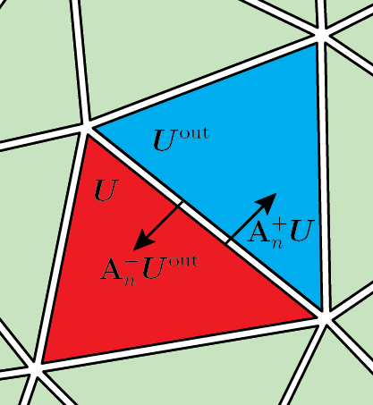

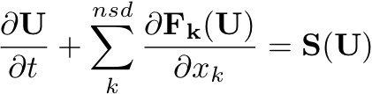
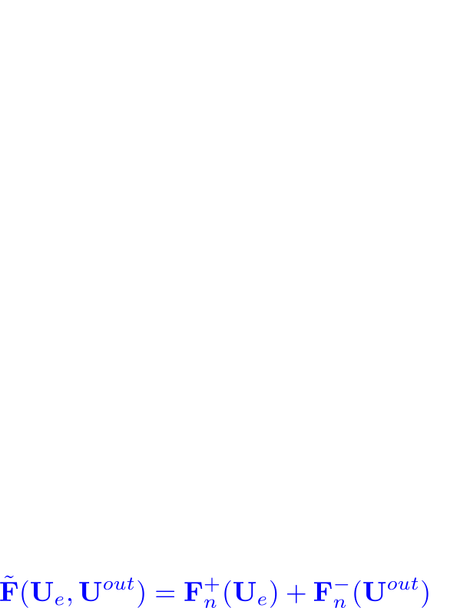
Governing equations
Mention that a dispersive material has maerial parameters which depend on frequency, mention. Say what the polarisation vector is, (very, very briefly) how it arises from material finite response time, is obtained directly from the drude model and outline the meaning of quantities omega and gamma (briefly). Mention how a transform to time domain results in a coupled ODE and show the final resulting total system.
Again, remove resonators please! Regarding the message that you have on the side. Can you show first U, F1,..F2, S for free-space and how this changes when a dispersive material is considered.
Things are not defined (what is E, H, J) The source that you have introduced is only valid for free-space, write the one for dielectrics instead
Maxwell’s curl equations in dimensionless conservation form:
We use Discontinuous Galerkin in space and explicit 4th order Runge-Kutta in time
By flux splitting we employ an upwind numerical flux
M is block diagonal
Weak form on each element
Why only curl/divergence eqtns?? Differential vs integral formulation? How do I handle BCs. Freq vs Time.
High order approx of soltn, capture boundries
Notes:
Why do we care about dispersive materials

Slide 5
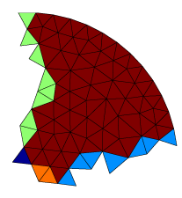
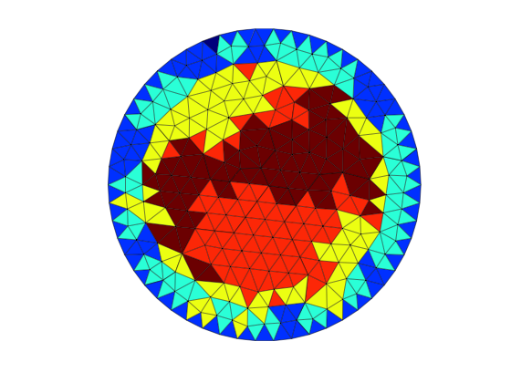
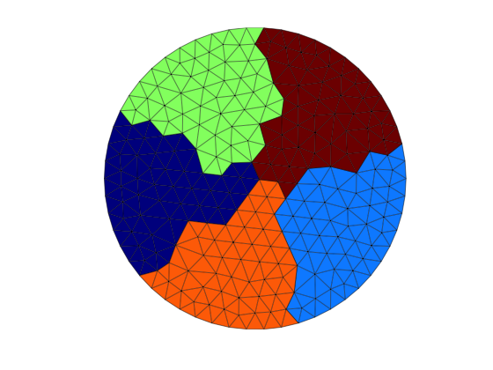
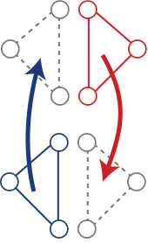
Parallelisation
Mention (very briefly) that we’ll see later that long times are necessary – justify the need for Parallelisation.
Bottom Left:
Talk about the issues of element ordering (contribution to face integral from gauss points need to be summed in the correct order so that numerical flux contributions are equal).
Bottom Right:
briefly mention the partitioning of X and T – and how data node coordinates are used and reordered to calculate faces integrals.
The first comment is adequate but must be linked to the fact that we use explicit time marching. I will ask you the following question next Thursday and in the conference if necessary: what if we want to use implicit? Can you transform the steps into a flowchart
Explicit time marching + weak form stated on each element = inherently parallel scheme
Read a part of mesh into each processor
Partition based on element numbering
use ParMetis
Minimised shared faces and communication
Advance solution in time
Update at each stage of the RK4
Rearrange elements
Duplicate interface elements
Create communication arrays
Notes:
Elemental matrices connected by Flux
except fo Num Flux – split up… but….connected → comms, how to minimise?
1 - …comms since comms expensive….lose advantge
2 – build up info that we need
3 – parmetis – equiv to min comms –each color goes to a processor – most of what we need except Num Flux
4 – Each processor also needs values of adjacent elements → get the elements from the graph → go off to assigned processors and ask where they’re going
4 – Send all of this information to destination processors → can now build a local data partition AND communications
5 – Advance…

Slide 6
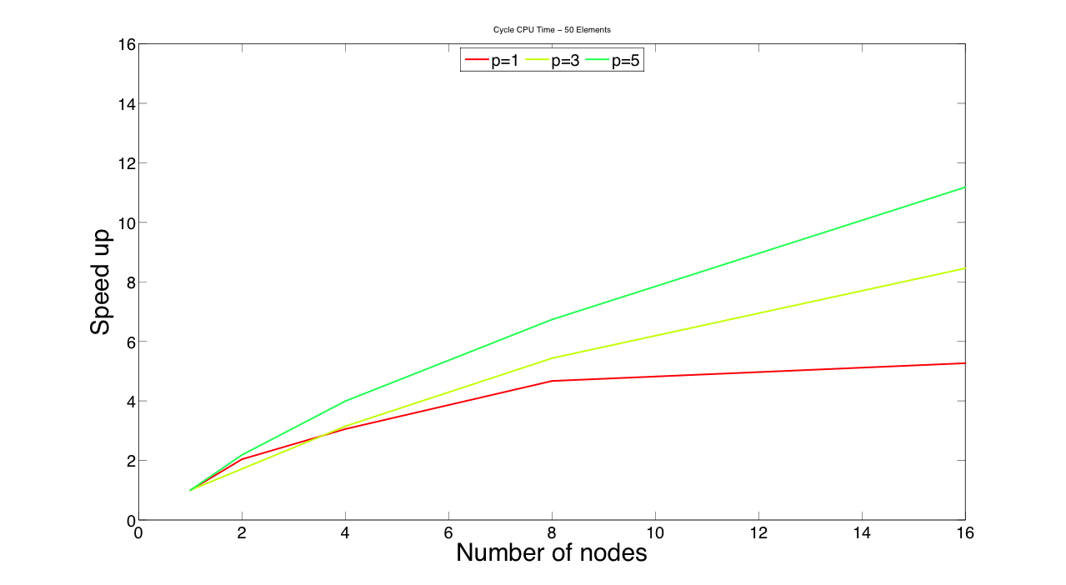
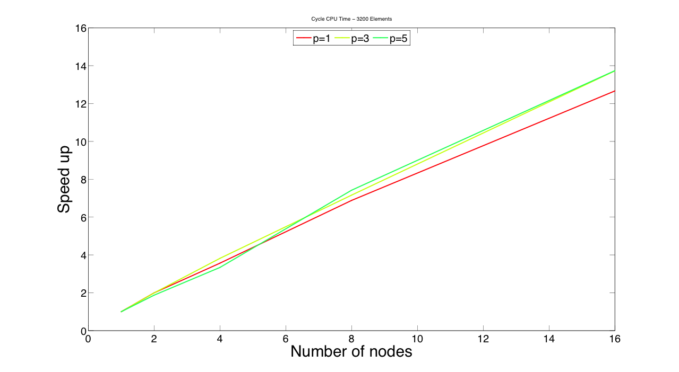
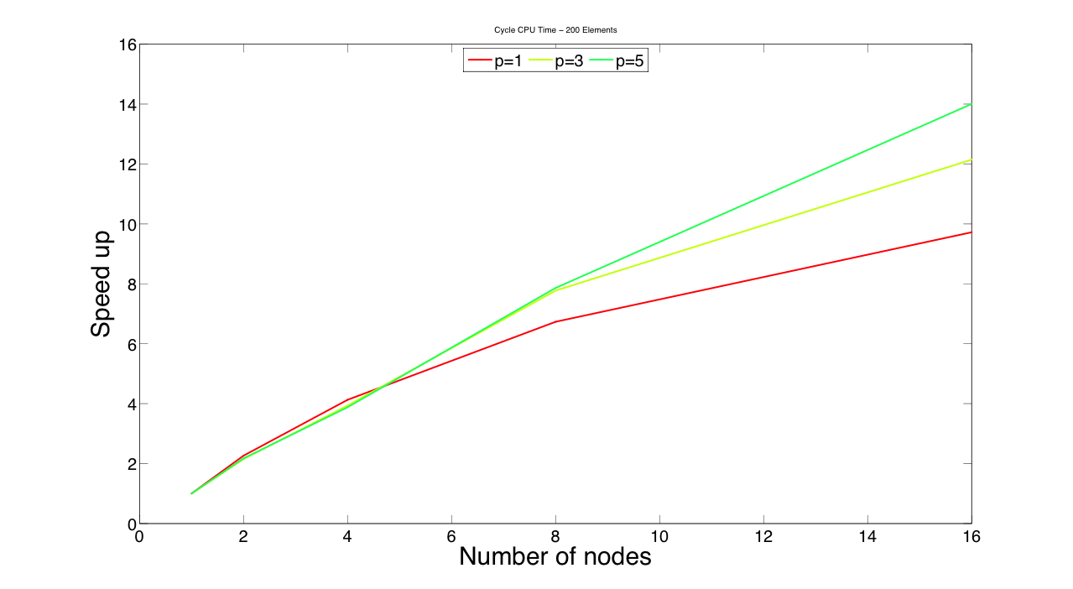
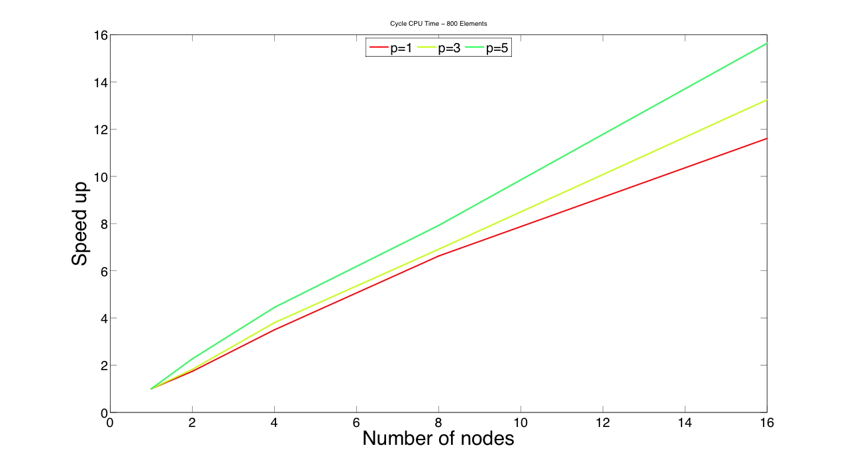
Speed Up: 2D Rectangular Cavity
50 Elements
200 Elements
800 Elements
3200 Elements

Slide 7
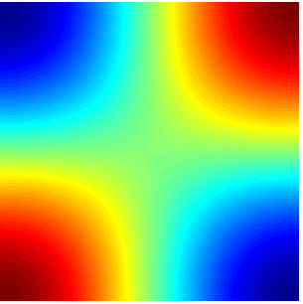
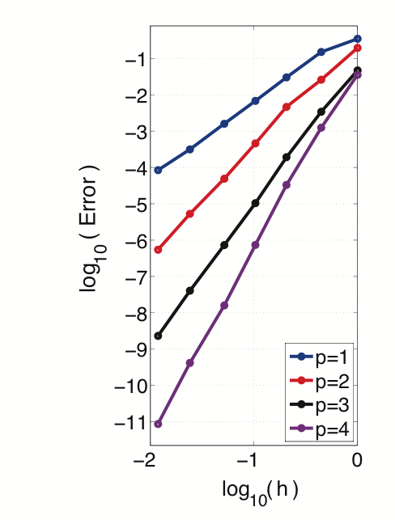
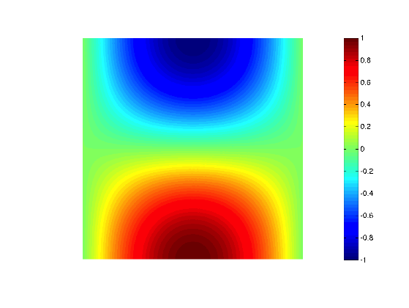
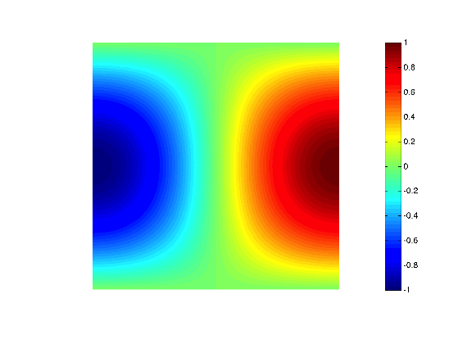
Time domain solution
Dispersive, unit length square 2D cavity
Filled with silver medium
Dirichlet boundary conditions
Unstructured triangular meshes
Optimal convergence of p + 1 achieved for all p and all components
E1:
E2:
E3:
Notes:
3488 elements

Slide 8
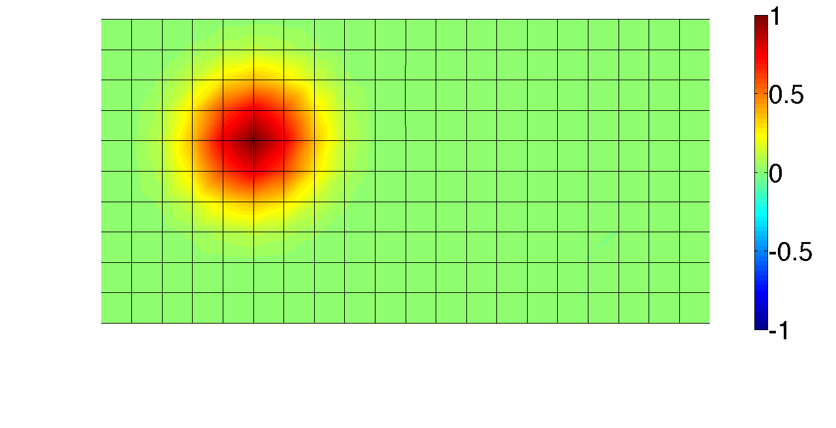
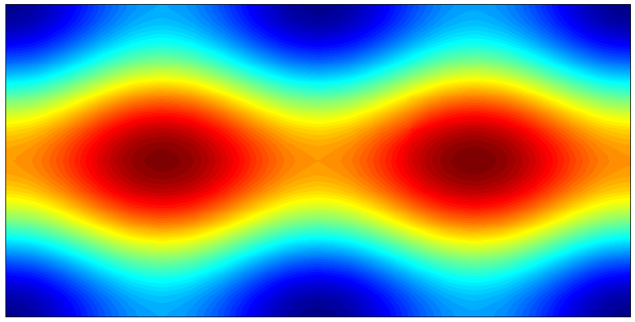
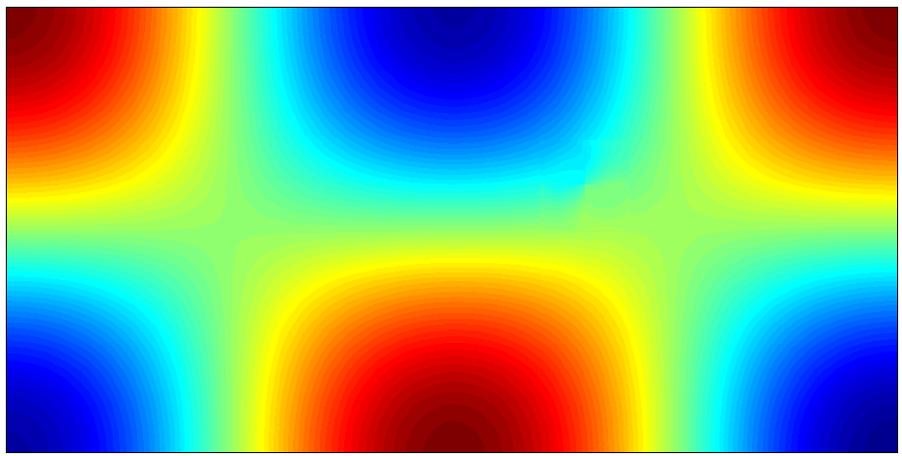
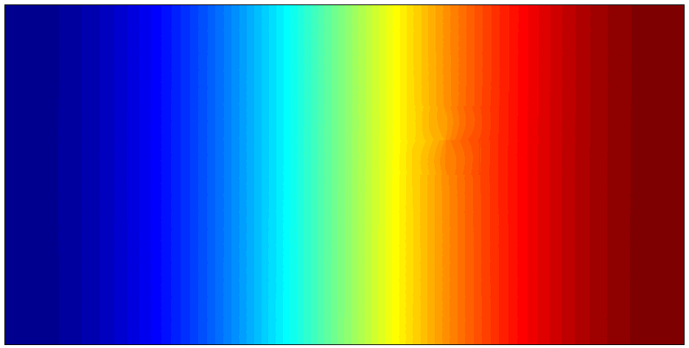
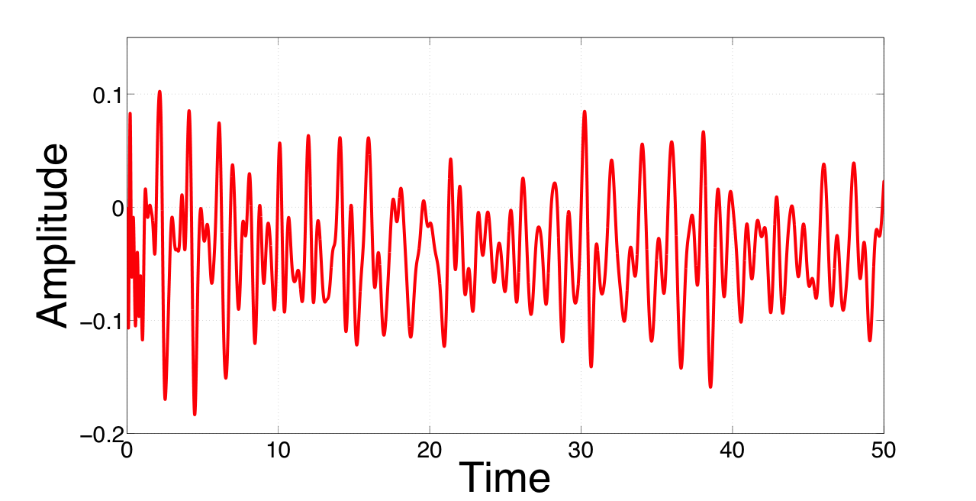
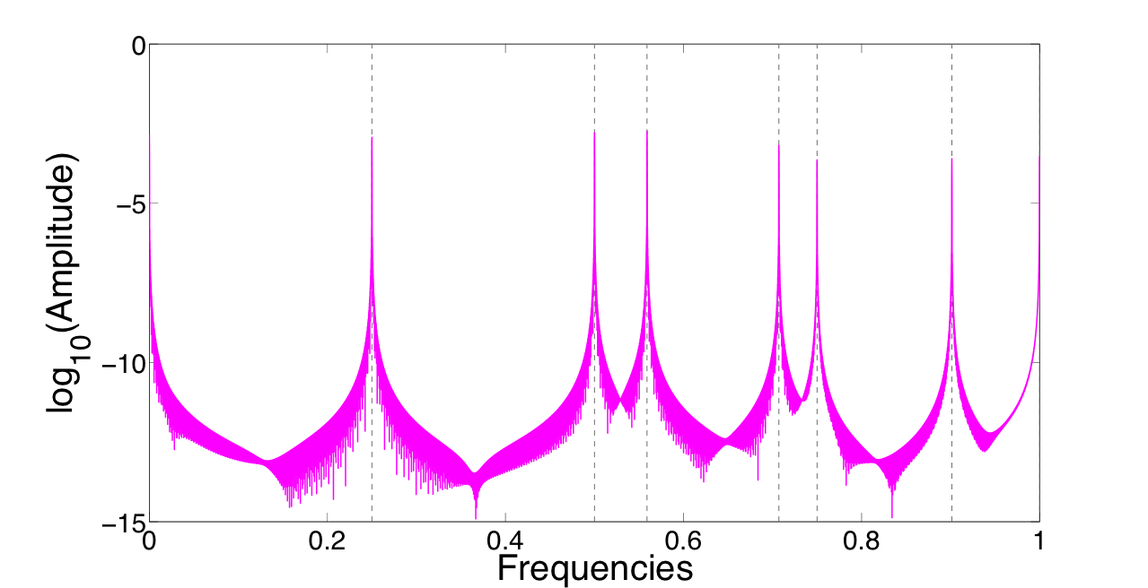
Computing resonant frequencies
Excite cavity with an initial condition at a selected point
Ensure point is not a symmetry point of the cavity
As an illustration I think you can just plot one component. If you can do a "smaller plot" (less range of frequencies) this might fit horizontally This will allow you to detail the steps on top and three figures on the bottom
Allow solution to evolve in time
Record value at a point at every timestep
Avoid symmetry points
Use Fast Fourier Transform to obtain frequency intensity spectrum
Broadband frequency response
Notes:
Replace with movie showing spectral refinement with period…
avoiding any symmetry points of the cavity.
Locate peaks of the spectrum which correspond to resonant frequencies of the cavities.
Blackman envelope

Slide 9
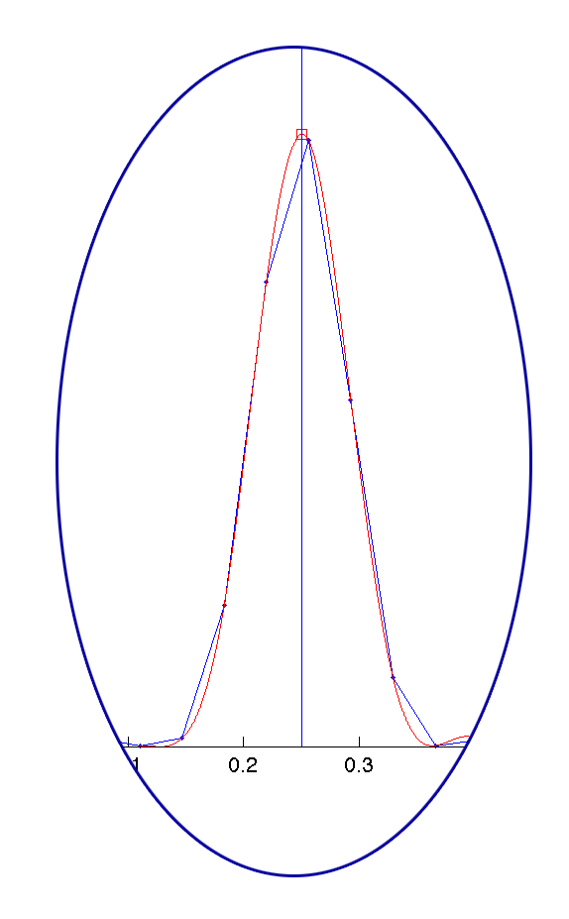
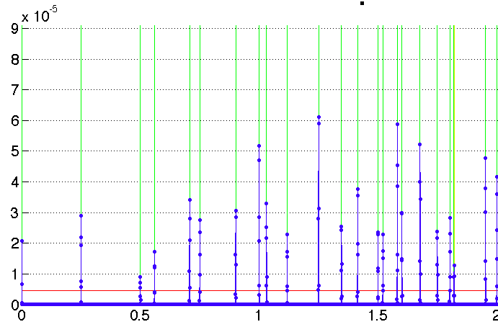
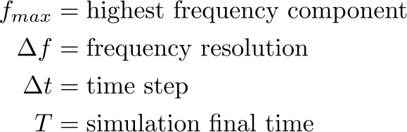
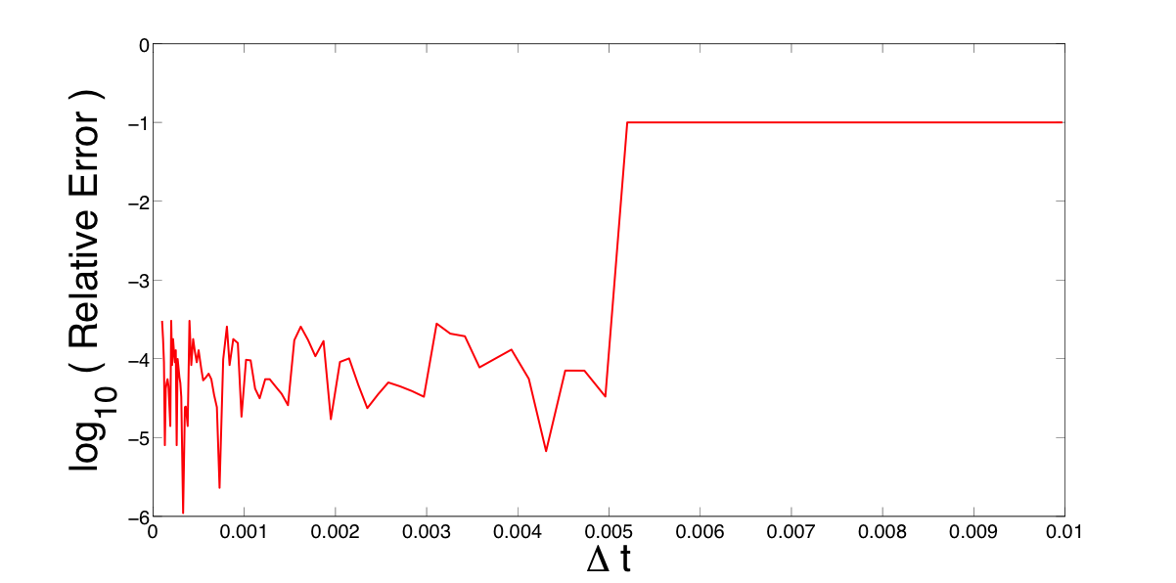
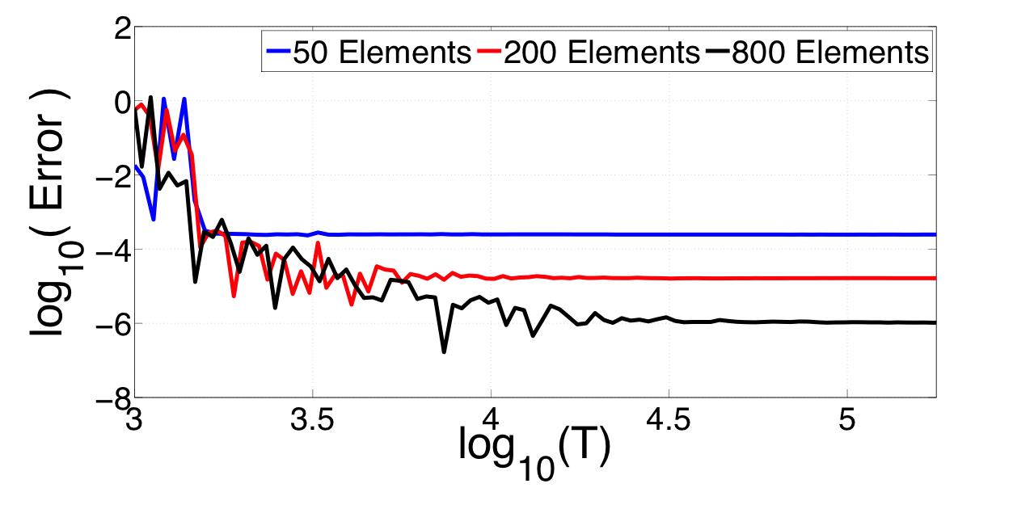
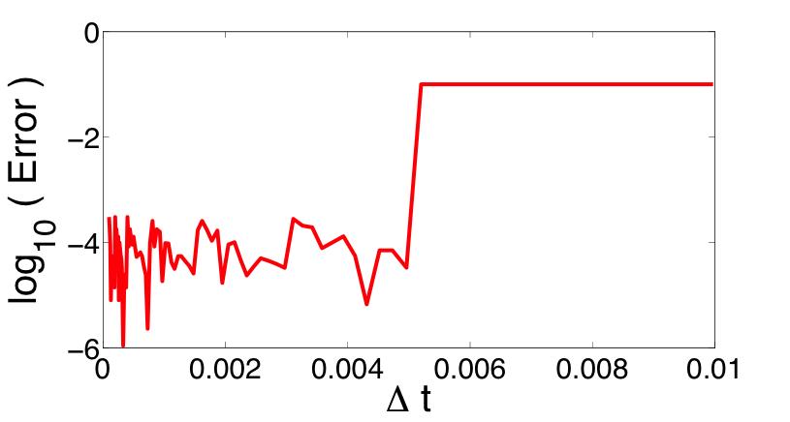
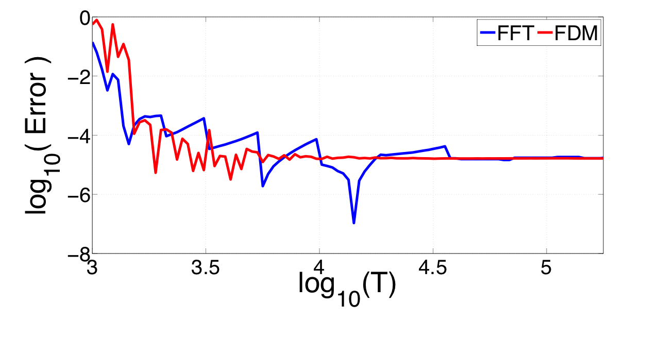


Frequency resolution and cut-off
Quality of spectrum affected by simulation run time and time step.
Discuss how accuracy is affected by final time. Mention how parallelisation helps achieve this.
Discuss FDM improvement – use the fitting of the FFT as (additional) motivation.
Frequency resolution:
Niquist-Shannon theorem:
You need to mention here the expressions of the paper explaining how the time domain parameters affect the resolution Then you demonstrate this with figures
Highest frequency depends on time step
Frequency resolution improves with T
Required time can be reduced by using parametric methods, such as the Filter Diagonalisation Method.
Notes:
Parametric method
Convergence of frequencies with meshes – talk about dispersion error dominating (not interpolation error)
Quality factor convergence
Talk about peak fitting FFT spectrum vs parameterized methods (FDM) => what are the issues with FFT – usefulness of FFT
Issues: Sources of error ( initial conditions, monitor points )
*** Read about excitation (point source, gaussian etc) *****

Slide 10
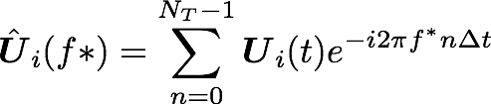
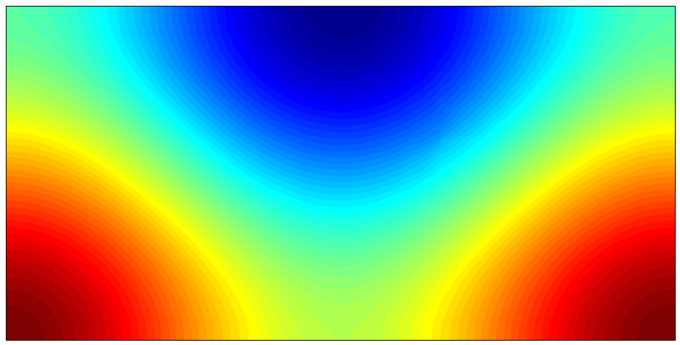
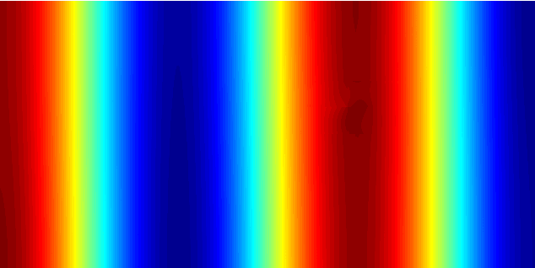
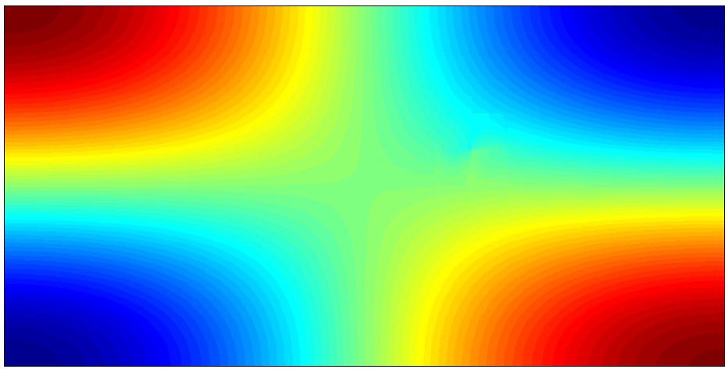
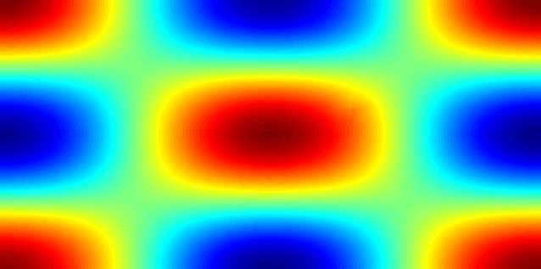
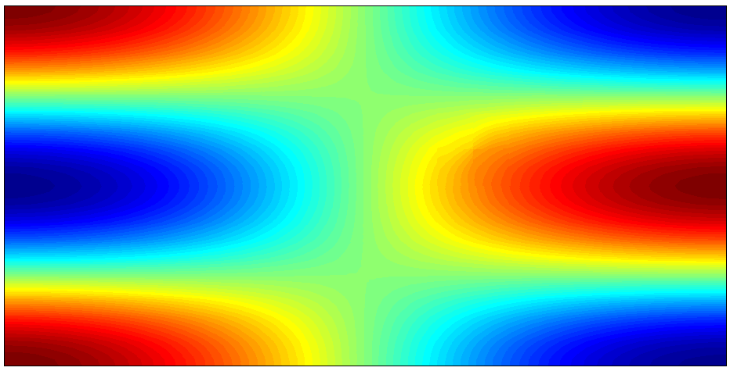
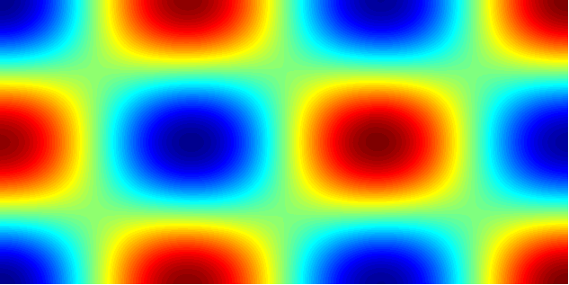
Obtaining mode shapes
Mode shapes are obtained by running the time domain solver with a built in Discrete Fourier Transform

Slide 11
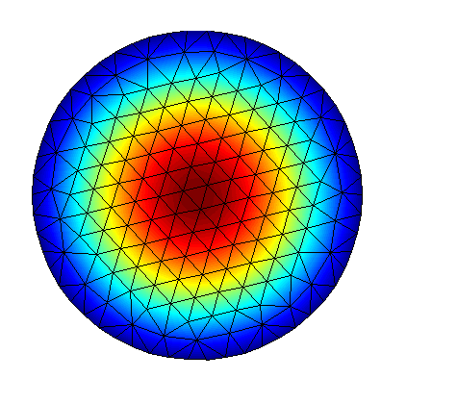
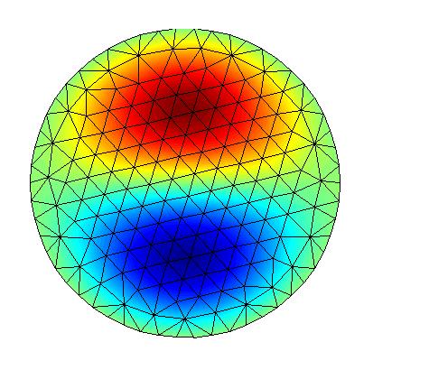
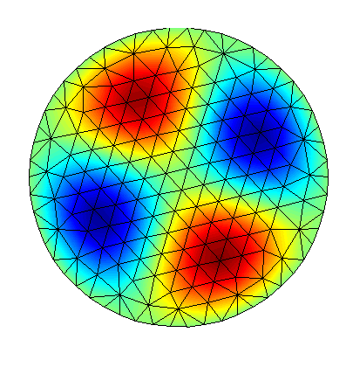
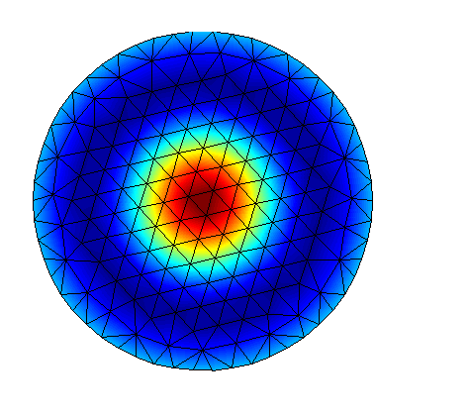
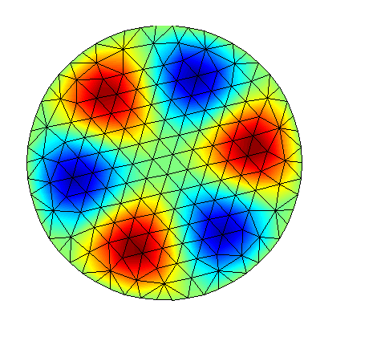
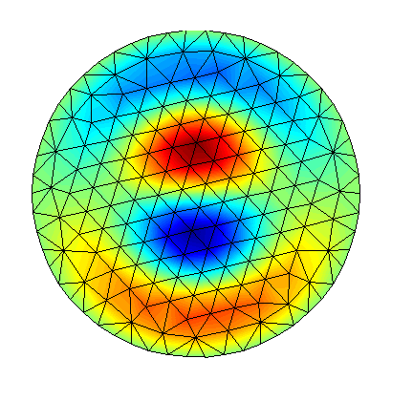
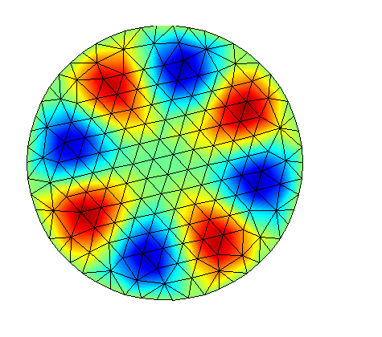
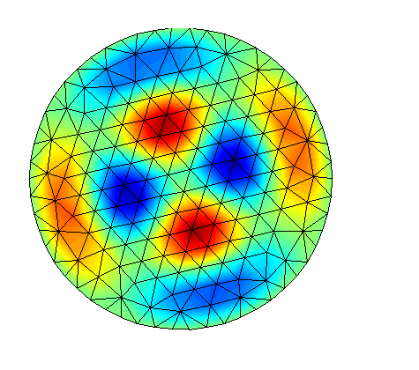
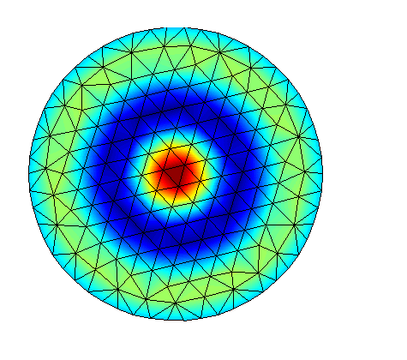
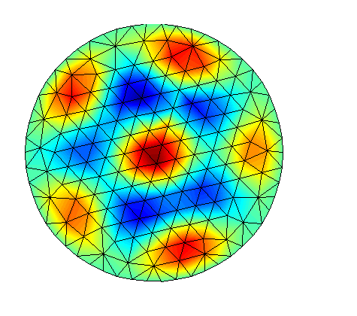
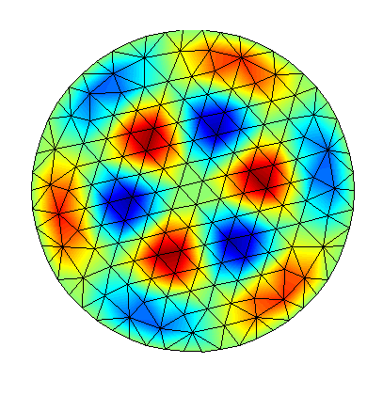
Numerical Example: 2D Circular Cavity
Free space
PEC boundaries
310 elements
Unit radius
Analytical Frequency | Log10(Error)
 | p1 | p2 | p3
0.382739 | 10^-3.4 | 10^-7.1 | 10^7.2
0.609834 | 10^-3.1 | 10^-6.6 | 10^7.8
0.878547 | 10^-2.9 | 10^-5.9 | 10^-7.8

Slide 12
Conclusions
Conclusions
Solution for dispersive media
Method for obtaining resonant frequencies and mode shapes
Validation for a simple test cases
Future Work and Objectives
Simulation of a real 3D dispersive cavities
Study effect of Nurb-Enhanced FEM to exactly represent boundary

