Slide 1
Module 7: Final Project
Modeling Home Prices Using Linear Regression
Author: Mark Godek

Slide 2
Introduction
Develop a linear regression model which can predict home prices based on several variables.
Explored data to determine suitability for linear regression modelling
Calculated coefficients of correlation
Top correlated variables were plotted to visualize the correlation
Explored skewness of the variables determine suitability for log transformation
Missing data was imputed or filled in with NAs
Continuous variables with an exponential trends log transformed
Three models were created and compared.
A model with log transformations
A model without log transformations
A model of “best-guess” variables
The model with the highest R^2 value for a training dataset was selected and applied to a test dataset.
*Please add slides as required.

Slide 3
The Data
Data imported from a file and stored in a variable
Head of the data printed ensure it was properly read
Data contained 100 observations of home sales with 82 variables of each home
*Please add slides as required.

Slide 4
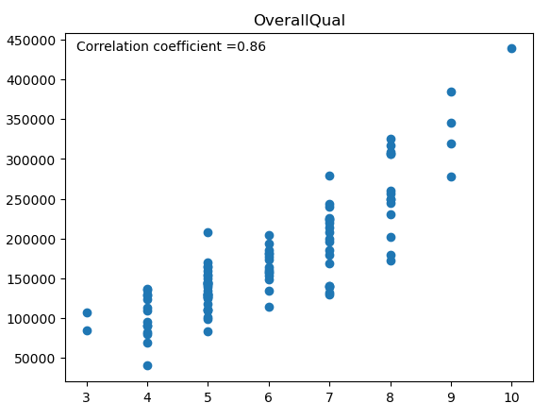
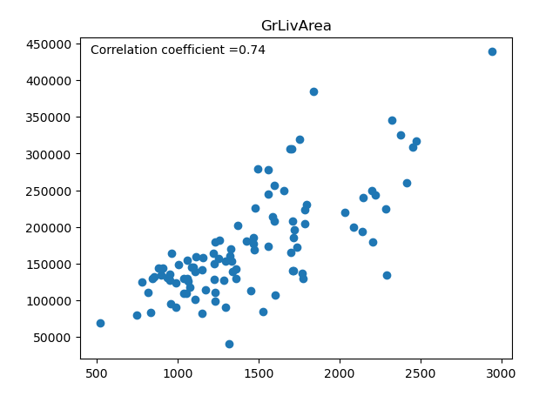
Data Exploration
OverallQual and GrLivArea were the variables most correlated to SalePrice.
OverallQual is a quality score of the home from 1 to 10.
GrLivArea is the above grade living area in square feet.
*Please add slides as required.

Slide 5
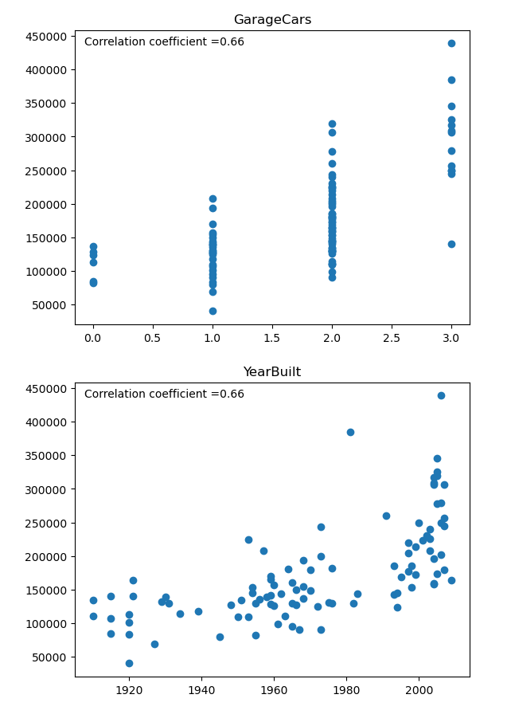
Data Exploration
GarageCars and YearBuilt were also highly correlated.
They indicate the number of cars the garage fits and the year the home was built, respectively.
*Please add slides as required.

Slide 6
Data Preparation
Columns containing null values were noted and nulls were counted
If all homes were missing a value like PoolArea, the column was dropped.
Year the home was built was used as a proxy for year the garage was built.
A ratio of frontage and lot area was used to impute missing lot frontages based on lot area.
*Please add slides as required.

Slide 7
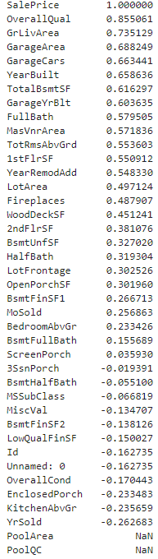
Correlation
Correlation
Correlation helped decide which columns to include in the model

Slide 8
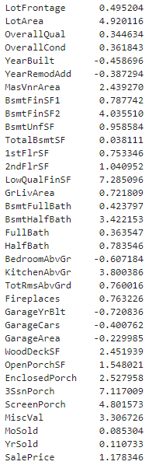

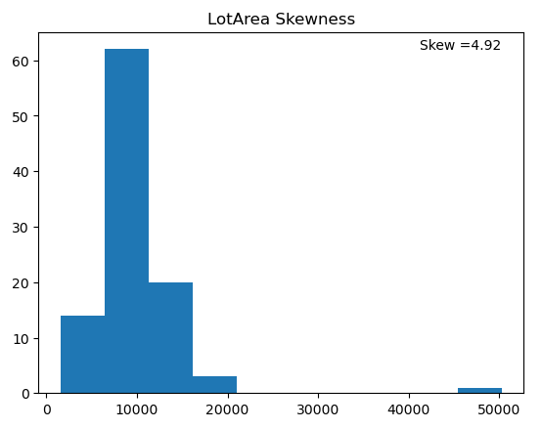
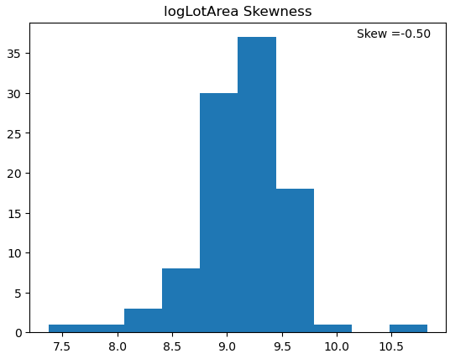
Correlation
Reduction in skewness between normal and log-transformed skewness helped decide which columns to log-transform
Skewness
Normal Log-transformed

Slide 9
Project Description
A linear regression algorithm was used to make predictions from the data.
A version of the model was used which log-transformed some of the data so it’s exponential contribution would become more linear, hence suitable for linear regression.
This data was suitable for linear regression because it fit most of the assumptions necessary for the algorithm to be appropriate for analysis:
Continuous variables
Linear relationship between the variables
No dependency between the variables, the are independent of each other
No significant outliers
Homoscedasticity - variances along the best-fit linear-regression line remain similar all through that line
Residual errors of the best-fit regression follow a normal distribution
*Please add slides as required.

Slide 10
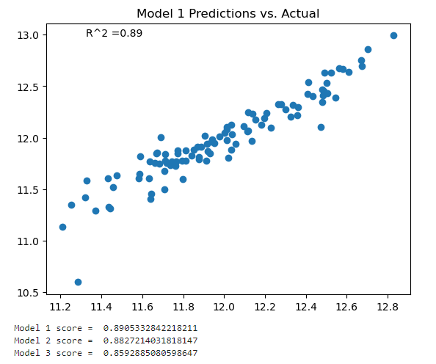
Analysis and Results
The variables chosen for the model were the 16 most correlated. Using more than 16 variables lead to diminishing returns and overfitting of the model.
*Please add slides as required.

Slide 11
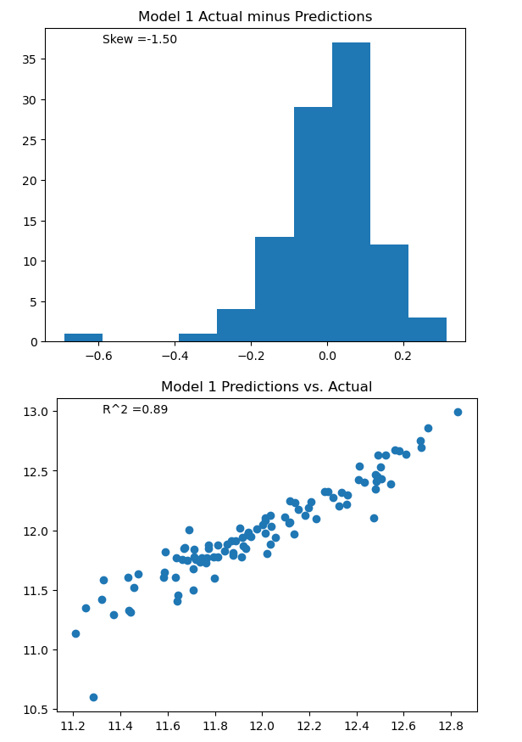
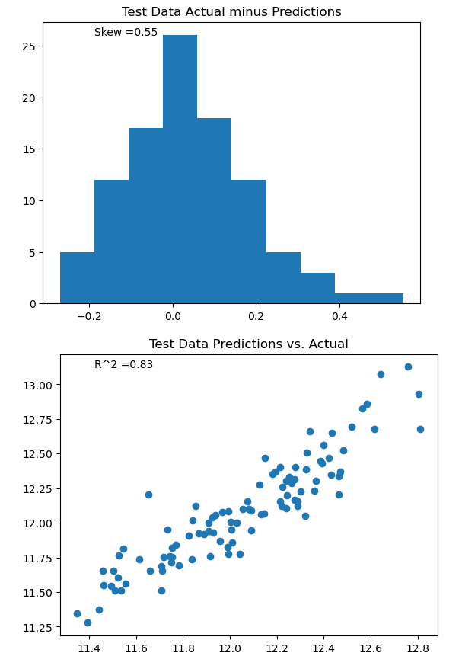
Verification
The model was very successful in predicting home prices of the test data.
The skewness of the result was much lower and the coefficient of determination (R^2) was relatively similar.
*Please add slides as required.

Slide 12
Conclusion
I was able to create a linear regression model which could use the independent variables to explain 0.83 of the dependent variable.
Transforming and restricting the number of variables improved the model.
I struggled a bit at the end, but I learned a lot about the applications and troubleshooting of transformed data. If you are attempting to fit variables which are exponential, taking their log converts them to a linear trend which improves linear regression models. In the event you use transformed data to build your model, you will need to transform the data before inputting data to generate predictions.
*Please add slides as required.

Slide 13
References
IBM. "What is linear regression?" What is linear regression? | IBM. July 2, 2024. https://www.ibm.com/topics/linear-regression .
jezrael. "df.drop if it exists." Stack Exchange. June 29, 2024. https://stackoverflow.com/questions/59116716/df-drop-if-it-exists .-
Shpaner, Leon. "Adding correlation coefficient to a seaborn scatter plot." Stack Exchange. June 29, 2024. https://stackoverflow.com/questions/70759369/adding-correlation-coefficient-to-a-seaborn-scatter-plot .
"Linear Regression." Introduction to Linear Regression | Solutions | DTREG. DTREG predictive modeling software. July 2, 2024. https://www.dtreg.com/solution/linear-regression#:~:text=Linear%20regression%20is%20the%20oldest,from%20Legendre's%20term%2C%20moindres%20carr%C3%A9s .
*Please add slides as required.

