Slide 1
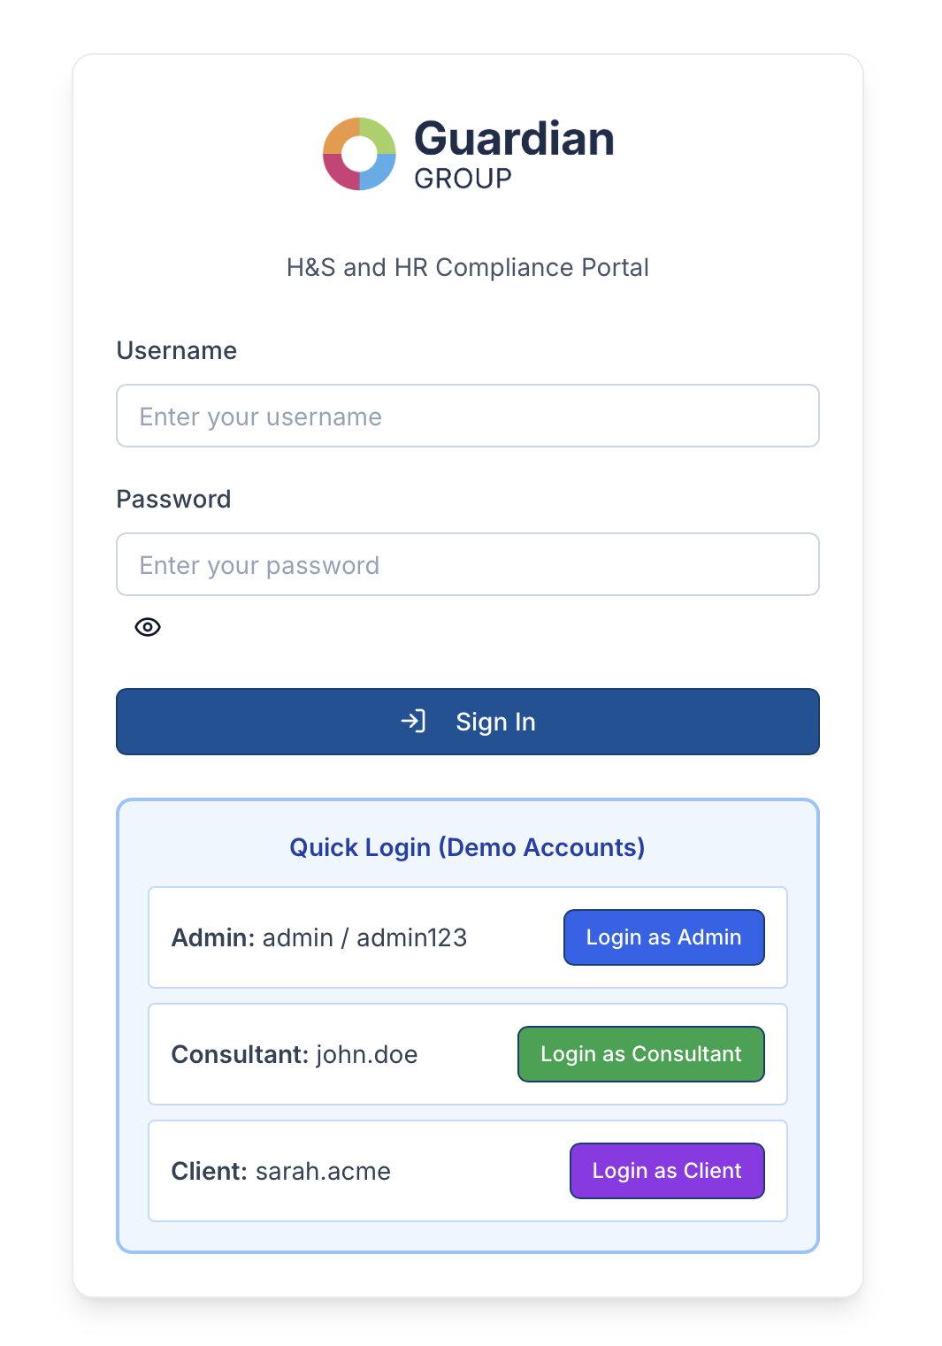
Guardian Group Compliance Portal

Slide 2
Contents
What is the portal
Why does it have value
How does it work
API Integrations – Accelo
Security
Where can it go
AI Automations

Slide 3
What is the portal?
Guardian Group Compliance Portal
A centralised digital platform for managing Health & Safety and HR/Employment Law compliance across multiple client sites.
It replaces SharePoint, scattered spreadsheets, emails, and paper trails with a single, secure system.
Core Capabilities
Document Management
Training Library
Multi-Site Management
Compliance Dashboard
Audit Trail

Slide 4
Why does it have value?
Pain Point | Solution
Documents scattered | Single source of truth
No visibility on compliance status | Compliance dashboard / overdue metrics
Clients can’t find documents | Self service portal 24/7
Consultants managing spreadsheets | Streamlined workflow per site
Security and GDPR concerns | Enterprise security with encrypted data, audit logs
AI automations hard to scale / streamline | Single portal with huge AI potential
Core Business Benefits
Reduces admin time
Improves client retention
Scales efficiently
Competitive edge
AI ready

Slide 5
How does it work?
For Clients:
Log in → See their sites and compliance status
Access documents → Download, review, request updates
Browse training → Request info or book courses
Get support → Submit tickets directly in the portal
For Consultants:
Assigned to specific client sites
Upload documents from template library
Track compliance and renewals
Respond to client requests
For Admins:
Create companies and sites
Manage users and permissions
Maintain document template library
Oversee training content
CURRENT STATUS
✅ Core platform built and functional
✅ Role-based access (Admin/Consultant/Client)
✅ Document and training management
✅ Multi-module (H&S, HR, Employment Law)
✅ Enterprise security foundation

Slide 6
API Integrations - Accelo
From Accelo | To Portal
Companies/Accounts | Companies in portal
Contacts | Client Users
Projects | Could link to sites
Possible integration features:
Sync companies
Create support tickets
Activity logging
Contact sync
From Portal | To Accelo
Support requests | Create tickets/request
Compliance Status | Update Co notes
Document Approvals | Log as activities

Slide 7
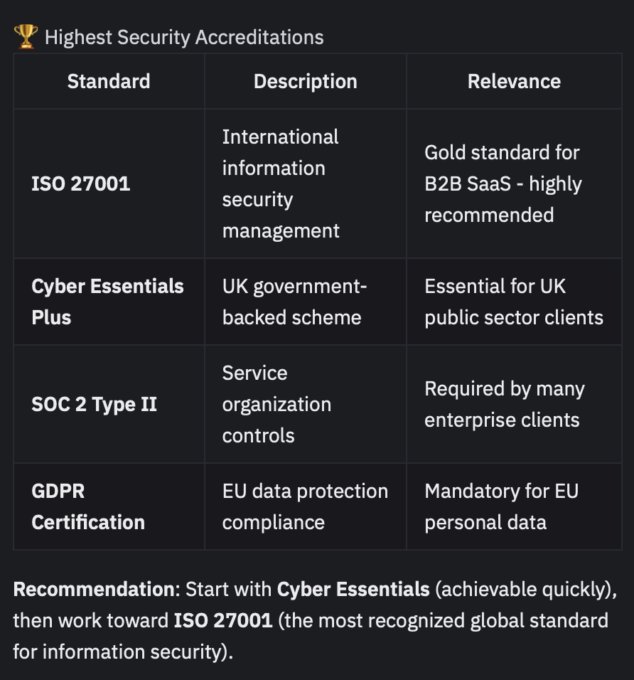
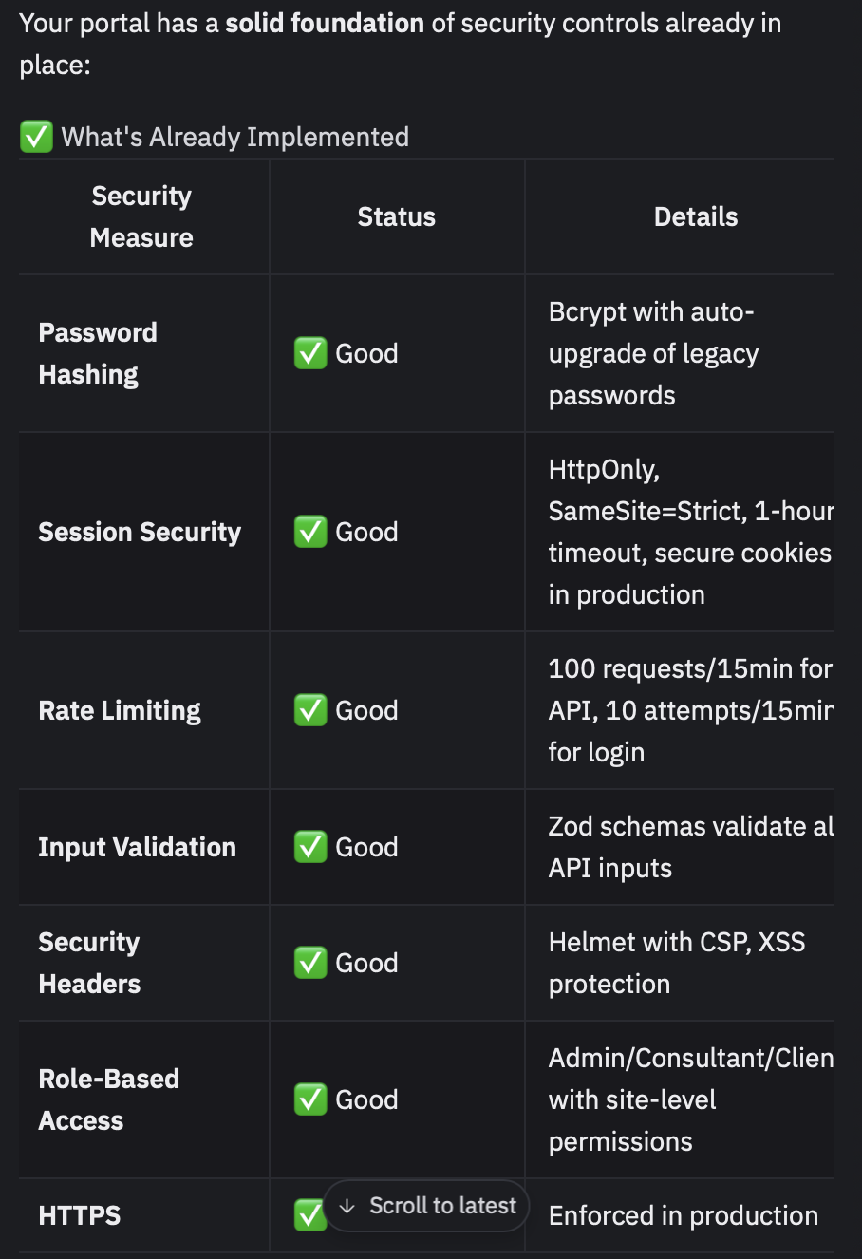
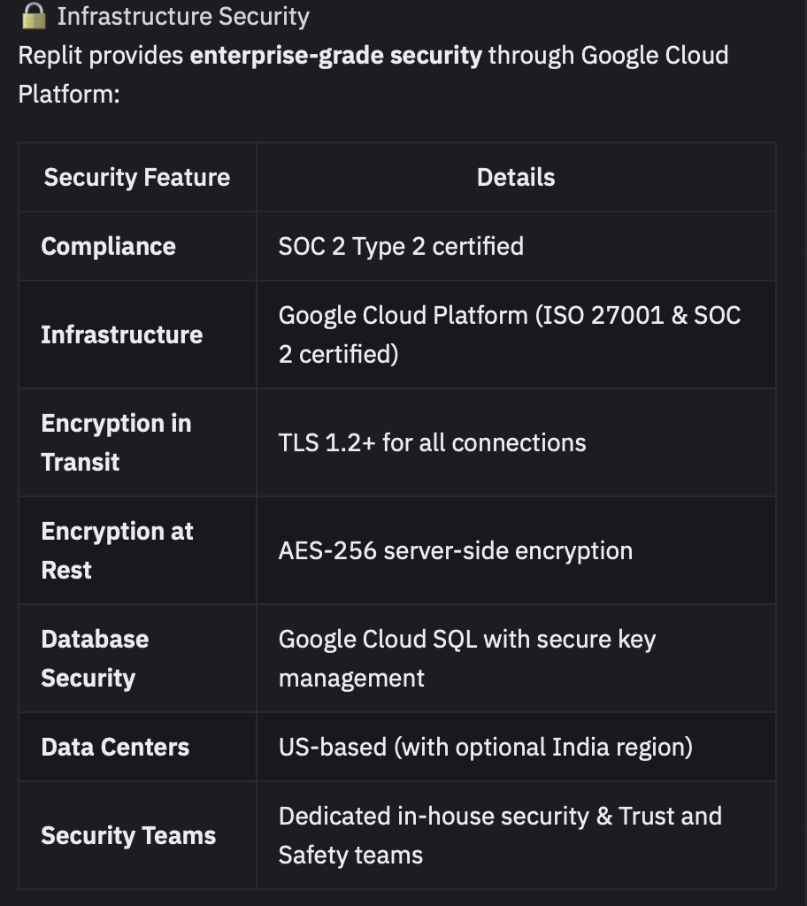
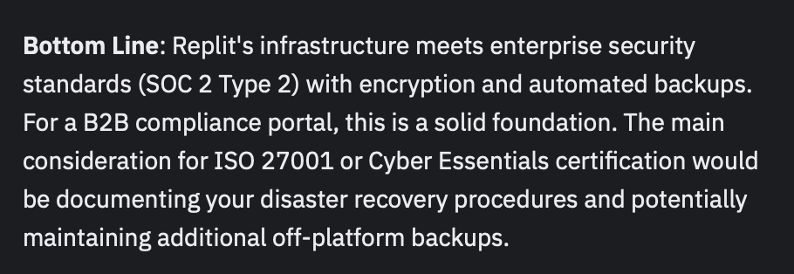
Security

Slide 8
Where can it could go?
AI-Powered Compliance Platform Vision
With AI integration, the portal transforms from a document management tool, into an intelligent compliance partner.

Slide 9
AI Automations
Document & Content Assistance
AI Document Drafting - Generate first drafts of documents based on templates and site-specific data
Document Summarisation - Automatically summarise lengthy compliance documents for quick review
Smart Search - Natural language search across all documents ("Show me fire safety policies updated in the last 6 months")
Compliance Intelligence
Gap Analysis - Analyze a site's documents against requirements and highlight missing or outdated items
Training Recommendations - Suggest relevant training courses based on a site's compliance gaps or industry type
Risk Prioritisation - Help identify and rank risks based on document analysis and site characteristics
Client Support
AI Chatbot - Answer common client questions about compliance requirements, document status, or training
Smart Notifications - Intelligent reminders that consider workload and prioritise urgent renewals
Consultant Productivity
Auto-tagging - Automatically categorise and tag uploaded documents
Meeting/Audit Prep - Generate site compliance summaries before client meetings or audits

