Slide 1
DATABRX: Defending Health with AI-Driven Drug Surveillance
Team: DatabRx

Slide 2


Slide 3



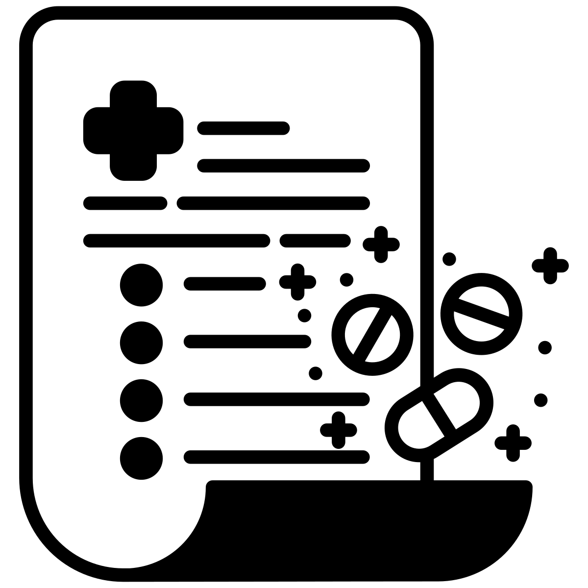


Problem Statement
Wicked Hard Problem
Aged
Population
​
Medical
Practioners
Chronic Illness
Non-Coordinated
Prescriptions

Slide 4



Problem Statement
Adverse Drug Events - Stats
​
20,822,030
Incidents
1,777,982
Deaths
8,065,433
Serious Incidents

Slide 5




Problem Statement
Adverse Drug Events – Hard Problem

Slide 6
Problem Statement
Adverse Drug Event – Hard Problem
Non coordinated Prescription
Scattered Unstrcutured Data
Clinical Reasoning
Polypharmacy in aged population is an issue as its results in multiple prescriptions that are not in sync, thereby prescribing medicines that could cause ADE.
A lot of health and life sciences data is digitised, but it’s scattered and unstructured.
There’s a lack of coordination among health practioners
With increasing population, it’s getting complicated to sync and reason with data.
Data driven infromed clinicial decision making is paramount in success of a medical procedure.
The decision needs to be derived from disparate sources and actionable insight for a patient’s health care should be readily available.

Slide 7
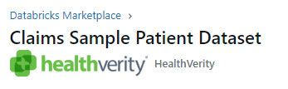


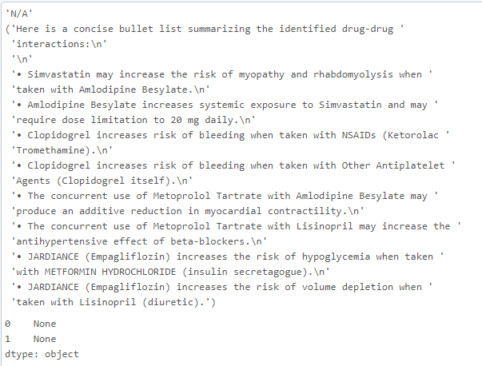
Solution Overview
Databrx LLM
Marketplace
Data
Enrich & Ingest
Fetch Drug-Drug
Interaction
Provide recommendation
On Drug interaction
Llama

Slide 8
Demo

Slide 9
Benefits
GenAI defending health
Early detection: identify potential ADEs before they manifest clinically.
Personalized Risk Assessment: Gen AI can assess risk factors for ADE unique to each patient
Cost savings: Minimizing hospitalization, ED visit, expensive interventions
Enhanced Pharmacovigilance: Analyse health data and identify emerging trends, thereby facilitating effective pharmacovigilance.
Patient empowerment: Patients can take proactive approach to prevent ADE by providing them recommendation for safe medicine use.

Slide 10
Future Directions
Enrich patient health record with pharmacogenomics dataset
Include data with ongoing research and findings especially for chronic diseases
Provide a platform for doctors to visualise the ongoing drug usage of a patient, and impact of introduction of new drug
Preventative health care at finger tips for everyone

Slide 11
QUESTIONS?

