Slide 1
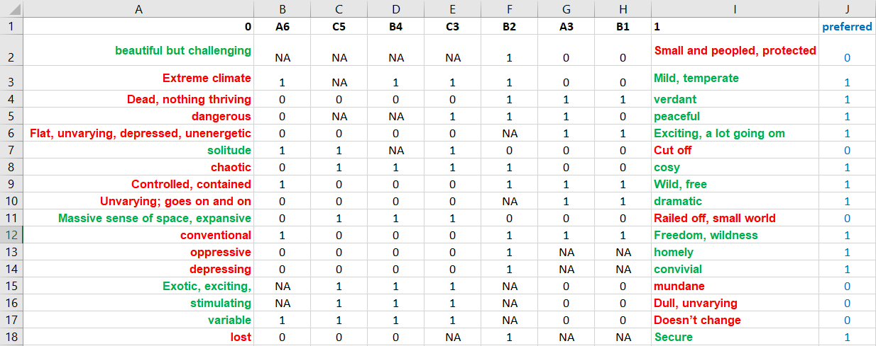
0 = left pole
Element names
1 = right pole
Labels of left poles
Valid ratings:
0 = left pole applies
1 = right pole applies
NA = missing value
Column indicating the „preferred“ pole of the construct:
0 = left pole is preferred
1 = right pole is preferred

