Slide 1
ph_with.character()
The body

Slide 2
ph_with.numeric()
1
2
3

Slide 3
ph_with.numeric()
1,000
2,000
3,000

Slide 4
ph_with.factor()
a
b
c

Slide 5
ph_with.Date()
08/11/26

Slide 6
ph_with.fpar()
text for first page header

Slide 7
ph_with.block_list()
text for first page header
text for first page header

Slide 8
ph_with.unordered_list()
Level1
Level2
Level1

Slide 9
ph_with.empty_content()

Slide 10
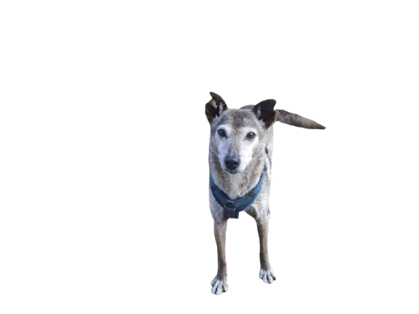
ph_with.external_img()

Slide 11
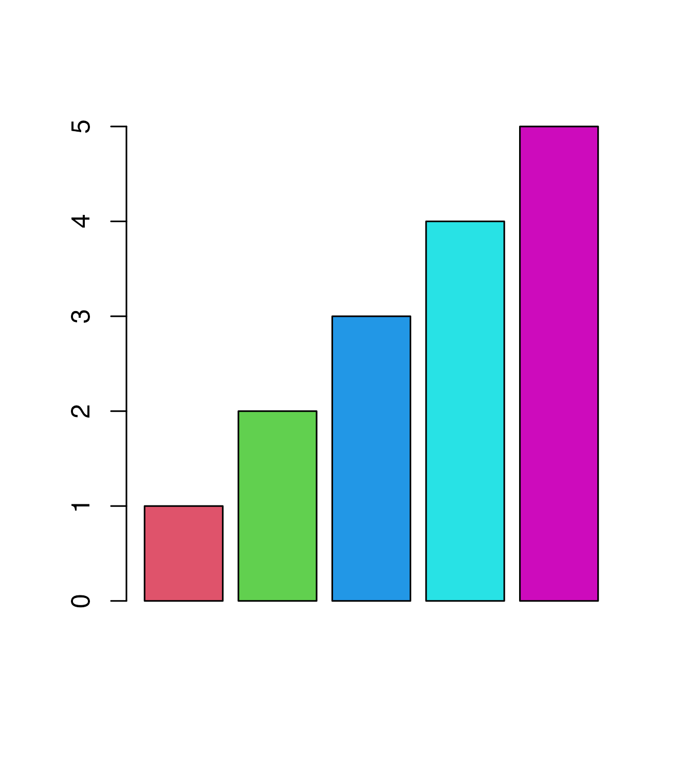
ph_with.plot_instr()

Slide 12
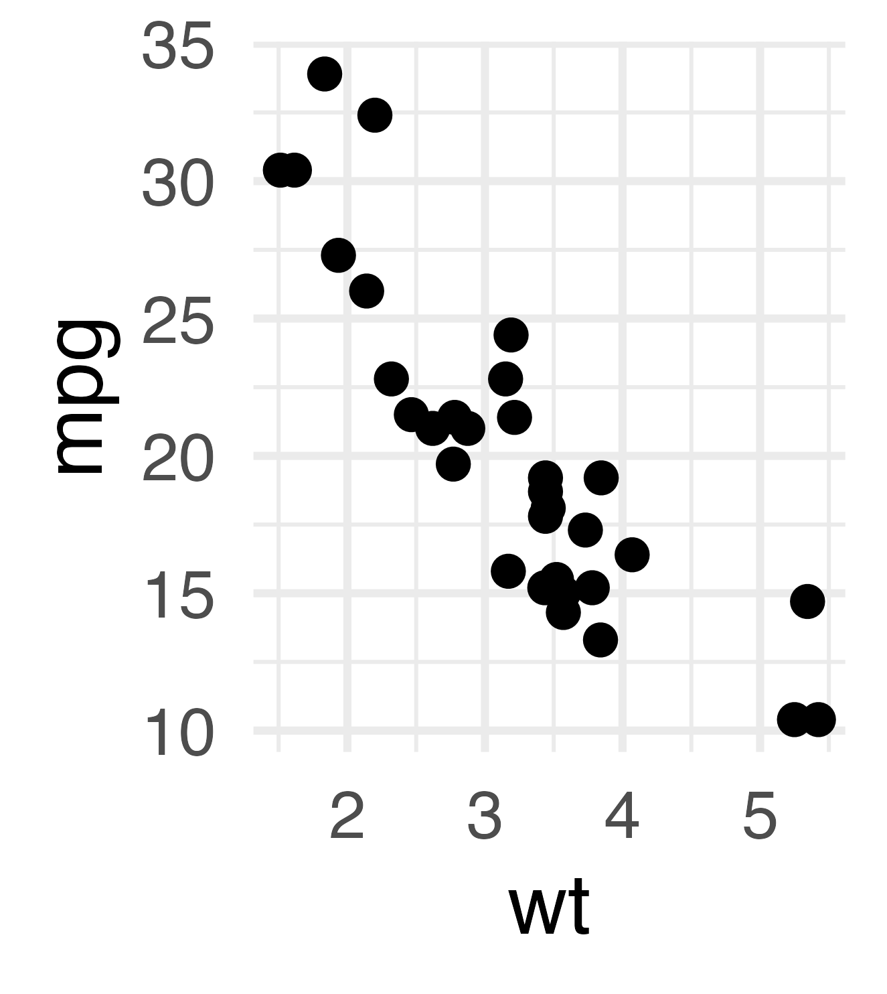
ph_with.gg()

Slide 13
ph_with.data.frame()
mpg | cyl | disp | hp | drat | wt | qsec | vs | am | gear | carb
21.0 | 6 | 160 | 110 | 3.90 | 2.620 | 16.46 | 0 | 1 | 4 | 4
21.0 | 6 | 160 | 110 | 3.90 | 2.875 | 17.02 | 0 | 1 | 4 | 4
22.8 | 4 | 108 | 93 | 3.85 | 2.320 | 18.61 | 1 | 1 | 4 | 1

