Slide 1
Box 5.1
Box 5.2.1
Box 1
Box 2
Box 5.2.2
Box 3.1
Box 3.2
Box 4.1
Box 4.2

Slide 2
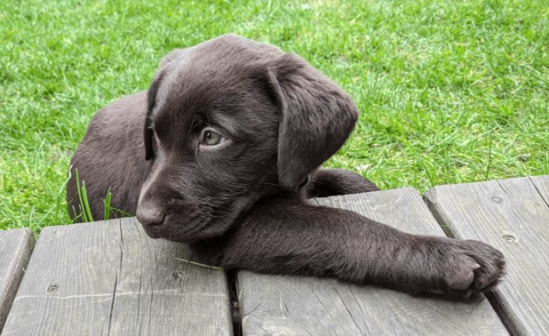


Slide 3
C1 | C2 | C3
1 | 2 | 3
4 | 5 | 6
C1 | C2
1 | 2
3 | 4
C1 | C2
1 | 2
3 | 4

