Slide 1
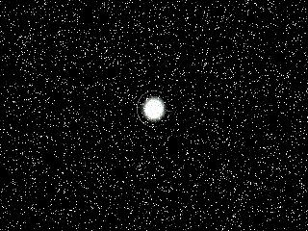

Slide 2
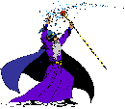
Number Wizard

Slide 3

The Wizard wants to make a magic 8 spell, but he needs help counting his ingredients- Can you help him?

Slide 4
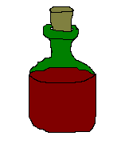
5 bottles of bat juice- how many more to make 8?

Slide 5
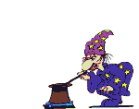

Oh dear…Try again!

Slide 6


Well Done!

Slide 7

3 spoons of cough medicine- how many more to make 8?

Slide 8
Oh dear…Try again!

Slide 9

Well Done!

Slide 10



4 snakes-how many more to make 8?

Slide 11
Oh dear…Try again!

Slide 12

Well Done!

Slide 13


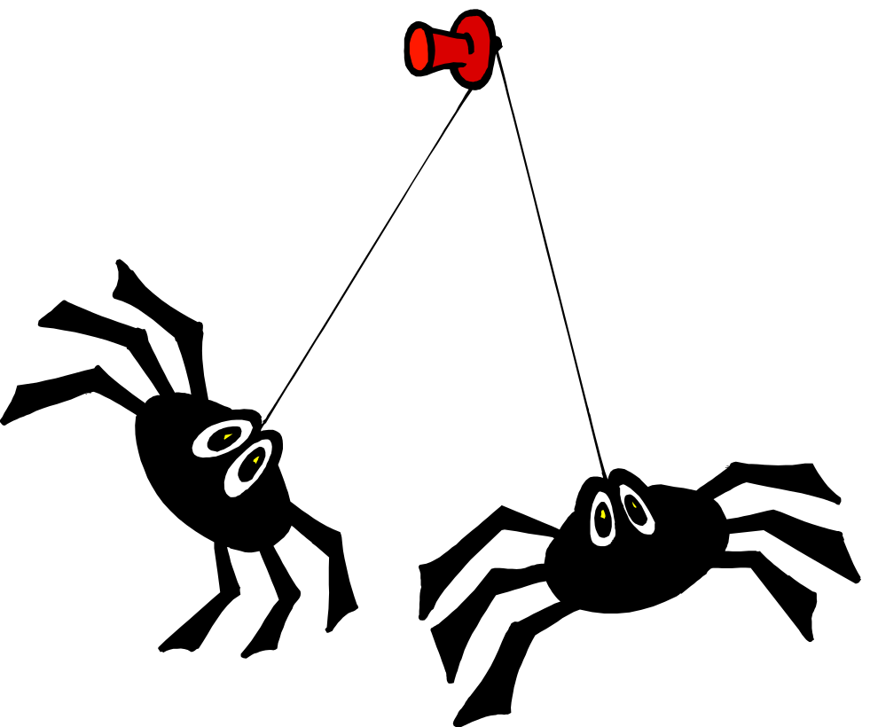

There are 2 spiders, the Wizard needs 8 for his potion, how many more does he need to find?

Slide 14
Oh dear…Try again!

Slide 15

Well Done!

Slide 16

Well Done! You have helped the Wizard make his potion!

