Slide 1
Least-Squares Track Fitter
Uses Levenberg-Marquardt algorithm from GNU Scientific Library (in turn, taken from MINPACK)
Works with FDC hits, CDC hits, or any combination
Current status: Unweighted fit (assume equal measurement errors)
Track parameters:
  Total inverse momentum: 1/p
  Polar angle: theta
  Azimuthal angle: phi
  Transverse distance of point of closest approach to beamline: x'0
  Z of point of closest approach to beamline: z0

Slide 2
Monte Carlo Data Sample
Thank you Simon
Positive pions
P = 2.0 GeV/c
Uniform in theta and phi
Fixed starting point:
  X'0 = 0
  z0 = 65 cm
100,000 events generated

Slide 3
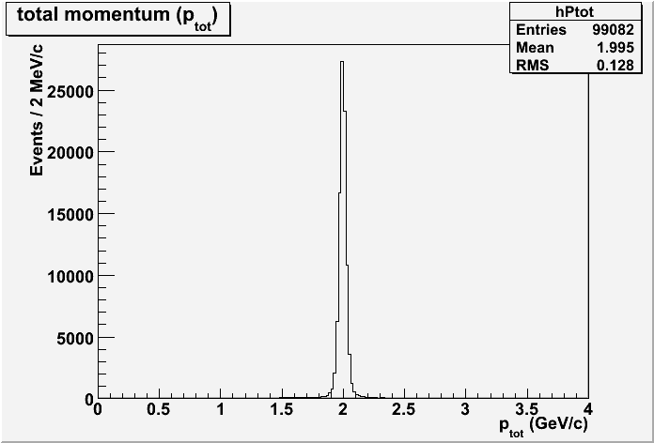
Total momentum

Slide 4
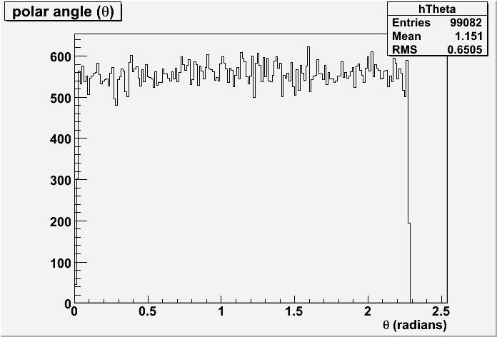
Polar angle

Slide 5
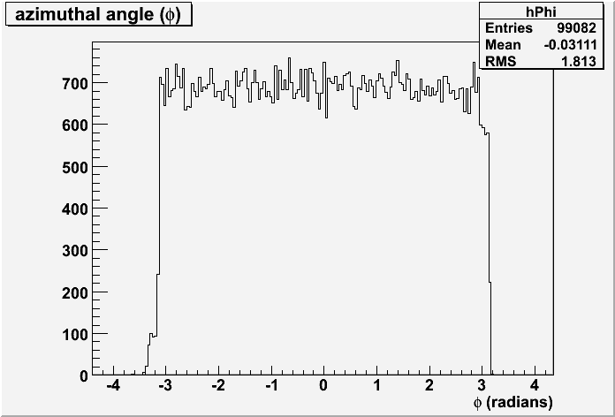
Azimuthal angle

Slide 6
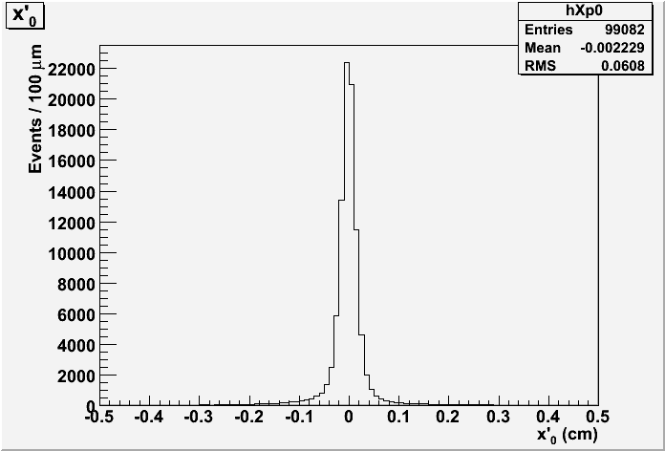
Transverse distance near beamline

Slide 7
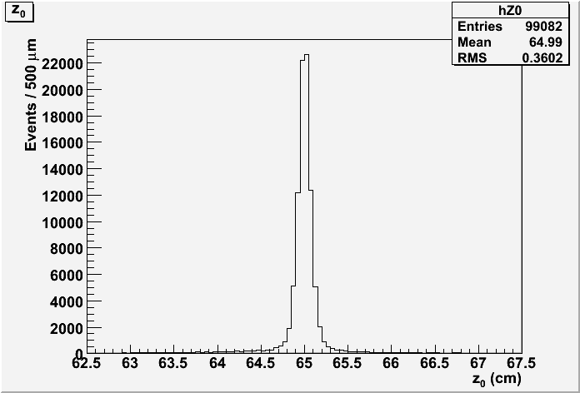
Z-position near beamline

Slide 8
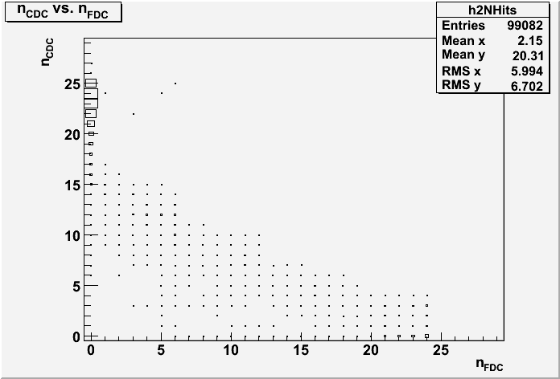
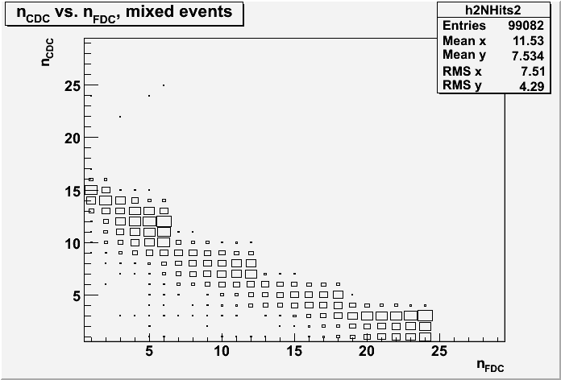
n_CDC vs. n_FDC
All events
Supress events where n_FDC = 0 or n_CDC = 0

Slide 9
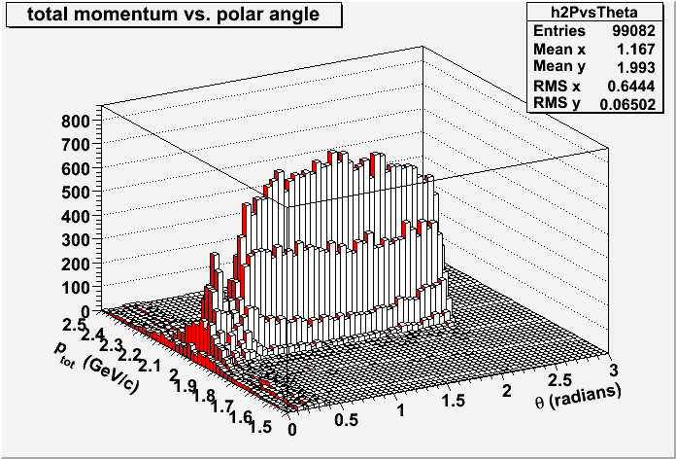
Momentum vs. polar angle
Camel humps!

Slide 10
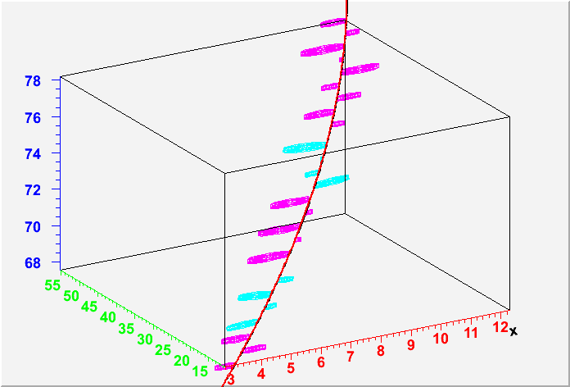
Event 1, 3-D fitter's view
Downstream is vertical (sorry)
Axes: x=red, y=green, z=blue
CDC-only event
Axial straws in magenta, stereo in cyan
Radius of cylinders = measured drift distance
Fitted trajectory in red, starting trajectory in black
Straws drawn only where near trajectory

Slide 11
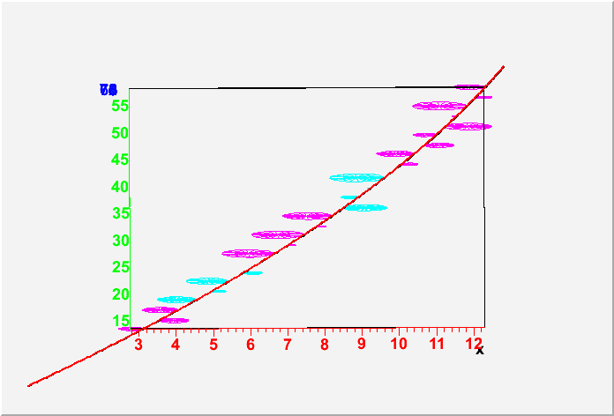
Event 1, x-y view

Slide 12
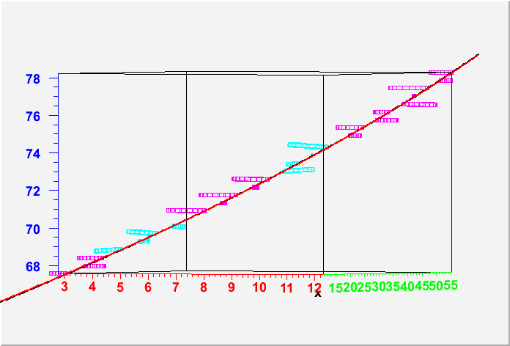
Event 1, z vs. x-y-mix
Length of drawn portion of straws = 2 mm (arbitrary)
Note tilt of stereo straws

Slide 13
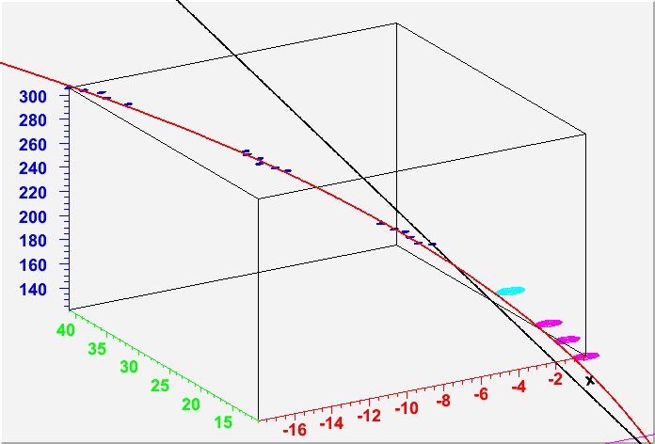
Event 2, CDC + FDC
FDC hits shown as blue spheres (arbitrary radius)
No Lorentz correction in display (coming soon)

Slide 14
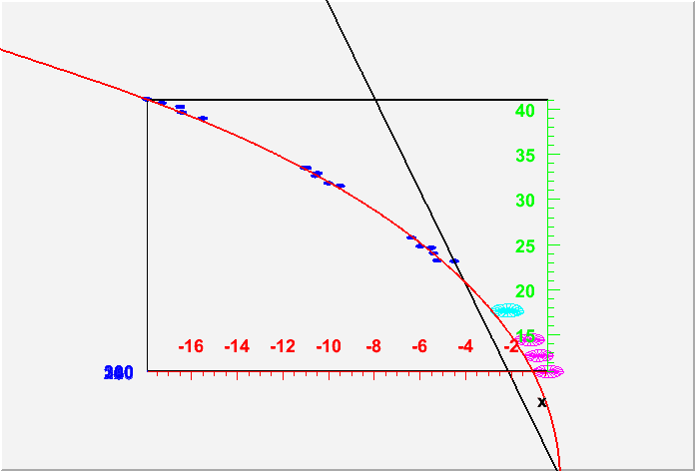
Event 2, x-y view

Slide 15
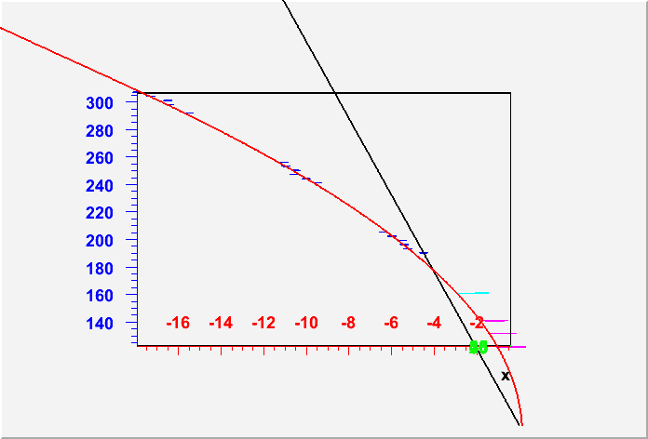
Event 2, x-z view

Slide 16
Summary
Robust convergence seen
Local, non-global minima observed
Wider event sample study needed
Errors need to be studied (covariance matrix is produced by default)
Software must be packaged for general users
Ready to turn back on detector: design studies

