Slide 1
USING EVE Proof of concept

Slide 2
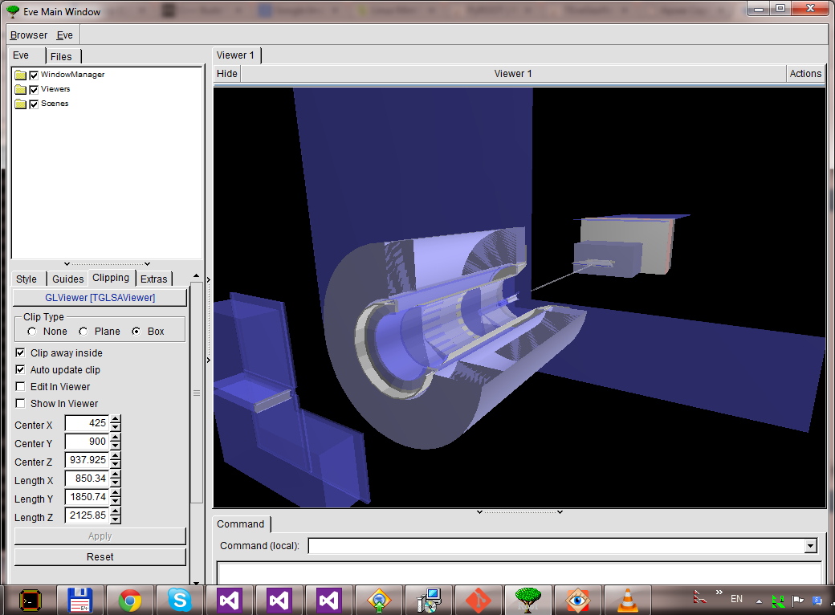
Hall D Geometry in EVE

Slide 3
Estimate complexity of
Load HallD geometry
Clipping, projections, scene management
Running EVE from DANA
Binding Event to EVE
Switch between events, manage scene, etc.

Slide 4
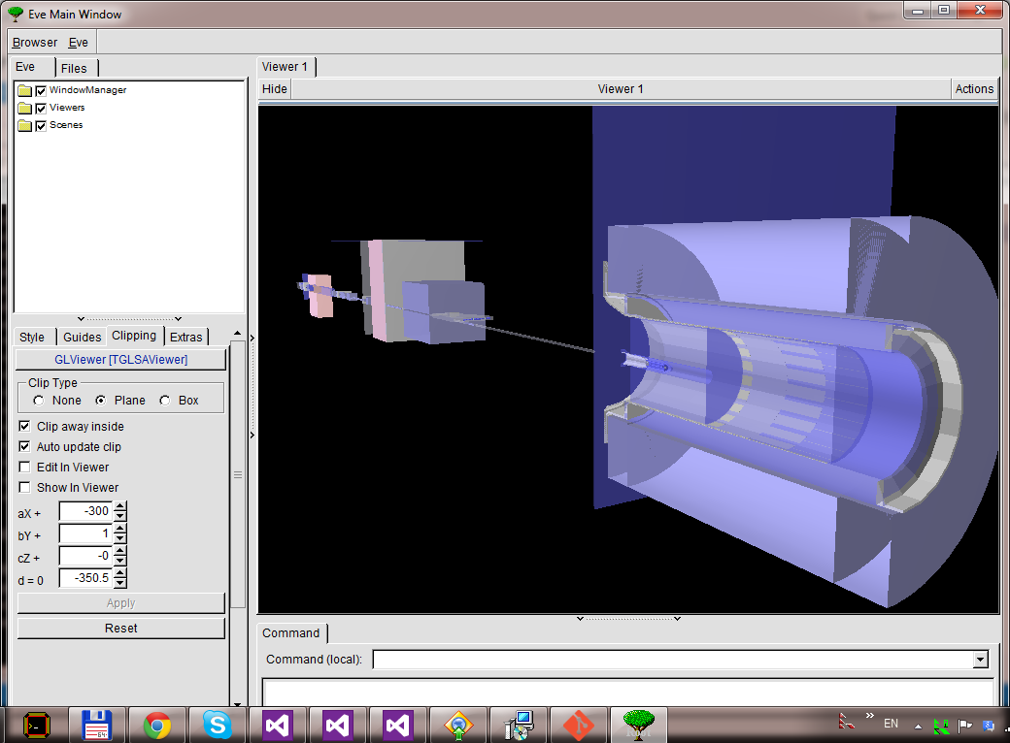
Sample horizontal clipping

Slide 5
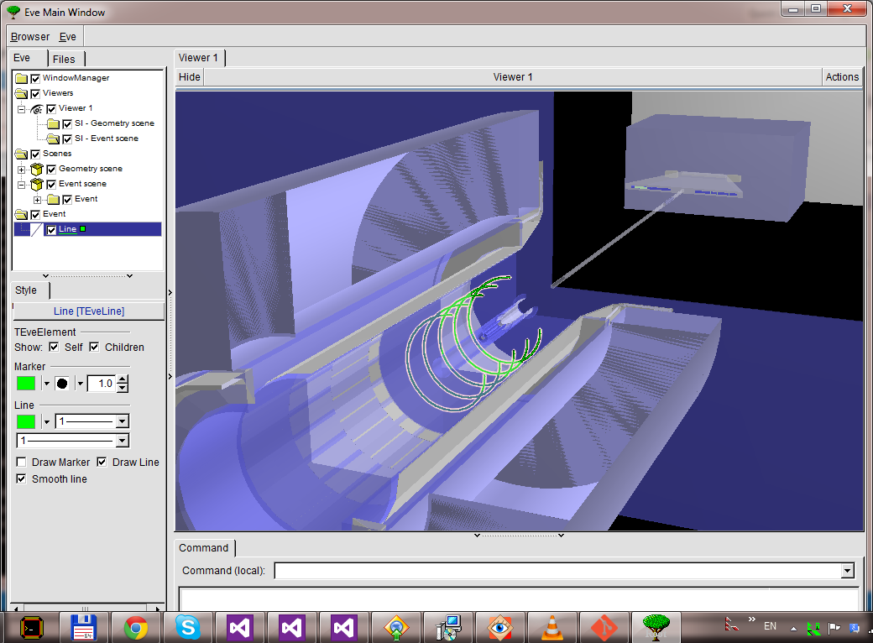
Sample event

Slide 6
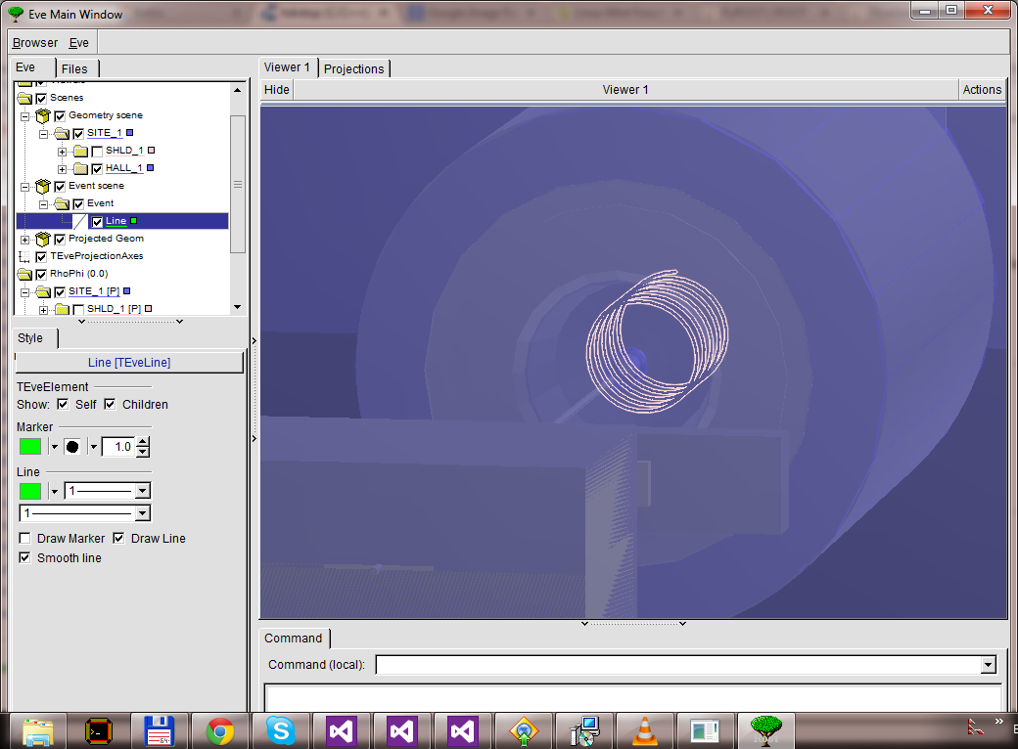
Sample event

Slide 7
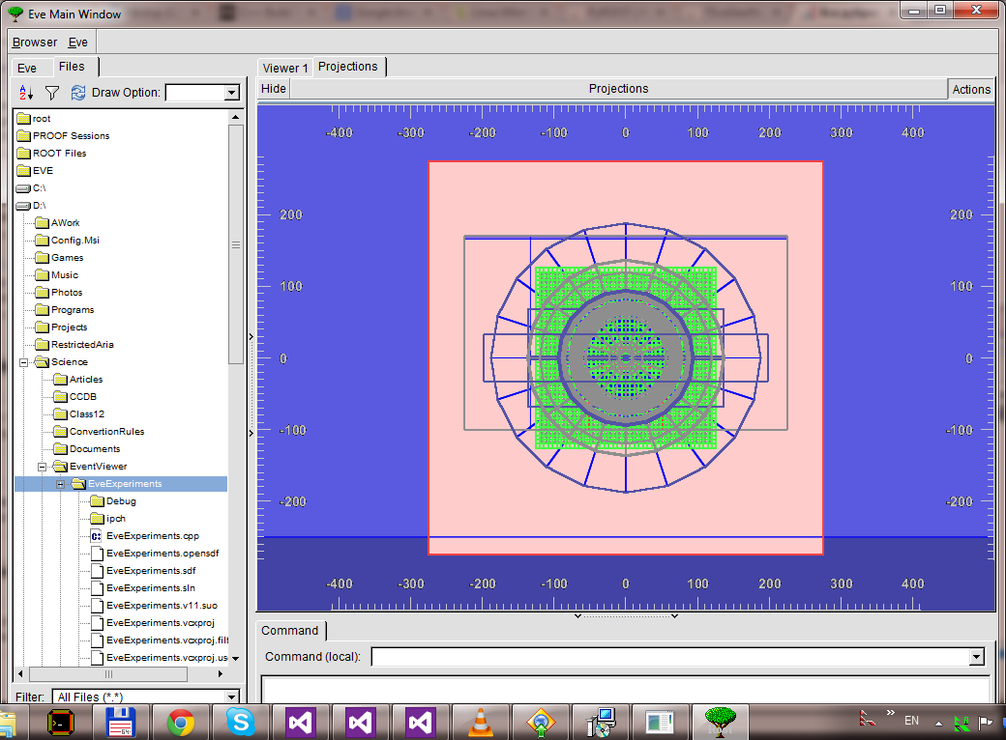
Projection

Slide 8
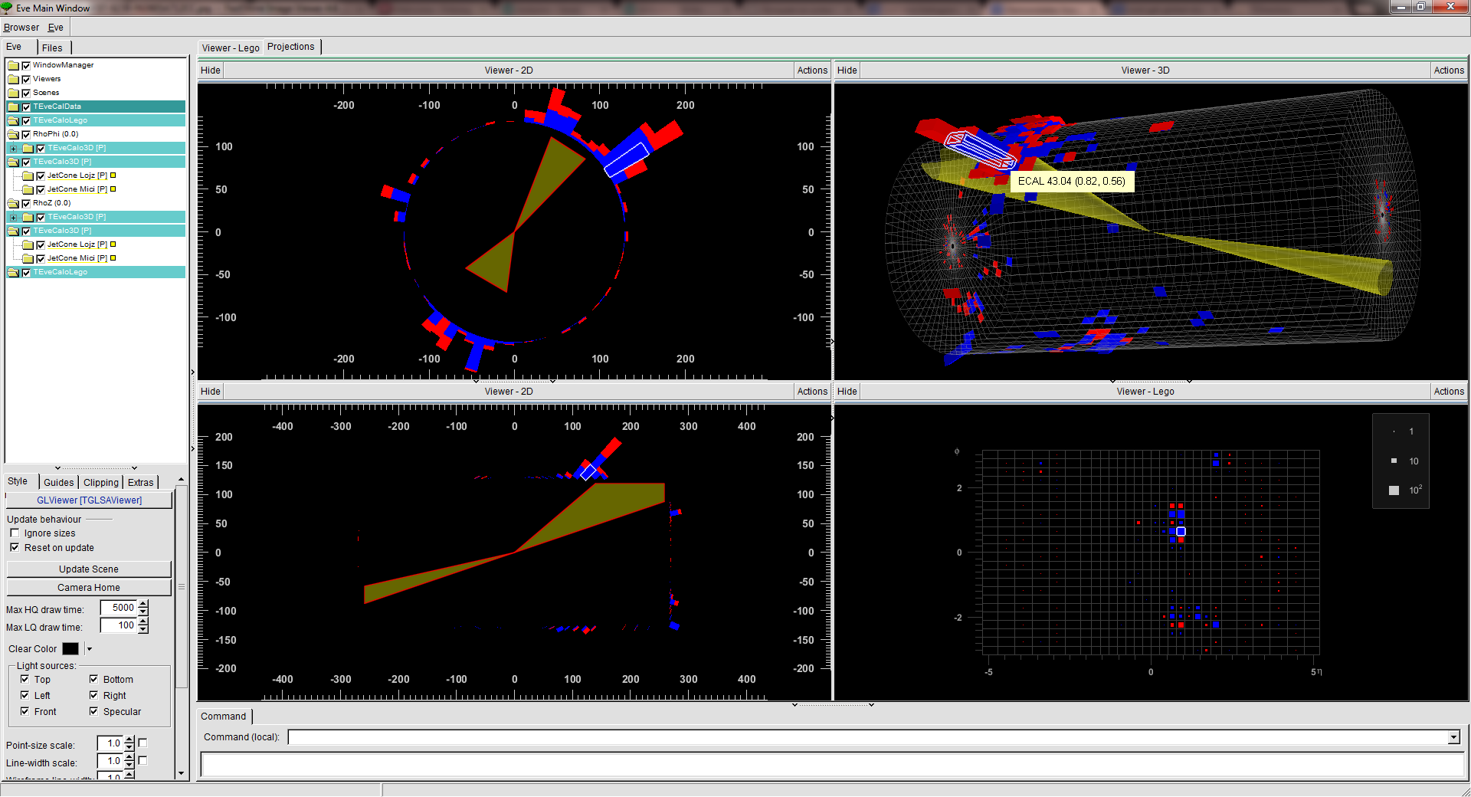
Calorimeter view

Slide 9
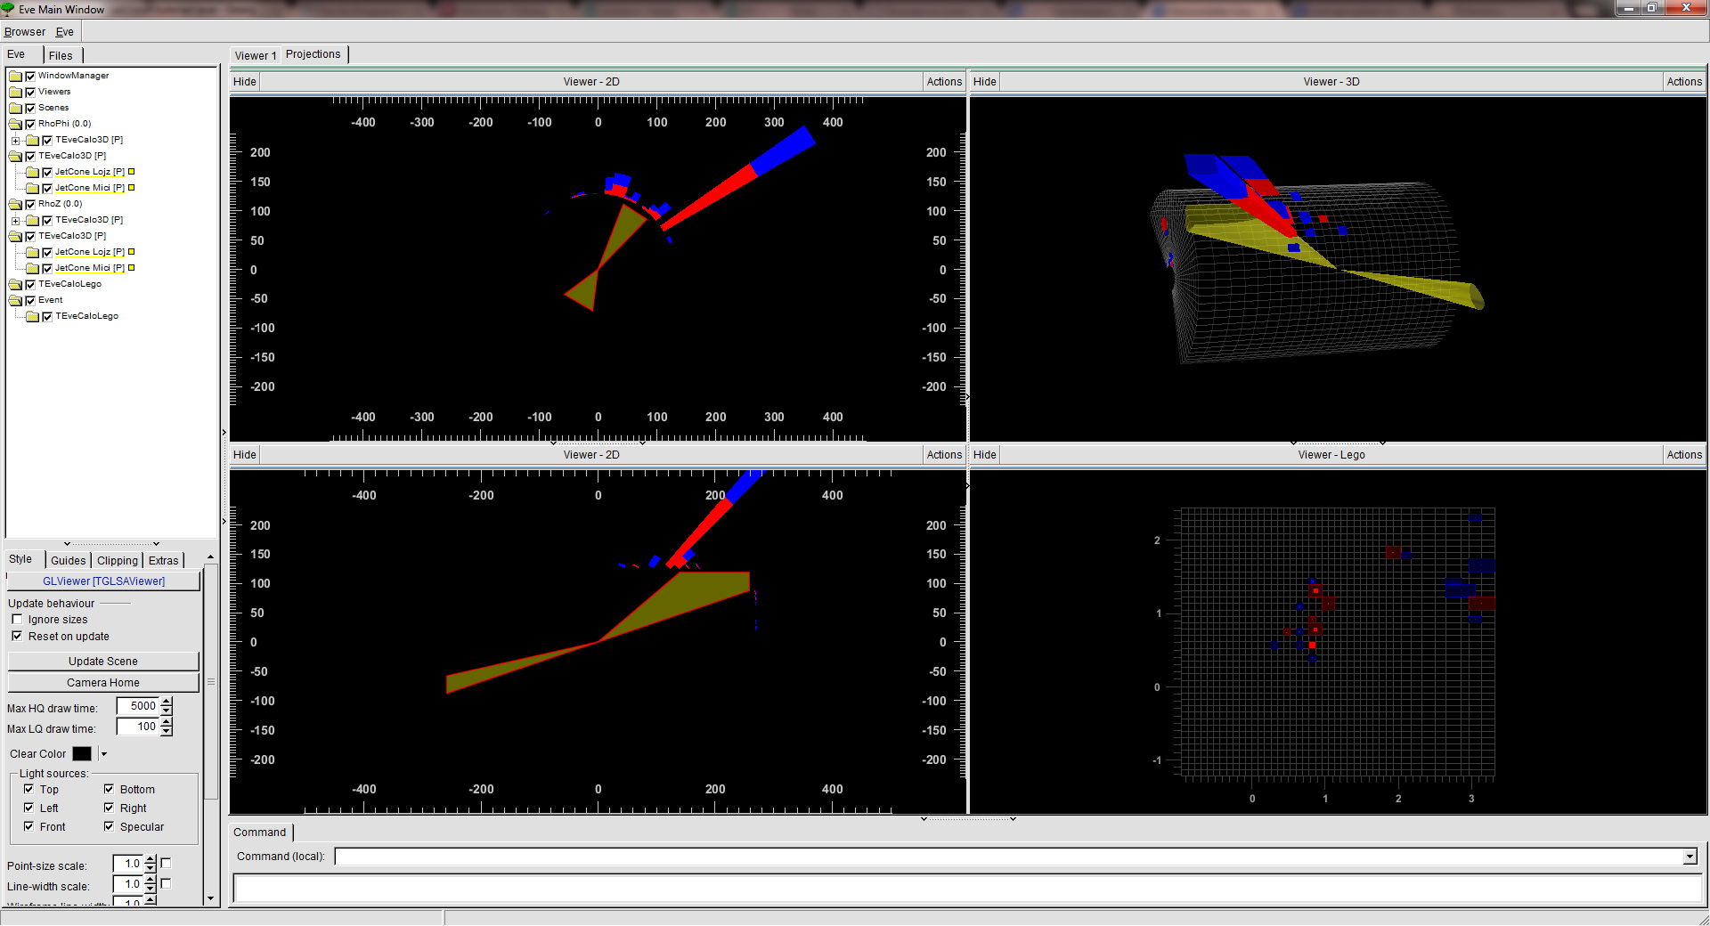
Calorimeter view

Slide 10
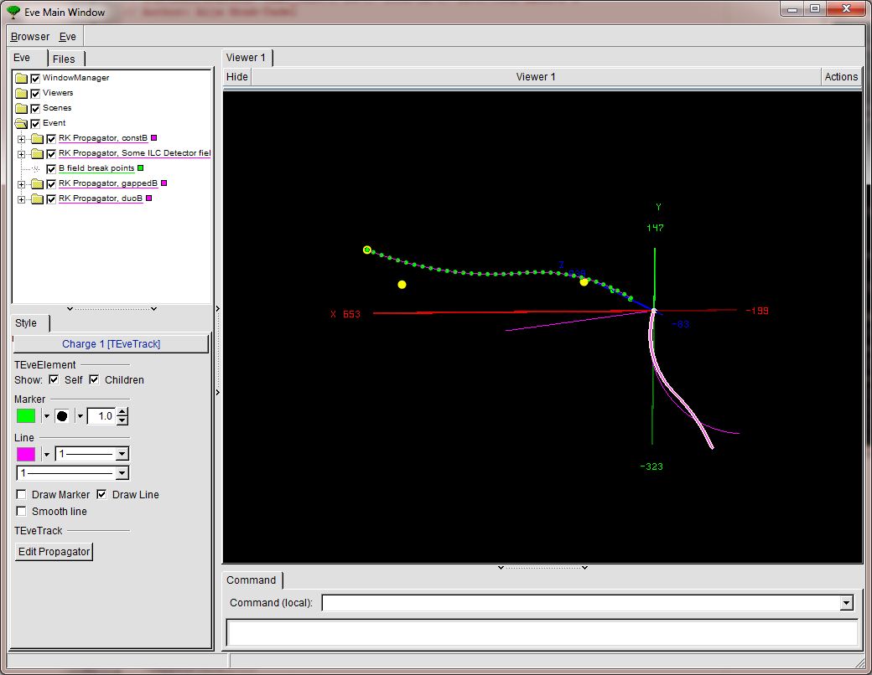
Tracks

Slide 11
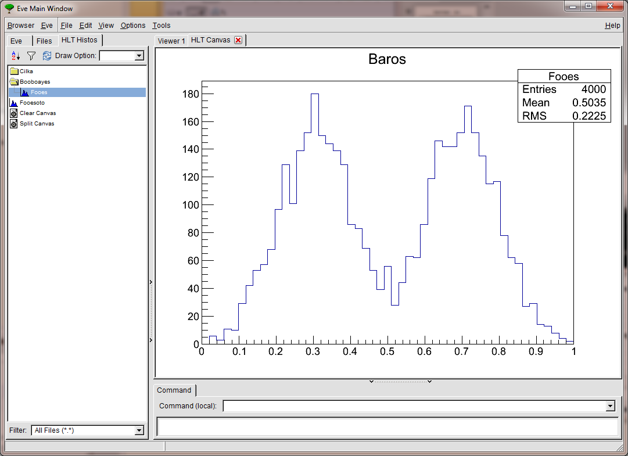
Histogram browser

Slide 12
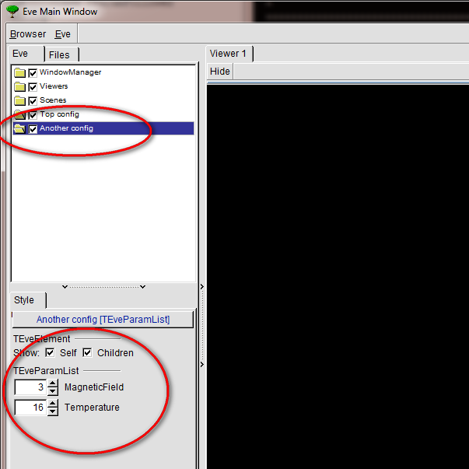
Switch parameters on fly

Slide 13
Future
DANA plugin (is in progress)
Binding to event
Navigating events

